Slide 1
Module 11: Lists, Generics, Sets and Maps
Chapter 20,19 and 21

Slide 2
Lists
Chapter 20

Slide 3
Objectives
To explore the relationship between interfaces and classes in the Java Collections Framework hierarchy (§20.2).
To use the common methods defined in the Collection interface for operating collections (§20.2).
To use the Iterator interface to traverse the elements in a collection (§20.3).
To use a for-each loop to traverse the elements in a collection (§20.4).
To explore how and when to use ArrayList or LinkedList to store elements (§20.5).
To compare elements using the Comparable interface and the Comparator interface (§20.6).
To use the static utility methods in the Collections class for sorting, searching, shuffling lists, and finding the largest and smallest element in collections (§20.7).

Slide 4
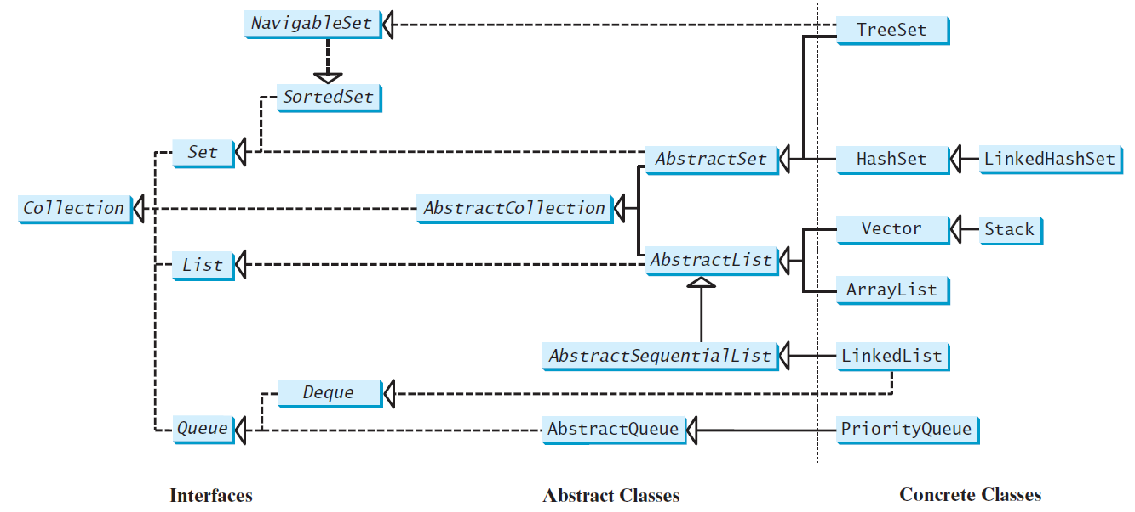
Java Collection Framework hierarchy
A collection is a container object that holds a group of objects, often referred to as elements.
The Java Collections Framework supports three types of collections named lists, sets, and maps.
The interfaces define the common operations
The abstract classes provide partial implementation
The concrete classes implement the interfaces with concrete data structures
convenience abstract class

Slide 5
Java Collection Framework hierarchy
The Java Collections Framework supports two types of containers:
One for storing a collection of elements is simply called a collection.
The other, for storing key/value pairs, is called a map.
Maps are efficient data structures for quickly searching an element using a key
Sets store a group of nonduplicate elements.
Lists store an ordered collection of elements.
Stacks store objects that are processed in a last-in, first-out fashion.
Queues store objects that are processed in a first-in, first-out fashion.
PriorityQueues store objects that are processed in the order of their priorities.

Slide 6
The Collection Interface
The Collection interface defines the common operations for lists, vectors, stacks, queues, priority queues, and sets.
All the concrete classes in the Java Collections Framework implement the java.lang.Cloneable and java.io.Serializable interfaces except that java.util.PriorityQueue does not implement the Cloneable interface.

Slide 7
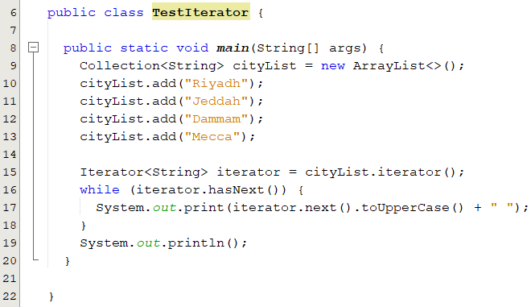
Iterators
Each collection is Iterable. You can obtain its Iterator object to traverse all the elements in the collection.
The Iterator interface provides a uniform way for traversing elements in various types of collections.
Provides sequential access to the elements in the collection using the next() method.
Output:
RIYADH JEDDAH DAMMAM MECCA
use the hasNext() method to check whether there are more elements in the iterator
use the Next() method to obtain an element in the collection from an iterator.

Slide 8
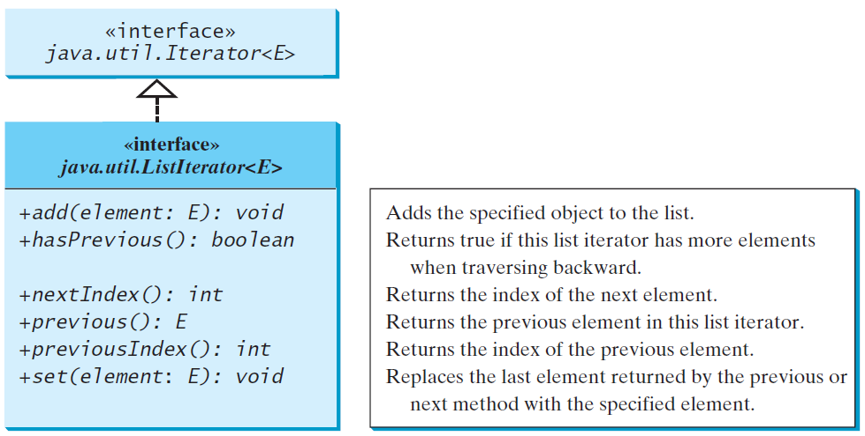
The List Iterator
Iterator is a classic design pattern for walking through a data structure without having to expose the details of how data is stored in the data structure
The element is inserted immediately before the next element that would be returned by the next() method defined in the Iterator interface if any, and after the element that would be returned by the previous() method

Slide 9
Using the forEach Loop
You can use the forEach loop to perform an action for each element in a collection.
for (String element: cityList)
System.out.print( element.toUpperCase() + " " );

Slide 10
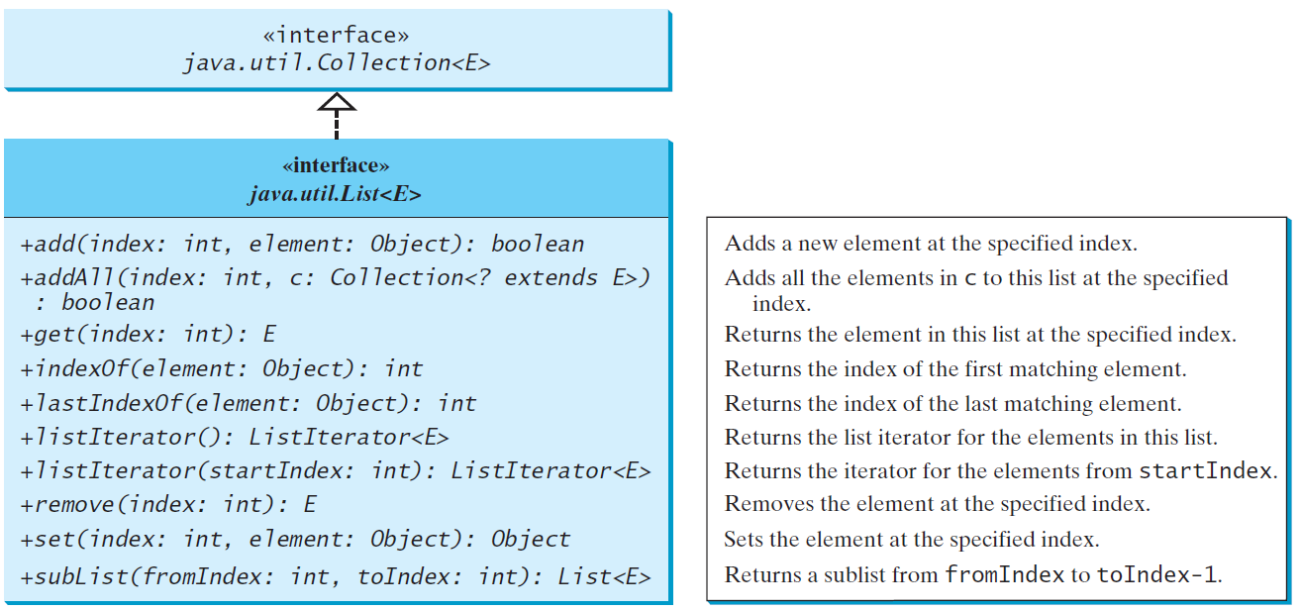
The List Interface
A list stores elements in a sequential order, and allows the user to specify where the element is stored. The user can access the elements by index.
- adds position-oriented operations
- enables a list to be traversed bidirectionally.

Slide 11
ArrayList and LinkedList
The ArrayList class and the LinkedList class are concrete implementations of the List interface.
ArrayList or LinkedList
ArrayList : If your application requires random access through an index without inserting or removing elements from any place other than the end.
LinkedList: your application requires the insertion or deletion of elements from any place in the list.
List or Arrays:
A list can grow or shrink dynamically.
An array is fixed once it is created.
If your application does not require insertion or deletion of elements, the most efficient data structure is the array.

Slide 12
java.util.ArrayList
ArrayList is a resizable-array implementation of the List interface
Each ArrayList instance has a capacity, the maximum number of elements it can hold without resizing the internal array.
The size of ArrayList is the number of elements it currently has
ArrayList capacity grows automatically
If the capacity of the array is exceeded, a larger new array is created and all the elements from the current array are copied to the new array.
ArrayList does not automatically shrink.
You can use the trimToSize() method to reduce the array capacity to the size of the list

Slide 13
ArrayList Operations
Creating ArrayList
ArrayList <Integer> list1 = new ArrayList<>();
String[] array = {"yellow", "red", "green", "blue"};
List<String> list2 = Arrays.asList(array);
ArrayList<String> lis3 = new ArrayList<String>( list2 );
Adding elements to an ArrayList:
list.add(object)
list.add(index,object)
Accessing an element in ArrayList
list.get(index,object)
Updating an element in ArrayList
list.set(index,object)
Removing an element from ArrayList
list.remove(object)
list.remove(index)

Slide 14
java.util.LinkedList
LinkedList stores elements in a linked list.
The class provides the methods for retrieving, inserting, and removing elements from both ends of the list

Slide 15
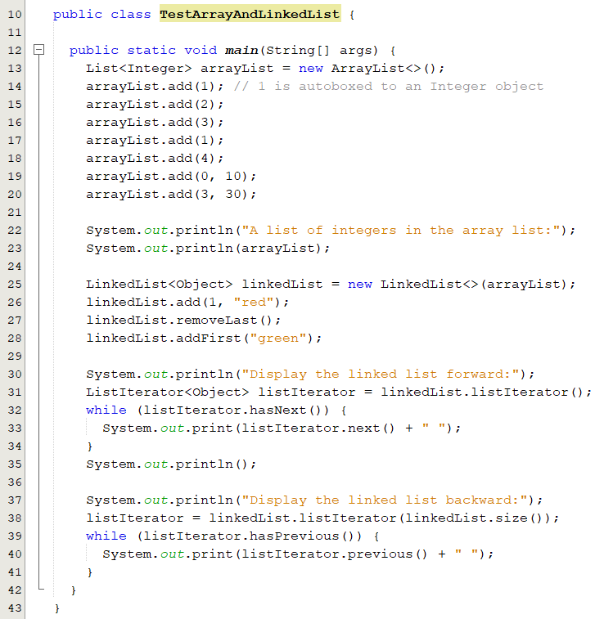
Example: Using ArrayList and LinkedList
A list of integers in the array list:
[10, 1, 2, 30, 3, 1, 4]
Display the linked list forward:
green 10 red 1 2 30 3 1
Display the linked list backward:
1 3 30 2 1 red 10 green

Slide 16
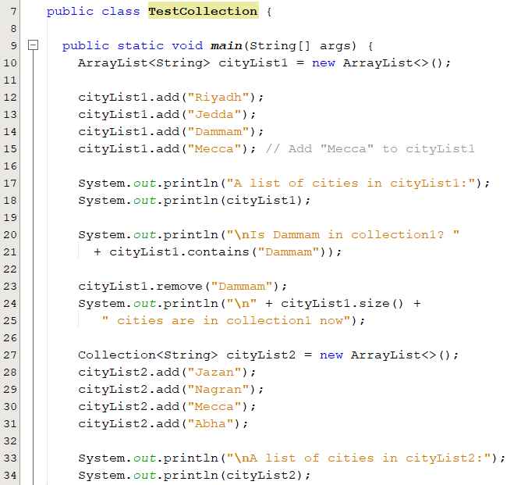
Example(1/2)
A list of cities in cityList1:
[Riyadh, Jedda, Dammam, Mecca]
Is Dammam in collection1? true
3 cities are in collection1 now
A list of cities in cityList2:
[Jazan, Nagran, Mecca, Abha]

Slide 17
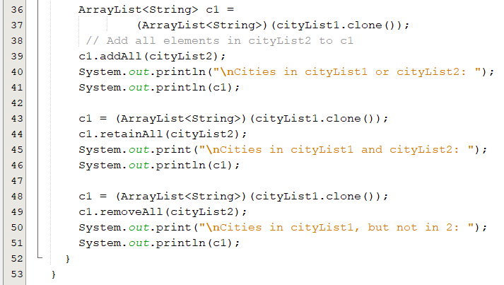
Example(2/2)
Cities in cityList1 or cityList2:
[Riyadh, Jedda, Dammam, Mecca, Jazan, Nagran, Mecca, Abha]
Cities in cityList1 and cityList2: [Mecca]
Cities in cityList1, but not in 2: [Riyadh, Jedda]

Slide 18
Popup-Questions(1)
Given the following declaration
ArrayList<String> x = new ArrayList<>(4)
What is the capacity and the size of x?
Suppose ArrayList x contains four strings [“DMM”, “RYD”, “JDA”,”TBK”]. Which of the following methods will cause runtime errors?
x capacity is currently 4.
x size is 0
A. x.get(3)
B. x.set(4, “JZN");
C. x.get(4)
D. x.remove(3)
E. x.size()
B and C

Slide 19
Popup-Questions(2)
What is the output of the following code
Collection<Integer> list = new ArrayList<>();
list.add(1);
list.add(2);
list.add(3);
list.remove(2);
System.out.println(list);
Output: [1, 3]
If a list is declared as Collection<Integer>, list.remove(i) is the same as list.remove(new Integer(i)).
If a list is declared as List<Integer>, ArrayList<Integer>, or AbstractList<Integer>, list.remove(i) is to remove the element at the index i.
ArrayList<Integer> list = new ArrayList<>();
list.add(1);
list.add(2);
list.add(3);
list.remove(2);
System.out.println(list);
Output: [1, 2]
list.remove(new Integer(2));
Output: [1, 3]

Slide 20
The Comparator Interface
Sometimes you want to compare elements of different types. However, the elements may not be instances of Comparable or are not comparable.
You can define a comparator to compare these elements.
To do so, define a class that implements the Comparator interface.
The Comparator interface has the compare method for comparing two objects.
public int compare(T element1, T element2)
Returns
a negative value if element1 is less than element2
a positive value if element1 is greater than element2
zero if they are equal.

Slide 21
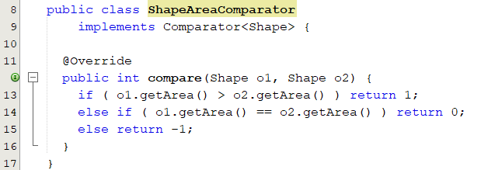
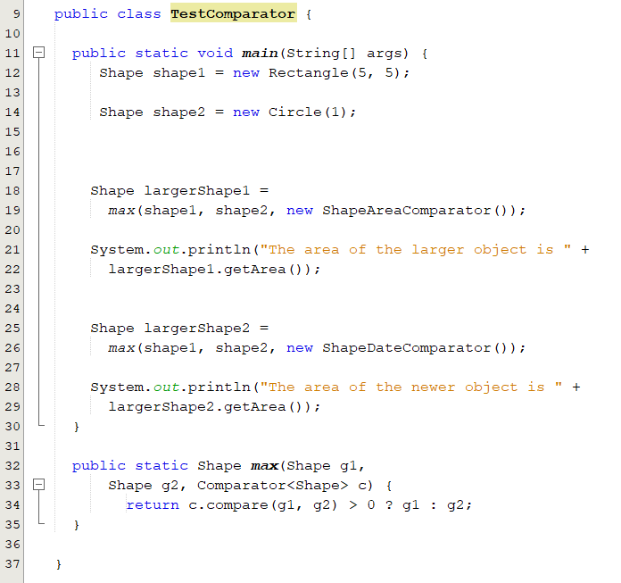
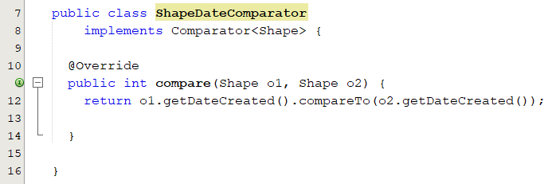
The Comparator Interface: Example 1
new ShapeAreaComparator()
new ShapeDateComparator ()
The area of the larger object is 25.0
The area of the newer object is 3.141592653589793

Slide 22
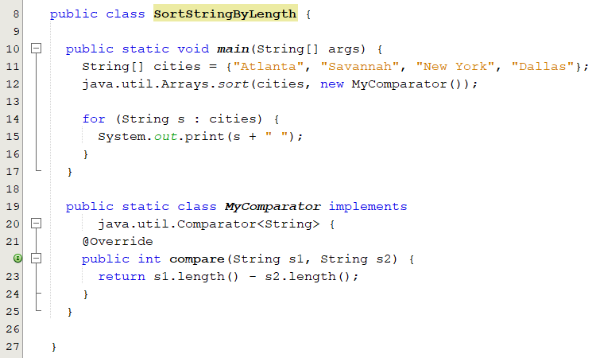
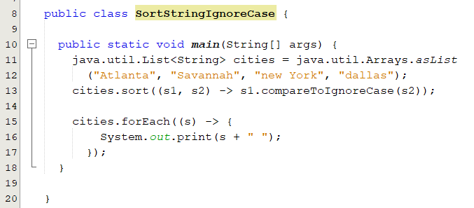
The Comparator Interface: Example 2

Slide 23
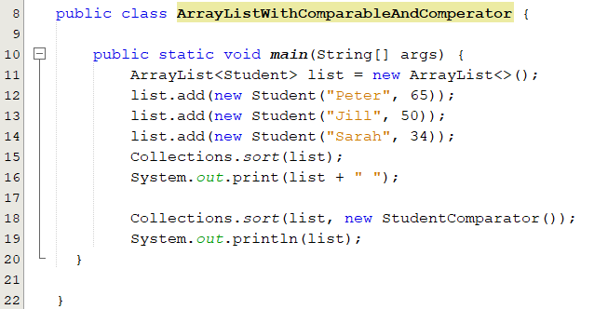
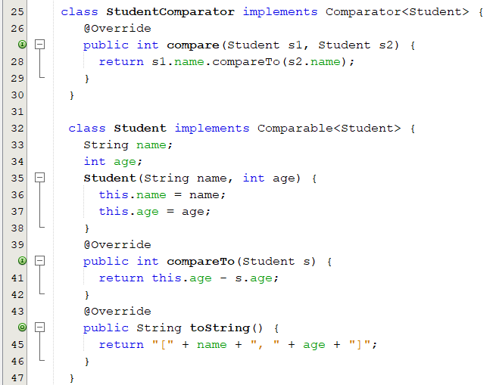
The Comparator and Comparable Interfaces: Example
Sorting students based on their ages using comparable interface and based on their names using comparator interface.

Slide 24
Popup-Questions(3)
Define a class B that implements the Comparator interface and override the compare method to compare two objects of type B1?
public class B implements Comparator<B1> {
public int compare(B1 o1, B1 o2) {
return an integer;
}
}

Slide 25
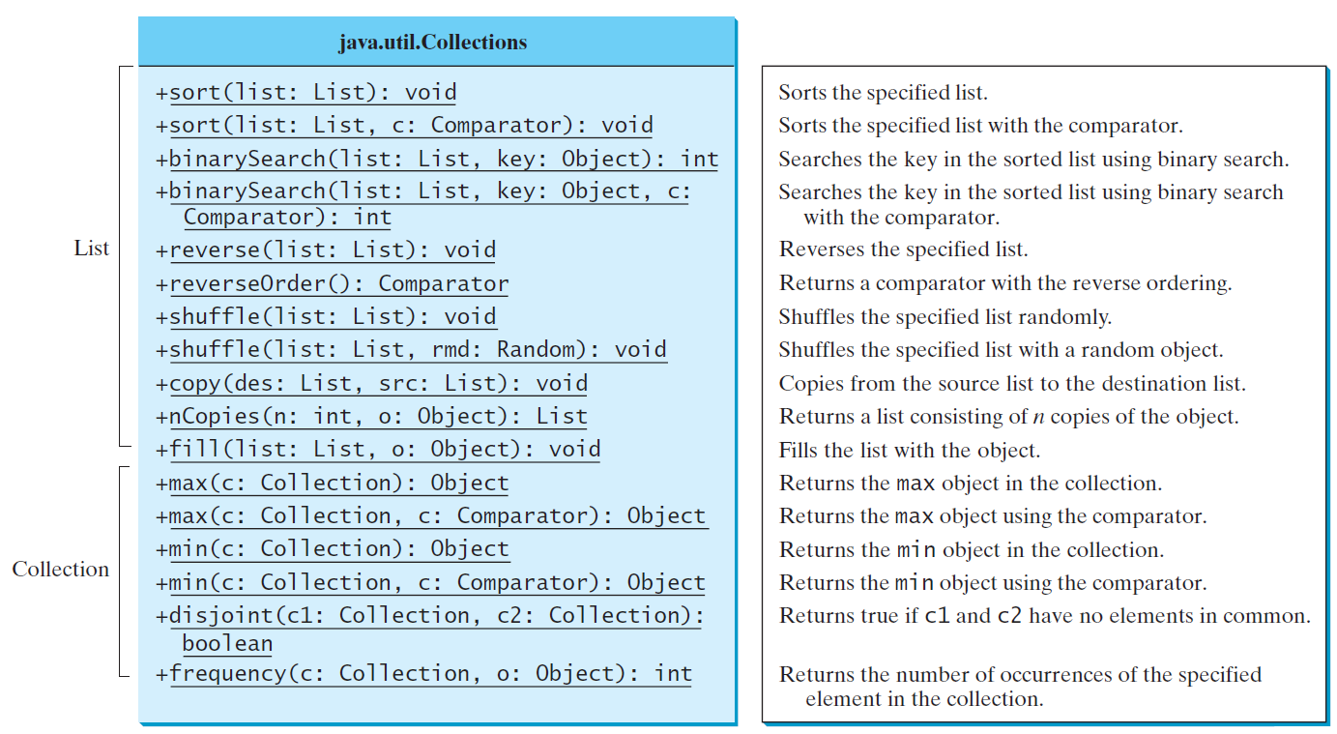
The Collections class
The Collections class contains various static methods for
operating on collections and maps,
creating synchronized collection classes, and
creating read-only collection classes.

Slide 26
The Collections class
List<String> list = Arrays.asList("red", "green", "blue");
Collections.sort(list);
System.out.println(list)
Collections.sort(list, Collections.reverseOrder());
System.out.println(list);
List<String> list2 = Arrays.asList("blue", "green", "red");
System.out.println("(3) Index: " + Collections.binarySearch(list2, "red"));
List<String> list = Arrays.asList("yellow", "red", "green", "blue");
Collections.reverse(list);
System.out.println(list)
List<String> list = Arrays.asList("yellow", "red", "green", "blue");
Collections.shuffle(list);
System.out.println(list);

Slide 27
The Collections class
List<String> list1 = Arrays.asList("yellow", "red", "green", "blue");
List<String> list2 = Arrays.asList("green", "blue“, "yellow", "red");
Collections.shuffle(list1, new Random(20));
Collections.shuffle(list2, new Random(20));
System.out.println(list1);
List<String> list1 = Arrays.asList("yellow", "red", "green", "blue");
List<String> list2 = Arrays.asList("white", "black");
Collections.copy(list1, list2);
System.out.println(list1);
List<GregorianCalendar> list1 = Collections.nCopies
(5, new GregorianCalendar(2005, 0, 1));

Slide 28
Generics
Chapter 19

Slide 29
Objectives
To know the benefits of generics (§19.1).
To use generic classes and interfaces (§19.2).
To declare generic classes and interfaces (§19.3).
To understand why generic types can improve reliability and readability (§19.3).
To define and use generic methods and bounded generic types (§19.4).
To use raw types for backward compatibility (§19.6).
To explain why wildcard generic types are necessary (§19.7).
To describe restrictions on generic types (§19.8).

Slide 30
Introduction
Generics is the capability to parameterize types
You can define a class or a method with generic types that the compiler can replace with concrete types.
Replacing a generic type is called a generic instantiation
Examples:
Here, String and Integer are concrete type that replace the generic type.
java.util.ArrayList<String> list = new java.util.ArrayList<String>();
java.util.ArrayList<Integer> list = new java.util.ArrayList<Integer>();
Notes:
. From this generic class, you can create an ArrayList object for holding strings, and an ArrayList object for holding numbers. Here, strings and numbers are concrete types that replace the generic type.

Slide 31
Why Generics?
The key benefit of generics is to enable errors to be detected at compile time rather than at runtime.
A generic class or method permits you to specify allowable types of objects that the class or method may work with.
If you attempt to use the class or method with an incompatible object, a compile error occurs.
<T> represents a formal generic type, which can be replaced later with an actual
concrete type
Runtime error
Compile error
Improves reliability

Slide 32
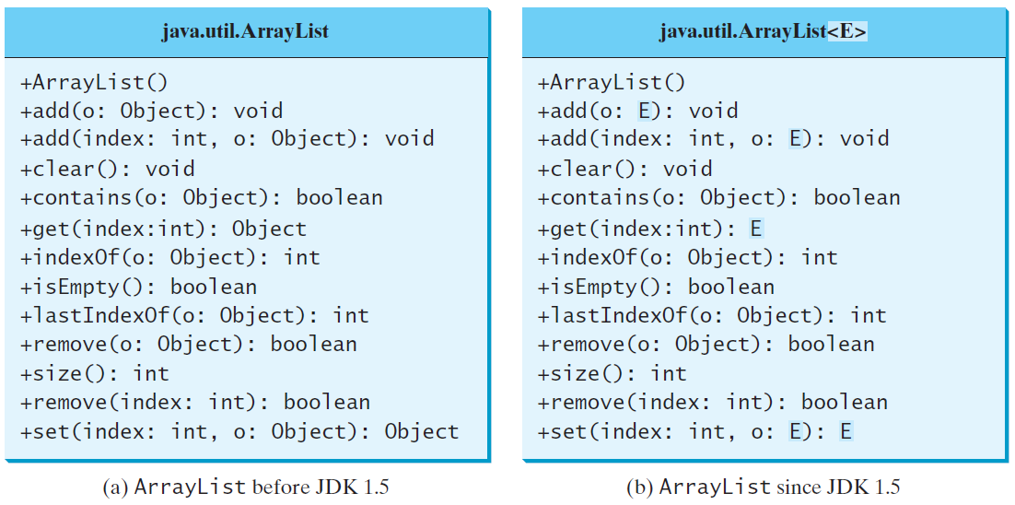
Generic ArrayList in JDK 1.5
Generic types must be reference types.
You cannot replace a generic type with a primitive type such as int, double, or char
Creating a list for strings:
ArrayList<String> list = new ArrayList<>();
You can now add only strings into the list
list.add("Red");
If you attempt to add a nonstring, a compile error will occur.
list.add(new Integer(1));

Slide 33
Casting
Prior to JDK 1.5 casting is needed
ArrayList list = new ArrayList();
list.add(5.5);
double d = list.get(1); // compilation error
double d = (double) list.get(1); // casting is necessary
Since JDK 1.5 casting is not needed
ArrayList<Double> list = new ArrayList<>();
list.add(5.5); // 5.5 is automatically converted to new Double(5.5)
list.add(3.0); // 3.0 is automatically converted to new Double(3.0)
Double doubleObject = list.get(0); // No casting is needed
double d = list.get(1); // Automatically converted to double

Slide 34
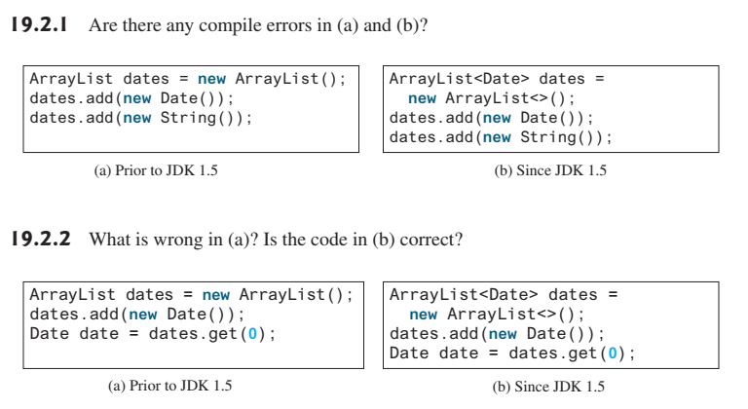
Popup-Question(1)

Slide 35
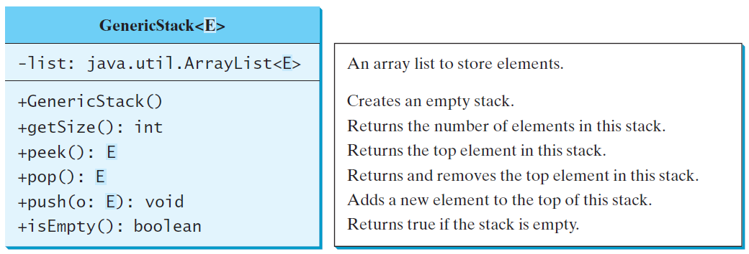
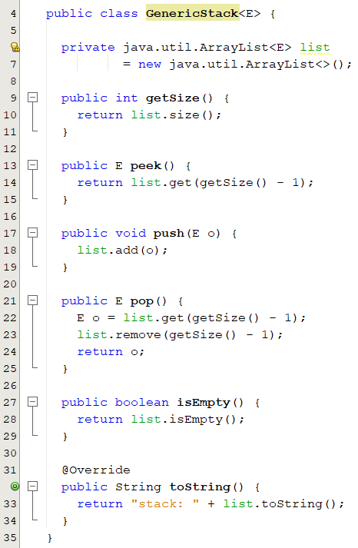
Defining Generic Classes and Interfaces
GenericStack<String> stack1 = new GenericStack<>();
stack1.push("London");
stack1.push("Paris");
stack1.push("Berlin");
GenericStack<Integer> stack2 = new GenericStack<>();
stack2.push(1); // autoboxing 1 to new Integer(1)
stack2.push(2);
stack2.push(3);
A generic class may have more than one parameter. In this case, place the parameters together inside the brackets, separated by commas—for example, <E1, E2, E3>
Notes:
A generic type can be defined for a class or interface. A concrete type must be specified when using the class to create an object or using the class or interface to declare a reference variable

Slide 36
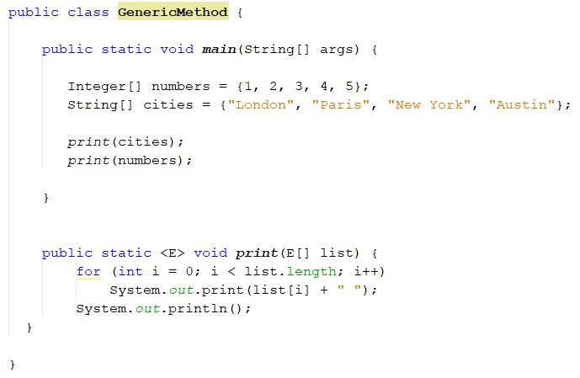
Generic Methods
Generic methods are methods that introduce their own type parameters.
A generic type can be defined for static and instance methods.
To declare a generic method, you place the generic type <E> immediately after the keyword static in the method header

Slide 37
Raw Types and Backward Compatibility
Raw type
This is roughly equivalent to
ArrayList list = new ArrayList();
ArrayList<Object> list = new ArrayList<Object>();

Slide 38
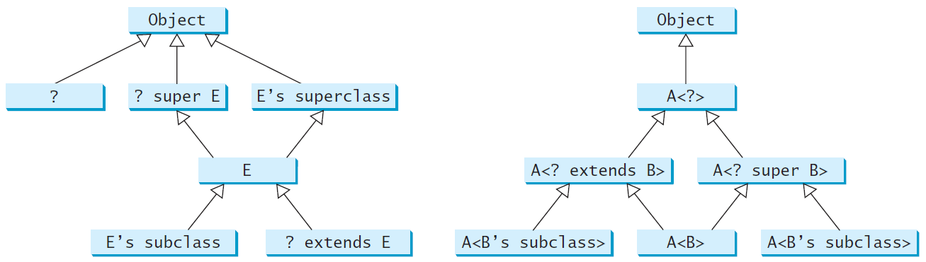
Wildcard Generic Types
Used to specify a range for a generic type.
? unbounded wildcard
? extends T bounded wildcard
? super T lower bound wildcard
? extends Object
T or a subtype of T
T or a supertype of T
The relationship between generic types and wildcard types

Slide 39
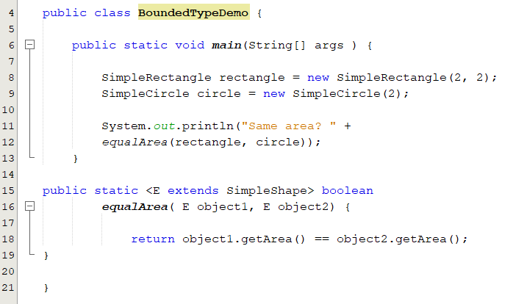
Bounded Generic Type
A generic type can be specified as a subtype of another type. Such a generic type is called bounded.
( line 15) specifies that E is a generic subtype of SimpleShape.
We must invoke equalArea by passing two instances of SimpleShape.

Slide 40
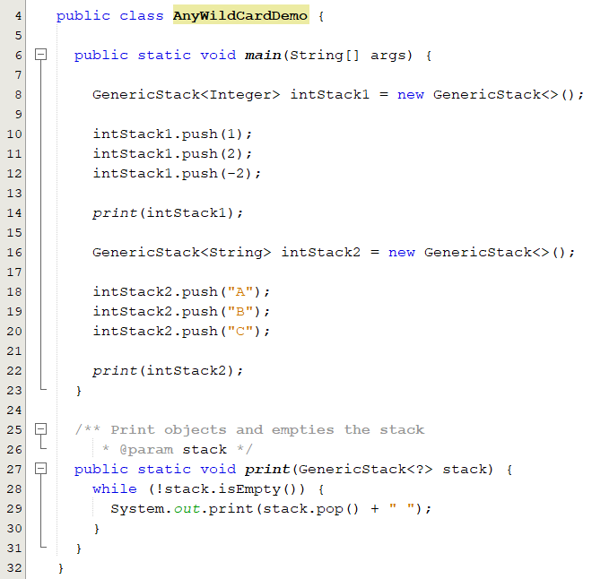
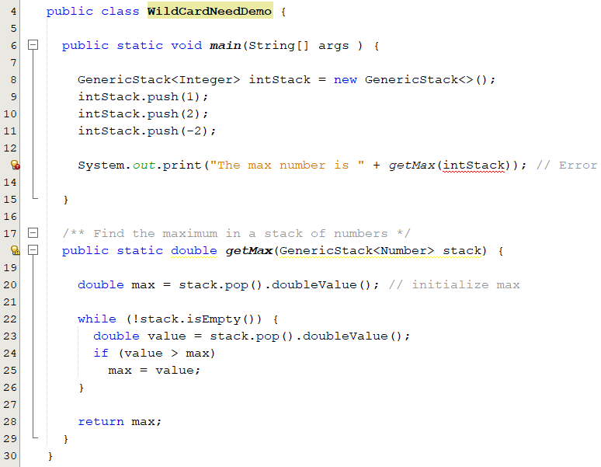
Unbounded wildcard

Slide 41
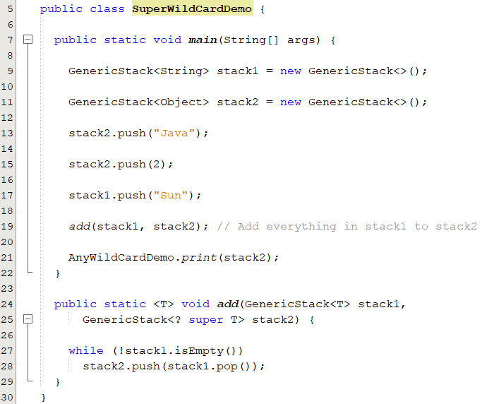
Super wildcard

Slide 42
Restrictions on Generics
Restriction 1: Cannot Create an Instance of a Generic Type. (i.e., new E()).
Restriction 2: Generic Array Creation is Not Allowed. (i.e., new E[100]).
Restriction 3: A Generic Type Parameter of a Class Is Not Allowed in a Static Context.
Restriction 4: Exception Classes Cannot be Generic.
E object = new E();
E[] elements = new E[10];
×
public static void m(E o1)
public void m(E o1)
√
public class MyException<T> extends Exception { }

Slide 43
Sets and Maps
Chapter 21

Slide 44
Objectives
To store unordered, nonduplicate elements using a set (§21.2).
To explore how and when to use HashSet (§21.2.1), LinkedHashSet (§21.2.2), or TreeSet (§21.2.3) to store elements.
To compare performance of sets and lists (§21.3).
To use sets to develop a program that counts the keywords in a Java source file (§21.4).
To know when and how to use HashMap, LinkedHashMap, and TreeMap to store values associated with keys (§21.5).
To use maps to develop a program that counts the occurrence of the words in a text (§21.6).

Slide 45
Review of Java Collection Framework hierarchy

Slide 46
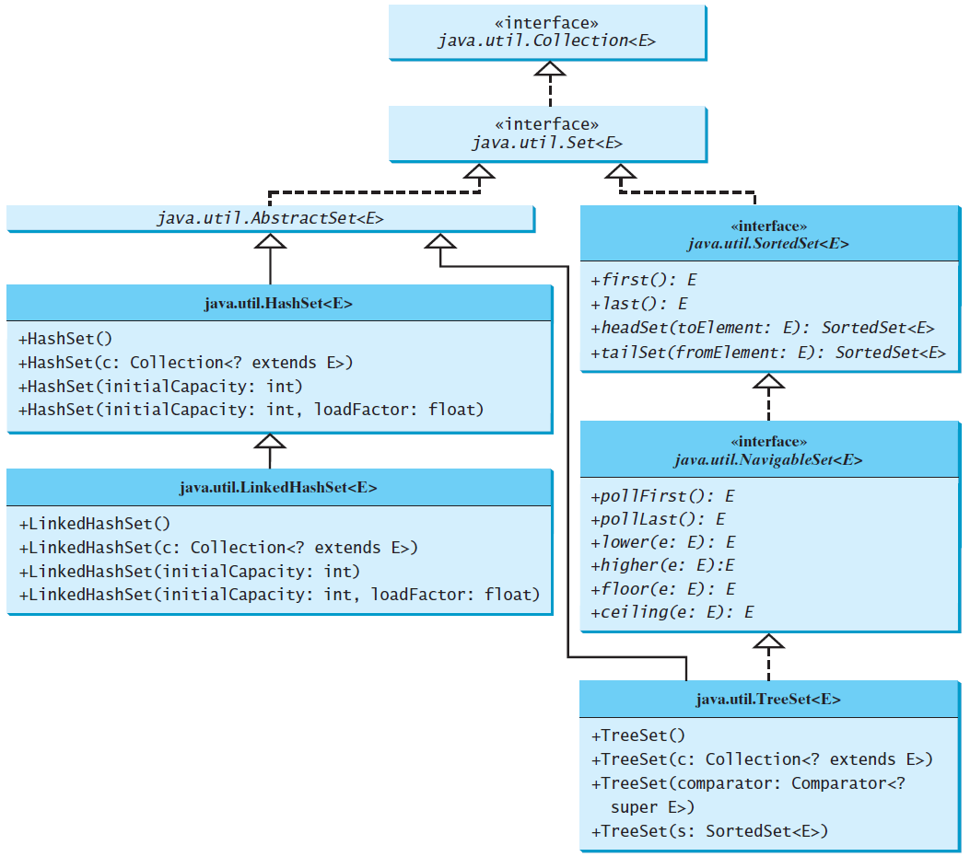
The Set Interface
A set is an efficient data structure for storing and processing nonduplicate elements
The hash codes of two objects must be the same if the two objects are equal
Two elements e1 and e2 are considered duplicate for a HashSet,
if e1.equals(e2) is true and e1.hashCode() == e2.hashCode().
The AbstractSet class provides concrete implementations for the equals method and the hashCode method
The hash code of a set is the sum of the hash codes of all the elements in the set

Slide 47
Concrete Set Classes
HashSet | There is no particular order for the elements in a hash set. They are not stored in the order in which they are inserted into the set. e.g stores unordered, non-duplicate elements
LinkedHashSet | The LinkedHashSet maintains the order in which elements are inserted. e.g non-duplicate elements in the order of insertion
TreeSet | elements in the set are sorted ( using the compareTo method in the comparable interface or using the compare method in the comparator interface. e.g non-duplicate , sorted elements (in increasing order of the element values)
When creating a HashSet or LinkedHashSet
You can specify the initial capacity and load factor in the constructor.
The initial capacity is 16 and the load factor is 0.75.
The load factor measures how full the set is allowed to be before its capacity is increased.
,

Slide 48
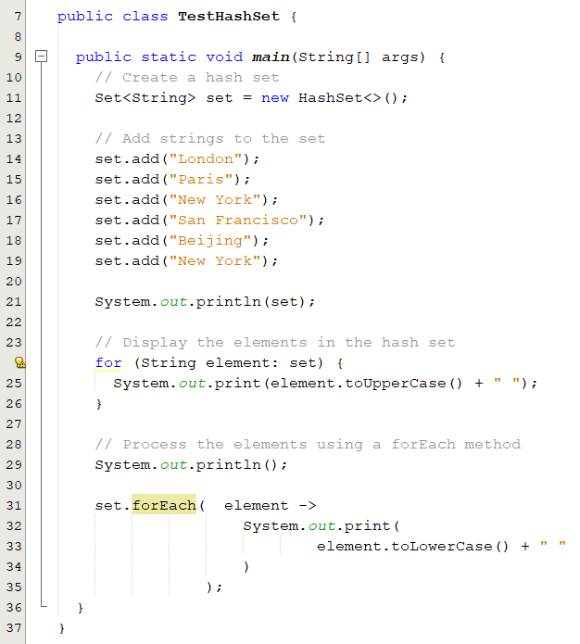
Example: Using HashSet
output
[San Francisco, Beijing, New York, London, Paris]
SAN FRANCISCO BEIJING NEW YORK LONDON PARIS
san francisco beijing new york london paris
Different ways to print the elements in the set
The order in which the elements are displayed is not predictable.
In line 19, we add “New York” for the second, however, it will not be inserted since already added in line 16

Slide 49
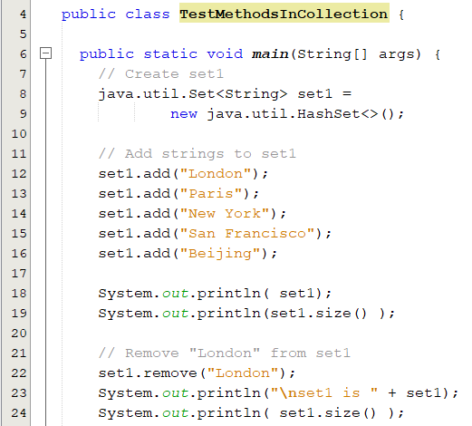
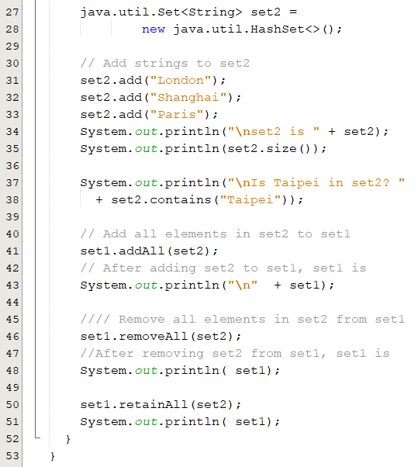
Example: Using HashSet
set1 is [San Francisco, New York, Paris, Beijing, London]
5 elements in set1
set1 is [San Francisco, New York, Paris, Beijing]
4 elements in set1
set2 is [Shanghai, Paris, London]
3 elements in set2
Is Taipei in set2? false
output
[San Francisco, New York, Shanghai, Paris, Beijing, London]
After removing set2 from set1, set1 is
[San Francisco, New York, Beijing]
After retaining common elements in set1 and set2, set1 is []

Slide 50
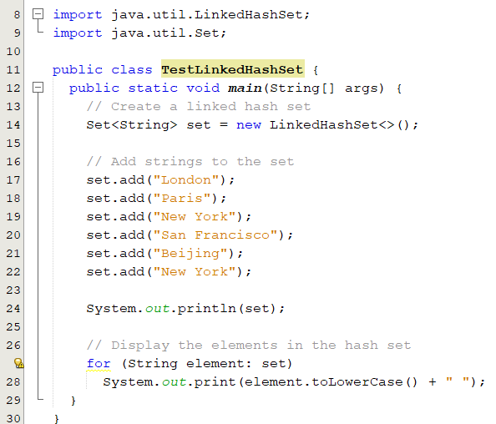
The LinkedHashSet Class
LinkedHashSet extends HashSet with a linked-list implementation that supports an ordering of the elements in the set.
The LinkedHashSet maintains the order in which the elements were inserted.
[London, Paris, New York, San Francisco, Beijing]
london paris new york san francisco beijing
Elements are displayed based on their insertion order

Slide 51
The TreeSet Class
TreeSet is a concrete class that implements the SortedSet interface which guarantees that the elements in the set are sorted.
headSet(toElement): returns all elements that are less than toElement.
tailSet(fromElement): returns all elements are greater than or equal to fromElement.
// Use the methods in NavigableSet interface
lower(e): returns the largest element less than e
higher(e): returns the smallest element greater than e
floor(e): returns the largest element less than or equal to e
ceiling(e): returns the smallest element greater than or equal to e
You can add objects into a tree set as long as they can be compared with each other.

Slide 52
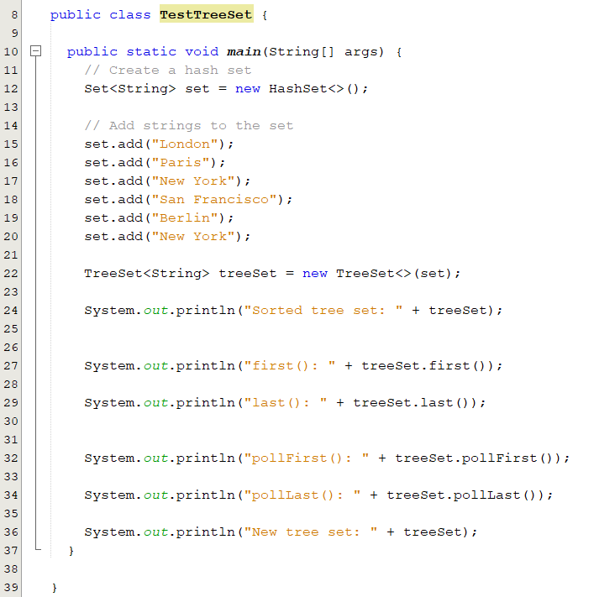
The TreeSet Class: Example
Output
Sorted tree set: [Berlin, London, New York, Paris, San Francisco]
first(): Berlin
last(): San Francisco
pollFirst(): Berlin
pollLast(): San Francisco
New tree set: [London, New York, Paris]

Slide 53
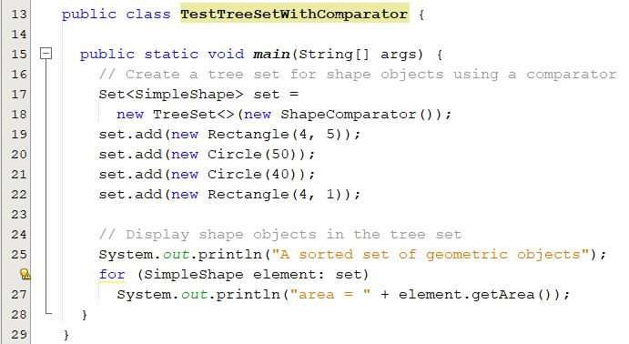
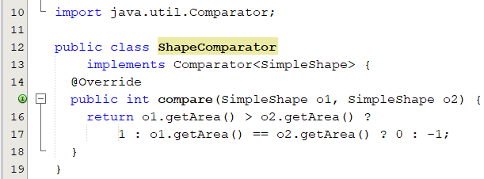
Example: Using Comparator to Sort Elements in a Set
The elements can be sorted in two ways.
using the Comparable interface
Your class should implement comparable
Otherwise, ClassCastException occurs
using the Comparator interface
A sorted set of geometric objects
area = 4.0
area = 20.0
area = 5026.548245743669
area = 7853.981633974483

Slide 54
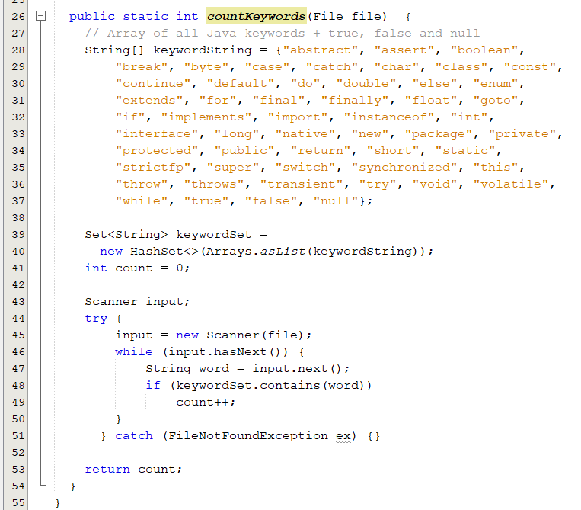
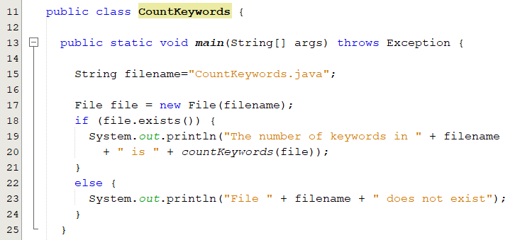
Case Study: Counting Keywords
An application that counts the number of keywords in a Java source file.
Store all the keywords in a HashSet and use the contains method to test if a word is in the keyword set

Slide 55
Pop-Questions(1)
Suppose you need to write a program that
stores unordered, non-duplicate elements,
non-duplicate elements in the order of insertion
non-duplicate elements in increasing order of the element values
What data structure should you use?
HashSet
LinkedHashSet
TreeSet

Slide 56
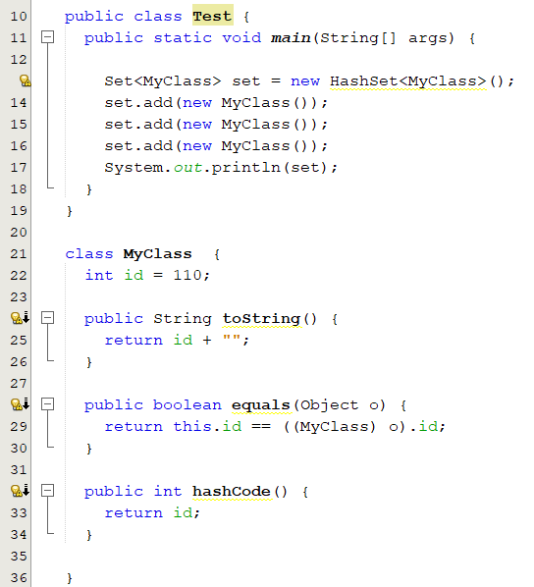
Pop-Questions(2)
What is the output of the following code?
[110]
What is the output if we remove the hashcode method?
[110, 110, 110]
What is the output if we remove the equals method?
[110, 110, 110]

Slide 57
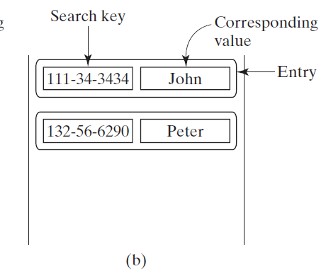
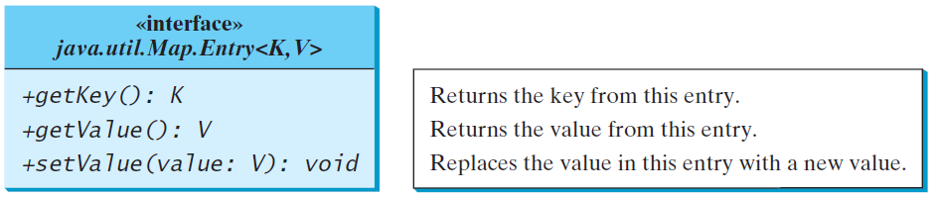
The Map Interface
A map is a container object that stores a collection of key/value pairs.
It enables fast retrieval, deletion, and updating of the pair through the key.
The keys are like indexes.
In List, the indexes are integer.
In Map, the keys can be any objects.

Slide 58
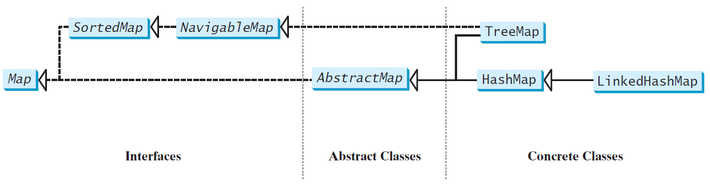
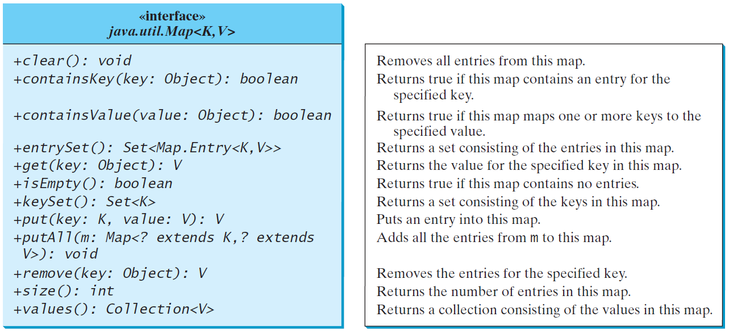
Map Interface and Class Hierarchy
update methods
query methods

Slide 59
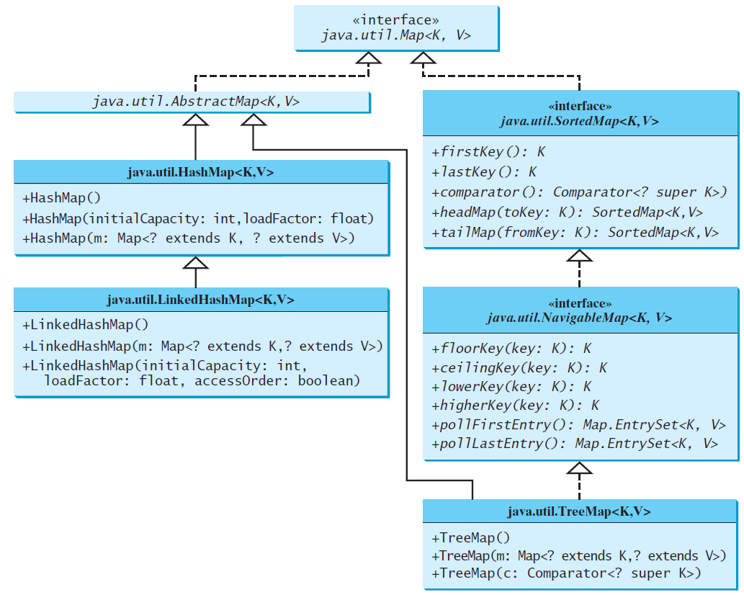
Concrete Map Classes
You can create a map using one of its three concrete classes
HashMap | - There is no particular order for the elements in a hash map. They are not stored in the order in which they are inserted into the map. - Efficient for locating a value, inserting an entry, and deleting an entry.
LinkedHashMap | - Supports an ordering of the entries in the map, (known as the insertion order, access order)
TreeMap | - Elements are sorted based on their keys

Slide 60
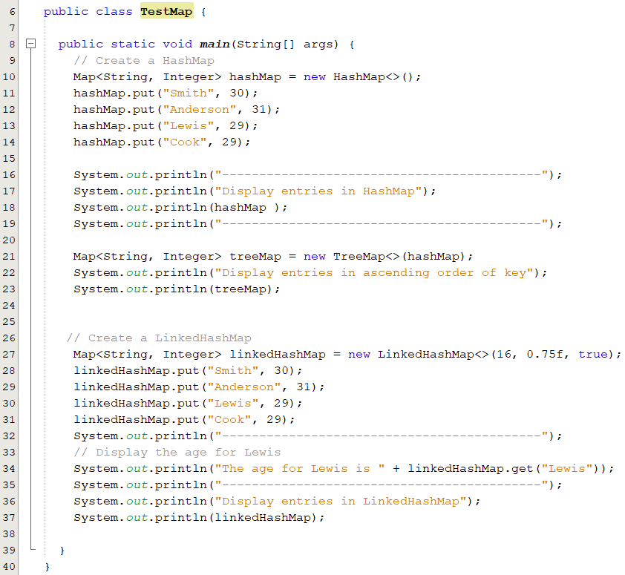
Example: Using HashMap and TreeMap
-------------------------------------------
Display entries in HashMap
{Lewis=29, Smith=30, Cook=29, Anderson=31}
-------------------------------------------
Display entries in ascending order of key
{Anderson=31, Cook=29, Lewis=29, Smith=30}
-------------------------------------------
The age for Lewis is 29
-------------------------------------------
Display entries in LinkedHashMap
{Smith=30, Anderson=31, Cook=29, Lewis=29}
Lewis is the last element accessed. So it is printed the last one

Slide 61
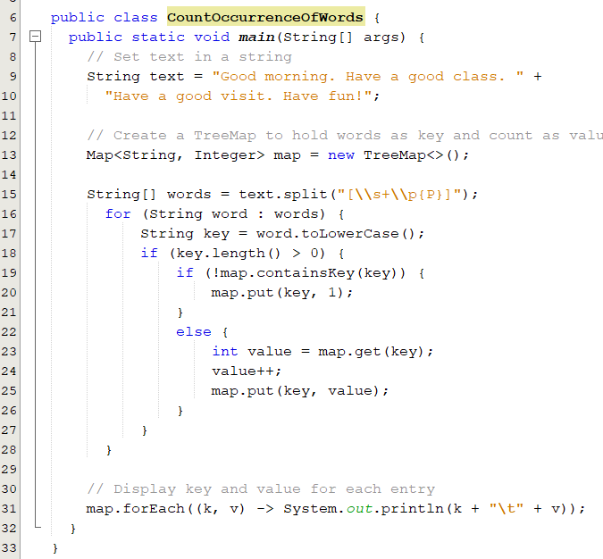
Case Study: Counting the Occurrences of Words in a Text
The program uses a hash map to store a pair consisting of a word and its count.
For each word, check whether it is already a key in the map.
If not, add the key and value 1 to the map.
Otherwise, increase the value for the word (key) by 1 in the map.
output
a 2
class 1
fun 1
good 3
have 3
morning 1
visit 1

Slide 62
Pop-Questions(3)
Show the printout of the following code:
Map<Integer, String> map = new LinkedHashMap<>();
map.put(123, "John Smith");
map.put(111, "George Smith");
map.put(123, "Steve Yao");
map.put(222, "Steve Yao");
System.out.println("(1) " + map);
System.out.println("(2) " + new TreeMap<Integer, String>(map));
(1) {123=Steve Yao, 111=George Smith, 222=Steve Yao}
(2) {111=George Smith, 123=Steve Yao, 222=Steve Yao}

