Slide 1
CDN Content Delivery Network 内容分发网络
网络存储技术

Slide 2
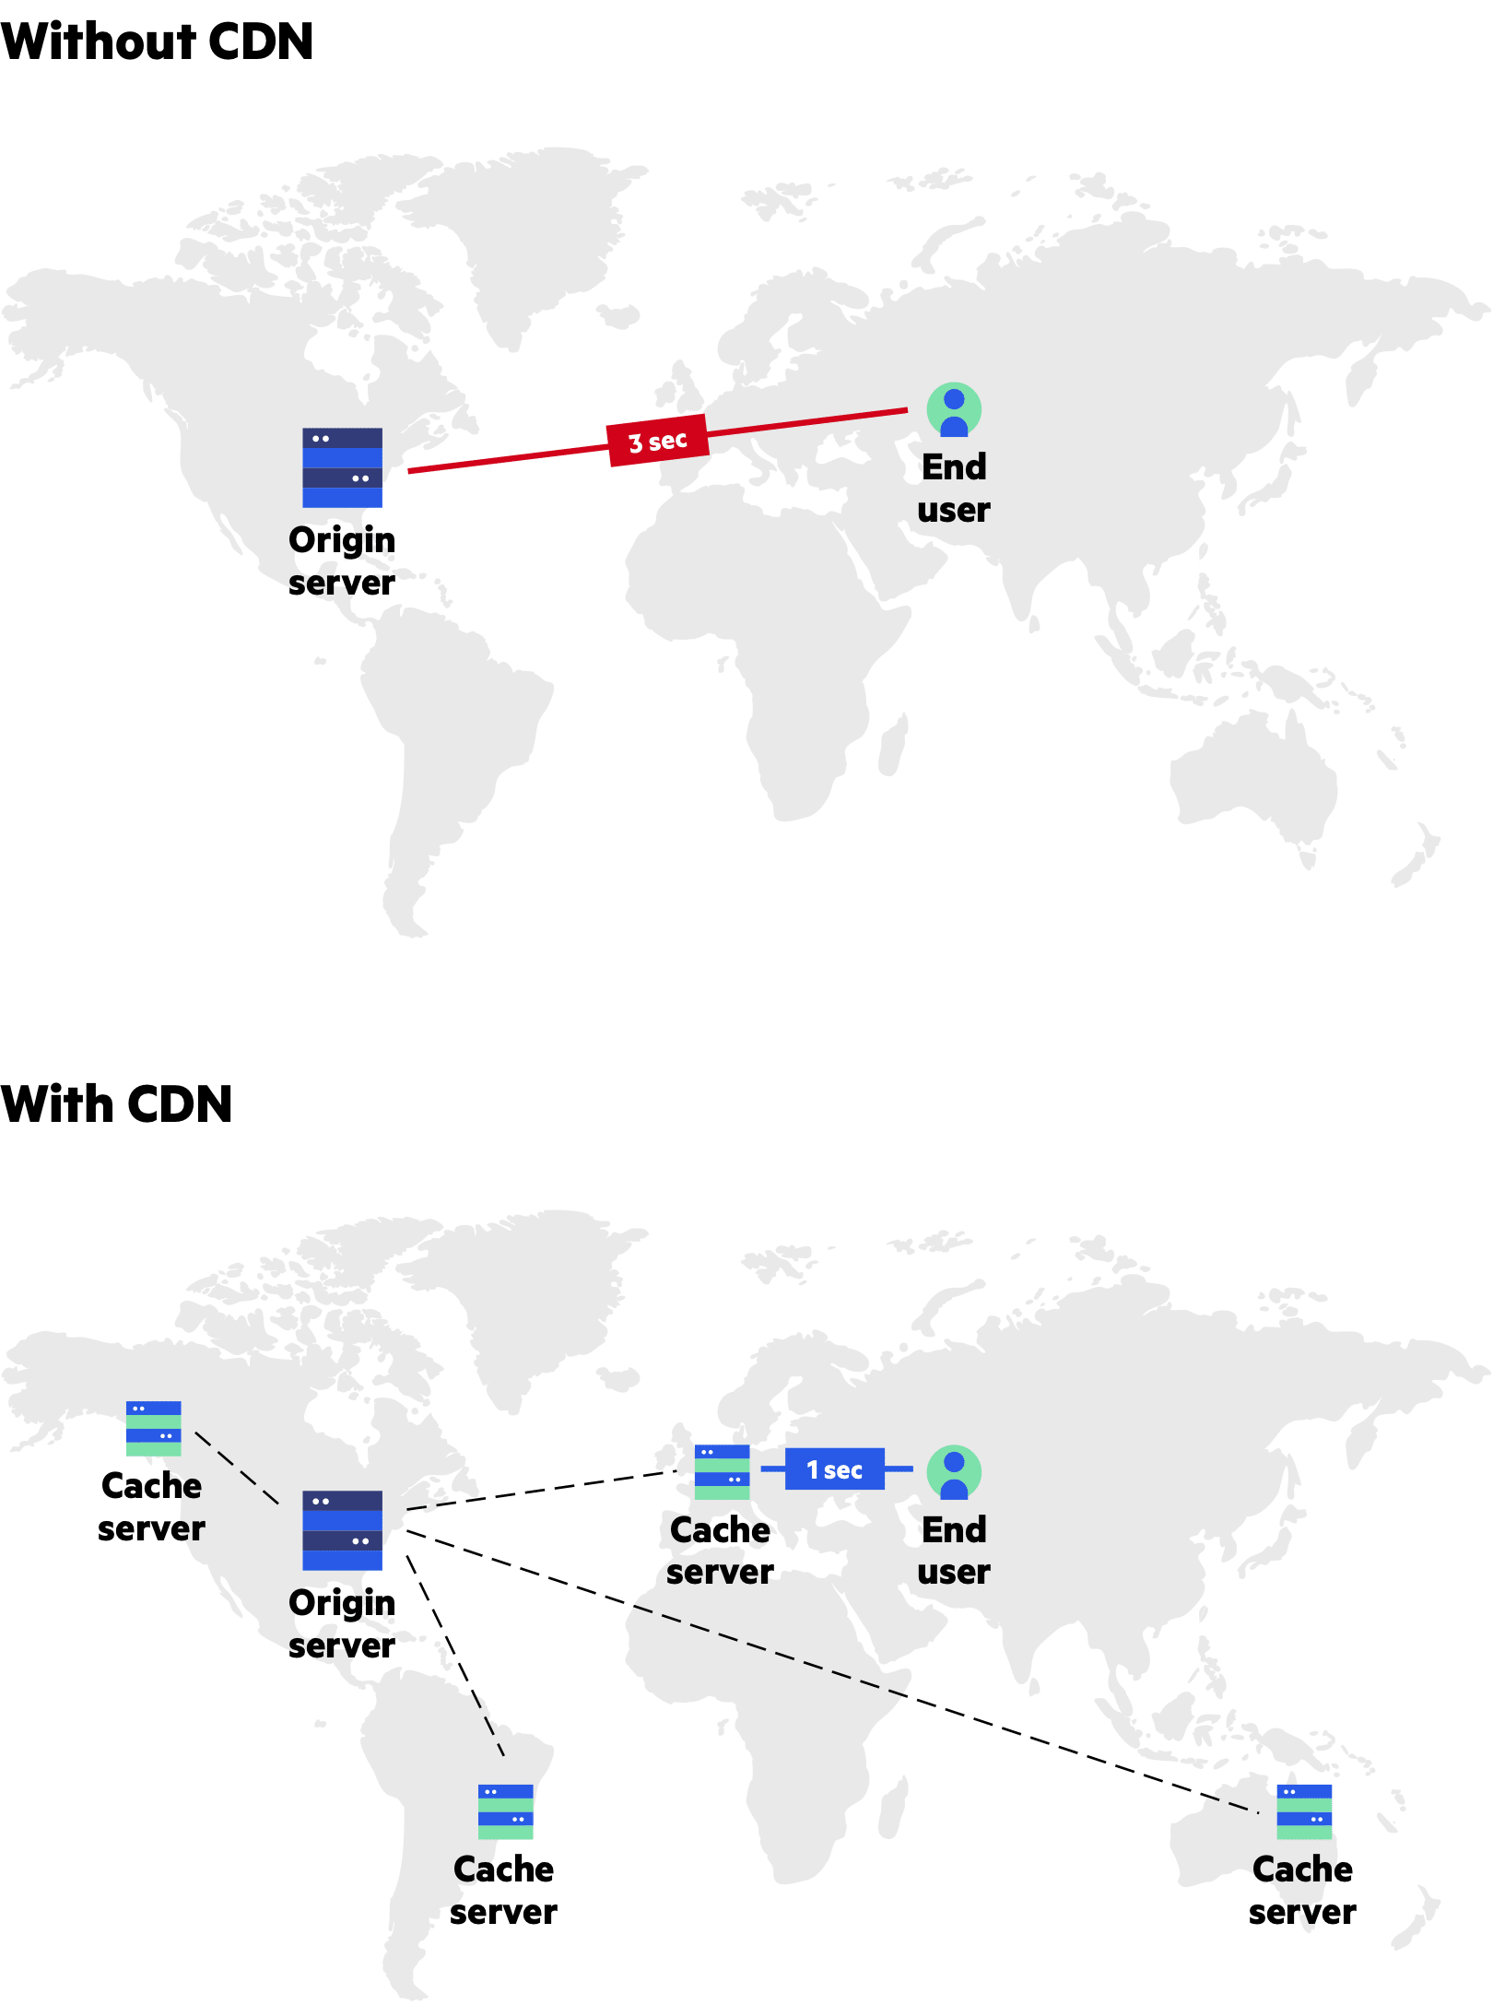
What is a CDN
Content delivery networks (CDN) are the transparent backbone of the Internet in charge of content delivery. Whether we know it or not, every one of us interacts with CDNs on a daily basis; when reading articles on news sites, shopping online, watching YouTube videos or perusing social media feeds.
That delay interval is affected by a number of factors, many being specific to a given web page. In all cases however, the delay duration is impacted by the physical distance between you and that website’s hosting server.
A CDN’s mission is to virtually shorten that physical distance, the goal being to improve site rendering speed and performance.

Slide 3
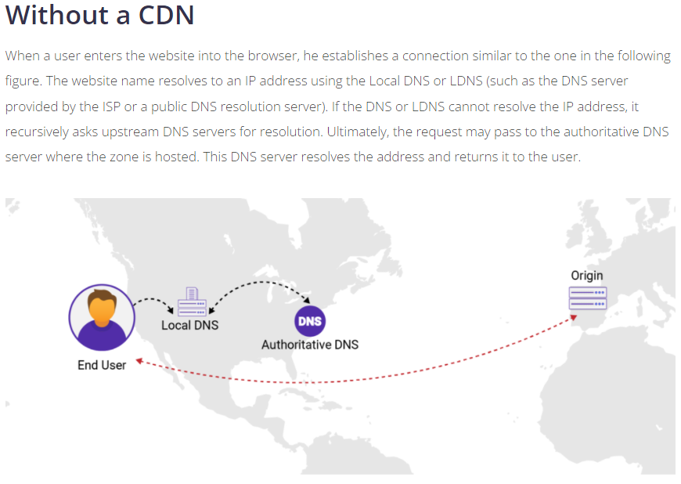

Slide 4
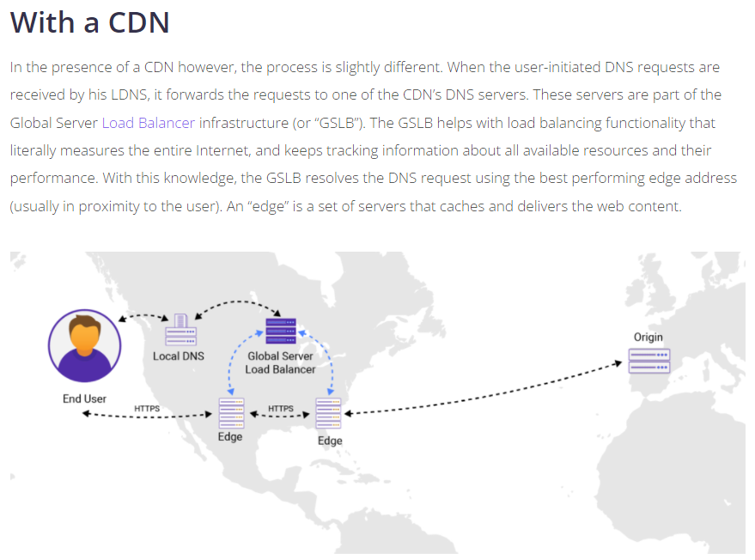

Slide 5
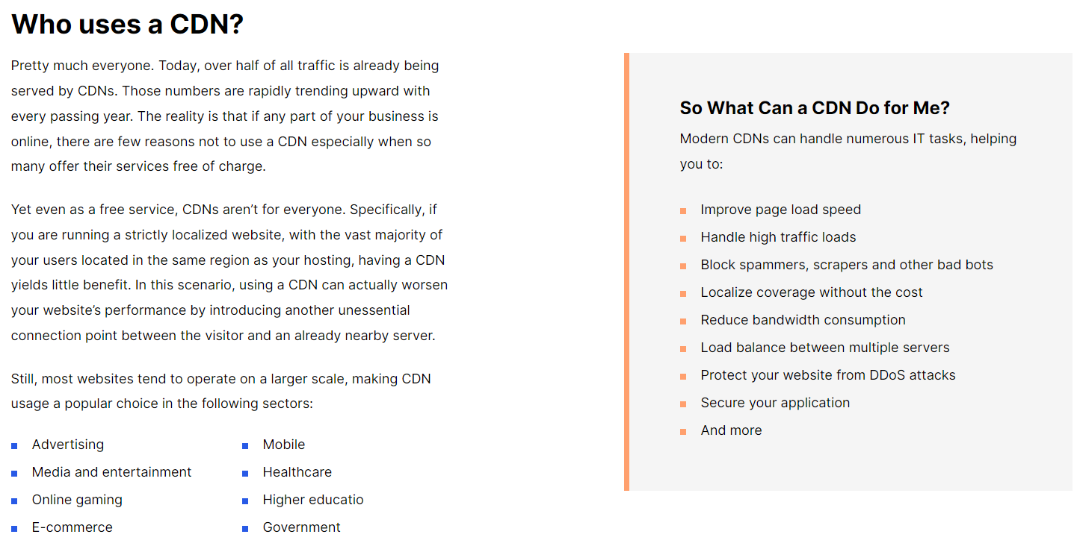

Slide 6
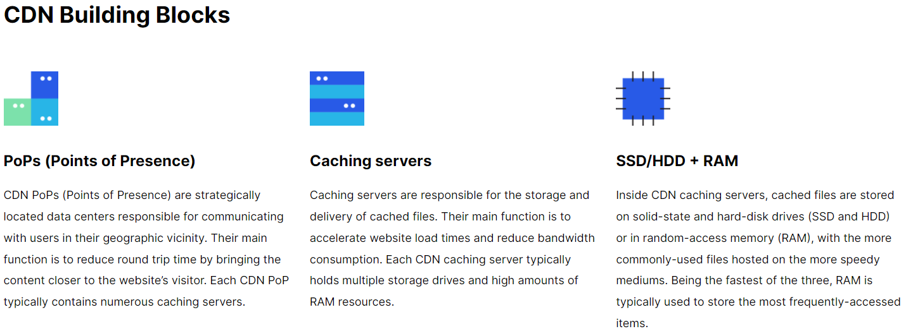

Slide 7
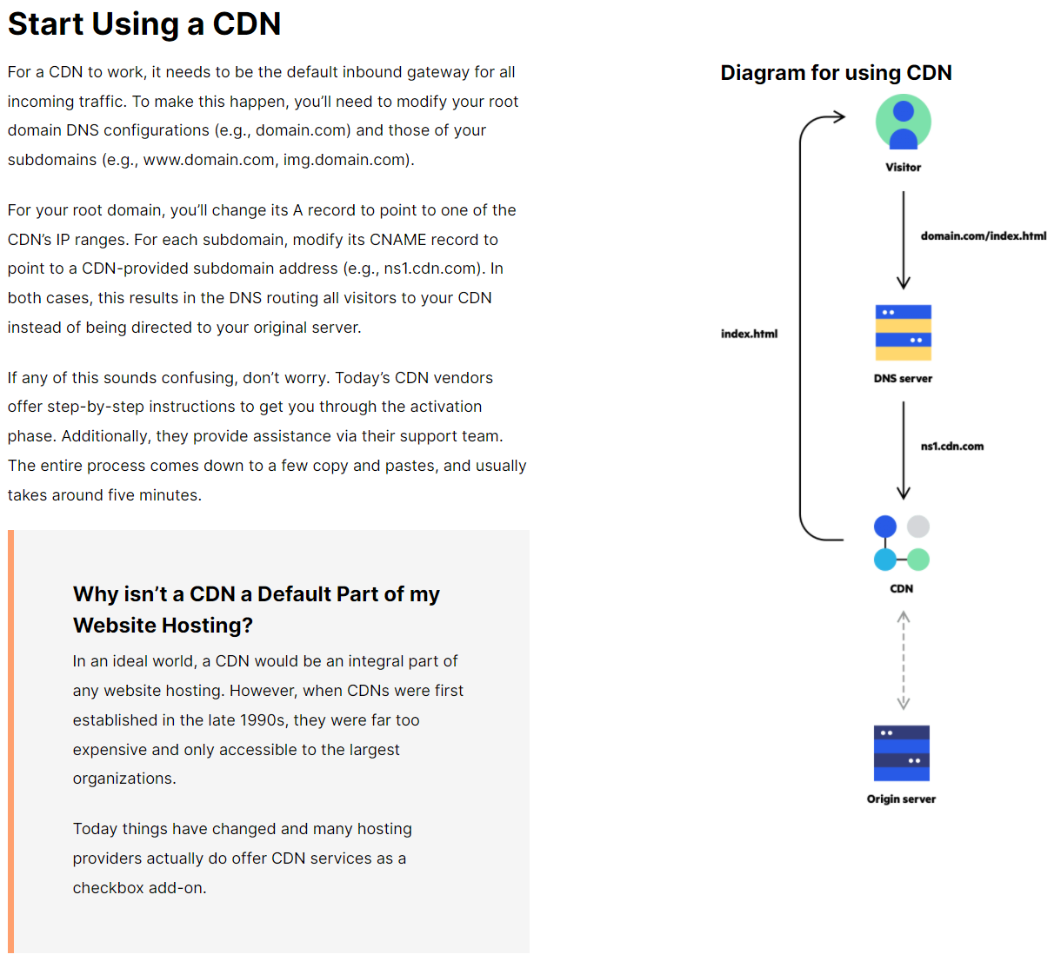

Slide 8


Slide 9
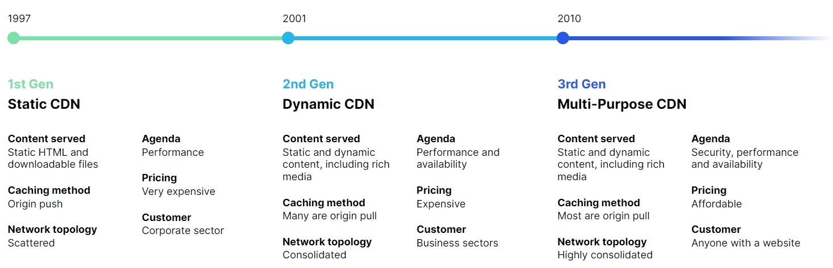

Slide 10
CDN Architecture

Slide 11
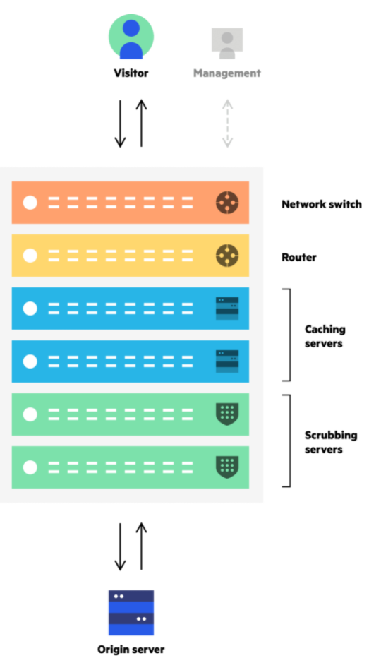
CDN Architecture
The choice of infrastructure architecture is critical to shaping a CDN’s product identity while also defining the value of its offering. The basic building blocks of CDN infrastructures are PoPs (points of presence)—regional data centers responsible for communicating with users in their proximity.
Using regional content distribution centers cuts down on round-trip time (RTT), making your website faster and more responsive for all visitors, regardless of their geolocation.
Typically, each PoP holds multiple servers and routers responsible for caching, connection optimization and other content delivery features. For CDNs providing security solutions, PoPs also hold DDoS scrubbing servers and machines responsible for other security-related functions.

Slide 12
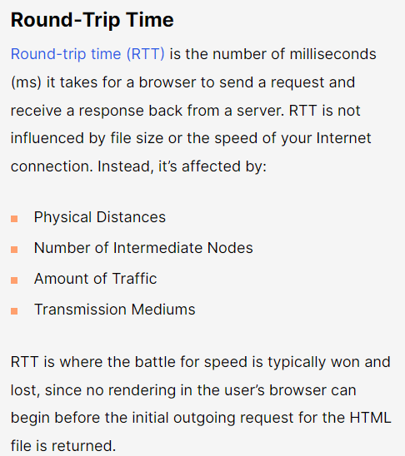
CDN Architecture

Slide 13
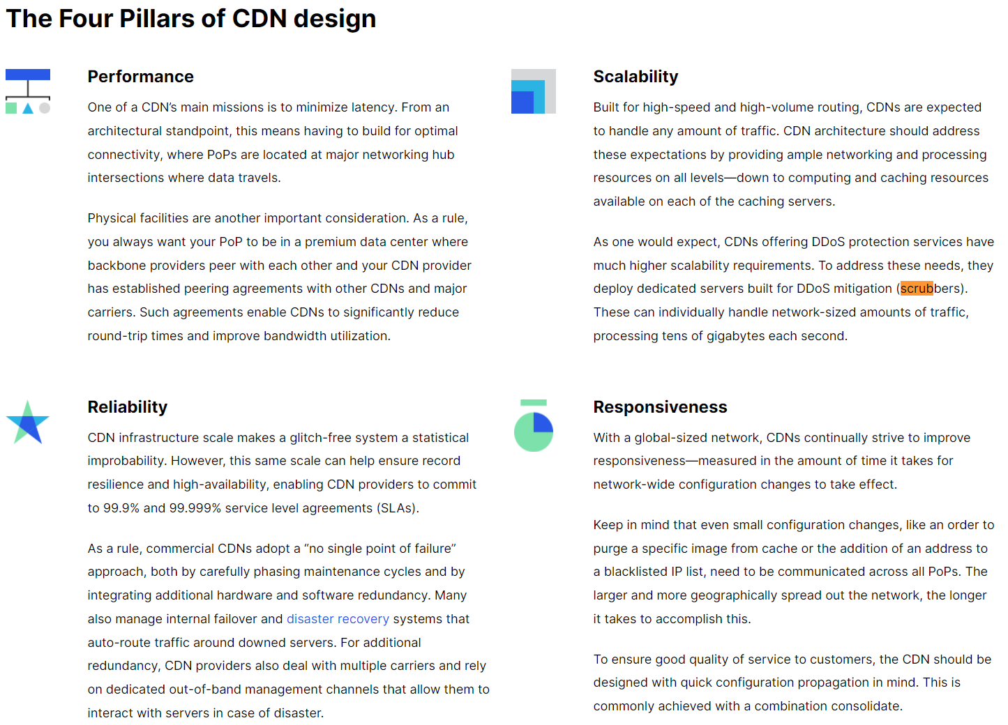

Slide 14
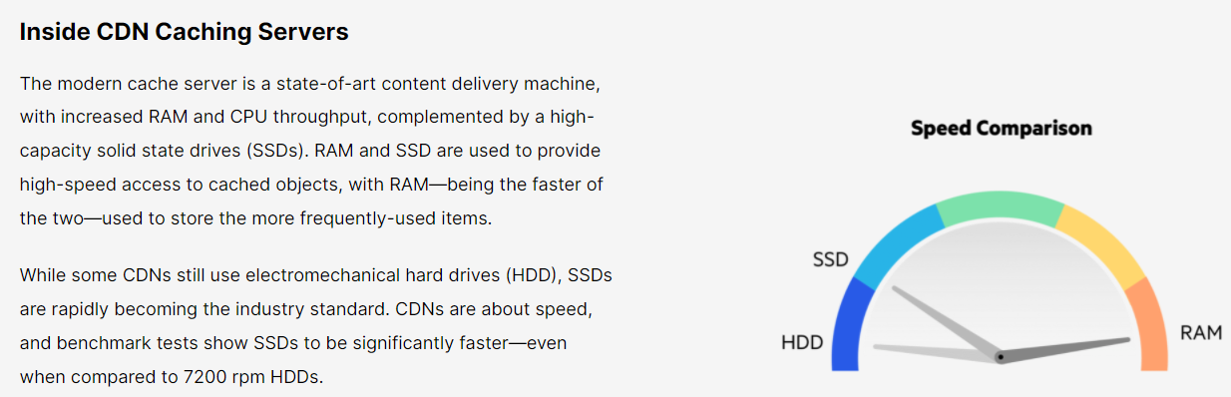

Slide 15
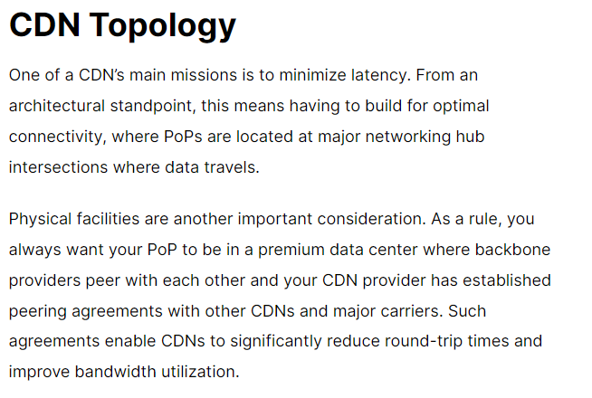

Slide 16
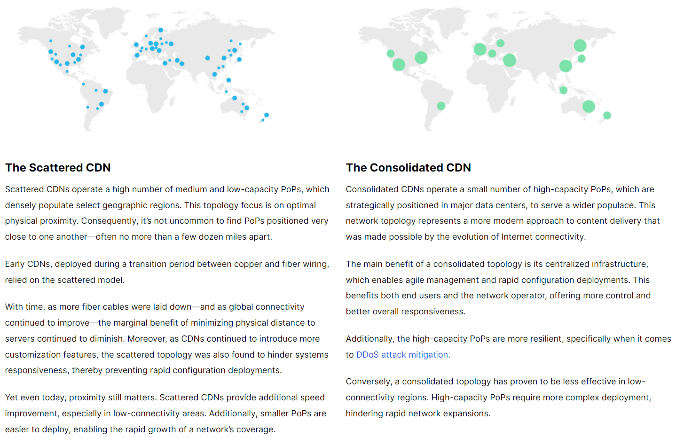

Slide 17
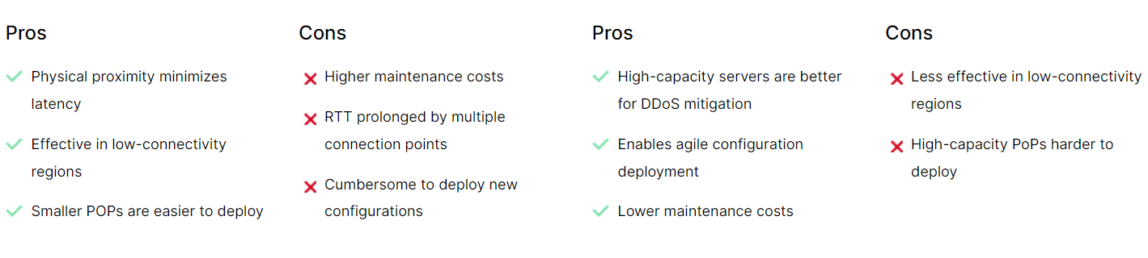

Slide 18
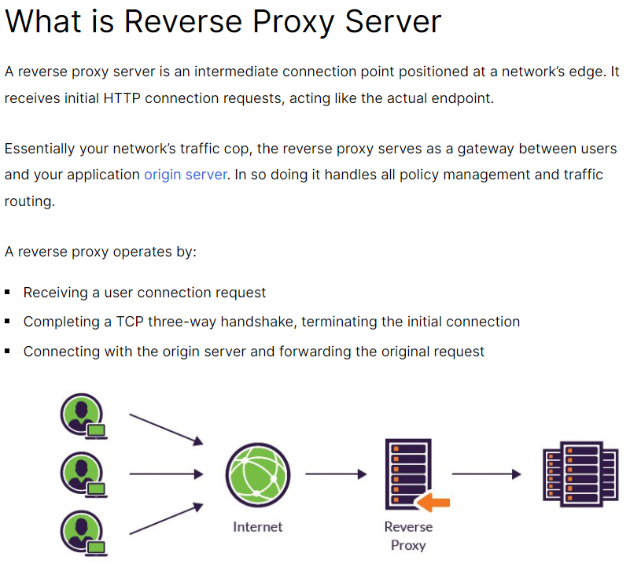

Slide 19
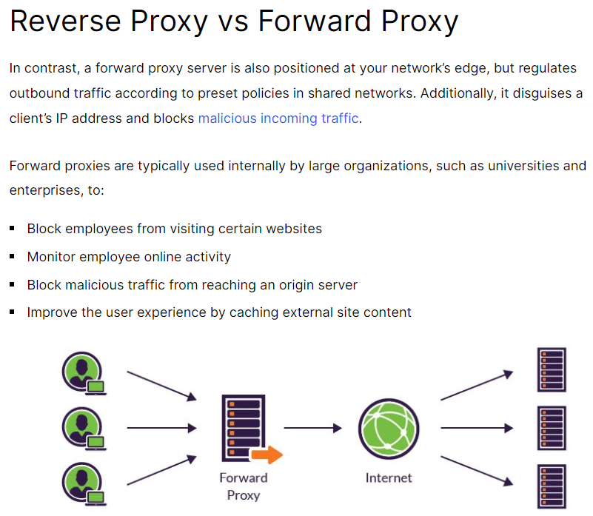

Slide 20
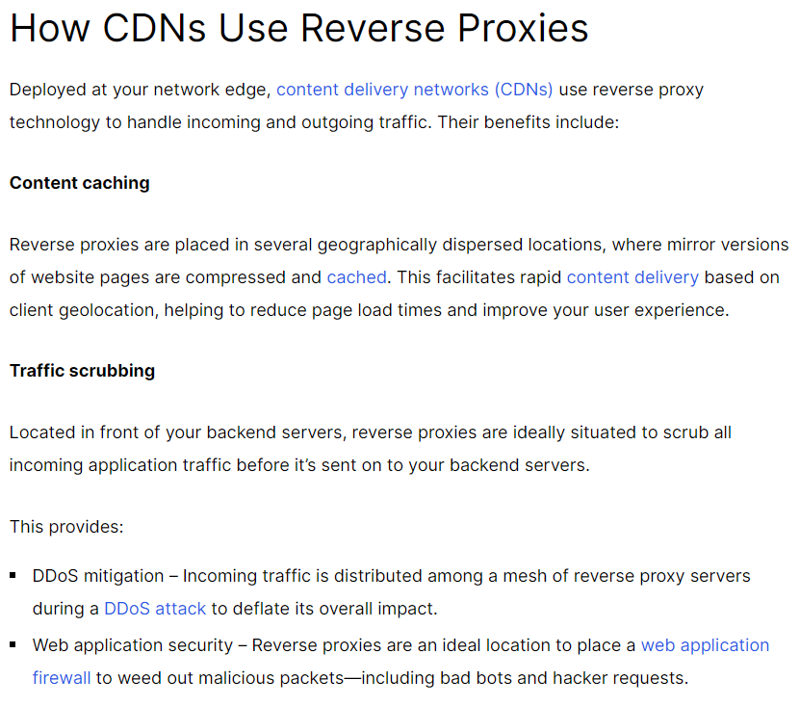

Slide 21
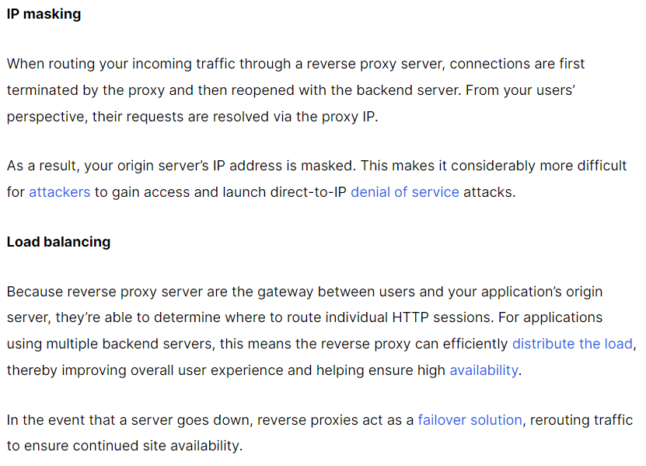
How CDNs Use Reverse Proxies

Slide 22
CDN Caching

Slide 23
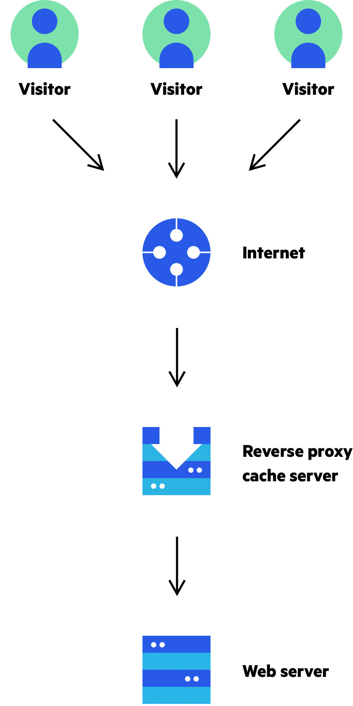
CDN Caching
Caching is at the heart of content delivery network (CDN) services. Similar to how browser caching stores files on a hard drive, where they can be more rapidly accessed, a CDN moves your website content to powerful proxy servers optimized for accelerated content distribution.
Caching works by selectively storing website files on a CDN’s cache proxy servers, where they can be quickly accessed by website visitors browsing from a nearby location.

Slide 24
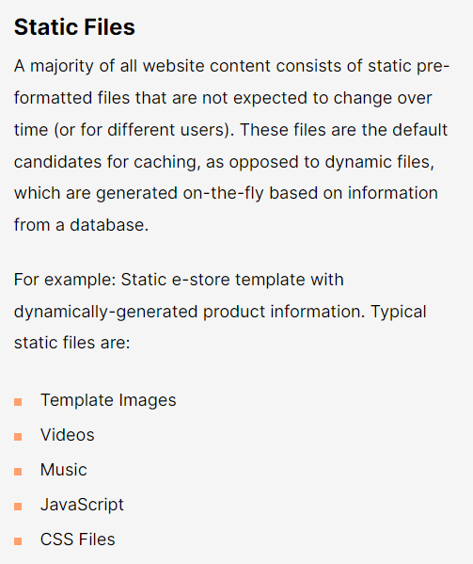
CDN Caching

Slide 25
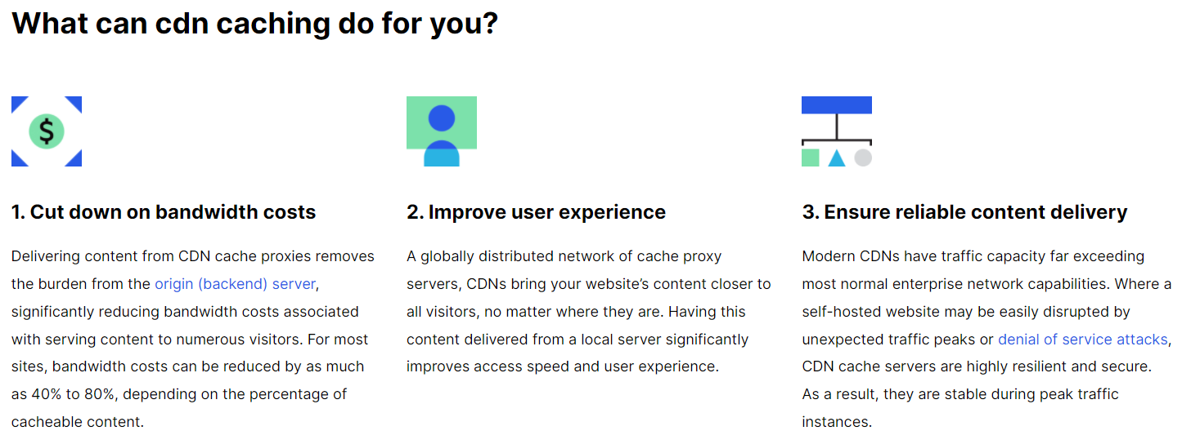

Slide 26
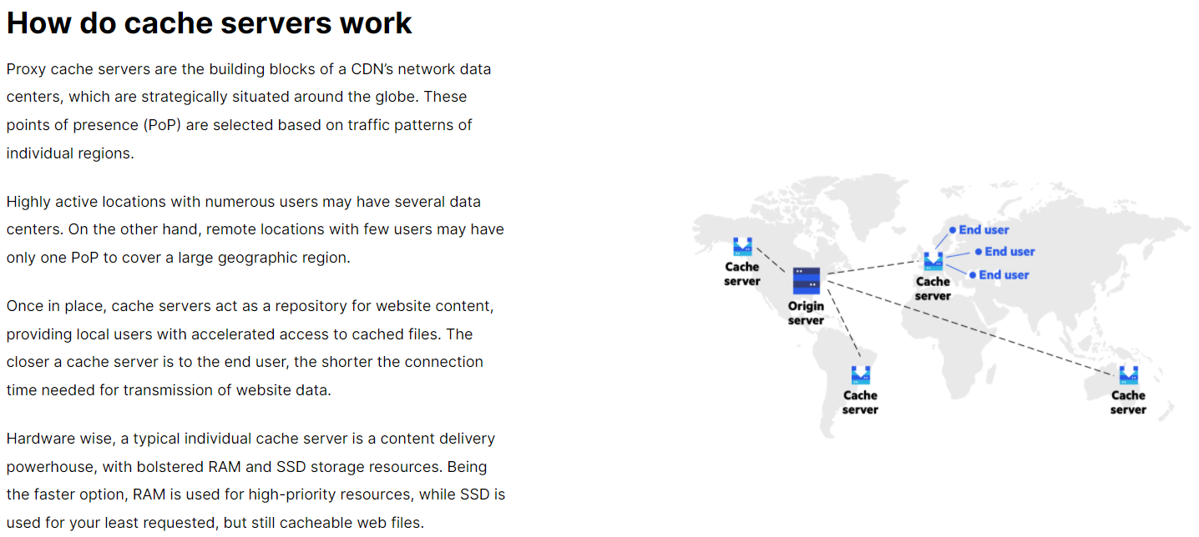

Slide 27
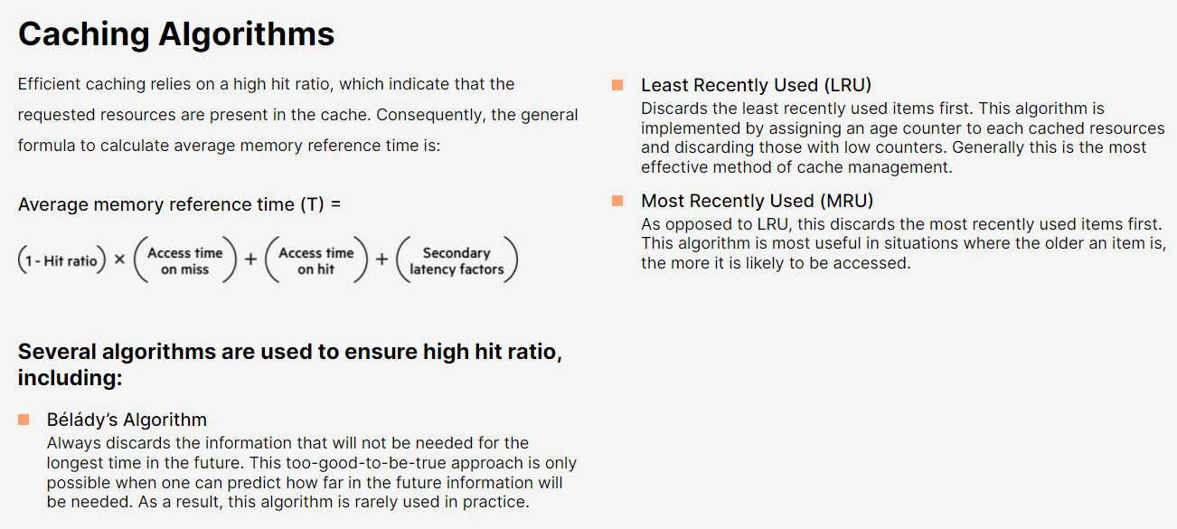

Slide 28
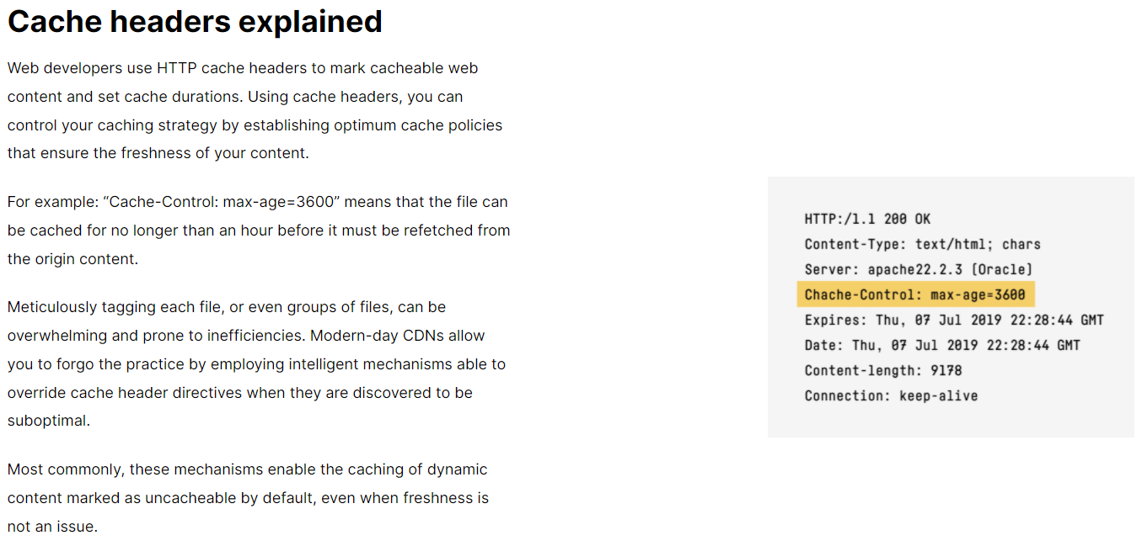

Slide 29
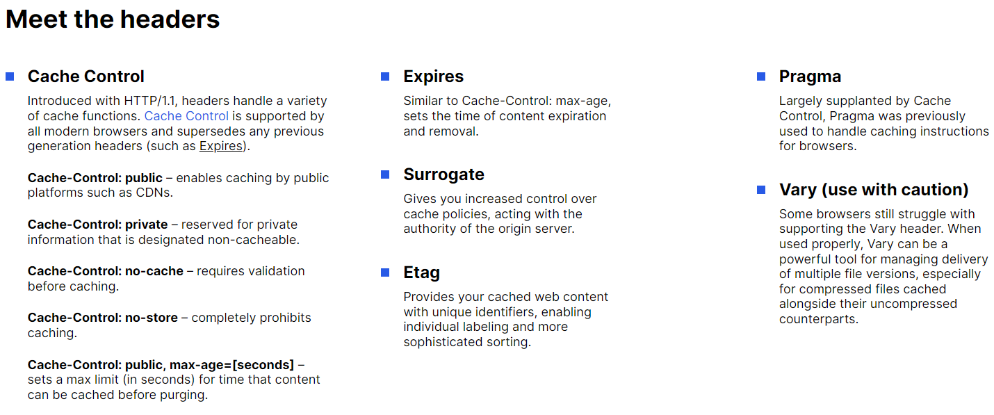

Slide 30
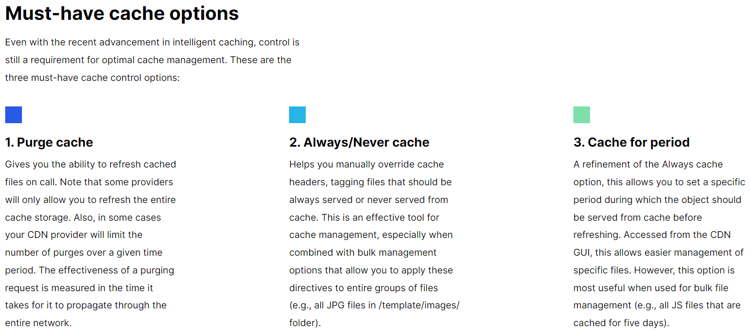

Slide 31
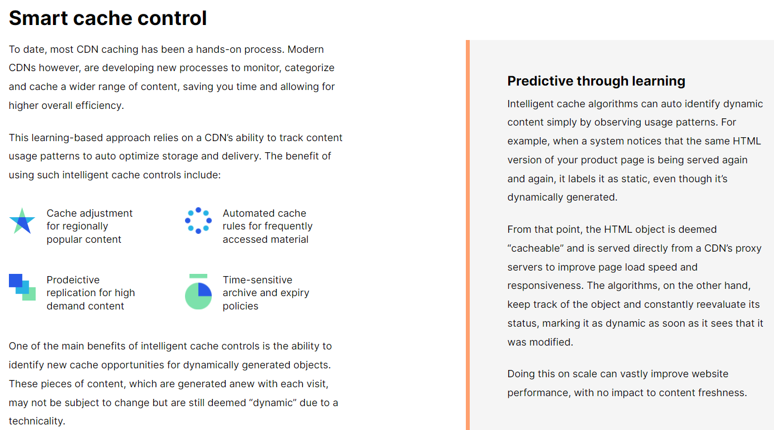

Slide 32
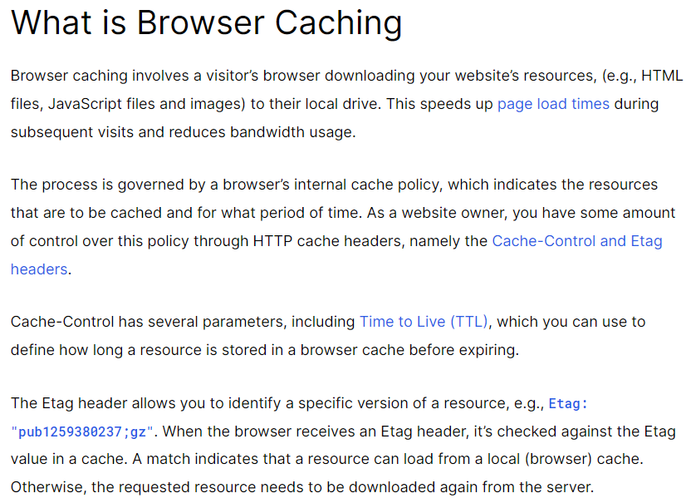

Slide 33
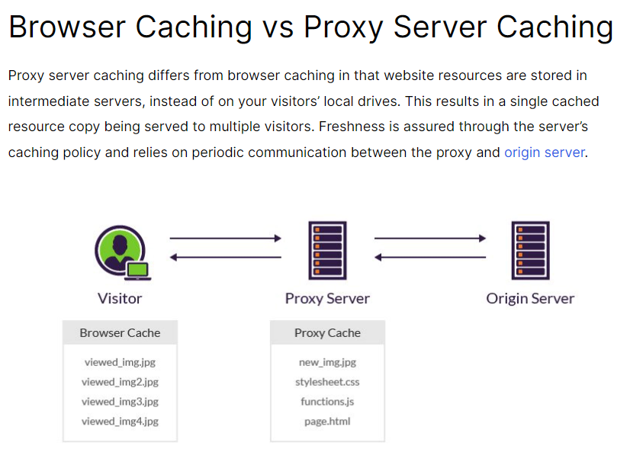

Slide 34
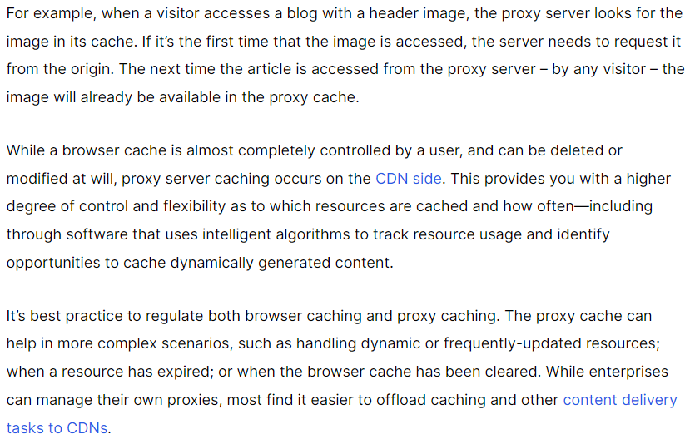
Browser Caching vs Proxy Server Caching

Slide 35
Front End Optimization

Slide 36
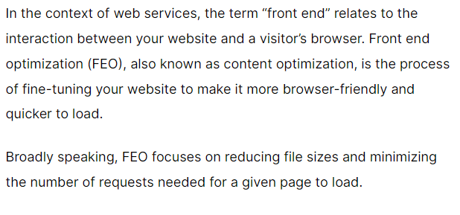
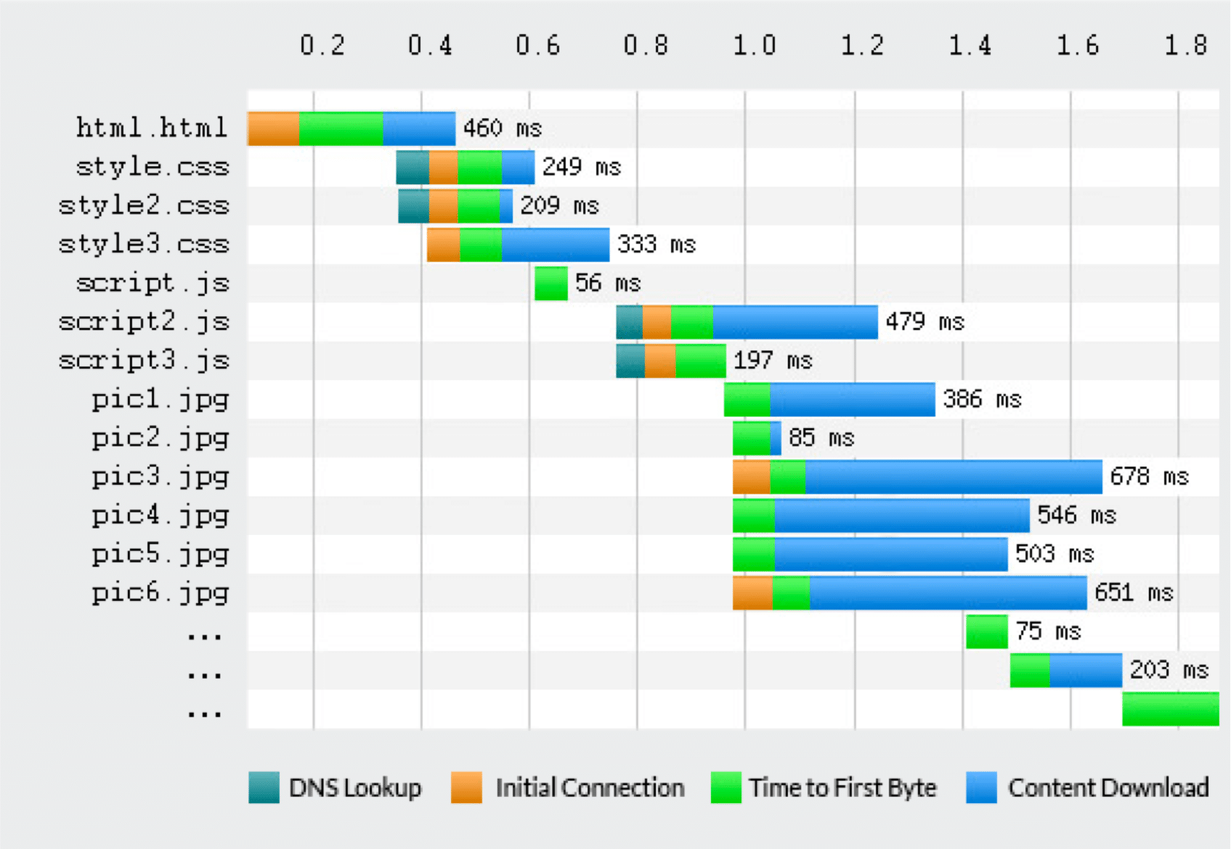
Front End Optimization

Slide 37
Front End Optimization
During the FEO process, web designers draw a distinction between the perceived and the actual page load time. Perceived load time is considered because of its impact on the overall user experience (UX), while the actual load time is often used as a performance benchmark metric.
Content delivery networks (CDNs) play an important role in the FEO process of front end optimization, as they are commonly used to streamline many of the more time-demanding optimization tasks. For example, a typical CDN offers auto-file compression and auto-minification features, freeing you from having to manually tinker with individual website resources.

Slide 38
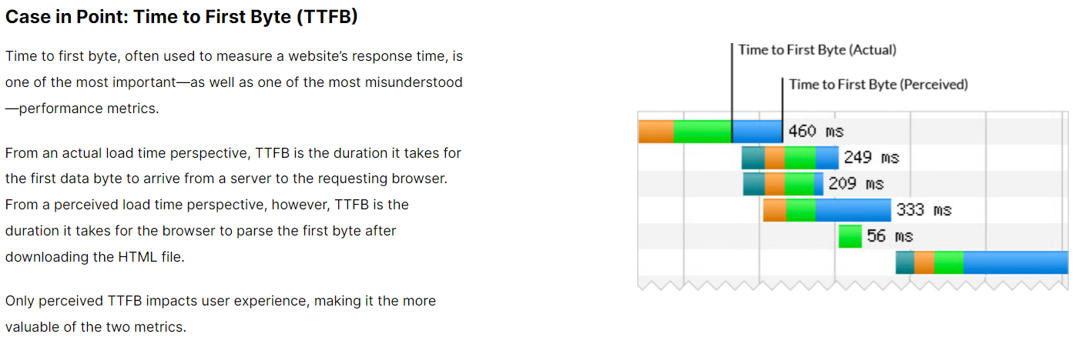

Slide 39
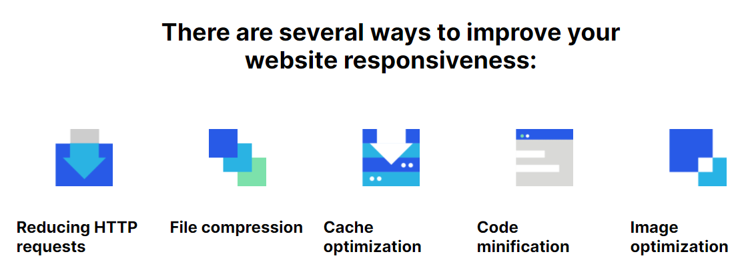

Slide 40
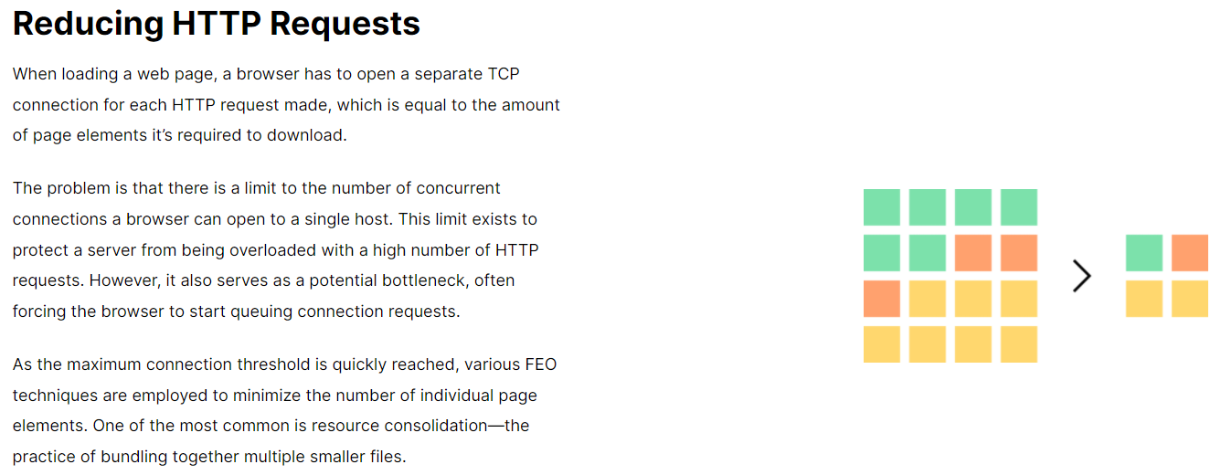

Slide 41
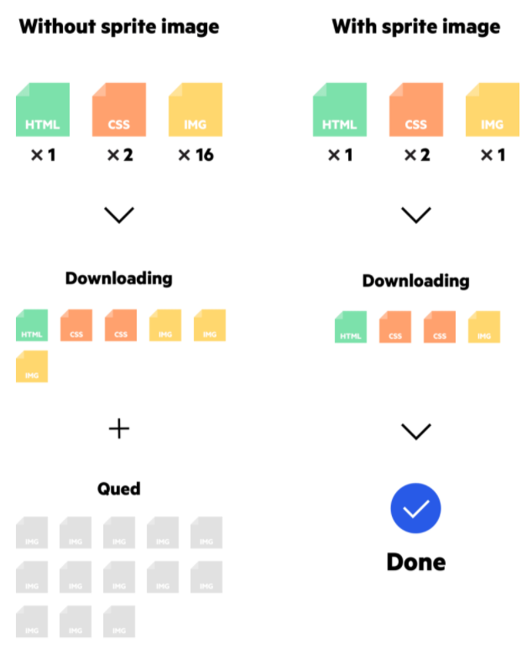
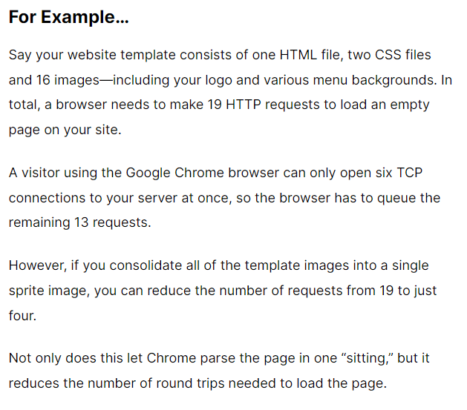

Slide 42
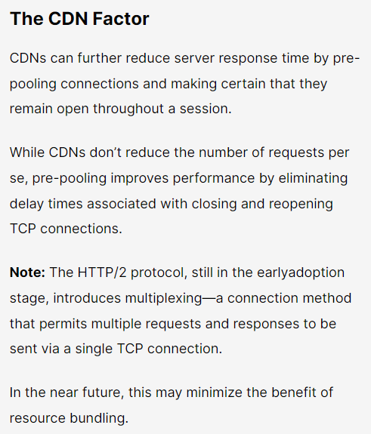

Slide 43
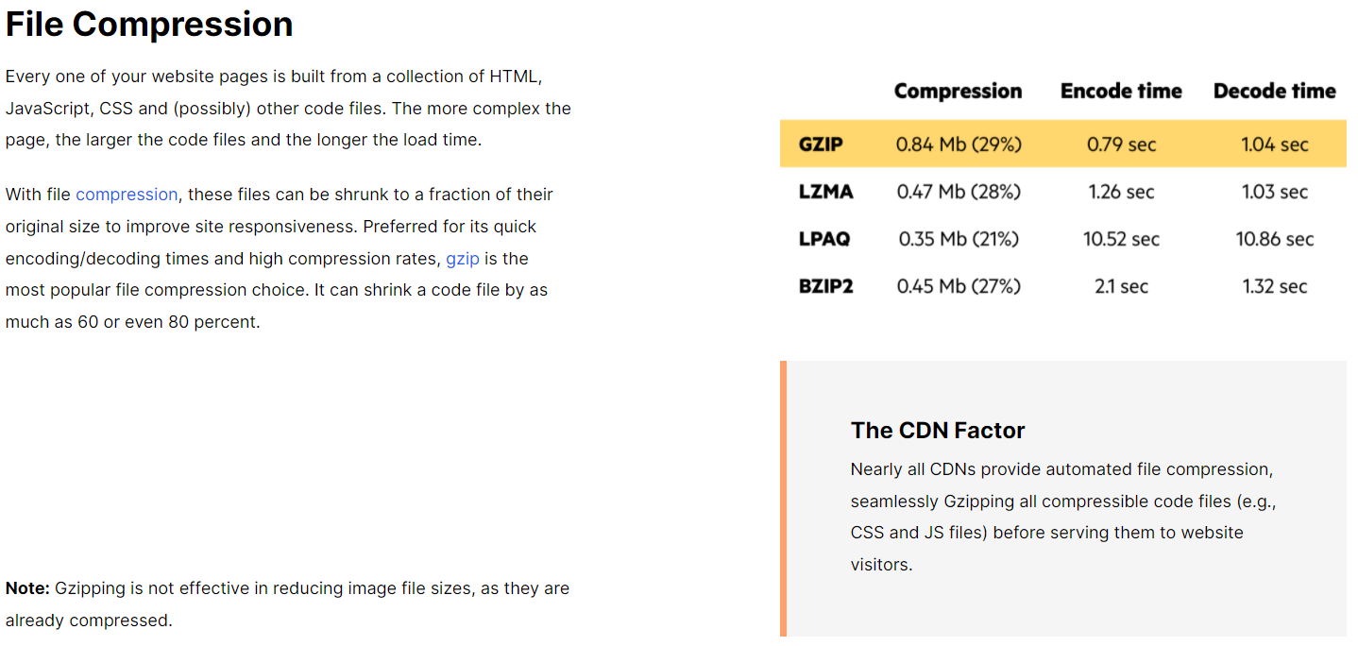

Slide 44
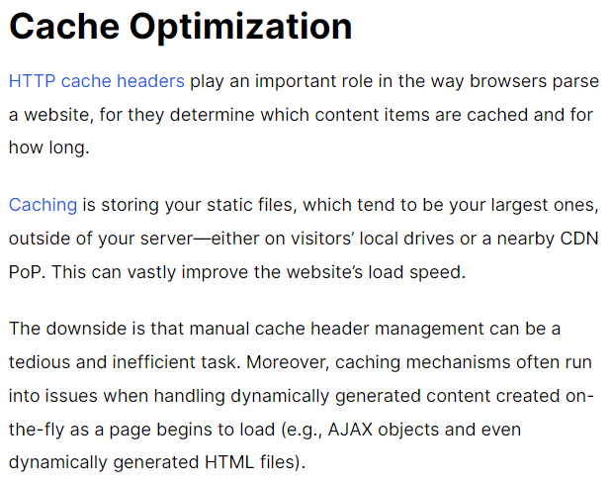
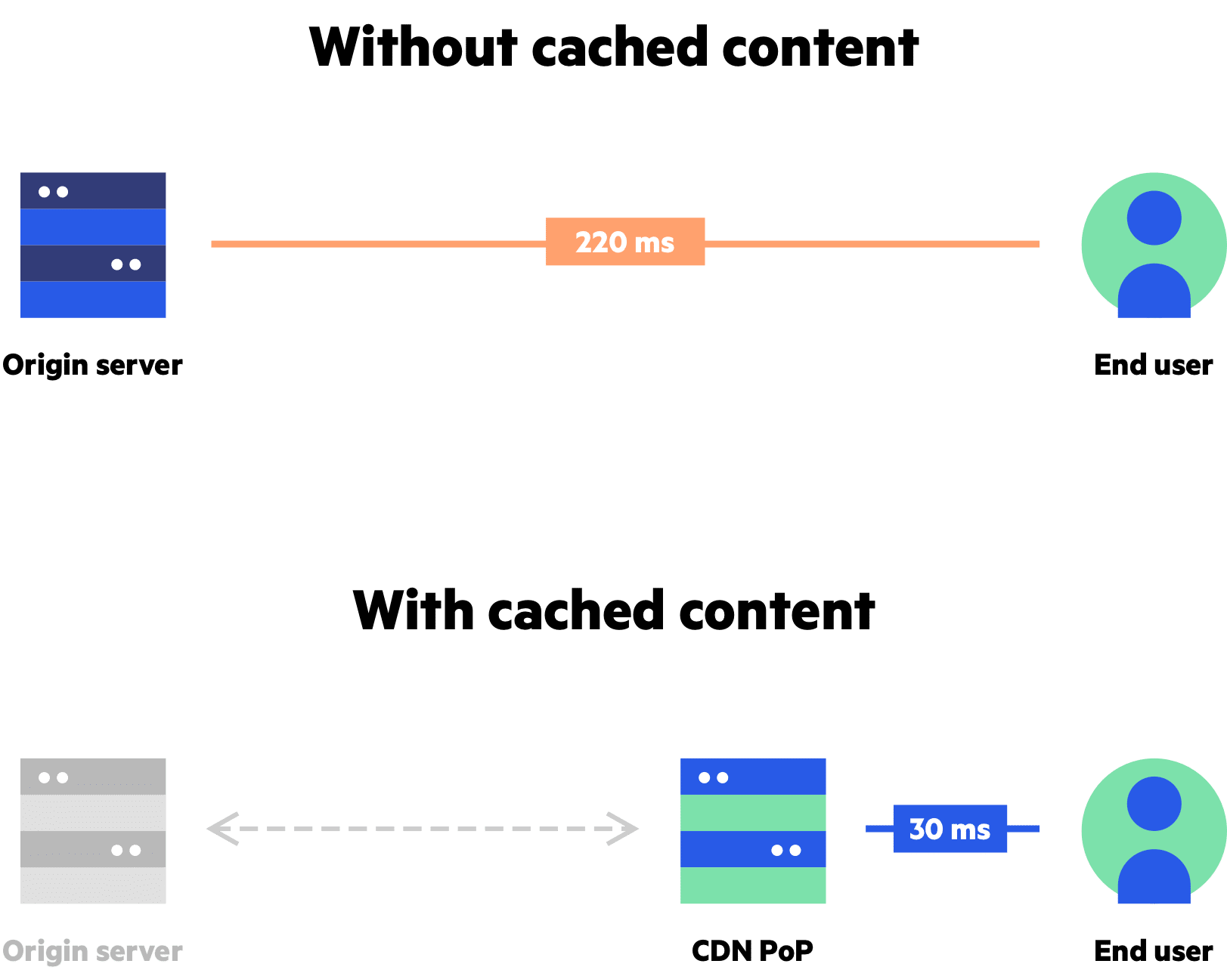

Slide 45
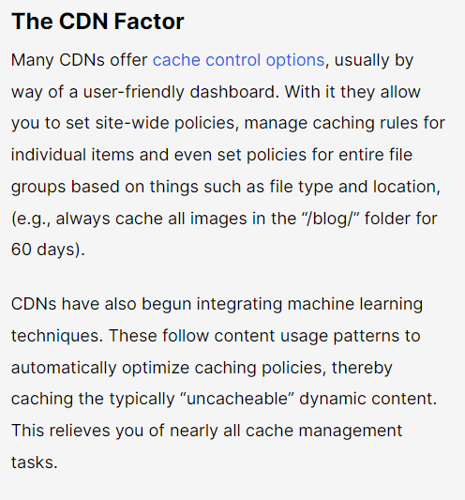

Slide 46



Slide 47
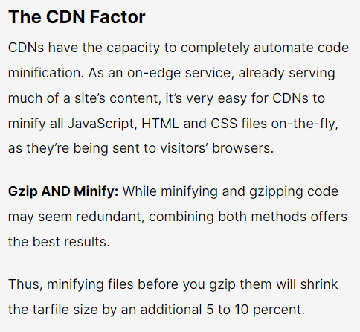

Slide 48
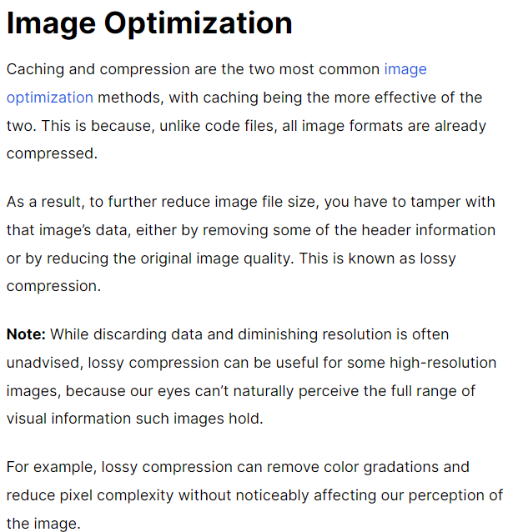
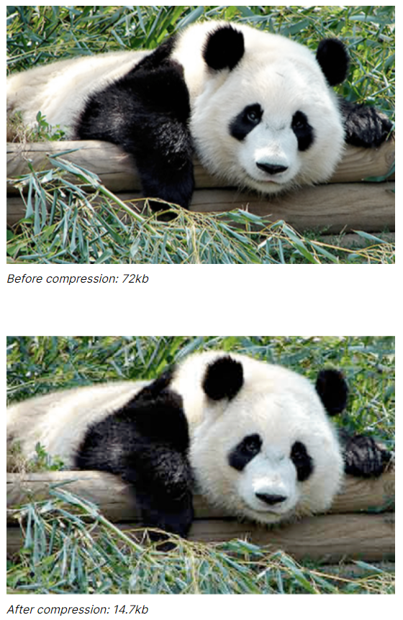

Slide 49
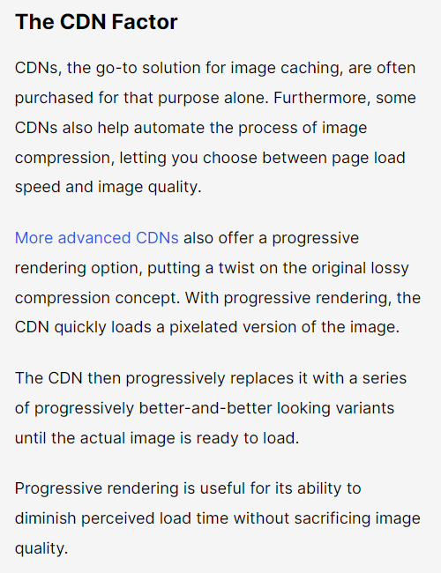
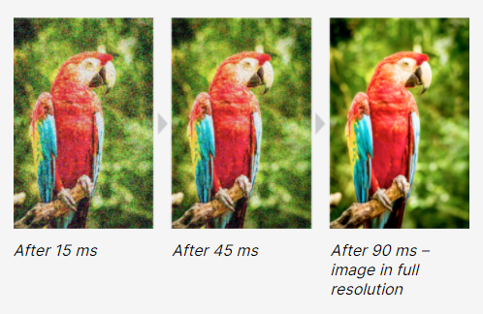

Slide 50

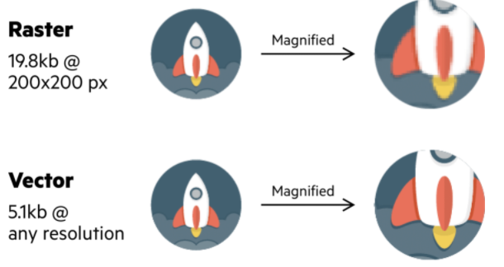

Slide 51
CDN and SSL/TLS

Slide 52
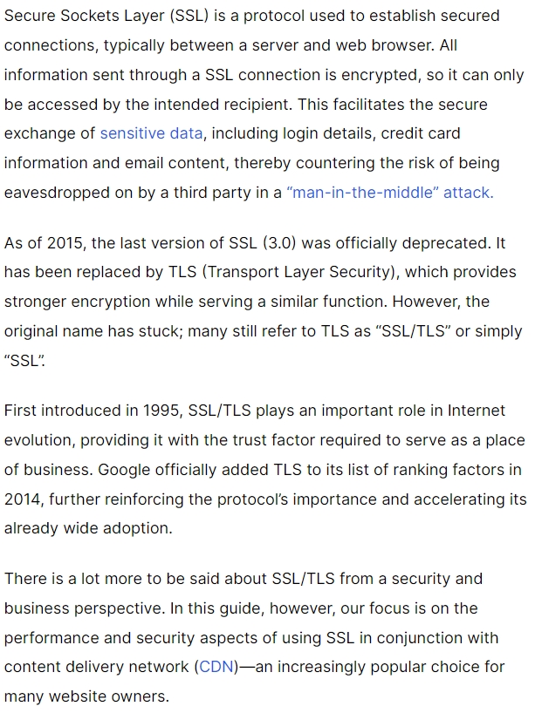
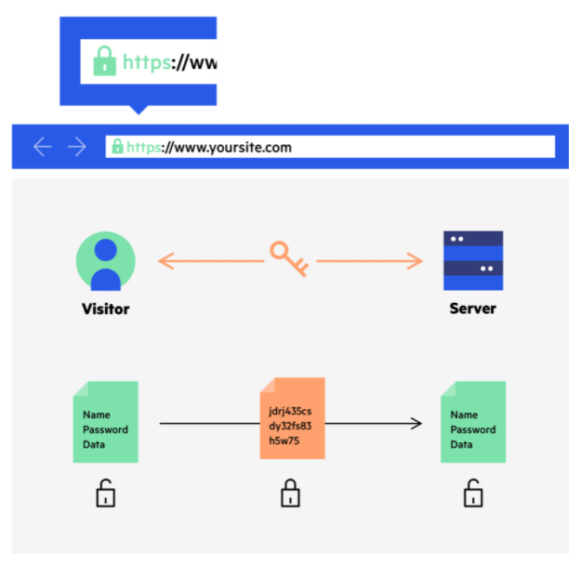

Slide 53



Slide 54


Slide 55



Slide 56


Slide 57



Slide 58



Slide 59




Slide 60


Slide 61



Slide 62


Slide 63
Route Optimization

Slide 64



Slide 65


Slide 66



Slide 67



Slide 68


Slide 69



Slide 70



Slide 71
结束
网络存储技术

