Slide 1

无线传感器网络 Wireless Sensor Networks
2019年高新“标杆课程”项目
计算机学院 刘 亮

Slide 2
Chapter I Motivation for a Network of Wireless Sensor Nodes

Slide 3
Outline
Definitions and background
Challenges and constraints
Overview of topics covered

Slide 4
Sensing and Sensors
Sensing: technique to gather information about physical objects or areas
Sensor (transducer): object performing a sensing task; converting one form of energy in the physical world into electrical energy
Examples of sensors from biology: the human body
eyes: capture optical information (light)
ears: capture acoustic information (sound)
nose: captures olfactory information (smell)
skin: captures tactile information (shape, texture)

Slide 5
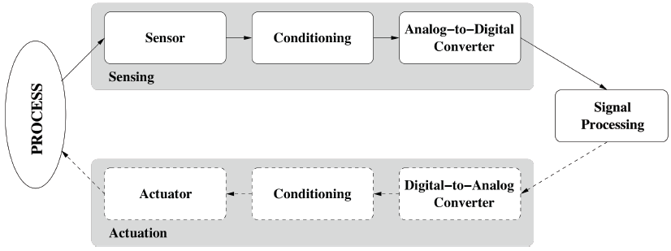
Sensing (Data Acquisition)
Sensors capture phenomena in the physical world (process, system, plant)
Signal conditioning prepare captured signals for further use (amplification (放大), attenuation (衰减), filtering of unwanted frequencies...)
Analog-to-digital conversion (ADC) translates analog signal into digital signal
Digital signal is processed and output is often given (via digital-analog converter and signal conditioner) to an actuator (device able to control the physical world)

Slide 6
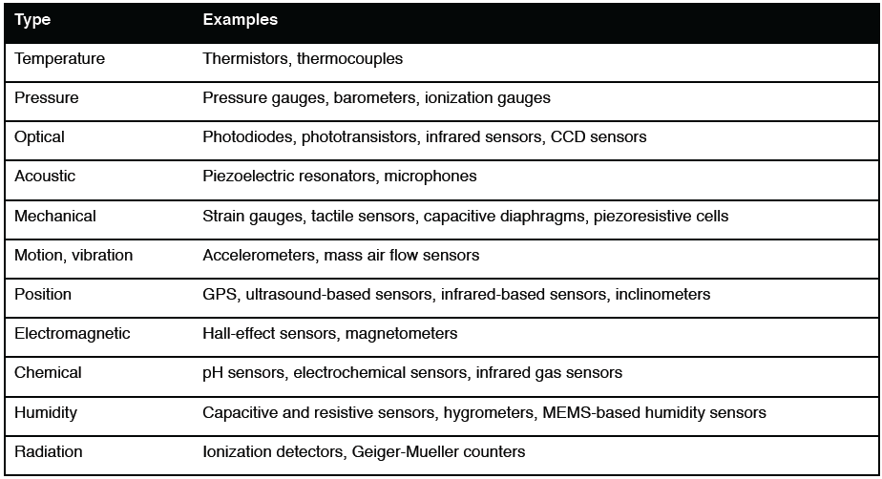
Sensor Classifications
Physical property to be monitored determines type of required sensor
机械的
电磁的
辐射

Slide 7
Other Classifications
Power supply:
active sensors require external power, i.e., they emit energy (microwaves, light, sound) to trigger response or detect change in energy of transmitted signal (e.g., electromagnetic proximity sensor)
passive sensors detect energy in the environment and derive their power from this energy input (e.g., passive infrared (红外) sensor)

Slide 8
Other Classifications
Electrical phenomenon:
resistive sensors (电阻式传感器) use changes in electrical resistivity (ρ) based on physical properties such as temperature (resistance R = ρ*l/A)
capacitive sensors (电容式传感器) use changes in capacitor dimensions or permittivity (电容率) (ε) based on physical properties (capacitance C = ε*A/d)
inductive sensors (电感式传感器) rely on the principle of inductance（感应系数）(electromagnetic force is induced by fluctuating current)
piezoelectric sensors（压电传感器）rely on materials (crystals, ceramics) that generate a displacement of charges in response to mechanical deformation

Slide 9
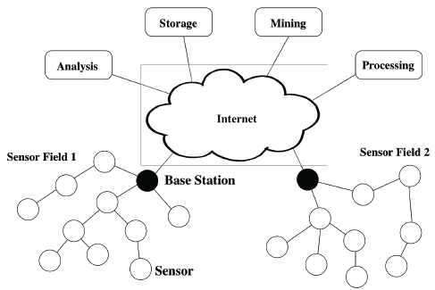
Wireless Sensor Network (WSN)
Multiple sensors form a network to cooperatively monitor large or complex physical environments
Acquired information is wirelessly communicated to a base station (BS), which propagates the information to remote devices for storage, analysis, and processing

Slide 10
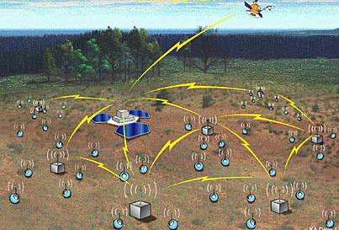

History of Wireless Sensor Networks
DARPA:
Distributed Sensor Nets Workshop (1978)
Distributed Sensor Networks (DSN) program (early 1980s)
Sensor Information Technology (SensIT) program

Slide 11
History of Wireless Sensor Networks
UCLA and Rockwell Science Center
Wireless Integrated Network Sensors (WINS)
Low Power Wireless Integrated Microsensor (LWIM) (1996)
UC-Berkeley
Smart Dust project (1999)
concept of “motes”: extremely small sensor nodes
Berkeley Wireless Research Center (BWRC)
PicoRadio project (2000)
MIT
μAMPS (micro-Adaptive Multidomain Power-aware Sensors) (2005)

Slide 12
History of Wireless Sensor Networks
Commercial efforts
Crossbow (www.xbow.com)
Sensoria (www.sensoria.com)
Worldsens (worldsens.citi.insa-lyon.fr)
Dust Networks (www.dustnetworks.com)
Ember Corporation (www.ember.com)

Slide 13
WSN Communication
Characteristics of typical WSN:
low data rates
energy-constrained sensors
IEEE 802.11 family of standards
most widely used WLAN protocols for wireless communications in general
can be found in early sensor networks or sensors networks without stringent energy constraints
IEEE 802.15.4 is an example for a protocol that has been designed specifically for short-range communications in WSNs
low data rates
low power consumption
widely used in academic and commercial WSN solutions

Slide 14
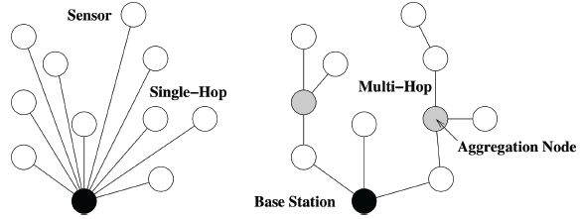
Single-Hop versus Multi-Hop
Star topology
every sensor communicates directly (single-hop) with the base station
may require large transmit powers and may be infeasible in large geographic areas
Mesh topology
sensors serve as relays (forwarders) for other sensor nodes (multi-hop)
may reduce power consumption and allows for larger coverage
introduces the problem of routing

Slide 15
Outline
Definitions and background
Challenges and constraints
Overview of topics covered

Slide 16
Challenges in WSNs: Energy
Sensors typically powered through batteries
replace battery when depleted
recharge battery, e.g., using solar power
discard sensor node when battery depleted
For batteries that cannot be recharged, sensor node should be able to operate during its entire mission time or until battery can be replaced
Energy efficiency is affected by various aspects of sensor node/network design

Slide 17
Challenges in WSNs: Energy
Physical layer:
switching and leakage energy of CMOS-based processors
Medium access control layer:
contention-based strategies lead to energy-costly collisions
problem of idle listening
Network layer:
responsible for finding energy-efficient routes

Slide 18
Challenges in WSNs: Energy
Operating system:
small memory footprint and efficient task switching
Security:
fast and simple algorithms for encryption (加密), authentication（鉴定）, etc.
Middleware:
in-network processing of sensor data can eliminate redundant data or aggregate sensor readings

Slide 19
Challenges in WSNs: Self-Management
Ad-hoc deployment
many sensor networks are deployed “without design”
sensors dropped from airplanes (battlefield assessment)
sensors placed wherever currently needed (tracking patients in disaster zone)
moving sensors (robot teams exploring unknown terrain)
sensor node must have some or all of the following abilities
determine its location
determine identity of neighboring nodes
configure node parameters
discover route(s) to base station
initiate sensing responsibility

Slide 20
Challenges in WSNs: Self-Management
Unattended operation
once deployed, WSN must operate without human intervention
device adapts to changes in topology, density, and traffic load
device adapts in response to failures
Other terminology
self-organization is the ability to adapt configuration parameters based on system and environmental state
self-optimization is the ability to monitor and optimize the use of the limited system resources
self-protection is the ability recognize and protect from intrusions and attacks
self-healing is the ability to discover, identify, and react to network disruptions

Slide 21

Challenges in WSNs: Wireless Networks
Attenuation（衰减）
limits radio range
Multi-hop communication
increased latency
increased failure/error probability
complicated by use of duty cycles

Slide 22
Challenges in WSNs: Decentralization
Centralized management (e.g., at the base station) of the network often not feasible due to large scale of network and energy constraints
Example: routing
Centralized:
BS collects information from all sensor nodes
BS establishes “optimal” routes (e.g., in terms of energy)
BS informs all sensor nodes of routes
can be expensive, especially when the topology changes frequently
Decentralized:
each sensor makes routing decisions based on limited local information
routes may be non-optimal, but route establishment/management can be much cheaper

Slide 23
Challenges in WSNs: Design Constraints
Many hardware and software limitations affect the overall system design
Examples include:
Low processing speeds (to save energy)
Low storage capacities (to allow for small form factor and to save energy)
Lack of I/O components such as GPS receivers (reduce cost, size, energy)
Lack of software features such as multi-threading (reduce software complexity)

Slide 24
Challenges in WSNs: Security
Sensor networks often monitor critical infrastructure or carry sensitive information, making them desirable targets for attacks
Attacks may be facilitated by:
remote and unattended operation
wireless communication
lack of advanced security features due to cost, form factor, or energy
Conventional security techniques often not feasible due to their computational, communication, and storage requirements
As a consequence, sensor networks require new solutions for intrusion detection, encryption, key establishment and distribution, node authentication, and secrecy

Slide 25
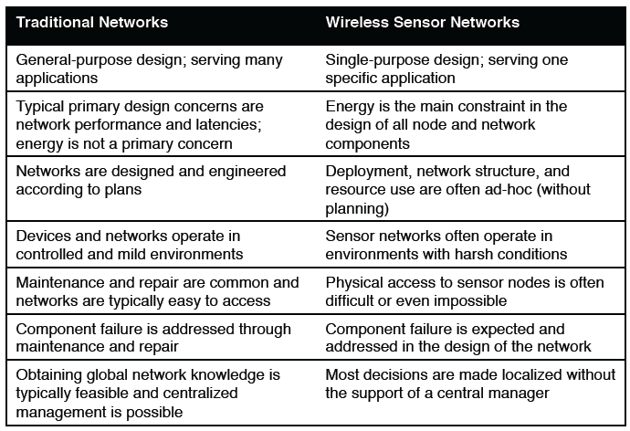
Comparison

Slide 26
Outline
Definitions and background
Challenges and constraints
Overview of topics covered

Slide 27
Overview of topics covered
Part One: Introduction
1 Motivation for a Network of Wireless Sensor Nodes
2 Applications
3 Node Architecture
4 Operating Systems
Part Two: Basic Architecture Framework
5 Physical Layer
6 Medium Access Control
7 Network Layer

Slide 28
Overview of topics covered
Part Three: Node and Network Management
8 Power Management
9 Time Synchronization
10 Localization
11 Coverage
Part Four: Other Specific Types of WSN
12 Multimedia Sensor Networks
13 Mobile Crowd-Sensing Networks

Slide 29
Chapter 2 Applications

Slide 30
Outline
Structural Health Monitoring
Wisden
Golden Gate Bridge
Traffic Control
Knaian (2000)
Arora (2004)
Precision Agriculture
Wine Vinyard (2004)
Lofar Agro (2005)
Active Volcano
Volcán Tungurahua

Slide 31
Structural Health Monitoring
Motivation:
Events:
On August 2, 2007, a highway bridge unexpectedly collapsed in Minnesota
Nine people were killed in the event
Potential causes: wear and tear, weather and the weight of a nearby construction project
In fact, the BBC reported (August 14, 2007) that China had identified more than 6,000 bridges that were damaged or considered to be dangerous
These accidents motivate wireless sensor networks for monitoring bridges and similar structures

Slide 32
Structural Health Monitoring
Traditionally Inspections:
Visual Inspection : everyday
Labor-intensive, tedious, inconsistent and subjective
Basic Inspections : at least once a year
Detailed Inspection : at least every five years on selected bridges
Special Inspections : according to technical needs
The rest require sophisticated tools: expensive, bulky and power consuming

Slide 33
Local and Global Inspections
Local inspection techniques focus on detecting highly localized, imperceptible fractures in a structure
Requires:
A significant amount of time
The disruption of the normal operation of the structure
Global inspection techniques aim to detect a damage or defect that is large enough to affect the entire structure
Researcher have been developing and testing wireless sensor networks as global inspection techniques

Slide 34
Wisden
The first prototype to employ WSN for monitoring structural health
First deployment ---- for conducting seismic experiments
On an imitation of a full-scale 28×28 square foot hospital ceiling
The overall weight which the ceiling supports is approximately 12,000 pounds
Second deployment
25 nodes (a tree topology) and a 16 bit vibration card
A high-sensitive triaxial accelerometer (三轴加速器) is attached to the vibration card
Designed for high-quality, low-power vibration sensing
The task of the network was to reliably send time-synchronized vibration data to a remote sink over a multi-hop route

Slide 35
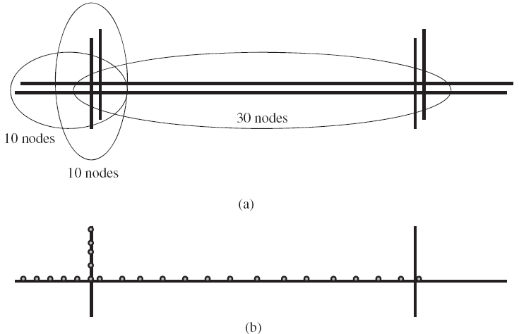
Golden Gate Bridge (Univ. of California)

Slide 36
Golden Gate Bridge
64 wireless sensor nodes deployed on this bridge
The network monitors ambient vibrations synchronously
1 KHz rate, ≤10μs jitter, accuracy=30μG, over a 46 hop network
The goal of the deployment:
Determine the response of the structure to both ambient and extreme conditions
Compare actual performance to design predictions
Measure ambient structural accelerations from wind load
Measure strong shaking from a potential earthquake
The installation and the monitoring was conducted without the disruption of the bridge’s operation

Slide 37
Outline
Structural Health Monitoring
Wisden
Golden Gate Bridge
Traffic Control
Knaian (2000)
Arora (2004)
Precision Agriculture
Wine Vinyard (2004)
Lofar Agro (2005)
Active Volcano
Volcán Tungurahua

Slide 38
Traffic Control
Motivation:
Ground transportation is a vital and a complex socio-economic infrastructure
it is linked with and provide support for a variety of systems, such as supply-chain, emergency response and public health
The 2009 Urban Mobility Report, reveals that in 2007, congestion caused urban Americans to
Travel 4.2 billion hours more
Purchase an extra 2.8 billion gallons of fuel
Congestion cost is very high ---- $87.2 billion an increase of more than 50% over the previous decade

Slide 39
Traffic Control
Motivation:
Building new roads is not a feasible solution for many cities
the lack of free space
the high cost of demolition of old roads
One approach: put in place distributed systems that reduce congestions
Gather information about the density, sizes and speed of vehicles on roads
Infer congestions
Suggest to drivers alternative routes and emergency exits

Slide 40
The Sensing Task
Inductive Loops (in-road sensing devices)
Advantages:
Unaffected by weather
Provide direct information (few ambiguity)
How does it work: using Faraday’s induction law
A coil of wire (several meters in diameter, passes an electric current through the coil)
It can be buried under the road and connected to a roadside control box
A magnetic field strength can be induced as a result of a current and the speed and the size of passing vehicles

Slide 41
Magnetic Sensors
Magnetic sensors can determine the direction and speed of a vehicle
A moving vehicle can disturb the distribution of the magnetic field
By producing its own magnetic field
By cutting across it
The magnitude and direction of the disturbance depends on
The speed, size, density and permeability（导磁系数）of the vehicle
Classification of Magnetic sensors:
Low field ( below 1μGauss)
Medium field ( between 1μGauss and 10μGauss)
High field ( above 10μGauss)

Slide 42
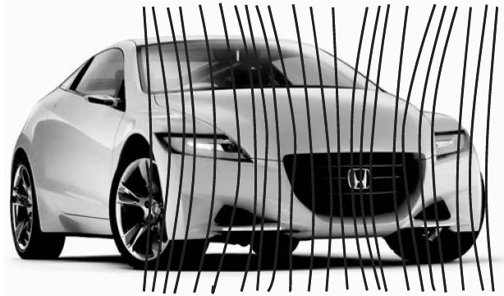
Magnetic Sensors
Detection of a moving vehicle with an ARM magnetic sensor (Caruso and Withanawasam 1999)

Slide 43
Magnetic Sensors
Almost all road vehicles contain a large mass of steel
The magnetic permeability (磁导系数) of steel is much higher than the surrounding air
Steel has the capacity to concentrate the flux lines of the Earth’s magnetic field
The concentration of magnetic flux varies as the vehicle moves; it can be detected from a distance of up to 15m
The field variation reveals a detailed magnetic signature
It is possible to distinguish between different types of vehicles

Slide 44
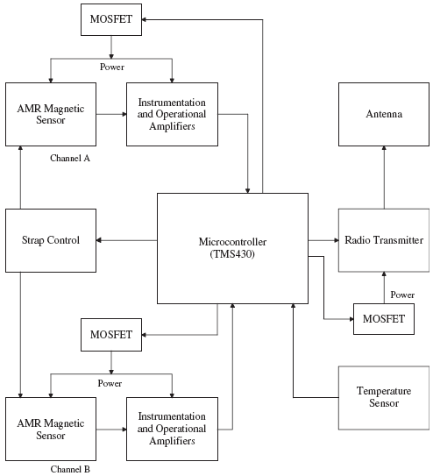
Knaian (2000)
Block diagram of the MIT node for traffic monitoring
(Knaian 2000)

Slide 45
Knaian (2000)
The node consists of
Two AMR magnetic sensors to detect vehicular activities
By observing the disturbance in the Earth’s magnetic field the vehicular creates
The vehicle pulls field lines away from the sensor when it approaches it
Then towards the sensor when it drives away from it
A temperature sensor to monitor road condition (snow, ice, or water)

Slide 46
Knaian (2000)
To measure the speed of a vehicle, the node waits until it detects an excursion from the predefined baseline and then starts sampling at a frequency of 2KHz
Two AMR magnetic sensors are placed one at the front of the node and the other at the back ---- they are shifted in time
The node waits for the signal from the rear sensor to cross the baseline
Then it begins to count the number of samples until the signal from the forward sensor crosses the baseline
From this count, it computes the speed of the passing vehicle

Slide 47
Arora et al.(2004)
It deploy 90 sensor nodes to detect the movement of vehicles, soldiers and people
78 of the nodes were magnetic sensor nodes that were deployed in a 60×25 square foot area
12 radar sensor nodes were overlaid on the network
These nodes form a self-organizing network which connects itself to a remote computer via a base station and a long haul radio repeater

Slide 48
Outline
Structural Health Monitoring
Wisden
Golden Gate Bridge
Traffic Control
Knaian (2000)
Arora (2004)
Precision Agriculture
Wine Vinyard (2004)
Lofar Agro (2005)
Active Volcano
Volcán Tungurahua

Slide 49
Precision Agriculture
Motivation:
A large farm is taken resource distribution and its response to climate change, weeds and pests
Accordingly, farmers administer
Fertilizers (肥料), pesticides (农药), and water resources
In reality, wide spatial diversity in soil types, nutrient content and other important factors
Therefore, treating it as a uniform field can cause
Inefficient use of resources
Loss of productivity
Precision agriculture is a method of farm management that enables farmers to produce more efficiently through a frugal use of resources

Slide 50
Precision Agriculture
Precision agriculture technologies:
Yield monitors
Yield mapping
Variable rate fertilizer
Weed mapping
Requirements of precision agriculture technologies:
Collect a large amount of data
Over several days
Variable spraying
Topography and boundaries
Salinity mapping
Guidance systems

Slide 51
Wine Vinyard (2004)
Motivation:
In a vineyard, temperature is the predominant climate that affects the quality as well as the quantity of harvest
Wine grapes see no real growth until the temperature goes above 10°C
Different wine grapes have different requirements for heat units
Subsequently, the deployment aims to
Measure the temperature over a 10°C baseline that a site accumulates over the growing season

Slide 52
Wine Vinyard (2004)
Beckwith et al. deploy a WSN to monitor and characterize variation in temperature of a wine vineyard
Heat summation and periods of freezing temperatures
65 nodes in a grid like pattern 10 to 20 meters apart, covering about two acres
Easy to develop the network(1 person day)
Due to self-configuration nature of the network
Inherent structured layout of vineyard fields
Two essential constraints of the network topology
Placement of nodes in an area of viticulture interest
The support for multi-hop communication

Slide 53
Wine Vinyard (2004)
The data were used to investigate several aspects:
The existence of co-variance between the temperature data collected by the network
Growing degree day differences
Potential frost damage
The mean data enabled to observe the relative differences between heat units accumulation during that period
According to the authors’ report, the extent of variation in this vineyard – there was a measured difference of over 35% of heat summation units (HSUs) in as little as 100 meters

Slide 54
Lofar Agro (2005)
Baggio deploy a WSN at Lofar Agro, the Netherlands.
The network was tasked to monitor phytophthora
Phytophthora is a fungal disease in a potato field
Climatologically conditions are the main cause to phytophthora
Thus, observing the humidity and temperature conditions in the field
Observing the wetness of the potato leaves
To determine the potential risk of the disease and the requirements for fungicide

Slide 55
Lofar Agro (2005)
Implementation:
150 wireless sensor nodes (20, 40 and 60 cm)
Temperature and humidity sensors
Additional 30 nodes (75 cm) to ensure the network’s connectivity
The radio range of the nodes reduced when the potato crop was flowering
The nodes sampled temperature and humidity at a rate of 1 sample per minute and stored the result temporarily
The data were communicated to a remote base station every 10 minutes

Slide 56
Lofar Agro (2005)
Implementation:
Delta encoding and periodic sleeping to efficiently utilize energy
Delta encoding: ten samples were encoded in a single packet
The sampled data were logged to a server
The server filtered out erroneous readings and handed the accumulated data to the Phytophthora decision support system (DSS) server
Finally, the decision support system combined the field data with a detailed weather forecast to determine the treatment policy

Slide 57
Outline
Structural Health Monitoring
Wisden
Golden Gate Bridge
Traffic Control
Knaian (2000)
Arora (2004)
Precision Agriculture
Wine Vinyard (2004)
Lofar Agro (2005)
Active Volcano
Volcán Tungurahua

Slide 58
Active Volcano
Volcanoes occur when broken slabs of the Earth’s outermost shell -- collide
Float on the hotter and softer layer in the Earth’s mantle
Motivation:
The Earth’s volcanoes are hidden from view
Occurring on the ocean floor along spreading ridges
At present, typical active volcanoes are monitored by expensive devices that are difficult to move or require external supply voltage
The deployment and maintenance of these devices require vehicle or helicopter assistance
Data storage must be retrieved on a periodic basis

Slide 59
Active Volcano
WSN can be very useful for active volcano monitoring
A large number of small, cheap and self-organizing nodes
They can be deployed to cover a vast field
Advantage of WSN in active volcano monitoring
Fast and economical deployment
Possible to achieve high spatial diversity
The networks can operate without requiring stringent maintenance routines

Slide 60
Volcán Tungurahua
Volcán Tungurahua in central Ecuador(2004)
3 sensor nodes
Integrate microphones
Volcán Reventador in northern Ecuador(2005)
16 sensor nodes
Integrate seism acoustic sensors
Linear topology (3km)

Slide 61
Volcán Tungurahua
An important task in active volcano monitoring is to capture discrete events
Eruptions, earthquakes, or tremor activities
These events are transient
Having duration of less than 60 seconds
Occurring several times a day
The researchers employed the raw data to investigate volcanic activities
The samples must be accurately time stamped to allow comparisons between correlated measurements

Slide 62
Volcán Tungurahua
The sensor architecture consisted of
An 8dBi 2.4GHz external omnidirectional antenna
A seismometer
A microphone
A custom hardware interface board
Operating environment ---- TinyOS
The flash memory ---- for buffering raw data
Conclusion
WSN are suitable for capturing triggered events
WSN are inadequate for capturing complete waveforms for a long time

Slide 63
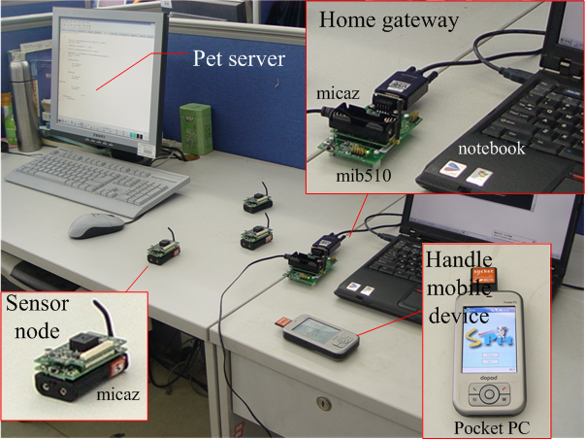
Wireless Sensor Network Based Mobile Pet

Slide 64
Chapter 3 Node Architecture

Slide 65
Outline
Node Architecture
The Sensing Subsystem
The Processor Subsystem
Communication Interfaces
Prototypes

Slide 66
Node Architecture
Wireless sensor nodes are the essential building blocks in a wireless sensor network
Sensing, processing and communication take place through a node
Stores and executes the communication protocols as well as data processing algorithms
The node consists of sensing, processing, communication and power subsystems
Trade-off between flexibility and efficiency – both in terms of energy and performance

Slide 67
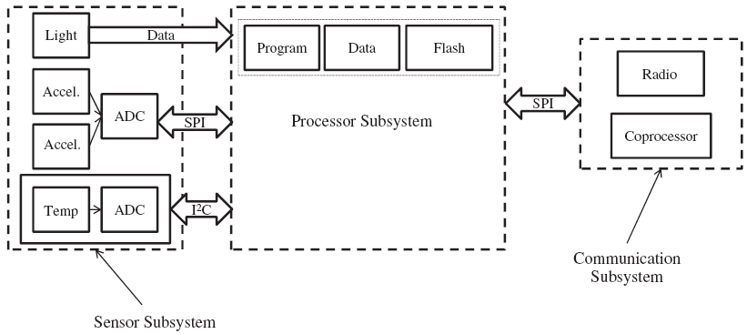
Node Architecture
Architecture of a wireless sensor node

Slide 68
Outline
Node Architecture
The Sensing Subsystem
The Processor Subsystem
Communication Interfaces
Prototypes

Slide 69
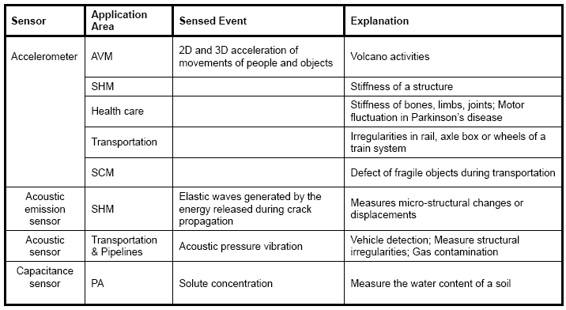
The Sensing Subsystem
The sensing subsystem integrates

Slide 70
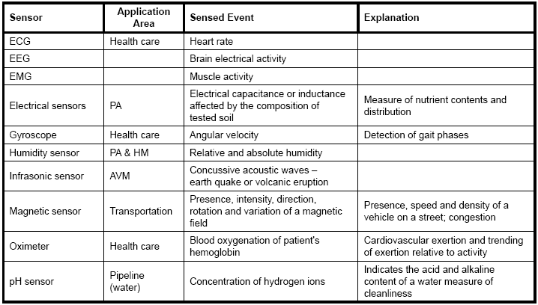
The Sensing Subsystem
The sensing subsystem integrates

Slide 71
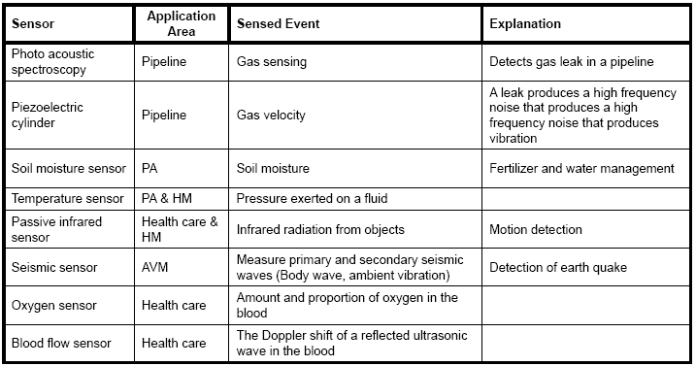
The Sensing Subsystem
The sensing subsystem integrates

Slide 72
Analog-to-Digital Converter
ADC converts the output of a sensor ---- which is a continuous, analog signal ---- into a digital signal.
It requires two steps:
Step1: The analog signal has to be quantized (量化)
Allowable discrete values is influenced :
a) By the frequency and magnitude of the signal
b) By the available processing and storage resources

Slide 73

Analog-to-Digital Converter
Step2: The sampling frequency (采样)
Nyquist rate does not suffice because of noise and transmission error
Resolution of ADC -- An expression of the number of bits that can be used to encode the digital output
where Q is the resolution in volts per step (volts per output code); E_{pp} is the peak-to-peak analog voltage; M is the ADC’s resolution in bits

Slide 74
Outline
Node Architecture
The Sensing Subsystem
The Processor Subsystem
Communication Interfaces
Prototypes

Slide 75
The Processor Subsystem
The processor subsystem
Interconnects all the other subsystems and some additional peripheries
Its main purpose is to execute instructions pertaining to sensing, communication and self-organization
It consists
A processor chip
A nonvolatile memory ---- stores program instructions
An active memory ---- temporarily stores the sensed data
An internal clock

Slide 76
Architectural Overview
The processor subsystem can be designed by employing one of the three basic computer architectures
Von Neumann architecture
Harvard architecture
Super-Harvard (SHARC) architecture

Slide 77
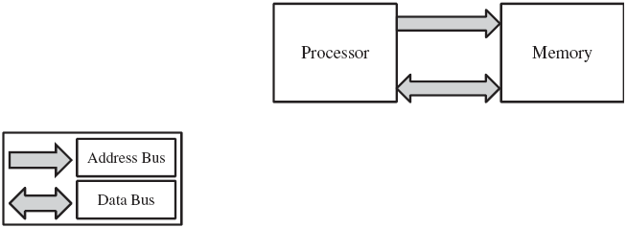
Von Neumann Architecture
Von Neumann architecture
provides a single memory space ---- storing program instructions and data
provides a single bus ---- to transfer data between the processor and the memory
Slow processing speed ---- each data transfer requires a separate clock

Slide 78
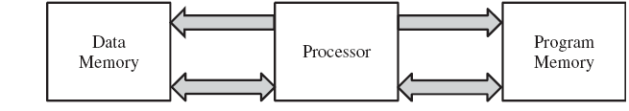
Harvard Architecture
Provides separate memory spaces ---- storing program instructions and data
Each memory space is interfaced with the processor with a separate data bus
Program instructions and data can be accessed at the same time
A special Single instruction, multiple data (SIMD) operation, a special arithmetic operation and a Bit reverse. Supports multitasking operating systems; but does not provide virtual memory protection

Slide 79
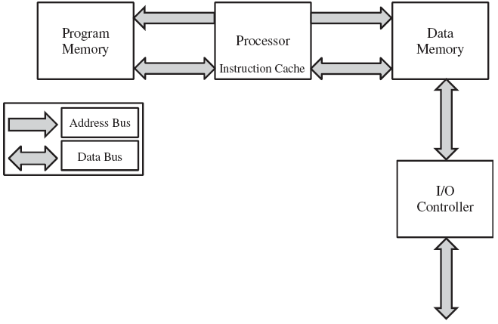
Super-Harvard Architecture
An extension of the Harvard architecture, adds two components:
Internal instruction cache ---- temporarily store frequently used instructions ---- enhances performance
An underutilized program memory can be used as a temporary relocation place for data
Direct Memory Access (DMA)
The costly CPU cycles can be invested in a different task
Program memory bus and data memory bus accessible from outside the chip

Slide 80
Microcontroller
Structure of Microcontroller
A CPU core
A volatile memory (RAM) for data storage
A ROM, EPROM, EEPROM or Flash memory
Parallel I/O interfaces
Discrete input and output bits
A clock generator
One or more internal analog-to-digital converters
Serial communications interfaces

Slide 81
Microcontroller
Advantages:
It suitable for building computationally less intensive, standalone applications, because of its compact construction, small size, low-power consumption and low cost
High speed of the programming and eases debugging, because of the use of higher-level programming languages
Disadvantages:
Not as powerful and as efficient as some custom-made processors (such as DSPs and FPGAs)
Some applications (simple sensing tasks but large scale deployments) may prefer to use architecturally simple but energy and cost efficient processors

Slide 82
Digital Signal Processor
The main function:
Process discrete signals with digital filters
Filters minimize the effect of noise on a signal or enhance or modify the spectral characteristics of a signal
While analog signal processing requires complex hardware components, digital signal process (DSP) requires simple adders, multipliers, and delay circuits
DSPs are highly efficient
Most DSPs are designed with the Harvard Architecture

Slide 83
Digital Signal Processor
Advantages:
Powerful and complex digital filters can be realized with commonplace DSPs
Useful for applications that require the deployment of nodes in harsh physical settings (where the signal transmission suffers corruption due to noise and interference and, hence, requires aggressive signal processing)
Disadvantage:
Some tasks require protocols (and not numerical operations) that require periodical upgrade or modifications (i.e., the networks should support flexibility in network reprogramming)

Slide 84
Application-specific Integrated Circuit
ASIC is an IC that can be customized for a specific application
Two types of design approaches: fully customized and half-customized
A full-customized IC:
some logic cells, circuits, or layout are custom made in order to optimize cell performance
Includes features which are not defined by the standard cell library
Expensive and long design time
A half-customized ASIC is built with logic cells that are available in the standard library
In both cases, the final logic structure is configured by the end user ---- An ASIC is a cost efficient solution, flexible and reusable

Slide 85
Application-specific Integrated Circuit
Advantages:
Relatively simple design; can be optimized to meet a specific customer demand
Multiple microprocessor cores and embedded software can be designed in a single cell
Disadvantage:
High development costs and lack of re-configurability
Application:
ASICs is not to replace microcontrollers or DSPs but to complement them
Handle rudimentary and low-level tasks
To decouple these tasks from the main processing subsystem

Slide 86
Field Programmable Gate Array (FPGA)
The distinction between ASICs and FPGAs is not always clear
FPGAs are more complex in design and more flexible to program
FPGAs are programmed electrically, by modifying a packaged part
Programming is done with the support of circuit diagrams and hardware description languages, such as VHDL and Verilog

Slide 87
Field Programmable Gate Array (FPGA)
Advantages:
Higher bandwidth compared to DSPs
Flexible in their application
Support parallel processing
Work with floating point representation
Greater flexibility of control
Disadvantages:
Complex
The design and realization process is costly

Slide 88
Comparison
Working with a micro-controller is preferred if the design goal is to achieve flexibility
Working with all the other is preferred if power consumption and computational efficiency is desired
DSPs are expensive, large in size and less flexible; they are best for signal processing, with specific algorithms

Slide 89
Comparison
FPGAs are faster than both microcontrollers and digital signal processors and support parallel computing; but their production cost and the difficulty with programming make them less suitable
ASICs have higher bandwidths; they are the smallest in size, perform much better and consume less power than any of the other processing types; but have a high cost of production owing to the complex design process

Slide 90
Outline
Node Architecture
The Sensing Subsystem
The Processor Subsystem
Communication Interfaces
Prototypes

Slide 91
Communication Interfaces
Fast and energy efficient data transfer between the subsystems of a wireless sensor node is vital
However, the practical size of the node puts restriction on system buses
Communication via a parallel bus is faster than a serial transmission
A parallel bus needs more space
Therefore, considering the size of the node, parallel buses are never supported

Slide 92
Communication Interfaces
The choice is often between serial interfaces:
Serial Peripheral外围 Interface (SPI)
General Purpose Input/Output (GPIO)
Secure Data Input/Output (SDIO)
Inter-Integrated Circuit (I²C)
Among these, the most commonly used buses are SPI and I²C

Slide 93
Serial Peripheral Interface
SPI (Motorola, in the mid of the 1980s)
A high-speed, full-duplex synchronous serial bus
Does not have an official standard, but use the SPI interface should conform to the implementation specification of others ---- correct communication
The SPI bus defines four pins:
MOSI (MasterOut/SlaveIn)
It is used to transmit data from the master to the slave when a device is configured as a master
MISO (MasterIn/SlaveOut)
SCLK (Serial Clock)
By the master to send the clock signal that is needed to synchronize transmission
By the slave to read this signal synchronize transmission
CS (Chip Select) ---- communicate via the CS port

Slide 94
Serial Peripheral Interface
Both master and slave devices hold a shift register
Every device in every transmission must read and send data
SPI supports a synchronous communication protocol
The master and the slave must agree on the timing
Master and slave should agree on two additional parameters
Clock polarity (CPOL) ---- defines whether a clock is used as high- or low-active
Clock phase (CPHA) ---- determines the times when the data in the registers is allowed to change and when the written data can be read

Slide 95
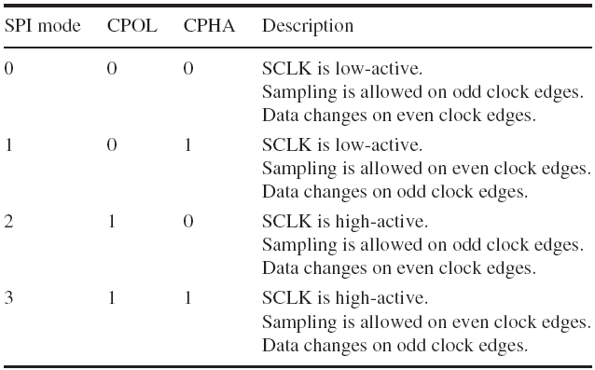
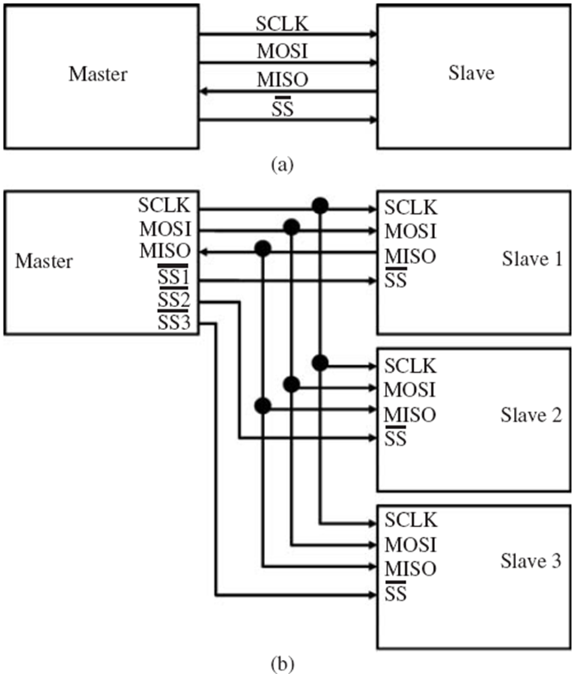
Serial Peripheral Interface

Slide 96
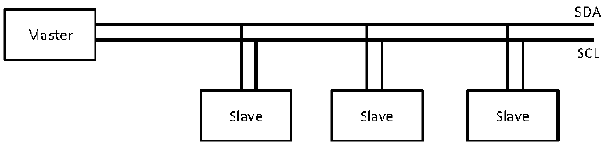
Inter-Integrated Circuit

Slide 97
Inter-Integrated Circuit
Every device type that uses I²C must have a unique address that will be used to communicate with a device
In earlier versions, a 7 bit address was used, allowing 112 devices to be uniquely addressed ---- due to an increasing number of devices, it is insufficient
Currently I²C uses 10 bit addressing
I²C is a multi-master half-duplex synchronous serial bus
Only two bidirectional lines: (unlike SPI, which uses four)
Serial Clock (SCL)
Serial Data (SDA)

Slide 98
Inter-Integrated Circuit
Since each master generates its own clock signal, communicating devices must synchronize their clock speeds
A slower slave device could wrongly detect its address on the SDA line while a faster master device is sending data to a third device
I²C requires arbitration between master devices wanting to send or receive data at the same time
No fair arbitration algorithm
Rather the master that holds the SDA line low for the longest time wins the medium？

Slide 99
Inter-Integrated Circuit
I²C enables a device to read data at a byte level for a fast communication
the device can hold the SCL low until it completes reading or sending the next byte ---- it is called handshaking
The aim of I²C is to minimize costs for connecting devices
Accommodating lower transmission speeds
I²C defines two speed modes:
A Fast-mode ---- a bit rate of up to 400Kbps
High-speed mode ---- a transmission rate of up to 3.4 Mbps
They are downwards compatible to ensure communication with older components

Slide 100
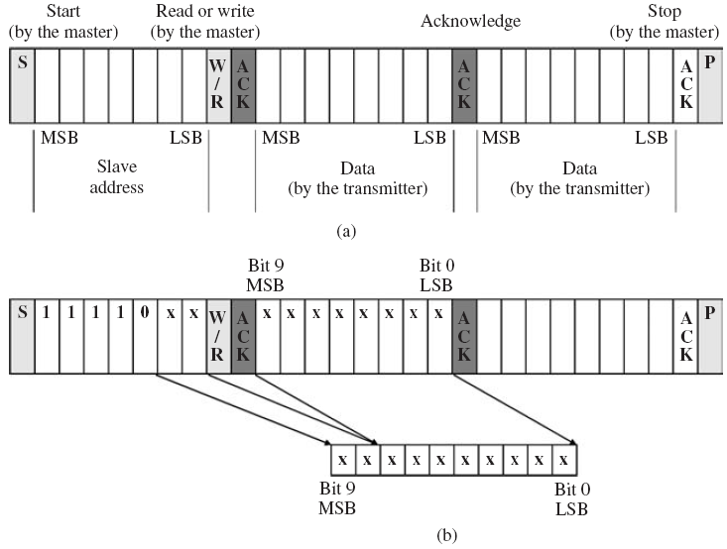
Inter-Integrated Circuit

Slide 101
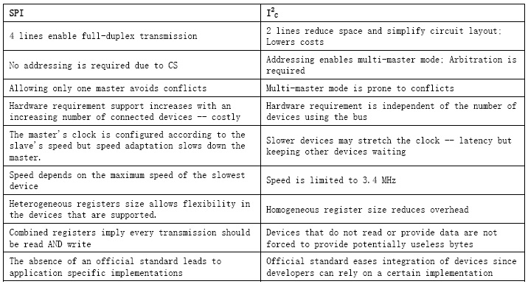
Comparison

Slide 102
Communication Interfaces
Buses are essential highways to transfer data
Due to the concern for size, only serial buses can be used
Serial buses demand high clock speeds to gain the same throughput as parallel buses
Serial buses can also be bottlenecks (e.g.. Von Neumann architecture) or may not scale well with processor speed (e.g.. I²C)
Delays due to contention for bus access become critical, for example, if some of the devices act unfairly and keep the bus occupied

Slide 103
Outline
Node Architecture
The Sensing Subsystem
The Processor Subsystem
Communication Interfaces
Prototypes

Slide 104
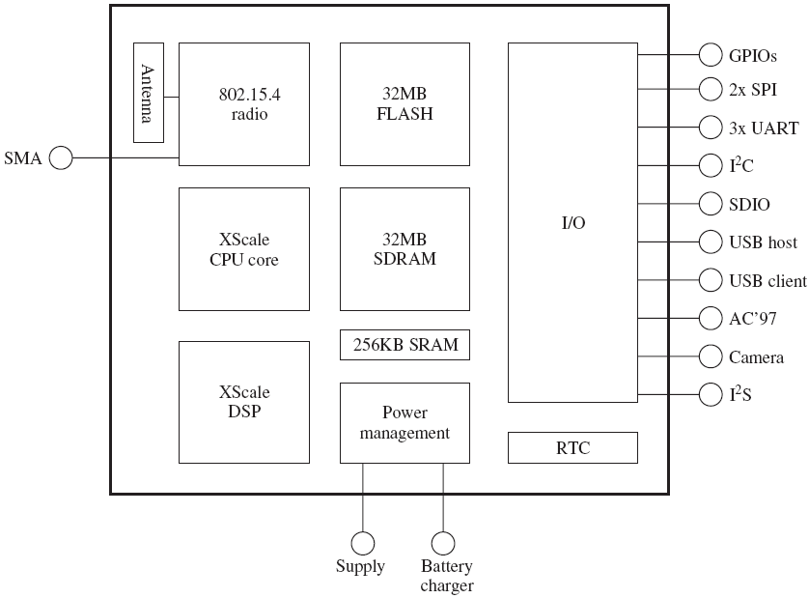
The IMote Node Architecture
The IMote sensor node architecture is a multi-purpose architecture, consisting of :
A power management subsystem
A processor subsystem
A sensing subsystem
A communication subsystem
An interfacing subsystem

Slide 105
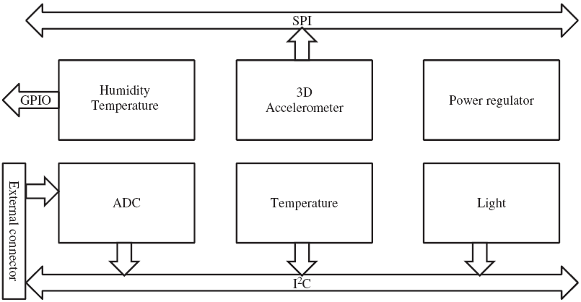
The IMote Node Architecture
A multiple sensor board contains :
A 12-bit, four channels ADC
A high-resolution temperature/humidity sensor
A low-resolution digital temperature sensor
A light sensor
The I²C bus is chosen to connect low data rate sources
The SPI bus is used to interface high data rate sources

Slide 106
The IMote Node Architecture
The processing subsystem provides
A main processor (microprocessor)
Operate at a low voltage (0.85V), low frequency (13MHz) mode
Dynamic Voltage Scaling (104MHz ---- 416MHz)
Sleep and deep sleep modes
Thus enabling low power operation
A coprocessor (a DSP)
Accelerate multimedia operations ---- computation intensive

Slide 107
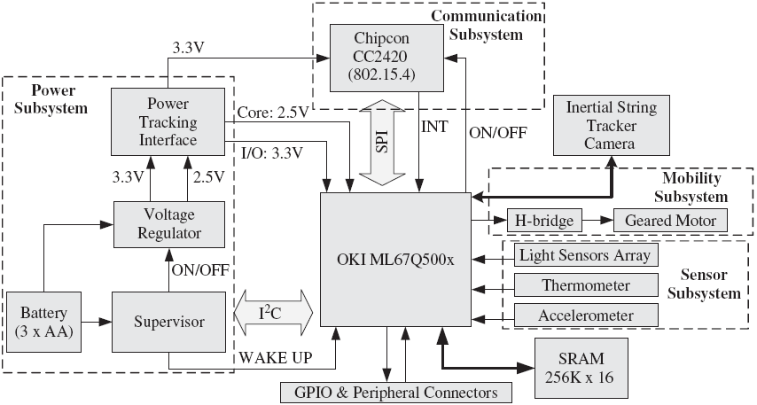
The XYZ Node Architecture
It consists of the four subsystems:
The power subsystem
The communication subsystem
The mobility subsystem
The sensor subsystem

Slide 108
The XYZ Node Architecture
The processor subsystem is based on the ARM7TDMI core microcontroller
f max = 58MHz
Two different modes (at 32bits and 16bits)
Provides an on-chip memory of 4KB boot ROM and a 32KB RAM ---- can be extended by up to 512KB of flash memory
The peripheral components:
A DMA controller
Four 10-bit ADC inputs
Serial ports (RS232, SPI, I²C, SIO)
42 multiplexed general purpose I/O pins

Slide 109
The XYZ Node Architecture
The communication subsystem connected to the processing subsystem through a SPI interface
The CC2420 is a RF transceiver
When an RF message has been successfully received
The SPI interface enables the radio to wake up a sleeping processor
The processor subsystem controls the communication subsystem by either turning it off or putting it in sleep mode

Slide 110
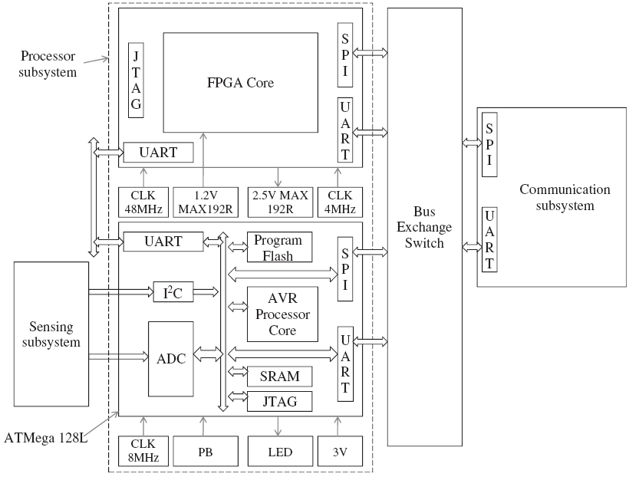
The Hogthrob Node Architecture
It is designed for a specific application, namely, to monitor pig production
Motivation:
Monitors movements between a sow and the onset of estrus, so that appropriate care can be given for pregnant sows
Detecting cough or limping to monitor illness

Slide 111
The Hogthrob Node Architecture
The processing subsystems consists of :
A microcontroller
Performs less complex, less energy intensive tasks
Initializes the FPGA and functions as an external timer and an ADC converter to it
A Field Programmable Gate Array
Executes the sow monitoring application
Coordinates the functions of the sensor node

Slide 112
The Hogthrob Node Architecture
There are a number of interfaces supported by the processing subsystem, including
The I²C interface for the sensing subsystem
The SPI interface for the communication subsystem
The JTAG interface for in-system programmability and debugging
The serial (RS232) interface for interaction with a PC

Slide 113
Chapter 4 Operating Systems

Slide 114
Operating Systems
An operating System is
a thin software layer
resides between the hardware and the application layer
provides basic programming abstractions to application developers
Its main task is to enable applications to interact with hardware resources

Slide 115
Operating Systems
Operating systems are classified as: single-task/multitasking and single-user/multiuser operating systems!
multi-tasking OS - the overhead of concurrent processing because of the limited resources!
single task OS - tasks should have a short duration!
The choice of a particular OS depends on several factors; typically functional and non-functional aspects

Slide 116
Outline
Functional Aspects
Non-Functional Aspects
Prototypes
Evaluation

Slide 117
Outline
Functional Aspects
Non-Functional Aspects
Prototypes
Evaluation
Data Types
Scheduling
Stacks
System Calls
Handling Interrupts
Multithreading
Thread-based vs. Event-based Programming
Memory Allocation

Slide 118
Data Types
Interactions between the different subsystems take place through:
well-formulated protocols
data types
Complex data types have strong expression power but consume resources - struct and enum
Simple data types are resource efficient but have limited expression capability - C programming language

Slide 119
Scheduling
queuing-based scheduling
FIFO - the simplest and has minimum system overhead, but treats tasks unfairly
sorted queue - e.g., shortest job first (SJF) - incurs system overhead (to estimate execution duration)
round-robin scheduling
a time sharing scheduling technique
several tasks can be processed concurrently
Regardless of how tasks are executed, a scheduler can be either
a non-preemptive scheduler - a task is executed to the end, may not be interrupted by another task
or preemptive scheduler - a task of higher priority may interrupt a task of low priority

Slide 120
Stacks & System Calls
Stacks
a data structure that temporarily stores data objects in memory by piling one upon another
objects are accessed using last-in-first-out (LIFO)
System Calls
decouple the concern of accessing hardware resources from implementation details
whenever users wish to access a hardware resource, they invoke these operations without the need to concern themselves how the hardware is accessed

Slide 121
Handling Interrupts
An interrupt is an asynchronous signal generated by
a hardware device
several system events
OS itself
An interrupt causes:
the processor to interrupt executing the present instruction
to call for an appropriate interrupt handler
Interrupt signals can have different priority levels, a high priority interrupt can interrupt a low level interrupt
Interrupt mask: let programs choose whether or not they wish to be interrupted

Slide 122
Multi-threading
A thread is the path taken by a processor or a program during its execution
Multi-threading - a task is divided into several logical pieces
scheduled independent from each other
executed concurrently
Two advantages of a multi-threaded OS:
tasks do not block other tasks
short-duration tasks can be executed along with long-duration tasks
Keep the number of threads to a manageable size using a thread pool
the creation of threads slows down the processor
no sufficient resources to divide􀀁

Slide 123
Thread-based vs Event-based Programming
Decision whether to use threads or events programming
need for separate stacks
need to estimate maximum size for saving context information
Thread-based programs use multiple threads of control within:
a single program
a single address space
Advantage: a thread blocked can be suspended while other tasks are executed in different threads
Disadvantages: 1) must carefully protect shared data structures with locks; 2) use condition variables to coordinate the execution of threads

Slide 124
Thread-based vs Event-based Programming
In event-based programming: use events and event handlers
event-handlers register with the OS scheduler to be notified when a named event occurs
a loop function:
polls for events
calls the appropriate event-handlers when events occur
An event is processed to completion
unless its handler reaches at a blocking operation (callback and returns control to the scheduler)

Slide 125
Memory Allocation
How and for how long a memory is allocated for a piece of program determines the speed of task execution
Memory can be allocated to a program:
statically - a frugal approach, but the requirement of memory must be known in advance
memory is used efficiently
runtime adaptation is not allowed
dynamically - the requirement of memory is not known in advance (on a transient basis)
enables flexibility in programming
but produces a considerable management overhead

Slide 126
Outline
Functional Aspects
Non-Functional Aspects
Prototypes
Evaluation
Separation of Concern
System Overhead
Portability
Dynamic Reprogramming

Slide 127
Separation of Concern
Separation between the operating system and the applications layer
The operation systems can provide:
a number of lightweight modules - “wired” together, or
an indivisible system kernel + a set of library components for building an application, or
a kernel + a set of reconfigurable low-level services
Separation of concern enables:
flexible and efficient reprogramming and reconfiguration

Slide 128
Portability
Ideally, operating systems should be able to co-exist and collaborate with each other
However, existing operating systems do not provide this type of support
In order to accommodate unforeseen requirements, operating systems should be portable and extensible

Slide 129
System Overhead
An operating system executes program code – requires its own share of resources
The resources consumed by the OS are the system's overhead
the size of the operating system
the type of services that the OS provides to the higher-level services and applications
The resources of wireless sensor nodes have to be shared by programs that carry out:
sensing, data aggregation, self-organization, network management, network communication

Slide 130
Dynamic Reprogramming
Once a wireless sensor network is deployed, it may be necessary to reprogram some part of the application or the operating system for the following reasons:
the network may not perform optimally
both the application requirements and the network's operating environment can change over time
may be necessary to detect and fix bugs􀀁

Slide 131
Dynamic Reprogramming
Manual replacement may not be feasible - develop an operating system to provide dynamic reprogramming support, which depends on
clear separation between the application and the OS
the OS can receive software updates and assemble and store it in memory
OS should make sure that this is indeed an updated version
OS can remove the piece of software that should be updated and install and configure the new version
all these consume resources and may cause their own bugs

Slide 132
Dynamic Reprogramming
Software reprogramming (update) requires robust code dissemination protocols:
splitting and compressing the code
ensuring code consistency and version controlling
providing a robust dissemination strategy to deliver the code over a wireless link

Slide 133
Outline
Functional Aspects
Non-Functional Aspects
Prototypes
Evaluation
TinyOS
SOS
Contiki
LiteOS

Slide 134

TinyOS
TinyOS is the most widely used, richly documented, and tool-assisted runtime environment in WSN
static memory allocation
event-based system
http://webs.cs.berkeley.edu/tos/

Slide 135
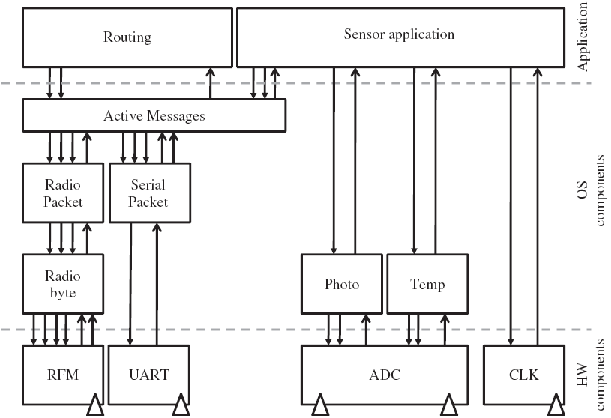
TinyOS
TinyOSʼs architecture
a scheduler
a set of components, which are classified into
configuration components - "wiring" (how modules are connected with each other)
modules - the basic building blocks of a TinyOS program
Logical distinction between low-level and high-level components

Slide 136
TinyOS
A component is made up of
a frame
command handlers
event handlers
a set of non-preemptive tasks
A component is similar to an object in object-based programming languages:
it encapsulates state and interacts through well-defined interfaces
an interface that can define commands, event handlers, and tasks

Slide 137
TinyOS
Components are structured hierarchically and communicate with each other through commands and events:
higher-level components issue commands to lower-level components
lower-level components signal events to higher-level components
Two components at the highest level communicate asynchronously through active messages
routing component - establishing and maintaining the network
sensor application - responsible for sensing and processing

Slide 138
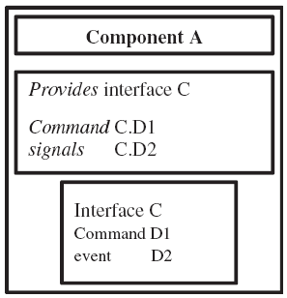
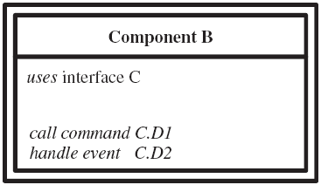
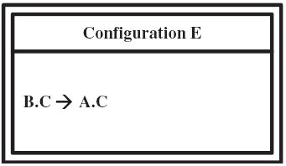
TinyOS
The logical structure of components and component configurations
A TinyOS component providing an interface
A TinyOS component that uses an interface
A TinyOS configuration that wires an interface provider and an interface user
Component A declares its service by providing interface C, which in turn provides command D1 and signals event D2.
Component B expresses interest in interface C by declaring a call to command D1 and by providing an event handler to process event D2.
A binding between Component A and Component B is established through the Configuration E.

Slide 139
Tasks, Commands and Events
The fundamental building blocks of a TinyOS runtime environment: tasks, commands, and events
enabling effective communication between the components of a single frame
Tasks:
monolithic processes 单独进程- should execute to completion – they cannot be preempted by other tasks, though they can be interrupted by events
possible to allocate a single stack to store context information
call lower level commands; signal higher level events; and post (schedule) other tasks
scheduled based on FIFO principle (in TinyOS)􀀁

Slide 140
Tasks, Commands and Events
Commands:
non-blocking requests made by higher-level components to lower-level components
split-phase operation:
a function call returns immediately
the called function notifies the caller when the task is completed
Events:
events are processed by the event handler
event handlers are called when hardware events occur
an event handler may react to the occurrence of an event in different ways
deposit information into its frame, post tasks, signal higher level events, or call lower level commands

Slide 141
SOS (Han et al. 2005 )
The SOS operating system (Han et al. 2005)
establishes a balance between flexibility and resource efficiency
supports runtime reconfiguration and reprogramming
The SOS operating system consists of:
a kernel :
provides interfaces to the underlying hardware
provides priority-based scheduling mechanism
supports dynamic memory allocation
a set of modules – can be loaded and unloaded - a position independent binary
enables SOS to dynamically link modules with each other

Slide 142
Interaction
messages (asynchronous communication)
a message that originates from module A to module B
the message goes through the scheduler
the kernel calls the appropriate message handler in module B and passes the message to it
direct calls to registered functions (synchronous communication)
requires modules to register their public functions at the kernel – all modules can subscribe to these functions
the kernel creates a function control block (FCB) to store key information about the function
this information is used to:
handle function subscription
support dynamic memory management
support runtime module update (replacement)

Slide 143
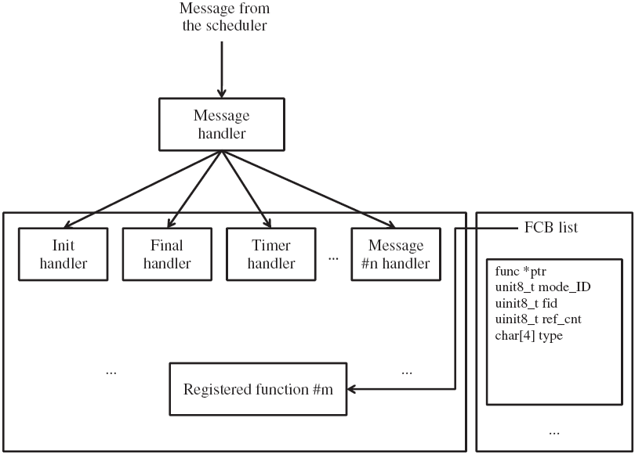
Interaction
illustrates the two basic types of interactions between modules
Interaction through a function call is faster than message-based communication

Slide 144
Dynamic Reprogramming
Five basic features enable SOS to support dynamic reprogramming
modules are position independent binaries
they use relative addresses rather than absolute addresses ---- they are re-locatable
every SOS module implements two types of handlers – the init and final message handlers
the init message handler - to set the moduleʼs initial state
the final message handler - to release all resources the module owns and to enable the module to exit the system gracefully
after the final message, the kernel performs garbage collection

Slide 145
Dynamic Reprogramming
SOS uses a linker script to place the init handler of a module at a known offset in the binary
enables easy linking during module insertion
SOS keeps the state of a module outside of it
enables the newly inserted module to inherit the state information of the module it replaces
Whenever a module is inserted, SOS generates and keeps metadata that contains information:
the ID of the module
the absolute address of the init handler
a pointer to the dynamic memory holding the module state

Slide 146
Dynamic Reprogramming
In SOS, dynamic module replacement (update) takes place in three steps:
a code distribution protocol advertises the new module in the network
the protocol proceeds with downloading the module and examines the metadata
the metadata contains the size of the memory required to store the local state of the module
if a node does not have sufficient RAM, module insertion is immediately aborted
if everything is correct, module insertion takes place and the kernel invokes the handler by scheduling an init message for the module􀀁

Slide 147
Contiki
an event-driven kernel but multi-threading with a dynamic linking strategy
separate the kernel from processes
communication of services through the kernel by posting events
the kernel does not provide hardware abstraction
device drivers and applications communicate directly with the hardware
the kernel is easy to reprogram and it is easy to replace services

Slide 148
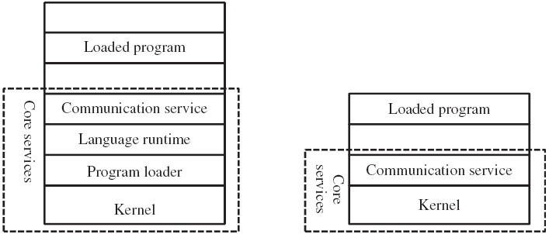
Contiki
The Contiki operating system: the system programs are partitioned into core services and loaded programs

Slide 149
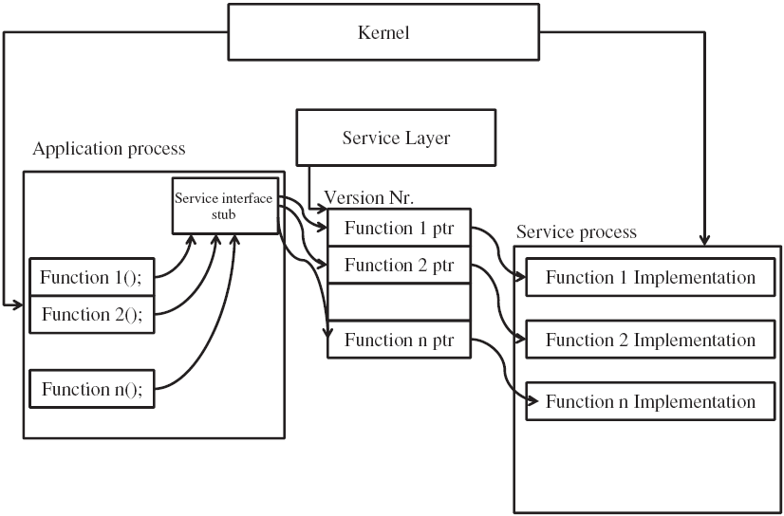
Service Structure
Contiki OS supports
dynamic loading
reconfiguration of services
This is achieved by defining
services
service interfaces
service stubs
service layers
A Contiki service interaction architecture

Slide 150
LiteOS
LiteOS is a thread-based operating system and supports multiple applications
based on the principle of clean separation between the OS and the applications
does not provide components or modules that should be “wired” together
provides several system calls
provides a shell - isolates the system calls from a user
provides a hierarchical file management system
provides a dynamic reprogramming technique

Slide 151
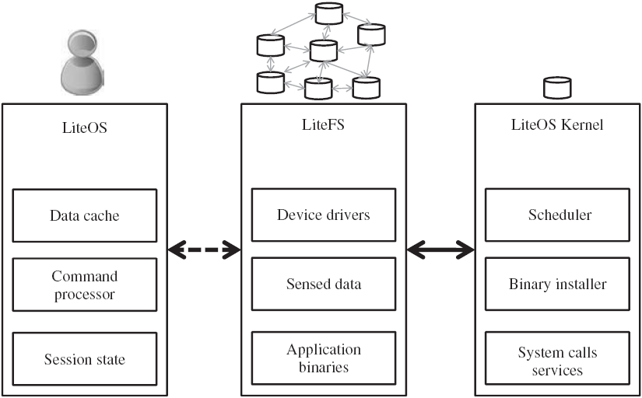
LiteOS
The LiteOS operating system architecture (Cao et al. 2008)
LiteOS is modeled as a distributed file system

Slide 152
Shell and System Calls
The shell provides:
a mounting mechanism to a wireless node which is one-hop away from it
a distributed and hierarchical file system
a user can access the resources of a named node
a large number of Linux commands
file commands - move, copy and, delete files and directories
process commands - manage threads
debugging commands - set up a debugging environment and debug code
environment commands
user - managing the environment of OS
manual - displaying interaction history and providing command reference
device commands - provide direct access to hardware devices

Slide 153
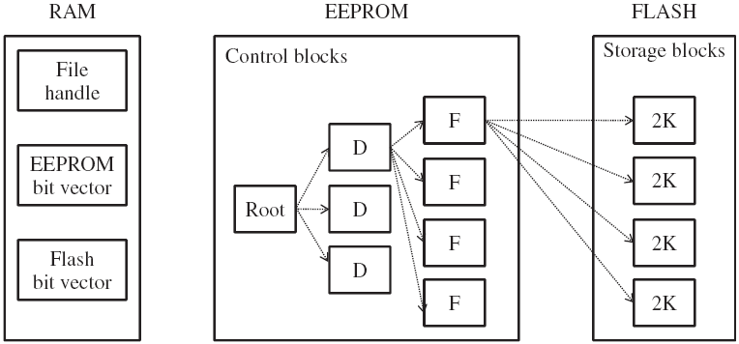
LiteFS
The file system structure of LiteFS (Cao et al. 2008)

Slide 154
Dynamic Reprogramming
The LiteFS is a distributed file system
A user can
access the entire sensor network
program and manage individual nodes
LiteOS supports the dynamic replacement and reprogramming of user applications
if the original source code is available to the OS
recompiled with a new memory setting
the old version will be redirected

Slide 155
Dynamic Reprogramming
If the original source code is not available to the OS
use a differential patching mechanism to replace an older version binary
the start address (S) of the binary executable in the flash memory
the start address of allocated memory in RAM (M)
the stack top (T)
T - M = the memory space allocated for the program code
but the parameters are obtained empirically and require knowledge of the node architecture - limits the usefulness of the patching scheme

Slide 156
Outline
Functional Aspects
Non-Functional Aspects
Prototypes
Evaluation

Slide 157
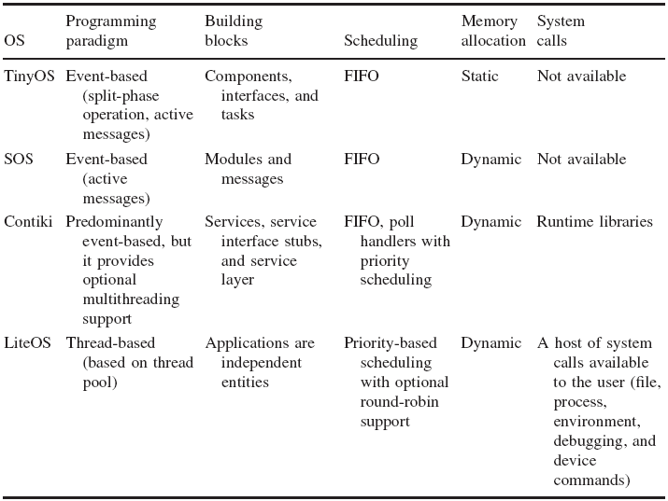
Evaluation
Comparison of functional aspects of existing operating systems

Slide 158
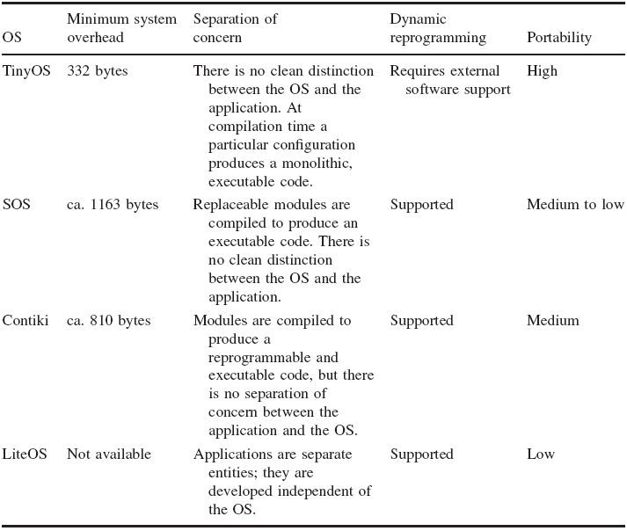
Evaluation
Comparison of nonfunctional aspects of existing operating systems

Slide 159
Task I
PAPER READING: TinyOS An Operating System for Sensor Networks
Download and install TinyOS on your own laptop

Slide 160
Chapter 5 Medium Access Control Layer

Slide 161
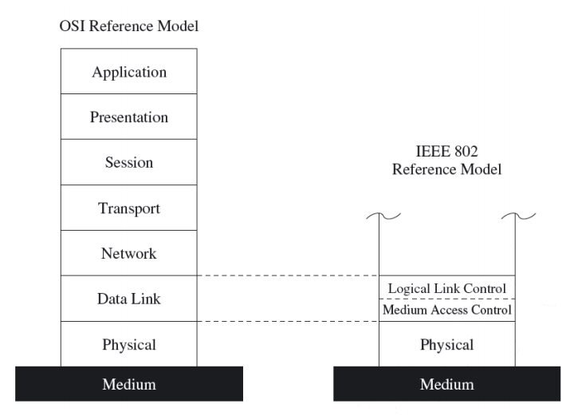
Overview
Second layer of the OSI reference or the IEEE 802 reference model
Responsibilities of MAC layer include:
decide when a node accesses a shared medium
resolve any potential conflicts between competing nodes
correct communication errors occurring at the physical layer
perform other activities such as framing, addressing, and flow control

Slide 162
Medium Access Control
In most networks, multiple nodes share a communication medium for transmitting their data packets
The medium access control (MAC) protocol is primarily responsible for regulating access to the shared medium
The choice of MAC protocol has a direct bearing on the reliability and efficiency of network transmissions
due to errors and interferences in wireless communications and to other challenges
Energy efficiency also affects the design of the MAC protocol
trade energy efficiency for increased latency or a reduction in throughput or fairness

Slide 163
Outline
Wireless MAC protocols
Characteristics of MAC Protocols in Sensor Networks
Contention-Free MAC Protocols
Contention-Based MAC Protocols
Hybrid MAC Protocols

Slide 164
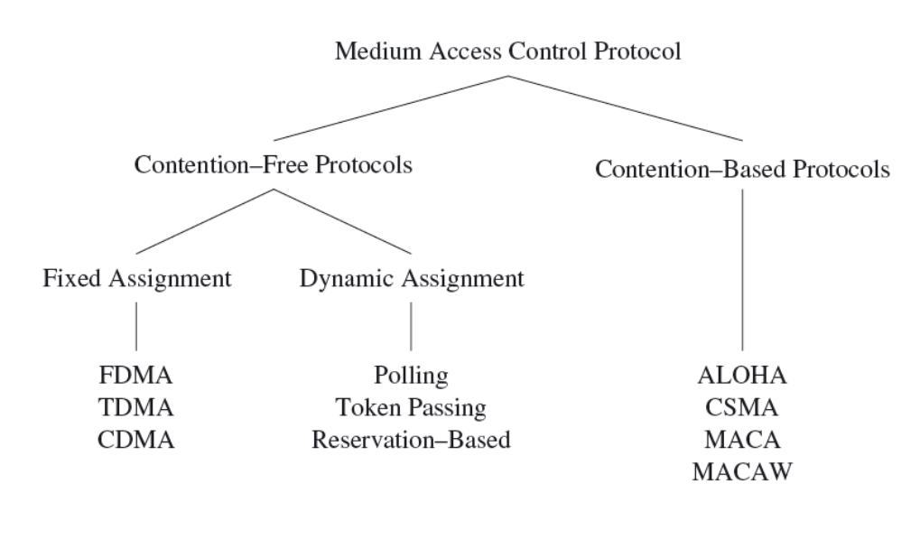
MAC Protocol Categorization

Slide 165
Contention-Free Medium Access
Collisions can be avoided by ensuring that each node can use its allocated resources exclusively
FDMA : Frequency Division Multiple Access
the frequency band is divided into several smaller frequency bands
the data transfer between a pair of nodes uses one frequency band
all other nodes use a different frequency band
TDMA : Time Division Multiple Access
multiple devices to use the same frequency band
relies on periodic time windows ( frames)
frames consist of a fixed number of transmission slots to separate medium accesses of different devices
a time schedule indicates which node may transmit data during a certain slot

Slide 166
Contention-Free Medium Access
CDMA : Code Division Multiple Access
simultaneous accesses of the wireless medium are supported using different codes
if these codes are orthogonal, it is possible for multiple communications to share the same frequency band
forward error correction (FEC) at the receiver is used to recover from interferences among these simultaneous communications
Fixed assignment strategies are inefficient
it is impossible to reallocate slots belonging to one device to other devices if not needed in every frame
generating schedules for an entire network can be a taunting task
these schedules may require modifications every time the network topology or traffic characteristics in the network change

Slide 167
Contention-Free Medium Access
Dynamic assignment strategies: allow nodes to access the medium on demand
polling-based protocols
a controller device issues small polling frames in a round-robin fashion, asking each station if it has data to send
if no data to be sent, the controller polls the next station
token passing
stations pass a polling request to each other (round-robin fashion) using a special frame called a token
a station is allowed to transmit data only when it holds the token
reservation-based protocols
static time slots used to reserve future access to the medium
these often very complex protocols then ensure that other potentially conflicting nodes take note of such a reservation to avoid collisions

Slide 168
Contention-Based Medium Access
Nodes may initiate transmissions at the same time
requires mechanisms to reduce the number of collisions and to recover from collisions
Example 1: ALOHA protocol
uses acknowledgments to confirm the success of a broadcast data transmission
allows nodes to access the medium immediately
addresses collisions with approaches such as exponential back-off to increase the likelihood of successful transmissions
Example 2: slotted-ALOHA protocol
requires that a station may commence transmission only at predefined points in time (the beginning of a time slot)
increases the efficiency of ALOHA
introduces the need for synchronization among nodes

Slide 169
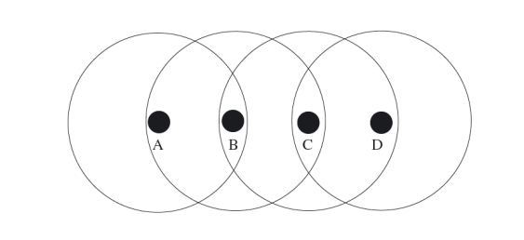
Hidden and Exposed Terminal Problems
Hidden-terminal problem
senders A and C are able to reach B, but cannot overhear each other ʼ s signals
it is possible for A and C to transmit data to B at the same time, causing a collision at B, without being able to directly detect this collision
Exposed-terminal problem
C wants to transmit data D, but decides to wait because it overhears an ongoing transmission from B to A
Bʼ s transmission could not interfere with data reception at C

Slide 170
Contention-Based Medium Access
CSMA with Collision Detection (CSMA/CD)
sender first senses the medium to determine whether it is idle or busy
if it is found busy, the sender refrains from transmitting packets
if the medium is idle, the sender can initiate data transmission
CSMA with Collision Avoidance (CSMA/CA)
CSMA/CD requires that sender aware of collisions
CSMA/CA attempts to avoid collisions in the first place

Slide 171
Carrier Sense Multiple Access
Nodes first sense the medium before they begin a transmission (reduces number of collisions)
Non-persistent CSMA
node is allowed to immediately transmit data once medium is idle
if the medium is busy, the node performs a back-off operation
wait for a certain amount of time before attempting to transmit again
1-persistent CSMA
node wishing to transmit data continuously senses the medium for activity
once the medium is found idle, the node transmits data immediately
if a collision occurs, the node waits for a random period of time before attempting to transmit again

Slide 172
Carrier Sense Multiple Access
p-persistent CSMA
node continuously senses the medium
node transmits data with a probability p once the medium becomes idle
delays transmission with a probability 1 − p
random back-off values are either continuous values in the case of un-slotted CSMA or multiples of a fixed slot size in slotted CSMA
CSMA/CA (CSMA with Collision Avoidance)
nodes sense the medium, but do not immediately access the channel when it is found idle
instead, a node waits for a time period called DCF interframe space (DIFS) plus a multiple of a slot size
in case there are multiple nodes attempting to access the medium, the one with the shorter back-off period will win

Slide 173
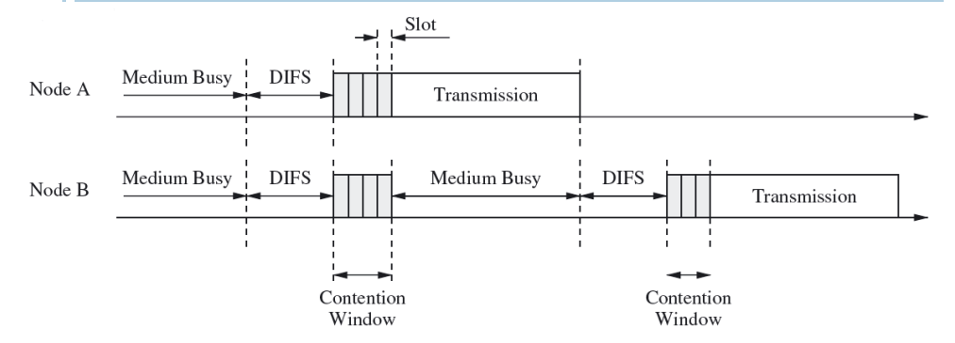
Carrier Sense Multiple Access
Example:
node A waits for DIFS + 4 ∗ s (where s represents the slot size), while node Bʼ s back-off is DIFS + 7 ∗ s
once node A begins with its transmission, node B freezes its own back-off timer and resumes the timer after node A completes its transmission plus another period of DIFS
once node B ʼs back-off timer expires, it can also begin its transmission

Slide 174
MACA and MACAW
Multiple Access with Collision Avoidance (MACA)
dynamic reservation mechanism
sender indicates desire to send with ready-to-send (RTS) packet
intended receiver responds with clear-to-send (CTS) packet
if sender does not receive CTS, it will retry at later point in time
nodes overhearing RTS or CTS know that reservation has taken place and must wait (e.g., based on the size of data transmission)
address hidden terminal problem and reduces number of collisions
MACA for Wireless LANs (MACAW)
receiver responds with acknowledgment (ACK) after data reception
other nodes in receiverʼs range learn that channel is available
nodes hearing RTS, but not CTS do not know if transmission will occur
MACAW uses data sending (DS) packet, sent by sender after receiving CTS to inform such nodes of successful handshake

Slide 175
MACA By Invitation
In MACA-BI, destination device initiates data transfers by sending a Ready To Receive (RTR) packet to the source
source then responds with the data message
Compared to MACA, MACA-BI reduces overhead
increases the theoretical maximum throughput
depends on the destination knowing when to receive data
Source nodes can use an optional field within the data message to indicate the number of queued messages
providing the destination with an indication that more RTS packets will be required

Slide 176
IEEE 802.11
Published in 1999 by the Institute of Electrical and Electronics Engineers
specifies the physical and data link layers of the OSI model for wireless connections
Often referred to as Wireless Fidelity (Wi-Fi)
certification given by Wi-Fi Alliance, a group that ensures compatibility between devices that use 802.11 standard
Wi-Fi combines concepts found in CSMA/CA and MACAW, but also offers features to preserve energy
Two modes of operation
Point Coordination Function (PCF) mode
communication among devices goes through a central entity called an access point (AP) or base station (BS) : managed mode
Distributed Coordination Function (DCF) mode
devices communicate directly with each other: ad-hoc mode

Slide 177
IEEE 802.11
IEEE 802.11 is based on CSMA/CA
before a node transmits, it first senses the medium for activity
the node is allowed to transmit, if the medium is idle for at least a time period called the DCF interframe space (DIFS)
otherwise the device executes a back-off algorithm to defer transmission to a later time
this algorithm randomly selects a number of time slots to wait and stores this value in a back-off counter
for every time slot that passes without activity on the network, the counter is decremented and the device can attempt transmission when this counter reaches zero
if activity is detected before the counter reaches zero, the device waits until the channel has been idle for a period of DIFS before it continues to decrement the counter value

Slide 178
IEEE 802.11
After a successful transmission
receiver device responds with an acknowledgment after waiting for a time period called the short interframe space (SIFS)
the value of SIFS is smaller than the value of DIFS to ensure that no other device accesses the channel before the receiver can transmit its acknowledgment
Once a node A makes a reservation using RTS and CTS control messages
another neighboring node B, overhearing the RTS message, must refrain from accessing the medium until node A ʼ s transmission has been completed and acknowledged
however, this would mean that node B has to continuously sense the medium to detect when it becomes idle again

Slide 179
IEEE 802.11
Instead, A ’ s RTS message carries the size of the data it will transmit
allowing node B to estimate how long the transmission will take and to decide whether to enter a low-power sleep mode
some neighboring nodes may only overhear CTS (but not RTS), therefore, the data size is also carried in the CTS message
using the data size information, neighboring nodes set a network allocation vector (NAV) that indicates how long the medium will be unavailable
reduces the need for continuously sensing the medium, allowing a node to save power

Slide 180
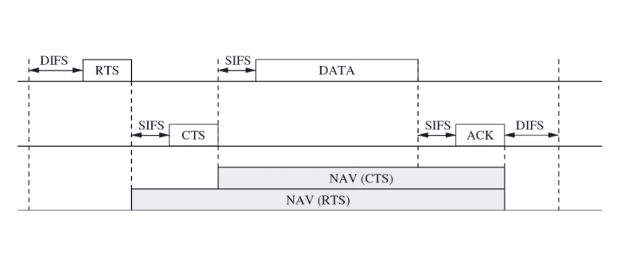
IEEE 802.11

Slide 181
IEEE 802.11
PCF mode
access point (AP) coordinates channel access to ensure collision-free communication
periodically broadcasts a beacon to its client devices (includes list of devices with data pending at AP)
during contention-free period, AP transmits these packets to its client devices
AP can also poll client devices to allow them to initiate data transfers
AP uses a wait period called the PCF interframe space (PIFS)
PIFS is shorter than DIFS, but longer than SIFS
ensures that PCF traffic has priority over traffic generated by devices operating in the DCF mode, without interfering with control messages in the DCF mode such as CTS and ACK

Slide 182
IEEE 802.11
Focus of IEEE 802.11 is on providing fair access to the medium with support for high throughput and mobility
since devices spend a large amount of time listening to the medium and collisions occur frequently, this standard incurs large overheads, including significant energy costs
Energy consumption problem
IEEE 802.11 offers a power saving mode (PSM) for devices operating in the PCF mode
devices can inform the AP that they wish to enter a low-power sleep mode using special control messages
these devices wake up periodically to receive beacon messages from the AP to determine if they should stay awake to receive incoming messages
saves energy, but only works in the infrastructure mode and it is not specified when or how long devices should sleep

Slide 183
IEEE 802.15.4 & ZigBee
IEEE 802.15.4
created for low-power devices in the 868 MHz, 915 MHz, and 2.45 GHz frequency bands
supports two transmission modes :
UWB PHY
bit rates: 110 kbps, 851 kbps (nominal), 6.81 kbps, and 27.24 Mbps
CSS PHY
bit rates: 1 Mbps (nominal) and 250 kbps
Before 802.15.4, ZigBee Alliance worked on low-cost communication technology for low data rates and low power consumption
IEEE and ZigBee Alliance joined forces and ZigBee has become the commercial name for the IEEE 802.15.4 technology

Slide 184
ZigBee
Star mode:
communication via the Personal Area Network (PAN) coordinator
synchronized mode (beacon-enabled)
PAN coordinator periodically broadcasts beacons for synchronization and management
slotted channel access: device performs random backoff before channel is sensed
if no activity, node waits until next slot and senses channel again until no activity has been detected for two consecutive slots
if activity, backoff procedure is repeated
unsynchronized mode: device access channel immediately when no activity is detected during the first initial backoff time

Slide 185
ZigBee
Peer-to-peer mode:
devices are free to communicate directly with each other
but they still must associate with the PAN coordinator before they can participate in peer-to-peer communication
Data transfer between the device and its PAN coordinator is always initiated by the device
allows a device to determine when data is transferred and to maximize its energy savings
when a device wants to send data to the PAN coordinator, it can use the previously described channel access method
the PAN coordinator transmits data intended for a device only after the device explicitly requested such a transmission
in both cases, optional acknowledgments can be used to let the PAN coordinator or device know that the transmission was successful

Slide 186
IEEE 802.15.4 and ZigBee
Challenges:
standard does not clearly define the operation of the peer-to-peer approach
in large WSNs, it is unlikely that all devices will be able to use the same PAN coordinator
standard does allow communication among PAN coordinators, but this again is not well defined

Slide 187
Outline
Wireless MAC protocols
Characteristics of MAC Protocols in Sensor Networks
Contention-Free MAC Protocols
Contention-Based MAC Protocols
Hybrid MAC Protocols

Slide 188
Characteristics of MAC Protocols in WSN
Most MAC protocols are built for fairness
everybody should get an equal amount of resources
no one should receive special treatment
In a WSN, all nodes cooperate to achieve a common purpose, therefore fairness is less of a concern
Instead, wireless nodes are mostly concerned with energy consumption
Sensing applications may value low latency or high reliability over fairness

Slide 189
Energy Efficiency
Sensor nodes must operate using finite energy sources, therefore MAC protocols must consider energy efficiency
Common technique: dynamic power management (DPM)
a resource can be moved between different operational modes (active, idle, and asleep)
for resources such as the network, the active mode can group together multiple different modes of activity, e.g., transmitting and receiving
Periodic traffic models are very common in WSNs
significant energy savings can be obtained by putting a device into a low-power sleep mode
fraction of time a sensor nodes spends in active mode is called the duty cycle
often very small due to infrequent and brief data transmissions occurring in most sensor networks

Slide 190
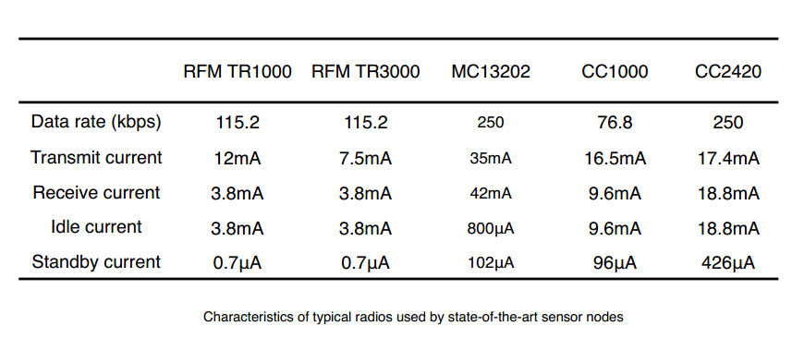
Energy Efficiency

Slide 191
Energy Efficiency
Reasons for energy inefficiency
idle listening
inefficient protocol designs (e.g., large packet headers)
reliability features (collisions requiring retransmissions or other error control mechanisms)
control messages to address the hidden-terminal problem
choice of modulation scheme
choice of transmission rate
overemitting

Slide 192
Scalability
Many wireless MAC protocols have been designed for use in infrastructure-based networks
access points or controller nodes arbitrate access to the channel and perform some centralized coordination and management functions
Most wireless sensor networks rely on multi-hop and peer-to-peer communications without centralized coordinators
MAC protocols must be able to allow for efficient use of resources without incurring unacceptable overheads, particularly in very large networks

Slide 193
Scalability
MAC protocols based on CDMA have to cache a large number of code (may be impractical for resource-constrained sensor devices)
WSNs are not only constrained in their energy resources, but also in their processing and memory capacities
MAC protocols should not impose excessive computational burden should not require too much memory to save state information

Slide 194
Adaptability
A key characteristic of a WSN is its ability to self-manage
adapt to changes in the network
including changes in topology, network size, density, and traffic characteristics
A MAC protocol for a WSN should be able to gracefully adapt to such changes without significant overheads
This requirement generally favors protocols that are dynamic in nature
protocols that make medium access decisions based on current demand and network state
Protocols with fixed assignments (e.g., TDMA with fixed-size frames and slots) may incur large overheads due to adaptations of such assignments that may affect many or all nodes in the network

Slide 195
Low Latency and Predictability
Many WSN applications have timeliness requirements
sensor data must be collected, aggregated, and delivered within certain latency constraints or deadlines
example: wildfire detection (sensor data must be delivered to monitoring stations in a timely fashion to ensure timely responses)
MAC protocol design
choice of frame size and slot allocations in TDMA-based protocols lead to large delays
in contention-based protocols, nodes may be able to access the wireless medium sooner (than TDMA), but collisions and the resulting retransmissions incur delays
choice of MAC protocol can affect how predictable the experienced delay is (expressed as upper latency bounds )
some contention-based MAC protocols allow the theoretical possibility of starvation

Slide 196
Reliability
Common requirement for WSNs
MAC protocol design affects reliability
responsible for detecting and recovering from transmission errors and collisions

Slide 197
Outline
Wireless MAC protocols
Characteristics of MAC Protocols in Sensor Networks
Contention-Free MAC Protocols
Contention-Based MAC Protocols
Hybrid MAC Protocols

Slide 198
Contention-Free MAC Protocols
Concept:
allow only one sensor node to access the channel at any given time
assuming a perfect medium and environment
i.e., no other competing networks or misbehaving devices exist that could otherwise cause collisions or even jam a channel
Contention-free protocols allocate resources to individual nodes to ensure exclusive resource access by only one node at any given time
Exposes a number of characteristics
node knows exactly when it has to turn on its radio
during all other times, radio can be turned off to preserve energy
fixed slot allocations impose upper bounds on delay
difficult to design schedules for large networks
difficult to handle changes in topology, density, traffic load

Slide 199
Traffic-Adaptive Medium Access
TRAMA is an example of a contention-free MAC protocol with the goal to increase network throughput and energy efficiency (compared to TDMA)
It uses a distributed election scheme to determine when nodes are allowed to transmit
based on information about the traffic at each node
avoids assigning slots to nodes with no traffic to send (increased throughput)
allows nodes to determine when they can become idle and do not have to listen to the channel (increased energy efficiency)
TRAMA assumes a time-slotted channel, where time is dived into:
periodic random-access intervals (signaling slots)
scheduled-access intervals (transmission slots)

Slide 200
Traffic-Adaptive Medium Access
Random-access intervals
Neighbor Protocol (NP) is used to propagate one-hop neighbor information among neighboring nodes
nodes join a network by transmitting during a randomly selected slot
packets transmitted during these slots are used to gather neighborhood information by carrying a set of added and deleted neighbors
in case no changes have occurred, these packets serve as “keep-alive” beacons
NP allows nodes to obtain consistent two-hop topology information

Slide 201
Traffic-Adaptive Medium Access
Random-access intervals (contd.)
Schedule Exchange Protocol (SEP) establishes and broadcasts actual schedules (i.e., allocations of slots to a node)
each node computes a duration SCHEDULE_INTERVAL
– represents the number of slots for which the node can announce its schedule to its neighbors
– this duration depends on the rate at which the node ʼ s applications can produce packets
at time t, the node then computes the number of slots within [t, t+ SCHEDULE_INTERVAL] for which it has the highest priority among its two-hop neighbors
the node announces the selected slots and the intended receivers using a schedule packet
the last slot in this schedule is used to announce the next schedule for the next interval

Slide 202
Traffic-Adaptive Medium Access
Random-access intervals (contd.)
Schedule Exchange Protocol (SEP) (contd.)
example:
– a nodeʼ s SCHEDULE_INTERVAL is 100 slots
– the current time (slot number) is 1000
– a possible slot selection for interval [1000, 1100] for this node could be 1011, 1021, 1049, 1050, and 1093
– during slot 1093, the node broadcasts its new schedule for interval [1093, 1193]
list of intended receivers in the schedule packet is implemented as a bitmap
– length of a bitmap is equal to the number of one-hop neighbors
each bit in the bitmap corresponds to one particular receiver ordered by its identities
every node can determine the receiver address based on the bitmap and its list of neighbors

Slide 203

Traffic-Adaptive Medium Access
Random-access intervals (contd.)
Schedule Exchange Protocol (SEP) (contd.)
slot selection is based on the nodeʼ s priority at time t
– uses a pseudo-random hash of the concatenation of the nodeʼ s identity i and t :
– node can indicate which slots it gives up, allowing other nodes to claim these unused slots
a node can determine its state for any given time slot t based on its two-hop neighborhood information and the announced schedules
– node i is in the transmit (TX) state if it has the highest priority and if it has data to send
– node i is in the receive (RX) state if it is the intended receiver of the transmitter during slot t
– otherwise, the node can be switched into the sleep (SL) state

Slide 204
Traffic-Adaptive Medium Access
Summary
compared to CSMA-based protocols
reduces the probability of collisions
increases the sleep time and energy savings
unlike standard TDMA approaches
TRAMA divides time into random-access and scheduled-access intervals
during the random-access intervals
– nodes are awake to either transmit or receive topology information
– the length of the random-access interval affects the overall duty cycle and achievable energy savings of a node

Slide 205
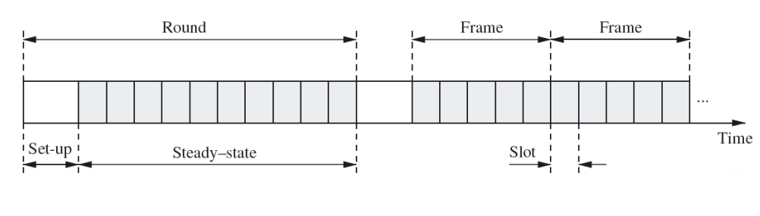
Low-Energy Adaptive Clustering Hierarchy
The LEACH protocol combines TDMA-style contention-free communication with a clustering algorithm for wireless sensor networks
a cluster consists of a single cluster head and any number of cluster members, which only communicate with their cluster head
clustering is a popular approach for sensor networks
facilitates data aggregation and in-network processing at the cluster head
reduces the amount of data that needs to be transmitted to the base station
LEACH operates in rounds consisting of two phases:
A setup phase
A steady-state phase

Slide 206
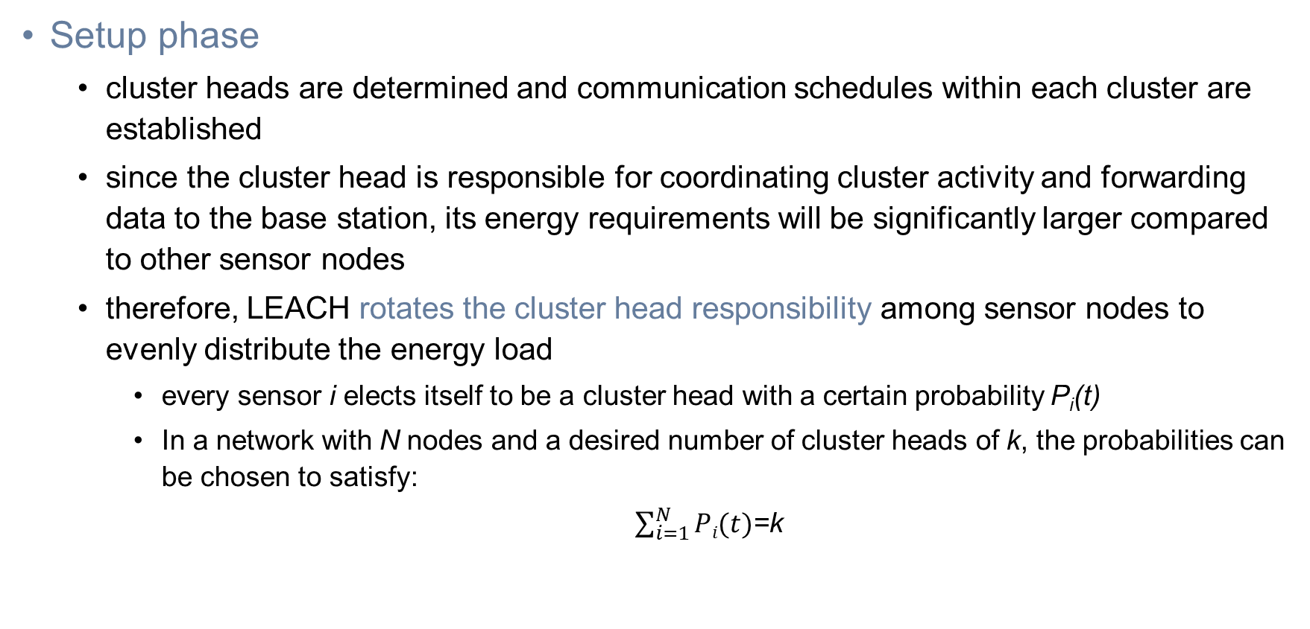
Low-Energy Adaptive Clustering Hierarchy
Setup phase
cluster heads are determined and communication schedules within each cluster are established
since the cluster head is responsible for coordinating cluster activity and forwarding data to the base station, its energy requirements will be significantly larger compared to other sensor nodes
therefore, LEACH rotates the cluster head responsibility among sensor nodes to evenly distribute the energy load
every sensor i elects itself to be a cluster head with a certain probability P_{i}(t)
In a network with N nodes and a desired number of cluster heads of k, the probabilities can be chosen to satisfy:
$\sum_{i=1}^{N}{Pi(t)}$=k

Slide 207
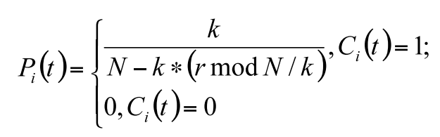
Low-Energy Adaptive Clustering Hierarchy
There are various approaches to choose P_{i} (t) , e.g.,:
This approach uses an indicator function C_{i} (t) to determine whether node i has been a cluster head in the r mod (N/k) previous rounds
Only nodes that have not been cluster heads recently are candidates for the cluster head role, in order to evenly distribute the cluster head responsibility (and energy overhead) among all nodes

Slide 208
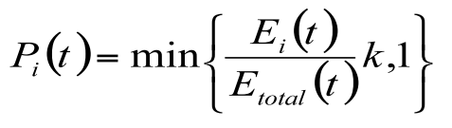
Low-Energy Adaptive Clustering Hierarchy
This approach does not consider the actual amount of energy available to each node
An alternative approach to determining the probability of becoming a cluster head can be used:
E_{i}(t) is node i ʼ s actual current energy and E_{total}(t) is the sum of the energy levels of all nodes
a disadvantage of this approach is that every node must know (or estimate) E_{total}(t)

Slide 209
Low-Energy Adaptive Clustering Hierarchy
Once a sensor node has determined that it will serve as cluster head for the next round, it informs other sensor nodes of its new role by broadcasting an advertisement message (ADV) using a non-persistent CSMA protocol
Every sensor node joins a cluster by selecting the cluster head that can be reached with the smallest amount of transmit energy, based on received signal strength of the ADV messages from the cluster heads
Joining is achieved by transmitting a join-request (Join-REQ) message to the chosen cluster head using CSMA
The cluster head establishes a transmission schedule for its cluster and transmits this schedule to each node in its cluster

Slide 210
Low-Energy Adaptive Clustering Hierarchy
Steady-state phase
a sensor node communicates only with the cluster head
it is allowed to transmit data only during its allocated slots (indicated by the schedule received from the cluster head)
the responsibility of the cluster head is to forward sensor data originating at one of its sensor nodes to the base station
in order to preserve energy
each cluster member uses the minimum required transmit power to reach the cluster head
each cluster member turns off the wireless radio between its designated slots
the cluster head remains awake at all times
to receive sensor data from its cluster members
to communicate with the base station

Slide 211
Low-Energy Adaptive Clustering Hierarchy
Sensor nodes use the direct sequence spread spectrum (DSSS) 直接序列扩频technique to limit the interference among clusters, while intra-cluster communication is contention-free using TDMA-style frames and slots
Communication occurring in one cluster can still interfere with communication in another cluster
Each cluster uses a spreading sequence that is different from the spreading sequences used in neighboring clusters
Another reserved sequence is used for communication between cluster heads and the base station
Communication between cluster heads and base station is based on CSMA
Before a cluster head transmits data, it first senses the channel to see if there is an ongoing transmission using the same spreading code

Slide 212
Low-Energy Adaptive Clustering Hierarchy
LEACH-C
variation of LEACH protocol
relies on the base station to determine the cluster heads
during setup phase, each sensor node transmits its location and energy levels to the base station
based on this information, the base station determines the cluster heads and informs the cluster heads of their new role
other sensor nodes can then join clusters using join messages as described in the original LEACH protocol

Slide 213
Low-Energy Adaptive Clustering Hierarchy
Summary
LEACH relies on a variety of techniques to reduce energy consumption
minimum transmit energy
avoiding idle listening of cluster members
LEACH attempts to obtain contention-free communication
schedule-based communication
DSSS
intra-cluster communication is contention-free and interferences among clusters are avoided
communication between the cluster heads and the base station is still based on CSMA
assumes that all nodes are able to reach the base station (affects the scalability of this protocol; can be addressed using multi-hop routing or by implementing a hierarchical clustering approach)

Slide 214
Y-MAC
Y-MAC uses TDMA-based medium access but for multiple channels
Divides time into frames and slots
each frame contains a broadcast period and a unicast period
every node must wake up at the beginning of a broadcast period
nodes contend for access to the medium during this period
if there are no incoming broadcast messages, each node turns off its radio awaiting its first assigned slot in the unicast period
each slot in the unicast period is assigned to only one node for receiving data

Slide 215
Y-MAC
Y-MAC uses a receiver-driven model
can be more energy-efficient under light traffic conditions, because each node samples the medium only in its own receive time slots
particularly important for radio transceivers, where the energy costs for receiving are greater than for transmitting (e.g., due to sophisticated despreading (解扩) and error correction techniques)
Medium access in Y-MAC is based on synchronous low power listening

Slide 216
Y-MAC
The contention window (at beginning of each slot) resolves contention between multiple senders
a node wishing to send data sets a random wait time (back-off value) within the contention window
after this wait time, the node wakes up and senses the medium for activity for a certain amount of time
if the medium is free, the node sends a preamble until the end of the contention window to suppress competing transmissions and the receiver wakes up at the end of the contention window to wait for packets in its assigned slot
if the medium receives no signal from any of its neighboring nodes, it turns off the radio and returns to the sleep mode

Slide 217
Y-MAC
Unicast period
messages are initially exchanged on the base channel
at the beginning of its receive slot
a receiver switches its frequency to the base channel
the node that won the medium in the contention window also uses the base channel to transmit its packet
the receiver acknowledges this packet (if the acknowledgment request flag was set in the packet)
Broadcast period
every node tunes to the base channel
the potential senders take part in the contention process described above

Slide 218
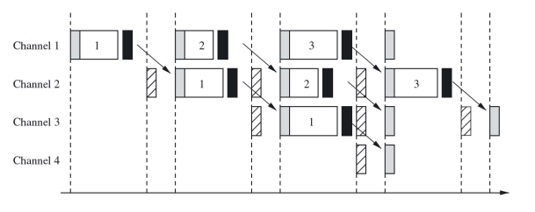
Y-MAC
Every node polls the medium only during broadcast time slots and its own unicast receive time slots
makes this approach energy-efficient
under heavy traffic conditions, many unicast messages may have to wait in the message queue or are dropped due to the limited bandwidth reserved for the receiving node
as a consequence, Y-MAC uses a channel hopping mechanism to reduce packet delivery latency

Slide 219
Y-MAC
After receiving a packet during its time slot on the base channel, the receiving node hops to the next channel and sends a notification
it can continue to receive packets on the second channel
contention for the medium in the second channel is resolved as before
At the end of this slot, the receiving node can decide to hop again to another channel
until reaching the last channel or
until no more data is being received
The hopping sequence generation algorithm
determines the actual hopping sequence among the available channels
should guarantee that there is only one receiver among one-hop neighbors on any particular channel

Slide 220
Y-MAC
Summary
Y-MAC uses slot assignments (such as TDMA)
communication is receiver-driven to ensure low-energy consumption
i.e., a receiver briefly samples the medium during its slot and returns to the sleep mode if no packets arrive
uses multiple channels
to increase the achievable throughput
to reduce delivery latency
main drawbacks of the Y-MAC approach:
has the same flexibility and scalability issues as TDMA (i.e., fixed slot allocations)
requires sensor nodes with multiple radio channels

Slide 221
Lightweight Medium Access Control
The LMAC protocol is based on TDMA
each slot is owned by exactly one node
nodes execute a distributed algorithm to allocate slots instead of relying on a central manager to assign slots to nodes
each node uses its slots to transmit a message consisting of two parts:
control message
– identity of the time slot controller
– distance (in hops) of the node to the gateway (base station)
– address of the intended receiver
– length of the data unit
data unit
upon receiving a control message, a node determines if it is the intended receiver and decides whether to stay awake or to turn off the radio until the next slot

Slide 222
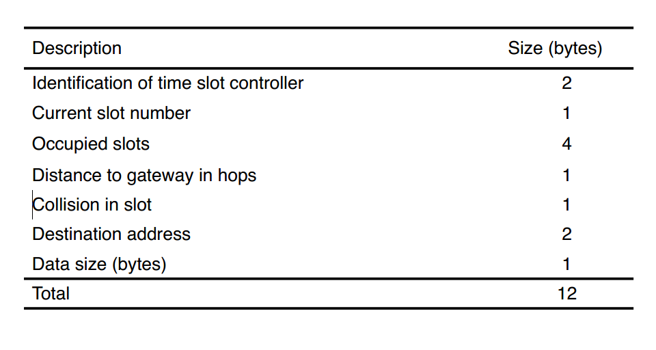
Lightweight Medium Access Control

Slide 223
Lightweight Medium Access Control
The Occupied Slots field of the control message is a bit-mask of slots
where an unoccupied slot is represented by 0
an occupied slot is represented by 1
A node is able to determine unoccupied slots by combining control messages from all neighbors
The process of claiming slots starts at the gateway device , which determines its own slots
After one frame, all direct neighbors of the gateway know the gateway ʼ s slots and choose their own slots

Slide 224
Lightweight Medium Access Control
This process continues throughout the network and during each frame, a new set of nodes with a higher hop distance from the gateway determine their slots
Each node must select slots that are not in use within a two-hop neighborhood
Slots are selected randomly, so it is possible for multiple nodes to select the same slot
will result in a collision of control messages during the slot
can be observed by the competing nodes, therefore, they will restart the slot selection process

Slide 225
Mobile LMAC
Slot allocations in LMAC are computed only once, therefore, this protocol is not suitable for mobile sensor network, where nodes frequently join and leave other nodes ʼ radio ranges
Mobile LMAC (MLMAC) uses a distributed slot allocation mechanism, but it is able to adapt to changes in the network topology
When a node X leaves the radio range of node Y, both nodes will realize that they no longer receive control messages from each other and they will remove each other from their neighbor lists
Assume that node X moves into the radio range of node Z and that another node in Z ʼs range, node W, uses the same slot as X
Control messages from X and W will collide at Z and node Z will no longer receive any correct control messages during this slot and will therefore mark this slot as unused
Nodes X and W will receive Zʼ s control message, indicating that their slot is unused and meaning that there must have been a collision.
As a consequence, they give up their current slot and restart the slot selection mechanism

Slide 226
LMAC and MLMAC
Both LMAC and MLMAC have the same advantages as TDMA
collision-free communication
energy efficiency
Additionally, they are able to establish transmission schedules in a distributed fashion
However, in both protocols
slot size is fixed
slot allocations are also fixed
except when a node has to restart the slot selection mechanism
leading to bandwidth inefficiency

Slide 227
Contention-Based MAC Protocols
The main advantage is simplicity compared to most schedule-based techniques
schedule-based MAC protocols must save and maintain schedules or tables indicating the transmission order
most contention-based protocols do not require to save, maintain, or share state information
this also allows contention-based protocols to adapt quickly to changes in network topologies or traffic characteristics
However, they typically result in higher collision rates and overheads due to idle listening and overhearing (overheads usually refer to additional bits in a packet or additional packets such as control packets)
They may also suffer from fairness issues (i.e., some nodes may be able to obtain more frequent channel accesses than others)

Slide 228
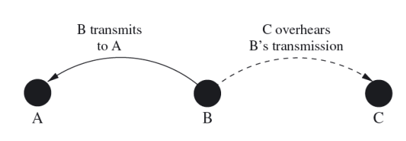
Power Aware Multi-Access with Signaling
The PAMAS protocol attempts to avoid unnecessary energy expenditure caused by overhearing
PAMAS uses two separate channels to prevent collisions among data transmissions: one for data frames and one for control frames (ready-to-send or RTS and clear-to-send or CTS)
The separate signaling channel allows nodes to determine when and how long to power down their wireless transceivers
devices transmit busy tones on the control channel to ensure that devices that did not overhear either RTS or CTS will not access the data channel for transmissions

Slide 229
Power Aware Multi-Access with Signaling
Initiating a data transfer
a PAMAS device sends an RTS message over the control channel to the receiver
receiver responds with CTS if it does not detect activity on the data channel and has not overheard other recent RTS or CTS messages
if the source does not receive a CTS within a specific timeout interval, it will attempt to transmit again after a back-off time (exponential back-off algorithm)
otherwise, it begins data transmission and the receiver node issues a busy tone over the control channel (whose length is greater than twice the length of a CTS)
the receiver device also issues a busy tone over the control channel whenever it receives an RTS message or detects noise on the control channel while it receives a frame
done to corrupt possible CTS message replies to the detected RTS, thereby blocking any data transmission of the receiverʼs neighbors

Slide 230
Power Aware Multi-Access with Signaling
Every node in a PAMAS network independently decides when to power off its transceiver
Specifically, a node decides to turn off its transceiver whenever one of two conditions holds:
a neighbor begins a transmission and the node has no frames to transmit
a neighbor transmits a frame to another neighbor, even if the node has frames to transmit
A node can easily detect either condition by
overhearing its neighborʼ s transmissions (condition 1) or
overhearing its neighborʼ s busy tone (condition 2)
A node can identify how long to power down its transceiver by embedding the size or expected transmission duration into messages

Slide 231
Power Aware Multi-Access with Signaling
However, when a transmission begins while a node is still asleep, it does not know how long this transmission will last and how long it should continue to sleep
Therefore, the node issues a probe frame (containing a certain time interval) over the control channel to all transmitting nodes in its neighborhood
all transmitters that will complete during this interval respond with their predicted completion time
if such a response is received by the awakening node without collision, it can return to the sleep mode until the completion time indicated by the transmitting node
if multiple transmitters respond and their responses collide, the node reissues the probe frame with a shorter time interval
similarly, if the node did not receive a response, it can reissue the probe with a different time interval
in effect, the node chooses time intervals to perform a binary search to identify when the last ongoing transmission will end

Slide 232
Sensor MAC
The goal of the S-MAC protocol is
to reduce unnecessary energy consumption
while providing good scalability and collision avoidance mechanism
S-MAC adopts a duty-cycle approach
nodes periodically transition between a listen state and a sleep state
each node chooses its own schedule, although it is preferred when nodes synchronize their schedules such that nodes listen or sleep at the same time
nodes using the same schedule are considered to belong to the same virtual cluster (but no real clustering takes place)
all nodes are free to communicate with nodes outside their clusters

Slide 233
Sensor MAC
Nodes periodically exchange their schedules with their neighbors using SYNC messages (every node knows when any of its neighbors will be awake)
If node A wants to communicate with a neighbor B that uses a different schedule, A simply waits until B is listening and then initiates the data transfer
contention for the medium is resolved using the RTS/CTS scheme
In order to choose a schedule, a node initially listens to the medium for a certain amount of time
if this node receives a schedule from a neighbor, it chooses this schedule as its own and this node becomes a follower
the node broadcasts its new schedule after a random delay t_{d} to minimize the possibility for collisions from multiple new followers

Slide 234
Sensor MAC
Nodes can adopt multiple schedules if a node receives a different schedule after it has broadcast its own schedule
it then adopts both schedules
If a node does not hear a schedule from another node
it determines its own schedule
broadcasts this schedule to any potential neighbors
and this node becomes a synchronizer (in that other nodes will begin to synchronize themselves with it)

Slide 235

Sensor MAC
S-MAC divides a node ʼ s listen interval further into
a part for receiving SYNC packets
a part for receiving RTS messages
Each part is further divided into small slots to facilitate carrier sensing

Slide 236
Sensor MAC
A node trying to send a SYNC or RTS message randomly selects a time slot within the SYNC or RTS part of the interval, respectively
senses the carrier for activity from when the receiver begins listening to the selected slot
if no activity has been detected, it wins the medium and begins transmission
Contention for the medium is addressed using collision avoidance based on RTS/CTS handshakes (S-MAC adopts a contention-based approach)
when a node hears an RTS or CTS and concludes that it cannot transmit or receive at the same time, it can go to sleep to avoid wasting energy caused by overhearing

Slide 237
Sensor MAC
Summary
S-MAC is a contention-based protocol
utilizes the sleep mode of wireless radios to trade energy for throughput and latency
collision avoidance is based on RTS/CTS (which is not used by broadcast packets, thereby increasing the collision probability)
duty cycle parameters (sleep and listen periods) are decided beforehand and may be inefficient for the actual traffic characteristics in the network

Slide 238
Timeout MAC
If there is little traffic, S-MAC can actually waste energy because the listening period of S-MAC is of fixed duration; If traffic is heavy, fixed duration may not be large enough
Therefore, the T-MAC protocol is a variation of S-MAC that uses an active period that adapts to traffic density
Nodes wake up during the beginning of a slot to listen very briefly for activity and return to the sleep mode when no communication has been observed
When a node transmits, receives, or overhears a message, it remains awake for a brief period of time after completion of the message transfer to see if more traffic can be observed
this brief timeout interval allows a node to return to the sleep mode as quickly as possible
the end effect is that a node ʼ s awake times will increase with the heavier traffic and will be very brief if traffic is light

Slide 239

Timeout MAC
To reduce potential collisions, each node waits for a random period of time within a fixed contention interval before the medium is accessed

Slide 240
Timeout MAC
Once a node hears a CTS, it knows that another node won the medium
This node then stays awake until the end of the transmission, which can be observed by overhearing the acknowledgment (ACK) sent by node B
This event initiates the beginning of the next contention interval and node C will have an opportunity to transmit its data if it wins the medium
In figure, assume that messages flow from top to bottom
node A sends only to node B, node B sends to node C
every time node C wants to send a message to node D, C must contend for the medium
C may lose to node B (B may transmit an RTS before C does) or
C may lose to node A (C overhears a CTS transmitted by node B)
while node C stays awake after overhearing node B ʼ s CTS message, its intended receiver (node D) is not aware of C ʼ s intention to transmit data and therefore returns to the sleep mode after TA has expired

Slide 241
Timeout MAC
Early sleeping problem
possible solution: future-request-to-send technique
a node with pending data can inform its intended receiver by transmitting a future-request-to-send (FRTS) packet immediately after overhearing a CTS message
node D, upon receiving the FRTS message, knows that node C will attempt to send data to it and will therefore remain active
however, sending an FRTS message immediately after CTS could interfere with node Bʼs reception of node Aʼs data
therefore, Node A first sends a dummy message called Data-Send (DS) to delay the transmission of the actual data
DS has the same size as FRTS
DS can collide with FRTS at node B, which is of no consequence since it does not contain any useful information

Slide 242
Timeout MAC
Summary
T-MACʼs adaptive approach allows it to adjust a nodeʼ s sleep and awake intervals based on the traffic load
nodes send messages as bursts of variable length and sleep between such bursts to conserve energy
both S-MAC and T-MAC concentrate message exchanges to small periods of time, resulting in inefficiencies under high traffic loads
intended receivers are kept awake using messages that indicate future transmissions, which can significantly increase the idle listening times (and energy consumption) of nodes

Slide 243
Routing-Enhanced MAC
The RMAC protocol is another example of a protocol that exploits duty cycles to preserve energy
Compared to S-MAC, it attempts to improve upon end-to-end latency and contention avoidance
They key idea behind RMAC is to align the sleep/wake periods of nodes along the path of sensor data such that a packet can be forwarded to the destination within a single operational cycle
It achieves this by sending a control frame along the route to inform nodes of the upcoming packet, allowing them to learn when to be awake to receive and forward this packet

Slide 244
Routing-Enhanced MAC
RMAC partitions an operational cycle into three components:
SYNC period
nodes synchronize their clocks (to maintain sufficient precision)
DATA period
used to announce and initiate the packet transmission process along packetʼs route to destination
contention-based
sender waits for a randomly chosen period of time plus an additional DIFS period (and senses the medium during this time)
if no activity is detected, the sender transmits a Pioneer Control Frame (PION) containing the addresses of the sender, destination, and next hop, the duration of the transmission, and the number of hops travelled so far (0 at sender)
the next hop along the route looks up the next hop for this route and forwards the PION to the next hop after waiting for a SIFS period
this process continues until the PION reaches the destination
SLEEP period

Slide 245

Routing-Enhanced MAC

Slide 246
Routing-Enhanced MAC
Actual data transmission takes place during the SLEEP period
Example in figure:
node A stays awake to receive the data packet from the sender and after successful transmission A returns an acknowledgment (ACK)
all data and ACK packets are separated by a SIFS period similar to the PION schedule during the DATA period
after receiving the ACK from node A, the sender has completed its part and it can return its radio into the sleep mode
node A relays the received packet to the next hop (node B) and also returns its radio to sleep mode once B has acknowledged the data packet
this process continues until the data packet has been received and acknowledged by the destination

Slide 247

Routing-Enhanced MAC
The sender and node A stay awake after the DATA period to immediately begin the transmission of the data packet over the first hop
All other nodes along the route can turn off their radios after the DATA period has completed to further preserve energy
Each node wakes up at the right time to receive the data packet from the upstream node
This time to wake up can be computed by node i as:
where size(DATA) and size(ACK) are the times required to send a single data and ACK frame

Slide 248
Routing-Enhanced MAC
Summary
RMAC addresses the large latencies often experienced in MAC protocols based on duty cycles
it is able to perform end-to-end packet delivery within a single operational cycle
it also alleviates contention by separating medium contention and data transfer into two separate periods
however, collisions can still occur, even on the data packets during the SLEEP period
a source always commences transmission at the beginning of the SLEEP period, therefore it is possible that data packets coming from two different sources (which succeeded in the PION scheduling process during the DATA period, but cannot see each other) may still collide

Slide 249

Routing-Enhanced MAC
This problem has been addressed by a similar protocol called Demand-Wakeup (DW-MAC)
the schedule is a one-to-one mapping between a DATA period and the following SLEEP period:
T_{i}^{S} is the start time of the scheduling frame (SCH) (the equivalent of the pioneer frame in RMAC) measured from the start of the DATA period
T_{i}^{D} is the start time of the data transmission in the SLEEP period (measured from the start of the SLEEP period)
T_{sleep} and T_{data} are the durations of the SLEEP and DATA periods
data packet transmissions do not necessarily coincide with the start of the SLEEP period, but instead depend on the contention window during the DATA period
reduces the risk of collisions during the SLEEP period

Slide 250

Data-Gathering MAC
The DMAC protocol exploits the fact that many wireless sensor networks rely on convergecast as communication pattern, i.e., data from sensor nodes are collected at a central node (the “sink”) in a data-gathering tree
The goal of DMAC is to deliver data along the data gathering tree with low latency and high energy efficiency
The duty cycles of nodes along the multi-hop path to the sink are “staggered”, i.e., nodes wake up sequentially like a chain reaction

Slide 251
Data-Gathering MAC
Nodes switch between sending, receiving, and sleep states
During the sending state, a node sends a packet to the next hop node on the route and awaits an acknowledgment (ACK)
At the same time, the next hop node is in the receiving state, immediately followed by a sending state to forward the packet to the next hop (unless the node is the destination of packet)
A node enters the sleep state between these intervals of receiving and sending of packets, where it can power down its radio to preserve energy
The sending and receiving intervals are large enough for exactly one packet
Since there are no queuing delays, a node at depth d in the tree can then deliver a packet to the sink within d intervals
While limiting a nodeʼ s activity to brief intervals for sending and receiving reduces the contention, collisions can still occur
e.g., nodes with the same depth in the tree will have synchronized schedules

Slide 252
Data-Gathering MAC
If a sender does not receive an ACK, it queues the packet until the next sending interval and after three failed retransmissions, the packet will be dropped
To reduce collisions, nodes do not transmit immediately at the beginning of the sending slot, but instead have a back-off period (BP) plus a random time within a contention window
When a node has multiple packets to send during a sending slot!
it can increase its own duty cycle and
it requests other nodes along the route to the sink to do the same !
This is implemented through a slot-by-slot renewal mechanism using a more data flag in the MAC header
A receiver checks for this flag and if set
it returns an acknowledgment that has also the more data flag set
it then stays awake to receive and forward one additional packet

Slide 253
Data-Gathering MAC
Summary
DMAC ʼ s staggering technique achieves very low latency
nodes only stay awake for brief receive and send intervals
since many nodes in the data-gathering tree share the same schedule, collisions will occur and DMAC only employs limited collision avoidance methods
DMAC works best for networks in which the transmission paths and rates are well known and do not change over time

Slide 254
Hybrid MAC Protocols
Display characteristics of both categories
attempt to reduce the number of collisions by relying on features present in contention-free medium access protocols
take advantage of the flexibility and low complexity of contention-based protocols

Slide 255
Zebra MAC
The Z-MAC protocol uses frames and slots to provide contention-free access to the wireless medium
similar to TDMA-based protocols
However, Z-MAC also allows nodes to utilize slots they do not own using CSMA with prioritized back-off times
As a consequence:
in low-traffic scenarios, Z-MAC emulates a CSMA-based approach
when traffic loads are high, Z-MAC emulates a TDMA-based approach

Slide 256
Zebra MAC
When a node starts up, it enters a setup phase to allow it
to discover its neighbors
to obtain its slot in the TDMA frame
Every node periodically broadcasts a message containing a list of its neighbors
through this process, a node learns about its 1-hop and 2-hop neighbors
this information is used as input to a distributed slot assignment protocol (provides each node with time slots)
ensures a schedule where no two nodes within an 2-hop neighborhood will be assigned the same slot

Slide 257
Zebra MAC
Z-MAC allows nodes to select the periodicity of their assigned slots where different nodes can have different periods (time frames or TF)
The advantage of this approach is that it is not necessary to propagate a maximum slot number (MSN) to the entire network
The protocol can adapt slot allocations locally
assume that node i is assigned slot s_{i}
and F_{i} represents the MSN within the nodeʼs 2-hop neighborhood
then: i ʼs TF is set to be 2ª
a is a positive integer that satisfies 2^{a-1}≤F_{i}<2ª-1
node i then uses the s_{i} th slot in every 2ª time frame

Slide 258

Zebra MAC
Example with eight nodes
number indicates the assigned slot for each node
number in parenthesis is F_{i}
bottom part of the figure shows the corresponding schedule for all nodes
light-shaded slots are the ones used for transmissions
dark-shaded slots are the empty slots that are not used by any 1-hop or 2-hop neighbors
if a global time frame is used, the chosen time frame size will be 6
nodes A and B will be allowed to use their slots only once every 6 slots even though their frame sizes are 2 each

Slide 259
Zebra MAC
In Z-MAC, these nodes can use frame size 4
increases the concurrency in the channel usage
reduces message delays
The resulting schedule shows that some slots are not assigned to any node
specifically slots 6 and 7
In a global time frame, a frame size could have been chosen that reduces the number of empty slots
However, Z-MAC allows nodes to compete for these “extra” slots using CSMA

Slide 260
Zebra MAC
After the schedule has been determined, every node forwards its frame size and slot number to its 1-hop and 2-hop neighbors
Even though slots are owned by nodes, Z-MAC uses CSMA to determine who may transmit
However, slot owners are given preference
by using a random back-off value chosen from the range [0, T_{o}]
whereas other nodes choose their back-off values from the range [T_{o}, T_{no}]

Slide 261
Zebra MAC
Z-MAC also uses explicit contention notification (ECN) to which it has a message
where each node decides to whether to send an ECN message to a neighbor based on its local estimate of the contention level (e.g., determined using the packet loss rate or channel noise level)
this neighbor then broadcasts the ECN to its own neighbors, which then enter a high contention level (HCL) mode
a node in the HCL mode only transmits data in its own slots or slots belonging to its 1-hop neighbors
thereby reducing the contention between 2-hop neighbors
it returns to a low contention level (LCL) mode if it has not received any ECN messages for a certain amount of time

Slide 262
Zebra MAC
Summary
Z-MAC adopts characteristics found in both TDMA and CSMA protocols
allowing it to quickly adapt to changing traffic conditions
under light traffic loads Z-MAC behaves more like CSMA
under heavy traffic loads contention for slots is reduced
Z-MAC requires an explicit setup phase (consumes both time and energy)
while ECN messages be used to reduce the contention locally
these messages add more traffic to an already busy network and take time to propagate
thereby causing delays in the adaptation to a more TDMA-like behavior

Slide 263
Summary
The choice of a medium access protocol has a substantial impact on the performance and energy-efficiency of a WSN
MAC protocols should also be designed to accommodate changes in network topology and traffic characteristics
Latency, throughput, and fairness among competing nodes determined or affected by the characteristics of the MAC layer
Protocols based on transmission schedules
collision-free
resource-inefficient
may require well synchronized nodes throughout the network
difficult to adapt to changing topologies

Slide 264
Summary
Protocols that let nodes compete for access to the medium
more flexible (easily accommodate changing network topologies)
require less overhead
not collision-free
must possess features that allow them to recover from collisions
network utilization may suffer when collisions occur frequently

Slide 265
Chapter 6 Network Layer

Slide 266
Roadmap
Routing basics
Data-centric routing
Proactive routing
On-demand routing
Hierarchical routing
Location-based routing
QoS-based routing

Slide 267

Network Layer Responsibility
Direct communication model: every sensors communicates directly (single-hop) with the sink device (base station)
not feasible due to lack of energy, scale of network, lack of unobstructed communication links between sensors and sink
Multi-hop communication model: sensors cooperate in propagating sensor data towards the sink
Routing is a key responsibility of the network layer
Routing protocol is responsible for finding and maintaining path from sensor to sink

Slide 268

Classification of Routing Protocols

Slide 269
Classification of Routing Protocols
Network organization
flat: all nodes are “equal”
hierarchical: different “roles” for different nodes (e.g., cluster heads versus cluster members)
location-based: nodes rely on location information
Route discovery
reactive (on-demand): find route only when needed
proactive (table-driven): establish routes before they are needed
hybrid: protocols with reactive and proactive characteristics
Protocol operation
negotiation-based: negotiate data transfers before they occur
multi-path: use multiple routes simultaneously
query-based: receiver-initiated
QoS-based: satisfy certain QoS (Quality-of-Service) constraints
coherent-based: perform only minimum amount of in-network processing

Slide 270
Routing Metrics
Minimum hop (shortest hop)
Energy
minimum energy consumed per packet
maximum time to network partition
minimize variance in node power levels
maximum (average) energy capacity
maximum minimum energy capacity
Quality-of-Service
latency (delay), throughput, jitter, packet loss, error rate
Robustness
link quality, link stability

Slide 271

Routing Metrics (Example)
Numbers along links: cost for transmission
Numbers in parentheses: remaining energy capacity

Slide 272


New Arch.
Networking Named Content，CoNEXT’09
Van Jacobson：primary contributors to the TCP/IP protocol stack

Slide 273



New Arch.
Directed Diffusion
Date-centric Routing
Deborah Estrin
“Van Jaobson suggested some of the initial ideas that later led to the design of direted diffusion.”

Slide 274

Evolution of Communication Abstraction

Slide 275

Flooding
Every sensor node (re-)broadcasts sensor data to all of its neighbors
Simple and reliable technique
Incurs large traffic overhead (maximum-hop counts and sequence numbers can be used to limit broadcasts and eliminate duplicates)
flooding faces three more challenges:
Implosion: nodes will re-broadcast even when neighbors already have a copy
Overlap: sensor data contains redundant information
Resource blindness: resource constraints are ignored

Slide 276
Roadmap
Routing basics
Data-centric routing
Proactive routing
On-demand routing
Hierarchical routing
Location-based routing
QoS-based routing

Slide 277
SPIN Family of Protocols
Sensor Protocols for Information via Negotiation (SPIN)
Example of data-centric routing
Uses negotiations to address all problems of flooding
implosion: nodes negotiate before data transmission
overlap: nodes negotiate before data transmission
resource blindness: resource manager keeps track of actual resource consumption and adapts routing and communication behavior
SPIN uses meta-data to succinctly and completely describe sensor data
Requirements:
if x describes the meta-data for some sensor data X, the size of x (in bytes) must be less than the size of X
if two pieces of sensor data differ, their meta-data representations should differ too

Slide 278

SPIN-PP
Optimized for networks using point-to-point transmission media (two nodes communicate exclusively with each other without interference)
Flooding occurs using a 3-way handshake :
node A advertises newly available data using ADV (advertisement) message (containing dataʼ s meta-data)
neighbor nodes (B, C, D, E) check if advertised data needed and if so, respond with REQ (request for data) message
A sends DATA message to nodes that responded (i.e., B and D)

Slide 279
SPIN-PP
Only nodes needed the advertised data respond
Nodes can aggregate received data with their own and advertise aggregate
Simple protocol
Nodes need to know their single-hop neighbors only
Lost ADV messages: periodically re-advertise
Lost REQ/DATA messages: re-request data of interest if data does not arrive within certain timeout interval
Protocol could also use explicit acknowledgments (e.g., REQ can contain list of data a node wants or does not want and using this list, a node can identify whether previous advertisements were received successfully)

Slide 280
SPIN-EC and SPIN-BC
SPIN-EC:
adds simple heuristic to protocol to add energy conservation
as long as energy sufficient, node participates in 3-way handshake
nodes does not participate if it believes that this will reduce its energy below a certain low-energy threshold
node replies to ADV only if sufficient energy for transmitting REQ and receiving DATA
node initiates handshake only if it has sufficient energy to send DATA to all neighbors
SPIN-BB:
uses one-to-many communications (broadcast)
receiver node waits for a random time interval before issuing REQ; if other node ʼ s REQ overheard, the receiver node cancels timer and does not send its own REQ
advertiser broadcasts DATA only once (ignore duplicate REQs)

Slide 281
SPIN-RL
Reliable version of SPIN-BC
nodes keep track of overheard REQ messages
if DATA message does not arrive within certain timeout interval, it assumes that either REQ or DATA did not arrive
node broadcasts REQ to re-request data
in message header, node specifies identity of randomly selected node among nodes that previously sent ADV for missing DATA
SPIN-RL limits frequency with which DATA messages are sent
once a node sends a DATA message, it will wait for certain amount of time before responding to other requests for the same data

Slide 282
Directed Diffusion
Data-centric and application-aware dissemination protocol
Nodes request data by sending interests for named data
data is named by attribute-value pairs
Interest dissemination sets up gradients within network to direct sensor data toward recipient
Intermediate nodes along the paths can combine data from different sources
eliminates redundancy
reduce number of transmissions

Slide 283
Directed Diffusion: Attribute-Value Pairs
Simple vehicle-tracking application
type = vehicle // detect vehicle location
interval = 20 ms // send data every 20 ms
duration = 10 s // perform task for 10 s
rect = [-100,-100,200,200] // from sensors within rectangle

Slide 284

Directed Diffusion
Interested node (sink) periodically sends interest to neighbors, which re-broadcast these messages (a)
Each node establishes a gradient towards the sink, which is a reply link toward the neighbor from which the interest was received (b)
Source can send data towards sink using these gradients (c)

Slide 285
Directed Diffusion
Reinforcement:
multiple paths from source to sink may exist
sink can reinforce one particular neighbor based on some data-driven local rule
example: sink could reinforce neighbor from which it has received a previously unseen event
sink resends original interest message to that neighbor, which in turn reinforces one or more of its neighbors based on its own local rule
Comparison to SPIN:
interests (queries) are issued on demand by the sink (instead of source advertisements)
query-based approach may not be best solutions for networks with need for continuous data transfers (e.g., environmental monitoring)
communication is all neighbor-to-neighbor (removing the need for addressing schemes and allowing nodes to perform aggregation and caching)

Slide 286
Rumor Routing
Attempt to combine characteristics of event flooding (classic flooding) and query flooding (directed diffusion)
Nodes maintain two data structures:
list of neighbors
event table that contains forwarding information to all known events
once an event is witnessed, it is added to the table (including a distance of 0) and an agent is generated with certain probability
agent is a long-lived packet traveling the network to propagate information about this new event (and other events encountered along its route)
once agent arrives at a node, the node can update its table

Slide 287

Rumor Routing: Example
Node E reports new event E1 using agent
A receives agent via G and updates its table reflecting shorter distance to E1 via G

Slide 288
Rumor Routing: Queries
When node wants to issue query for certain event:
check if route towards event is in table
if yes, forward query to next-hop neighbor indicated in table
if no, pass query to randomly selected neighbor
process is continued on each forwarding node and query collects list of recently seen nodes (to avoid revisiting them)
TTL (time-to-live) counter is used to limit traveled distance
if no response received after certain timeout value (i.e., the query did not reach the target), a different technique (classic flooding of the query) can be used

Slide 289
Rumor Routing: Queries
Summary: strikes balance between query and event flooding
query flooding may be too expensive with large query/event ratio
event flooding may be too expensive when number of events large
rumor routing propagates queries directly to nodes that seen event of interest
latency secondary concern in rumor routing
table can grow large with large number of events

Slide 290
Gradient-Based Routing (GBR)
Another variant of directed diffusion
Gradient is determined on the basis of the number of hops to the sink
a sink floods interest message
each interest message records number of hops traveled
therefore, a node can determine its distance (called height ) to sink
gradient is difference between a node ʼ s height and height of neighbor
packet is forwarded on the link with the largest gradient

Slide 291
Gradient-Based Routing (GBR)
Nodes can establish a Data Combining Entity (DCE), which is responsible for data compaction
Nodes can use a traffic spreading technique to balance traffic over network
stochastic scheme: node selects next hop randomly when there are two or more with same gradient
energy-based scheme: node increases its height when its energy level is low
stream-based scheme: new streams are diverted away from nodes that already serve other streams (e.g., by reporting increased heights)

Slide 292
Roadmap
Routing basics
Data-centric routing
Proactive routing
On-demand routing
Hierarchical routing
Location-based routing
QoS-based routing

Slide 293
Proactive Routing
Routes are established before they are actually needed
Also called table-driven routing
Main advantage: routes can be used immediately when needed (table look up for next-hop neighbor)
Main disadvantages:
establishing and maintaining routes that are infrequently (or never) needed
routing tables can become very large
stale information in tables can lead to routing errors

Slide 294
Destination-Sequenced Distance Vector
DSDV is a modified version of class Distributed Bellman-Ford algorithm
Concept of distance-vector algorithms :
node i maintains a list of distances {d_{ij}^{x}} for each destination x via node j
node i selects k as next-hop if d_{ik}^{x} = min {d_{ij}^{x}}
distances stored in routing table , along with sequence number for each entry (assigned by destination node)
purpose of sequence number is to identify stale routes
nodes broadcast their routing tables to their neighbors periodically and whenever significant information is available
full dump packet: contains entire routing table
incremental packet: contains only changed table entries
a receiving node updates its table if the received information has a more recent sequence number or if sequence number is identical, but new route is shorter

Slide 295

DSDV: Example

Slide 296
Optimized Link State Routing
OLSR is a protocol based on the link state algorithm
nodes periodically broadcast topological information updates to all other nodes in the network
allows nodes to obtain complete topological map and to compute paths
Nodes use neighbor sensing using HELLO messages:
allows nodes to identify neighbors and to detect changes in neighborhood
HELLO message contains nodeʼ s identity (address) and list of all known neighbors
if node A can receive node B ʼs HELLO messages, but is not in node Bʼ s list of known neighbors, the link B A is asymmetric (otherwise symmetric )
instead of flooding HELLO messages to all nodes in network, OLSR uses multipoint relays (MPRs)

Slide 297

Optimized Link State Routing
Multipoint relays:
a node selects a set of symmetric neighbors as MPRs (MPR selector set); each node can use different algorithm/heuristic for the selection process
example: node determines its 2-hop neighbors (using HELLO messages) and selects minimum set of 1-hop neighbors to reach all 2-hop neighbors
only MPRs forward messages to other nodes
HELLO messages contain addresses of MPRs, i.e., a node advertises its reachability via MPRs only instead of all neighbors

Slide 298
Roadmap
Routing basics
Data-centric routing
Proactive routing
On-demand routing
Hierarchical routing
Location-based routing
QoS-based routing

Slide 299
On-Demand (Reactive) Routing
Routes are not established until actually needed
Instead, a source node (knowing the identity/address of a destination node) initiates a route discovery process which completes when at least one route has been found or all possible paths have been examined
A newly discovered route is then maintained until it either breaks or is no longer needed by the source

Slide 300
Ad Hoc On-Demand Distance Vector
AODV relies on broadcast route discovery mechanism, which is used to dynamically establish route table entries at intermediate nodes
Path discovery process:
initiated whenever a source needs to transmit data to a sink and the source does not have an entry for the sink in its routing table
source broadcasts route request (RREQ) packet containing:
addresses of source and sink
hop count value
broadcast ID (incremented whenever source issues a new RREQ)
two sequence numbers
upon receiving RREQ, if a node knows a route to the destination, responds by sending a unicast route reply (RREP) message back to source
otherwise RREQs are re-broadcast or duplicate RREQs (identified by source address and broadcast ID) are discarded

Slide 301
Ad Hoc On-Demand Distance Vector
Use of sequence numbers:
every node maintains own sequence numbers
sourceʼ s RREQ includes its own sequence number and the most recent sequence number (if known) from the destination
intermediate nodes only reply to RREQ if the sequence number of their route to the destination is greater than or equal to the destination sequence number in the RREQ
when RREQ is re-broadcast, node records the address of neighbor from which RREQ came (establishing a reverse path towards source)
as RREP travels towards source, intermediate nodes set up forward pointers to the node from which the RREP came and records latest destination sequence number

Slide 302
Ad Hoc On-Demand Distance Vector
Use of RREPs:
RREP contains:
addresses of source and destination
destination sequence number
hop count
intermediate node propagates RREP only if
this is the first copy of this RREP the node sees
or destination sequence number in RREP is greater than that of previous RREP
or destination sequence number is the same as in previous RREP, but the hop count is smaller
limits the number of RREPs in network and ensures that the RREP over the shortest route reaches the source

Slide 303

Ad Hoc On-Demand Distance Vector

Slide 304
Ad Hoc On-Demand Distance Vector
Routes expire after certain amount of time
Link state monitored using HELLO messages among neighbors
when a link/route breaks, the node noticing this issues a route error (RRER) packet towards the source (which can re-initiate route discovery)
Summary:
routes are established only when needed
no need for route table updates and exchanges for unused routes
periodic HELLO messages
initial transmission delay if route must be discovered first
RREP uses reverse path of RREQ, i.e., AODV assumes symmetric links

Slide 305
Roadmap
Routing basics
Data-centric routing
Proactive routing
On-demand routing
Hierarchical routing
Location-based routing
QoS-based routing

Slide 306
Hierarchical Routing
Cluster head:
responsible for propagating sensor data to sink
sometimes more powerful than “regular” nodes
experiences more traffic than “regular” nodes
Challenges in cluster formation:
selection (election) of cluster heads
selection of cluster to join
adaptation of clusters in response to topology changes, failures, etc.
Advantages:
potentially fewer collisions (compared to flat routing)
easier duty cycling (energy efficiency)
easier routing process (though routes may be longer)
easier in-network data aggregation

Slide 307

Variations of Hierarchical Routing

Slide 308

Landmark Routing
Landmark: node to which its neighbors within certain number of hops know a route to that node
Example:
nodes 2…6 have routes to node 1
node 1 is a landmark “visible” to all nodes within 2-hop distance, i.e., node 1 is a landmark of radius 2
Node i for which nodes within n hops have routes toward is a landmark of radius n

Slide 309
Landmark Routing
Hierarchy of landmarks: packet can be forwarded toward a destination by choosing an appropriate sequence of landmarks
Example:
landmark address of node LM0: LM2.LM1.LM0
source has entry for LM2: packet travels towards LM2
once packet reaches node within range of LM1: packet travels towards LM1
once packet reaches node within range of LM0: packet travels to LM0

Slide 310
LEACH
Low-Energy Adaptive Clustering Hierarchy
Combines clustering with MAC-layer techniques (see previous discussion on LEACH MAC layer)
Assumes that cluster heads can communicate directly with base station
Cluster heads are responsible for forwarding sensor data to base station
Cluster heads are responsible for data aggregation to eliminate redundancy

Slide 311
Roadmap
Routing basics
Data-centric routing
Proactive routing
On-demand routing
Hierarchical routing
Location-based routing
QoS-based routing

Slide 312
Location-Based Routing
Also referred to as geographic routing
Used when nodes are able to determine their (approximate) positions
Nodes use location information to make routing decisions
sender must know the locations of itself, the destination, and its neighbors
location information can be queried or obtained from a location broker
Types of geographic routing:
unicast: single destination
multicast: multiple destinations
geocast: data is propagated to nodes within certain geographic area

Slide 313

Unicast Location-Based Routing
One single destination
Each forwarding node makes localized decision based on the location of the destination and the node ʼ s neighbors ( greedy forwarding)
Challenge: packet may arrive at a node without neighbors that could bring packet closer to the destination (voids or holes)

Slide 314

Greedy Perimeter Stateless Routing
In GPRS, a node forwards packet to neighbor that is geographically closest to the destination
Challenge of voids/holes (example: x is closer to the destination its neighbors w and y)
GPRS uses right-hand rule to traverse graph
when a packet arrives at node x from node y, the next edge traversed is the next one sequentially counterclockwise (反时针方向) about x from edge (x,y)
right-hand rule traverses interior of a polygon in clockwise edge order and exterior region in counterclockwise edge order

Slide 315
Greedy Perimeter Stateless Routing
Sequence of edges traversed according to rule is called perimeter
In non-planar graphs, right-hand rule may take tour of edges that does not trace the boundary of a closed polygon
To obtain planar graphs, crossing edges must be removed (without partitioning the network)
Relative Neighborhood Graph (RNG)
Gabriel Graph (GG)
Example: RNG
lune between u and v (intersection of radio ranges) must be empty of any witness node w such that edge (u,v) can be included in the RNG (i.e., if this region is nonempty, the link (u,v) will be removed)

Slide 316

Forwarding Strategies
Greedy: minimize distance to destination in each hop
Nearest with Forwarding Progress (NFP): nearest of all neighbors that make positive progress (in terms of geographic distance) toward destination
Most Forwarding Progress within Radius (MFR): neighbor that makes greatest positive progress (progress is distance between source and its neighbor node projected onto a line drawn from source to destination)
Compass Routing: neighbor with smallest angle between a line drawn from source to the neighbor and the line connecting source and destination

Slide 317

Geographic Adaptive Fidelity
GAF was primarily designed for networks with mobile nodes
Network region is divided into virtual grid
In each cell, only one node is a forwarder at any given time (all other nodes can sleep)
Assumption: all nodes within a cell can communicate with all nodes within all adjacent cells

Slide 318
Geographic Adaptive Fidelity
Discovery state:
nodes are initially in the discovery state, listen for messages from other nodes within cell
when timer expires, node broadcasts discovery message and enters active state
Active state:
node periodically re-broadcasts discovery messages
node sets another timer to re-enter discovery state after timer expiration
Sleep state:
entered whenever node determines that some other node is forwarder
nodes periodically re-enter discovery state
Forwarder node:
determined using negotiation process
nodes in active state win over nodes in discovery state
node IDs used to break ties

Slide 319
Multicast Location-Based Routing
Multicast: deliver the same packet to multiple receivers
Simple solution 1: deliver copies of same packet to each individual receiver via unicast routing
resource-inefficient
Simple solution 2: flood the entire network
resource-inefficient
Concerned with efficiently delivering the same packet to receivers, i.e., minimize the number of links the packet has to travel
Common approach: multicast tree rooted at source and destinations are leaf

Slide 320
Geocasting
Packet is sent to all or some nodes within specific geographic region
Example: query sent to all sensors within geographic area of interest
Routing challenge:
propagate a packet near the target region (similar to unicast routing)
distribute packet within the target region (similar to multicast routing)

Slide 321
Roadmap
Routing basics
Data-centric routing
Proactive routing
On-demand routing
Hierarchical routing
Location-based routing
QoS-based routing

Slide 322
QoS-Based Routing Protocols
Protocols that explicitly address one or more Quality-of-Service (QoS) metrics
Examples of QoS metrics:
low (end-to-end) latency/delay
low jitter
low energy consumption
low bandwidth requirements
high reliability

Slide 323
SPEED
Support for soft real-time applications, providing real-time unicast, real-time area-multicast, real-time area-anycast
Location-based routing
Periodic HELLO (beacon) messages
node ID
position
average receive delay
Each node maintains neighbor table with the following entries for each neighbor:
node ID
position
expiration time (ExpireTime)
ReceiveFromDelay
SendToDelay (delay received from beacon message)
ReceiveFromDelay values of all neighbors are averaged periodically to obtain single receive delay

Slide 324
SPEED
Routing component: Stateless Nondeterministic Geographic Forwarding (SGNF)
Neighbor set of i : neighbors of i at least distance K away from i
Forwarding candidate set FS_{i}^{Dest}: all neighbors that are at least distance K closer to destination
neighbor j is in set if L-L_{next}≥ K
L = d(i,dest)
L_{next} = d(j,dest)
Packets are forwarded to nodes in FS_{i}^{Dest} only; if empty, packet is dropped
FS_{i}^{Dest} further subdivided:
set of nodes with SendToDelay less than certain single hop delay D
set of all other nodes

Slide 325

SPEED
Forwarding candidate is selected from first group where nodes with higher relay speed have a greater chance of being selected.
Relay speed considers both distance and delays:
If there are no nodes in the first set, a relay ratio can be calculated, based on SPEEDʼs neighborhood feedback loop
responsible for determining relay ratio by looking at miss ratios of neighbors
if relay ratio is less than randomly selected number between 0 and 1, packet is dropped
goal is to keep system performance at desired value, attempting to keep single hop delay below D

Slide 326

SPEED
Back-pressure rerouting protocol of SPEED is responsible for
preventing voids that occur when nodes fail to find next hop node
reducing congestion using a feedback approach

Slide 327

Summary

Slide 328
Chapter 7 Time Synchronization

Slide 329
Roadmap
The time synchronization problem
Time synchronization in wireless sensor networks
Basic techniques for time synchronization
Time synchronization protocols

Slide 330
Clocks and the Synchronization Problem
Common time scale among sensor nodes is important for a variety of reasons
identify causal relationships between events in the physical world
support the elimination of redundant data
facilitate sensor network operation and protocols
Typical clocks consist of quartz-stabilized oscillator (石英震荡器) and a counter that is decremented with every oscillation of the quartz crystal

Slide 331
Clocks and the Synchronization Problem
When counter reaches 0, it is reset to original value and interrupt is generated
Each interrupt (clock tick) increments software clock (another counter)
Software clock can be read by applications using API
Software clock provides local time with C(t) being the clock reading at real time t
Time resolution is the distance between two increments (ticks) of software clock

Slide 332

Clock Parameters
Clock offset: difference between the local times of two nodes
Synchronization is required to adjust clock readings such that they match
Clock rate: frequency at which a clock progresses
Clock skew: difference in frequencies of two clocks
Clock rate dC/dt depends on temperature, humidity, supply voltage, age of quartz, etc., resulting in drift rate (dC/dt-1)

Slide 333

Clock Parameters
Maximum drift rate ρ given by manufacturer (typical 1ppm to 100ppm)
Guarantees that:
$$1−\text{ρ} \text{≤} \frac{dC}{dt} ≤ 1+\text{ρ}$$
Drift rate causes clocks to differ even after synchronization
Two synchronized identical clocks can drift from each other at rate of at most ${2\text{ρ}}_{max}$
To limit relative offset to δ seconds, the resynchronization interval ${\text{τ}}_{sync}$must meet the requirement:
$${\text{τ}}_{sync} ≤\frac{\text{δ}}{{2\text{ρ}}_{max}}$$

Slide 334
Clock Parameters
C(t) must be piecewise continuous (strictly monotone function of time)
clock adjustments should occur gradually, e.g., using a linear compensation function that changes the slope of the local time
simply jumping forward/backward in time can have unintended consequences
time-triggered events may be repeated or skipped

Slide 335
Time Synchronization
External synchronization
clocks are synchronized with external source of time (reference clock)
reference clock is accurate real-time standard (e.g., UTC)
Internal synchronization
clocks are synchronized with each other (no support of reference clock)
goal is to obtain consistent view of time across all nodes in network
network-wide time may differ from external real-time standards

Slide 336
Time Synchronization
External synchronization also provides internal synchronization
Accuracy (准确度): maximum offset of a clock with respect to reference clock
Precision (精度): maximum offset between any two clocks
If two nodes synchronized externally with accuracy of Δ, also synchronized internally with precision 2Δ

Slide 337


Why Time Synchronization in WSNs?
Sensors in WSNs monitor objects and events in the physical world
Accurate temporal correlation is crucial to answer questions such as
how many moving objects have been detected?
what is the direction of the moving object?
what is the speed of the moving object?
If real-time ordering of events is $t_{1}$<$t_{2}$<$t_{3}$, then sensor times should reflect this ordering: $C_{1}$($t_{1}$)<$C_{2}$($t_{2}$)<$C_{3}$($t_{3}$)

Slide 338

Why Time Synchronization in WSNs?
Time difference between sensor time stamps should correspond to real-time differences: Δ= $C_{2}$($t_{2}$) - $C_{1}$($t_{1}$)= $t_{2}$ - $t_{1}$
important for data fusion (aggregation of data from multiple sensors)
Synchronization needed by variety of applications and algorithms
communication protocols (at-most-once message delivery)
security (limit use of keys, detect replay attacks)
data consistency (caches, replicated data)
concurrency control (atomicity and mutual exclusion)
medium access control (accurate timing of channel access)
duty cycling (know when to sleep or wake up)
localization (based on techniques such as time-of-flight measurements)

Slide 339
Challenges for Time Synchronization
Traditional protocols (e.g., NTP) are designed for wired networks
Environmental effects
sensors often placed in harsh environments
fluctuations in temperature, pressure, humidity
Energy constraints
finite power sources (batteries)!
time synchronization solutions should be energy-efficient
Wireless medium and mobility
throughput variations, error rates, radio interferences, asymmetric links
topology changes, density changes
node failure (battery depletion)
Other challenges
limited processor speeds or memory (lightweight algorithms)
cost and size of synchronization hardware (GPS)

Slide 340


Synchronization Messages
Pairwise synchronization: two nodes synchronize using at least one message
Network-wide synchronization: repeat pairwise synchronization throughout network
One-way message exchange:
single message containing a time stamp
difference can be obtained from ($t_{2}$-$t_{1}$)=D+δ(D=propagation delay)

Slide 341

Synchronization Messages
Two-way message exchange:
receiver node responds with message containing three time stamps
assumption: propagation delay is identical in both directions and clock drift does not change between measurements

Slide 342

Receiver-Receiver Synchronization
So far: sender-receiver approaches
Receiver-receiver: multiple receivers of broadcast messages exchange their message arrival times to compute offsets among them
Example: 2 receivers; 3 messages (1 broadcast, 2 exchange messages)
No time stamp in broadcast message required

Slide 343
Nondeterminism of Communication Latency
Several components contribute to total communication latency
Send delay:
generation of synchronization message
passing message to network interface
includes delays caused by OS, network protocol stack, device driver
Access delay:
accessing the physical channel
mostly determined by medium access control (MAC) protocol
Propagation delay:
actual time for message to travel to sender (typically small)
Receive delay:
receiving and processing the message
notifying the host (e.g., interrupt)

Slide 344

Nondeterminism of Communication Latency

Slide 345
Reference Broadcasts
Global Positioning System (GPS) is a well-known global source of time
time measured from epoch started at 0h January 6, 1980 UTC
unlike UTC, GPS not perturbed by leap seconds
GPS is ahead by 15 seconds (and increasing)
Terrestrial radio stations
WWV/WWVH & WWVB (National Institute of Standards &Technology)
continuously broadcast time based on atomic clocks
Problems with these techniques:
not universally available (underwater, indoors, outer space)
need for high-power receivers
size
cost

Slide 346



Lightweight Tree-Based Synchronization
Goal of LTS is to provide specified precision with little overhead
Based on pairwise synchronization:
message from j to k, containing time stamp $t_{1}$ (jʼs clock)
message from k to j, containing $t_{1}$ (jʼs clock) and $t_{2}$, $t_{3}$ (kʼs clock)
assuming message delay D
$$offset=\frac{t_{2}−t_{4}−t_{1}+t_{3}}{2}$$

Slide 347
Lightweight Tree-Based Synchronization
Centralized multi-hop version of LTS
reference node is root of spanning tree containing all nodes
breadth first search used to construct tree
once tree established, reference nodes synchronizes with children
errors from pairwise synchronization are additive
keep depth of tree small
overhead of pairwise synchronization: 3 messages
overhead of network-wide synchronization: 3n-3 messages (n edges)

Slide 348
Lightweight Tree-Based Synchronization
Distributed multi-hop version of LTS
one or more reference nodes contacted by sensors whenever synchronization is required
nodes determine resynchronization period based on desired clock accuracy, distance to reference node, clock drift ρ, time of last synchronization
node can query neighbors for pending synchronization requests, i.e., node synchronizes with neighbor instead of reference node

Slide 349
Timing-sync Protocol for Sensor Networks
TPSN is another sender-receiver technique
Uses a tree to organize network
Uses two phases for synchronization
discovery phase
synchronization phase

Slide 350
Timing-sync Protocol for Sensor Networks
Level discovery phase
establish hierarchical topology
root initiates phase by broadcasting level_discovery message (contains level and identity of sender)
receiver can determine own level (level of sender plus one)
receiver re-broadcasts message with its own identity and level
receiver discards multiple received broadcasts
if node does not know its level (corrupted messages, etc.), it can issue level_request message to neighbors (which reply with their levels)
nodeʼs level is then one greater than the smallest level received
node failures can be handled similarly (i.e., if all neighbors at level i-1 disappear, node issues level_request message
if root node dies, nodes in level 1 execute leader election algorithm

Slide 351

Timing-sync Protocol for Sensor Networks
Synchronization phase
pairwise synchronization along the edges of hierarchical structure
each node on level i synchronizes with nodes on level i-1
approach similar to LTS:
– node j issues synchronization pulse at $t_{1}$ (containing level and time stamp)
– node k receives message at $t_{2}$ and responds with an ACK at $t_{3}$(containing $t_{1}$, $t_{2}$, $t_{3}$, and level)
– node j receives ACK at $t_{4}$
node j calculates drift and propagation delay
$$D=\frac{{（t}_{2}−t_{1}）+（t_{4}−t_{3）}}{2}$$
$$offset=\frac{（t_{2}−t_{1}）−（t_{4}−t_{3}）}{2}$$

Slide 352
Timing-sync Protocol for Sensor Networks
Synchronization phase (contd.)
phase initiate by root node issuing time_sync packet
after waiting for random interval (to reduce contention), nodes in level 1 initiate two-way message exchange with root node
nodes on level 2 will overhear synchronization pulse and initiate twoway message exchange with level 1 nodes after random delay
process continues throughout network
Synchronization error of TPSN
depth of hierarchical structure
end-to-end latencies

Slide 353
Flooding Time Synchronization Protocol
Goals of FTSP include:
network-wide synchronization with errors in microsecond range
scalability up to hundreds of nodes
robustness to topology changes
FTSP uses single broadcast message to establish synchronization points
Decomposes end-to-end delay into different components

Slide 354


Flooding Time Synchronization Protocol
$t_{1}$: wireless radio informs CPU that it is ready for next message
$d_{1}$: interrupt handling time (few microseconds)
$t_{2}$: CPU generates time stamp
$d_{2}$: encoding time (transform message into electromagnetic waves; deterministic, low hundreds of microseconds)
$d_{3}$: propagation delay (from t3on node I to $t_{4}$ on node j; typically very small and deterministic)
$d_{4}$: decoding time (deterministic, low hundreds of microseconds)
$d_{5}$: byte alignment time (delay caused by different byte alignments (bit offsets), i.e., receiving radio has to determine the offset from a known synchronization byte and then shift incoming message accordingly); can reach several hundreds of microseconds
$t_{7}$: interrupt, CPU obtains time stamp

Slide 355

Flooding Time Synchronization Protocol
Time-stamping in FTSP
sender sends single broadcast containing time stamp (estimated global time)
receiver extracts time stamp from message and time-stamps arrival (leads to global-local time pair, providing a synchronization point)
synchronization message begins with preamble followed by SYNC bytes, data field, and CRC
preamble bytes are used to synchronize receiver radio to carrier frequency
SYNC bytes are used to calculate bit offset

Slide 356
Flooding Time Synchronization Protocol
Time-stamping in FTSP (contd.)
multiple time stamps are used at both sender and receiver to reduce jitter of interrupt handling and encoding/decoding times
time stamps are recorded at each byte boundary after the SYNC bytes as they are transmitted or received
time stamps are normalized by subtracting appropriate integer multiple of nominal byte transmission time (e.g., approx. 417μs on Mica2)
jitter in interrupt handling can be reduced by taking the minimum of normalized time stamps
jitter in encoding/decoding can be reduced by averaging these corrected normalized time stamps
final (error-corrected) time stamp is added into data part of message
at receiver side, time stamp must further be corrected by the byte alignment time (can be determined from transmission speed and bit offset)

Slide 357
Flooding Time Synchronization Protocol
Multi-hop synchronization
root node is elected based on unique node IDs
root node maintains global time and all other nodes synchronize to root
synchronization is triggered by broadcast message by the root node
whenever node does not receive synchronization message for certain amount of time, it declares itself to be the new root
whenever root receives a message from node with lower node ID, it gives up root status
all receiver nodes within range establish synchronization points
other nodes establish synchronization points from broadcasts of synchronized nodes that are closer to the root
a new node joining the network with lowest node ID will first collect synchronization messages to adjust its own clock before claiming root status

Slide 358
Chapter 8 Localization

Slide 359
Roadmap
Ranging techniques
Range-based localization
Range-free localization
Event-driven localization

Slide 360
Overview
Without knowledge of location of a sensor, the information produced by such sensor is of limited use
location of sensed events in the physical world
location-aware services
location often primary sensor information (supply chain management, surveillance)
object tracking
protocols based on geographic information (routing)
coverage area management
Location often not known a priori, therefore, localization is the task of determining the position (e.g., coordinates) of a sensor or the spatial relationships among objects

Slide 361
Overview
Global position
position within general global reference frame
Global Positioning System or GPS (longitudes, latitudes)
Universal Transverse Mercator (莫卡托方位法) or UTM (zones and latitude bands)
Relative position
based on arbitrary coordinate systems and reference frames
distances between sensors (no relationship to global coordinates)
Accuracy versus precision
GPS: true within 10m for 90% of all measurements
accuracy: 10m (“how close is the reading to the ground truth?”)
precision: 90% (“how consistent are the readings?”)
Symbolic position information
“office 354”
“mile marker 17 on Highway 23”

Slide 362

Ranging Techniques
Time of Arrival (ToA, time of flight)
distance between sender and receiver of a signal can be determined using the measured signal propagation time and known signal velocity
sound waves: 343m/s, i.e., approx. 30ms to travel 10m
radio signals: 300km/s, i.e., approx. 30ns to travel 10m
One-way ToA
one-way propagation of signal
requires highly accurate synchronization of sender and receiver clocks
$${dist}_{ij}=（t_{2}−t_{1}）∗v$$
Two-way ToA
round-trip time of signal is measured at sender device
third message if receiver wants to know the distance
$${dist}_{ij}=\frac{（t_{4}−t_{1}）−（t_{3}−t_{2}）}{2}∗v$$

Slide 363


Ranging Techniques
Time Difference of Arrival (TDoA)
two signals with different velocities
example: radio signal (sent at $t_{1}$ and received at $t_{2}$), followed by acoustic signal (sent at $t_{3}$= $t_{1}$+ $t_{wait}$ and received at $t_{4}$)
$$dist=（v_{1}−v_{2}）∗(t_{4}−t_{2}−t_{wait})$$
no clock synchronization required
distance measurements can be very accurate
need for additional hardware

Slide 364
Ranging Techniques
Angle of Arrival (AoA)
direction of signal propagation
typically achieved using an array of antennas or microphones
angle between signal and some reference is orientation
spatial separation of antennas or microphones leads to differences in arrival times, amplitudes, and phases
accuracy can be high (within a few degrees)
adds significant hardware cost

Slide 365

Ranging Techniques
Received Signal Strength (RSS)
signal decays with distance
many devices measure signal strength with received signal strength indicator (RSSI)
vendor-specific interpretation and representation
typical RSSI values are in range of 0..RSSI_Max
common values for RSSI_Max: 100, 128, 256
in free space, RSS degrades with square of distance
expressed by Friis transmission equation
$$\frac{P_{r}}{P_{t}}=G_{t}G_{r}\frac{λ^{2}}{{(4π)}^{2}R^{2}}$$
in practice, the actual attenuation depends on multipath propagation effects, reflections, noise, etc.
realistic models replace $R^{2}$ with $R^{n}$(n=3..5)

Slide 366

Triangulation
Example of range-based localization
Uses the geometric properties of triangles to estimate location
Relies on angle (bearing) measurements
Minimum of two bearing lines (and the locations of anchor nodes or the distance between them) are needed for two-dimensional space

Slide 367

Triangulation
Unknown receiver location ${ x}_{r}={[x_{r},y_{r}]}^{T}$
Bearing measurements from N anchor points: $β={[β_{1},…,β_{N}]}^{T}$
Known anchor locations ${ x}_{i}={[x_{i},y_{i}]}^{T}$
Actual (unknown) bearings $\text{θ}\text{(}\text{x}\text{)}={[{\text{θ}}_{1}\text{(}\text{x}\text{)},…,{\text{θ}}_{N}\text{(}\text{x}\text{)}]}^{T}$
Relationship between actual and measured bearings is β=$\text{θ}(x_{r})$+δθ with δθ= ${\text{[}\text{δ}{\text{θ}}_{1},…,\text{δ}{\text{θ}}_{N}\text{]}}^{T}$ being the Gaussian noise with zero-mean and NxN covariance matrix S=diag(${{\text{σ}}_{1}}^{2},…,{{\text{σ}}_{N}}^{2}$)
Relationship between bearings of N anchors and their locations:
$${tanθ}_{i}\left(\text{x}\right)=\frac{y_{i}−y_{r}}{x_{i}−x_{r}}$$
Maximum likelihood (ML) estimator of receiver location is then:
This non-linear least squares minimization can be performed using Newton-Gauss iterations:

Slide 368

Trilateration
Localization based on measured distances between a node and a number of anchor points with known locations
Basic concept: given the distance to an anchor, it is known that the node must be along the circumference of a circle centered at anchor and a radius equal to the node-anchor distance
In two-dimensional space, at least three non-collinear anchors are needed and in three-dimensional space, at least four non-coplanar anchors are needed

Slide 369



n anchor nodes: ${\text{x}}_{i}$=($x_{i},y_{i}$) (i=1..n)
Unknown sensor location x=(x,y)
Distances between sensor and anchors known ($r_{i}$, i=1..n)
Relationships between anchor/sensor positions and distances (2 dimensions):
This can be represented as Ax=b with:

Slide 370


Trilateration
Based on this least squares system, we can obtain estimation of position (x,y) using x=${(A^{T}A)}^{−1}A^{T}b$
Anchor positions and distance measurements are inaccurate, therefore, if they are based on Gaussian distributions, we can assign a weight to each equation i:
$w_{i}=1/\sqrt{{σ^{2}}_{{distance}_{i}}+{σ^{2}}_{{position}_{i}}}$ ${σ^{2}}_{{position}_{i}}={σ_{xi}}^{2}+{σ_{yi}}^{2}$
The least squares system is then again Ax=b with:
The covariance matrix of x is then ${Cov}_{x}={(A^{T}A)}^{−1}$

Slide 371
GPS-Based Localization
Global Positioning System
most widely publicized location-sensing system"
provides lateration framework for determining geographic positions
originally established as NAVSTAR (Navigation Satellite Timing and Ranging)
only fully operational global navigation satellite system (GNSS)
consists of at least 24 satellites orbiting at approx. 11,000 miles
started in 1973, fully operational in 1995
Two levels of service:
Standard Positioning Service (SPS)
available to all users, no restrictions or direct charge
high-quality receivers have accuracies of 3m and better horizontally
Precise Positioning Service (PPS)
used by US and Allied military users
uses two signals to reduce transmission errors

Slide 372
GPS-Based Localization
Satellites are uniformly distributed in six orbits (4 satellites per orbit)
Satellites circle earth twice a day at approx. 7000 miles/hour
At least 8 satellites can be seen simultaneously from almost anywhere
Each satellite broadcasts coded radio waves (pseudorandom code), containing
identity of satellite
location of satellite
the satelliteʼs status
data and time when signal was sent
Six monitor stations constantly receive satellite data and forward data to a master control station (MCS)
MCS is located near Colorado Springs, Colorado
MCS uses the data from monitor stations to compute corrections to the satellitesʼ orbital and clock information which are sent back to the satellites

Slide 373

GPS-Based Localization
Satellites and receivers use accurate and synchronized clocks
Receiver compares generated code with received code to determine
the actual code generation time of the satellite
time difference Δ between code generation time and current time
Δ expresses the travel time of the code from satellite to receiver

Slide 374
GPS-Based Localization
Radio waves travel at the speed of light (approx. 186,000 miles/second)
With known Δ, the distance can be determined
Receiver knows that it is located somewhere on a sphere centered on the satellite with a radius equal to this distance
With three satellites, the location can be narrowed down to two points
typically one of these two points can be eliminated easily
With four satellites, accurate localization is possible
accurate positioning relies on accurate timing
receiver clocks are much less accurate than atomic GPS clocks
small timing errors lead to large position errors
example: clock error of 1ms translates to a position error of 300km
fourth sphere would ideally intersect with all three other spheres in one exact location
spheres too large: reduce them by adjusting the clock (moving it forward)
spheres too small: increase them by adjusting the clock (moving it backward)

Slide 375
GPS-Based Localization
Most GPS receivers today can achieve good accuracy (e.g., 10m or less)
Additional advanced techniques can be used to further improve accuracy:
example: Differential GPS (DGPS)
relies on land-based receivers with exactly known locations
they receive signals, compute correction factors, and broadcast them to GPS receivers
GPS receivers correct their own measurements
GPS in wireless sensor networks
prohibitive factors: power consumption, cost, size, need for LOS
deployment can be limited to a few (more powerful) nodes
used as anchor nodes and reference points for range-free localization techniques

Slide 376
Ad Hoc Positioning System (APS)
Example of a range-free localization approach
based on connectivity information instead of distance/angle measurements
no additional hardware required (cost-effective)
APS is a distributed connectivity-based localization algorithm
estimates node locations with the support of at least three anchor nodes
localization errors can be reduced by increasing the number of anchors
uses concept of DV (distance vector), where nodes exchange routing tables with their one-hop neighbors

Slide 377

Ad Hoc Positioning System (APS)
Most basic scheme of APS: DV-hop
each node maintains a table {$X_{i}$, $Y_{i}$, $h_{i}$} (location of node i and distance in hops between this node and node i)
when an anchor obtains distances to other anchors, it determines the average hop length (“correction factor” $c_{i}$), which is then propagated throughout the network
$$c_{i}=\frac{\sum{\sqrt{{(X_{i}−X_{j})}^{2}{+(Y_{i}−Y_{j})}^{2}}}}{\sum{h_{i}}}$$
given the correction factor and the anchor locations, a node can perform trilateration

Slide 378


Ad Hoc Positioning System (APS)
Example with three anchors
$A_{1}$ knows its distance to $A_{2}$ (50m) and $A_{3}$ (110m)
$A_{1}$ knows its hop distance to $A_{2}$ (2) and $A_{3}$ (6)
correction factor: (50+110)/(2+6) = 20 (estimated distance of a hop)
corrections are propagated using controlled flooding, i.e., a node only uses one correction factor and ignores subsequently received ones

Slide 379
Ad Hoc Positioning System (APS)
Variation of this approach: DV-distance method
distances are determined using radio signal strength measurement"
distances are propagated to other nodes
provides finer granularity (not all hops are estimated to be the same size)
more sensitive to measurement errors
Another variation: Euclidean method
true Euclidian distances to anchors are used
node must have at least two neighbors that have distance measurements to anchors and the distance between the two neighbors is known
simple trigonometric relationships are used to determine the distance between node and anchor

Slide 380


Lighthouse Approach
Example of an event-driven localization approach
Requirement: base station with light emitter
Idealistic light source: emitted beam of light is parallel (constant width b)
Light source rotates s. t. sensor sees beam of light for $t_{beam}$

Slide 381
Lighthouse Approach
Perfectly parallel light beams are hard to realize in practice
Small beam spreads can result in large localization errors
if b=10cm and spread=1°, b’=18.7cm at 5m distance
Beam width should be large to keep inaccuracies small
Solution: two laser beams that outline a “virtual” parallel beam
only edges of the virtual beam are of interest

