Slide 1

Analysis of Clinical Trials with Biologics Using Dose-Time-Response Models
Group 2
Lin Baoyu
Zhang Yaowen

Slide 2
Agenda
Background
Methodology
Dose-Time-Response Model
Simulation
Clinical Trail
Evaluations

Slide 3
Background
1

Slide 4

Background
Monoclonal Antibodies (mAbs)

Slide 5


Background
Clinical trial: Conventional Drug VS mAbs
Conventional Drug
Small and fixed interval
Only optimize dose
Fast effect
mAabs
Long and Flexible interval
Both dose and time need to be optimized
Slow and Long Term effect

Slide 6
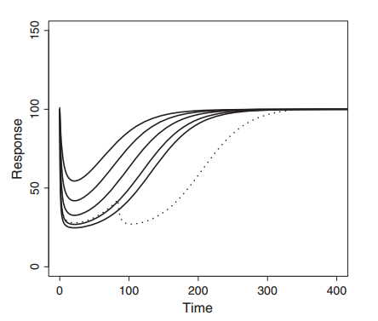
Background
Main Idea
The proposed approach uses nonlinear regression models to describe and predict the time-changing response for complex dosing regimens.

Slide 7
Methodology
2

Slide 8
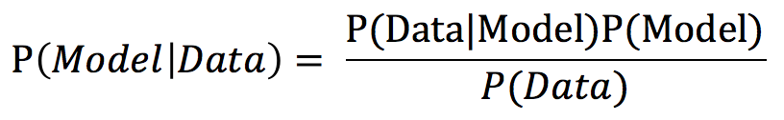
Methodology
Bayesian Inference
Observed data ⇒ prior probability and Statistical Model ⇒ Posterior probabilitys

Slide 9

Methodology
Bayesian VS Frequentist
Frequentist Reasoning
Judgment from listening
Bayesian Reasoning
Judgment from listening
Previous knowledge of phone location
Where is the ringing phone?

Slide 10


Methodology
Maximum Likelihood
Likelihood Function
Bayesian estimation
Posterior Distribution

Slide 11
Dose-Time-Response Model
3

Slide 12
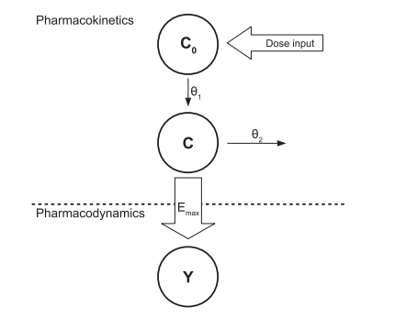


Dose-Time-Response Model
Basic Model
pharmacokinetic–pharmacodynamic (PKPD) model

Slide 13


Dose-Time-Response Model
Direct-Response E_{max}-model
The Basic Model

Slide 14
Dose-Time-Response Model
Model Extension
Placebo response
Baseline covariates
Multiple doses
Route of administration
Residual error
Indirect-response models and turnover models

Slide 15
Simulation
4

Slide 16
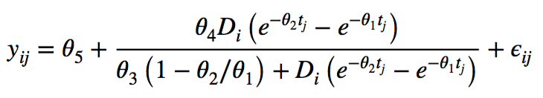
Simulation
To estimate the operating characteristics of the basic model
A mAb is administered by subcutaneous injection
1000 datasets generated using a multivariate normal distribution
E_{max} model is used to assess the expected value
Notes:
1. In clinical trial simulations, data are generated repeatedly for a given dose–time-response model. Then the operating characteristics are evaluated by statistical methods based on the data obtained.
2. Here, a clinical trial where a mAb is administered by subcutaneous injection is considered. 1000 datasets are generated using a multivariate normal distribution. E_{max} model is used to asses the expected value, and the results are shown in Table 1.
3. For the expected value, we used the (5), with true parameters shown in Table I (The true values of the error covariance matrix were set to

Slide 17
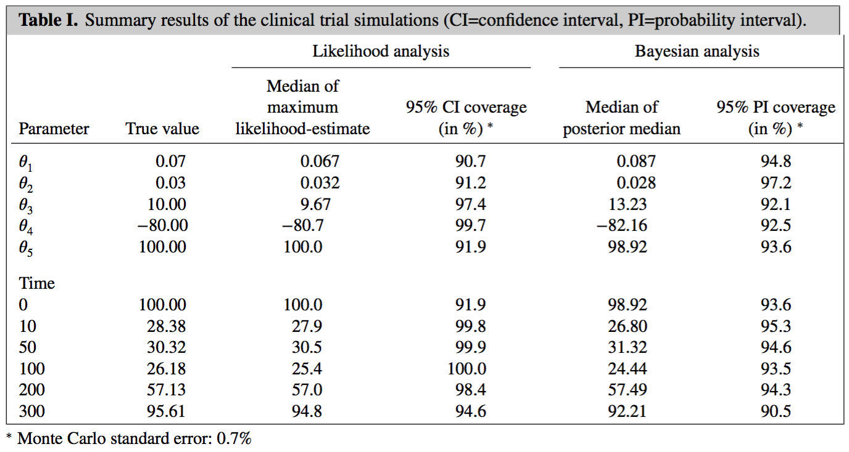
Simulation
Summary of the simulation results
Notes:
Both the ML and the Bayesian methods provided point estimates near to the true parameter values, with ML estimates tending to be closer. Furthermore, the coverage of the confidence and probability intervals seems acceptable in this example. The coverage of the Bayesian probability intervals was somewhat better than the coverage of ML-confidence intervals in the sense of being typically closer to 95%.

Slide 18
Simulation
Simulation results
Point estimates near to the true parameter values
ML estimates close to the true values on average
Acceptable confidence and probability interval coverage
Slightly better Bayesian probability interval coverage
Notes:
Both the ML and the Bayesian methods provided point estimates near to the true parameter values, with ML estimates tending to be closer. Furthermore, the coverage of the confidence and probability intervals seems acceptable in this example. The coverage of the Bayesian probability intervals was somewhat better than the coverage of ML-confidence intervals in the sense of being typically closer to 95%.

Slide 19
Clinical Trail
5

Slide 20
Clinical Trail
Objectives
To evaluate the fitness of the dose-time-response model in the clinical trail
To evaluate the accuracy of the dose-time-response model predictions of the untested treatment regimens response
Notes:
Ideally, the model should describe the data well for each single-dose group, and also predict the actual observed response of the treatment group with multiple injections with a reasonable level of accuracy.

Slide 21
Clinical Trail
Dose-time-response models used to analyze the clinical trail
The effects of canakinumab subcutaneous injection were examined
24 weeks, 400 patients
Participants randomly divided into seven groups
Five groups received single doses (either 25 mg, 50 mg, 100 mg, 200 mg, or 300 mg at day 1)
One group received multiple doses (50 mg at day 1, 50 mg at week 4, 25 mg at week 8, and 25 mg at week 12)
The last group as the placebo
The logarithm of C-reactive protein (CRP) levels as a proxy of the response
CRP is a biomarker signaling the severeness of the disease
Notes:
Dose-time-response models are used to analyze a clinical trail where the effects of canakinumab subcutaneous injection were examined. Active control was used in this 24-week double-blinded dose-ranging study.

Slide 22
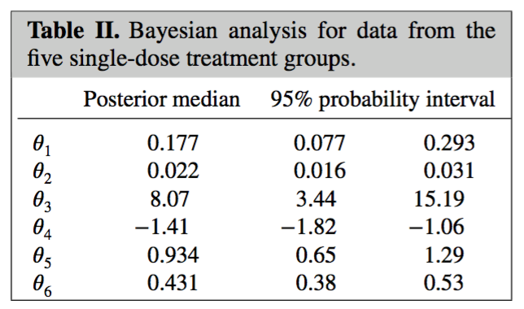
Clinical Trail
Bayesian analysis for the five single-dose groups
𝜃₆ is added to the basic model to measure the effect of the baseline CRP levels (X₀)

Slide 23
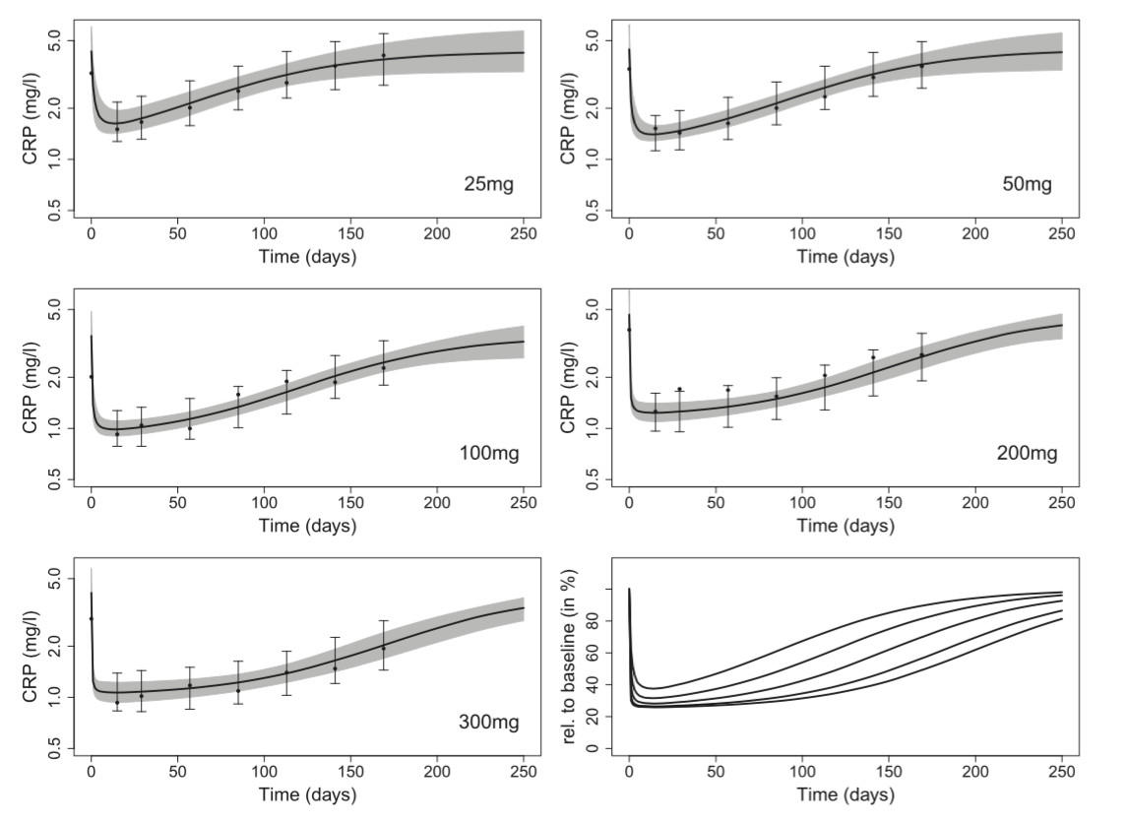
Clinical Trail
Comparison of observed values and the fitted Bayesian model
Dots: CRP mean
Solid curve: CRP median
Grey area: 95% posterior probability interval
Vertical lines: 95% prediction probability interval
Last plot: all posterior median curves relative to their baseline value
Notes:
The dots represent the means of the CRP levels, the solid curves the median of the posterior CRP levels, the grey area the 95% posterior probability interval, and the vertical lines the 95% prediction probability interval. The last plot displays all posterior median curves relative to their baseline value.

Slide 24
Clinical Trail
Accuracy evaluation
With R² = 0.82, the dose-time-response model describes the single-dose data well
Notes:
The dots represent the means of the CRP levels, the solid curves the median of the posterior CRP levels, the grey area the 95% posterior probability interval, and the vertical lines the 95% prediction probability interval. The last plot displays all posterior median curves relative to their baseline value.

Slide 25
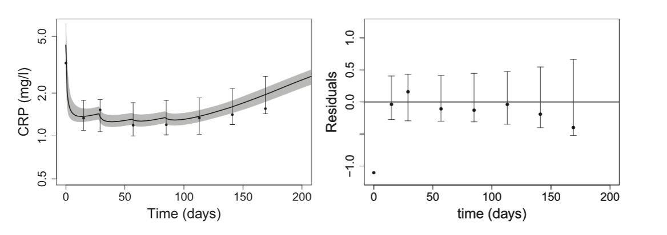
Clinical Trail
Bayesian prediction for the multiple dose treatment
Notes:
1. Bayesian prediction of the repeated dosing regimen based on the dose-time-response model derived from single-dose regimens
2. Figure 5 is a comparison of the data from the multiple dose group of the trial and the prediction from the dose-time-response model derived from the Bayesian analysis of the single-dose data. All of the data points are within the 95% prediction intervals, which implies a good accuracy of the dose-time-response model predictions of the response over time for the multiple dose treatment.

Slide 26
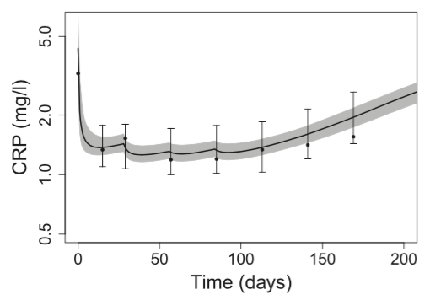
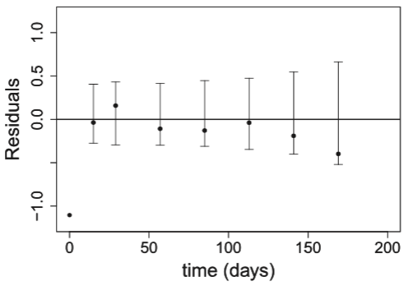
Clinical Trail
Results of the Bayesian prediction
All data points within the 95% prediction intervals
Good accuracy of the dose-time-response model predictions of the response over time for the multiple dose treatment
Notes:
1. Bayesian prediction of the repeated dosing regimen based on the dose-time-response model derived from single-dose regimens
2. Figure 5 is a comparison of the data from the multiple dose group of the trial and the prediction from the dose-time-response model derived from the Bayesian analysis of the single-dose data. All of the data points are within the 95% prediction intervals, which implies a good accuracy of the dose-time-response model predictions of the response over time for the multiple dose treatment.

Slide 27
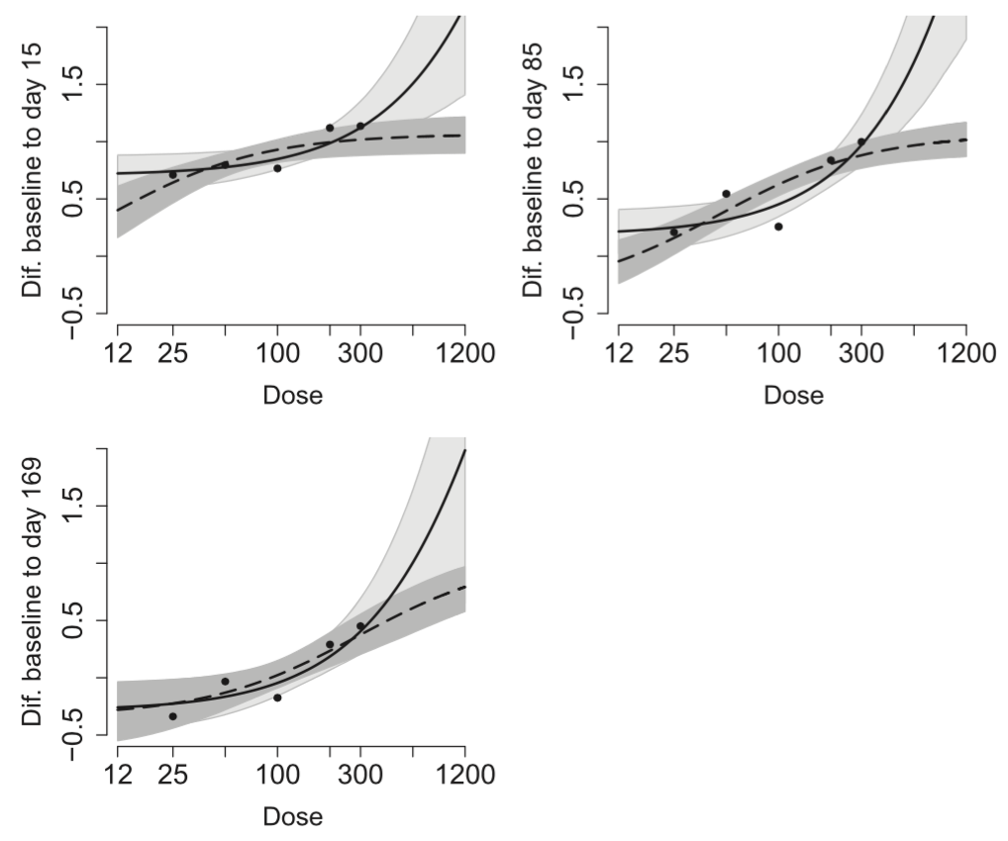
Clinical Trail
Dose-time-response model VS Standard E_{max} model
Dots: CRP mean
Solid line: fitted E_{max} model
Dashed line: fitted dose–time-response model
Light/Dark grey area: respective 95% confidence bands of the expected response
Notes:
1. Comparison of the dose-time-response model with the standard E_{max} model. The dots represent the means of the measurements, the solid line the fitted E_{max} model, and the dashed line the fitted dose-time-response model. The light grey area and the dark grey area mark the respective 95%-confidence bands of the expected response.
2. Figure 6 is a comparison of the fitted dose-time-response model with the standard fitted E_{max} (dose-response) model in estimating the difference to baseline. It is obtained by using Bayesian approach to fit the model for three time points at day 15, 85, and 169. Although the fits of data are similar for both models, the confidence band of the dose-time-response model is narrower than that of dose-response model, especially for the higher doses. This suggests that the predictions for higher doses in the dose-time-response model are more accurate on average.

Slide 28
Clinical Trail
Results of Comparison
Similar fits of data for both models
More accurate predictions for higher doses in the dose-time-response
Notes:
1. Comparison of the dose-time-response model with the standard E_{max} model. The dots represent the means of the measurements, the solid line the fitted E_{max} model, and the dashed line the fitted dose-time-response model. The light grey area and the dark grey area mark the respective 95%-confidence bands of the expected response.
2. Figure 6 is a comparison of the fitted dose-time-response model with the standard fitted E_{max} (dose-response) model in estimating the difference to baseline. It is obtained by using Bayesian approach to fit the model for three time points at day 15, 85, and 169. Although the fits of data are similar for both models, the confidence band of the dose-time-response model is narrower than that of dose-response model, especially for the higher doses. This suggests that the predictions for higher doses in the dose-time-response model are more accurate on average.

Slide 29
Evaluations
6

Slide 30
Evaluations
Limitations
ML methods may not be valid for small samples in the experiments
Bayesian framework may cause unintended informative prior problems
Sample generated using Markov chain Monte Carlo (MCMC) methods are subject to the validity problem
Notes:
1. ML methods make inferences based on asymptotic theory, but it may not be valid for small samples in the experiments.
2. In a Bayesian framework, unintended informative prior problems may occur because of inappropriate prior distributions for nonlinear models.
3. Samples from the posterior are generated using MCMC methods, rather than direct calculations. Therefore, the estimation results are subject to the validity problem.
4. In the clinical trail, only five single-dose arms and one multiple-dose arm are carried out for assessment, which may not be complete enough to achieve the accuracy of the model evaluation.

Slide 31
Evaluations
Issues & Challenges
Challenging to ensure the fitness of nonlinear regression models
Bayesian analysis requires MCMC algorithms, which is computer-intensive and time-consuming
Notes:
1. Form both technical and conceptual perspectives, It is often challenging to ensure the fitness of nonlinear regression models.
2. Convergence problems, identifiability problems, and ill-conditioning problems are commonly encountered in the experiments.
3. Bayesian analysis requiring MCMC algorithms is computer-intensive and time-consuming. Doing so for many simulated datasets need a significant amount of computing powers and time.

Slide 32
Thanks!
Any questions ?

Slide 33
Maximum Likelihood
Maximum likelihood is the procedure of finding the value of one or more parameters for a given statistic which makes the known likelihood distribution a maximum.
http://mathworld.wolfram.com/MaximumLikelihood.html
http://statweb.stanford.edu/~susan/courses/s200/lectures/lect11.pdf

Slide 34
MLE
Maximum-likelihood estimation (MLE) is a method of estimating the parameters of a statistical model given data.
In general, for a fixed set of data and underlying statistical model, the method of maximum likelihood selects the set of values of the model parameters that maximizes the likelihood function.

Slide 35
Bayesian Analysis
Bayesian analysis is a statistical procedure which endeavors to estimate parameters of an underlying distribution based on the observed distribution
prior distribution -> observed distribution -> posterior distribution
Bayesian analysis is somewhat controversial because the validity of the result depends on how valid the prior distribution is, and this cannot be assessed statistically.
http://mathworld.wolfram.com/BayesianAnalysis.html

Slide 36
Bayesian Inference
A method of statistical inference in which Bayes' theorem is used to update the probability for a hypothesis as more evidence or information becomes available.
Bayesian updating is particularly important in the dynamic analysis of a sequence of data.

Slide 37
Monte Carlo Method
Any method which solves a problem by generating suitable random numbers and observing that fraction of the numbers obeying some property or properties.
The method is useful for obtaining numerical solutions to problems which are too complicated to solve analytically.
Monte Carlo methods are mainly used in three distinct problem classes: optimization, numerical integration, and generating draws from a probability distribution.
http://mathworld.wolfram.com/MonteCarloMethod.html

Slide 38
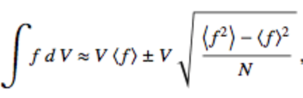

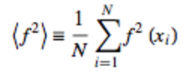
Monte Carlo Integration
In mathematics, Monte Carlo integration is a technique for numerical integration using random numbers.
Many algorithms usually evaluate the integrand at a regular grid, Monte Carlo randomly choose points at which the integrand is evaluated. This method is particularly useful for higher-dimensional integrals.
where
http://mathworld.wolfram.com/MonteCarloMethod.html

Slide 39
MCMC Method
Markov chain Monte Carlo (MCMC) methods are a class of algorithms for sampling from a probability distribution based on constructing a Markov chain that has the desired distribution as its equilibrium distribution.
The state of the chain after a number of steps is then used as a sample of the desired distribution.
Markov chain is collection of random variables {X_{t}} (t = 0, 1, ...) having the property that, given the present, the future is conditionally independent of the past. i.e.

Slide 40
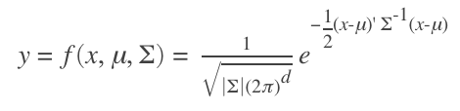
Multivariate Normal Distribution
A generalization of the one-dimensional (univariate) normal distribution to higher dimensions
A random vector is said to be k-variate normally distributed if every linear combination of its k components has a univariate normal distribution
The probability density function of the d-dimensional multivariate normal distribution is given by
http://www.mathworks.com/help/stats/multivariate-normal-distribution.html

