Slide 1


Analysis of IMDB Rating with GLM
(GROUP 10)
Ruiwen Ma, Xiaoyu Zhao, Xuqin Tan,
Yola Yola Kamalita, Ziheng Cao
20-March-2024

Slide 2
CONTENTS
01
Introduction
02
Exploratory data analysis
03
Statistical modelling and results
04
Conclusions
05
Future work

Slide 3
Introduction
The GLM for binary response variables, in this case, Logistic Regression, will be used to investigate the relationship between categorical rating and film properties.
Year
Length
Budget
Votes
Genre
Binary rating
(1 indicates rating >7, 0 otherwise)
Continuous variable
Categorical variable
Response variable

Slide 4
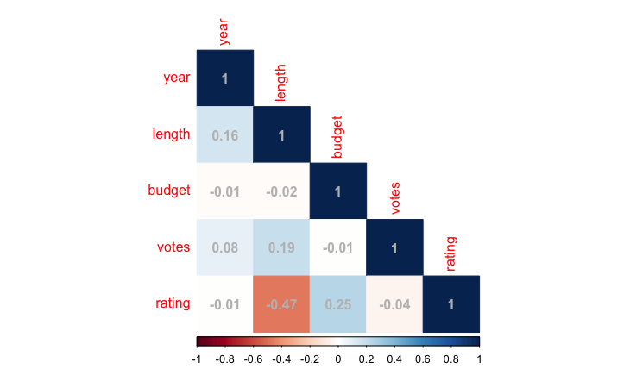
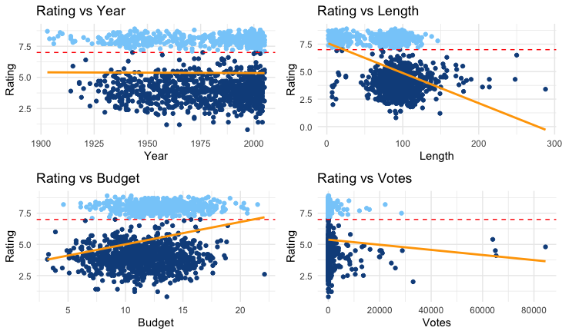
Exploratory data analysis (numeric variables)
A weak linear relationship to the rating is noticeable for budget and length, while year and votes show a very weak negative correlation to the rating.
Figure1: correlation
Figure2: scatterplot

Slide 5
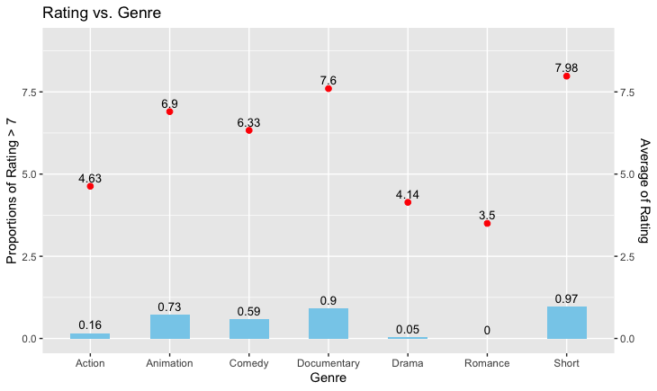
Exploratory data analysis (categorical variables)
The Short genre becomes the highest for both proportion and average rating. Visually, the genre helps distinguish whether the rating will be high or low.
Figure3: The proportion and average of rating for each genre

Slide 6
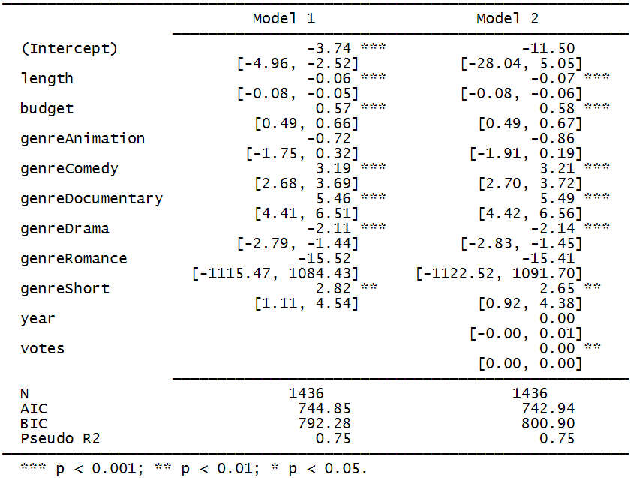
Statistical Modelling
Method: GLM
Model : Logistic
Reason:
Our target response data is a binary variable, following a binomial distribution. GLM allows us to choose the appropriate link function to model the relationship between probability and explanatory variables.
Table 1: Hypothesis Testing and Goodness of fit.

Slide 7
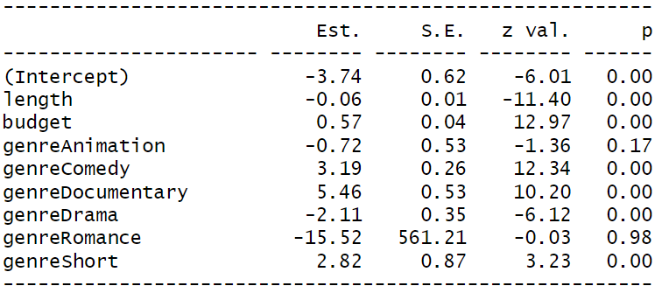
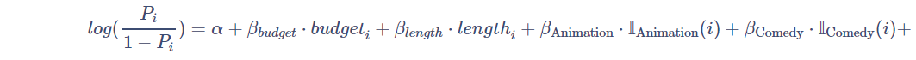

Modelling result
Variable explain
The log-odds coefficients for budget is positive indicating the higher their values then the rating will be more likely to be higher than 7. Furthermore, the log-odds coefficients for length is negative, and it indicates that the lower the values, the rating to be higher than 7 is more likely.
Table2: Regression Model Coefficients.
Notes:
ffc2f6c2-9da7-4fe4-94d4-d589ec75da77.source.default.zh-Hans

Slide 8
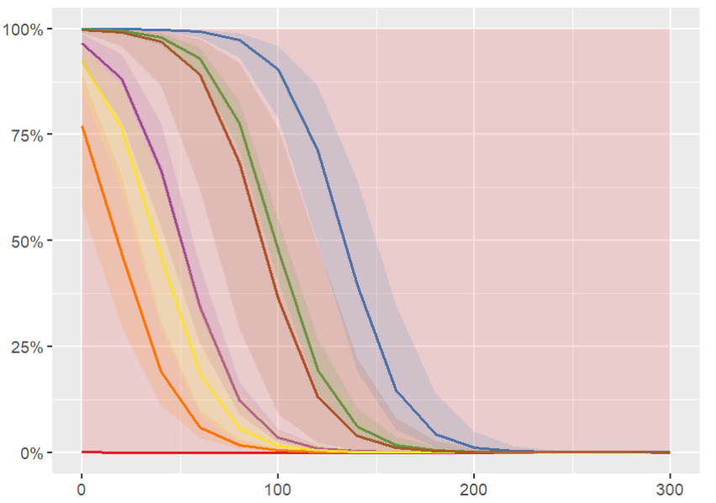
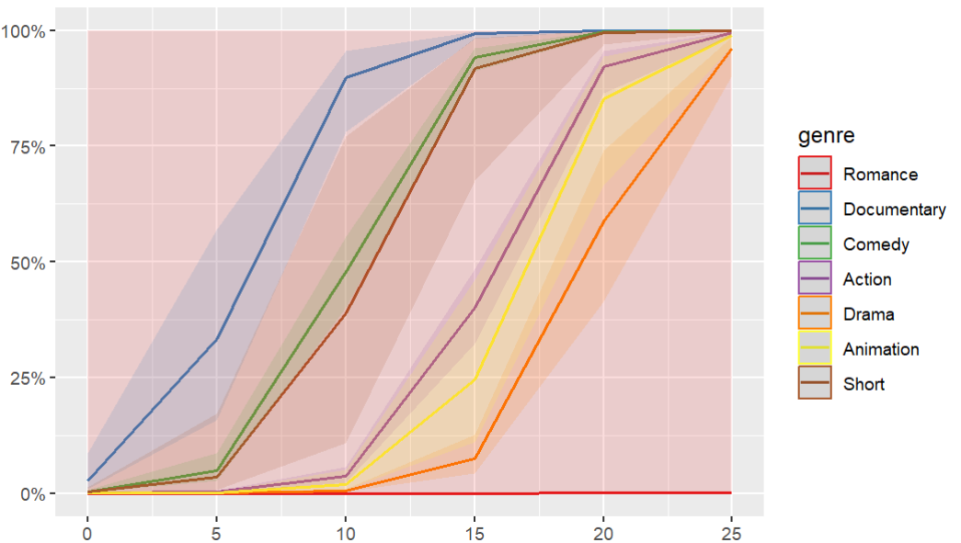
Length
Budget
Predicted probabilities of having rating higher than 7
The probability of a rating higher than 7 gradually diminishes with longer runtimes.
As the budget increases, the most of movies receiving high ratings also tends to increase.
Rating_higher_than_7
Length
Budget
Notes:
a5b37123-4c14-4e6e-b198-27e0564fd569.source.default.zh-Hans

Slide 9
Conclusions
1
The model with budget, length, and genre as the predictors is chosen to be the best, resulting in a minor increment in AIC but significantly reducing the BIC.
There are two types variable of genres that are not significant
2 Quality of the information system
3
4
5
There are two variables about genres that are not significant in this model, but if the genre is removed, AIC will increase significantly.
The budget, length, and genre significantly influence whether an IMDB rating is greater than 7. These predictors have been selected as optimal, resulting in a slight increase in AIC while substantially reducing the BIC.
The hypothesis on Hosmer-Lemeshow also shows no evidence for lack of fit.
2
3

Slide 10
Future Work
The model with budget, length, and genre as the predictors is chosen to be the best, resulting in a minor increment in AIC but significantly reducing the BIC.
There are two types variable of genres that are not significant
2 Quality of the information system
3
4
5
As the Animation’s (genre) odds is 0.49 times to the baseline category’s and this does not align with the fact that the Animation’s proportion (having a rating >7) is bigger than the baseline’s, future studies should consider interaction terms between movie length and genre which provide insights into the nuanced effects these variables have on ratings, potentially describing the data more accurately.

Slide 11

Thank You

