Slide 1


“DATA SCIENCE CAPSTONE”
The outcomes of tasks in modules and labs:
A presentation prepared for peer-data-scientists
YolandaCL
Feb 2024

Slide 2

Outline
Executive Summary
Introduction
Methodology:
Data collection and data wrangling
EDA and interactive visual analytics
Predictive analysis
Results :
EDA with visualization results
EDA with SQL results
Interactive map with Folium results
Plotly Dash dashboard
Predictive analysis (classification)
Conclusion
Innovative insights

Slide 3
Executive Summary
We start by collecting diverse and relevant data from various sources.
Next, we enhance data quality through data wrangling. Then, we explore the data using SQL skills, perform statistical analysis and data visualization, and further explorer by grouping data. Building predictive models uncovers insights.
Finally, we conclude by creating accurate results and visualizations where ‘less is more effective, more attractive, and more impactful’

Slide 4
Introduction
In this capstone project, the aim is to predict the successful landing of the Falcon 9 first stage, a key factor in reducing launch costs.
SpaceX offers Falcon 9 launches at $62 million, significantly less than competitors due to its reusable first stage.
Accurate predictions can inform launch cost estimates, aiding potential competitors in bidding against SpaceX.
* Falcon 9 : is a reusable, two-stage rocket designed and manufactured by SpaceX.

Slide 5
Methodology
- Data collection and data wrangling
- EDA and interactive visual analytics
- Predictive analysis

Slide 6
Methodology : Data collection methodology
The Data Collection API Lab
spacex_url="https://api.spacexdata.com/v4/launches/past"
In the get request, the response contains massive information,
then we use a static response object, to make the requested JSON results more consistent :
static_json_url='https://cf-courses-data.s3.us.cloud-object-storage.appdomain.cloud/IBM-DS0321EN-SkillsNetwork/datasets/API_call_spacex_api.json'
we filter the dataframe to only include Falcon 9 launches,
dealing with Missing Values
The Data Collection with Web Scraping Lab
static_url = “https://en.wikipedia.org/w/index.php?title=List_of_Falcon_9_and_Falcon_Heavy_launches&oldid=1027686922”
get request BeautifulSoup() , extract all column/variable names from the HTML table header
create a data frame by parsing the launch HTML tables

Slide 7
Methodology : Perform data wrangling
We perform EDA to find some patterns in the data
and determine what would be the label for training supervised models.
df=pd.read_csv(“https://cf-courses-data.s3.us.cloud-object-storage.appdomain.cloud/IBM-DS0321EN-SkillsNetwork/datasets/dataset_part_1.csv")
we identify and calculate the percentage of the missing values (isnull) in each attribute,
then we identify which columns are numerical and categorical (dtypes),
after that we calculate the number an occurrence (value_counts),
and finally we create a landing outcome label from Outcome column (df[‘Class']=landing_class)

Slide 8
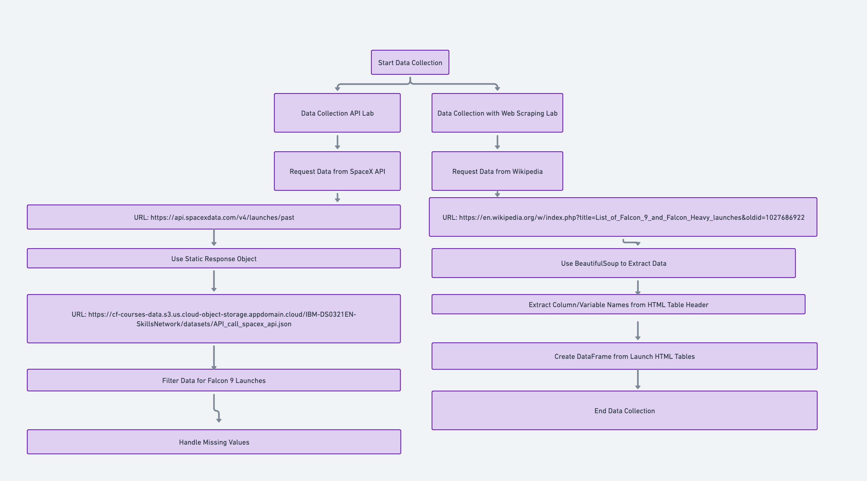

Slide 9
Methodology : EDA and interactive visual analytics
Perform exploratory data analysis (EDA) using visualization and SQL
we first load the SQL extension and establish a connection with the database :
https://cf-courses-data.s3.us.cloud-object-storage.appdomain.cloud/IBM-DS0321EN-SkillsNetwork/labs/module_2/data/Spacex.csv,
then we remove blank rows from table Display the names of the unique launch sites in the space mission (%sql SELECT DISTINCT Launch_Site FROM SPACEXTABLE;
finally, we write and execute SQL queries to solve the assignment tasks.

Slide 10
Methodology : EDA and interactive visual analytics
Launch Sites Locations Analysis with Folium
We Download and read the `spacex_launch_geo.csv URL = ‘https://cf-courses-data.s3.us.cloud-object-storage.appdomain.cloud/IBM-DS0321EN-SkillsNetwork/datasets/spacex_launch_geo.csv'
And Select relevant sub-columns: `Launch Site`, `Lat(Latitude)`, `Long(Longitude)`, `class`, Landing Outcome
We first create a folium Map object, with an initial center location to be NASA Johnson Space Center at Houston, Texas.

Slide 11
Then :
Download and read the `spacex_launch_geo.csv URL = ‘https://cf-courses-data.s3.us.cloud-object-storage.appdomain.cloud/IBM-DS0321EN-SkillsNetwork/datasets/spacex_launch_geo.csv'
Select relevant sub-columns: `Launch Site`, `Lat(Latitude)`, `Long(Longitude)`, `class`, Landing Outcome
We first create a folium Map object, mark all launch sites on a map and the success/failed launches for each site on the map
Calculate the distances between a launch site to its proximities

Slide 12
Methodology : EDA and interactive visual analytics
Predictive analysis using classification models
perform exploratory Data Analysis and determine Training Labels
create a column for the class
Standardize the data
Split into training data and test data

Slide 13
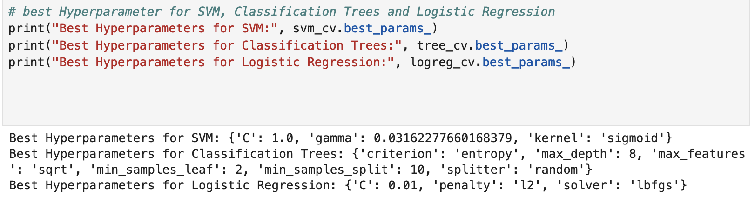
Methodology : EDA and interactive visual analytics
Predictive analysis using classification models
Find best Hyperparameter for SVM, Classification Trees and Logistic Regression

Slide 14
Results
- EDA with visualization results
- EDA with SQL results
- Interactive map with Folium results
- Plotly Dash dashboard
- Predictive analysis (classification)

Slide 15
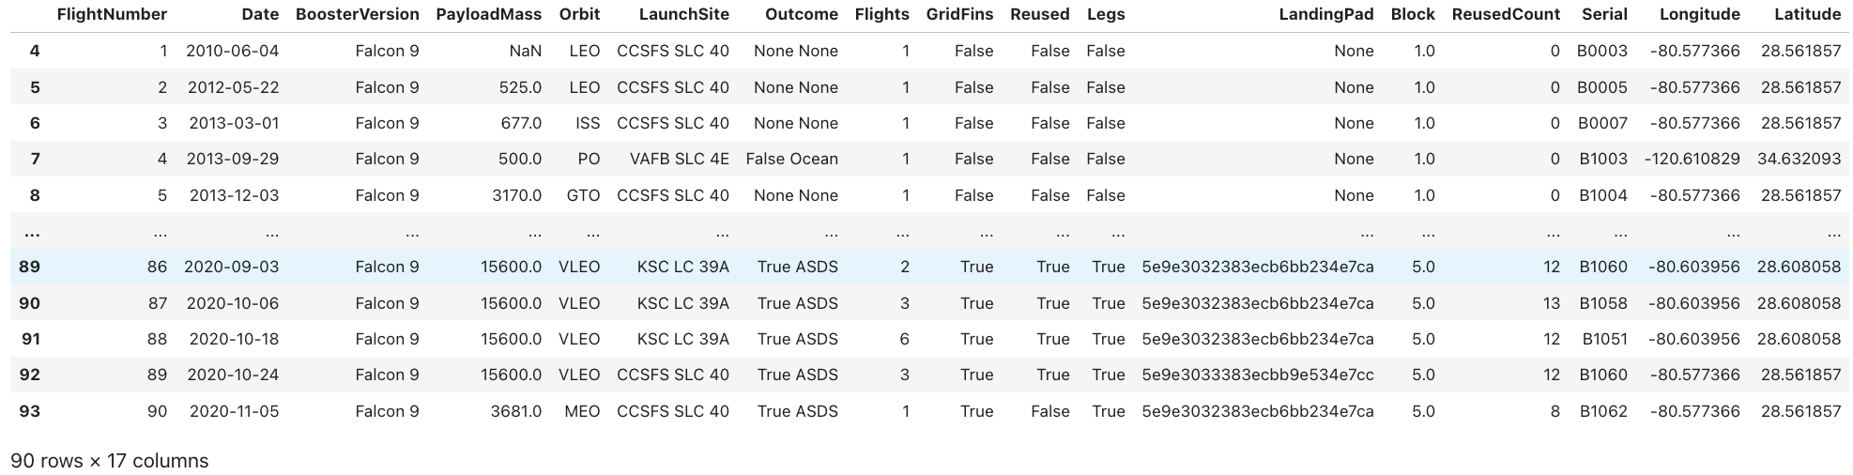
EDA with visualization results :
Data Collection – with SpaceX API
we make a get request to the SpaceX API
and we clean the requested data, dealing with missing values
data_falcon9 :
The GitHub URL of the completed SpaceX API calls notebook (this include completed code cell and outcome cell), as an external reference:
https://github.com/YolandaCL/DataScienceCertificate_IBM/blob/main/SpaceX_data_collection_API.ipynb

Slide 16
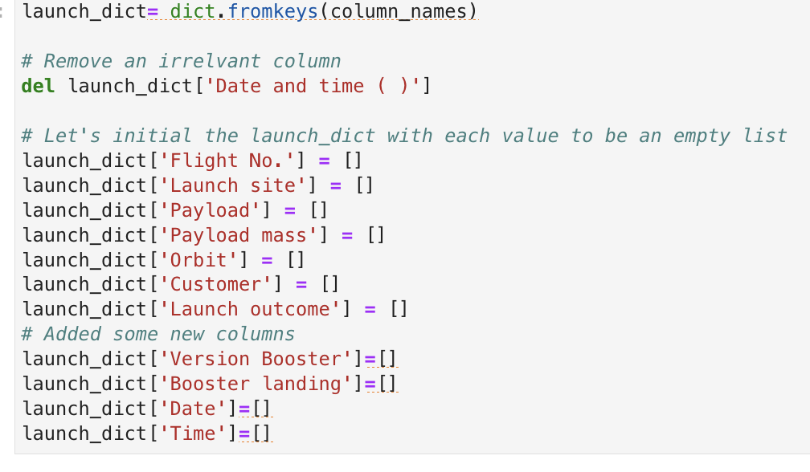
EDA with visualization results :
Data Collection – with Web Scraping
Web scrap Falcon 9 launch records with BeautifulSoup:
we extract a Falcon 9 launch records HTML table from Wikipedia
And we parse the table and convert it into a Pandas data frame
(we create this dictionary, fill it with data, and then convert it into a DataFrame)
The GitHub URL of the completed web scraping notebook, as an external reference:
https://github.com/YolandaCL/DataScienceCertificate_IBM/blob/main/SpaceX_WebScraping.ipynb

Slide 17
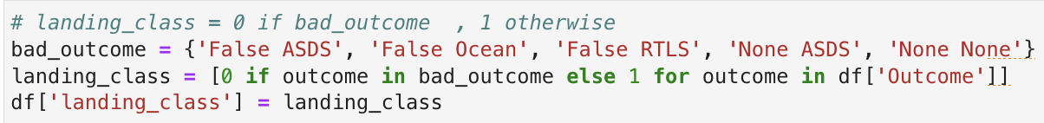
EDA with visualization results :
Data Wrangling
we perform exploratory data analysis.
and we determine training labels
The GitHub URL of the completed data wrangling related notebooks, as an external reference:
https://github.com/YolandaCL/DataScienceCertificate_IBM/blob/main/SpaceX_data_Wrangling.ipynb

Slide 18
EDA with SQL
The GitHub URL of the completed EDA with SQL notebook, as an external reference:
https://github.com/YolandaCL/DataScienceCertificate_IBM/blob/main/SpaceX_EDA_with_pandas_matplotlib.ipynb

Slide 19
we execute these SQL queries to answer assignment questions :
# Display 5 records where launch sites begin with the string 'CCA'
%sql SELECT * FROM SPACEXTABLE WHERE Launch_Site LIKE 'CCA%' LIMIT 5;
# Display the total payload mass carried by boosters launched by NASA (CRS)
%sql SELECT Booster_Version, SUM(Payload_Mass__KG_) AS total_payload FROM SPACEXTABLE WHERE Customer LIKE '%NASA (CRS)%' GROUP BY Booster_Version;
# Display average payload mass carried by booster version F9 v1.1
%sql SELECT Booster_Version, ROUND(AVG(Payload_Mass__KG_), 2) AS average_payload FROM SPACEXTABLE WHERE Booster_Version LIKE 'F9 v1.1%' ;
# List the date when the first succesful landing outcome in ground pad was acheived.
%sql SELECT MIN(Date) AS "first_succesful_landing" FROM SPACEXTABLE WHERE Landing_Outcome='Success';
# List the names of the boosters which have success in drone ship and have payload mass greater than 4000 but less than 6000
%sql SELECT Booster_Version FROM SPACEXTABLE WHERE Landing_Outcome='Success (drone ship)' AND Payload_Mass__KG_ BETWEEN 4000 AND 6000;

Slide 20
# List the total number of successful and failure mission outcomes
%sql SELECT 'Success' AS Outcome, COUNT(*) AS Count FROM SPACEXTABLE WHERE Mission_Outcome = 'Success' UNION ALL SELECT 'Failure' AS Outcome, COUNT(*) AS Count FROM SPACEXTABLE WHERE Mission_Outcome = 'Failure (in flight)';
# List the names of the booster_versions which have carried the maximum payload mass
%sql SELECT Booster_Version FROM SPACEXTABLE WHERE PAYLOAD_MASS__KG_ = (SELECT MAX(PAYLOAD_MASS__KG_) FROM SPACEXTABLE);
# List the records which will display the month names, failure landing_outcomes in drone ship ,booster versions, launch_site for the months in year 2015.
%sql SELECT substr(Date, 6, 2) AS Month, Landing_Outcome, Booster_Version, Launch_Site FROM SPACEXTABLE WHERE substr(Date, 0, 5) = '2015' AND Landing_Outcome LIKE 'Failure%' AND Landing_Outcome LIKE '%drone ship%';
# Rank the count of landing outcomes (such as Failure (drone ship) or Success (ground pad)) between the date 2010-06-04 and 2017-03-20, in descending order.
%sql SELECT Landing_Outcome, COUNT(*) FROM SPACEXTABLE WHERE Date BETWEEN '2010-06-04' AND '2017-03-20' GROUP BY Landing_Outcome ORDER BY COUNT(*) DESC;

Slide 21
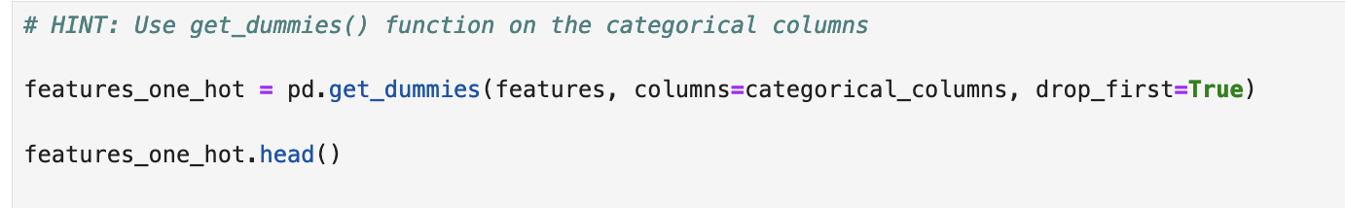
Complete EDA with visualization
we perform exploratory data analysis and feature engineering using Pandas and Matplotlib
The GitHub URL of the completed data wrangling related notebooks, as an external reference:
https://github.com/YolandaCL/DataScienceCertificate_IBM/blob/main/SpaceX_data_Wrangling.ipynb

Slide 22
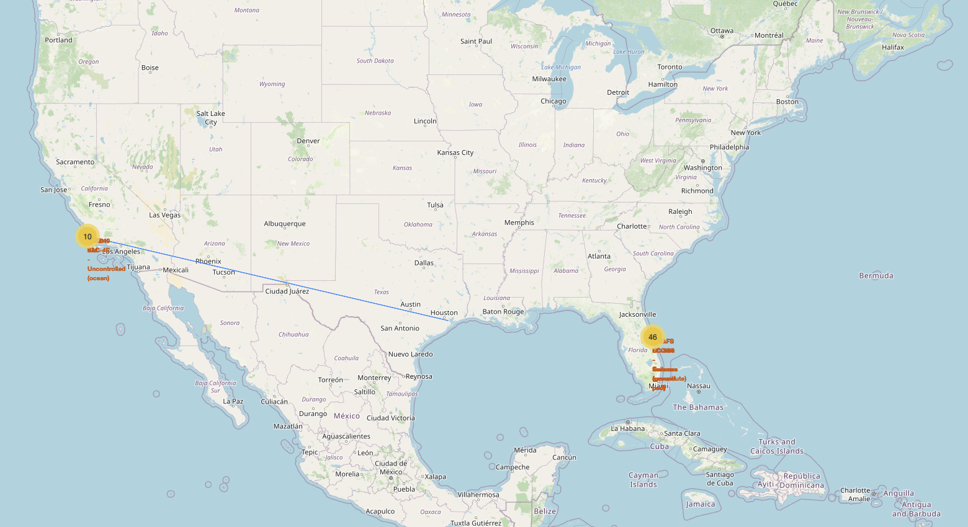
Interactive map with Folium results
The GitHub URL of your completed interactive map with Folium map, as an external reference:
https://github.com/YolandaCL/DataScienceCertificate_IBM/blob/main/SpaceX_Folium.ipynb

Slide 23
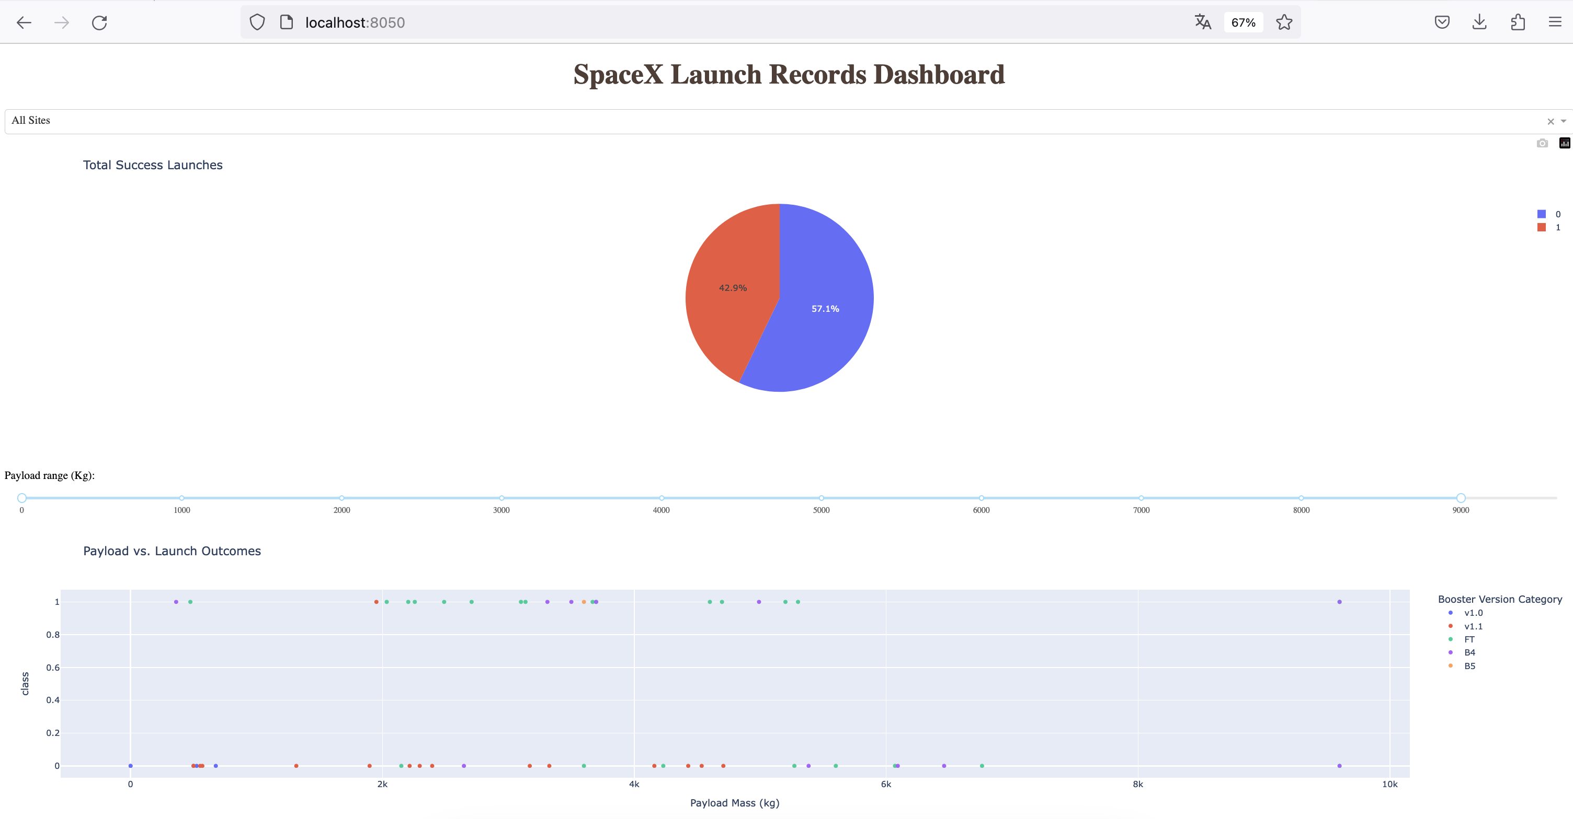
Plotly Dash Dashboard
We build an interactive dashboard with Plotly Dash
The GitHub URL of the completed Plotly Dash lab, as an external reference:
https://github.com/YolandaCL/DataScienceCertificate_IBM/blob/main/SpaceX_Plotly_Dash.py

Slide 24
Predictive Analysis (Classification)
we perform exploratory Data Analysis and determine Training Labels
* create a column for the class
* Standardize the data
* Split into training data and test data
we also find best Hyperparameter for SVM, Classification Trees and Logistic Regression
and finally we find the method performs best using test data.
The GitHub URL of your completed predictive analysis lab, as an external reference :
https://github.com/YolandaCL/DataScienceCertificate_IBM/blob/main/SpaceX_Machine_Learning_Prediction.ipynb

Slide 25
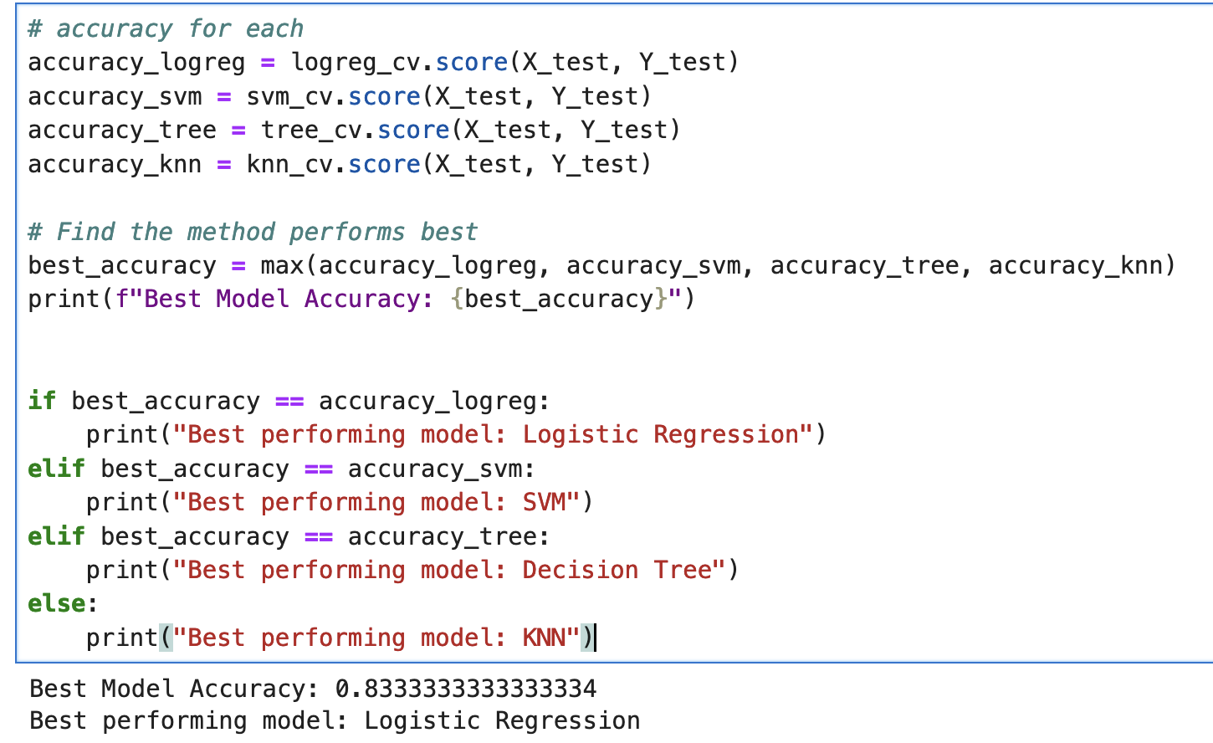
Classification Accuracy
we find that logistic regression has the highest classification accuracy :

Slide 26
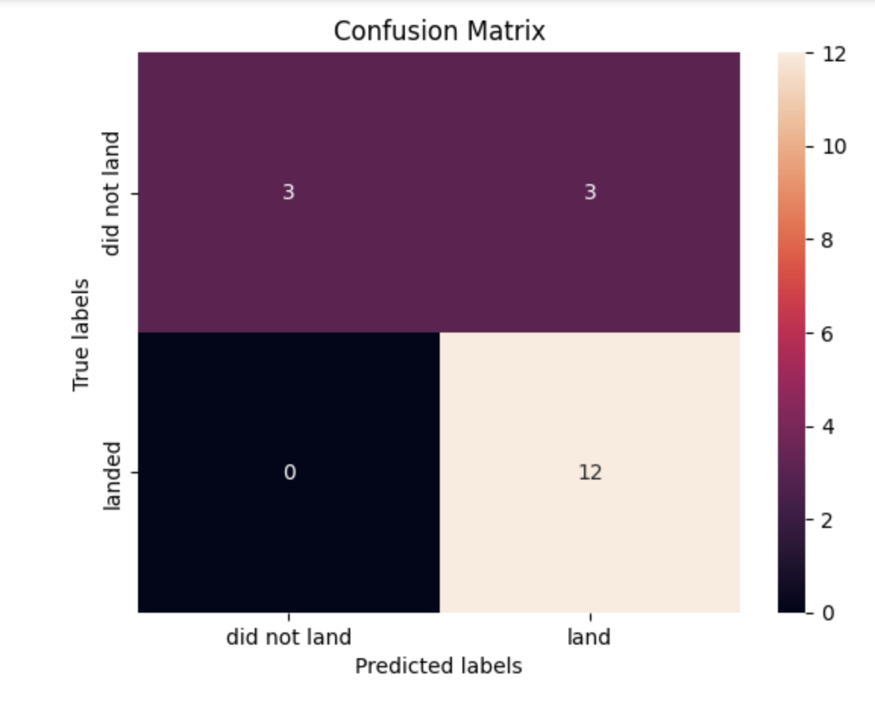
Confusion Matrix
Examining the confusion matrix, we see that logistic regression can distinguish between the different classes. We see that the major problem is false positives.

Slide 27
Conclusions
- Each attached code file includes the conclusions at the end.

Slide 28
Innovative insights
Innovative Insights are included directly in the README.md file
The GitHub URL :
https://github.com/YolandaCL/DataScienceCertificate_IBM/blob/main/README.md-

Slide 29
Thank you!

