Slide 1
Emotions Recognition
Group 2
Fredrik
Yolanda
Ammar
Swapna
Arijeet

Slide 2
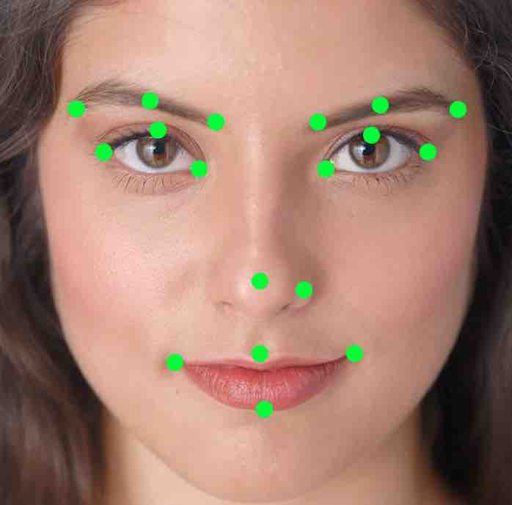
Preprocessing the data
Test dataset: BosphorusDB
433*22, which include 433 samples and each sample has 22 3D landmarks.
6 labels, anger-disgust-fear-happy-sadness-surprise

Slide 3
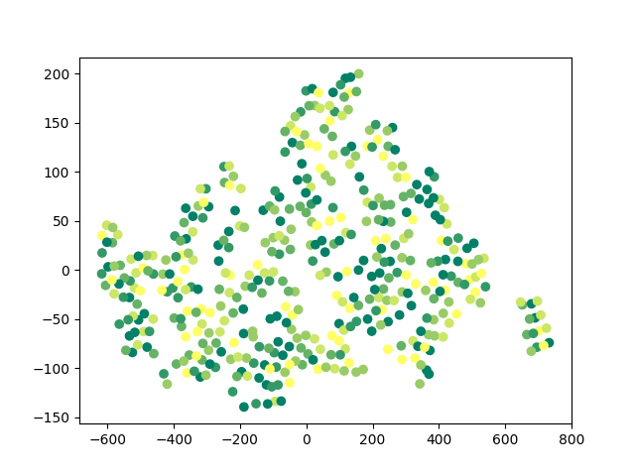

Slide 4
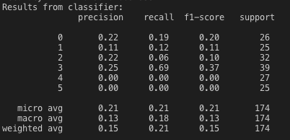
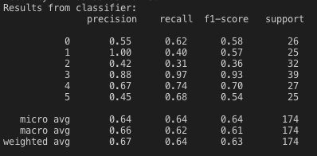
Classification
K-NN
Accuracy: 0.21264367816091953
SVM
Accuracy: 0.6379310344827587

Slide 5
Challenge we are facing
Low accuracy, eapecially knn
Target accuracy: >0.8
Possible solution
Dataset
Normilizaton
Parameters

Slide 6
Next steps
Optimise our current algorithm
Implement another two classifier
Random Forest
Neural network

Slide 7
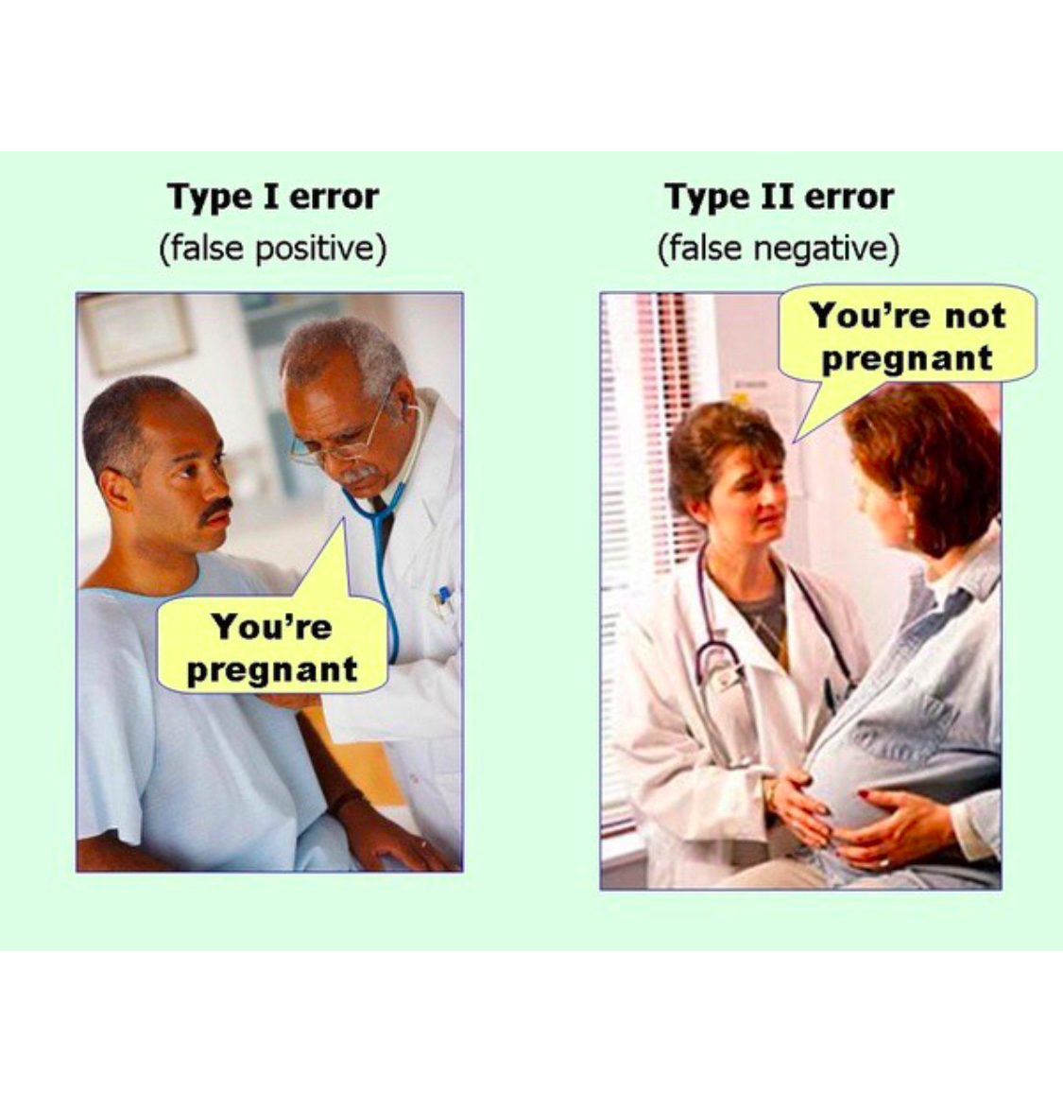
Thank you!

