Slide 1


Breast Cancer Dataset
Yolanda Lewis, Daniel O’Brien, Jose Guzman, Ross Gibson, Will Ranick
DSC 424: Final Project

Slide 2
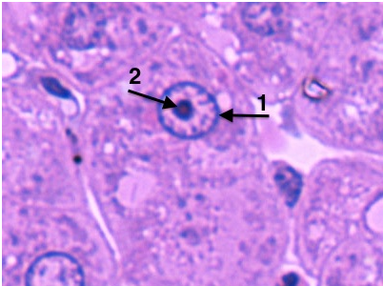
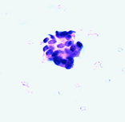
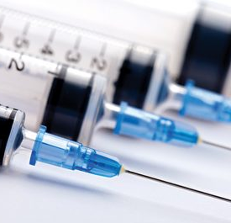
Introduction
Dataset describes findings from patients undergoing Fine Needle Aspiration (FNA)
Biopsy performed using a fine needle to obtain tissue and fluid samples
Features are computed from a digitized image of a fine needle aspirate (FNA) of a breast mass.
The Features describe characteristics of the cell nuclei present in the image
Texture, radius, perimeter, area, smoothness, compactness, concavity, symmetry, fractal dimension.
Features in dataset were used to determine if the patient was diagnosed with breast cancer
[1] 92_4964. (1994, November 3). Retrieved August 20, 2020, from ftp://ftp.cs.wisc.edu/math-prog/cpo-dataset/machine-learn/cancer/cancer_images/
[7] Yale. (n.d.). Microscope Image of Nuclear Membrane and Nuclei [Illustration]. Histology@Yale. http://medcell.med.yale.edu/histology/cell_lab.php ​
[8] AAPC. (2020). Fine Needle [Photograph]. https://www.aapc.com/blog/46771-how-to-be-the-best-fine-needle-aspiration-and-core-biopsy-coder/​
Notes:
Yolanda

Slide 3
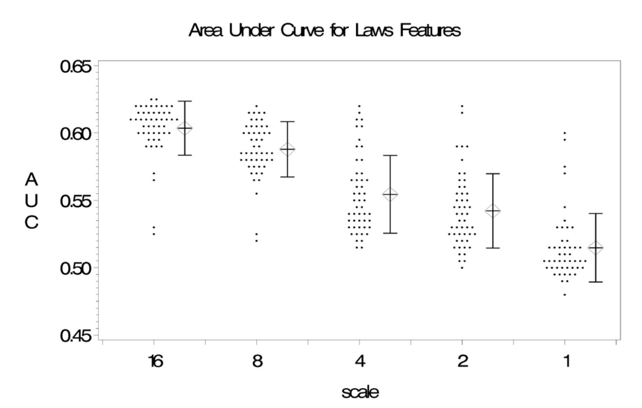
Texture Features from Mammographic Images and Risk of Breast Cancer
Research Question:
Can image texture features be used to predict breast cancer risk?
Methods:
Logistic Regression
Bootstrap based variable selection procedure
Results:
Texture features can be just as effective as percent density in predicting breast cancer risk.
^{[4]} Manduca, A., Carston, M. J., Heine, J. J., Scott, C. G., Pankratz, V. S., Brandt, K. R., Sellers, T. A. Vachon, C. M., & Cerhan, J. R. (2009). Texture features from mammographic images and risk of breast cancer. Cancer epidemiology, biomarkers & prevention : a publication of the American Association for Cancer Research, cosponsored by the American Society of Preventive Oncology, 18(3), 837–845. https://doi.org/10.1158/1055-9965.EPI-08-0631
Notes:
Daniel

Slide 4
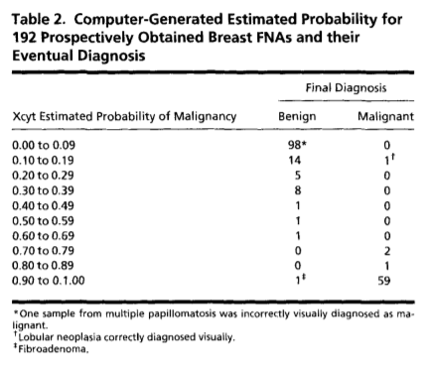
Literature Review
In 1994, three scientists created a classification model* that we predicted the diagnosis of FNA samples as either benign or malignant
Their model was able to predict the diagnosis of these FNA with 97.9% accuracy
Author points out that visual diagnosis of FNAs are easily done when FNA is at extreme of diagnosis, but more difficult to diagnosis when FNA is less extreme
Proves that our research question is a valid and that it is in fact possible to predict a diagnosis based on a linear based statistical model
^{[5]} Wolberg, W. H., Street, W. N., & Mangasarian, O. L. (1994). Machine learning techniques to diagnose breast cancer from image-processed nuclear features of fine needle aspirates. Cancer Letters, 77(2-3), 163-71.
*Authors used a classification technique called MSM-Tree and uses linear programming to create linear planes in a multidimensional space. MSM-Tree sounds similar to an Linear Discriminant Analysis (LDA)
Notes:
Ross

Slide 5
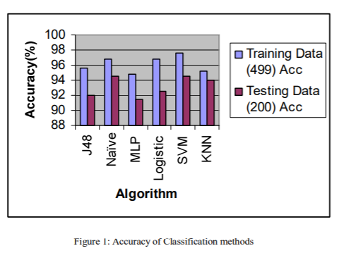
An Efficient Prediction of Breast Cancer Data using Data Mining Techniques
Comparison of several Data Mining Techniques
Result: The SVM classification technique had the best overall performance.
^{[6]} Kumar, G. R., Ramachandra, G. A., & Nagamani, K. (2013). An Efficient Prediction of Breast Cancer Data using Data Mining Techniques. International Journal of Innovations in Engineering and Technology (IJIET), 2(4), august, 139-144.
Notes:
Jose

Slide 6
Methods and Research Question
Classification Techniques
Principal Component Analysis (PCA)
Common Factor Analysis (CFA)
Prediction Techniques
Multiple Linear Regression
Logistic Regression
Linear Discriminant Analysis (LDA)
Our objective is to create a model that will allow us to predict whether a breast cell mass is benign or malignant based on measurements from a digitized image of a fine needle aspirate (FNA) biopsy.
Notes:
Ross

Slide 7
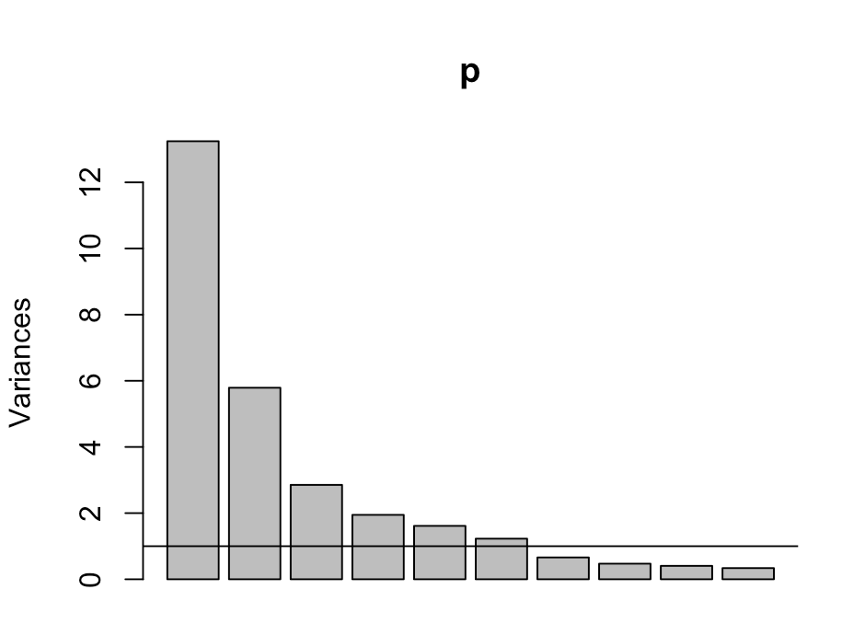
Results and Discussion (PCA)
Bartlet's Test of Sphericity:
P-value < 0.05
Cronbach's Alpha:
0.58
95% confidence interval 0.58-0.59
KMO:
0.63
Notes:
Daniel

Slide 8
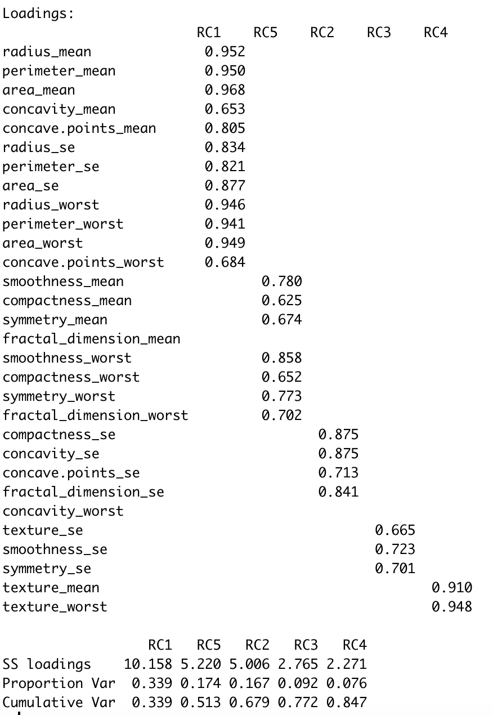
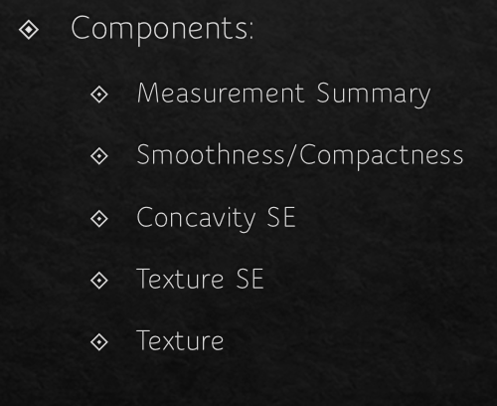
Results and Discussion (PCA)
Parallel Analysis
5 Components
Scree Plot
3-4 Components
Eigenvalues
6 component > 1
Limitation
Component with 2 variables
Cumulative variance:
5 components – 84.7%
Notes:
Daniel

Slide 9
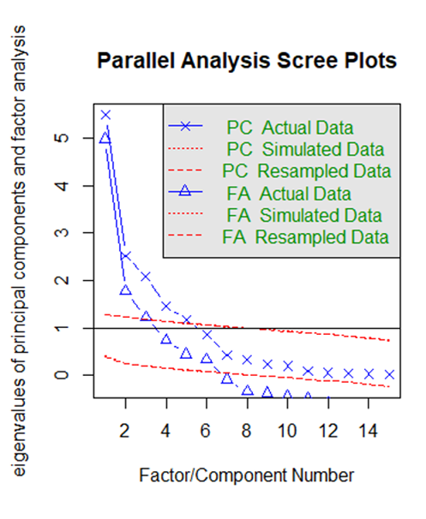
Underlying Theory (FA)
Shape of the cell correlated to malignancy
Bartlett's Test of Sphericity: p-value less than 0.05
Cronbach's Alpha: 0.60
KMO: 0.63
Eigenvalues > 1: 3 Factors
Scree Plot: 3-4 Factors
Notes:
Jose

Slide 10
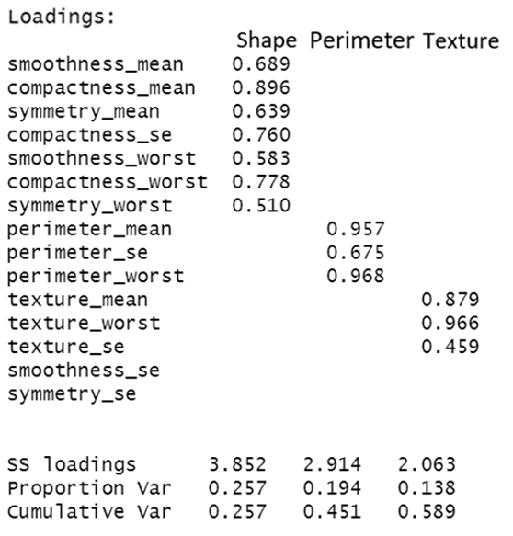
Results and Discussion (FA)
3 Factors
Shape
Perimeter
Texture
Cutoff: 0.45
Notes:
Jose

Slide 11
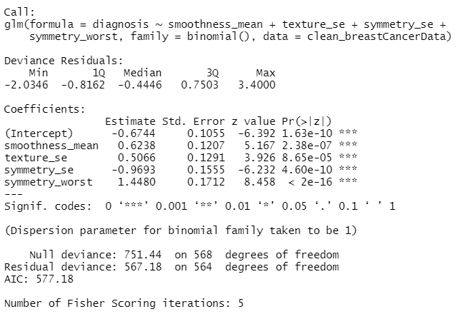
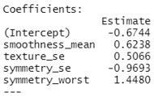
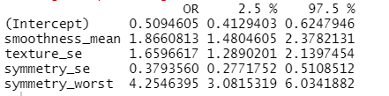
Logistic Regression Model
Final Model
All variables showed significance with a P value < 0.05
Symmetry worst had the strongest positive influence
For everyone one-unit change in the variables in the model the log odds increased or decreased.
Low VIFs
Goal: Build a model to predict the odds and probability of a breast cancer diagnosis
A word on model building
Checked for multicollinearity
Spilt data into training and testing 80/20
Backwards elimination for feature selection
Evaluate model performance
So what does this model mean statistically?
Notes:
Yolanda

Slide 12

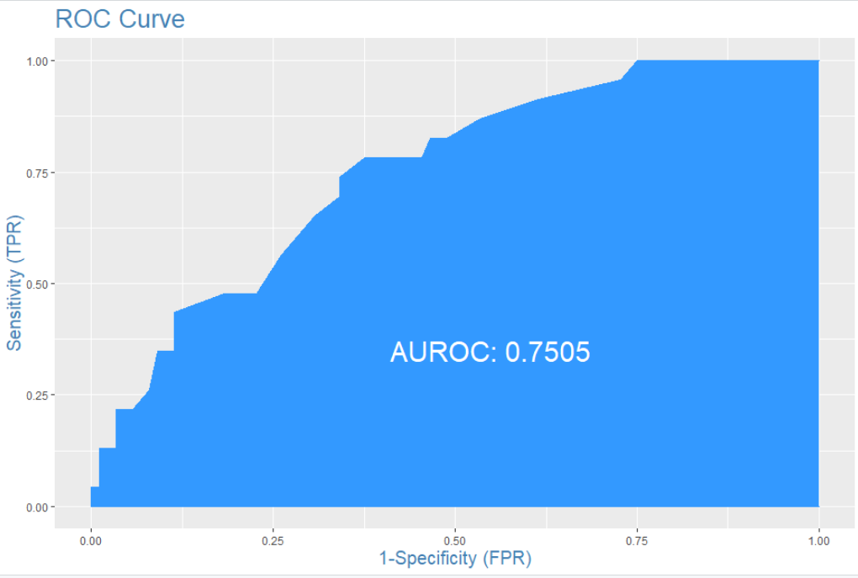
Results and Discussion Logistic Regression
Model Performance
AUC= 75% (Performing moderately)
High Specificity of 97%
10-Fold Cross Validation Accuracy= 76%
Misclassification Error Rate: 19%
Confusion Matrix = 81% Accuracy predicting diagnosis
What Are the odds Ratios?
Smoothness Mean :
Estimated odds ratio: 1.87
Odds of breast cancer diagnosis increase by 87%
Texture Standard Error :
Estimated odds ratio: 1.65
Odds of Breast Cancer diagnosis increase by 66%
Symmetry Standard Error:
Estimated odds ratio: 0.37
Odds of Breast Cancer diagnosis decrease by 62%
Symmetry Worst :
Estimated odds ratio: 4.25
Odds of Breast Cancer diagnosis increase by 325%
Symmetry Worst is the Strongest Influencer
Actual Values | Predicted Values
 | 0 = “Benign” | 1 = “Malignant”
0 | 85 | 18
1 | 3 | 5
[9] Colourbox. (2020). Thinking Doctor with Question Marks [Illustration]. https://www.colourbox.com/vector/thinking-doctor-with-question-marks-vector-25580883​
Notes:
Yolanda

Slide 13
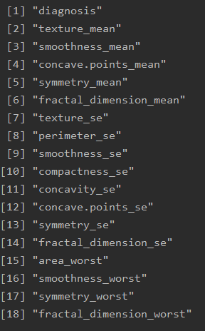
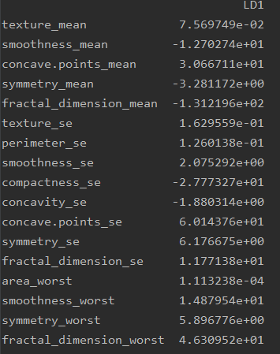
Results and Discussion (LDA)
Exploratory Analysis:
Multicollinearity (VIF)
Assumptions
Histograms of predictors
17 independent variables; 1 response variable
Mean texture, se concave points, and se symmetry were all strong predictors of malignancy
Notes:
Ross

Slide 14
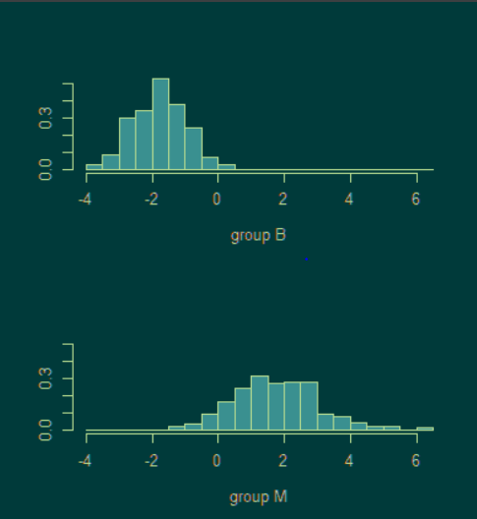
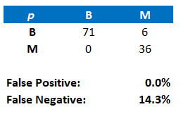
Results and Discussion (LDA)
Accuracy – 94.69%
Training & Testing dataset 80/20 split
No cross-validation used
LDA Plot
Confusion Matrix
False positive good; false negative high
Notes:
Ross

Slide 15
Conclusion
PCA - demonstrated the associations and relationships of the independent variables.
Factor Analysis – supports the theory that the shape of a cell is correlated with the classification of that cell.
Logistic Regression – showed that the probability of predicting a breast cancer diagnosis is increased when digital nuclei measurements such as the worst symmetry are used by healthcare professionals to determine a patients’ diagnosis.
Multiple Regression – showed that variables such as the cell's worst radius, worst texture, and mean compactness were significant in predicting tumor malignancy.
Linear Discriminant Analysis – was able to predict with a high degree of accuracy whether a cell mass from an FNA biopsy was malignant breast cancer, which can be used for future patient diagnosis
Limitations – More patients should be included from other geographical areas and other health factors about the patient should be included.
Future work – Use cluster analysis to group patients based on most common characteristics.
Notes:
All

Slide 16

Questions?
[10] Women’s Health Magazine. (2020). Puzzle Piece Question Mark [Illustration]. https://www.womenshealthmag.com/life/a22500573/questions-to-ask-to-get-to-know-someone/​

Slide 17
Appendix: APA Citations
^{[1]} 92_4964. (1994, November 3). Retrieved August 20, 2020, from ftp://ftp.cs.wisc.edu/math-prog/cpo-dataset/machine-learn/cancer/cancer_images/
^{[2]} Casaubon JT, Tomlinson-Hansen S, Regan JP. Fine Needle Aspiration Of Breast Masses. [Updated 2020 Aug 12]. In: StatPearls [Internet]. Treasure Island (FL): StatPearls Publishing; 2020 Jan-. Available from: https://www.ncbi.nlm.nih.gov/books/NBK470268/
^{[3]} Koriech O. M. (1996). Breast cancer and early detection. Journal of family & community medicine, 3(1), 7–9.
^{[4]} Manduca, A., Carston, M. J., Heine, J. J., Scott, C. G., Pankratz, V. S., Brandt, K. R., Sellers, T. A., Vachon, C. M., & Cerhan, J. R. (2009). Texture features from mammographic images and risk of breast cancer. Cancer epidemiology, biomarkers & prevention : a publication of the American Association for Cancer Research, cosponsored by the American Society of Preventive Oncology, 18(3), 837–845. https://doi.org/10.1158/1055-9965.EPI-08-0631
^{[5]} Wolberg, W. H., Street, W. N., & Mangasarian, O. L. (1994). Machine learning techniques to diagnose breast cancer from image-processed nuclear features of fine needle aspirates. Cancer Letters, 77(2-3), 163-71.
^{[6]} Kumar, G. R., Ramachandra, G. A., & Nagamani, K. (2013). An Efficient Prediction of Breast Cancer Data using Data Mining Techniques. International Journal of Innovations in Engineering and Technology (IJIET), 2(4), august, 139-144.
^{[7]} Yale. (n.d.). Microscope Image of Nuclear Membrane and Nuclei [Illustration]. Histology@Yale. http://medcell.med.yale.edu/histology/cell_lab.php
^{[8]} AAPC. (2020). Fine Needle [Photograph]. https://www.aapc.com/blog/46771-how-to-be-the-best-fine-needle-aspiration-and-core-biopsy-coder/
^{[9]} Colourbox. (2020). Thinking Doctor with Question Marks [Illustration]. https://www.colourbox.com/vector/thinking-doctor-with-question-marks-vector-25580883
^{[10]} Women’s Health Magazine. (2020). Puzzle Piece Question Mark [Illustration]. https://www.womenshealthmag.com/life/a22500573/questions-to-ask-to-get-to-know-someone/

