Slide 1




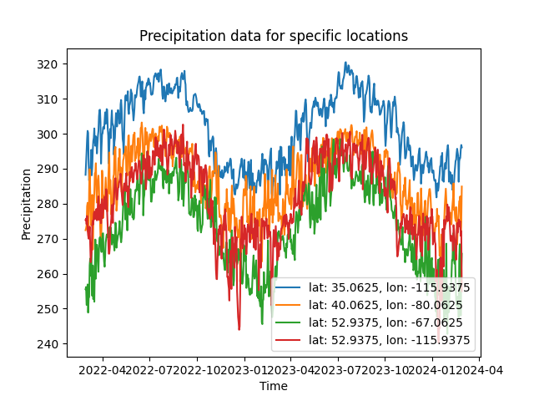
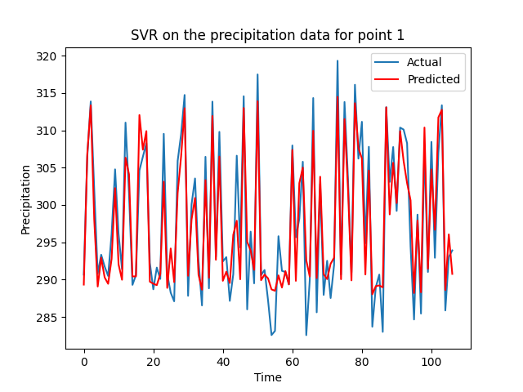
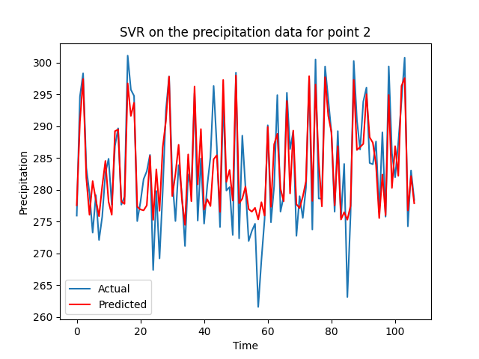
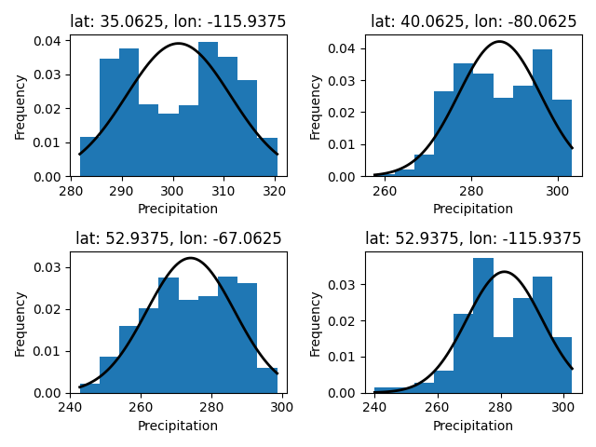
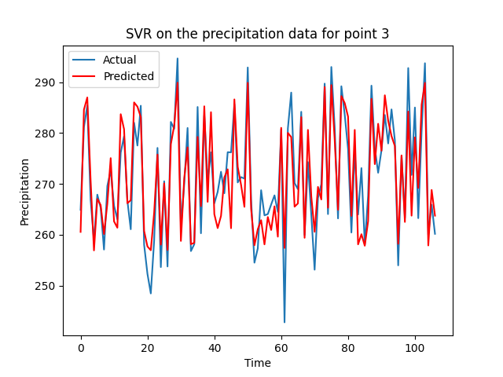
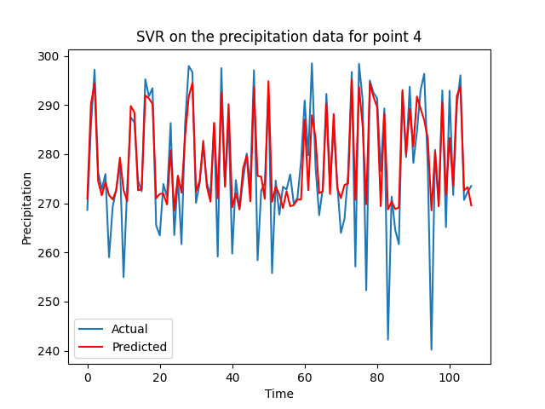
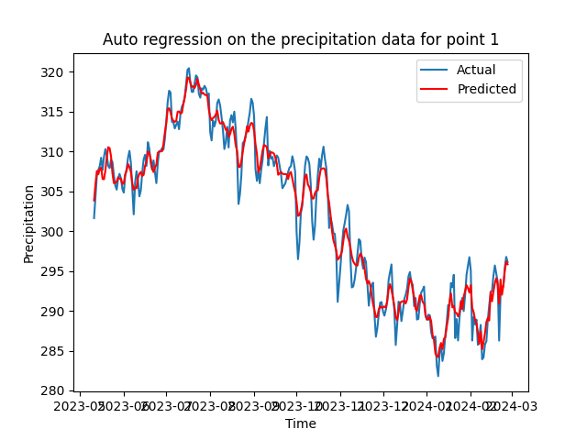
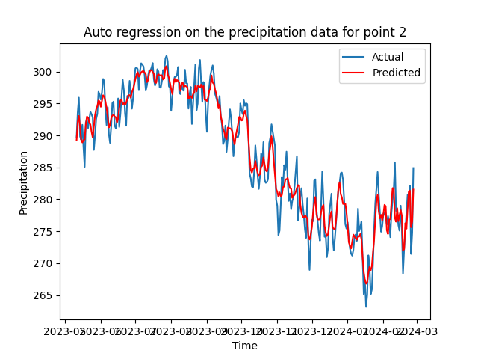
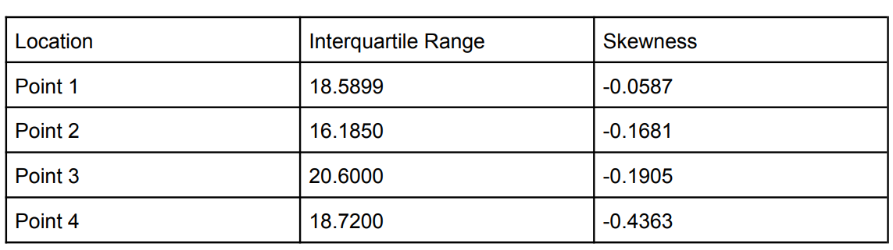
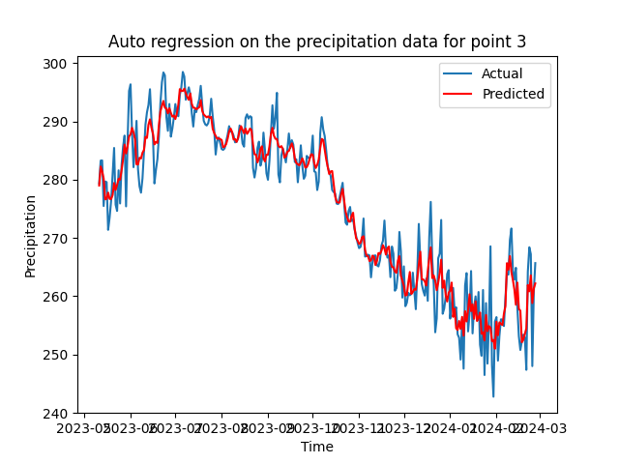
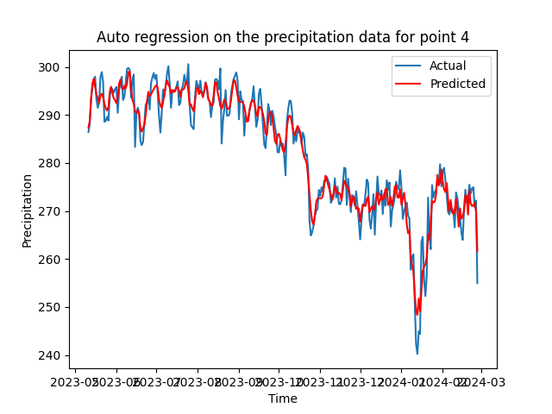
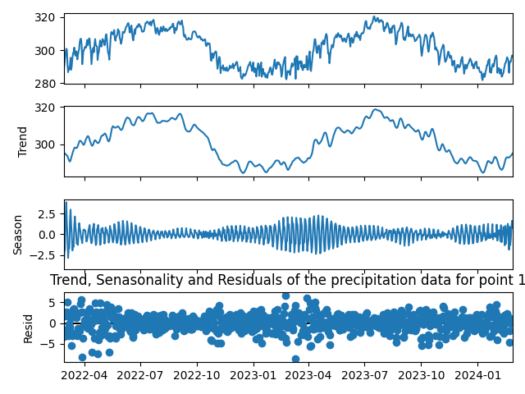
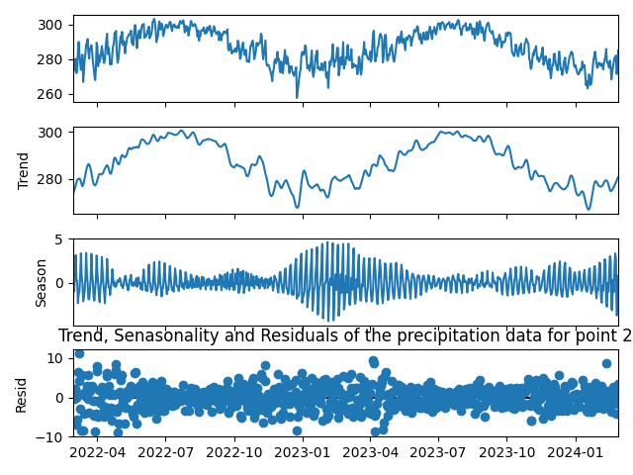
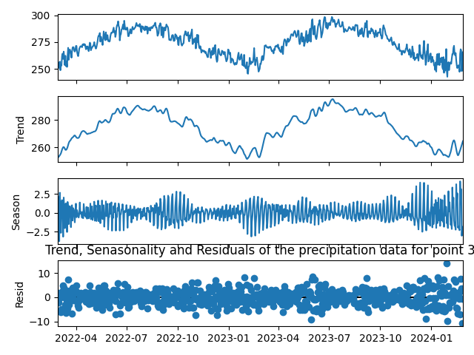
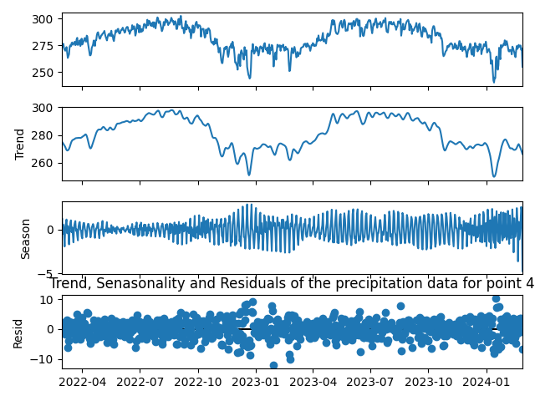
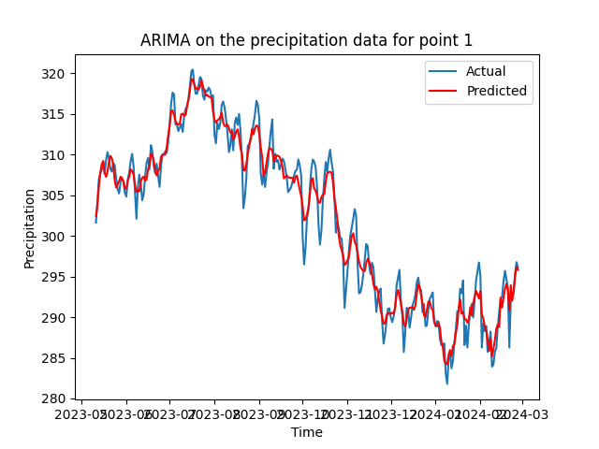
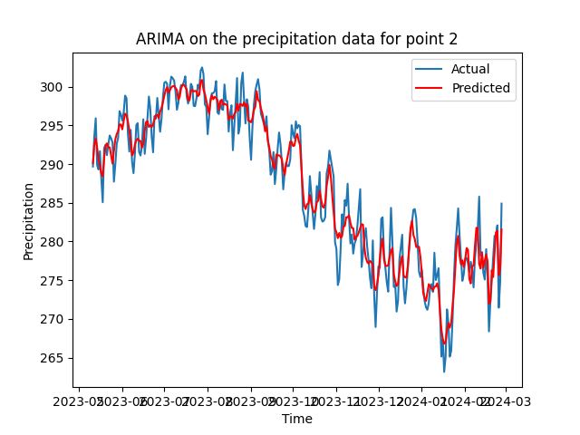
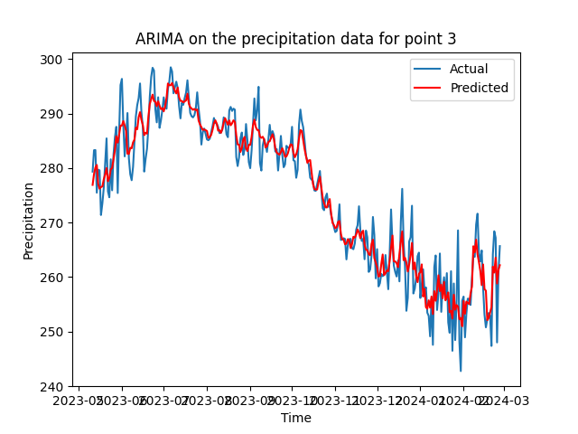
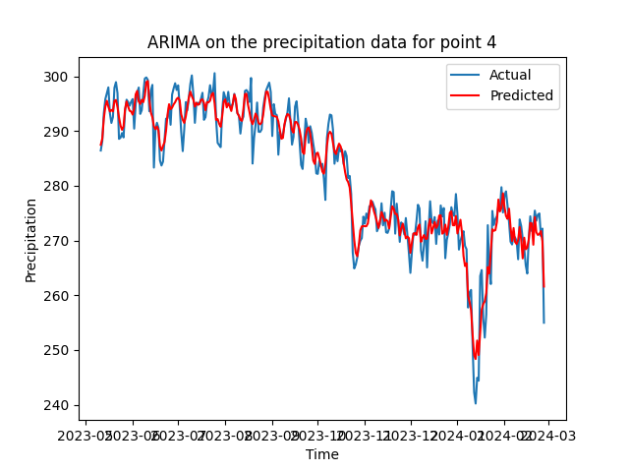
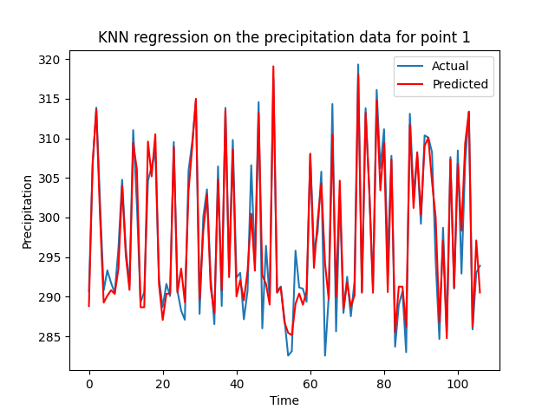
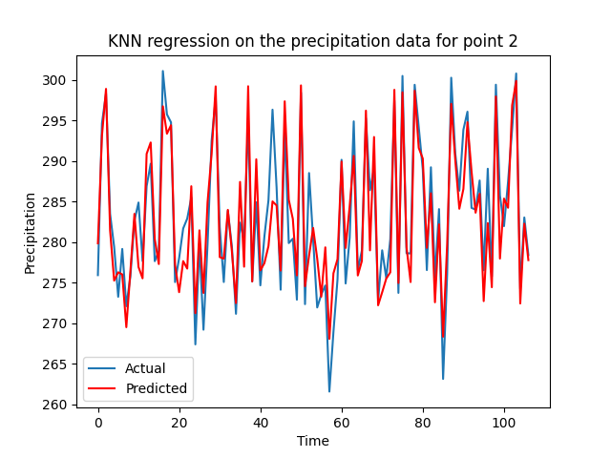
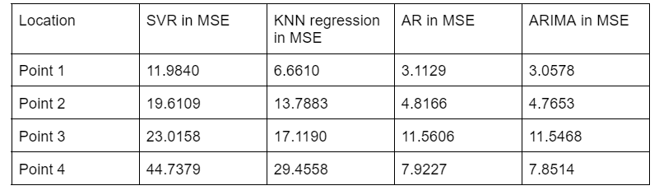
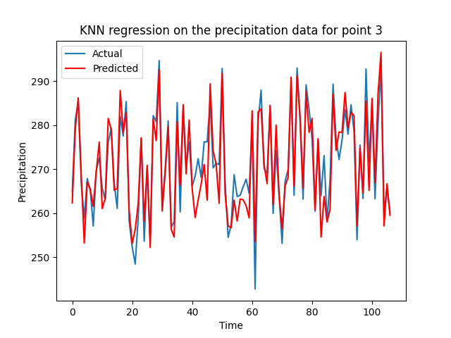
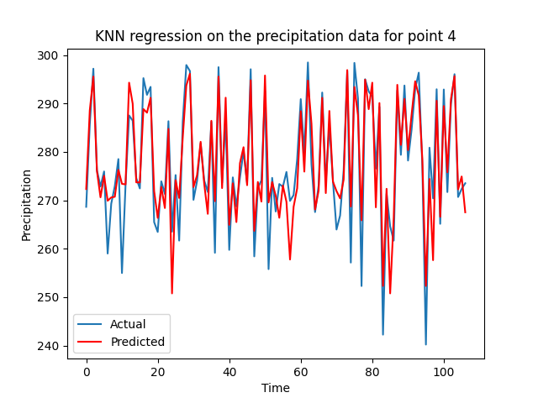

Analyzing and Forecasting Precipitation Patterns Using Time Series Analysis and Machine Learning Techniques
Ziyue Zhao and zhaoz10@rpi.edu
¹Rensselaer Polytechnic Institute, Tetherless World Constellation, Troy, NY, United States,
Abstract
Analysis Datasets
This research project leverages a synergistic approach, combining time series analysis with machine learning techniques, to unravel the complex dynamics of precipitation across diverse geographic locations. The core objective is to develop predictive models capable of capturing the nuanced patterns of precipitation with an eye towards application in agricultural planning, water resource management, and climate change adaptation strategies.
Key statistical models like ARIMA provide a deep dive into time-dependent patterns, while machine learning models such as Support Vector Regression (SVR) and k-Nearest Neighbors (k-NN) offer a flexible framework to handle the non-linear and stochastic nature of weather phenomena. The thoughtful application of these models, complemented by a meticulous process of hyperparameter optimization, allows for the distillation of insightful forecasts from complex data.
1. small analysis:
A. Read data form grb and save to csv files
B. Plot the original precipitation data
C. Plot the histgram for each points
D. Claculate the IQR and skewness for each point
E. Plot the Trend, seasonality, and resid about datas
use: from statsmodels.tsa.seasonal import STL
2.Use k-Nearest Neighbors (k-NN) :
use: from sklearn.neighbors
import KNeighborsRegressor
A. split the original data to test and train data
B. only 100 points on testing data
C. plot k-NN graph
3.Use Support Vector Regression (SVR) Model :
use: from sklearn.svm import SVR
A. split the original data to test and train data
B. only 100 points on testing data
C. plot SVR graph
histgram for precipitation about point 1
histgram for precipitation about point 2
histgram for precipitation about point 3
histgram for precipitation about point 4
3.Use AutoRegression (AR) Model :
use: from statsmodels.tsa.ar_model import AutoReg
A. split the original data to test and train data
B. 60% data in original data, 40% data in train data
C. plot AR graphs
Problem Area
The research aims to harness advanced statistical methods and machine learning techniques to predict precipitation, a vital component influencing agriculture and water resources affected by climate variability and change.
Data Description
- Source: The precipitation data was obtained from NLDAS Primary Forcing Data L4 Hourly 0.125 x 0.125 degree V002.
- Selection Criteria: Geographic diversity, continuity of daily data, and data quality.
- Exploratory Data Analysis: Initial visual assessment of trends, seasonality, outliers, and distribution..
4.Use AutoRegressive Integrated Moving Average (ARIMA) Model :
use: from statsmodels.tsa.arima.model
import ARIMA
Methodology
- Statistical Tests: Used to confirm the non-normal distribution and stationarity of the data.
- Models Applied: Support Vector Regression (SVR), k-Nearest Neighbors (k-NN), AutoRegression (AR), and ARIMA.
- Techniques and Tools: `scikit-learn`, `statsmodels`, `NumPy`, `pandas`, and `matplotlib`.
The Principles
Compare
- Point 1: Latitude 35.0625,
Longitude -115.9375
- Point 2: Latitude 40.0625,
Longitude -80.0625
- Point 3: Latitude 52.9375,
Longitude -67.0625
- Point 4: Latitude 52.9375,
Longitude -115.9375
The coner points for the dataset.
Conclution
This study's integrated application of time series analysis and machine learning has yielded a suite of models that effectively predict precipitation patterns across varied geographies. While each model—SVR, k-NN, AR, and ARIMA—demonstrates unique strengths, the research indicates that an ensemble approach could capitalize on these individual capabilities for superior predictive performance. The findings underscore the potential of machine learning in meteorological forecasting, with profound implications for agricultural and environmental planning. Moving forward, incorporating additional climate variables and exploring advanced ensemble methods could further enhance the models' robustness and accuracy in the face of climatic variability.
Sponsors:
Resources:
1. Harris, C. R., Millman, K. J., van der Walt, S. J., et al. (2020). Array programming with NumPy. Nature, 585(7825), 357–362.
2. McKinney, W., et al. (2010). Data structures for statistical computing in Python. Proceedings of the 9th Python in Science Conference, 445.
3. Pedregosa, F., et al. (2011). Scikit-learn: Machine learning in Python. Journal of Machine Learning Research, 12(Oct), 2825-2830.
4. Hunter, J. D. (2007). Matplotlib: A 2D graphics environment. Computing in Science & Engineering, 9(3), 90-95.
5. Hyndman, R. J., & Athanasopoulos, G. (2018). Forecasting: principles and practice. OTexts.
6. Seabold, S., & Perktold, J. (2010). Statsmodels: Econometric and statistical modeling with Python. Proceedings of the 9th Python in Science Conference.
7.Marquez-Martin, D., Ruiz-Arias, J. A., Tovar-Pescador, J., Pozo-Vazquez, D., & Gueymard, C. (2013). Forecasting solar radiation using autoregressive models in Almería, Southern Spain. arXiv preprint arXiv:1302.6613.
8.Olofsson, T., & Johannesson, M. (2018). Evaluation of Machine Learning Models for Short-Term Wind Power Forecasting. DiVA Portal. Retrieved from https://www.diva-portal.org/smash/get/diva2:1266336/FULLTEXT01.pdf

