Slide 1
Industrial Computing Design Project 3 - DES371S
Title of Project: SDN-Based Device Programming Using YANG Model and Languages, YANG-Based Network Automation & Configuration using NETCONF/RESTCONF.
Student Initials and Surname: Y Hlohla
Student Number: 230540414
Lecturers: Dr A Brandt & Dr Ali Almaktoof
Supervisor: Dr A Brandt
Date of Evaluation: 30 October 2025

Slide 2
Outline
1. Introduction
2. Project Objectives
3. System Design
4. Methodology
5. Management (GA 11)
6. Conclusion

Slide 3
1. Introduction
SDN-powered automation for responsive and scalable infrastructure
Motivation
Manual Configuration: Time-consuming, Error-Prone, Hard to Scale
CLI: Inconsistent, Lacks Automation
Model-Driven Control
Key Value Proposition
YANG Models: Structured, Vendor-Neutral Configurations
NETCONF/RESTCONF: Automated Device Programming
SDN Coordination: Flexible and Scalable Management Solutions

Slide 4
2. Project Objectives
Core Objectives:
OpenDaylight SDN controller for central management.
Employ NETCONF/RESTCONF protocols.
Implement and validate YANG models.

Slide 5
3. System Design
Frontend Layer
YANG Model Definition & Configuration Workflow
Backend Layer
SDN Controller, Protocol Engines (NETCONF/RESTCONF)
Hardware Layer
Virtual Routers(e.g., CSR1000v requires Cisco IOS-XE) for Testing and Deployment

Slide 6
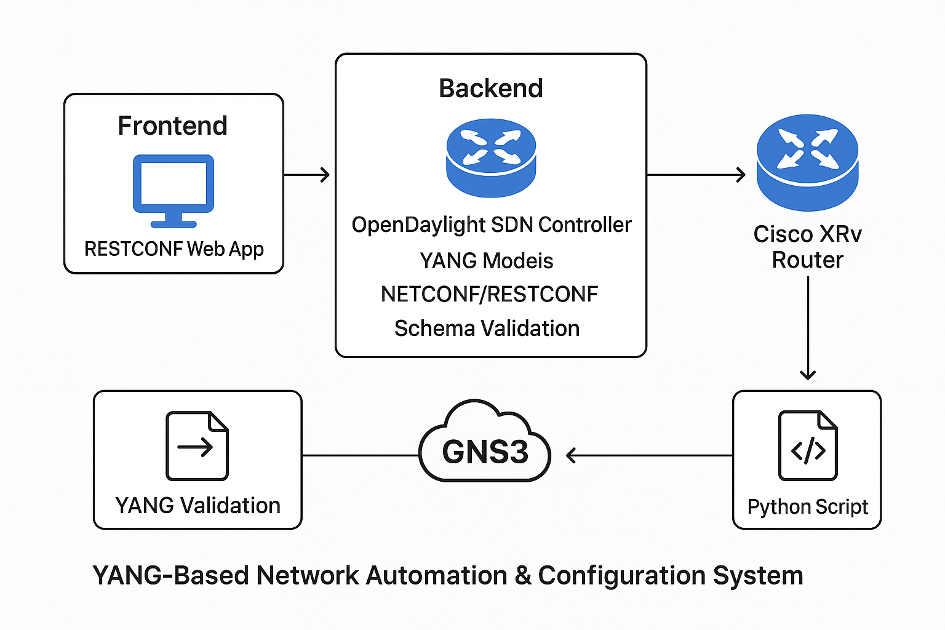

Slide 7
4. Methodology
Design: Define YANG models.
Validate: Use pyang.
Integrate: Load models into OpenDaylight
Deploy: Push configs to Cisco XRv routers.

Slide 8
6. Management (GA 11)
6.1 Proposal:
Problem
Manual configuration issues
Lack of centralized control limits scalability and consistency in SDN environments
Plan
Implement model-driven automation using YANG data models
Use NETCONF/RESTCONF protocols for structured device configuration
Deploy configurations via a central SDN controller
Expected Outcomes
Accelerated deployment and maintenance of network devices
Faster deployment cycles with reduced manual overhead
Foundation for future multi-vendor automation integration

Slide 9
6. Management (GA 11)
6.2 Budget:
Software & Design
Fully open-source
No licensing or platform costs
Hardware Requirements
A standard computer is sufficient for virtual lab setup
Physical routers are optional and budgeted based on user preference
Estimated Cost
Virtual setup: R0
Physical devices: Variable (user-defined)

Slide 10
6. Management (GA 11)
6.3 Risk Analysis:
Project-Level Risks
Risks due to initial misdirection specifically.
This limitation leads of virtual routers.
Technology Decision Risks
A key decision point involved choosing between Yang Suite and the OpenDaylight approach.
Opting for OpenDaylight introduced risks due to:
Limited functionality
Dependency on external sources before full utilization

Slide 11
6. Management (GA 11)
6.4 Time and Change Management:
Phase | Duration | Description
Phase 1: Theoretical Understanding | Months 1–3 | Deep dive into core concepts and protocols
Phase 2: Simulation Testing | Months 3-7 | Setup and validation of virtual environments
Phase 3: Full Testing | Months 7-9 | Comprehensive testing with real devices

Slide 12
6. Management (GA 11)
6.5 Quality Assurance:
Accuracy: 100% config match with YANG.
Protocol Compliance: Standard IETF protocols.
Efficiency: Reduced configuration time.

Slide 13
6. Management (GA 11)
6.6 Economics Principles:
Short-Term Cost
Development & integration effort
Tooling and setup (e.g., ODL, YANG models)
Long-Term Value
Reduced config errors
Operational efficiency
Positive return on investment
Principles Applied
Cost-benefit analysis
Return on investment modeling
Net present value positive
Impact
Scalable across devices
Financially sustainable

Slide 14
6. Management (GA 11)
6.7 Evaluation of Project Outcomes:
What has been done so far:
Tested communication devices
Implemented NETCONF and
RESTCONF
Conduct end-to-end testing from the
application
What’s next:
Develop a web-based application
Demonstration of the project

Slide 15
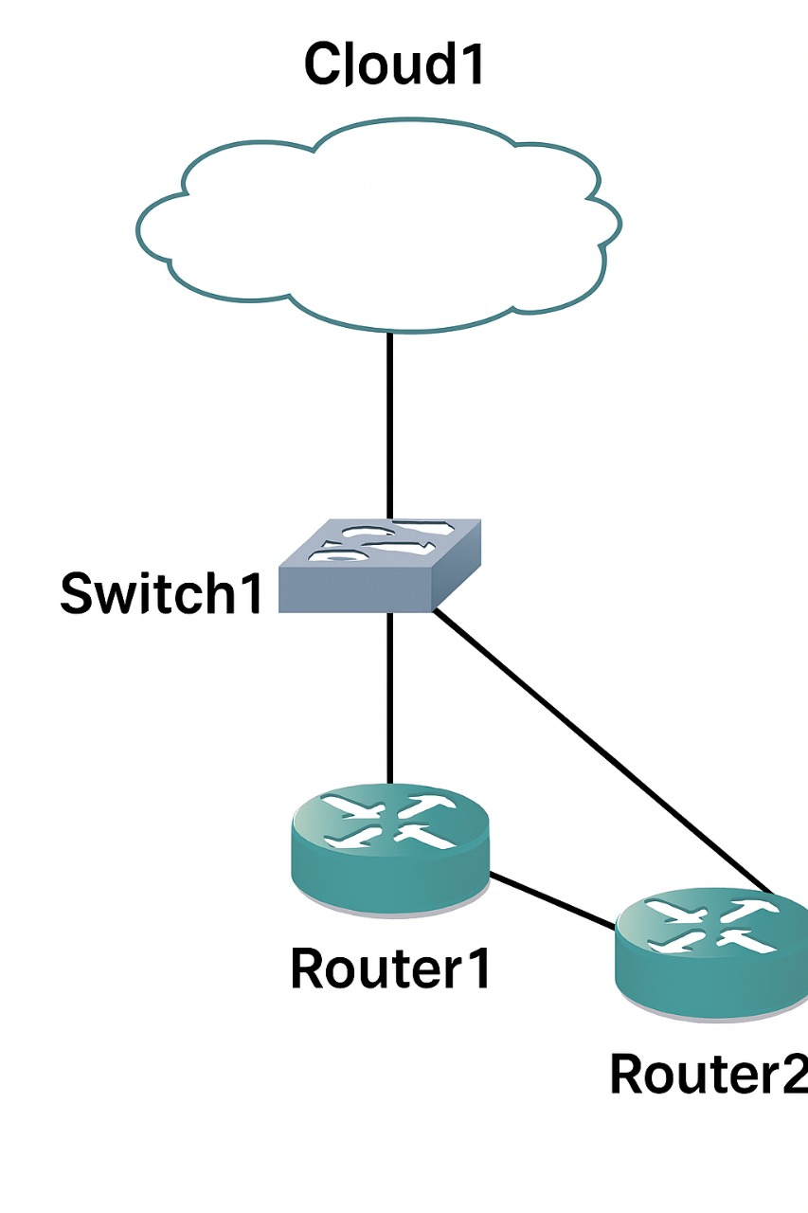
GNS3 Topology view

Slide 16
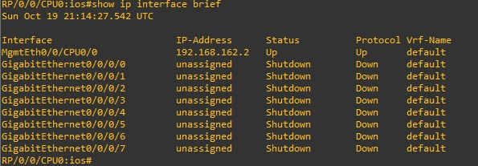
Router Interfaces before full yang, Netconf(xml) and python execution:

Slide 17
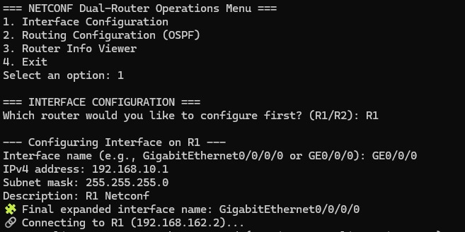
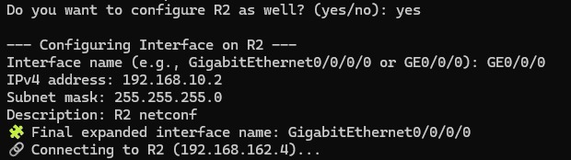
Router Interfaces during full yang, Netconf(xml) and python execution:

Slide 18
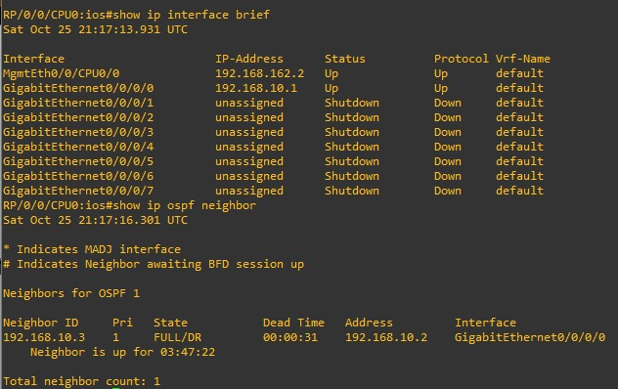
Router Interfaces after full yang, Netconf(xml) and python execution:

Slide 19
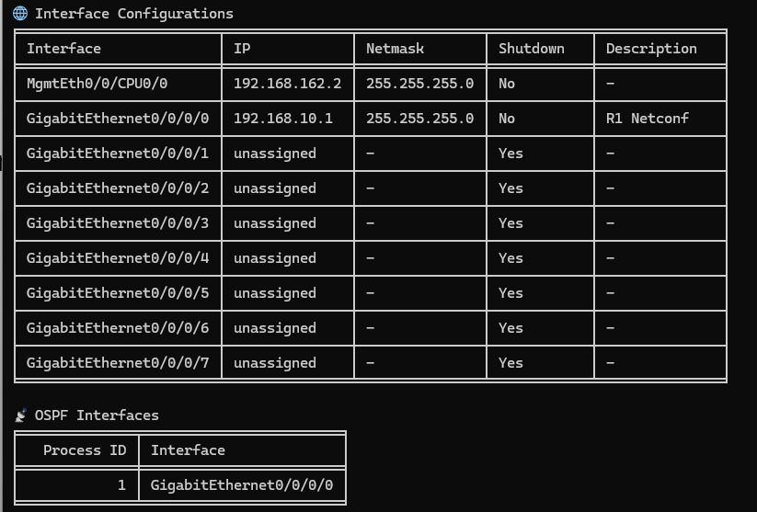
Router Interfaces after full yang, Netconf(xml) and python execution, shown on the application which is option 3

Slide 20
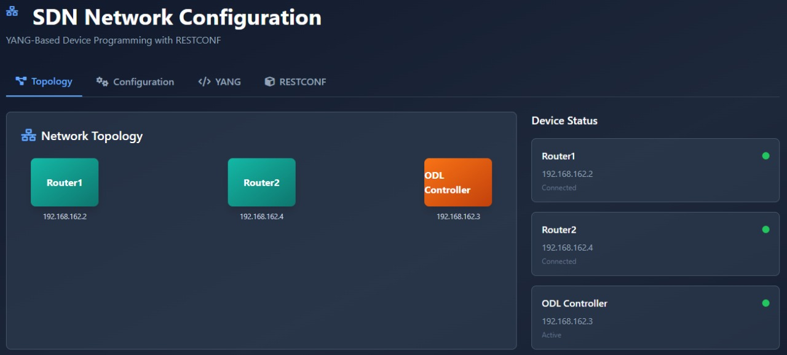
RESTCONF YANG BASED APPLICATION

Slide 21
7. Conclusion
Accomplishments: The project is yet successful implemented
Key Learnings: The project highlights the importance of data modelling, the challenges of tool capabilities and the value of adaptability in overcoming technical hurdles.
Relevance: This work demonstrates how modern network automation improves consistency and is important for scalable network management.

Slide 22
Thank you and Questions

