Slide 1

MACHINE LEARNING-BASED SOLUTION OF SIMPLE QUANTUM PROBLEMS
Inż. Jakub Grabowski
Big Data Analytics
Supervisor:
prof. dr hab. Maciej Maśka

Slide 2
Quantum Many-Body Systems
Neural Networks and Restricted Boltzmann Machines
Metropolis Algorithm
Variational Monte Carlo and Penalty-Based VMC
Overview of JAX and Flax
Constructing Hamiltonians and Algorithms in NetKet
Discussing the results
Introduction

Slide 3
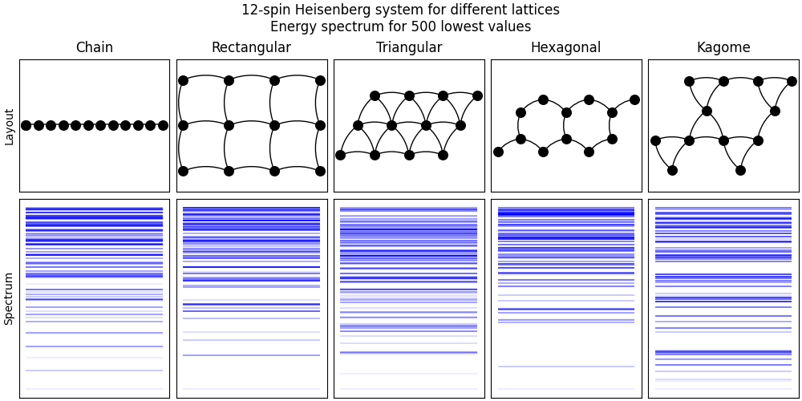

Quantum Many-Body Systems
Multiple interacting particles placed on a lattice
Collectively they exhibit phenomena such as quantum phase transitions, particularly ferromagnetic-antiferromagnetic phase.
The Hilbert space of these systems grows exponentially, which allows to solve them numerically up to 30 spins
Many models have been established so far, such as Ising, XY, Heisenberg or Kitaev
Heisenberg Model
$$\hat{H}=−J \sum_{\left\langle i, j\right\rangle }{\left({\hat{S}}_{i}^{x}{\hat{S}}_{j}^{x}+{\hat{S}}_{i}^{y}{\hat{S}}_{j}^{y}+{\hat{S}}_{i}^{z}{\hat{S}}_{j}^{z}\right)}$$

Slide 4
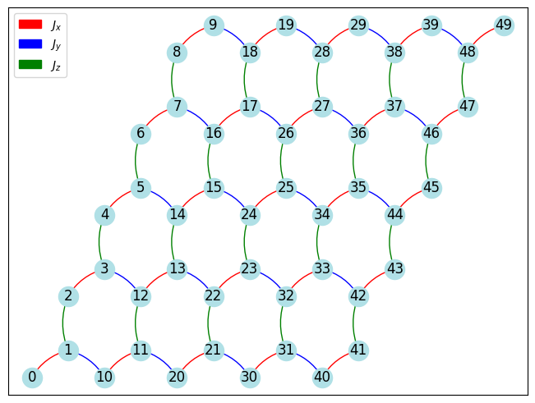

Kitaev Model
$$\hat{H}=−J_{x}\sum_{{\left\langle i, j\right\rangle }_{x}}{{\hat{S}}_{i}^{x}{\hat{S}}_{j}^{x}−J_{y}\sum_{{\left\langle i, j\right\rangle }_{y}}{{\hat{S}}_{i}^{y}{\hat{S}}_{j}^{y}}−J_{z}\sum_{{\left\langle i, j\right\rangle }_{z}}{{\hat{S}}_{i}^{z}{\hat{S}}_{j}^{z}}}$$
Involves bond-dependent interactions with three distinct types of coupling, which makes the model highly anisotropic
Exactly solvable by involving conserved plaquette operators and mapping spins into Majorana fermions
The model can exhibit a spin liquid phase characterized by the absence of long-range magnetic order, even at zero temperature

Slide 5
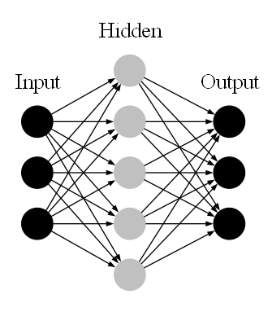
Neural Networks
NN are computational models consisting of interconnected layers of neurons
NNs can learn complex mappings between inputs and outputs through training
Here we mainly focus on unsupervised learning, where the model is trained on unlabeled data
The goal is to uncover hidden patters or features in the data
In quantum systems NNs replace the quantum wave function

Slide 6
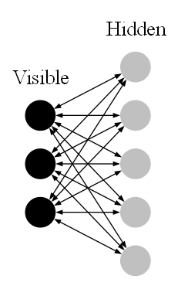
Restricted Boltzmann Machine
It is a type of energy-based neural network for unsupervised learning
Visible layer represents the input data, while hidden layer tries to capture higher-order correlations
There are no connections within the same layer, that is why the Boltzmann Machine is restricted
The goal is to model the probability distribution of the input data by minimizing the Energy of the system
In quantum systems, RBMs are used as the wave function Ansatz, which means that the true wave function is replaced by a simpler structure
RBMs can be extended into many hidden layers, which makes it a Deep Boltzmann Machine (DBM)

Slide 7



Metropolis Algorithm
It is a widely-used Markov Chain Monte Carlo method used to simulate complex probability distributions
Start with an initial random configuration of spins for a given system size and create its wave function
Propose a new configuration, it can be a random spin flip, for example
Calculate the Acceptance Probability
Generate a random numer between 0 and 1. If it is lower than Acceptance Probability, accept the change
Collect all configurations and use them to estimate the Energy of the system
$$E_{VMC}= \frac{1}{N}\sum_{i=1}^{N}{E_{local}\left(x_{i}\right)}$$
$$E_{local}\left(x\right)= \frac{\hat{H}ψ_{θ}\left(x\right)}{ψ_{θ}\left(x\right)}$$
$$A\left(x_{new} | x_{old}\right)=\min\left(1, \frac{{\left|ψ_{θ}\left(x_{new}\right)\right|}^{2}}{{\left|ψ_{θ}\left(x_{old}\right)\right|}^{2}}\right)$$

Slide 8
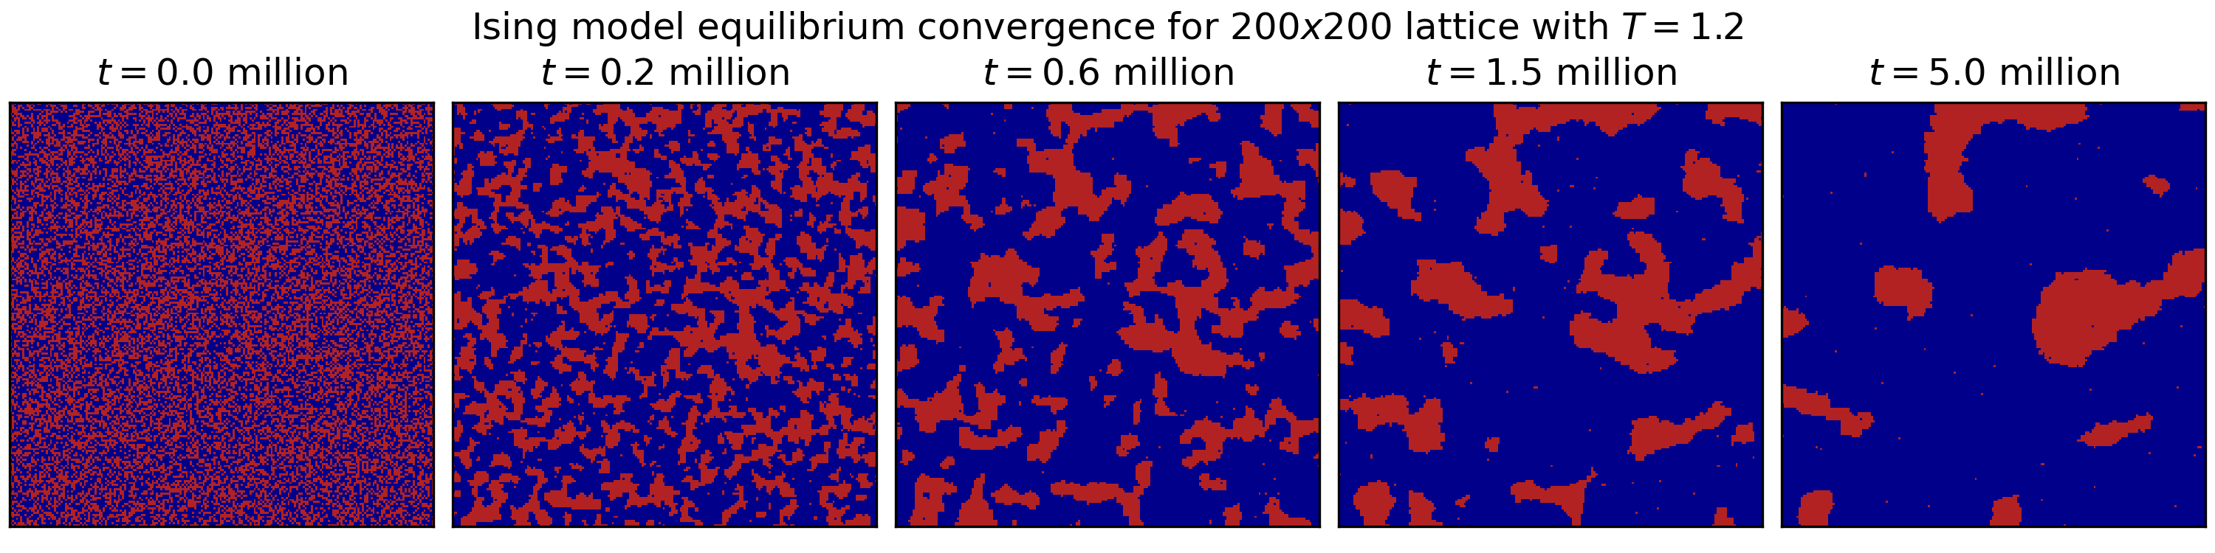
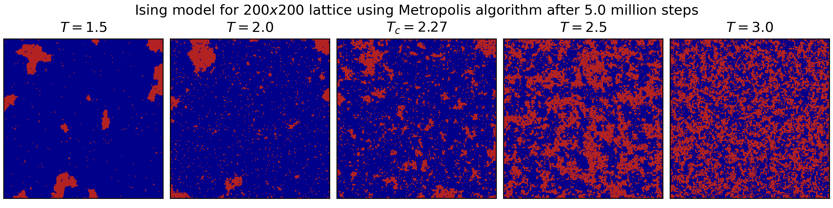
Metropolis Algorithm

Slide 9
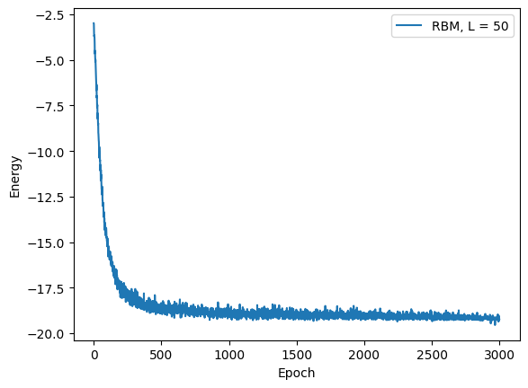

Variational Monte Carlo
$$E_{var}\left(x\right)= \frac{\left\langle ψ_{θ}\left(x\right) | \hat{H} | ψ_{θ}\left(x\right)\right\rangle }{\left\langle ψ_{θ}\left(x\right) | ψ_{θ}\left(x\right)\right\rangle }$$
Choose the wave function Ansatz and all necessary hyperparameters
Perform Monte Carlo sampling using Metropolis algorithm
Approximate total Energy of the system by averaging all local energies from MC sampling
Evaluate the gradients with respect to all parameters of the Ansatz
Use Stochastic Reconfiguration as a form of regularization
Update Ansatz parameters with an optimization algorithm, such as SGD
Repeat steps 2-6 for a given number of epochs, then evaluate the model

Slide 10
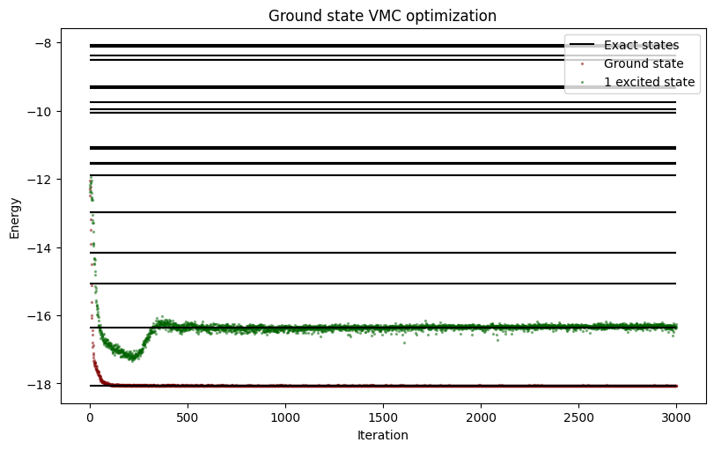


Penalty-Based Variational Monte Carlo
Works by incorporating a penalty term into the Hamiltonian. It informs about the overlap of previous eigenstates and tries to minimize it as well.
$${\hat{H}}_{n}\left(W\right)= {\hat{H}}_{0}+ \sum_{j=0}^{n−1}{β_{j}\frac{\left|\left.ψ_{j}\right\rangle \right.\left\langle \left.ψ_{j}\right|\right.}{\left\langle ψ_{j} | ψ_{j}\right\rangle }}$$
$$E_{n}\left(W\right)= \frac{\left\langle W | \hat{H} | W\right\rangle }{\left\langle W | W\right\rangle }+ \sum_{j=0}^{n−1}{β_{j}}\frac{\left\langle W | ψ_{j}\right\rangle \left\langle ψ_{j} | W\right\rangle }{\left\langle W | W\right\rangle \left\langle ψ_{j} | ψ_{j}\right\rangle }$$

Slide 11
Programming tools
JAX:
It is a Python library designed for high-performance numerical computing
Syntax similar to NumPy with additional features
Uses automatic differentiation, which computes gradients of funtions with respect to its inputs
Supports just-in-time (JIT) compilation, which transforms Python code into Mchine code stored in cache memory
Supports paralel computation, which allows to run computations more efficiently using GPU or TPU
Flax:
It is a neural network library built on top of JAX, providing flexibility to design efficient models
Promotes functional programming paradigm, which makes development highly modular and reusable
Wide compatibility with other libraries for optimization algorithms, such as Optax
Efficient parameter management, where neural network parameters are passed explicitly into other functions

Slide 12
NetKet – ML toolbox for quantum systems
Integrated with JAX and Flax to provide efficient and powerful computation. It also allows to implement custom algorithms and neural networks.
Provides built-in tools for efficient Monte Carlo sampling, including Metropolis algorithm and automatic gradient estimation
Efficient way of creating Operators and Hamiltonians
Built-in RBMs, convolutional and autoregressive neural networks
Built-in tools for creating Hilbert spaces, such as spins, fermions or Fock states
Built-in tools for creating custom Lattices, including 3D cells for solid state physics
Built-in drivers for VMC optimization and dynamics simulation using t-DVP algorithm
High modularity allowing for custom implementations of all elements mentioned before
Open-source with growing community developing the library

Slide 13
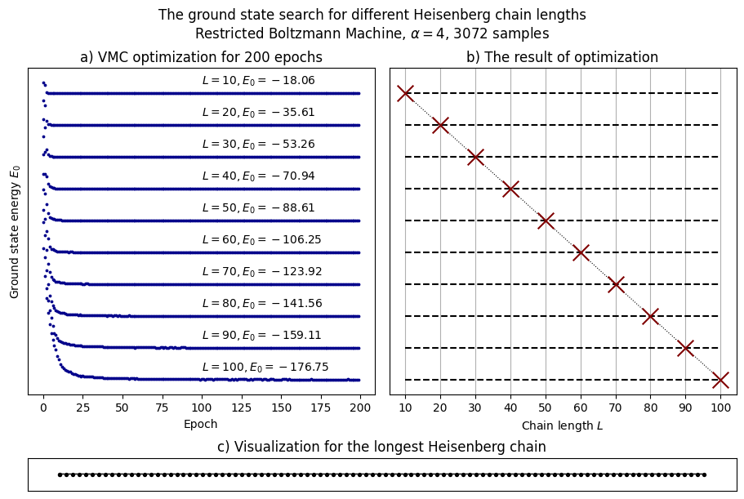
How many spins can we simulate?

Slide 14
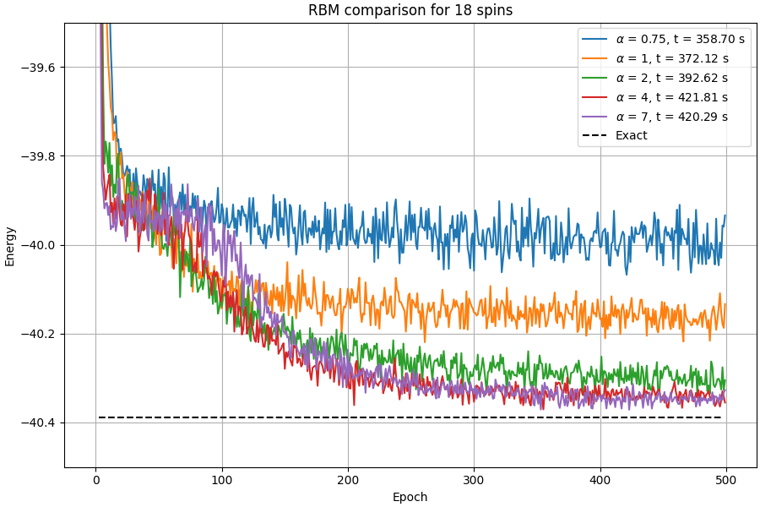
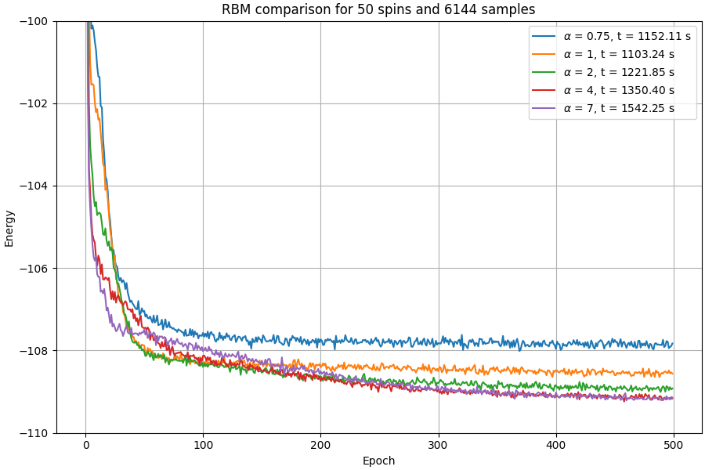
RBM Optimizations

Slide 15
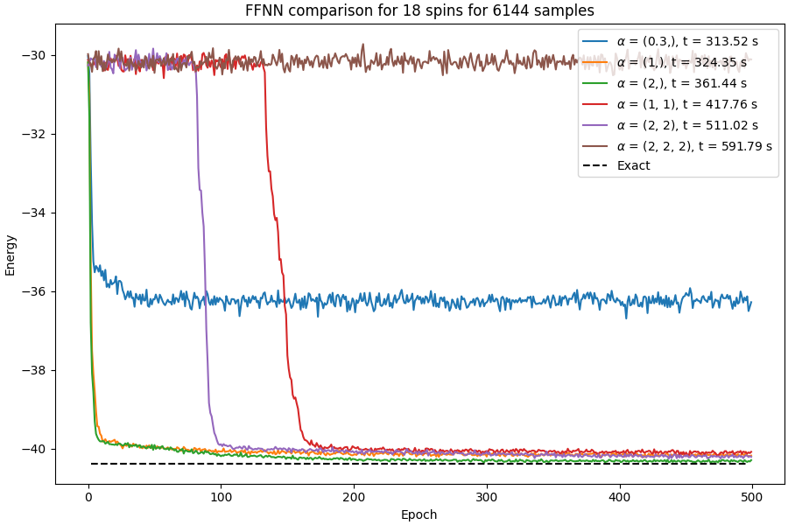
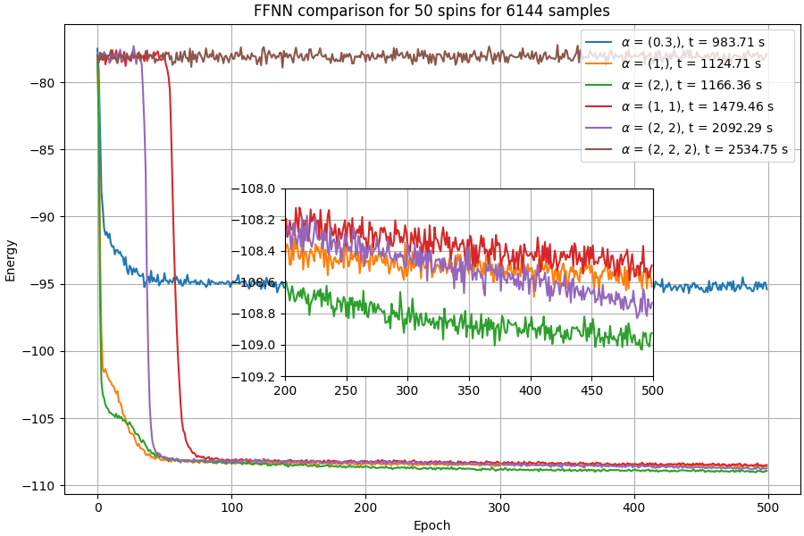
DBM optimizations

Slide 16
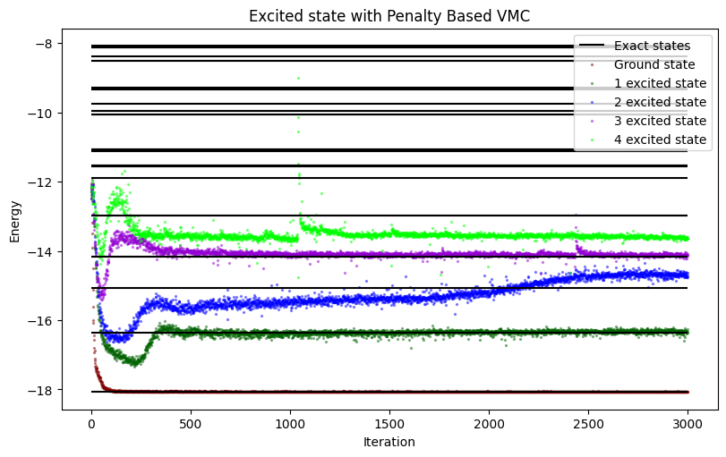
Attempt to find excited states

Slide 17
Finding phase transitions in the function of magnetic field for Ising or XY model
Reconstructing Kitaev phase diagram
Simulating dynamics of the system, such as magnetization
Further goals

Slide 18
Thank you for your attention!
All graphics presented in the presentation where created by the autor

