Slide 1
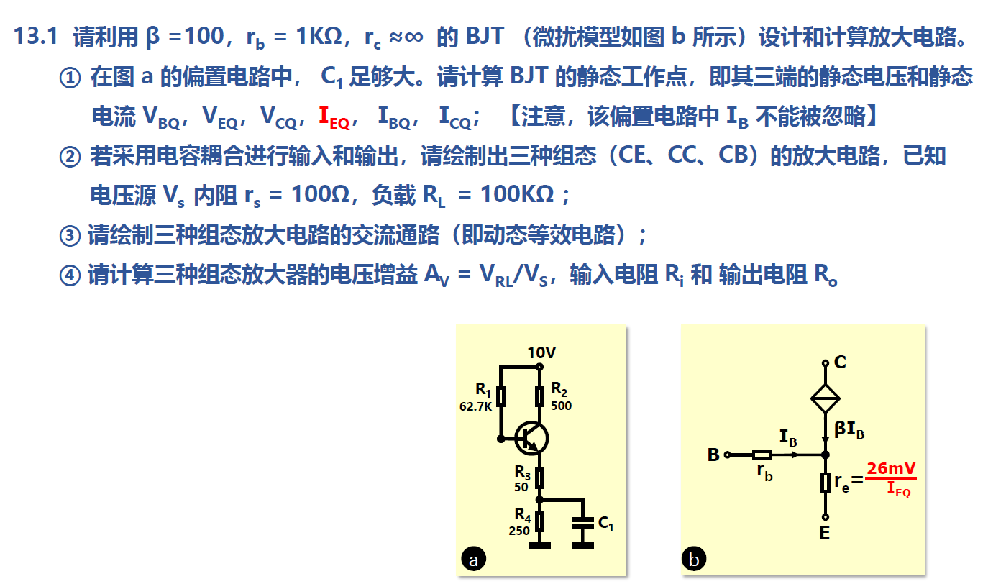

Slide 2
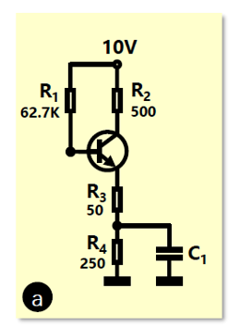

静态工作点->直流状态的计算
交流电压源置零，电容断路，电感短路
已知VBE≈0.7V
对$e点kvl得\frac{10−I_{B}R_{1}−0.7}{R_{3}+R_{4}}=\left(1+β\right)I_{B}$
可得
I_{BQ}=100μA
I_{CQ}=β*IB=10mA
I_{EQ}=(1+β)*IB=10.1mA
V_{CQ}=10V-R2*Ic=5V
V_{BQ}=10V-R1*IB=3.73V
V_{EQ}=3.03V

Slide 3
10V
CE
R1
R2
RL
R3
r_{s}
V_{s}
R4

Slide 4
CC
10V
R1
R2
r_{s}
R3
RL
V_{s}
R4

Slide 5
CB
10V
R1
R2
R3
RL
r_{s}
R4
V_{s}

Slide 6
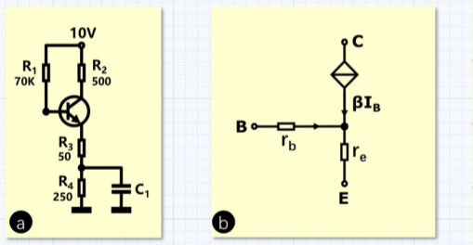
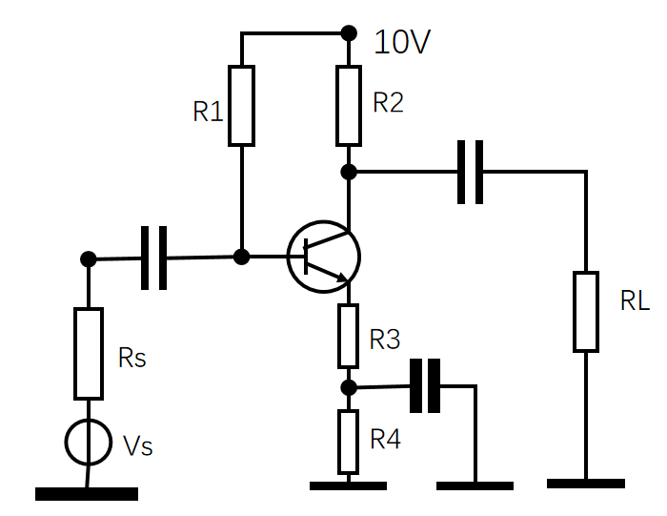
交流通路->电容短路，电感断路，直流源置零
CE
βIb
rb
re
Rs
R1
R2
RL
Vs
R3

Slide 7
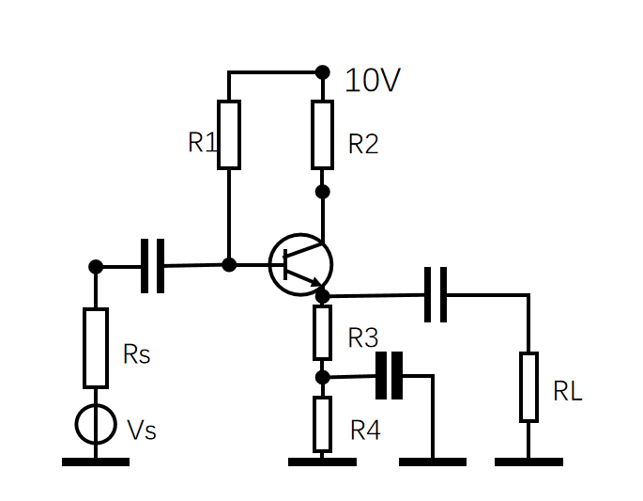
CC
βIb
rb
re
Rs
R1
R2
Vs
R3
RL

Slide 8
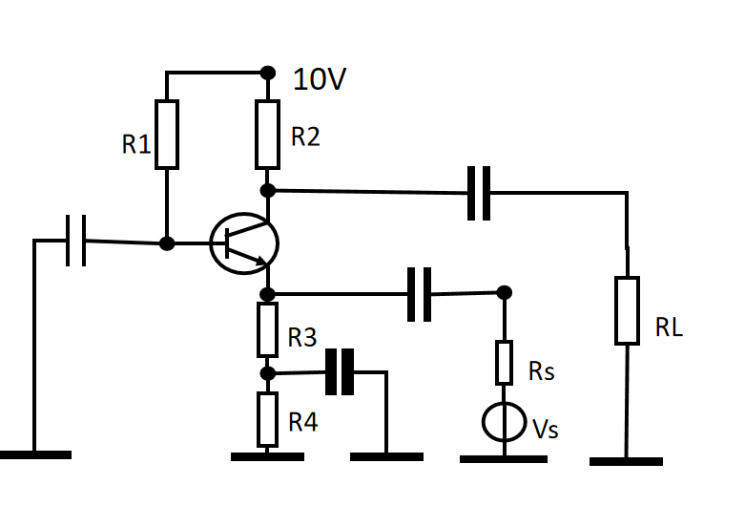
CB
rb
βIb
re
Rs
R2
RL
R3
Vs

Slide 9
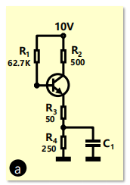


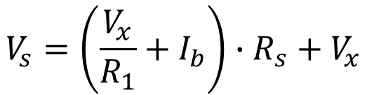


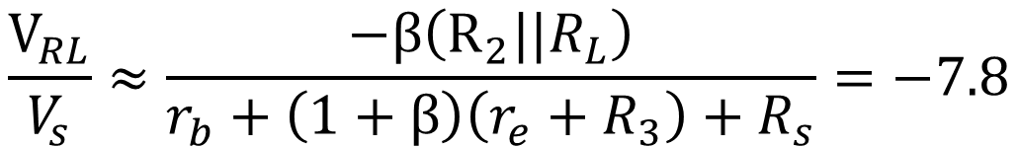
$$r_{e}=\frac{26mV}{I_{EQ}}$$
βIb
rb
$$I_{b}∙r_{b}+\left(1+β\right)I_{b}∙\left(r_{e}+R_{3}\right)=V_{x}$$
Vx
re
Rs
$$V_{s}=\left(\frac{V_{x}}{R_{1}}+I_{b}\right)∙R_{s}+V_{x}$$
②
R1
①
R2
RL
Vs
R3
$$V_{RL}=−βI_{b}\left(R_{2}||R_{L}\right)$$
可得
$$\frac{V_{RL}}{V_{s}}≈\frac{−β\left(R_{2}||R_{L}\right)}{r_{b}+\left(1+β\right)\left(r_{e}+R_{3}\right)+R_{s}}=−7.8$$
CE

Slide 10

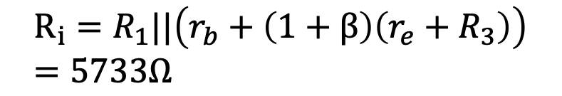
βIb
rb
$$R_{i}=R_{1}||\left(r_{b}+\left(1+β\right)\left(r_{e}+R_{3}\right)\right)=5733Ω$$
re
Rs
R1
R2
RL
Vs
R3
$$R_{o}=R_{2}=500Ω$$
CE

Slide 11

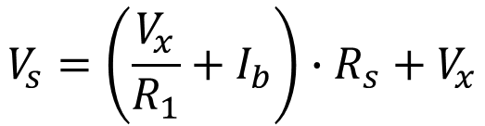
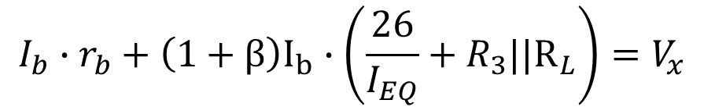
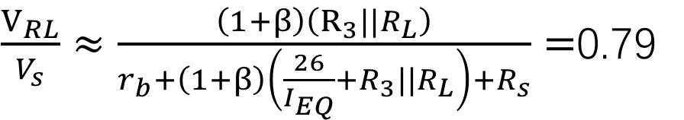
βIb
Vx
rb
$$I_{b}∙r_{b}+\left(1+β\right)I_{b}∙\left(\frac{26}{I_{EQ}}+R_{3}||R_{L}\right)=V_{x}$$
re
Rs
R2
$$V_{s}=\left(\frac{V_{x}}{R_{1}}+I_{b}\right)∙R_{s}+V_{x}$$
R1
Vs
R3
RL
$$V_{RL}=I_{b}\left(1+β\right)\left(R_{3}||R_{L}\right)$$
可得
$\frac{V_{RL}}{V_{s}}≈\frac{\left(1+β\right)\left(R_{3}||R_{L}\right)}{r_{b}+\left(1+β\right)\left(\frac{26}{I_{EQ}}+R_{3}||R_{L}\right)+R_{s}}=$0.79
CC

Slide 12
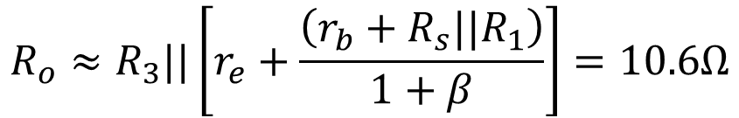
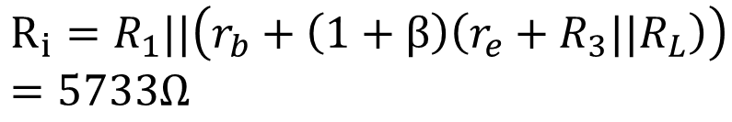
βIb
rb
$$R_{i}=R_{1}||\left(r_{b}+\left(1+β\right)\left(r_{e}+R_{3}||R_{L}\right)\right)=5733Ω$$
re
Rs
R2
$$R_{o}≈R_{3}||\left[r_{e}+\frac{\left(r_{b}+R_{s}||R_{1}\right)}{1+β}\right]=10.6Ω$$
R1
Vs
R3
RL
CC

Slide 13
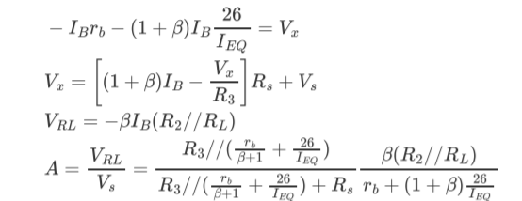
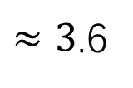
βIb
rb
①
re
Vx
②
Rs
R2
RL
R3
$≈3$.6
Vs
CB

Slide 14

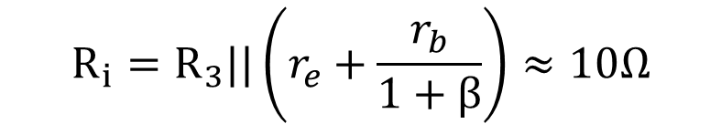
βIb
rb
$$R_{i}=R_{3}||\left(r_{e}+\frac{r_{b}}{1+β}\right)≈10Ω$$
re
$$R_{o}≈R_{2}=500Ω$$
RL
Rs
R2
R3
Vs
CB

Slide 15
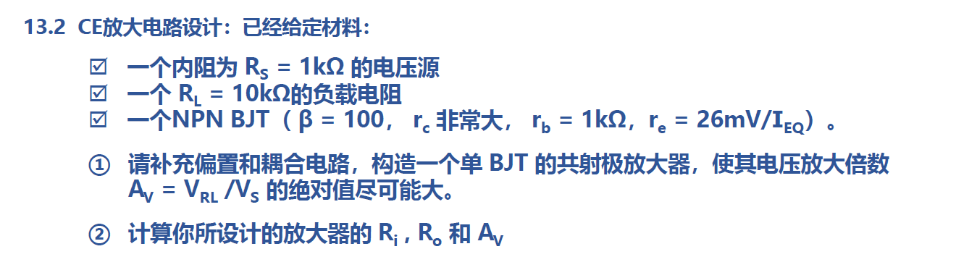

Slide 16
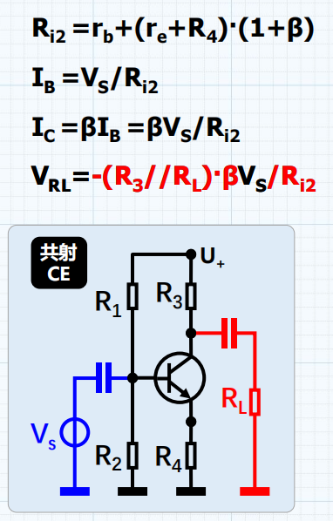

$$A=\frac{V_{RL}}{V_{s}}=−\frac{β(R_{3}//R_{L})}{r_{b}+(1+β)(r_{e}+R_{4})}$$
增加$R_{3}$，减小$R_{4}$：注意静态工作点满足要求（$V_{c}>V_{b}$）

Slide 17
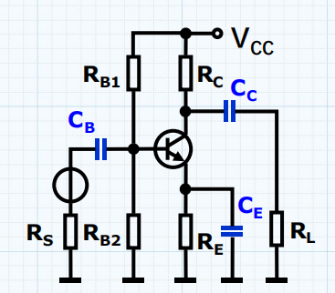

$$A=\frac{V_{RL}}{V_{s}}=−\frac{β(R_{3}//R_{L})}{r_{b}+(1+β)(r_{e}+R_{4})}$$
增加$R_{3}$，减小$R_{4}$：注意静态工作点满足要求（$V_{c}>V_{b}$）
增加电容$C_{1}$ （呈现高通性质）

Slide 18
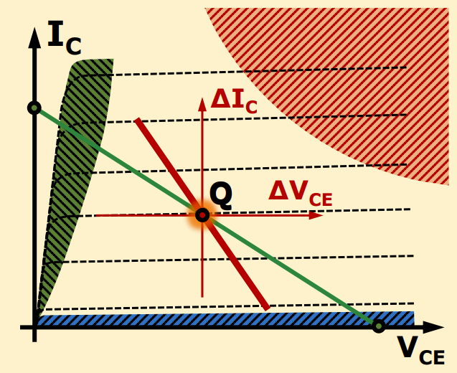
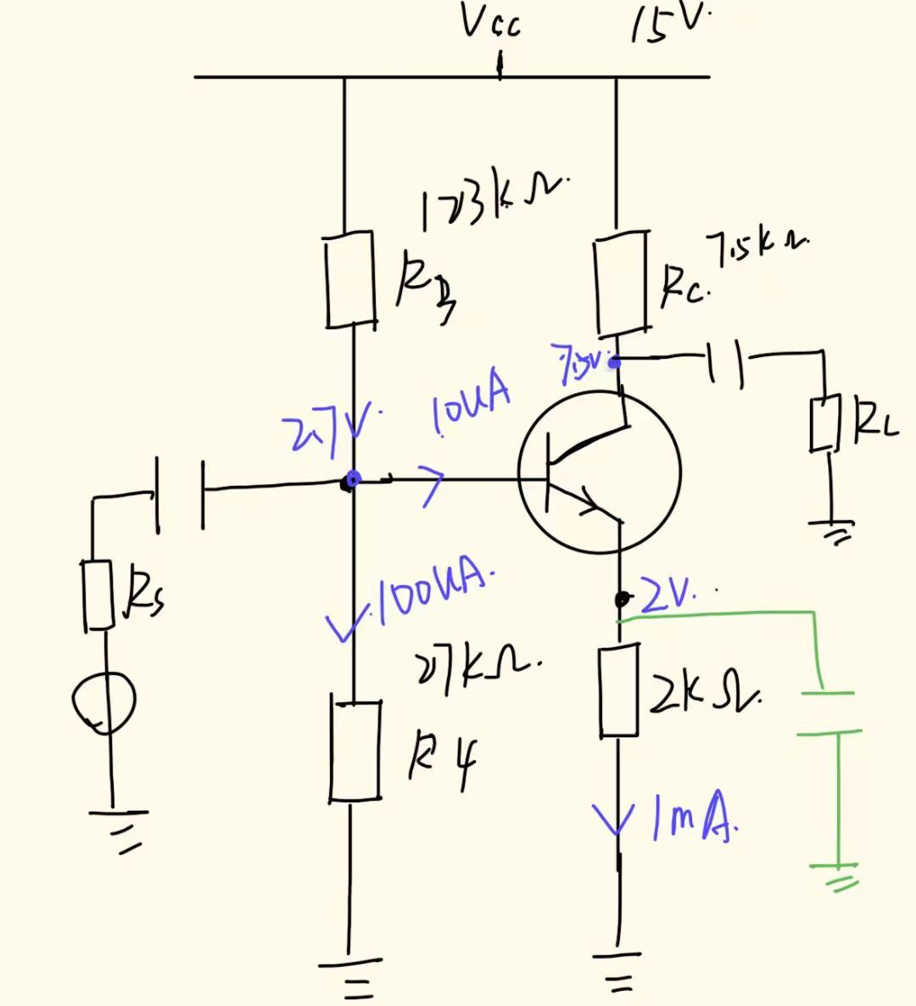
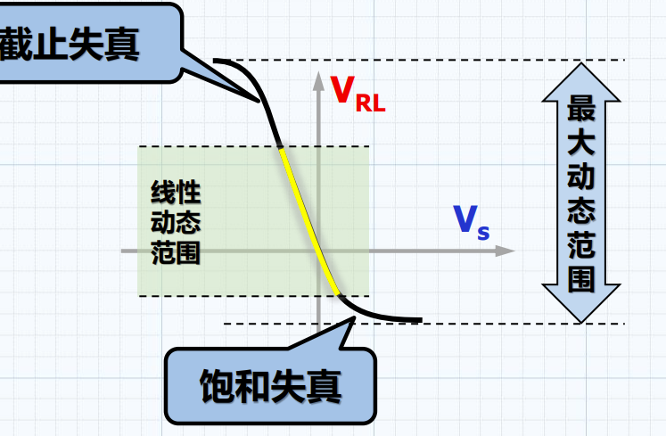
静态工作点的选择：
1.确定Vcc
2.线性放大区：Vb<Vc.Vbe=0.7（理想）
让动态范围最大化：选择中点。Vc=0.5Vcc
3.Ie=1mA（流控）
4.吸收温漂：Ve=2V
5.计算方便，Ib忽略，则IB>Ib至少一个数量级

Slide 19
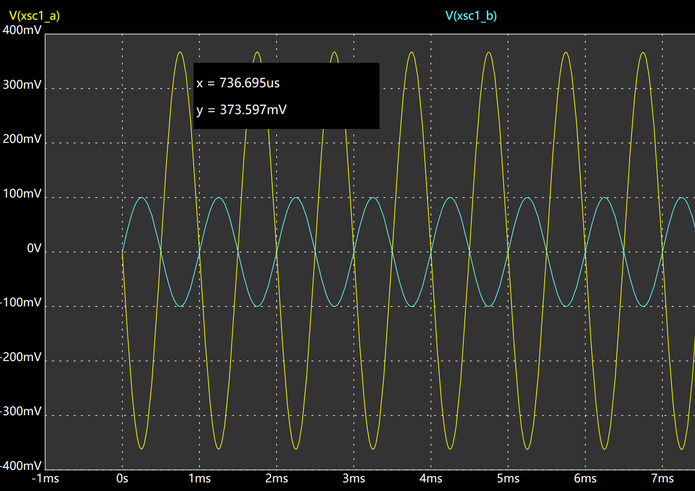
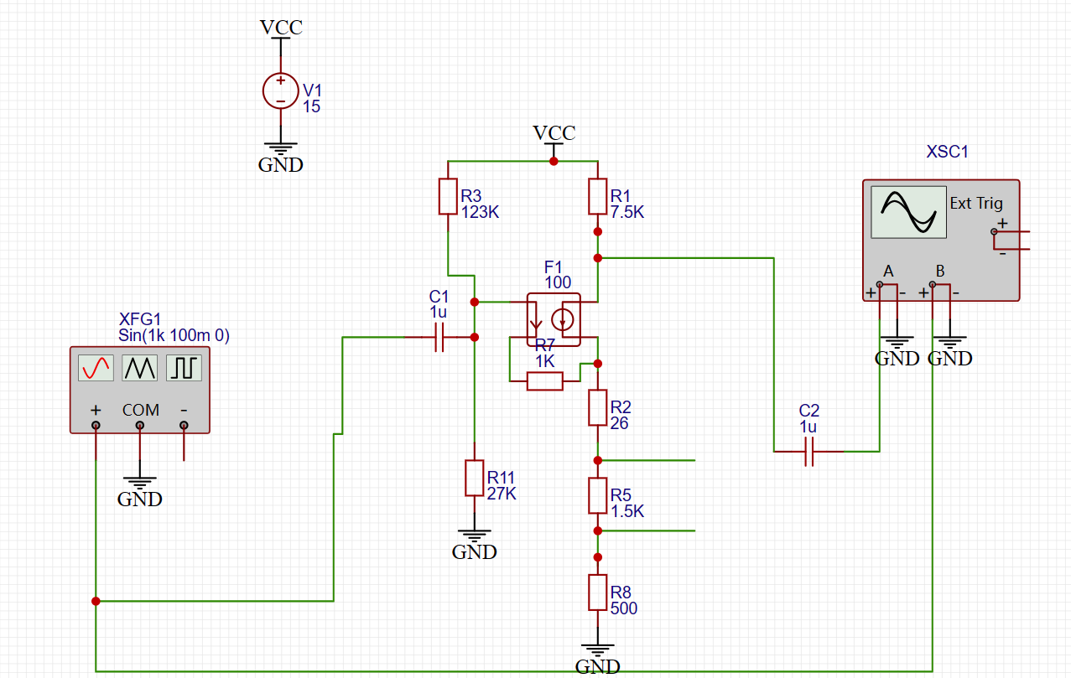
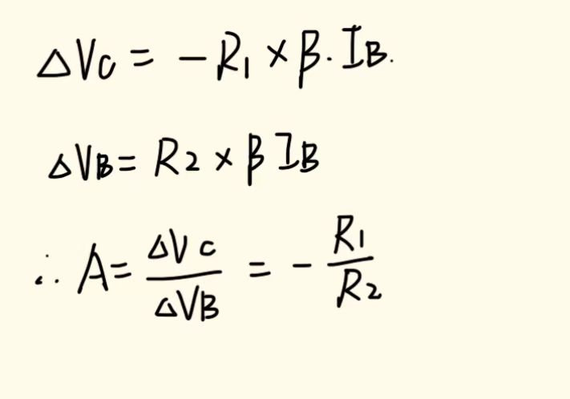
放大倍数：R1/R2=7.5/2=3.75

Slide 20
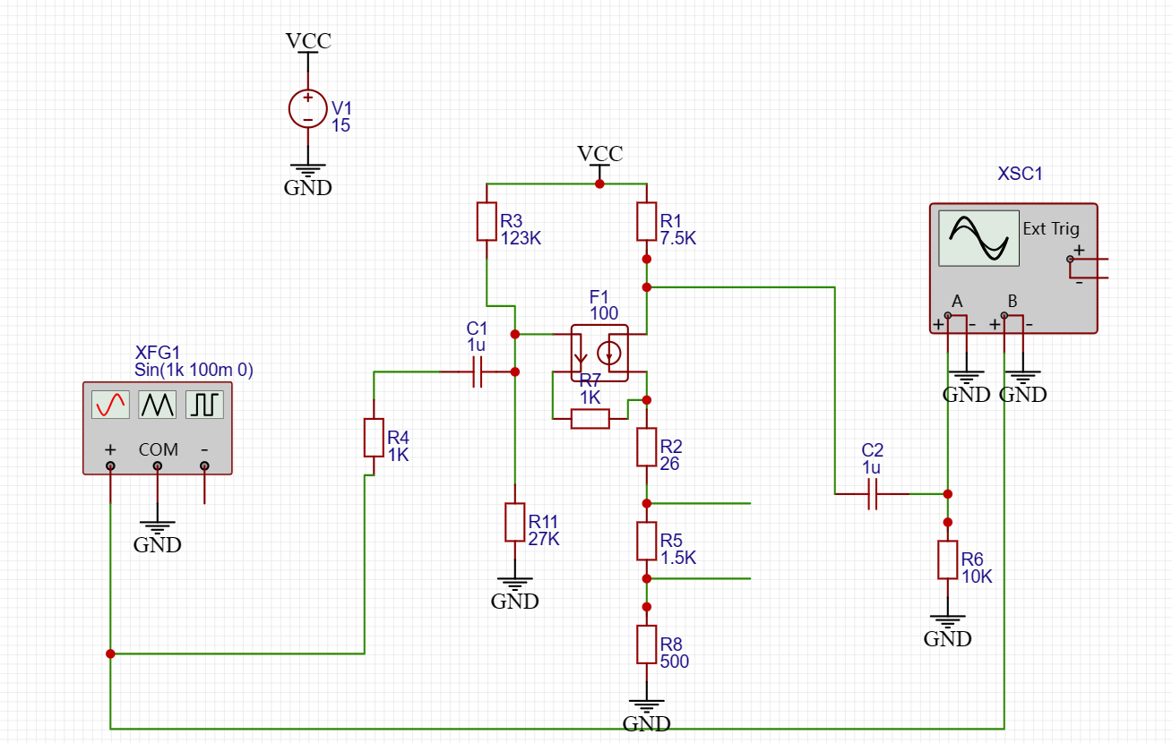
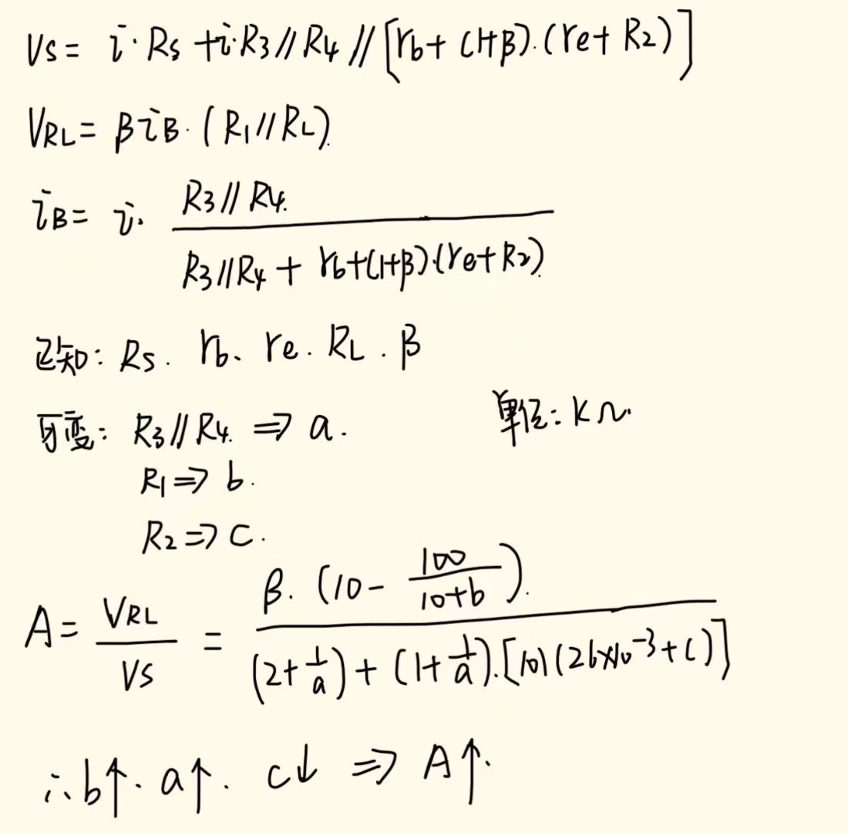

Slide 21
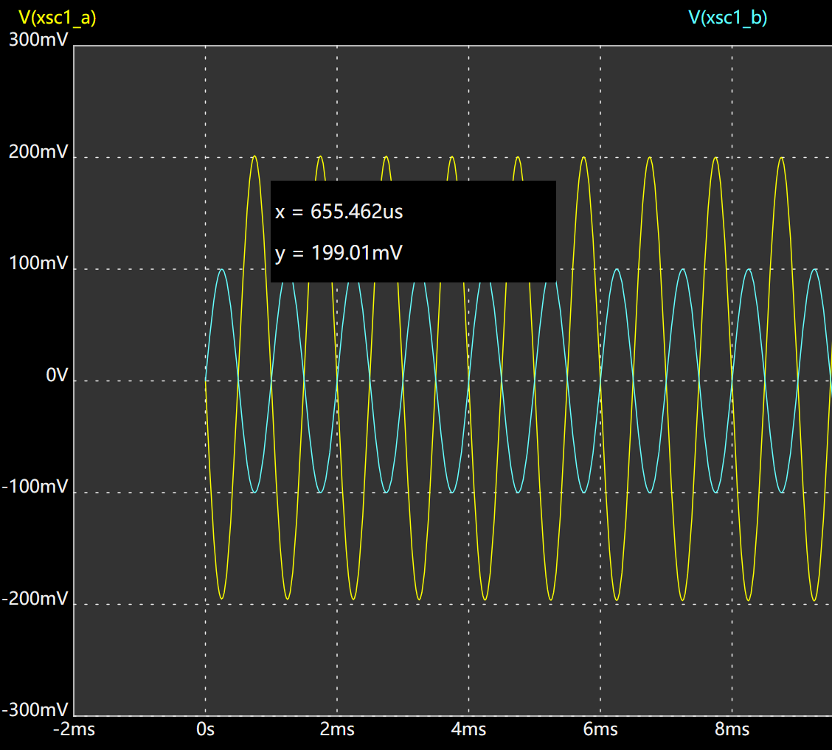
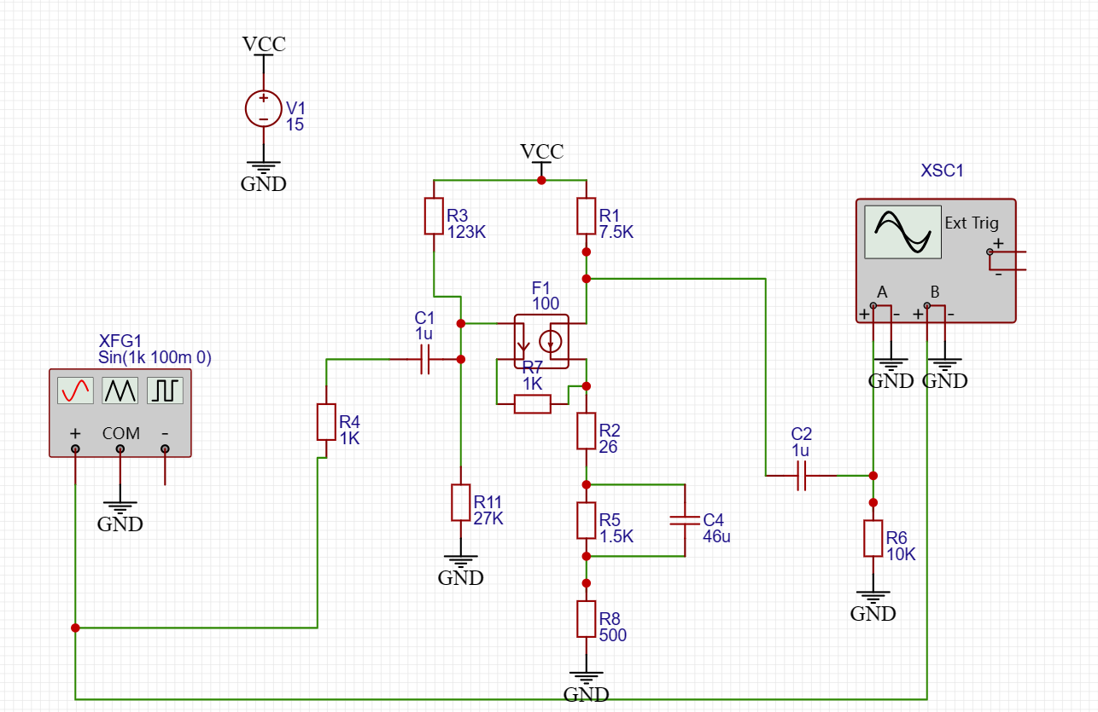
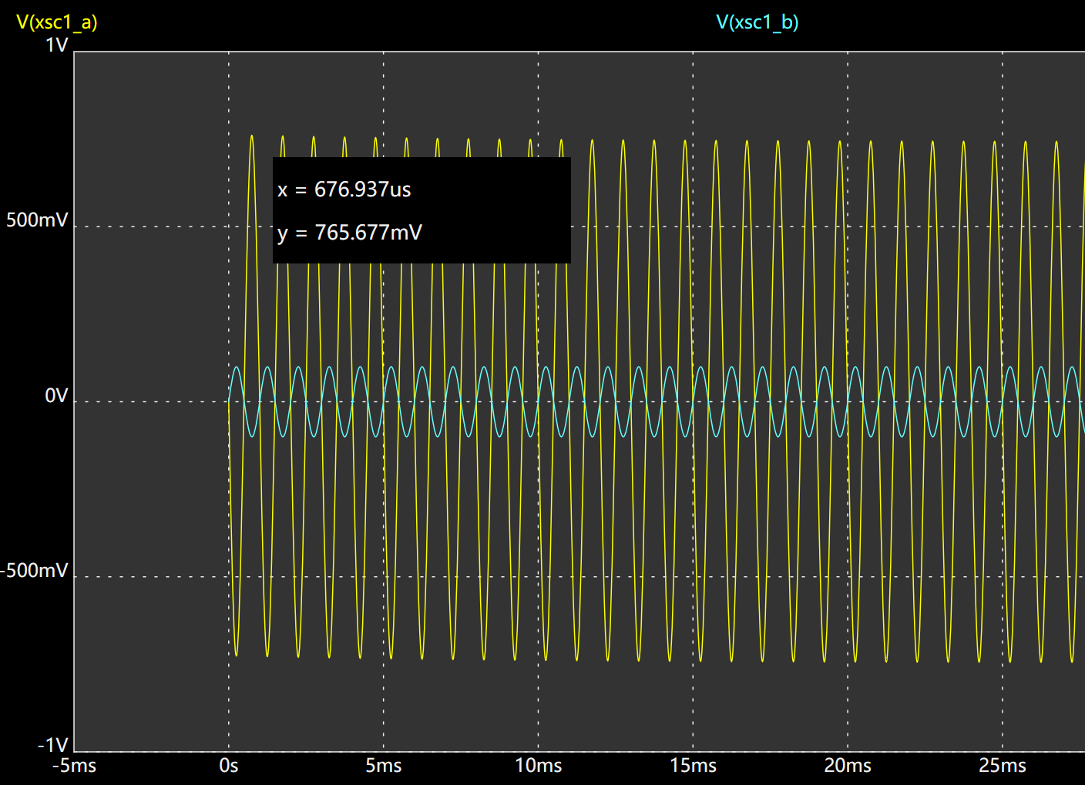
减小Re，增大Rb、Rc，不影响Q点

Slide 22
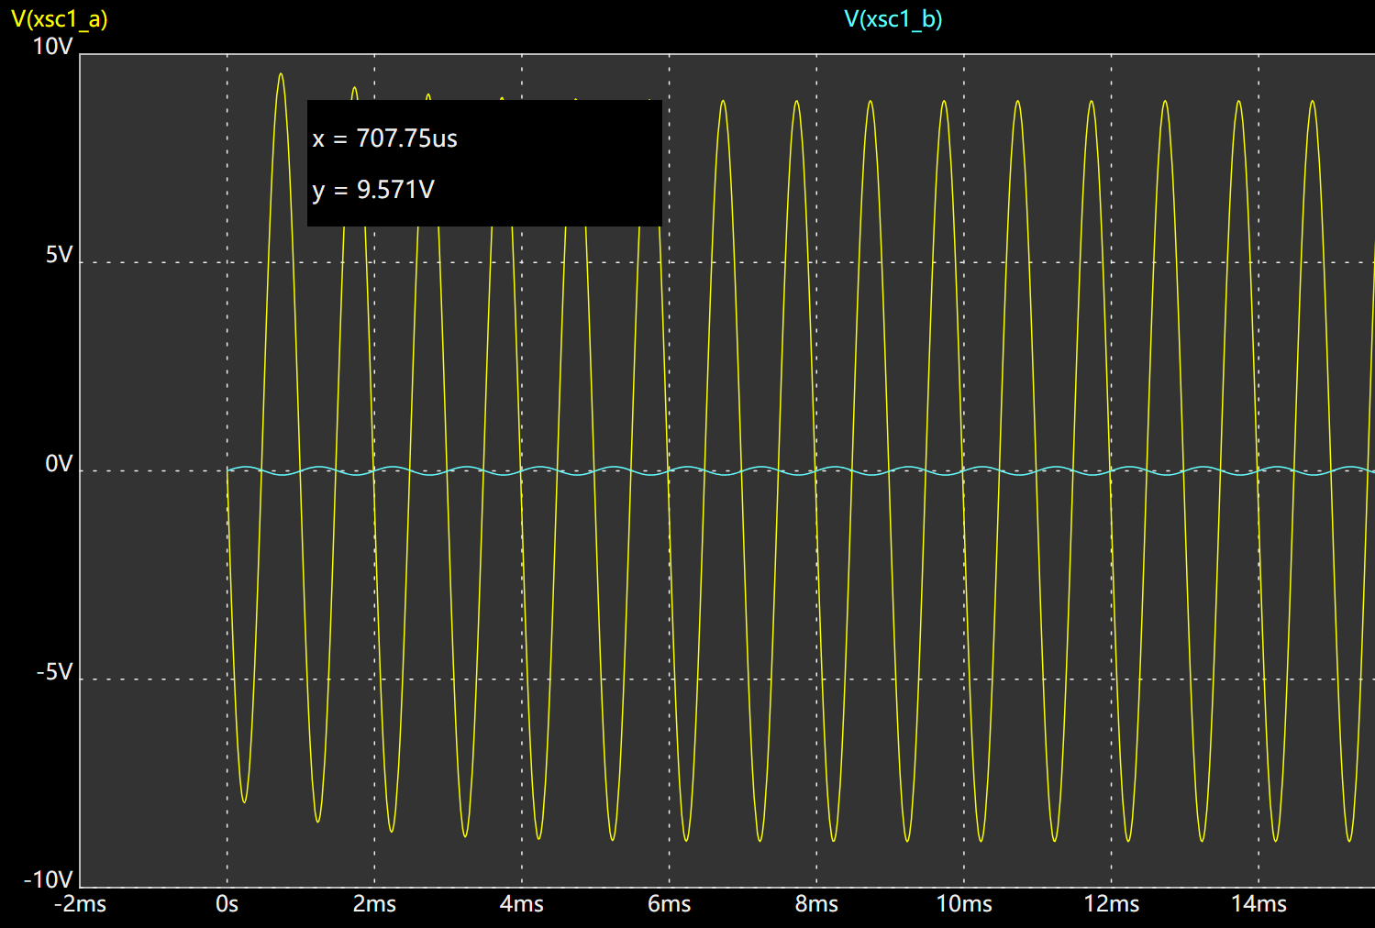
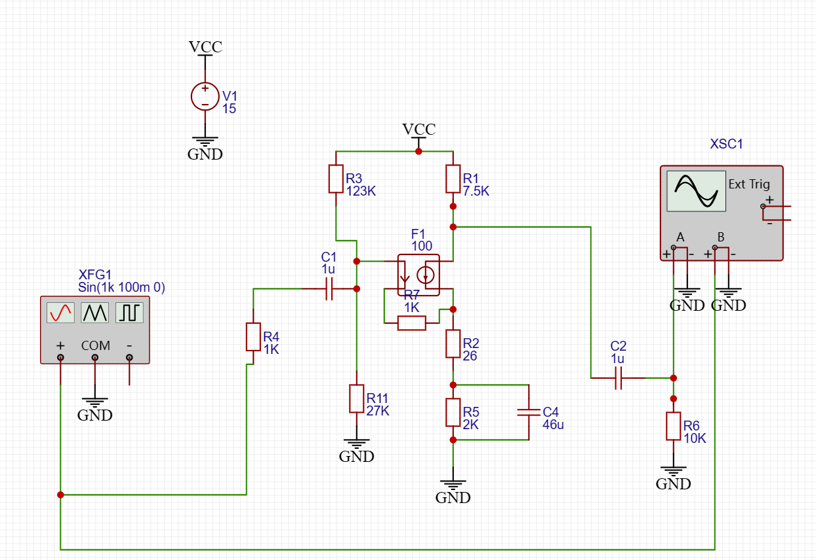
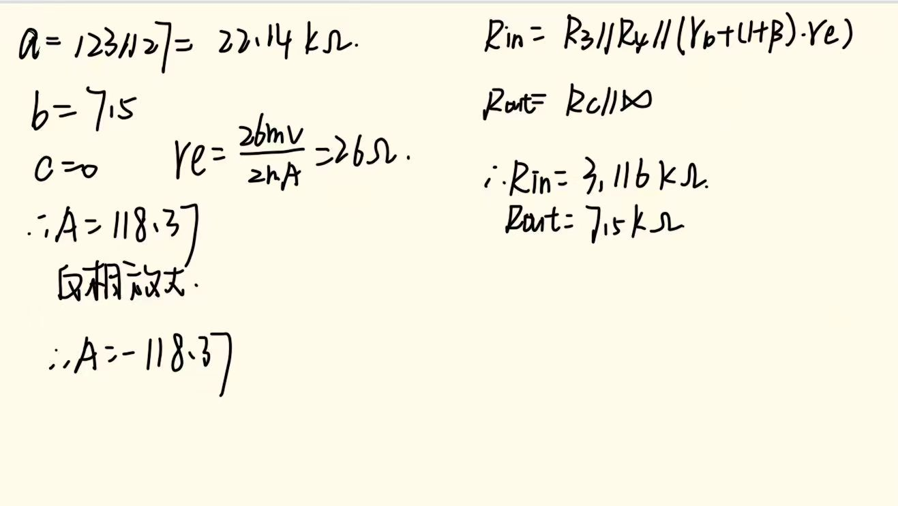








减小Re至0

