Slide 1

Bank Marketing Campaign
Virtual Internship
15-Sep-2023

Slide 2
Introduction
ABC Bank plans to launch a term deposit product and seek to build a predictive model to identify potential customers likely to purchase it. By utilizing machine learning (ML) models, the bank aims to optimize its marketing efforts, targeting customers with a higher probability of buying the product. This strategy, implemented through telemarketing, SMS, and marketing channels, aims to save resources and reduce costs associated with resource billing.
Based on the analysis of the provided data, several key business recommendations can be formulated to enhance the bank's marketing strategy for term purchases.

Slide 3
Hypothesis
Hypothesis:
Marital Status Hypothesis: Married couples are more likely to engage in term purchases compared to single individuals.
Education Level Hypothesis: University graduates are more inclined to engage in term purchases compared to those with lower educational attainment.
Loan Status Hypothesis: Individuals without outstanding loans are more likely to engage in term purchases compared to those with existing loans.
Age Hypothesis: Individuals in their late twenties to early forties are more likely to engage in term purchases compared to other age groups.
Consumer Price Index (CPI) Hypothesis: Individuals with a higher Consumer Price Index (CPI) are more likely to engage in term purchases compared to those with lower CPI.

Slide 4
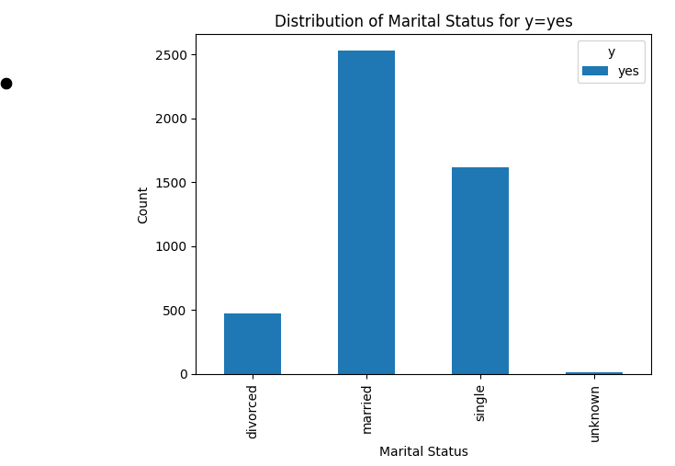
Marital Status Hypothesis
Recommended Strategy: It is advised that the bank focus its marketing efforts towards married couples, as they exhibit a higher likelihood of engaging in term purchases.

Slide 5
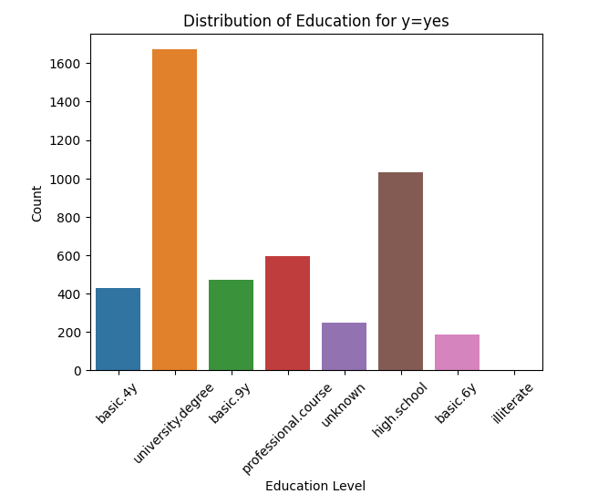
Education Level Hypothesis
Recommended Strategy: It is advisable for the bank to direct its marketing efforts towards university graduates, as this demographic displays a higher propensity to engage
in term purchases.

Slide 6
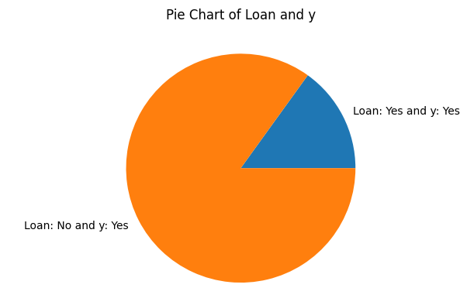
Loan Status Hypothesis
Recommended Strategy: The bank is encouraged to direct its marketing efforts towards individuals without outstanding loans, as this group exhibits a higher inclination to engage in term purchases.

Slide 7
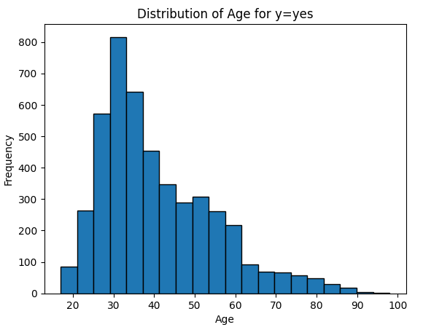
Age Hypothesis
Recommended Strategy:The bank is encouraged to focus its marketing efforts on individuals
in their late twenties to early forties, as this demographic is
more inclined to engage in term purchases.

Slide 8
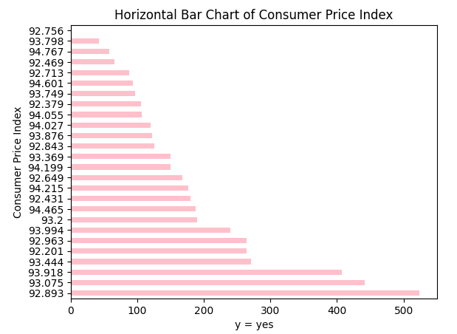
Consumer Price Index (CPI) Hypothesis
Recommended Strategy: The bank is advised to target individuals with higher Consumer Price Index, as they demonstrate a greater likelihood of engaging in term purchases.

Slide 9
Summary And Recommendations
To enhance the bank's term purchase marketing strategy, several key recommendations emerge from the data analysis. Firstly, targeting married couples is crucial, given their higher likelihood of engaging in term purchases. Second, tailoring campaigns towards university graduates, who exhibit a stronger inclination for such purchases, is advised. Additionally, focusing on individuals without outstanding loans is recommended, as they show a heightened interest in term purchases. Concentrating efforts on the late twenties to early forties age group and those with higher Consumer Price Index values can also yield positive results.
These strategies collectively aim to boost customer engagement and drive business success.

Slide 10
Model Recommendations
Based on the analysis, the following Machine Learning models will be used for marketing campaign:
Decision Trees
K-Nearest Neighbors (KNN)
Naive Bayes

Slide 11
Thank You

