Slide 1

Bank Marketing Campaign
Virtual Internship
30-Sep-2023

Slide 2
Introduction
ABC Bank plans to launch a term deposit product and seek to build a predictive model to identify potential customers likely to purchase it. By utilizing machine learning (ML) models, the bank aims to optimize its marketing efforts, targeting customers with a higher probability of buying the product. This strategy, implemented through telemarketing, SMS, and marketing channels, aims to save resources and reduce costs associated with resource billing.

Slide 3
Data Understanding
The dataset named ‘bank-additional-full’ is a CSV file that consists of 21 columns and 41188 rows. The file contains data from May 2008 to November 2010. The data covers information regarding the marketing campaign itself such as employment variation rate, number of employees, consumer confidence index, and Euribor 3-month rate. As well as all the basic client information, such as age, job, education, marital status…etc. Lastly, there’s the variable ‘y’ which is an answer to the question ‘Has the client subscribed to a term deposit? ’ The answer is a binary yes or no.

Slide 4
Data Problems
Null values
No null values were found in the dataset.
‘Unknown’ values
The following ‘unknown’ values were found in the dataset:
Column 'job' has 330 'unknown' values.
Column 'marital' has 80 'unknown' values.
Column 'education' has 1731 'unknown' values.
Column 'default' has 8597 'unknown' values.
Column 'housing' has 990 'unknown' values.
Column 'loan' has 990 'unknown' values.
Outliner values
The column ‘duration’ contains outliner data based on the fact that it has a mean of 258.28 while the max value is 4918.
unbalanced data
When calculating the proportion of each class in the target variable ‘y’, these were the results:
no 0.887346
yes 0.112654
the dataset is unbalanced given the fact that the class ‘no’ is significantly larger than the class ‘yes’

Slide 5
Data Cleaning
‘Unknown’ values
Depending on the column itself and the data it holds, either we will drop the row or replace the ‘unknown’ value with the mode. For the housing and loan columns, we replace the missing values with the mode. Moreover, for the columns job and marital, we will drop the missing values. Lastly, for the ‘education’ and ‘default’ columns, we’ll use logistic regression.
Outliner values
For removing the outliners, we’ll use the Z-Score Method and the IQR
unbalanced data
For the unbalanced data, we decided on undersampling: which involves reducing the number of instances in the majority class to balance it with the minority class.

Slide 6
Hypothesis
Hypothesis:
Marital Status Hypothesis: Married couples are more likely to engage in term purchases compared to single individuals.
Education Level Hypothesis: University graduates are more inclined to engage in term purchases compared to those with lower educational attainment.
Loan Status Hypothesis: Individuals without outstanding loans are more likely to engage in term purchases compared to those with existing loans.
Age Hypothesis: Individuals in their late twenties to early forties are more likely to engage in term purchases compared to other age groups.
Consumer Price Index (CPI) Hypothesis: Individuals with a higher Consumer Price Index (CPI) are more likely to engage in term purchases compared to those with lower CPI.

Slide 7
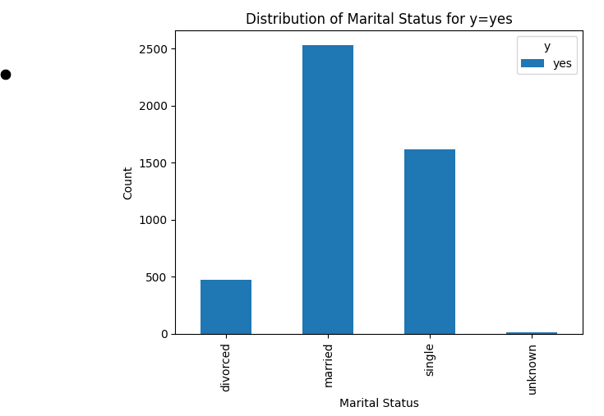
Marital Status Hypothesis
Recommended Strategy: It is advised that the bank focus its marketing efforts towards married couples, as they exhibit a higher likelihood of engaging in term purchases.

Slide 8
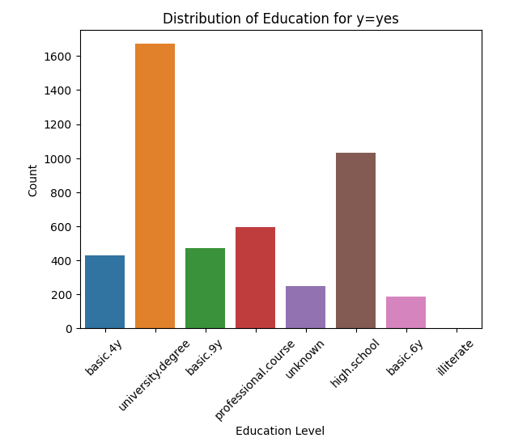
Education Level Hypothesis
Recommended Strategy: It is advisable for the bank to direct its marketing efforts towards university graduates, as this demographic displays a higher propensity to engage
in term purchases.

Slide 9
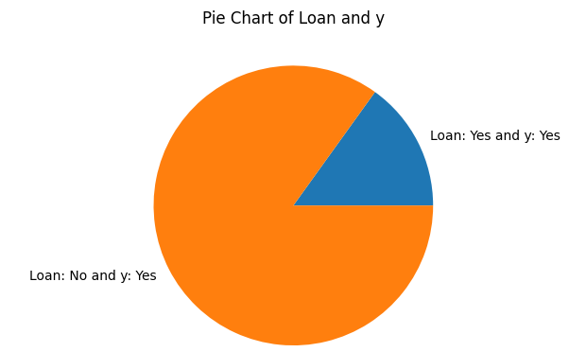
Loan Status Hypothesis
Recommended Strategy: The bank is encouraged to direct its marketing efforts towards individuals without outstanding loans, as this group exhibits a higher inclination to engage in term purchases.

Slide 10
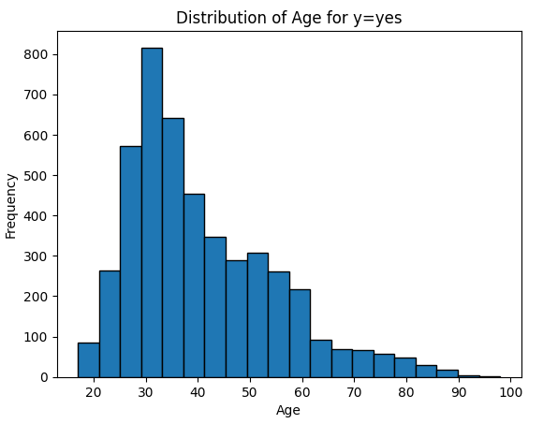
Age Hypothesis
Recommended Strategy:The bank is encouraged to focus its marketing efforts on individuals
in their late twenties to early forties, as this demographic is
more inclined to engage in term purchases.

Slide 11
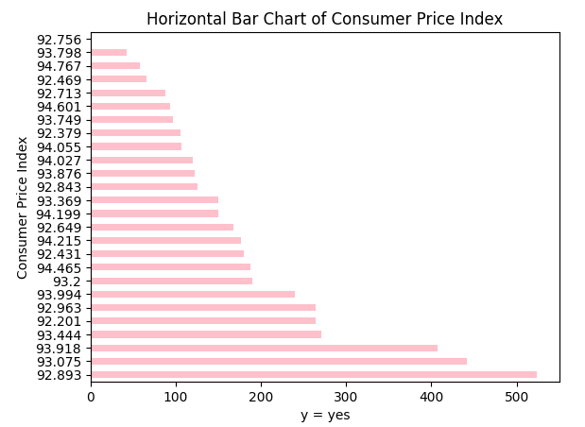
Consumer Price Index (CPI) Hypothesis
Recommended Strategy: The bank is advised to target individuals with higher Consumer Price Index, as they demonstrate a greater likelihood of engaging in term purchases.

Slide 12
Recommendations Based on EDA
To enhance the bank's term purchase marketing strategy, several key recommendations emerge from the data analysis. Firstly, targeting married couples is crucial, given their higher likelihood of engaging in term purchases. Second, tailoring campaigns towards university graduates, who exhibit a stronger inclination for such purchases, is advised. Additionally, focusing on individuals without outstanding loans is recommended, as they show a heightened interest in term purchases. Concentrating efforts on the late twenties to early forties age group and those with higher Consumer Price Index values can also yield positive results.
These strategies collectively aim to boost customer engagement and drive business success.

Slide 13
Model Recommendations
Based on the analysis, the following Machine Learning models will be used for marketing campaign:
Decision Trees
K-Nearest Neighbors (KNN)
Naive Bayes

Slide 14
Model Recommendations
After creating the models, the following accuracy levels were found
Decision Trees - 91%
K-Nearest Neighbors (KNN) - 93%
Naive Bayes - 86%
Based on accuracy we can conclude that K-Nearest Neighbors is the best model for this project based on it’s high accuracy

Slide 15
Conclusion
After thorough analysis, we proposed targeted marketing strategies, prioritizing married couples, university graduates, loan-free individuals, specific age brackets, and those with higher Consumer Price Index values. We successfully addressed data challenges, including 'unknown' values and outliers, implementing effective solutions. Employing K-Nearest Neighbors, Decision Tree, and Bernoulli Naive Bayes models, we observed exceptional accuracy of 93% with KNN. This comprehensive project equips ABC Bank with actionable insights to refine its marketing approach and drive the success of its new product.

Slide 16
Thank You

