Slide 1
2. Daily Mood Tracker Application
A Java CLI Application

Slide 2
Approach and Design
Log mood (date, mood, time of day, reason)
Select a specific Mood for a specific day
View Mood by “Mood Type”
Sort Date by Chronological Order

Slide 3
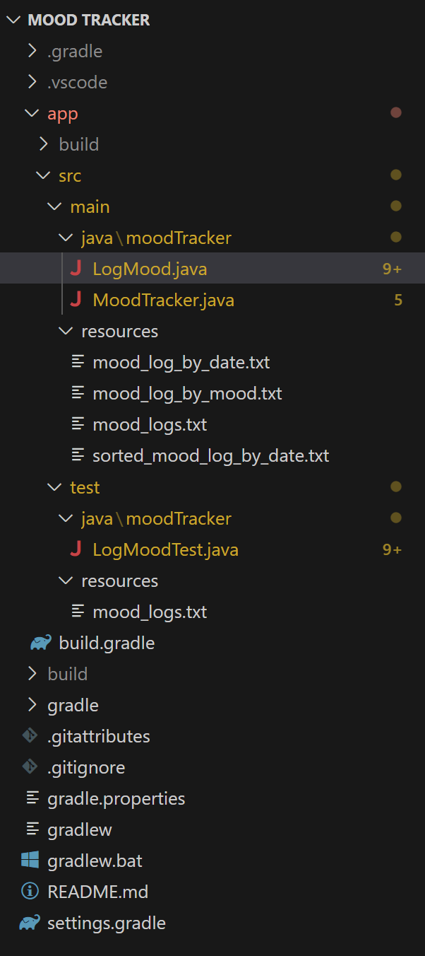
Key Files and Folders

Slide 4
Process to run, test, and verify
To compile the build, type "gradlew build"
to run the app, type "gradlew run"
once finished running the app, type "gradlew clean"
to run tests, run "gradlew test"

Slide 5
Test/Seed Data

Slide 6
Questions?

