Slide 1

Clustering Assignment
Group 2
Ashraqat Torky |Mahmoud Helmy | Sarah Elmasry |
Yomna Abdelsattar

Slide 2
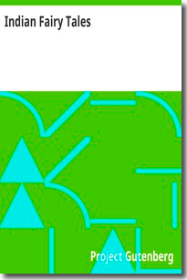
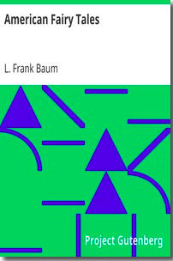



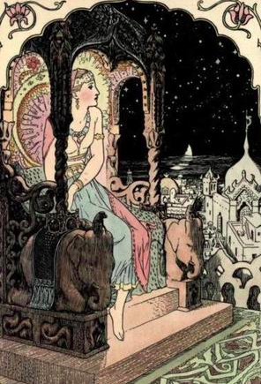
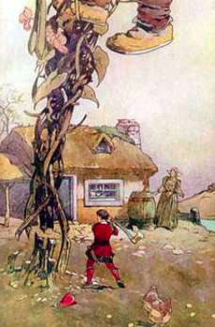
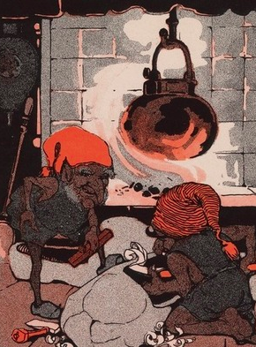
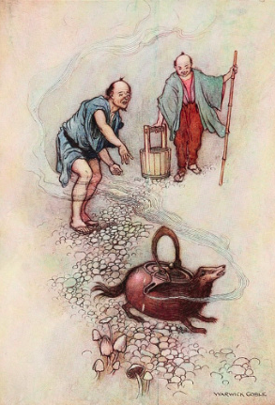
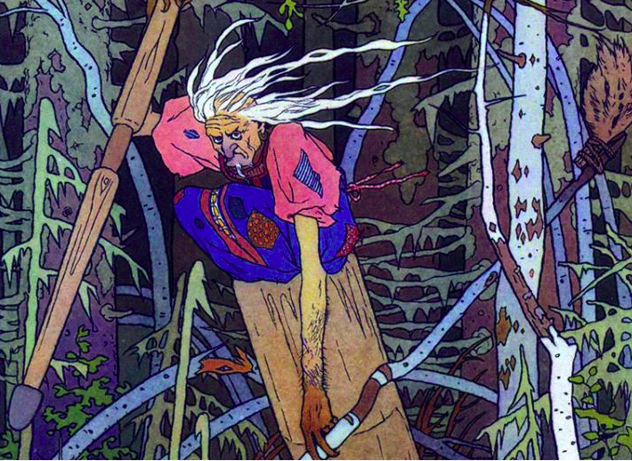
Data Choice | Data Preparation
￼
Semantically Similar: Children fairy tales

Slide 3
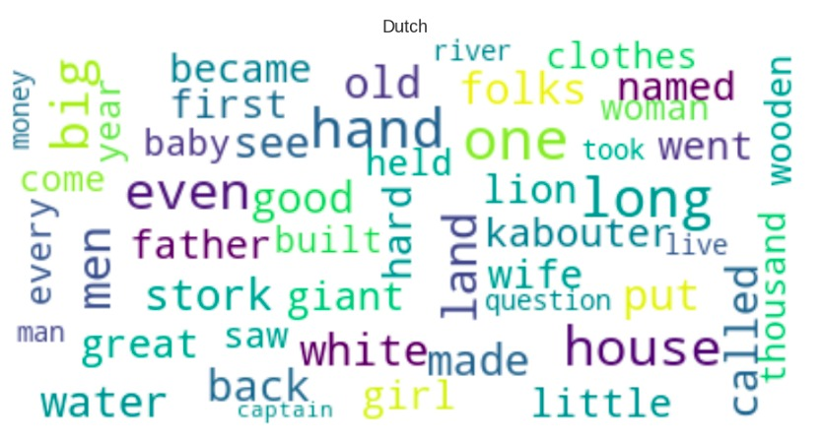
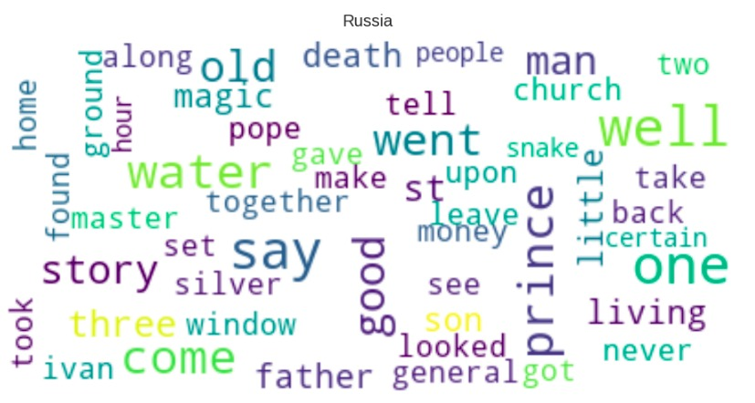
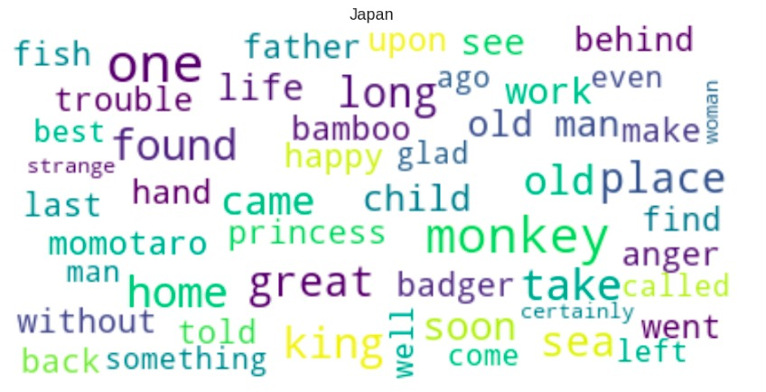
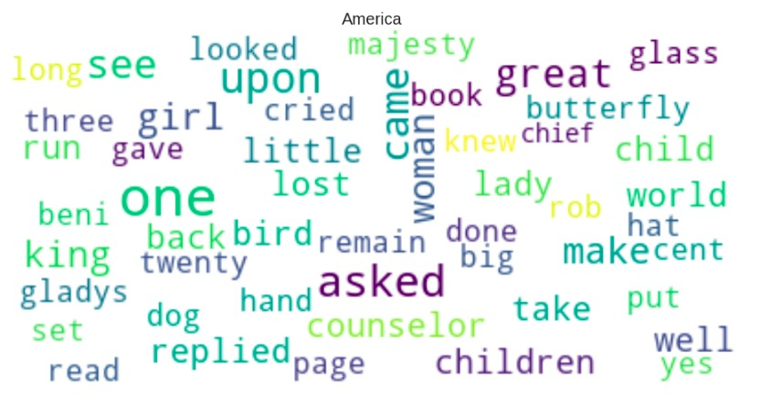
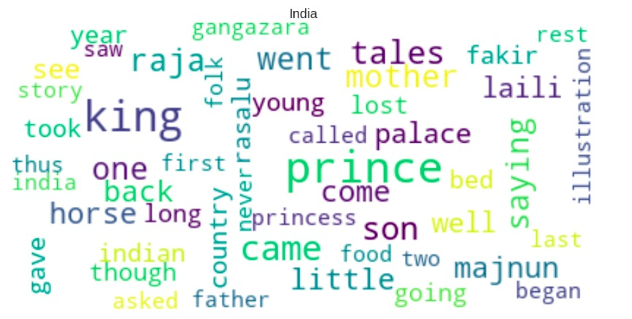
Word Frequencies with
Word Cloud
￼

Slide 4
Transformation and Feature Engineering
￼
Bag of Words (BOW)
TF-IDF
N-gram
Doc2word

Slide 5
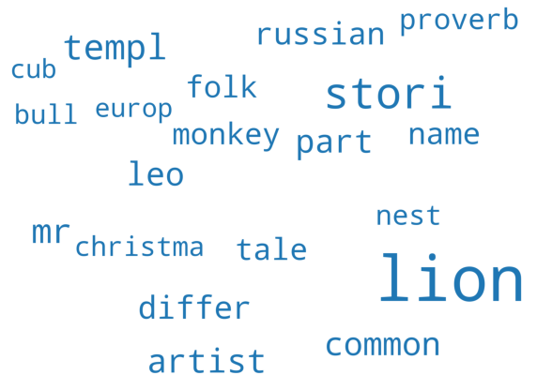
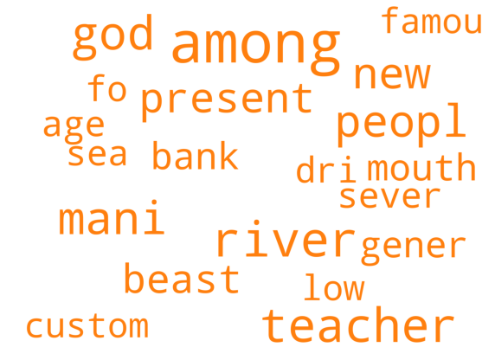
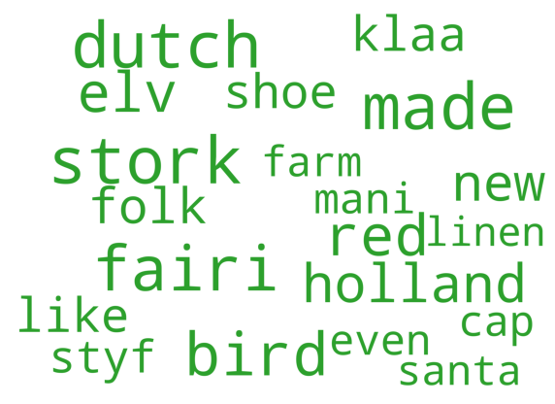
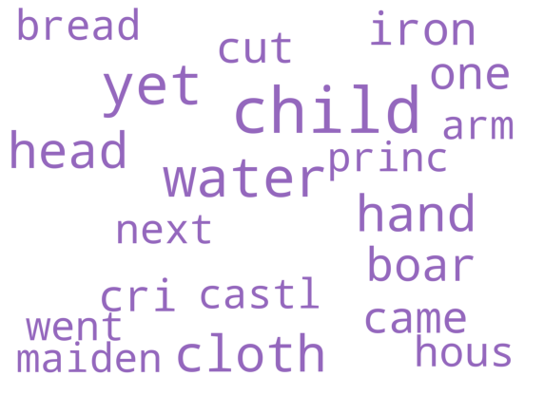
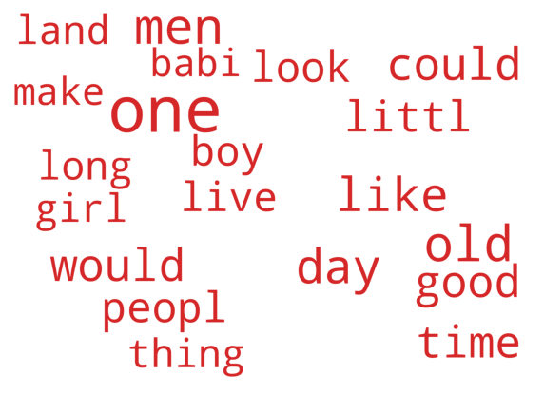
Topic Modeling
￼
Latent Dirichlet Allocation (LDA)

Slide 6
Clustering algorithms
￼
Kmeans
Expectation Maximization (EM)
Agglomerative Hierarchical Clustering

Slide 7
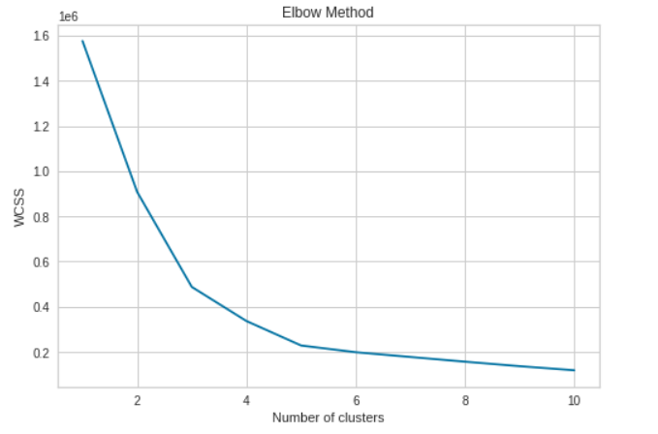
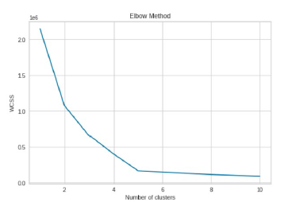
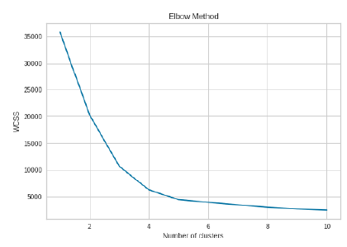
Elbow method
BOW
TF-IDF
Doc2Word

Slide 8
Evaluation Metrics
￼
Silhouette
Kappa
 | BOW |  |  | TF-IDF |  |  | Doc2Word
 | k-means | Agglomerative | EM | k-means | Agglomerative | EM | k-means | Agglomerative | EM
Kappa | 0.3 | 0.1 | 0.3 | 0.4 | 0.4 | 0.1 | 0.6 | 0.6 | 0.1
Silhouette | 0.03 | 0.007 | 0.02 | 0.027 | 0.03 | 0.013 | 0.001 | 0.02 | 0.06
Champion model: Doc2Word/Agglomerative

Slide 9
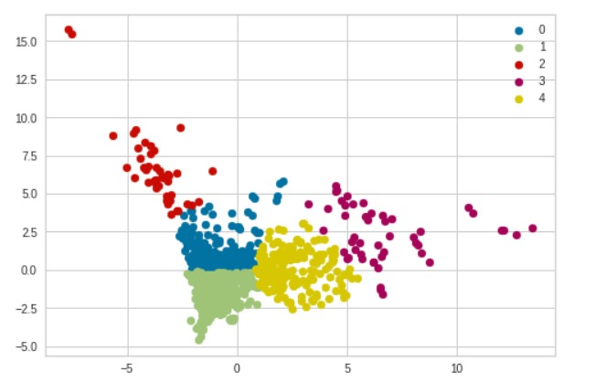
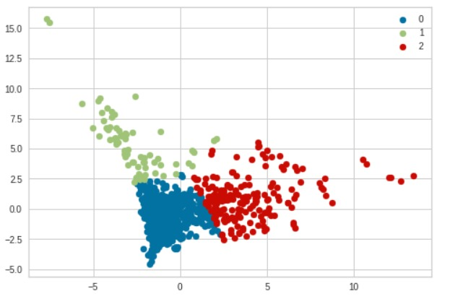
Error Analysis
￼

Slide 10
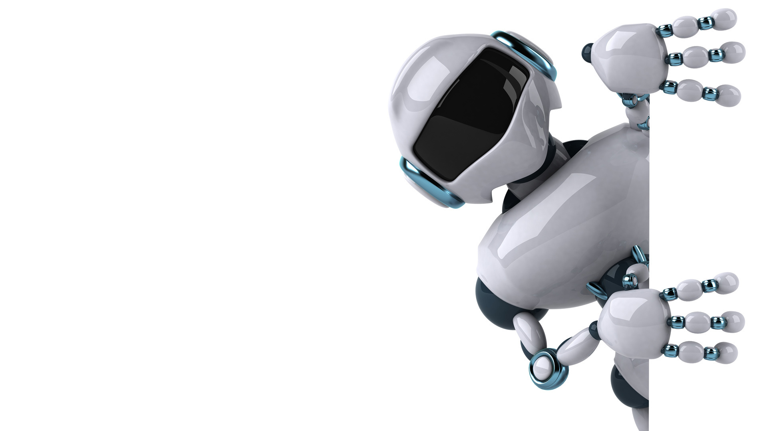
Thank you !
￼

