Slide 1
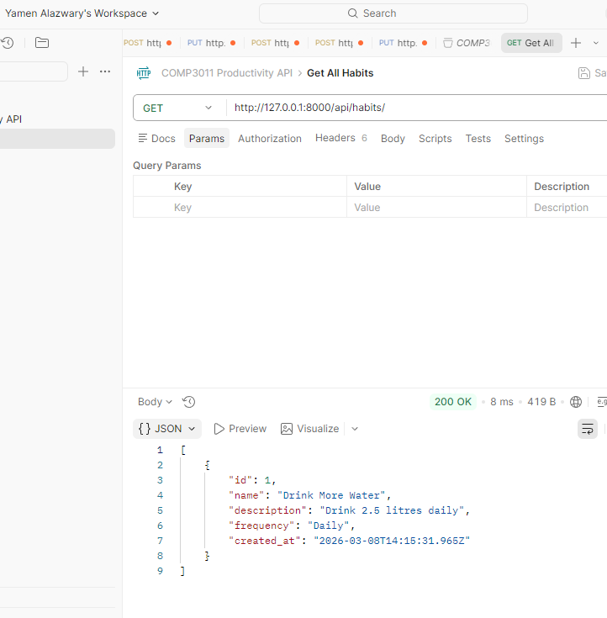
COMP3011 Coursework 1
Productivity and Habit
Analytics API
COMP3011 Coursework 1 oral presentation
5-minute summary
Focus: architecture, analytics, testing, and GenAI reflection
Name: Yamen Alazwary
Repo: github.com/Yoms24/comp3011-productivity-api
1
Notes:
This project started as a simple habit tracker, but I deliberately improved it into a productivity and habit analytics API so it would go beyond basic CRUD. In this presentation I will explain the problem, the data model, the main endpoints, how testing was done, and how Generative AI was used in a transparent way. The goal is to show both the implementation quality and the design decisions behind it. [Sources] - COMP3011_Coursework1_Brief__2025_2026.pdf - 18eca8aa-3ab9-4472-930e-cecf37e7eaa5.png (saved Postman request screenshot)

Slide 2
COMP3011 Coursework 1
What I built and why
How the project was pushed beyond minimum CRUD
Problem addressed A basic habit tracker would only demonstrate simple CRUD. I wanted a design that also showed relational modelling and simple behavioural analytics. Final direction A Django API that manages habits, stores completion logs, and calculates a current streak. Why this is stronger It is closer to a productivity and habit analytics API than a single-table demo, which better matches the brief’s higher-band expectations.
Basic
habit tracker
Productivity and
Habit Analytics API
Habit
+ HabitLog
+ Streak analytics
This was the biggest architectural upgrade in the project.
2
Notes:
Here I would explain the main project decision. I started with the idea of a basic habit tracker, but that felt too safe. The stronger version was to turn it into a productivity and habit analytics API. That is why I introduced the second model, HabitLog, and added streak analytics. This made the project more relational, more data-driven, and easier to justify as a higher-quality API rather than only a CRUD example. [Sources] - COMP3011_Coursework1_Brief__2025_2026.pdf

Slide 3
COMP3011 Coursework 1
Architecture and data model
Two related models instead of one flat table
HabitLog
Habit
• id
• habit (ForeignKey)
• completed_on
• notes
• created_at
• id
• name
• description
• frequency
• created_at
Main tracked activity
Stores dated completions and supports analytics
This relationship enables history and streak calculations.
3
Notes:
This slide explains the main architecture. The Habit model stores the tracked activity itself. HabitLog stores dated completion events and links back to Habit through a foreign key. That relationship is what enables me to return log histories and calculate a current streak. I would emphasise that this was the key decision that moved the project from a single-table design to a small relational analytics system. [Sources] - COMP3011_Technical_Report_appendix.docx

Slide 4
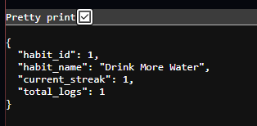
COMP3011 Coursework 1
Endpoints and analytics logic
The API does more than create, read, update and delete
Core habit endpoints
Analytics-related endpoints
GET /api/habits/
GET /api/habits/<id>/
POST /api/habits/create/
PUT /api/habits/<id>/update/
DELETE /api/habits/<id>/delete/
GET /api/habits/summary/
POST /api/habits/<id>/logs/create/
GET /api/habits/<id>/logs/
GET /api/habits/<id>/streak/
The streak endpoint checks recent log dates and returns the current streak plus total logs.
Validation: required fields + allowed frequency values
4
Notes:
This slide shows the API surface. The left side is the core CRUD behaviour for habits. The right side is the part that makes the project more advanced: completion logs and the streak endpoint. In the viva I would explain that the streak logic checks the saved completion dates and counts consecutive days from the current date backwards. That means the API is not only storing data; it is also deriving useful behavioural information from it. [Sources] - fa8a87f9-41a9-4bec-837d-f7dbb406f1e8.png (streak endpoint output)

Slide 5
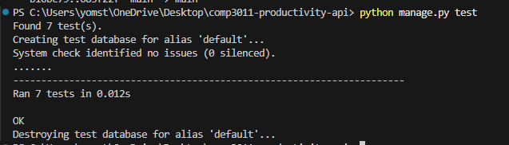
COMP3011 Coursework 1
Testing, documentation, and evidence
How I showed the API actually works
Evidence included in the repository
• Public GitHub repo with commit history
• README with setup instructions
• API documentation in PDF format
• Manual Postman testing
• 10 automated Django tests passing
• Report and GenAI declaration
Automated test suite result
The project includes ten passing Django tests, which made later refactoring safer and more defensible.
Testing helped validate CRUD, invalid input handling, log creation, log listing, summary retrieval, and streak retrieval.
5
Notes:
Here I would show that the project is not just code but a complete submission package. The screenshot on the left is the automated Django test result, where all 7 tests pass. On the right I would highlight the repository evidence: the public GitHub history, the README, the API documentation PDF, and the report. This slide is important because the brief makes it clear that documentation, version control and testing matter alongside implementation. [Sources] - COMP3011_Coursework1_Brief__2025_2026.pdf - 5b528d70-48a3-4f6f-b0eb-e518a91e3689.png (test output screenshot)

Slide 6
COMP3011 Coursework 1
Reflection and GenAI use
What I would emphasise in the Q&A
Key reflection points
GenAI declaration
• The strongest upgrade was adding HabitLog and streak analytics
• Helper-based refactoring improved maintainability
• Automated tests increased confidence after changes
• Current limitations: no authentication, no deployment, local prototype only
• I brought the initial idea
• ChatGPT helped improve architecture, validation, tests, and documentation
• I manually implemented, ran, debugged, and integrated the code
• Appendix A in the report summarises selected conversation-log evidence
Close: this project became a small relational analytics API rather than a basic CRUD demo.
6
Notes:
I would finish by reflecting on the project. The most important message is that the work evolved into a relational analytics API, not just a basic CRUD tracker. I would also be transparent about GenAI: I brought the initial idea, ChatGPT helped refine the design, testing approach and documentation, and I manually implemented and integrated the code. In the Q and A I would be ready to explain the architecture, streak logic, testing strategy, and the limitations of the current prototype. [Sources] - COMP3011_Technical_Report_appendix.docx - COMP3011_Coursework1_Brief__2025_2026.pdf

