Slide 1

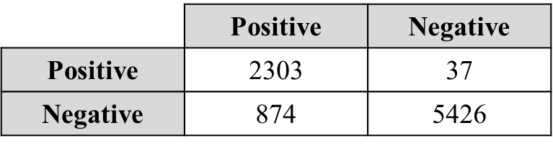
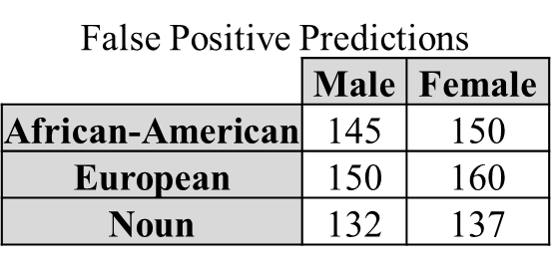
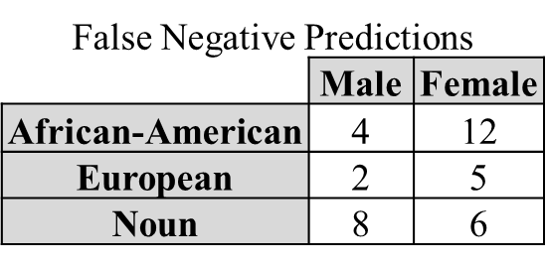
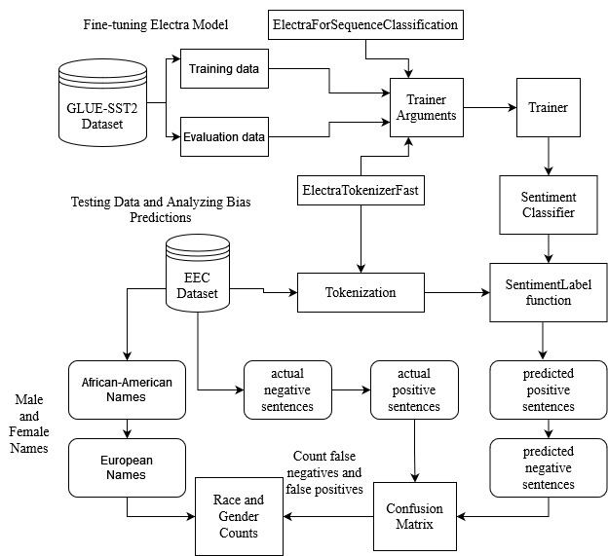
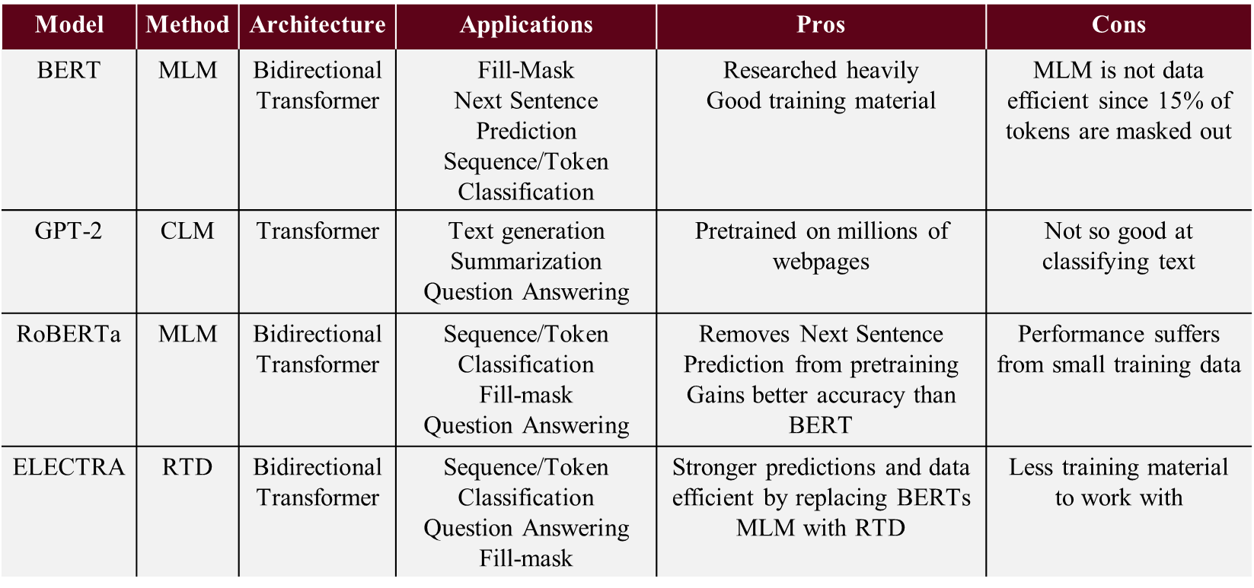
Fine-Tuning ELECTRA to Detect Racial and Gender Bias
Yonathan Torres, Maryam Taeb
Abstract
Dataset
Preliminary Results
Daily applications like voice recognition in smartphones, search engines that answer your queries, and job application sites that recommend positions use AI to learn to generate the best solution, but the data they learn from influences the quality of our experience. Data that contains human biases could leave groups of people misunderstood in smartphone apps, search engines finding wrong results, and even leave you without a job opportunity. This study leverages natural language processing (NLP) to train a sentiment classifier to detect bias in pretrained language models.
Training and Evaluation Data
The General Language Understanding Evaluation (GLUE) benchmark has dataset for scoring models on sentiment analysis, which is used in this study:
Stanford Sentiment Treebank (SST2): consists of movie reviews from IMDB
Classifies sentences by 0 for negative, and 1 for positive
Consists of three files titled train, validation, and test: first two are labeled
Training data uses train and evaluation data uses validation
Total fine-tuning data consists of 68221 labelled sentences
Testing Data
The Equity Evaluation Corpus (EEC) can be used to measure bias
8640 English Sentences; 1:3 ratio of positive labels to negative labels
Sentences are permutations of two groups: African-American, European, and Noun with male and female
Some sentences have no emotion; they help find whether the model gives higher sentiment values to specific names
The model after the training session → 89.1% accuracy
The confusion matrix indicates that the model had a better performance in predicting true negative labels:
A total of 7729 accurate predictions were made on the testing session → 89.4% accuracy
The distribution of False-positive and negative predictions indicates that the model was more biased toward Caucasian names → False-positive sentiments had a higher association with Caucasian names
Out of the 37 false negatives, 7 were sentences of African-American first names paired with negative emotion, 18.9%
Overall racial bias analysis indicates model paired negative sentiment to African-Americans compared to European names
Overall gender bias analysis indicates models are producing inaccurate sentiments toward female names
Overall results indicate that ELECTRA is less biased (Fair) compared to other language models like BERT
Actual Values
Predicted Values
Background
NLP is the study of creating language understanding models using statistics, machine learning, and deep learning.
Applications of models
Amazon/Netflix recommending movies/products by processing ratings/reviews
Job listing websites process keywords in resumes to find suitable jobs
Types of Models
Bag of Words (BoW); calculates word occurrences for every word, uses word embeddings to extract meaningful data
Deep learning models; use neural networks to learn deeper representations
Pre-trained models (PTM); are already built and can be fine-tuned to a task
In this study, PTMs are used for their ability to be easily trained on a task.
Table 1: compares some pre-trained models that were considered for the study
BERT started the wave of PTMs; considers context from both sides of word
GPT-2 is a deep-learning BoW; only considers left of word for
After consideration, ELECTRA was chosen to be analyzed for this study:
Improvement on BERT, lower accuracy than ELECTRA
GPT-2 is not good at sequence classification
RoBERTa only outperforms for large datasets, which may take up time
Methodology
Tools
Python 3.10.2
PyTorch
Huggingface transformers library
electra-small-discriminator pre-trained model as the base for fine-tuning
GLUE-SST2 and EEC datasets files
The figure below demonstrates the overall approach taken in this work
Conclusion and Future Work
This study demonstrated how a fine-tuned model towards an equal distribution of sentiments can be used to make predictions on data to detect bias, but many improvements can be made to strengthen the claim of bias than just this one task. Named-Entity Recognition (NER) is a classification task that would give direct results on name bias by inputting first names in the model and checking its ability to recognize the word as a valid name. Another tool that was not used in this study was cosine-similarity, which is a metric for how closely word vectors in an embedding space are to each other, which correlates to similar meanings between two words. Future work could analyze the embedding the test data for male/female and African-American/European to identify whether these relations were kept or maintained by the dataset’s distribution. In 2022, RoBERTa models are higher in the GLUE leaderboard than ELECTRA models. The research could further study fine-tune RoBERTa instead for greater accuracy, reducing our bias to simply an accuracy issue with the model, although it would require larger training data, which affects the time spent on pretraining.
Notes:
Since data is even for positive and negative sentences, for all names, bias can be easily detected when values for a group appear to not match another group when both are labelled with the same emotion.

