Slide 1

恶意文件检测 以及对抗性学习
王凤娇
2018年8月5日
Notes:
时间：30s

Slide 2
AI模型 & 安全？？
传统的AI模型
AI模型的逃逸
AI模型的抗逃逸
模型的应用场景
Notes:
时间：5s

Slide 3
恶意文件检测在学术界中的研究
Category | Focus | Detection | Work | Year | External Parser? | ML?
Static | JavaScript | Lexical Analysis [5] | PJScan | 2011 | Y | Y
 | JavaScript | Token Clustering [12] | Vatamanu et al. | 2012 | Y | Y
 | JavaScript | API Reference Classification [7] | Lux0r | 2014 | Y | Y
 | JavaScript | Shellcode and opcode sig [13] | MPScan | 2013 | N | N
 | Metadata | Linearized object path [11] | PDF Malware Slayer | 2012 | Y | Y
 | Metadata | Hierarchical Structure [1] | Srndic et al. | 2013 | Y | Y
 | Metadata | Content Meta-features [24] | PDFrate | 2012 | Y | Y
 | Both | Many Heuristics Combined [8] | Maiorca et al. | 2015 | Y | Y
 | Both | Many Heuristics Combined [9] | Maiorca et al. | 2016 | Y | Y
Dynamic | JavaScript | Shellcode and opcode sig [15] | MDScan | 2011 | Y | N
 | JavaScript | Known Attack Patterns [16] | PDF Scrutinizer | 2012 | Y | N
 | JavaScript | Memory Access Patterns [17] | ShellOS | 2011 | Y | N
 | JavaScript | Common Maldoc Behaviors [18] | Liu et al. | 2014 | N | N
 | JavaScript | Platform Independent Tap Point Identification [20] | tap point | 2016 | N | N
 | Memory | Violation of Invariants [19] | CWXDetector | 2012 | N | N
 | OS | Platform Diversity [21] | PlatPal | 2017 | Y | N
Notes:
时间：1min

Slide 4
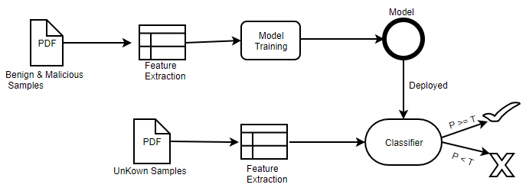
基于机器学习的框架
Notes:
时间：1min

Slide 5
AI模型解决的问题
训练数据：十万级别
预测时间：毫秒级别
精确度： 99%
误报率：0.01%
Model
Notes:
时间：2min

Slide 6
AI模型遇到的问题
Attack Scenarios | Adversarial Examples | Model 2
F | 2000 | 71.18%
FC | 240* | 2.92%
FT | 2000 | 84.25%
FTC | 2000 | 15.83%
Model
Notes:
时间：2min

Slide 7
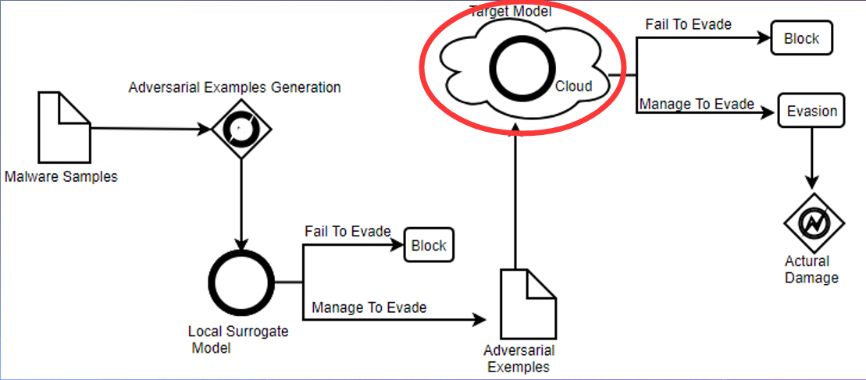
模型逃逸方法
Notes:
时间：3min

Slide 8
模型进化
Model 1
Model 2
Model 3
BY Robust Parser
BY Robust Model
SOLVE Parser-confusion attacks
SOLVE Model evasion attacks,
Mimicry attacks
Notes:
时间：3min

Slide 9
5 种抗逃逸的方法
增加多样化和最新的样本进行训练 (Model 2.1)
对抗性训练 (Model 2.2)
调整模型的阈值 (Model 2.3)
删除被对手利用的特征训练模型 (如下图)
隐藏分类器的相关参数，比如特征，阈值，算法
Notes:
时间：3min

Slide 10
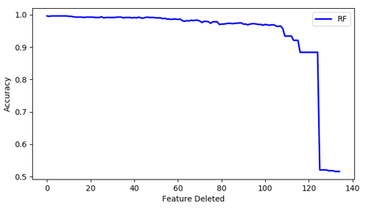
特征随着重要性依次删减后的准确率
Notes:
时间：3min

Slide 11
不同攻击场景下的检测率
Attack Scenarios | Adversarial Examples | Model 2 | Model 2.1 | Model 2.2 | Model 2.3 | Model 3
F | 2000 | 71.18% | 96.71% | 89.43% | 71.03% | 98.65%
FC | 240* | 2.92% | 12.50% | 81.95% | 2.85% | 88.89%
FT | 2000 | 84.25% | 96.76% | 98.58% | 85.89% | 98.98%
FTC | 2000 | 15.83% | 18.71% | 86.21% | 36.82 | 92.83%
Notes:
时间：3min

Slide 12
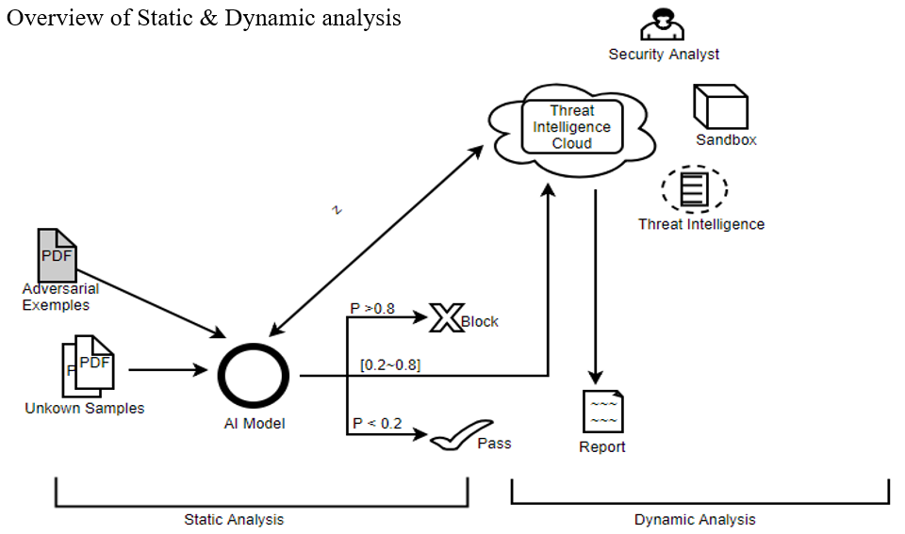
应用场景
Notes:
时间：3min

Slide 13
THANK
YOU
Notes:
时间：5min（包括提问环节）

