Slide 1
Selected Topics in CS
PHP - Advanced Concept
2020/2021(2013) AC
Chalew Tesfaye

Slide 2
Contents
OOP with PHP
OOP concept
Class and Object
Encapsulation
Inheritance
Polymorphism
Overloading
Overriding
Abstraction
…
Database Programming

Slide 3
PHP - OOP

Slide 4
OOP
An approach to software development
Models application around real world entity
Students, Courses, etc.
A class defines
Properties
Methods
An object is an occurrence of a class

Slide 5
OOP …
The basic components of object orientation
Object oriented analysis
functionality of the system
Object oriented designing
architecture of the system
Object oriented programming
implementation of the application

Slide 6
OOP principle
Encapsulation
Hiding implementation details
Expose only the method
Reduce software complexity
Protect internal state of an object
Implementation can be changed with out code breaking uses the class
Inheritance
Relationship between classes-> Parent –child
Re-usability
Polymorphism
Single form – many different implementation
Simplify maintaining application – more extendable

Slide 7
UML
Unified Modeling Language
is a technique used to
design and
document object oriented systems
UML produces a number of documents
focus on class diagram
very important to object oriented programming

Slide 8
UML …
Class diagram component
Upper box contains the class name
Middle box contains the class variables
Lower box contains the class methods
Minus (-) sign means private scope
Plus (+) sign means public scope
Hash (#) sign means protected scope
Student
-Id -Name #Grade
+Construct() +setId(id:string) +getId() +setName(name:string) +getName()

Slide 9
OOP in PHP
Encapsulation
via the use of “get” and “set” methods etc.
Inheritance
via the use of extends keyword
Polymorphism
via the use of implements keyword

Slide 10
Class in PHP
The class keyword is used to define a class in PHP
class name should start with a letter
class name cannot be a PHP reserved word
class name cannot contain spaces
Example:
a class for representing Course
Properties
Code, Title, Credit, …
Methods
getCode, setCode, getTitle, setTitle, …

Slide 11
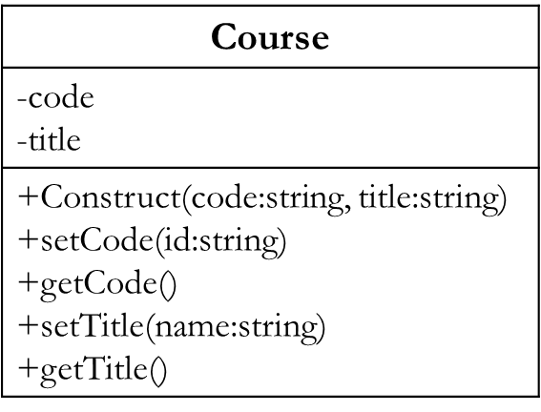
Class in PHP …
Class Diagram
Class Implementation
<?php
class Course
{
private $code;
private $title;
public function __construct($code, $title) {
$this->code = $code;
$this->title = $title;
}
public function getCode() {
return $this->code;
}
public function setCode($code){
$this->code = $code;
}
//…….
}
?>

Slide 12
Class in PHP …
“private $code, $title”
the variables cannot be accessed directly outside the class (Encapsulation)
“public function __construct($code…)”
is the php constructor method.
This function is called whenever an instance of the class has been created
“public function get…()”
is the method used to access the code or title value (Encapsulation)
“public function set…()”
is the method used to set the code or title value (Encapsulation)

Slide 13
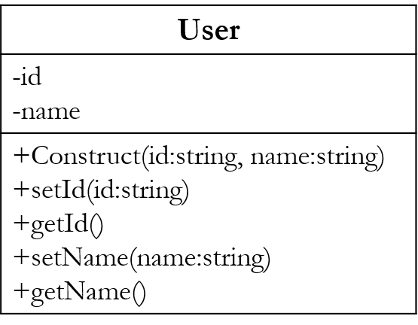
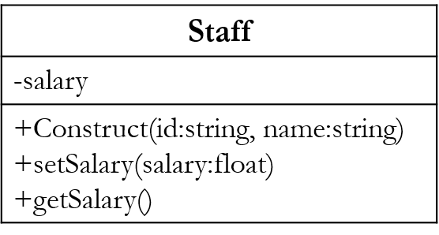
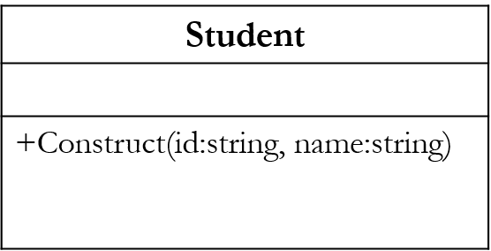
Inheritance in PHP
implemented with extends key word
Student and Staff inherit from User class
Staff inherits from the User class and defines its own variable and methods too

Slide 14
Inheritance in PHP …
User Class
<?php
class User
{
private $id;
private $name;
public function __construct($id, $name) {
$this->id=$id;
$this->name = $name;
}
public function setId($id) {
$this->id = $id;
}
public function getId() {
return $this->id;
}
public function setName($name) {
$this->name = $name;
}
public function getName(){
return $this->name;
}
}
?>

Slide 15
Inheritance in PHP …
Staff Class
Student Class
<?php
class Staff extends User {
private $salary;
public function __construct($id, $name) {
parent::__construct($id, $name);
}
public function setSalary($salary) {
$this->salary = $salary;
}
public function getSalary() {
return $this->salary;
}
}
?>
<?php
class Student extends User
{
public function __construct($id, $name)
{
parent::__construct($id, $name);
}
}
?>

Slide 16
Inheritance in PHP …
“class … extends User”
makes the Staff and Student use methods from the User class (Inheritance).

Slide 17
Example - Create object of the class
Create the application that uses our classes
<?php
require 'User.php';
require 'Staff.php';
require 'Student.php';
echo '<b>Object of a Class Example</b> <br> <hr/>';
$staff = new Staff('E0001', 'Fatuma');
$staff->setSalary(15000);
$student = new Student('S0001', 'Soliana');
echo '<b>Staff Info</b> <br>';
echo 'ID: ' . $staff->getId() . '<br>Name: ' . $staff->getName() . '<br>Salary: '. $staff->getSalary(). '<br><br>';
echo '<b>Student Info</b> <br>';
echo 'ID: ' . $student->getId() . '<br>Name: ' . $student->getName();
?>

Slide 18
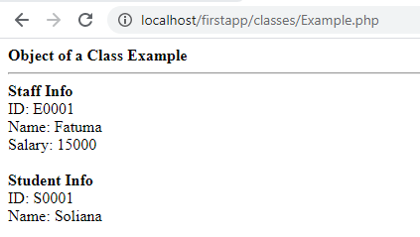
Example – Run the application
Let’s now view the application in a web browser

Slide 19
Polymorphism in PHP
Having sing form/structure – different implementation
Implemented by implements key word
Example:
develop an application that connects to different database engines
Oracle, MySQL and SQL Server but use the same uniform interface
create
an interface that defines the standard methods
an abstract class that implements the common methods

Slide 20
Polymorphism in PHP …
Interface
similar to a class
only defines the methods and parameters – Signature
Created with interface keyword
Abstract class
a class that cannot be used to create an object directly
provide partial or whole implementations of common methods
Created with abstract keyword

Slide 21
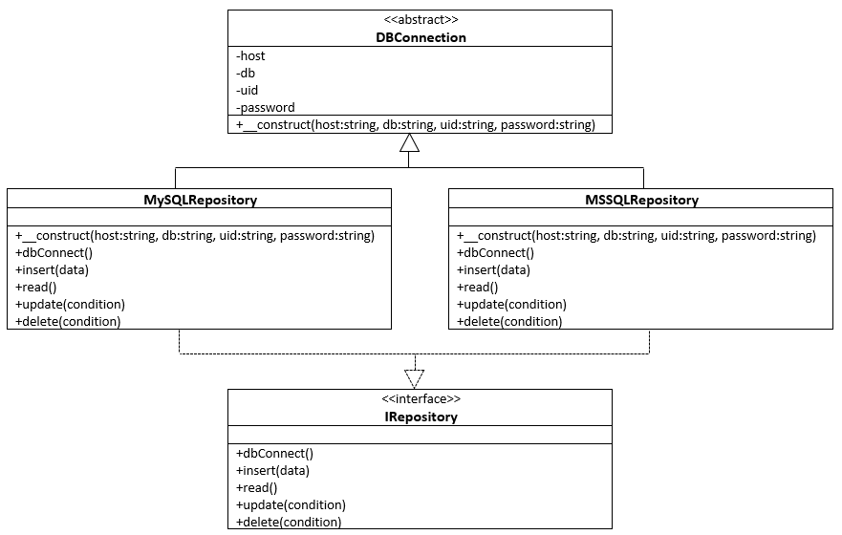
Polymorphism in PHP …

Slide 22
Polymorphism in PHP …
<?php
abstract class DBConnection
{
private $host;
private $db;
private $uid;
private $password;
public function __construct($host, $db, $uid, $password) {
$this->host = $host;
$this->db = $db;
$this->uid = $uid;
$this->password = $password;
}
}
?>

Slide 23
Polymorphism in PHP …
<?php
interface IRepository
{
public function dbConnect();
public function insert($data);
public function read($where);
public function update($where);
public function delete($where);
}
?>

Slide 24
Polymorphism in PHP …
<?php
class MySQLRepository extends DBConnection implements IRepository
{
public function __construct($host, $db, $uid, $password) {
parent::__construct($host, $db, $uid, $password);
}
public function dbConnect() {
//connect code goes here
}
public function delete($where) {
//delete code goes here
}
public function insert($data) {
//insert code goes here
}
public function read($where) {
//read code goes here
}
public function update($where) {
//update code goes here
}
}
?>

Slide 25
Polymorphism in PHP …
<?php
class MSSQLRepository extends DBConnection implements IRepository
{
public function __construct($host, $db, $uid, $password) {
parent::__construct($host, $db, $uid, $password);
}
public function dbConnect() {
//connect code goes here
}
public function delete($where) {
//delete code goes here
}
public function insert($data) {
//insert code goes here
}
public function read($where) {
//read code goes here
}
public function update($where) {
//update code goes here
}
}
?>

Slide 26
Polymorphism in PHP …
“class … extends DBConnection”
use the methods in the DBConnection abstract class
“… implements IRepository”
ensures that the class provides standard methods regardless of the database driver used
Usage of the above code
<?php
$db = new MySQLRepository($host,$db,$uid,$password);
?>
OR
<?php
$db = new MSSQLRepository($host,$db,$uid,$password);
?>
The rest of the code would be the same for both drivers such as;
<?php
$db->dbConnect();
$db->insert($data);
?>

Slide 27
Object Oriented Concepts summary
Class
Real world entity
Object
individual instance of a class
Member Variable
variables defined inside a class.
Member function
function defined inside a class and are used to access object data
Inheritance
a class is defined by inheriting existing function of a parent class

Slide 28
OO concepts …
Parent class/ base class /super class
A class that is inherited from by another class.
Child Class/ subclass /derived class.
A class that inherits from another class. also called a subclass or derived class
Polymorphism
same function can be used for different purposes
Overloading
polymorphism in types of argument(s)
also be overloaded with different implementation
Overriding
change the behavior of parent class method

Slide 29
OO concepts …
Data Abstraction
the implementation details are hidden (abstracted)
Encapsulation
hide all the data and member functions together to form an object
Constructor
special type of function which will be called automatically whenever there is an object formation from a class
Destructor
special type of function which will be called automatically whenever an object is deleted or goes out of scope

Slide 30
PHP - OOP
Questions?

Slide 31
PHP – Database Programming

Slide 32
Database Programming
Introduction to Relational Database System
Relational Database System Management System Software
Structured Query Language
Connecting PHP application to Database System
Creating and executing statements
Working on populated data/Result set
Using database objects in application program

Slide 33
Database System – Review
A database is
a collection of related,
logically coherent data used by the application programs in an organization.
Advantages of databases
Less redundancy
Inconsistency avoidance
Efficiency
Data integrity
Confidentiality

Slide 34
RDMS
A database management system (DBMS)
defines,
creates and
maintains a database
allows controlled access to data in the database.
A DBMS is a combination of five components:
hardware,
software,
data,
users and
procedures

Slide 35
Relational Database Model
Data are organized in two-dimensional tables called relations.
The tables are related to each other.
A relation in an RDBMS has the following features:
Name of entity
Attributes
Tuples

Slide 36
Relational Integrity Constraints
Constraints are conditions that must hold on all valid relation states.
There are three main types of constraints in the relational model:
Key constraints
Primary Key
Unique Key
Foreign Key
Entity integrity constraints
Referential integrity constraints
Another implicit constraint is the domain constraint
Every value in a tuple must be from the domain of its attribute (or it could be null, if allowed for that attribute)
Check constraints
Default value constraint

Slide 37
SQL
SQL is the language standardized by
the American National Standards Institute (ANSI) and
the International Organization for Standardization (ISO) for use on relational databases.
It is a declarative rather than procedural language,
which means that users declare what they want without having to write a step-by-step procedure.

Slide 38
SQL …
In a relational database,
can define several operations to create new relations out of the existing ones.
Basic operations:
Insert
Delete
Update
Select
Project
Join
Union
Intersection
Difference

Slide 39
SQL … violation
INSERT may violate any of the constraints:
Domain constraint:
if one of the attribute values provided for the new tuple is not of the specified attribute domain
Key constraint:
if the value of a key attribute in the new tuple already exists in another tuple in the relation
Primary Key
Unique Key
Referential integrity:
if a foreign key value in the new tuple references a primary key value that does not exist in the referenced relation
Entity integrity:
if the primary key value is null in the new tuple

Slide 40
SQL … Violation
DELETE may violate only referential integrity:
If the primary key value of the tuple being deleted is referenced from other tuples in the database
Can be remedied by several actions: RESTRICT, CASCADE, SET NULL, SET DEFAULT
RESTRICT/NO ACTION option: reject the deletion
CASCADE option: propagate the new primary key value into the foreign keys of the referencing tuples
SET NULL option: set the foreign keys of the referencing tuples to NULL
SET DEFAULT option : set the foreign keys of the referencing tuples to the default value if any
One of the above options must be specified during database design for each foreign key constraint

Slide 41
SQL … violation
UPDATE may violate domain constraint and NOT NULL constraint on an attribute being modified
Any of the other constraints may also be violated, depending on the attribute being updated:
Updating the primary key (PK):
Similar to a DELETE followed by an INSERT
Need to specify similar options to DELETE
Updating a foreign key (FK):
May violate referential integrity
Updating an ordinary attribute (neither PK nor FK):
Can only violate domain constraints

Slide 42
RDMS
Networked RDBMS
Oracle
For large mission critical systems runs on Linux
MS SQL Server
Used in small to medium sized systems run in Windows server
DB2
For large mission critical systems runs on IBM OS
MySQL/MariaDB
Open source, runs on major operating system, commonly used in web application
Apache Derby/Java DB
New java based relation database, can be embedded in application
…
Embedded RDBMS
Apache Derby/Java DB
MS Access
Compact/SQLite version of MS SQL, Oracle

Slide 43
SQL Skill
Creating and/or modifying database objects
Retrieving data from a table
Insert, Delete, update data
Using functions
String function
Numeric functions
Date/Time functions
Other functions
Creating View
Transact-SQL programming
Scripts
Creating triggers
Stored procedures
Functions
Working with Transaction

Slide 44
PHP – MySQL database
Mysql
mysql_connect
Open a connection to a MySQL Server
deprecated in PHP 5.5.0
removed in PHP 7.0.0.
MySQLi
MySQL Improved Extension
allows access to the functionality provided by MySQL 4.1 and above
PDO
implements the PHP Data Objects (PDO) interface to enable access from PHP to MySQL databases

Slide 45
Example - mysql_connect()
<?php $conn = mysql_connect('localhost', 'mysql_user', 'mysql_password'); if (!$conn) { die('Could not connect: ' . mysql_error()); } echo 'Connected successfully'; mysql_close($conn); ?>

Slide 46
Example - MySQLi - Object-oriented
<?php $servername = "localhost"; $username = "username"; $password = "password"; // Create connection $conn = new mysqli($servername, $username, $password); // Check connection if ($conn->connect_error) { die("Connection failed: " . $conn->connect_error); } // Create database $sql = "CREATE DATABASE testdb"; if ($conn->query($sql) === TRUE) { echo "Database created successfully"; } else { echo "Error creating database: " . $conn->error; } $conn->close(); ?>

Slide 47
MySQLi …
New database – three argument
mysqli object (servername, username and password).
If you have to use a specific port,
add an empty string for the database-name argument
new mysqli("localhost", "username", "password", "", port)

Slide 48
MySQLi – Procedural
<?php $servername = "localhost"; $username = "username"; $password = "password"; // Create connection $conn = mysqli_connect($servername, $username, $password); // Check connection if (!$conn) { die("Connection failed: " . mysqli_connect_error()); } // Create database $sql = "CREATE DATABASE testdb"; if (mysqli_query($conn, $sql)) { echo "Database created successfully"; } else { echo "Error creating database: " . mysqli_error($conn); } mysqli_close($conn); ?>

Slide 49
PDO - PHP Data Objects
<?php $servername = "localhost"; $username = "username"; $password = "password"; try { $conn = new PDO("mysql:host=$servername", $username, $password); // set the PDO error mode to exception $conn->setAttribute(PDO::ATTR_ERRMODE, PDO::ERRMODE_EXCEPTION); $sql = "CREATE DATABASE testdb"; // use exec() because no results are returned $conn->exec($sql); echo "Database created successfully<br>"; } catch(PDOException $e) { echo $sql . "<br>" . $e->getMessage(); } $conn = null; ?>
PDO
has exception class to handle any problems

Slide 51
Questions?

