Slide 1

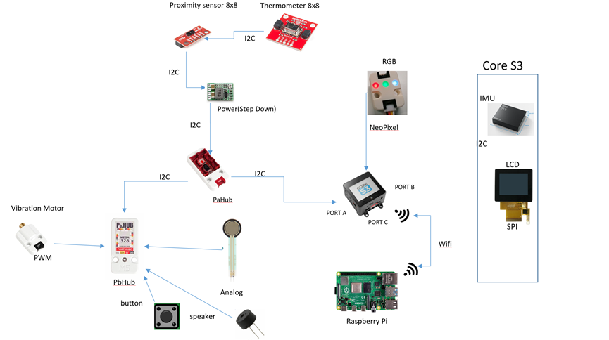
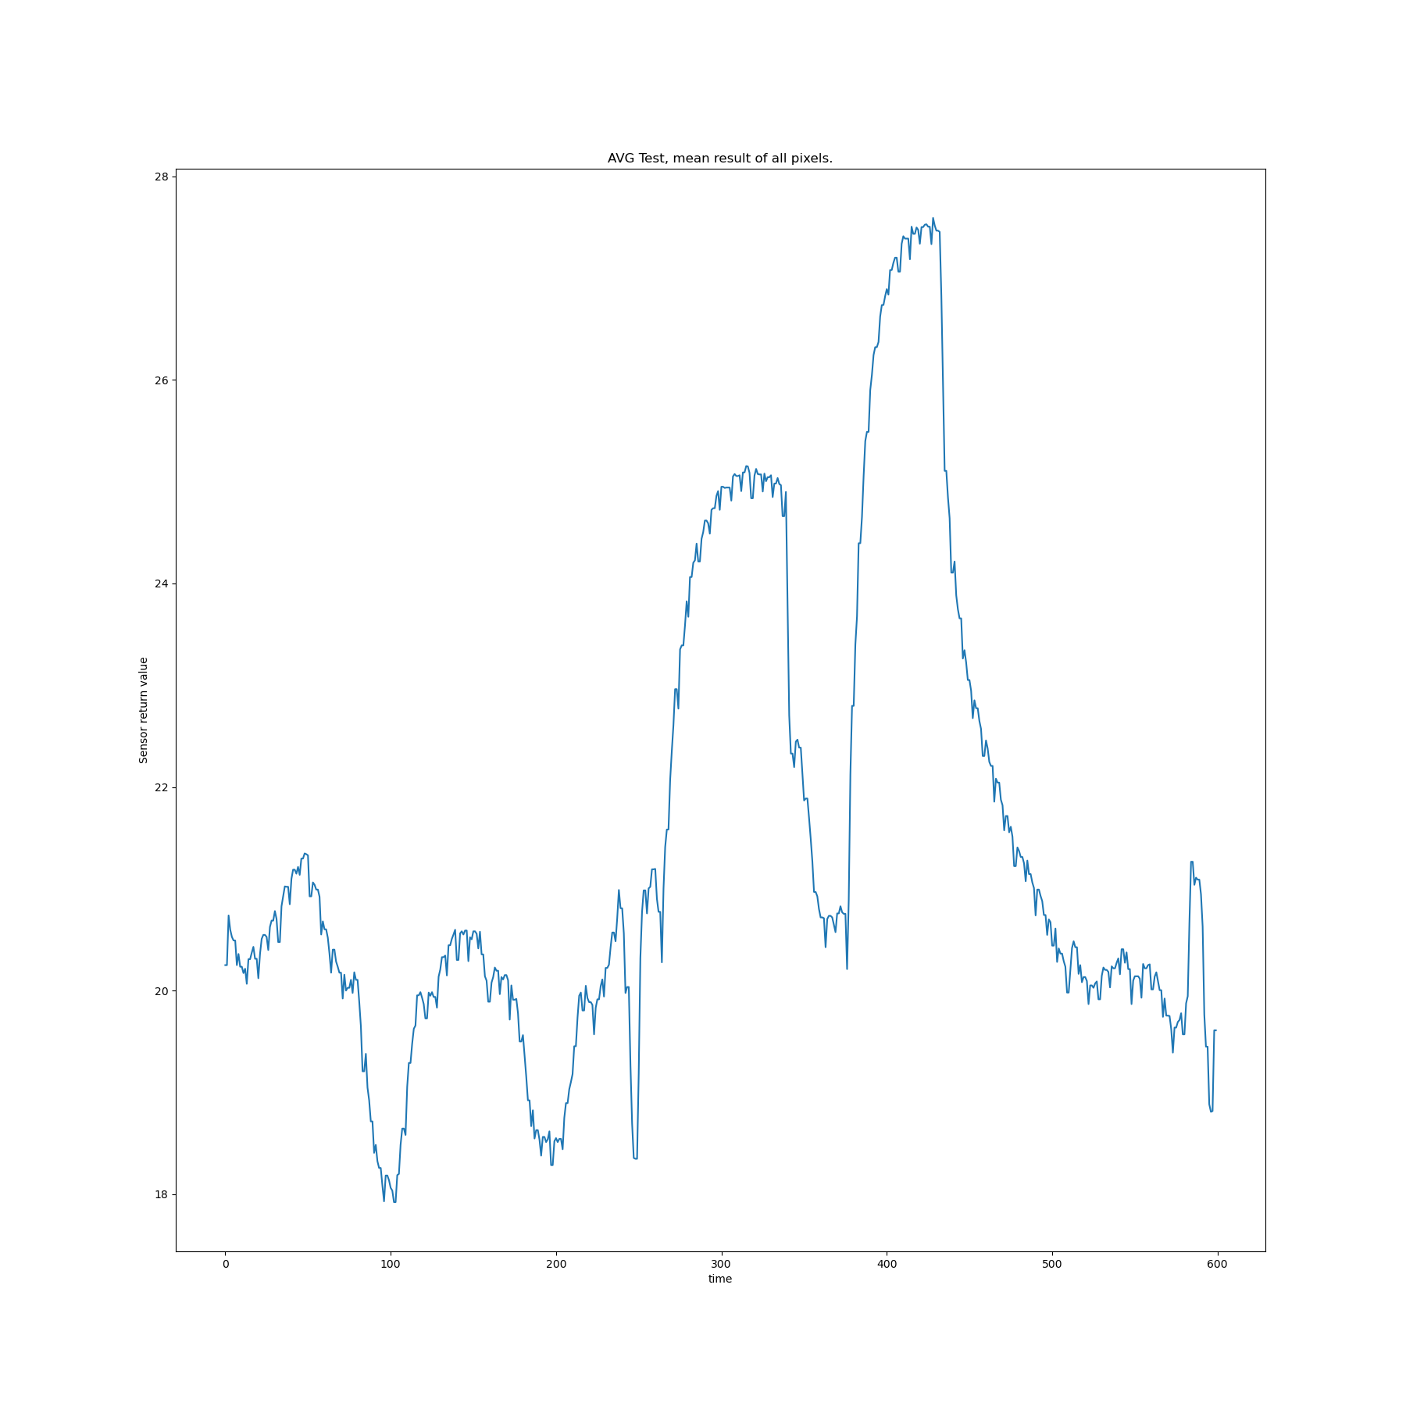
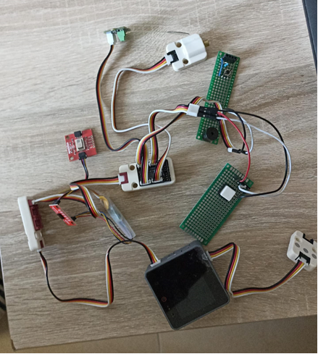
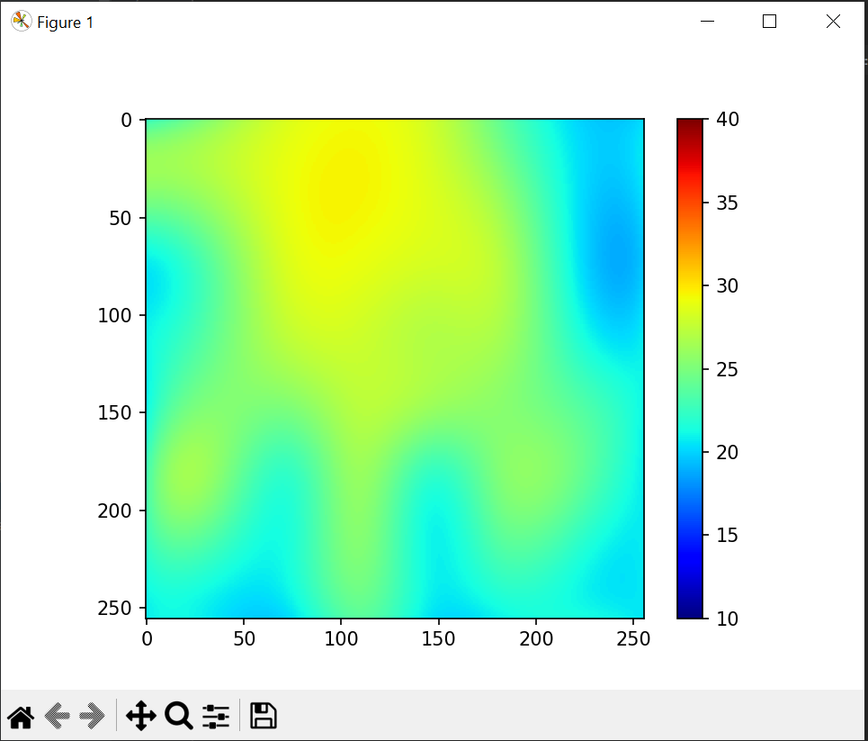
Insert The Project Name Here
Project Number: 22-1-1-2666
Names: Yonatan Amir, Yuri Lukach
Advisor: Simcha Leibovich
DON’T FORGET TO DELETE THIS TEXT! This spot is a reserved spot for the company/lab logo, only if applicable!
Introduction This final project focuses on developing an Arduino-based framework to support upcoming electrical engineering endeavors, specifically targeting applications within the realm of physiotherapy Motivation/Objectives In this initiative, our goal is to establish a comprehensive and standardized framework that will serve as a foundational resource for subsequent projects requiring such infrastructureץ The designed workspace and infrastructure will integrate various sensor inputs and outputs, along with auditory and visual stimuli, to create a rich sensory environment. | Methods/Implementation Results Infrastructure for user usage, As an example we’ve leveraged interpolation to enhance the resolution of temperature readings from an 8x8 grid to a 256x256 matrix using the AMG8833 thermal camera. This technique is demonstrated in the image, where hand was placed in front of the sensor to test the camera's ability to detect and visualize the heat signature at a higher resolution. | Conclusions The developed infrastructure successfully integrates a range of sensor inputs and outputs, along with visual and auditory elements, to create a comprehensive monitoring and interaction environment. This cohesive setup demonstrates a significant advancement in creating versatile and adaptable systems for various applications, from environmental monitoring to interactive installations.

