Slide 1

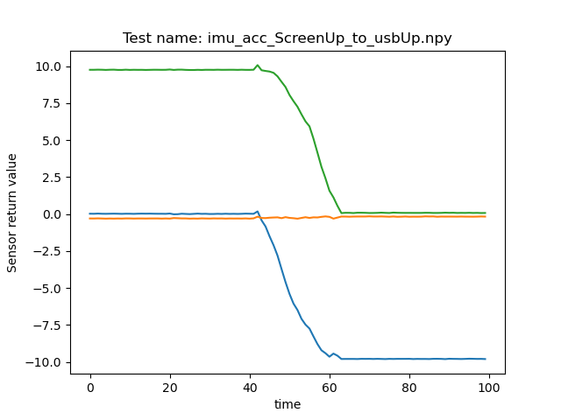
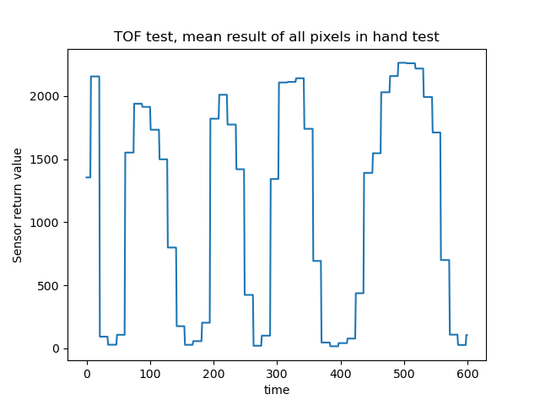
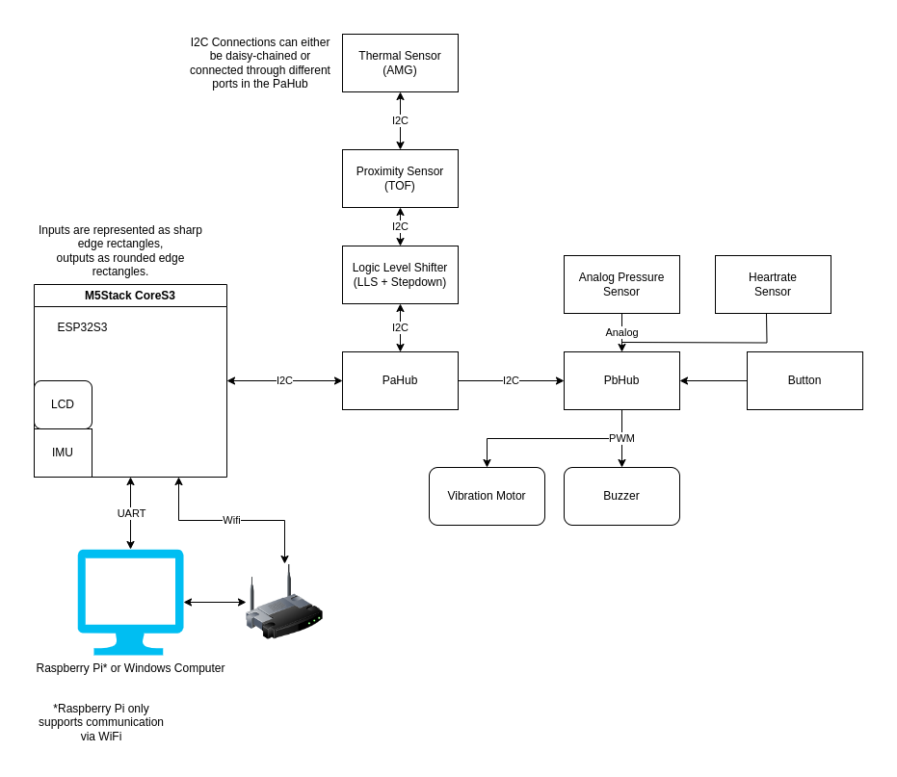
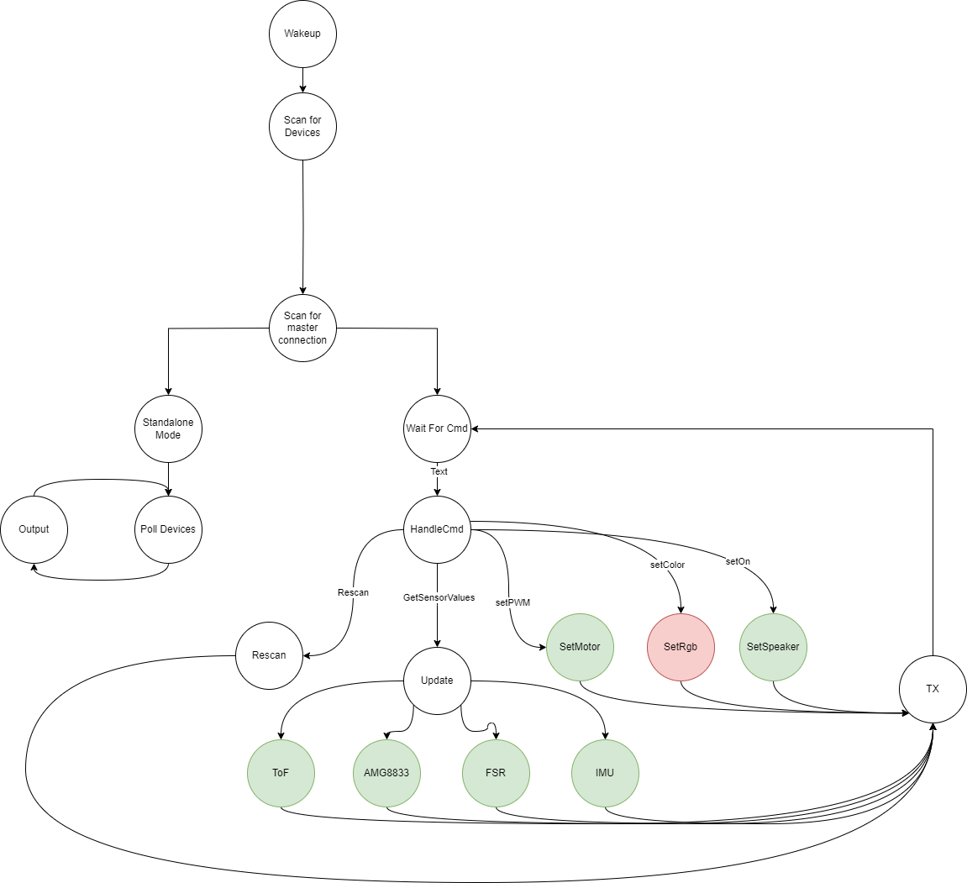
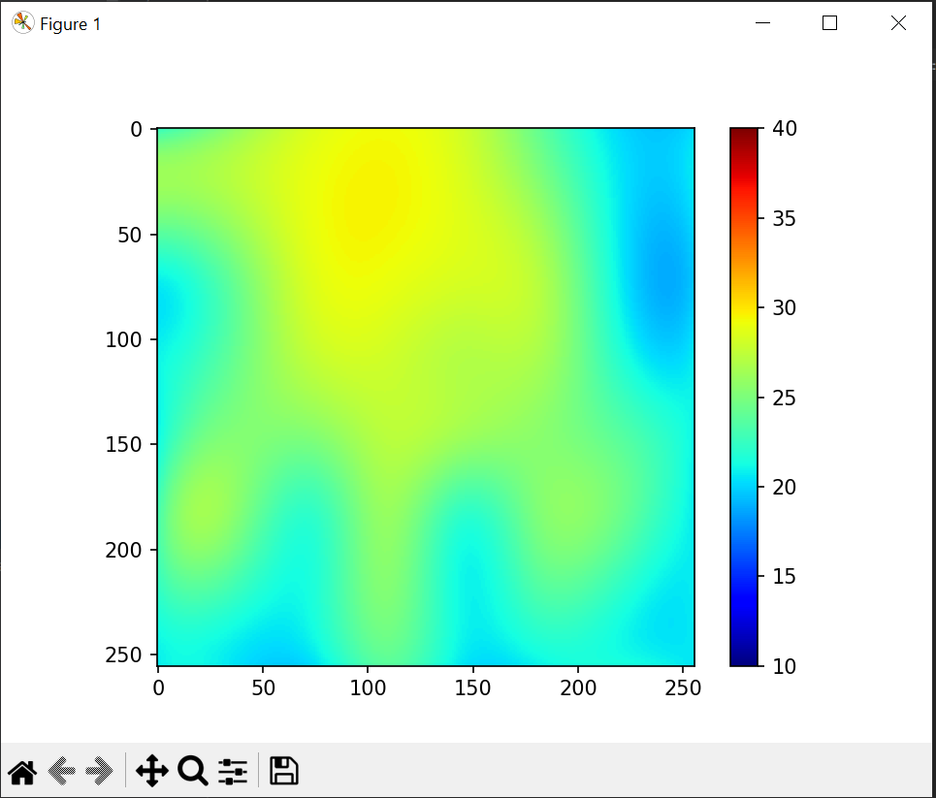
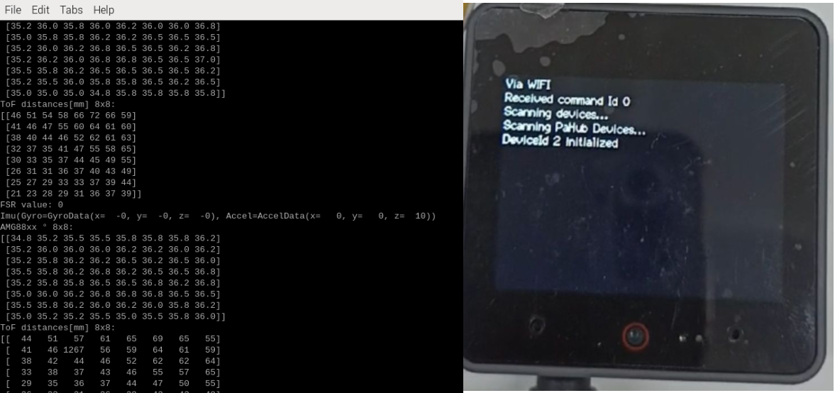
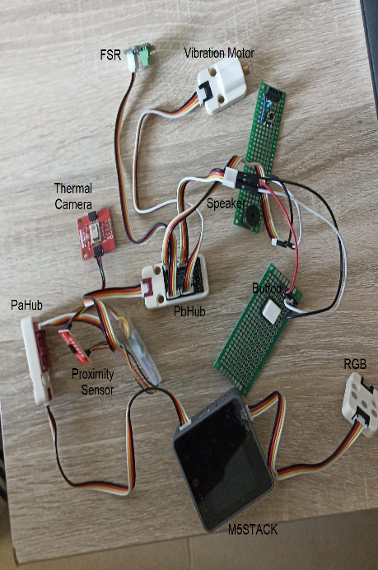
Arduino Telemetry
Project Number: 22-1-1-2666
Names: Yonatan Amir, Yuri Lukach
Advisor: Simcha Leibovich
Introduction This final project focuses on developing an Arduino-based framework to support upcoming electrical engineering endeavors, specifically targeting applications within the realm of physiotherapy. This versatile system is engineered to integrate seamlessly with both I2C and GPIO sensors, streamlining the process of connecting hardware and developing tailored software solutions. Accompanying this hardware is a thorough documentation, meticulously detailing the setup procedures and operational guidelines for the custom software we have developed, and regard the hardware and testing. Motivation/Objectives A robust framework around the M5 Stack controller with an ESP32 core, featuring a variety of sensors and outputs. Rigorous testing across the board ensures reliable results for sensors. Embedded documentation facilitates easy adoption, setting a solid foundation for future projects without redundant testing or development. Cross platform ability enables development on PC and implementation on RPI. Methods/Implementation System consists of the M5StackCoreS3, integrated sensors, connectible sensors and outputs. | Our design utilizes a modular styled API that supports different sensors and extendibility, built over a robust state machine in two different modes. Results The finished device supports a myriad of sensors. Below is example of the AMG thermal 8X8 camera being used to visualize the hand of one of our testers. Image above shows the enhanced output of a thermal camera after a hand was placed in view, with the original 8x8 data expanded to a clearer 256x256 resolution | Similar test results can be seen in the documentation. The above graphs display samples of tests done on several of the sensors in the system. Software The software operates in two modes: standalone mode, which displays Controller sensor data, and a slave mode API for transmitting results to a PC or Raspberry Pi using either a serial or Wi-Fi connection. On the left is the sensor data output sent to a Raspberry Pi via Wi-Fi, while the right shows the controller scanning for sensors and displaying hardware status in standalone mode Conclusions The developed infrastructure successfully integrates a range of sensor inputs and outputs, along with visual and auditory elements, to create a comprehensive monitoring and interaction environment. This cohesive setup demonstrates a significant advancement in creating versatile and adaptable systems for various applications, from environmental monitoring to interactive installations.

