Slide 1

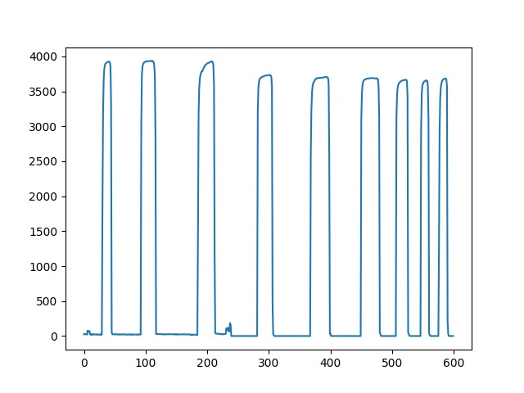
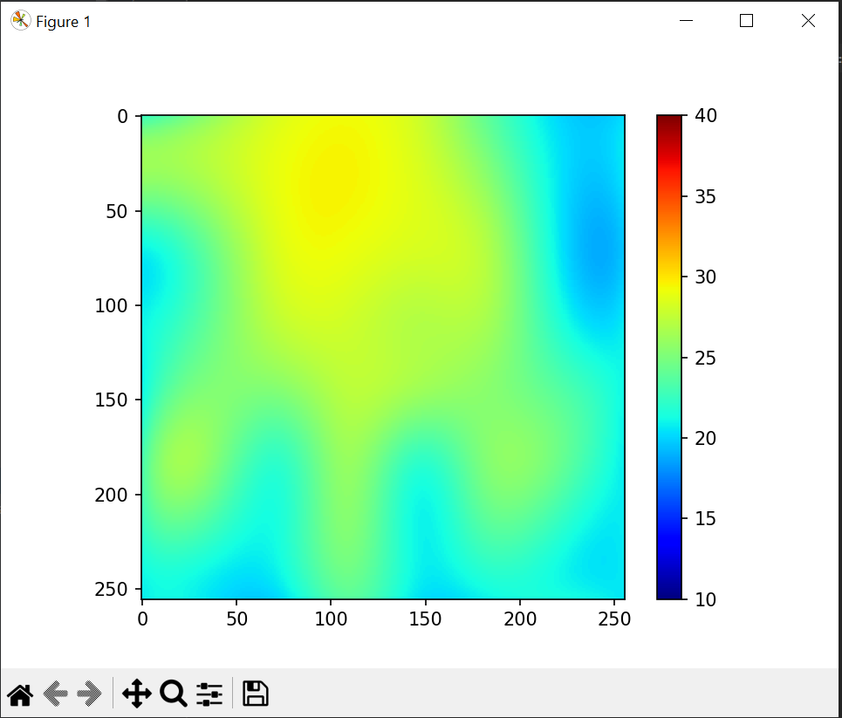
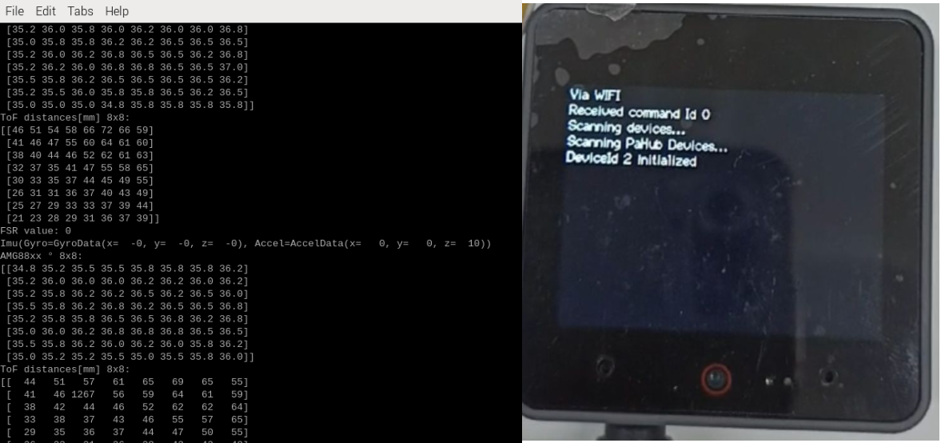
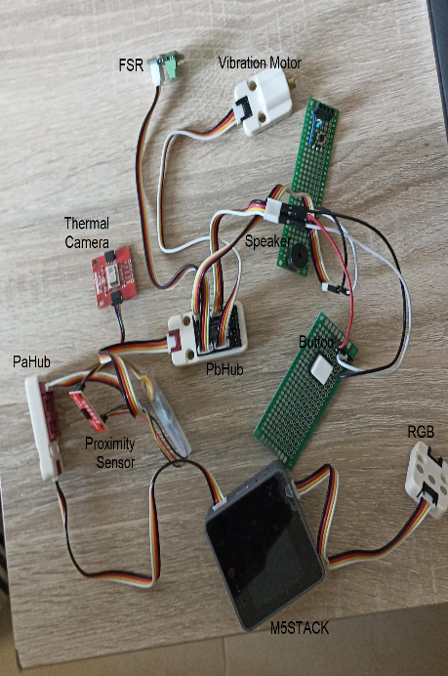
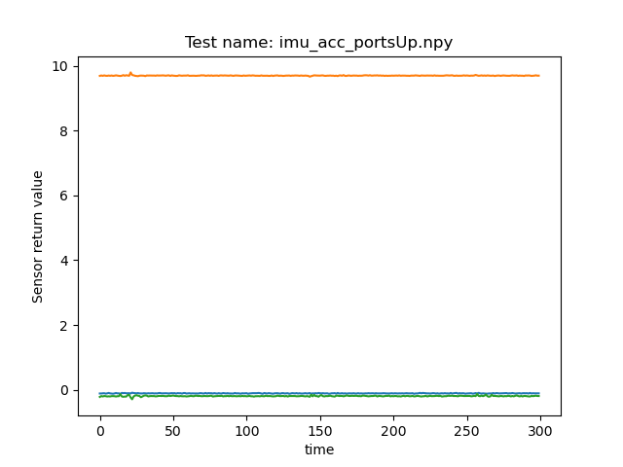
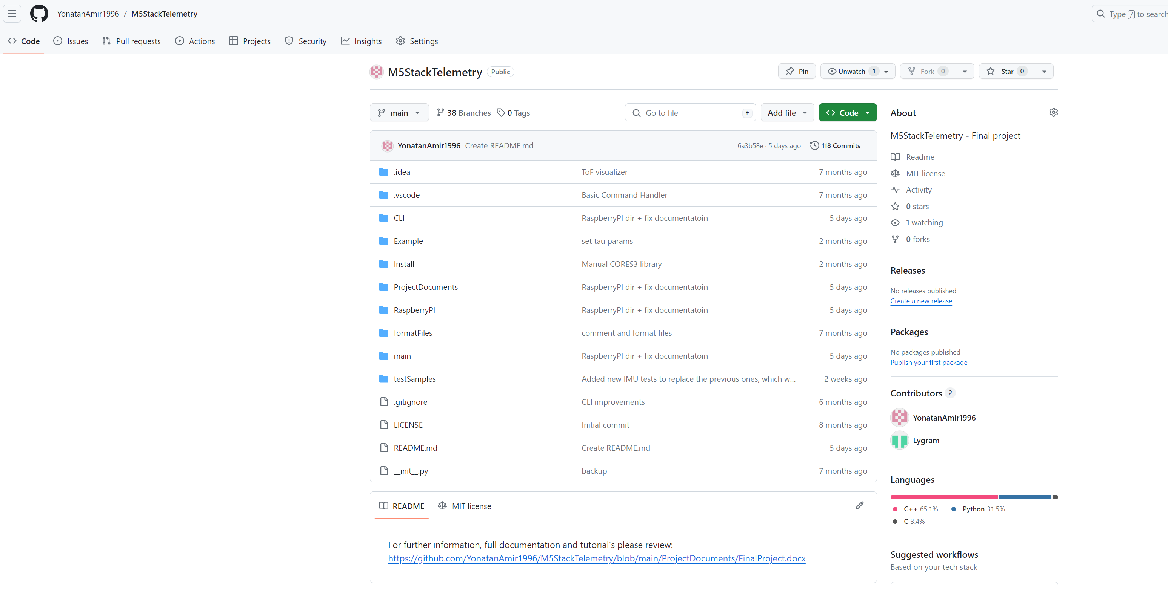
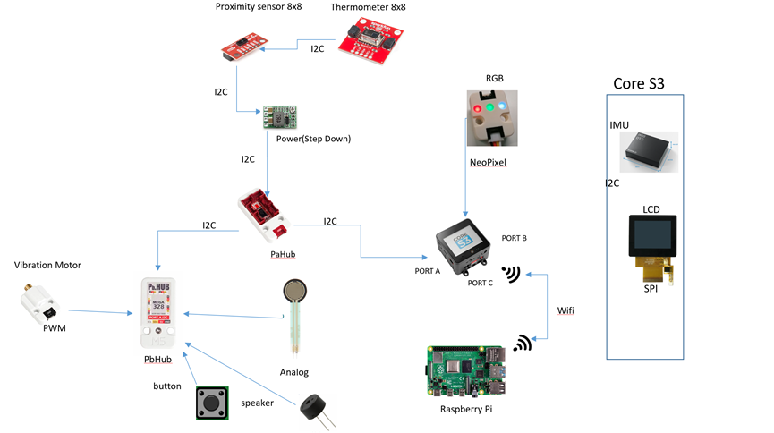
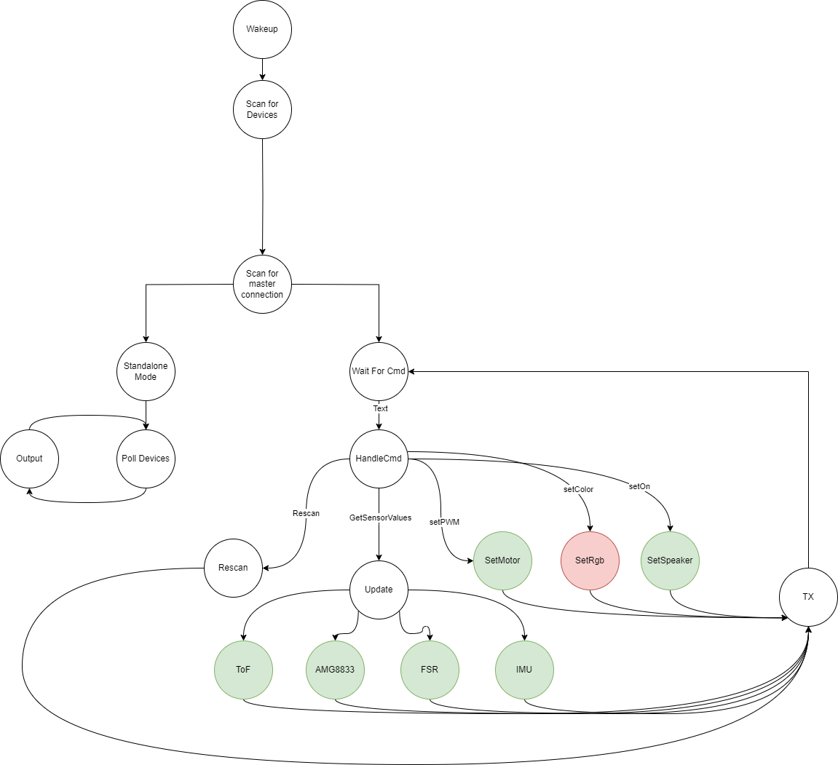
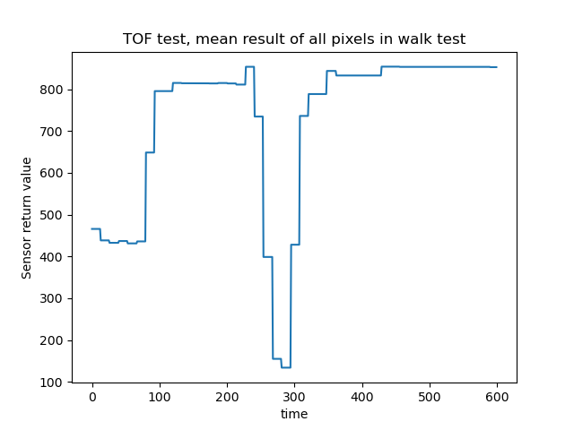
Arduino Telemetry
Project Number: 22-1-1-2666
Names: Yonatan Amir, Yuri Lukach
Advisor: Simcha Leibovich
Introduction This final project focuses on developing an Arduino-based framework to support upcoming electrical engineering endeavors, specifically targeting applications within the realm of physiotherapy. This versatile system is engineered to integrate seamlessly with both I2C and GPIO sensors, streamlining the process of connecting hardware and developing tailored software solutions. Software running modes - Standalone or slave mode. In case of slave mode, offering robust control through serial and Wi-Fi connectivity and integration with Raspberry PI. Accompanying this hardware is a thorough documentation, meticulously detailing the setup procedures and operational guidelines for the custom software we have developed, and regard the hardware and testing. Motivation/Objectives A robust framework around the M5 Stack controller with an ESP32 core, featuring: ToF sensor – distance Sensor AMG8833 - Thermal camera FSR – Force Resistor Sensor IMU – Inertial Measurement Unit. PaHub – I2C Multiplexer PbHub – Analog, PWM and GPIO Multiplexer Rigorous testing across the board ensures reliability: gyro and acceleration precision for the IMU, proximity accuracy for the Proximity Sensor, heat detection for the thermal camera and sensitivity for the Force resistor sensor. Output hardware are: Button Buzzer RGB Embedded documentation facilitates easy adoption, setting a solid foundation for future projects without redundant testing. System Image Methods/Implementation System Block Diagram and Arduino State Machine | Our design utilizes the M5 Stack Core S3 Controller, operating on a 5V supply. It interfaces with the I2C multiplexer, linking I2C sensors such as the distance sensor and the Thermal camera. A stepdown to 3.3V was necessary to be soldered for compatibility. The secondary, multiplexer, manages GPIO, Analog, and PWM inputs, including a built-in ADC, and connects devices like buttons, speakers, and FSR’s. For display output, the built-in port B powers an RGB Neopixel. We’ve engineered two operational modes: a standalone mode that displays sensor readings on an LCD, and a slave mode which leverages a Python API for sensor data output and command input to peripherals, such as speakers or vibration motors. Outputs can be exported as numpy matrices for in-depth analysis. To ease integration, we've compiled documentation covering installation, usage, and tutorials for extending the API's capabilities. Results Post-testing, we applied interpolation techniques to refine the thermal readings obtained with the thermal camera, transforming an 8x8 grid into a detailed 256x256 matrix. This upgrade allowed us to test the camera's capability to discern and enhance heat signatures, as demonstrated when a hand was placed in front of the sensor. Image above shows the enhanced output of a thermal camera after a hand was placed in view, with the original 8x8 data expanded to a clearer 256x256 resolution The graph presents results from advanced testing of the IMU's gyroscope and acceleration sensors, measuring the Earth’s gravitational force. Graph depicting the IMU's acceleration output across a series of samples, orange line represents the z-axis acceleration, closely matching the predicted value and confirming Earth's gravitational pull at approximately 9.81 m/s². The blue and green lines depict the stable x-axis and y-axis accelerations, respectively. For the distance sensor, we conducted a ‘walk test’ distance. By approaching and then distancing the from the sensor, we observed fluctuations in the mean sensor values, which effectively indicated increases and decreases in the distance. The chart illustrates the average output from a distance sensor during a movement test, with distance measurements in millimeters over a sequence of samples. Fluctuations in the data reflect the subject moving closer to or further from the sensor, based on the mean result from a 64-pixel (8x8 grid) array of the distance sensor | We conducted a series of press tests on the Force resistor sensor to evaluate its sensitivity and responsiveness. The sensor was repeatedly compressed and released to verify its ability to consistently register pressure changes. The graph displays the force resistor sensor readings across multiple samples, illustrating the cyclical application and removal of force on the sensor. The software operates in two modes: standalone mode, which displays Controller sensor data, and a slave mode API for transmitting results to a PC or Raspberry Pi using either a serial or Wi-Fi connection. On the left is the sensor data output sent to a Raspberry Pi via Wi-Fi, while the right shows the controller scanning for sensors and displaying hardware status in standalone mode The software's documentation and usage guidelines, including detailed installation instructions and tutorials, are available on GitHub GitHub repository page of the project Conclusions The developed infrastructure successfully integrates a range of sensor inputs and outputs, along with visual and auditory elements, to create a comprehensive monitoring and interaction environment. This cohesive setup demonstrates a significant advancement in creating versatile and adaptable systems for various applications, from environmental monitoring to interactive installations.

