Slide 1
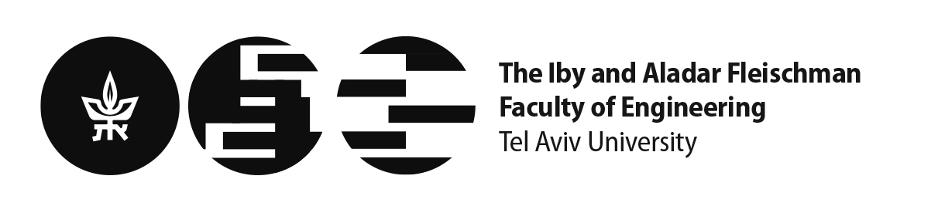
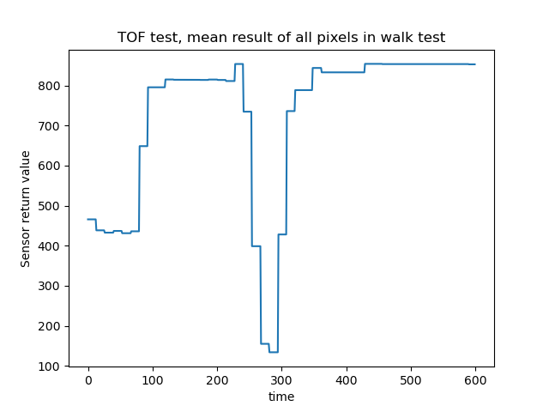
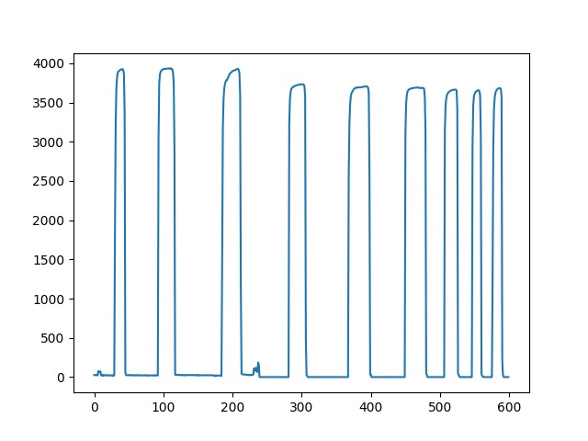
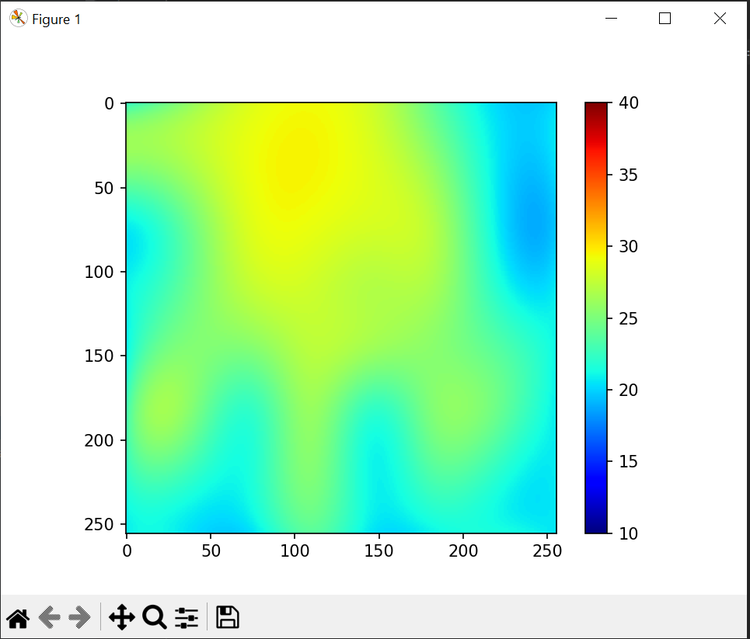
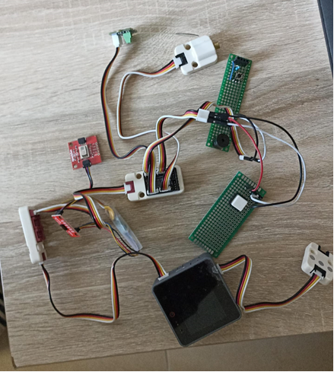
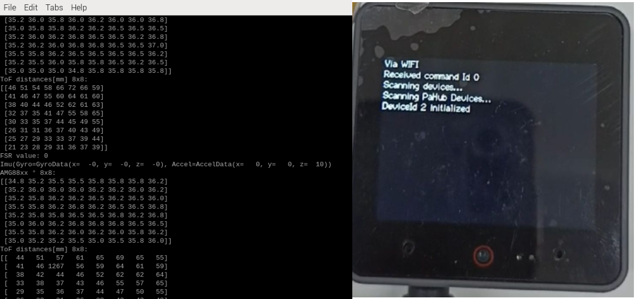
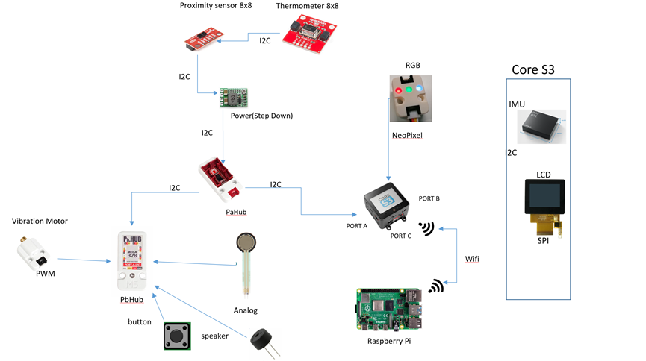
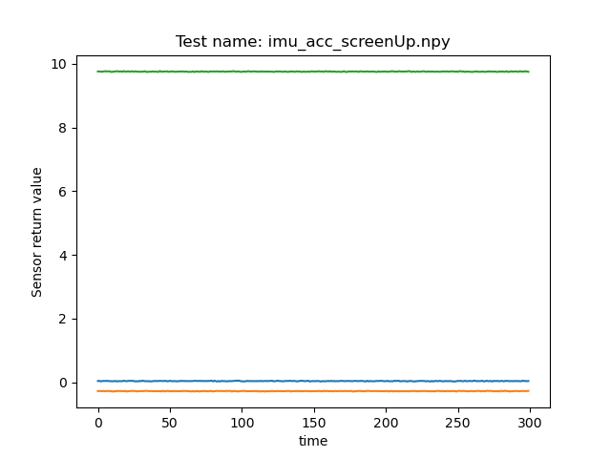
Arduino Telemetry
Project Number: 22-1-1-2666
Names: Yonatan Amir, Yuri Lukach
Advisor: Simcha Leibovich
Introduction This final project focuses on developing an Arduino-based framework to support upcoming electrical engineering endeavors, specifically targeting applications within the realm of physiotherapy. This versatile system is engineered to integrate seamlessly with both I2C and GPIO sensors, streamlining the process of connecting hardware and developing tailored software solutions. Software running modes - Standalone or slave mode. In case of slave mode, offering robust control through serial and Wi-Fi connectivity and integration with Raspberry PI. Accompanying this hardware is a thorough documentation, meticulously detailing the setup procedures and operational guidelines for the custom software we have developed, and regard the hardware and testing. Motivation/Objectives A robust framework around the M5 Stack controller with an ESP32 core, featuring a ToF sensor, AMG8833 thermal camera, and FSR, along with an integrated IMU for motion tracking. Rigorous testing across the board ensures reliability: gyro and acceleration precision for the IMU, proximity accuracy for the ToF, heat detection for the AMG8833, and sensitivity for the FSR. Output hardware—such as a button, speaker, vibration motor and RGB LEDs—enhances user interaction. Embedded documentation facilitates easy adoption, setting a solid foundation for future projects without redundant testing. Methods/Implementation | Our design utilizes the M5 Stack Core S3 Controller, operating on a 5V supply. It interfaces with the PaHub multiplexer, linking I2C sensors such as the ToF distance sensor and the AMG8833 Thermal camera. A stepdown to 3.3V was necessary to be soldered for compatibility. The PbHub, another multiplexer, manages GPIO, Analog, and PWM inputs, including a built-in ADC, and connects devices like buttons, speakers, and FSRs. For display output, the built-in port B powers an RGB Neopixel. We’ve engineered two operational modes: a standalone mode that displays sensor readings on an LCD, and a slave mode which leverages a Python API for sensor data output and command input to peripherals, such as speakers or vibration motors. Outputs can be exported as numpy matrices for in-depth analysis. To ease integration, we've compiled documentation covering installation, usage, and tutorials for extending the API's capabilities. Results Post-testing, we applied interpolation techniques to refine the thermal readings obtained with the AMG8833 thermal camera, transforming an 8x8 grid into a detailed 256x256 matrix. This upgrade allowed us to test the camera's capability to discern and enhance heat signatures, as demonstrated when a hand was placed in front of the sensor. Further testing of the IMU encompassed evaluations of its gyroscope and acceleration sensors. Notably, the z-axis acceleration, highlighted in green, aligned with predictions, substantiating the presence of Earth's gravitational force at around$9.81[\frac{m}{s^{2}}]$. | For the ToF sensor, we conducted a 'walk test' to assess its responsiveness to changes in distance. By approaching and then distancing from the sensor, we observed fluctuations in the mean sensor values, which effectively indicated increases and decreases in proximity. We conducted a series of press tests on the FSR to evaluate its sensitivity and responsiveness. The sensor was repeatedly compressed and released to verify its ability to consistently register pressure changes. We’ve managed to create an standalone mode and slave mode API’s Conclusions The developed infrastructure successfully integrates a range of sensor inputs and outputs, along with visual and auditory elements, to create a comprehensive monitoring and interaction environment. This cohesive setup demonstrates a significant advancement in creating versatile and adaptable systems for various applications, from environmental monitoring to interactive installations.

