Slide 1
Where Should I Live?
IBM Data Science professional certificate
Capstone project – the battle of neighbourhoods

Slide 2
Business Problem
According to INSEE, in France, in 2013, about one household in five changed housing at least once between 2009 and 2013.
A common question remains: which neighbourhoods are the best place for them to start their new adventure?
A household has several criterions on which it bases its choice, and they are often complex, sometimes incompatible

Slide 3
Business Solution
Provide households with a decision-making tool
Guide households in their choice of their future neighbourhood
HOW
Comparing and reconciling the characteristics of each city's neighbourhood

Slide 4
Data acquisition and cleaning
Three sources of data
Foursquare, gives us access to all the facilities near the neighbourhood. We will just extract the families of the categories. One can find the Foorsquare families’ tree there.
INSEE, the French National Institute of Statistics and Economic Studies which will provide to us distribution of ages and professional categories for each neighbourhood. You can find the data there.
IGN, French National Institute of Geographic information, which provides a breakdown of the French territory into districts, with geometric contours. You can find the data there.

Slide 5

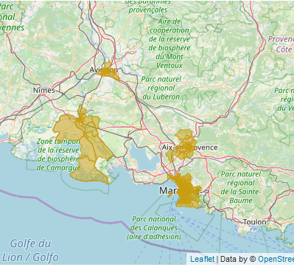
Geographic limitation
We have chosen to limit our analysis to four cities of the South of France: Aix-en-Provence, Arles, Avignon, Marseille

Slide 6
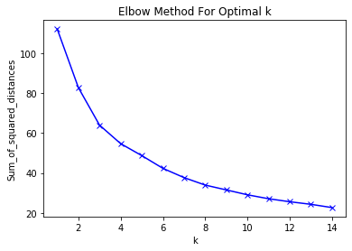
Methodology
Clustering the indicators
Clustering algorithm
Optimization: Elbow method
Suggested 4 clusters for each indicator

Slide 7
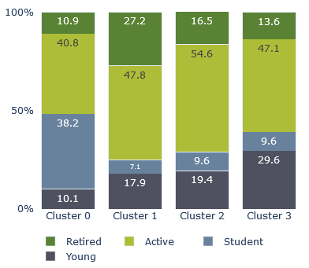
Clustering age groups
4 clusters
Cluster 0: student districts
Cluster 1: retirement districts
Cluster 2: business districts
Custer 3: family districts

Slide 8
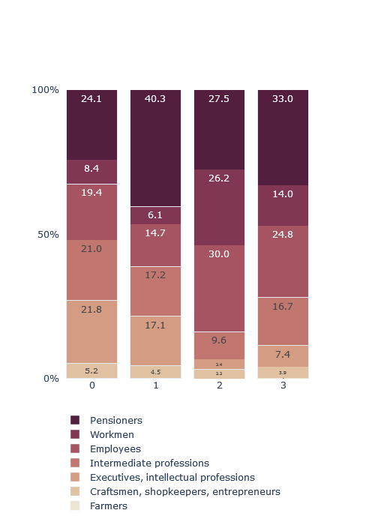
Clustering Professional groups
4 clusters
Cluster 0: Upper-middle class districts
Cluster 1: retirement districts
Cluster 2: low-middle class districts
Custer 3: mixed professional districts

Slide 9
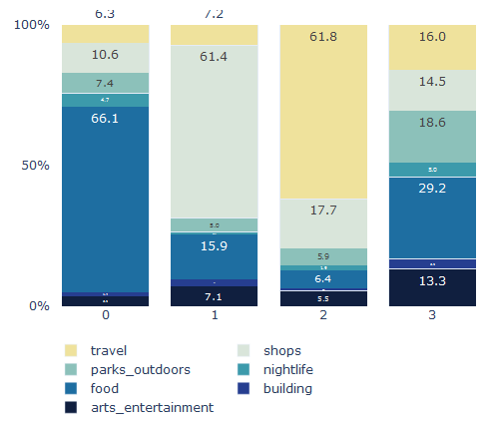
Clustering Professional groups
4 clusters
Cluster 0: restaurant district
Cluster 1: shopping districts
Cluster 2: travel districts (hotels, …)
Custer 3: complete districts

Slide 10
Discussion (1)
 | Young | Student | Active | Retired | Total
X | 100 | 50 | 200 | 100 | 450
X_{weight} | 22.2% | 11.1% | 44.5% | 22.2%
Y | 1000 | 500 | 2000 | 1000 | 4500
Y_{weight} | 22.2% | 11.1% | 44.5% | 22.2%
Clustering is based on proportions. These two examples would be in the same category

Slide 11
Discussion (2)
Choices are limited to three indicators: the age distribution, the professional distribution and the facilities’ categories distribution. However, households’ choices are more complex.
The age distribution could bias the analysis. Indeed, the presence of one retirement residence could sharply increase the proportion of retired people, mischievously transforming the neighbourhood to a “retirement district”.
This method can lead to an incomplete picture

Slide 12
Results & Conclusions
To each neighbourhood is assigned a cluster based on prefessional activity, age distribution, and facilities presence.
Next step:
Consolidate the three indicators
Get a houselhod wish based on our criteria
Extract most similar neighbourhoods, with the Jaccard similarity

