Slide 1
GNN Surrogate — Architecture Iteration Log
One slide per run: what changed, and the resulting train/val loss curves.

Slide 2
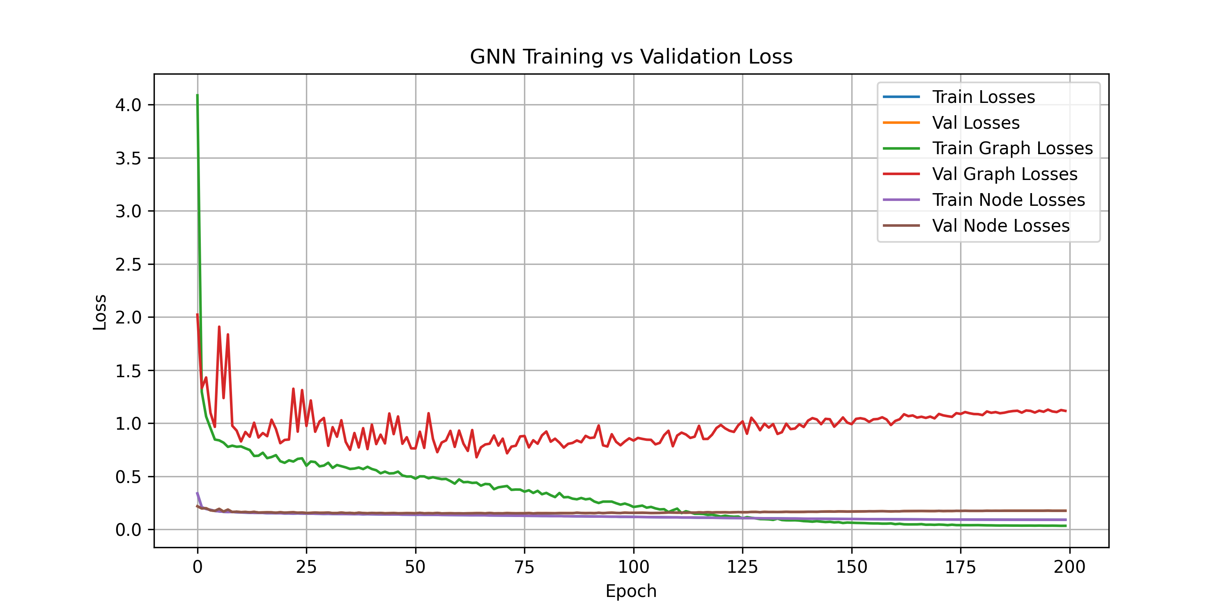
run_id::train
Run: train
Changed graph-level loss normalization: graph_pred is now rescaled from node-target stats into max_stress (target_mean/target_std) space before computing the loss, instead of comparing against node-target-normalized targets. This makes graph loss directly interpretable in max-stress units, and exposes that the model is currently no better than predicting the mean (val graph loss ~1.12, worse than train's 0.035). Next: revise GNN architecture to close this gap.
Metrics (final / best)
train_losses: 0.0916 / 0.0916
val_losses: 0.1765 / 0.1516
train_graph_losses: 0.0349 / 0.0346
val_graph_losses: 1.1165 / 0.6797
train_node_losses: 0.0916 / 0.0916
val_node_losses: 0.1765 / 0.1516

Slide 3
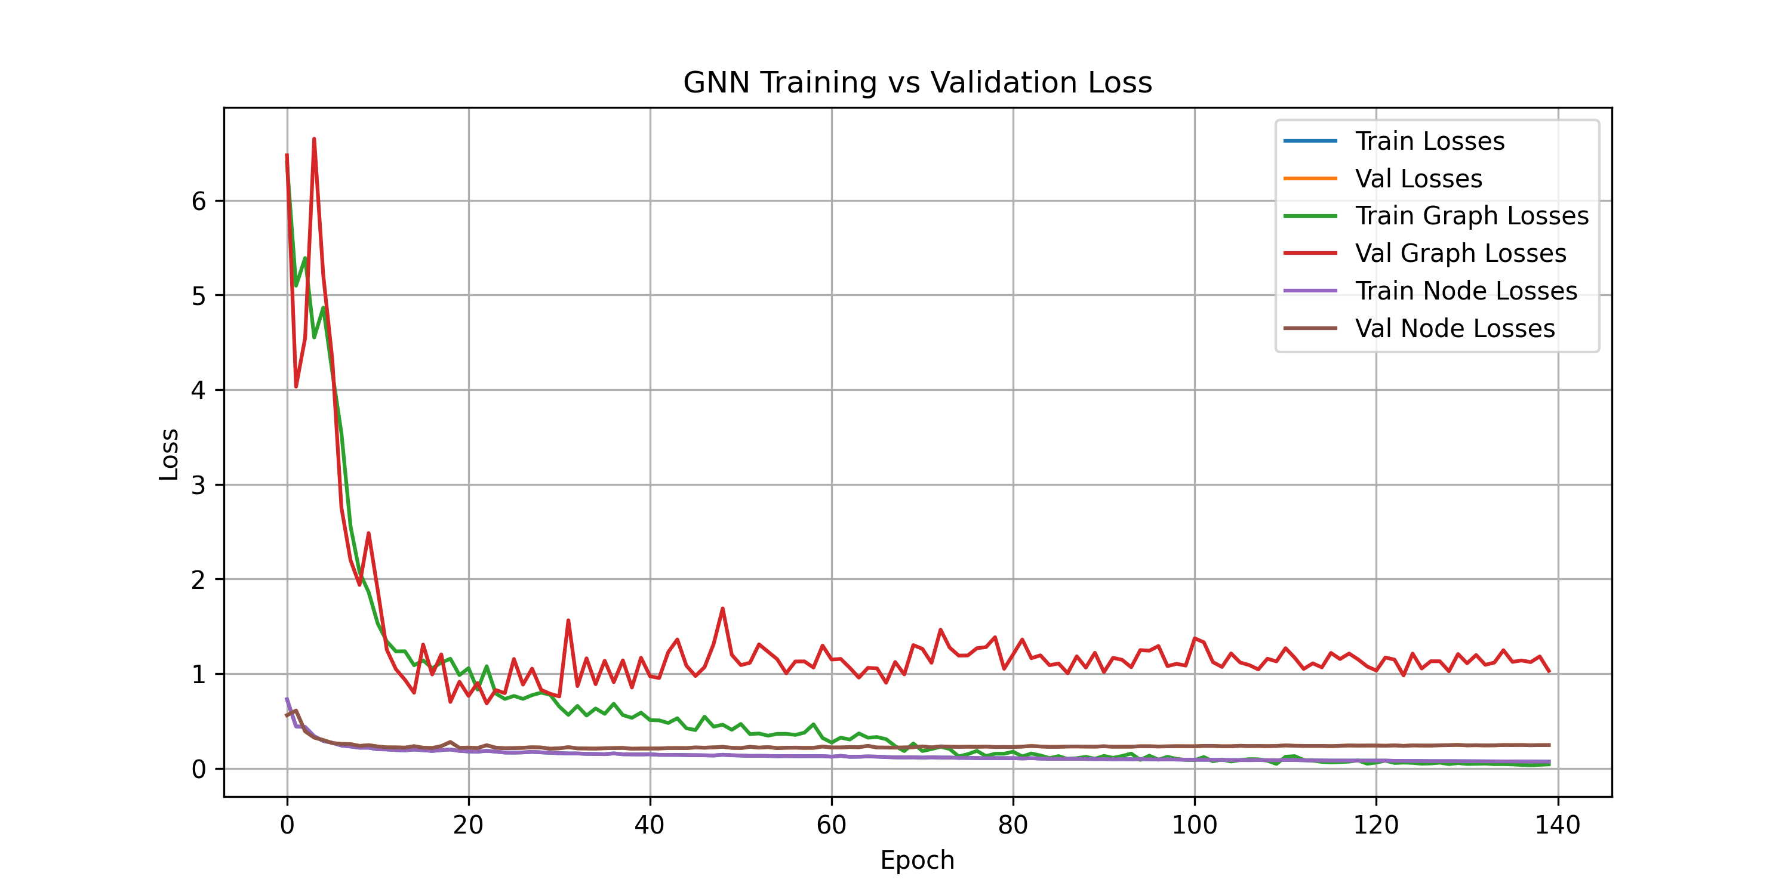
run_id::train_100samples
Run: train_100samples
Re-ran the same setup on a 100-sample subset (80 train / 20 val) instead of the full 1000-sample dataset. Same overfitting signature reproduces: train graph loss drops to ~0.03-0.04 while val graph loss plateaus/climbs around ~1.0, matching the full-dataset run's val graph loss of ~1.12. Since the failure mode is visible with 10x less data, decision: from now on, test architecture changes on 100-sample runs for fast iteration, and only validate on the full dataset once a change looks promising.
Metrics (final / best)
train_losses: 0.0701 / 0.0701
val_losses: 0.2448 / 0.2064
train_graph_losses: 0.0407 / 0.0319
val_graph_losses: 1.0286 / 0.6848
train_node_losses: 0.0701 / 0.0701
val_node_losses: 0.2448 / 0.2064

Slide 4
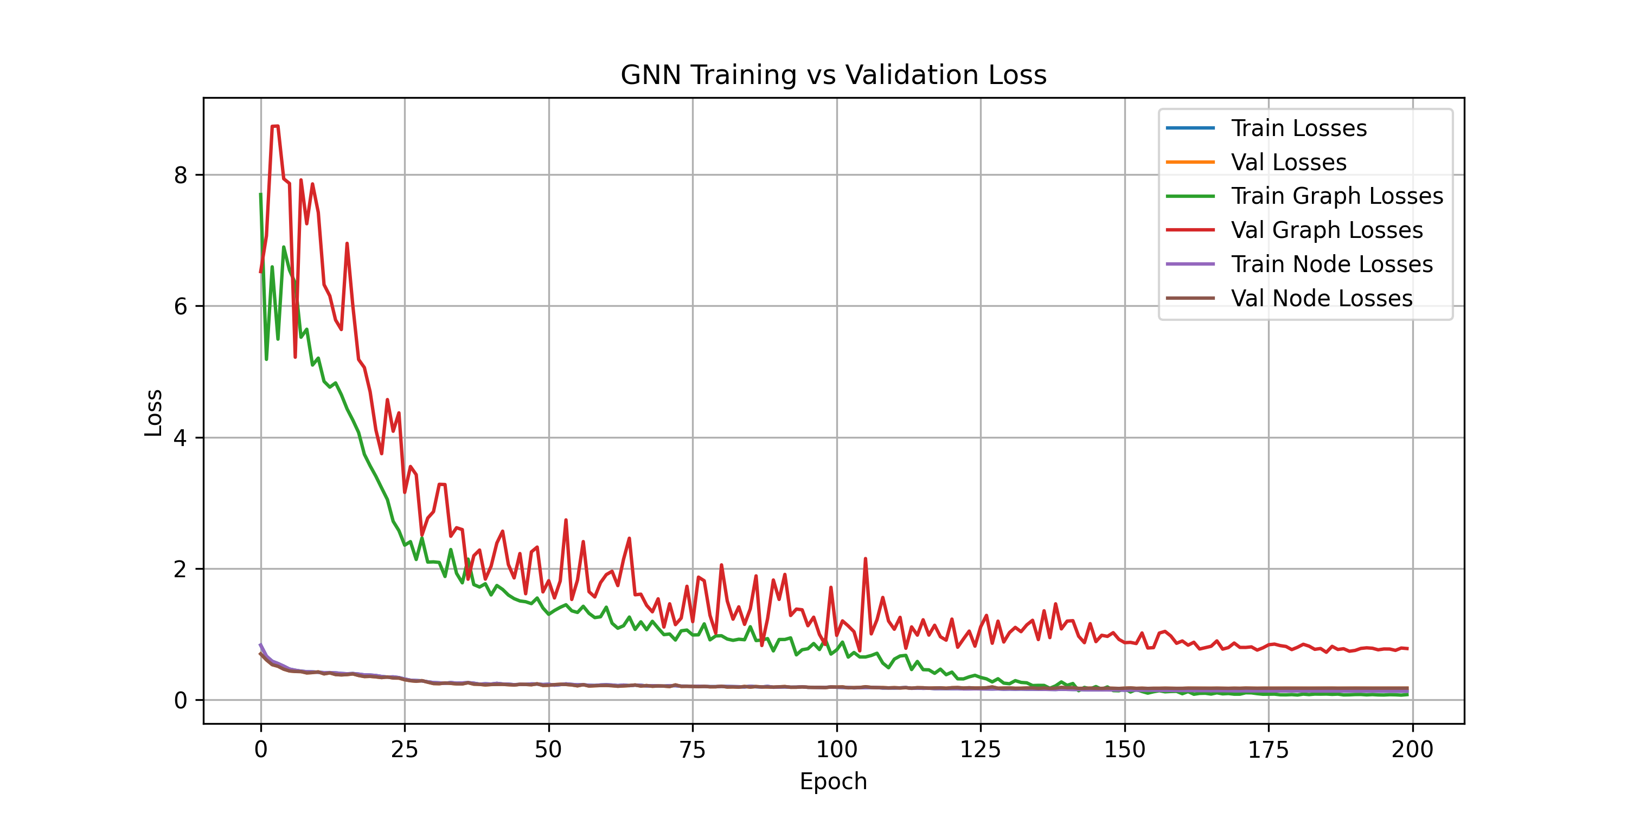
run_id::train_100samples_no_node_emb
Run: train_100samples_no_node_emb
Ablation test: disabled the per-node learned embedding table (node_emb, ~6.2M params over 48249 fixed-topology nodes) by passing --use_node_emb false, everything else identical to train_100samples (100 samples, 80/20 split, 200 epochs). Result confirms the hypothesis: train/val node-loss gap shrank from 0.070/0.245 (0.175 gap) to 0.132/0.178 (0.046 gap), and val graph loss dropped from 1.03 (final) / 0.68 (best) to 0.78 (final) / 0.72 (best). node_emb was letting the model memorize per-node training outputs instead of generalizing from strut/BC inputs. Decision: keep use_node_emb=false as the default going forward; revisit only if we need to model strong position-specific effects the input features can't capture.
Metrics (final / best)
train_losses: 0.1320 / 0.1320
val_losses: 0.1781 / 0.1739
train_graph_losses: 0.0795 / 0.0721
val_graph_losses: 0.7813 / 0.7244
train_node_losses: 0.1320 / 0.1320
val_node_losses: 0.1781 / 0.1739

Slide 5
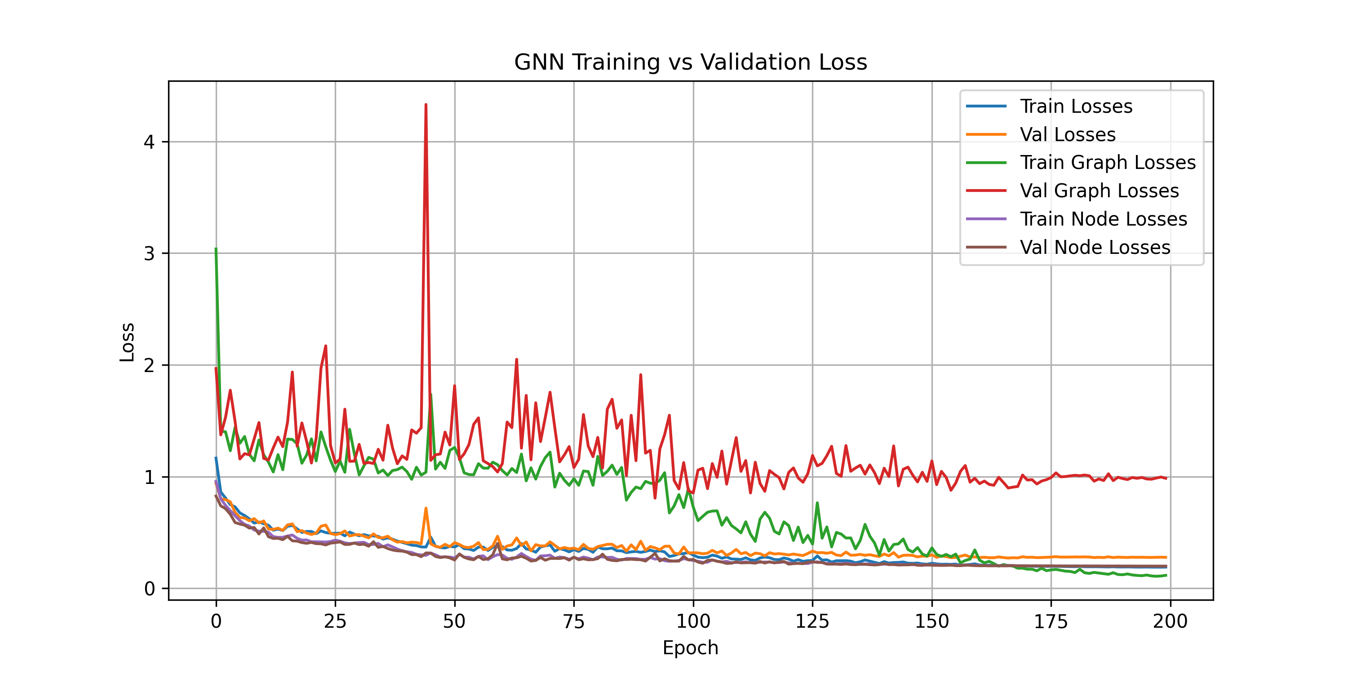
run_id::train_100samples_graph_w0.1
Run: train_100samples_graph_w0.1
Tested node_loss_weight=0.9 / graph_loss_weight=0.1 (previously graph_loss_weight was 0.0, i.e. no direct gradient on the max-stress objective), on top of the use_node_emb=false baseline. Result: did NOT help — both val node loss (0.199 vs 0.178 baseline) and val graph loss (0.985 vs 0.781 baseline) got worse. Giving graph_pred = max_pool(node_pred) a direct gradient path appears to inject noisy, single-node-concentrated updates that hurt node-level learning too, not just fail to help the graph objective. Next: try a much smaller graph_loss_weight (e.g. 0.01) to see if a lighter touch avoids the destabilization while still nudging the max-stress node.
Metrics (final / best)
train_losses: 0.1899 / 0.1891
val_losses: 0.2774 / 0.2709
train_graph_losses: 0.1162 / 0.1078
val_graph_losses: 0.9849 / 0.8069
train_node_losses: 0.1980 / 0.1980
val_node_losses: 0.1988 / 0.1987

Slide 6
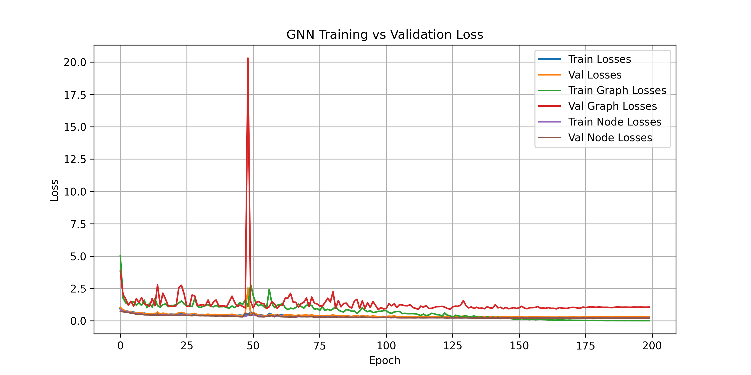
run_id::train_100samples_soft_max_w0.1
Run: train_100samples_soft_max_w0.1
Tested a differentiable soft-max (LogSumExp) pooling as the training-loss surrogate for the graph objective, annealing beta 1->50 across training so it sharpens toward the true hard max by the final epoch (node_loss_weight=0.9, graph_loss_weight=0.1, use_node_emb=false, same as the failed hard-max-weighted run for a clean comparison). Goal was to fix the gradient instability from global_max_pool concentrating updates on a single node per graph. Result: did NOT help -- val graph loss ended at 1.06 and val node loss at 0.21, both worse than the graph_loss_weight=0.0 baseline (0.78 / 0.18), and train graph loss collapsed to 0.016 (near-perfect) as beta sharpened, reopening a train/val overfitting gap on the graph objective specifically. Diagnosis: the pooling function was never the bottleneck (verified it converges exactly to hard max); graph_pred is fully derived from node_pred, so any direct graph-level gradient just competes with the node loss for the same predictions instead of adding new information. Decision: reverted to graph_loss_weight=0.0 (hard max, no direct graph gradient) and removed the soft-max code path entirely. Next candidates: weighted node loss upweighting high-stress nodes, or a dedicated graph-level head off the unused global_emb virtual node instead of pooling node_pred.
Metrics (final / best)
train_losses: 0.1868 / 0.1868
val_losses: 0.2923 / 0.2818
train_graph_losses: 0.0158 / 0.0145
val_graph_losses: 1.0625 / 0.8674
train_node_losses: 0.2058 / 0.2058
val_node_losses: 0.2067 / 0.2065

Slide 7
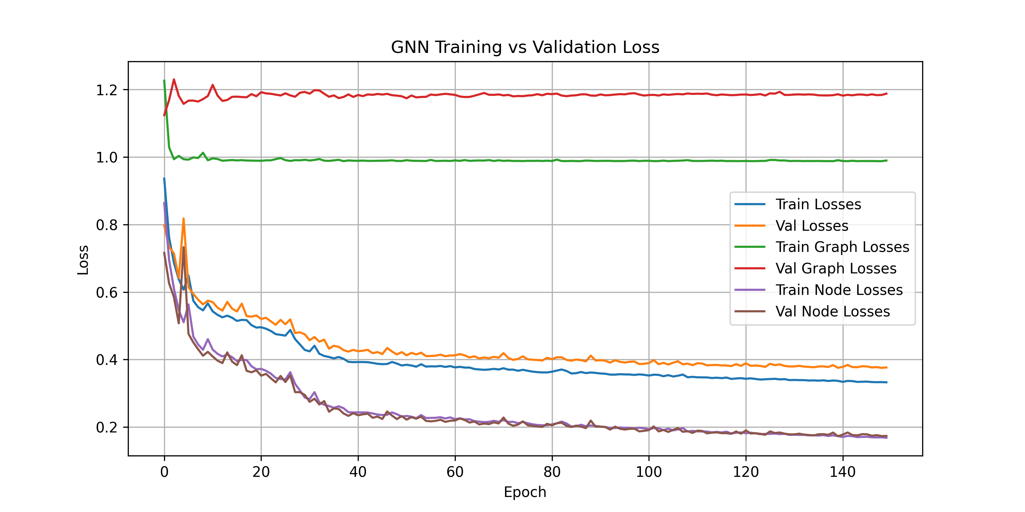
run_id::train_100samples_graph_head
Run: train_100samples_graph_head
Option 2: dedicated graph_head MLP on the global virtual node's h_global, decoupled from node_pred (replaces max_pool(node_pred)). node_loss_weight=0.8, graph_loss_weight=0.2, use_node_emb=false. Killed at epoch 158/200 -- graph loss flatlined at ~0.99 train / ~1.18 val from epoch ~11 onward, never improving (node loss learned fine: 0.86->0.16). Diagnosed with a forward-pass probe on the epoch-130 checkpoint: h_global is 99.88% cosine-similar across 20 different validation samples (per-dim std 0.0016 vs mean magnitude 0.034), and graph_pred varies by std=0.00009 across samples (corr with true target = -0.06). Root cause: global_emb is a single shared parameter broadcast identically to every graph; nothing forces h_global to become sample-specific, so graph_head reads a near-constant vector and just settles on the train-mean prediction. Verdict: architecture as built does not work -- next idea is feeding global_add_pool(node_pred) or pooled real-node features into graph_head alongside h_global so it has access to per-sample signal.
Metrics (final / best)
train_losses: 0.3325 / 0.3325
val_losses: 0.3764 / 0.3753
train_graph_losses: 0.9896 / 0.9878
val_graph_losses: 1.1878 / 1.1240
train_node_losses: 0.1682 / 0.1682
val_node_losses: 0.1736 / 0.1727

Slide 8
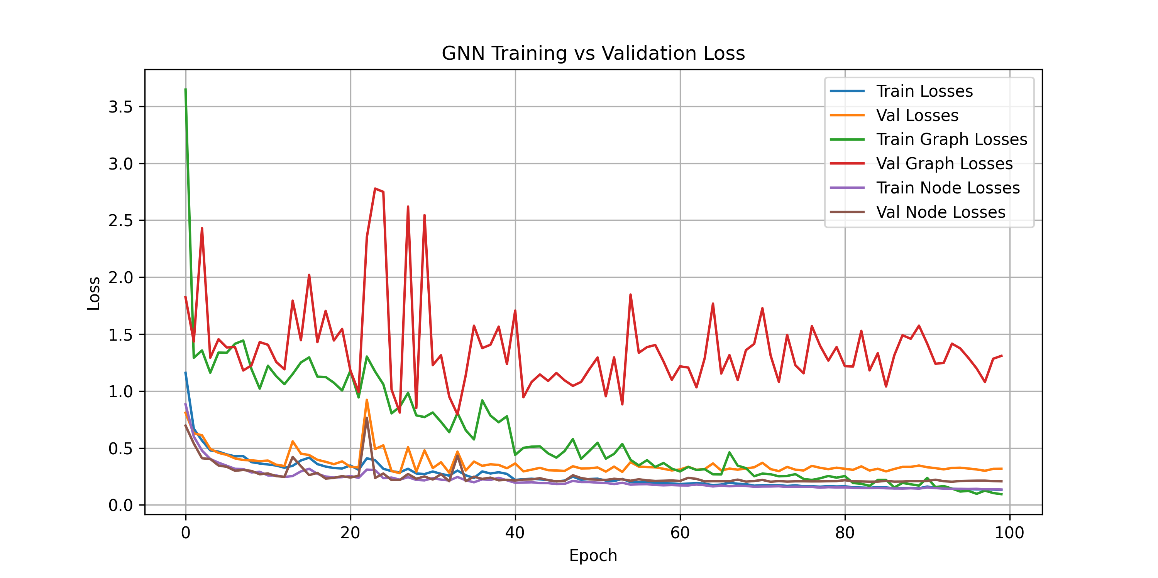
run_id::train_100samples_topk5
Run: train_100samples_topk5
Top-k mean pooling (k=5): graph_pred = mean of the 5 highest node_pred values per graph, replacing global_max_pool(node_pred). node_loss_weight=0.9, graph_loss_weight=0.1, use_node_emb=false. Killed at epoch 100/200. Train graph loss dropped fast and low (~0.09-0.24, i.e. ~20-27 MPa RMSE) -- a huge improvement over the previous max-pool plateau at ~0.99. BUT val graph loss stayed high and noisy (1.0-1.6, ~70-82 MPa RMSE), while val node loss tracked train node loss reasonably (0.21 vs 0.14). So top-k pooling let the graph head fit the train set well but it's still overfitting hard on the graph objective specifically -- the extreme-value target is still the bottleneck, likely because 80 training samples isn't enough to generalize the top-of-distribution behavior even with a smoother pooling function. Next: isolate graph_loss_weight=0 (pure node loss, node_loss_weight=1) as a baseline to see how much of this val overfit comes from optimizing graph_loss directly vs. it being inherent to the node predictions themselves.
Metrics (final / best)
train_losses: 0.1310 / 0.1310
val_losses: 0.3173 / 0.2782
train_graph_losses: 0.0940 / 0.0940
val_graph_losses: 1.3089 / 0.7936
train_node_losses: 0.1351 / 0.1351
val_node_losses: 0.2071 / 0.2033

Slide 9
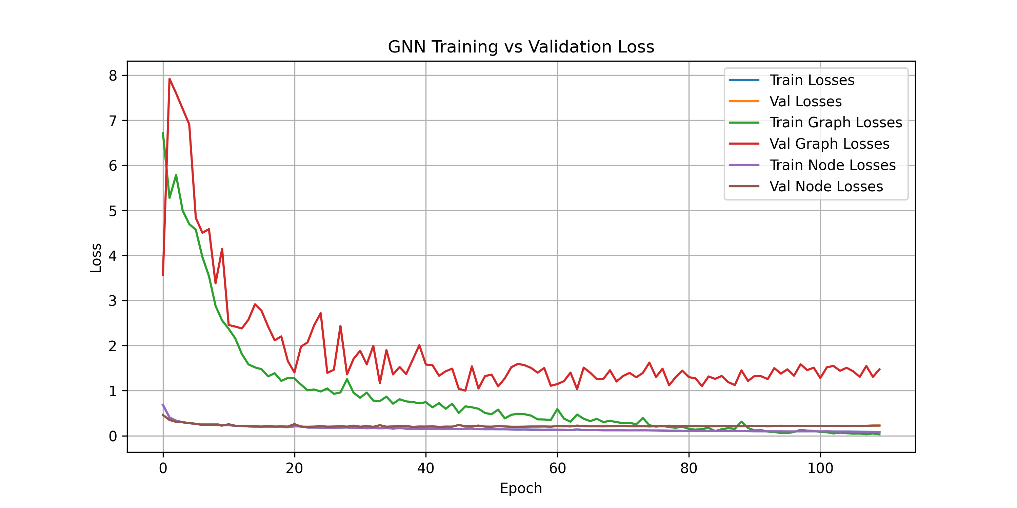
run_id::train_100samples_graph_w0
Run: train_100samples_graph_w0
Baseline isolation: node_loss_weight=1.0, graph_loss_weight=0.0 -- model trains purely on node_loss, graph_pred (top-k=5 mean pool) is logged but gets zero gradient. use_node_emb=false. Killed at epoch 116/200. Train graph loss (unoptimized, purely a side-effect of node_pred improving) still drops to ~0.03-0.08 (~11-13 MPa RMSE), but val graph loss stays stuck high and noisy at ~1.3-1.6 (~74-82 MPa RMSE) -- essentially the same magnitude as the weighted top-k run (train_100samples_topk5, val ~70-82 MPa). Node loss itself: train 0.68->0.08, val plateaus ~0.20-0.23 (mild overfit, much less severe than graph). Key finding: the val graph-loss overfit is NOT an artifact of directly optimizing graph_loss -- it persists identically even with zero gradient on it. This isolates the problem to the node predictions' extreme-value (max-stress) behavior itself: whatever handful of nodes determine the true max, the model can't generalize their stress values to unseen samples, regardless of pooling strategy or loss weighting. Next directions: more training data (this is the fast-iteration 100-sample regime), log-transforming targets, or explicit stress-concentration input features rather than further loss-shape/pooling tweaks.
Metrics (final / best)
train_losses: 0.0853 / 0.0853
val_losses: 0.2256 / 0.1967
train_graph_losses: 0.0305 / 0.0305
val_graph_losses: 1.4746 / 1.0001
train_node_losses: 0.0853 / 0.0853
val_node_losses: 0.2256 / 0.1967

Slide 10
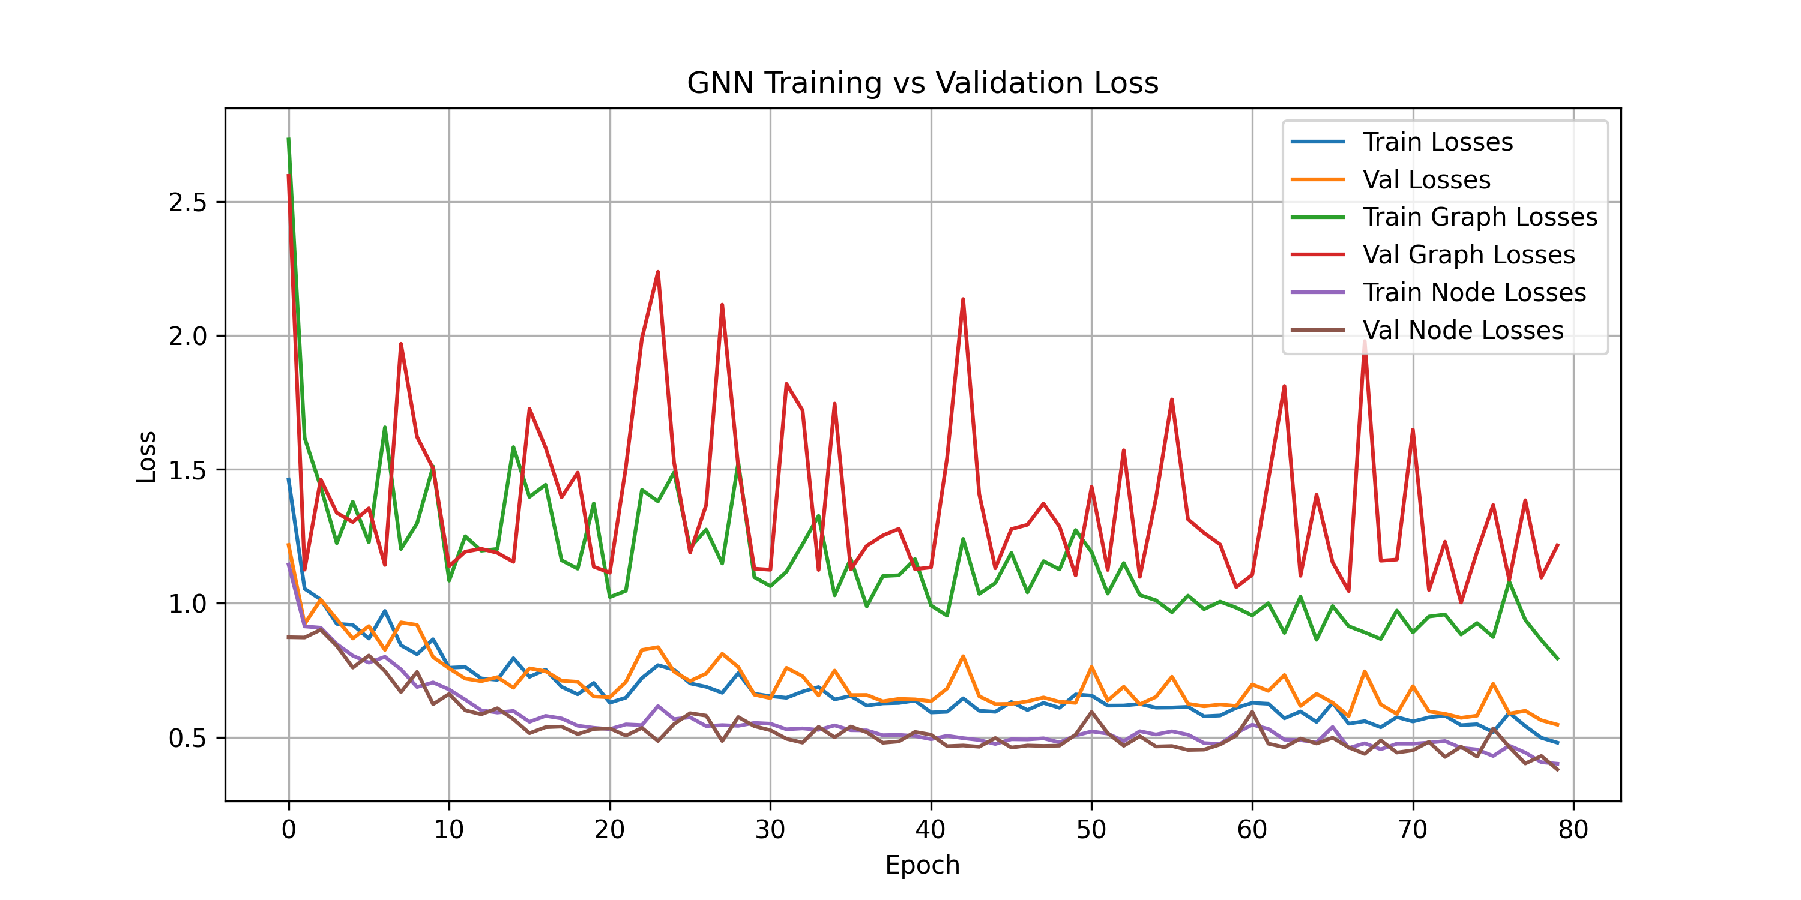
run_id::train_100samples_w0.8_0.2_topk5
Run: train_100samples_w0.8_0.2_topk5
Config: node_loss_weight=0.8, graph_loss_weight=0.2, weight_decay=1e-3, 100 samples, topk-mean graph pooling (graph_topk=30), use_node_emb=False. Killed at epoch 93/200 (results below through epoch 90).
Results: train graph loss RMSE ~64 MPa, val graph loss RMSE ~92 MPa (best around epoch 82: ~66 MPa), noisy/non-monotonic val curve. No improvement over the topk=5 / node-emb-on config or the earlier max-pool/graph_w0 baselines -- val graph loss remains stuck in the same ~65-90 MPa band. Reinforces that pooling width and node-embedding choice aren't the bottleneck; the generalization gap is inherent to node_pred's extreme-value behavior.
Metrics (final / best)
train_losses: 0.4591 / 0.4591
val_losses: 0.7158 / 0.5198
train_graph_losses: 0.7722 / 0.7680
val_graph_losses: 1.9884 / 0.9782
train_node_losses: 0.3808 / 0.3765
val_node_losses: 0.3976 / 0.3676

Slide 11
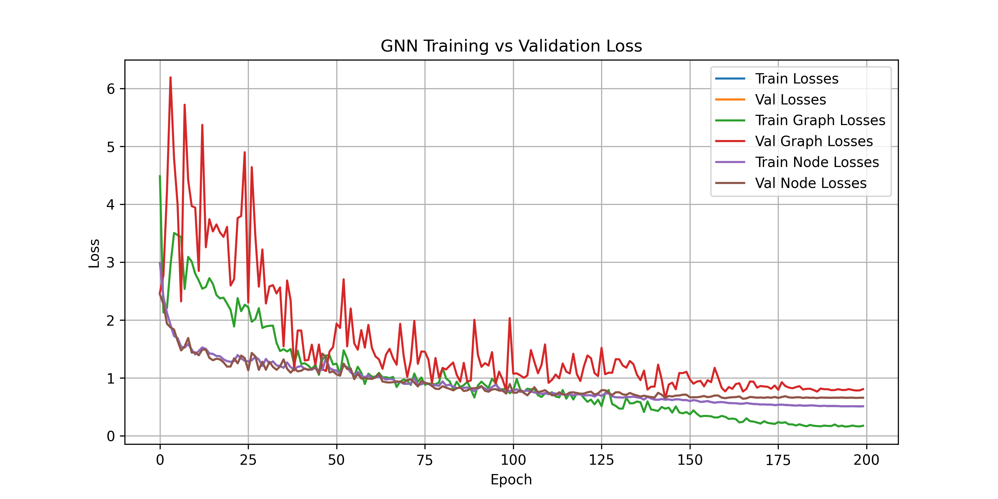
run_id::train_100samples_weighted_node_mse_g0_topk1
Run: train_100samples_weighted_node_mse_g0_topk1
node_loss_weight=1.0, graph_loss_weight=0.0, graph_topk=1. Node loss switched from plain MSE to per-graph weighted MSE (weight_i = raw von Mises stress_i / sum of raw stress in that graph), so high-stress nodes contribute more to the gradient. Final: train 0.5122, val 0.6589.
Metrics (final / best)
train_losses: 0.5122 / 0.5101
val_losses: 0.6589 / 0.6415
train_graph_losses: 0.1756 / 0.1597
val_graph_losses: 0.8073 / 0.6391
train_node_losses: 0.5122 / 0.5101
val_node_losses: 0.6589 / 0.6415

