Slide 1

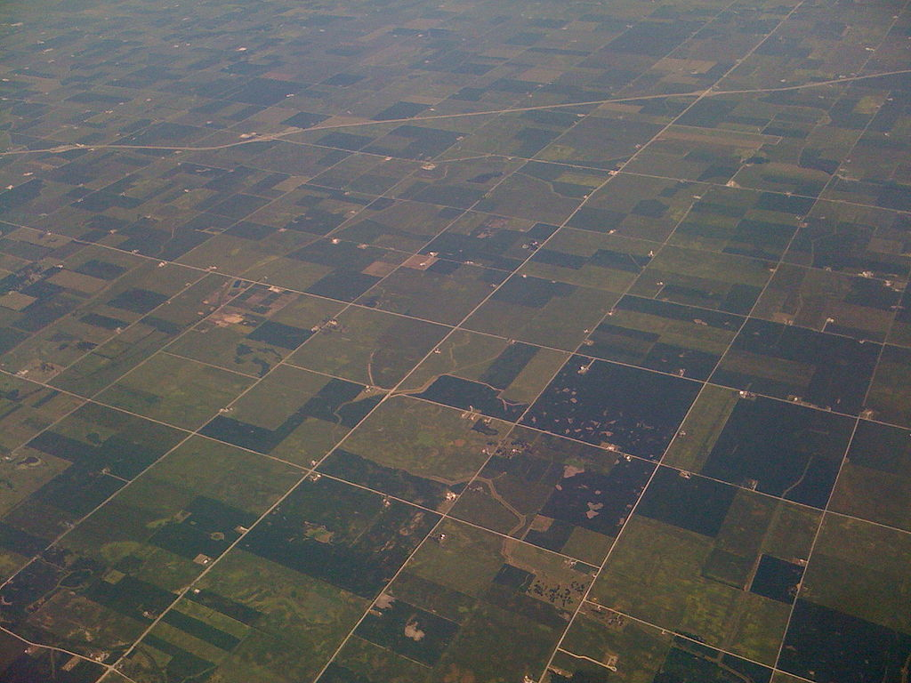

(Ezekiel 47:14)
Fair-and-Square:
Fair Division of Land
Erel Segal-haLevi
Advisors:
Yonatan Aumann
Avinatan Hassidim
Notes:
1
1
1
1
1
1
1
1
1

Slide 2
The Geometric Approach
Partitioning: Divide a complex object (polygon) to pieces: triangles, rectangles, squares, convex pieces, star-shapes, spirals, pseudo-triangles…
"Polygon Decomposition", Mark Keil, J., Handbook of Computational Geometry (2000).
No attention to value of pieces.

Slide 3
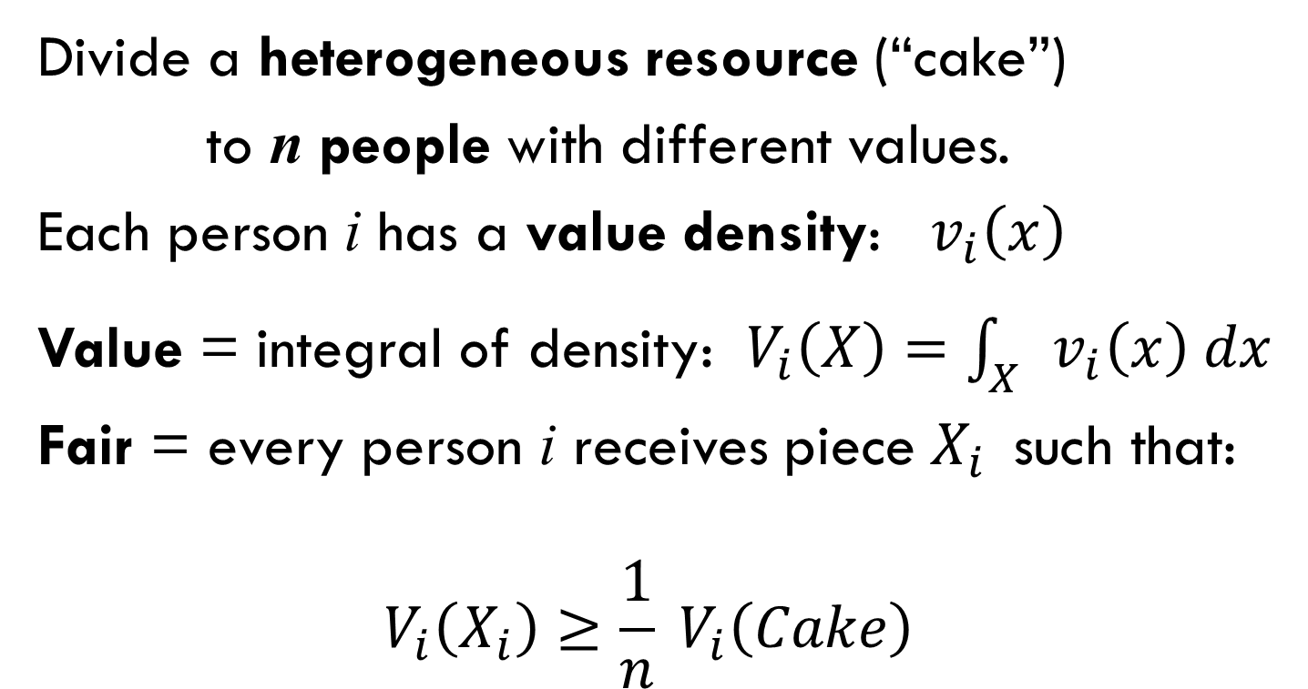
The Economic Approach
Divide a heterogeneous resource (“cake”)
to n people with different values.
Each person i has a value density: $v_{i}\left(x\right)$
Value = integral of density: $V_{i}\left(X\right)=\int_{X}{v_{i}\left(x\right) dx}$
Fair = every person i receives piece $X_{i}$ such that:
$$V_{i}\left(X_{i}\right)≥\frac{1}{n} V_{i}\left(Cake\right)$$
No attention to 2-D geometric shape of pieces.

Slide 4
Algorithm for 2 people (Blue&Green)
Each person marks a north-south line dividing land to two parts with subjective value 1/2.
Land is cut between the two division lines.
Each person receives part with his line.
G
B
For every person playing by the rules: $V_{i}\left(X_{i}\right)≥1/2$

Slide 5
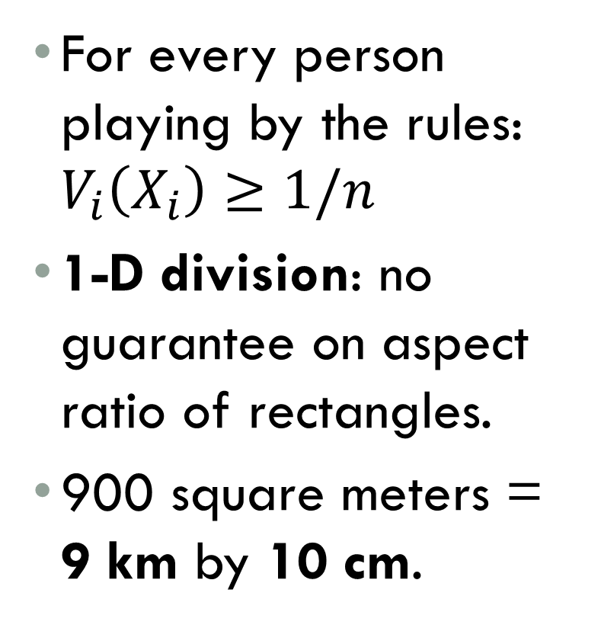

Algorithm for $n$ people
For every person playing by the rules: $V_{i}\left(X_{i}\right)≥1/n$
1-D division: no guarantee on aspect ratio of rectangles.
900 square meters = 9 km by 10 cm.

Slide 6
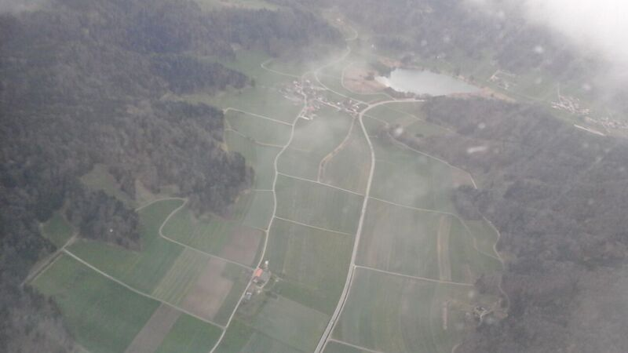

Slide 7
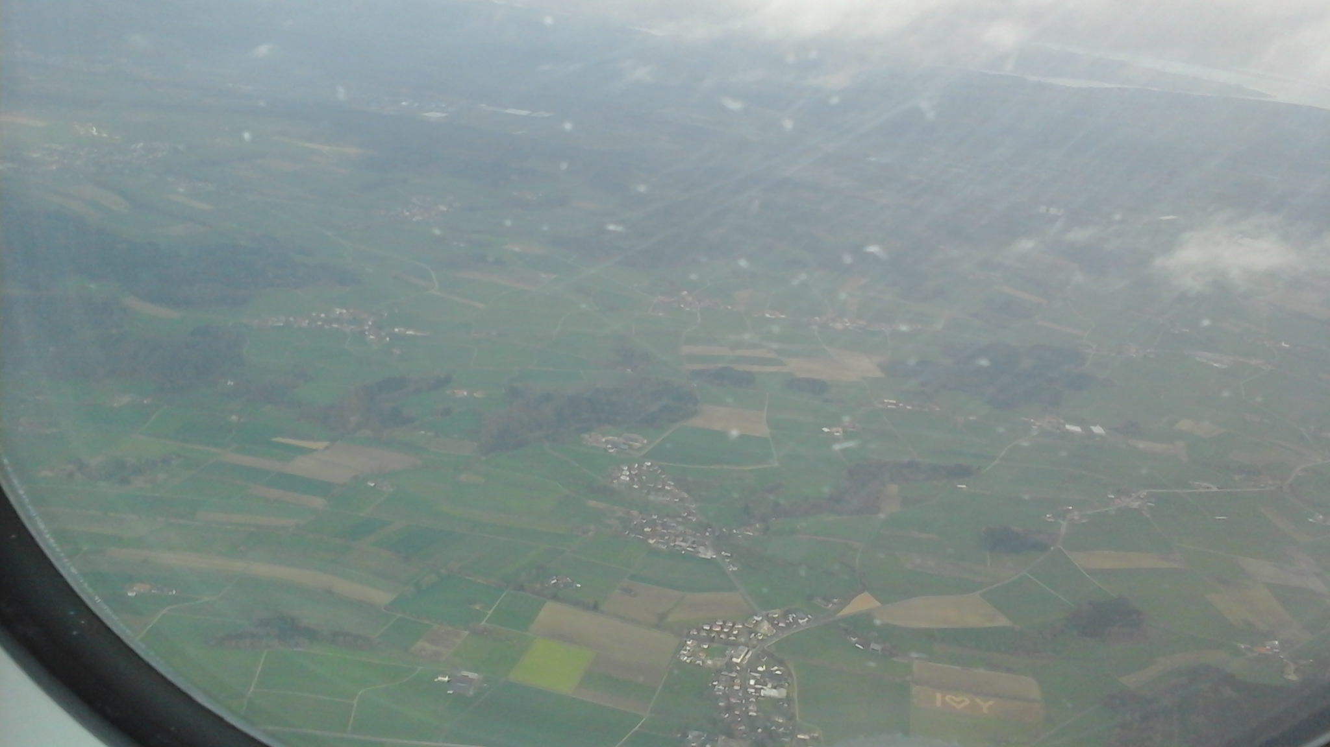

Slide 8


The Combined Approach
Give each person a usable piece (square)
with a value of at least 1/n (fair)
Value | Shape
 |  | Geometry
 |  | Economics
 |  | Our work

Slide 9
2 people, square cake, SQUARE plots
Is it possible to give each person at least 1/2 in a square?
No! More than 1/4 is impossible.
Is it always possible to give each person at least 1/4 in a square?
Yes! Algorithm omitted.

Slide 10
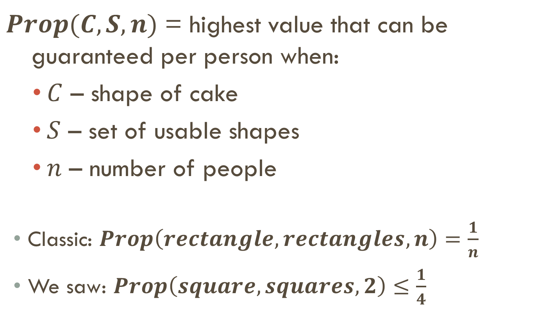
Proportionality Guarantee
$Prop(C,S,n)$ = highest value that can be guaranteed per person when:
$C$ – shape of cake
$S$ – set of usable shapes
$n$ – number of people
Classic: $Prop\left(rectangle,rectangles,n\right)=\frac{1}{n}$
We saw: $Prop\left(square,squares,2\right)≤\frac{1}{4}$

Slide 11
RESULTS in PAPER
# of ppl:
2 ppl
n ppl
1/4
1/3
1/3
1/2
1/2
≤1/ 2n
1/ (2n-1)
≤1/1.75n
≤1/ n
≥1/ (4n-4)
≥1/ (2n-1)

Slide 12
n people, ¼ plane
We want to show an algorithm that proves:
Prop (1/4-plane, squares, n) ≥ 1/(2n-1)

Slide 13
n people, k-stairs
k=4
We will show a recursive algorithm that proves:
For every staircase with k inner corners:
Prop (k-stairs, squares, n) ≥ 1/(2n-2+k)

Slide 14
n people, k-stairs
Total value = 2n-2+k
Each person marks square with value 1 in every corner.

Slide 15
n people, k-stairs
Total value = 2n-2+k
Each person marks square with value 1 in every corner.
Keep smallest square in each corner.

Slide 16
n people, k-stairs
Total value = 2n-2+k
Easy case: Some square ≤ corner:
Allocate 1 of them.
Recurse with:
Δn = -1
Δk = +1
ΔV ≥ -1

Slide 17
n people, k-stairs
Total value = 2n-2+k
Hard case: All squares > corner:
Shadows appear!
Lemma: There is a square with shadow ≤ other squares.
Allocate 1 of them & Recurse.

Slide 18
n people, k-stairs
Total value = 2n-2+k
Hard case: All squares > corner:
Allocate square with contained shadow.
Recurse with:
Δn = -1
Δk = +1 - #(shadows)
ΔV ≥ -1 - #(shadows)

Slide 19
n people, k-stairs
Total value ≥ 2n-2+k
Final step: n=1 Total value ≥ k
Cover-Number = k
By Cover-Number Lemma, there is a square with value at least 1. Q.E.D.

Slide 20
n people, k-stairs
Prop (k-stairs, squares, n) = 1/(2n-2+k)

Slide 21
open questions
Divide:
Rectilinear polytope,
Cylinder / torus / sphere,
General fat object;
To:
45-degree fat polytopes,
Finite unions of squares,
General fat objects.

Slide 22
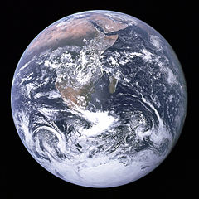
OPEN QUESTION
(Ezekiel 47:14)
Can we divide
Earth
Fair-and-Square?
Collaborations are welcome! erelsgl@gmail

Slide 23
Acknowledgements
Insightful discussions: Galya Segal-Halevi ☺, Rav Shabtay Rappaport, Shmuel Nitzan.
Helpful answers: Christian Blatter, Ilya Bogdanov, Henno Brandsma, Boris Bukh, Anthony Carapetis, Christopher Culter, David Eppstein, Yuval Filmus, Peter Franek, Nick Gill, John Gowers, Michael Greinecker, Dafin Guzman, Marcus Hum, Robert Israel, Barry Johnson, Joonas Ilmavirta, Tony K., V. Kurchatkin, Raymond Manzoni, Ross Millikan, Mariusz Nowak, Boris Novikov, Joseph O'Rourke, Emanuele Paolini, Rahul, Raphael Reitzig, David Richerby, András Salamon, Realz Slaw, B. Stoney, Steven Taschuk, Marc van Leeuwen, Martin van der Linden, Hagen von Eitzen, Martin von Gagern, Jared Warner, Frank W., Ittay Weiss, Phoemue X, Tomas Z and the StackExchange.com community.
Collaborations are welcome! erelsgl@gmail

