Slide 1

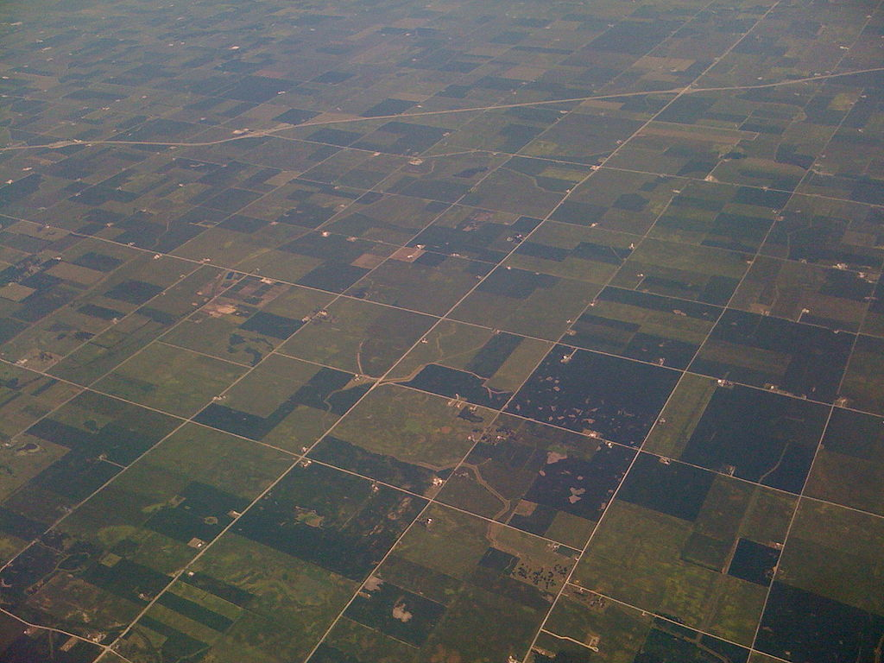

(Ezekiel 47:14)
Fair-and-Square:
Fair Division of Land
Erel Segal-haLevi
Advisors:
Yonatan Aumann
Avinatan Hassidim
Notes:
1
1
1
1
1
1
1
1
1

Slide 2
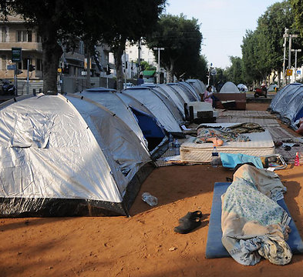
Fair division Applications
Divide:
Public lands to homeless.
Land-plots to settlers.
Family estate to heirs.
Museum space to presenters.
Webpage space to advertisers.

Slide 3
The Geometric Approach
Partitioning: Divide a complex object (polygon) to pieces: triangles, rectangles, squares, convex pieces, star-shapes, spirals, pseudo-triangles…
"Polygon Decomposition", Mark Keil, J., Handbook of Computational Geometry (2000).
No attention to value of pieces.

Slide 4
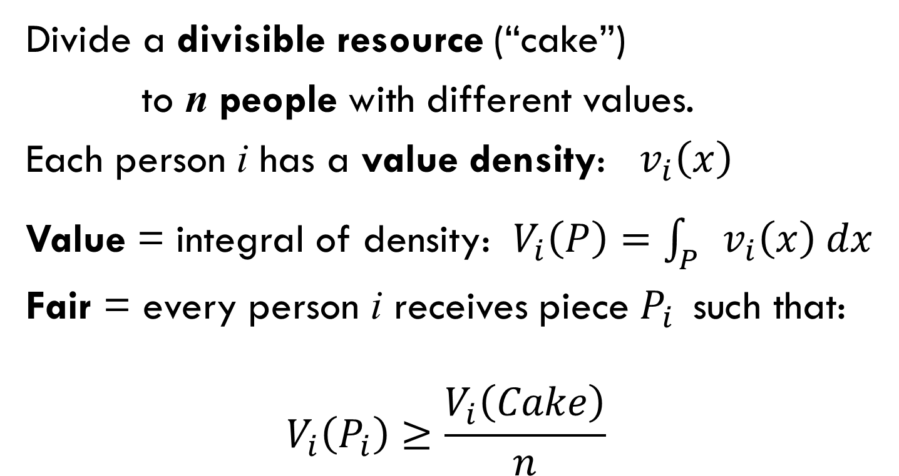
The Economic Approach
Divide a divisible resource (“cake”)
to n people with different values.
Each person i has a value density: $v_{i}\left(x\right)$
Value = integral of density: $V_{i}\left(P\right)=\int_{P}{v_{i}\left(x\right) dx}$
Fair = every person i receives piece $P_{i}$ such that:
$$V_{i}\left(P_{i}\right)≥\frac{V_{i}\left(Cake\right)}{n}$$
No attention to geometric shape of pieces.

Slide 5
Rectangle land, rectangle plots 2 people: Blue and Green
Each person marks a north-south line dividing land to two parts with subjective value 1/2.
Land is cut between the two division lines.
Each person receives part with his line.
G
B
For every person playing by the rules: $V_{i}\left(P_{i}\right)≥1/2$

Slide 6


The Combined Approach
Give each person a usable piece (square)
with a value of at least 1/n (fair)
Value | Shape
 |  | Geometry
 |  | Economics
 |  | Our work

Slide 7



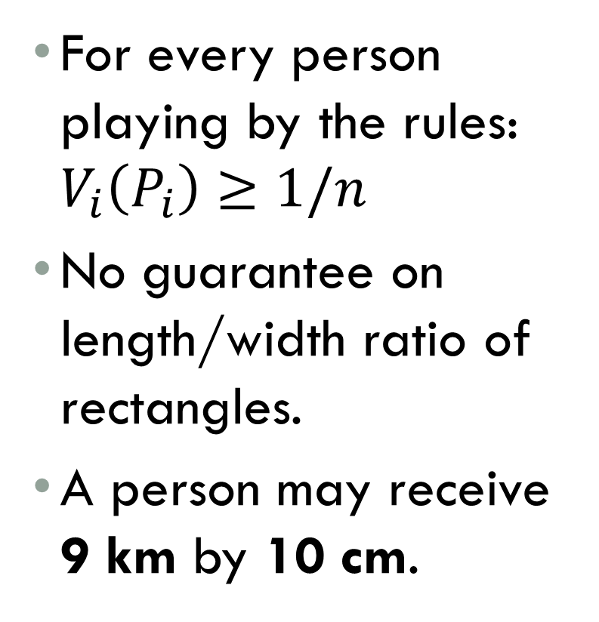

$n$ people, Rectangle land, rectangle plots
Shimon Even and Azaria Paz, 1984
For every person playing by the rules: $V_{i}\left(P_{i}\right)≥1/n$
No guarantee on length/width ratio of rectangles.
A person may receive 9 km by 10 cm.

Slide 8

$n$ people, Rectangle land, rectangle plots
Shimon Even and Azaria Paz, 1984
Each person marks line of value 1/2.
Cut in median.
Each n/2 people get their half-cake.
Recursively divide each half.
G
B
P
R
For every person playing by the rules: $V_{i}\left(P_{i}\right)≥1/n$

Slide 9
2 people, square LAND, SQUARE plots
Is it possible to give each person a value of at least 1/2?
Not in this case!
Here no more than 1/4 is possible.

Slide 10
QUESTIONS
Is it always possible to guarantee each person:
value at least 1/4 in a square?
value of at least 1/2 in a 2-fat rectangle (length/width ≤ 2) ?

Slide 11
Geometric prop function
Prop(C,S,n):= highest value that can be
guaranteed when dividing cake C
with pieces of family S to n people.
Classic result:
Prop(Rectangle, rectangles, n) = 1/n
We have just seen:
Prop(Square, squares, 2) ≤ 1/4

Slide 12
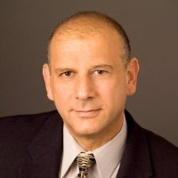
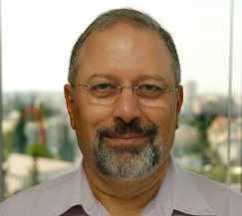
1 person, Any LAND, Any plots
Definition: for a cake C and family S:
CoverNum(C,S):= Minimum # of pieces of S, possibly overlapping, whose union is C.
Example:
CoverNum
(C,Squares)=3
C
Reuven Bar-Yehuda & Eyal Ben-Hanoch, 1996
Lemma: For every cake C and family S:
Prop(C, S, 1) ≥ 1/CoverNum(C,S)

Slide 13
2 people, square LAND, SQUARE plots
Define 4 sub-squares.
Each person chooses favorite sub-square.
Easy case: different choices: allocate choices and finish.
B
G

Slide 14
2 people, square LAND, SQUARE plots
Define 4 sub-squares.
Each person chooses favorite sub-square.
Hard case: same choices:
G
B

Slide 15
2 people, square LAND, SQUARE plots
Define 4 sub-squares.
Each person chooses favorite sub-square.
Hard case: same choices: each person draws corner square with value exactly 1/4

Slide 16
2 people, square LAND, SQUARE plots
Define 4 sub-squares.
Each person chooses favorite sub-square.
Hard case: same choices: Smaller square is allocated
G

Slide 17
2 people, square LAND, SQUARE plots
Define 4 sub-squares.
Each person chooses favorite sub-square.
Hard case: same choices: Smaller square is allocated.
Other person gets favorite square of 3 squares in remainder.
B
≥ 3/4
G

Slide 18
2 people, square LAND, SQUARE plots
Define 4 sub-squares.
Each person chooses favorite sub-square.
Hard case: same choices: Smaller square is allocated.
Other person gets favorite square of 3 squares in remainder.
B
G
Value ≥ 1/4

Slide 19
Half-Fair-and-square
Prop(Square, squares, 2) = 1/4
GENERALIZATIONS:
Other shapes of cakes.
Other shapes of pieces.
n people.

Slide 20
2 people, unbounded land, square pieces
Unbounded land:
Cut between two parallel marks;
Value ≥ 1/2

Slide 21
un/bounded cake
2 people
n people
1/4
?
1/2
?
?
?

Slide 22
2 people, ¼ plane
Someone gets at most one out of 3 pools.
Prop (1/4-plane, squares, 2) ≤ 1/3

Slide 23
n people, ¼ plane
Someone gets at most one
of 2n-1 pools.
Prop (1/4-plane, squares, n) ≤ 1/(2n-1)

Slide 24
n people, SQUARE land, square pieces
Someone gets at most one of 2n pools.
Prop (square, squares, n) ≤ 1/(2n)

Slide 25
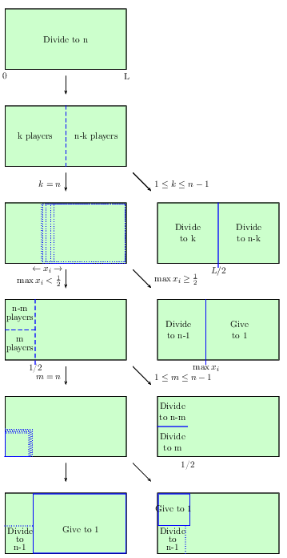
Dividing a square to n people
Several algorithms – details in paper
Prop (square, squares, n) ≥ 1/(4n-4)

Slide 26
un/bounded cake
2 p.
n p.
1/4
≤ 1/3
1/2
≤ 1/ 2n
≤ 1/ (2n-1)
≤ 1/ n
≥1/ (4n-4)
≥1/ (4n-4)
≥1/ (4n-4)

Slide 27
n people, ¼ plane
We want to show an algorithm that proves:
Prop (1/4-plane, squares, n) ≥ 1/(2n-1)

Slide 28
n people, k-stairs
k=4
Prop (k-stairs, squares, n) ≤ 1/(2n-2+k)

Slide 29
n people, k-stairs
k=4
We will show a recursive algorithm that proves:
For every staircase with k inner corners:
Prop (k-stairs, squares, n) ≥ 1/(2n-2+k)

Slide 30
n people, k-stairs
Total value = 2n-2+k
Each person marks square with value 1 in every corner.
Keep smallest square in each corner.

Slide 31
n people, k-stairs
Total value = 2n-2+k
Easy case: Some square ≤ corner:
Allocate 1 of them.
Recurse with:
Δn = -1
Δk = +1
ΔV ≥ -1

Slide 32
n people, k-stairs
Total value = 2n-2+k
Hard case: All squares > corner:
Shadows appear!
Lemma: There is a square with shadow ≤ other squares.
Allocate 1 of them & Recurse.

Slide 33
n people, k-stairs
Total value = 2n-2+k
Hard case: All squares > corner:
Allocate square with contained shadow.
Recurse with:
Δn = -1
Δk = +1 - #(shadows)
ΔV ≥ -1 - #(shadows)

Slide 34
n people, k-stairs
Total value ≥ 2n-2+k
Final step: n=1 Total value ≥ k
CoverNum = k
By CoverNum lemma, there is a square with value at least 1.
Q.E.D.

Slide 35
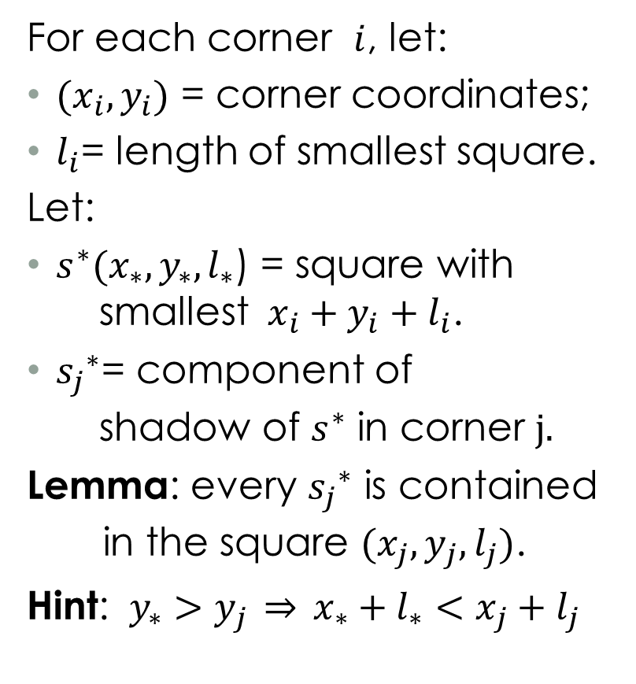
Shadow lemma
For each corner $i$, let:
$(x_{i},y_{i})$ = corner coordinates;
$l_{i}$= length of smallest square.
Let:
$s^{∗}(x_{∗},y_{∗},l_{∗}$) = square with smallest $x_{i}+y_{i}+l_{i}$.
${s_{j}}_{}^{∗}$= component of shadow of $s^{∗}$ in corner $j.$
Lemma: every ${s_{j}}_{}^{∗}$ is contained in the square $(x_{j},y_{j},l_{j})$.
Hint: $y_{∗}>y_{j} \overset{⇒}{} x_{∗}+l_{∗}<x_{j}+l_{j}$

Slide 36
n people, k-stairs
Prop (k-stairs, squares, n) = 1/(2n-2+k)

Slide 37
CURRENT BOUNDS
2 p.
n p.
1/4
1/3
1/2
≤1/ 2n
1/ (2n-1)
≤1/ n
≥1/ (4n-4)
≥1/ (2n-1)

Slide 38
n people, k-levels
k=7
Prop (k-levels, squares, n) = 1/(2n-2+k)

Slide 39
CURRENT BOUNDS
2 p.
n p.
1/4
1/3
1/2
≤1/ 2n
1/ (2n-1)
≤1/1.5n
≤1/ n
≥1/ (4n-4)
≥1/ (2n-1)

Slide 40
open questions
Divide:
Rectilinear polytope,
Cylinder / torus / sphere,
General fat object;
To:
45-degree fat polytopes,
Finite unions of squares,
General fat objects.

Slide 41
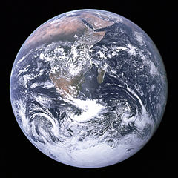
OPEN QUESTION
(Ezekiel 47:14)
Can we divide
Earth
Fair-and-Square?
Collaborations are welcome! erelsgl@gmail

Slide 42
Acknowledgements
Insightful discussions: Galya Segal-Halevi ☺, Rav Shabtay Rappaport, Shmuel Nitzan.
Helpful answers: Christian Blatter, Ilya Bogdanov, Henno Brandsma, Boris Bukh, Anthony Carapetis, Christopher Culter, David Eppstein, Yuval Filmus, Peter Franek, Nick Gill, John Gowers, Michael Greinecker, Dafin Guzman, Marcus Hum, Robert Israel, Barry Johnson, Joonas Ilmavirta, Tony K., V. Kurchatkin, Raymond Manzoni, Ross Millikan, Mariusz Nowak, Boris Novikov, Joseph O'Rourke, Emanuele Paolini, Rahul, Raphael Reitzig, David Richerby, András Salamon, Realz Slaw, B. Stoney, Steven Taschuk, Marc van Leeuwen, Martin van der Linden, Hagen von Eitzen, Martin von Gagern, Jared Warner, Frank W., Ittay Weiss, Phoemue X, Tomas Z and the StackExchange.com community.
Collaborations are welcome! erelsgl@gmail

