Slide 1

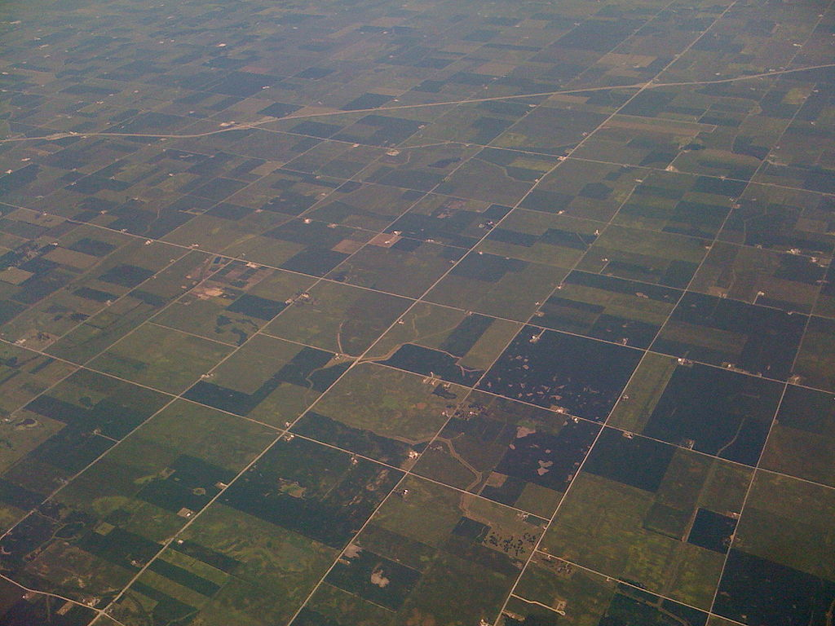
(Ezekiel 47:14)
Resource-Monotonicity &
Population-Monotonicity
In Cake-Cutting
Erel Segal-haLevi Bar-Ilan Univesity, Israel
Joint work with:
Balázs Sziklai, Hungarian Academy of Sciences, Hungary
Notes:
1
1
1
1
1
1
1
1
1

Slide 2
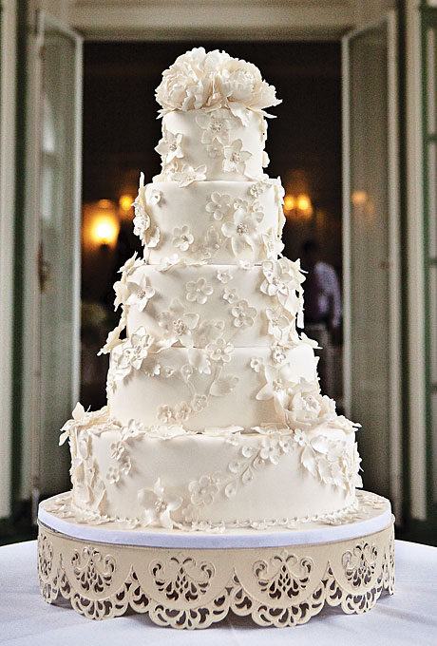

Resource Monotonicity: Intuition
A larger cake -
- should be weakly better for everyone.

Slide 3
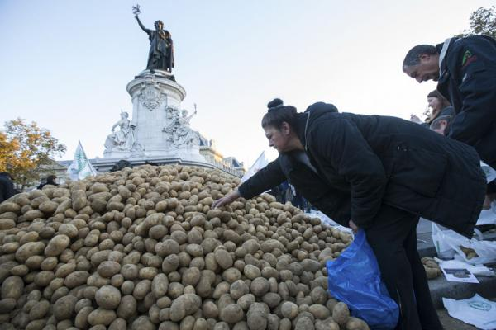
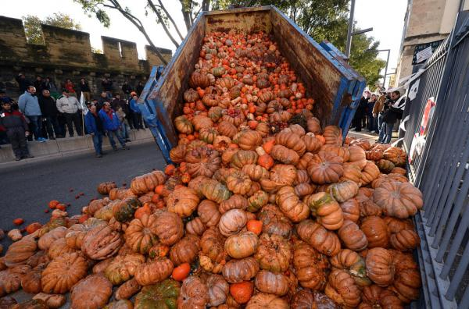
Resource Monotonicity: Violation
Throw away paradox (Aumann&Peleg ‘74)
http://www.blacklistednews.com/French_Farmers_Spray_Government_Buildings_With_Feces_to_Protest_Regulation_%26_Taxes/39010/0/38/38/Y/M.html

Slide 4
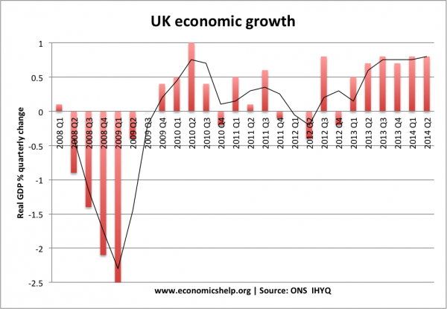
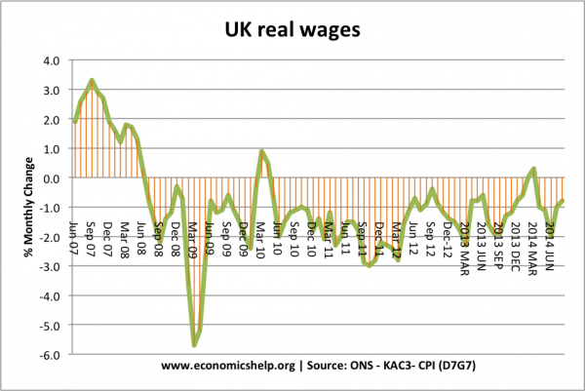
Resource Monotonicity: Violation
Throw away paradox (Aumann&Peleg ‘74)
Economic growth vs. real wages

Slide 5
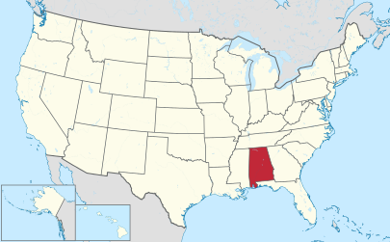
Resource Monotonicity: Violation
Throw away paradox (Aumann&Peleg ‘74)
Economic growth vs. real wages
Alabama Paradox
“Can everyone benefit from growth?”
(Moulin and Thomson, 1988)

Slide 6


Resource Monotonicity
“Can anyone benefit from growth?”
(Moulin and Thomson, 1988)
Cake
Ext

Slide 7
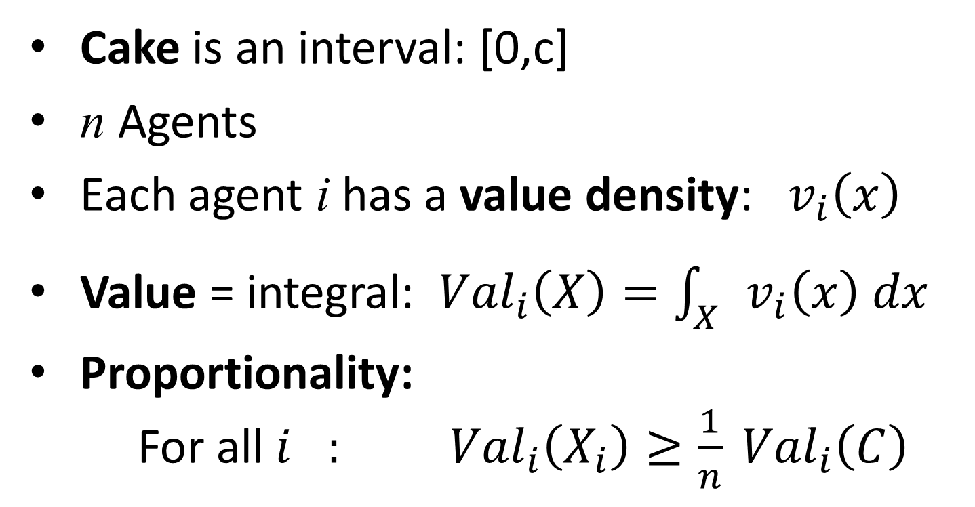
Cake-cutting: Definition
Cake is an interval: [0,c]
n Agents
Each agent i has a value density: $v_{i}\left(x\right)$
Value = integral: ${Val}_{i}\left(X\right)=\int_{X}{v_{i}\left(x\right) dx}$
Proportionality: For all $i_{}: {Val}_{i}\left(X_{i}\right)≥\frac{1}{n} {Val}_{i}\left(C\right)$

Slide 8
Is Proportionality possible?
Cake
B
G
Cut-and-choose:
Blue cuts two equal halves
Green chooses better half
Blue receives remaining half
Each agent receives at least 1/2.
Division is proportional!
Can be generalized to n agents.

Slide 9
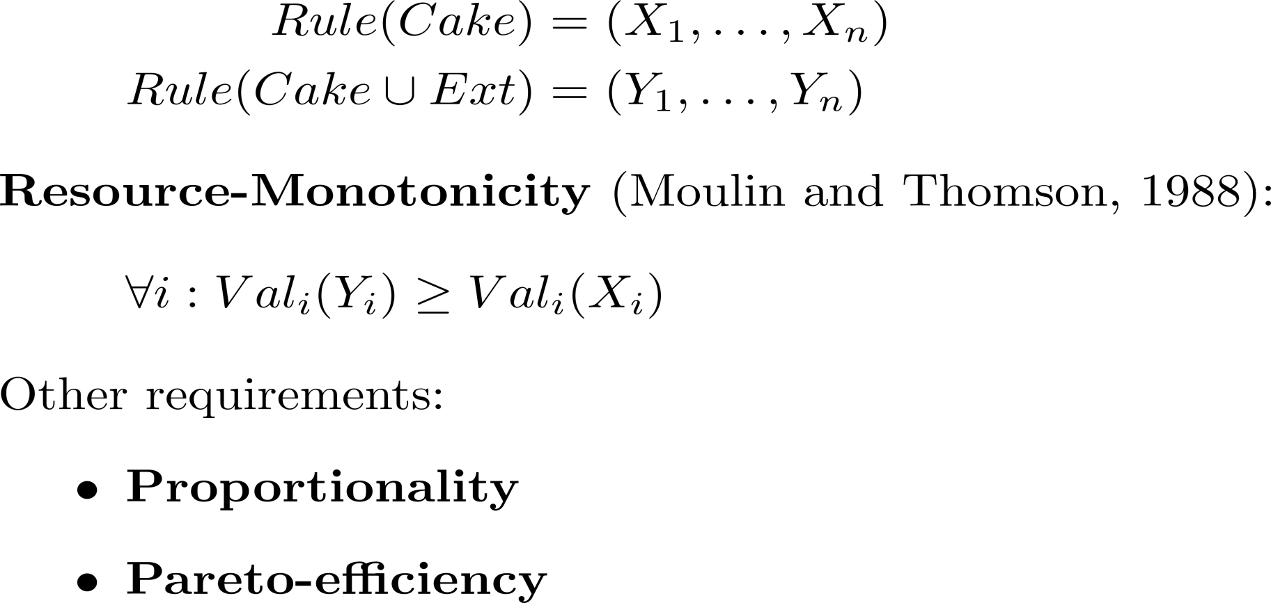
Resource Monotonicity: Definition
Cake
Ext

Slide 10
Is Proportionality + Monotonicity possible?
Cake
Ext
Cut-and-choose:
Blue cuts, Green chooses.
Value of Green in Cake: 3
Value of Green in Cake+Ext: 2.5
➔ not monotonic.

Slide 11

Is Proportionality + Monotonicity possible?
The Exact rule is:
Proportional,
Resource-monotonic,
Not Pareto-efficient.
B
G

Slide 12
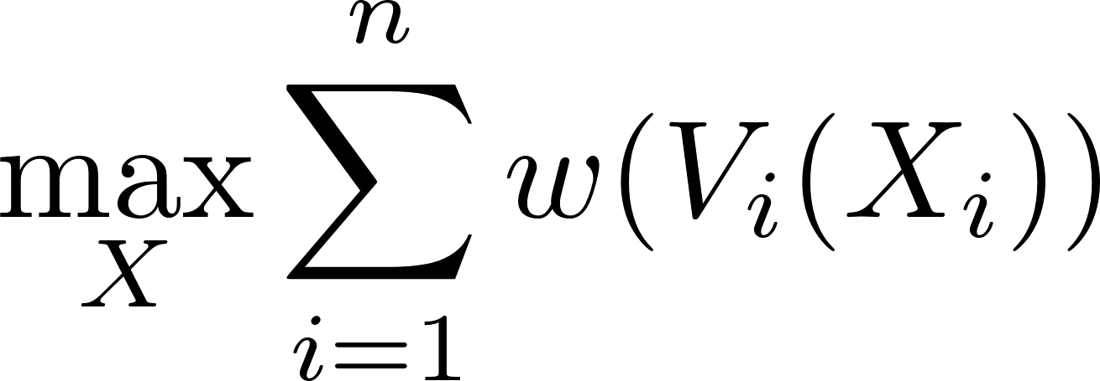
Is Efficiency + Monotonicity possible?
For an increasing function w,
Absolute-w-maximizer finds:
Pareto-efficient,
Resource-monotonic when w is concave (w’(x) is decreasing; does not like people becoming poorer)
Usually not proportional.
Example for: w(x)=x
G
G
B
G
B
G

Slide 13

Is Efficiency + Monotonicity possible?
For an increasing function w,
Absolute-w-maximizer finds:
Pareto-efficient,
Resource-monotonic when w is concave (w’(x) is decreasing; does not like people becoming poorer)
Usually not proportional.
Example for: $w\left(v\right)=−v^{−100}$
B
G
G
G
B

Slide 14
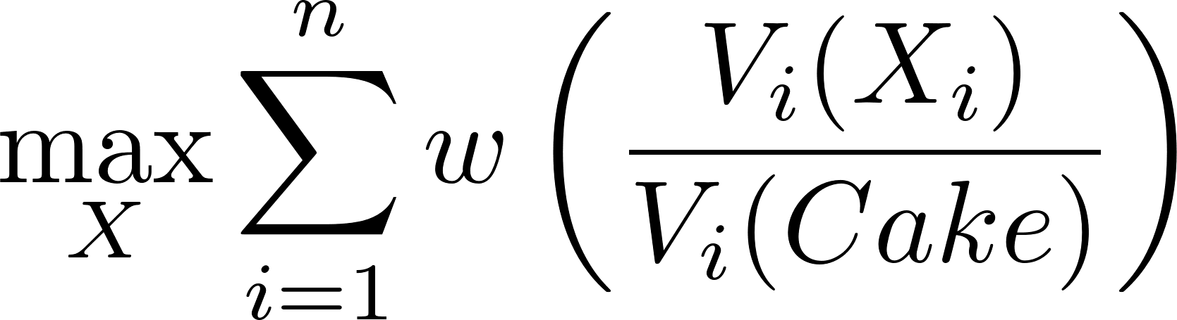
Is Efficiency + Proportionality possible?
For an increasing function w,
Relative-w-maximizer finds:
Pareto-efficient,
Proportional when w is “hyper-concave” (x w’(x) is decreasing)
Usually not resource-monotonic.
Example for: $w\left(v\right)=−v^{−100}$
B: 5/8
G: 3/8
G
G

Slide 15
Is Eff. + Prop. + Monotonicity possible?
Absolute-w-maximizer (w increasing & w’(x) decreasing):
Efficient, monotonic, but usually not proportional.
Relative-w-maximizer (w increasing & x w’(x) decreasing): Efficient, proportional, but usually not monotonic.
Is there a hyper-concave function w, such that
absolute-w-maximizer and relative-w-maximizer
are the same rule?
- yes! w(x) = log(x)

Slide 16

Is Eff. + Prop. + Monotonicity possible?
The Nash-optimal rule (Nash, 1950) is:
Pareto-efficient,
Resource-monotonic,
Proportional.
It is the only
welfare-maximizer
with these properties.

Slide 17
Cake-cutting with connected pieces
No connected division rule is simultaneously Proportional + Monotonic + Efficient!
G
B
Proof:
Initially, in any Prop.+Eff. rule, blue gets 3.
After the growth, blue gets at most 2.

Slide 18
Cake-cutting with connected pieces
Is there a division rule that is: Proportional + Monotonic + Weakly-Efficient? (e.g. the whole cake is divided)
For 2 agents: yes – the “rightmost mark” rule:
B
G
Each agent marks the half-value line.
Rightmost mark is selected.
Rightmost cutter gets right piece.
Monotonic if cake grows rightwards.
For 3 or more agents: open question!

Slide 19


(Ezekiel 47:14)
Resource-Monotonicity &
Population-Monotonicity
In Cake-Cutting
Erel Segal-haLevi Bar-Ilan Univesity, Israel
Joint work with:
Balázs Sziklai, Hungarian Academy of Sciences, Hungary
Notes:
19
19
19
19
19
19
19
19
19

