Slide 1

SBBA: a Strongly-Budget-Balanced Double-Auction Mechanism
Erel Segal-Halevi
with
Avinatan Hassidim
Yonatan Aumann

Slide 2
Goal: Gain-from-Trade
Value
Buyers:
Sellers:

Slide 3
Goal: Gain-from-Trade
Value
Buyers:
k=5 efficient deals
Gain from trade:
Sellers:

Slide 4
Solution 1: Price Equilibrium
k=5 efficient deals
Maximum gain
Single price – Budget balance
Not truthful
Price

Slide 5
VCG Mechanism
k=5 efficient deals
Maximum gain
Prior-free
Truthful
Two prices – Budget deficit
Seller price
Buyer price

Slide 6
Un-solution: Myerson & Satterthwaite (1983)
k=5 efficient deals
Impossible to get simultaneously:
Maximum gain,
Truthfulness,
Budget balance.

Slide 7
McAfee (1992)
k=5 efficient deals
Gain: (1 - 1/k) of maximum
Prior-free
Truthful
Two prices – Budget surplus
Buyer price
Seller price

Slide 8


VCG – Deficit
Seller price
Good for traders
May be very bad for auctioneer
Auctioneer Deficit
Buyer price

Slide 9


McAfee – Surplus
Buyer price
Good for auctioneer
May be very bad for traders
Auctioneer Surplus
Seller price

Slide 10
Our Goal
Gain: (1 - 1/k) of maximum
Prior-free
Truthful
Budget Balance: good for both traders and auctioneer.

Slide 11
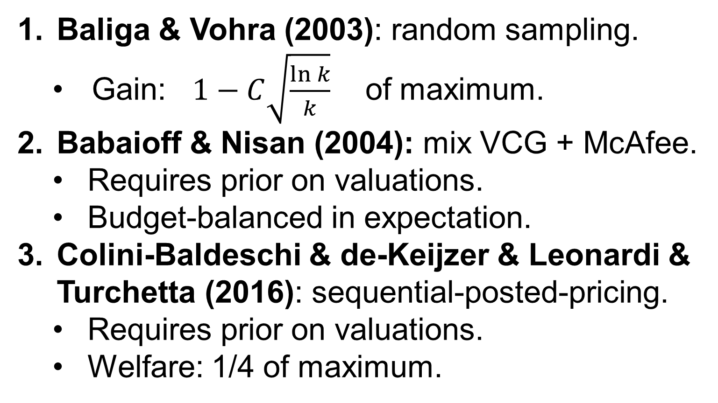
Previous Balance Attempts
Baliga & Vohra (2003): random sampling.
Gain: $1−C\sqrt{\frac{ln k}{k}}$ of maximum.
Babaioff & Nisan (2004): mix VCG + McAfee.
Requires prior on valuations.
Budget-balanced in expectation.
Colini-Baldeschi & de-Keijzer & Leonardi & Turchetta (2016): sequential-posted-pricing.
Requires prior on valuations.
Welfare: 1/4 of maximum.

Slide 12
Our Goal
Gain: (1 - 1/k) of maximum
Prior-free
Truthful
Budget Balance: good for both traders and auctioneer.

Slide 13

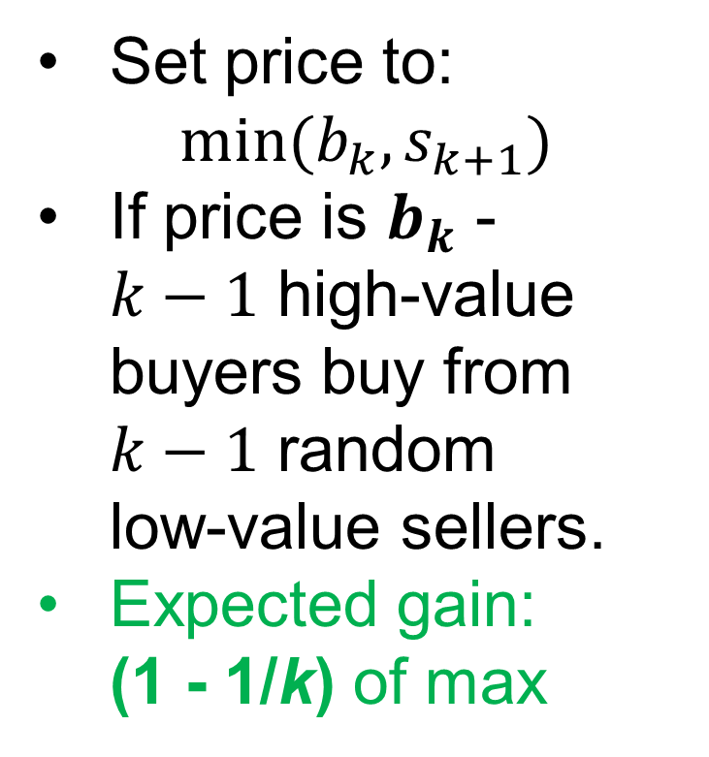

Our Solution: SBBA
$$s_{k+1}$$
Set price to: $min(b_{k},s_{k+1})$
If price is $b_{k}$ - $k−1$ high-value buyers buy from $k−1$ random low-value sellers.
Expected gain: (1 - 1/k) of max
$$b_{k}$$
price

Slide 14

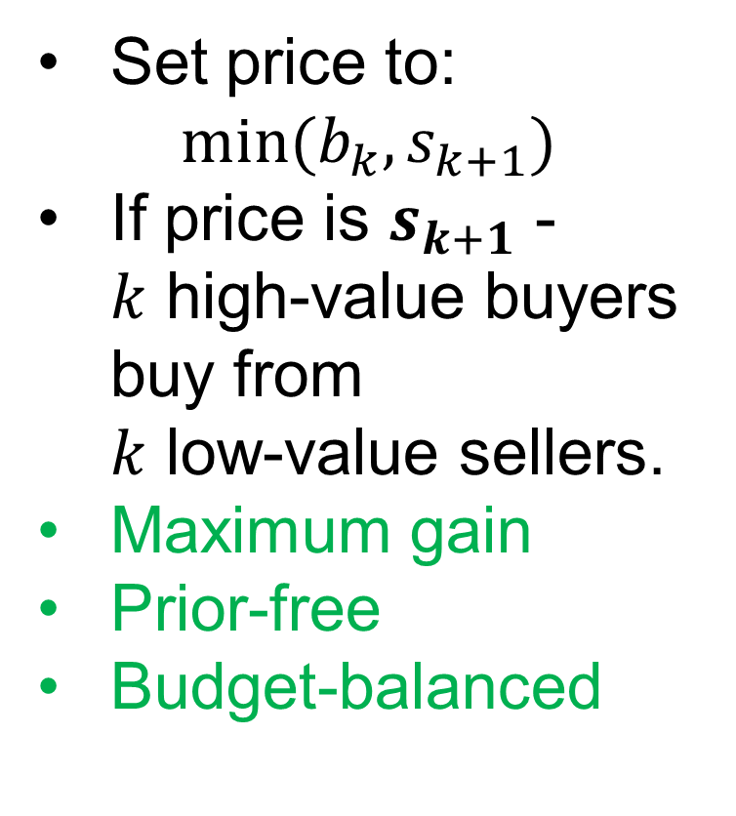

Our Solution: SBBA: Case #2
Set price to: $min(b_{k},s_{k+1})$
If price is $s_{k+1}$ - $k$ high-value buyers buy from $k$ low-value sellers.
Maximum gain
Prior-free
Budget-balanced
$$s_{k+1}$$
$$b_{k}$$
price

Slide 15
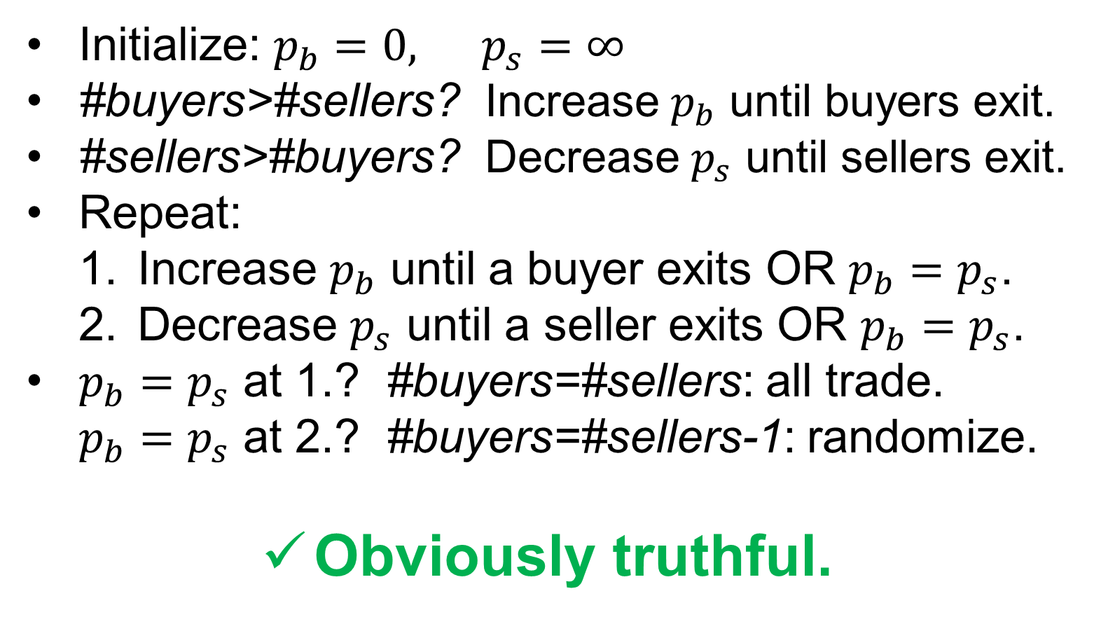
SBBA: Double-Clock Auction
Initialize: $p_{b}=0, p_{s}=∞$
#buyers>#sellers? Increase $p_{b}$ until buyers exit.
#sellers>#buyers? Decrease $p_{s}$ until sellers exit.
Repeat:
Increase $p_{b}$ until a buyer exits OR $p_{b}=p_{s}$.
Decrease $p_{s}$ until a seller exits OR $p_{b}=p_{s}$.
$p_{b}=p_{s}$ at 1.? #buyers=#sellers: all trade. $p_{b}=p_{s}$ at 2.? #buyers=#sellers-1: randomize.
Obviously truthful.

Slide 16


SBBA: Extensions
Spatial distribution & transaction costs: Babaioff & Nisan & Pavlov (2009): deficit or surplus.
Our paper: balance.
Constraints on trader-sets: Duetting&Roughgarden&Talgam-Cohen(2014): deficit or surplus. Can we achieve balance without prior?

Slide 17
SBBA: Open Question
VCG and McAfee are deterministic.
SBBA is randomized.
Is there a deterministic mechanism with the properties of SBBA:
Gain: 1 – o(1) of maximum
Truthful
Prior-free
Strong Budget Balance

Slide 18

Solutions
Gain | Bud | Tru
1 |  |  | Equilib.
1 |  |  | VCG
1-1/k |  |  | McAfee
McAfee - surplus
VCG - deficit
Balance?
Multi-parameter mechanism design
Sellers: m units Buyers: m types Both: Gross Sub. | 1-o(1) |  |  | This work

