Slide 1
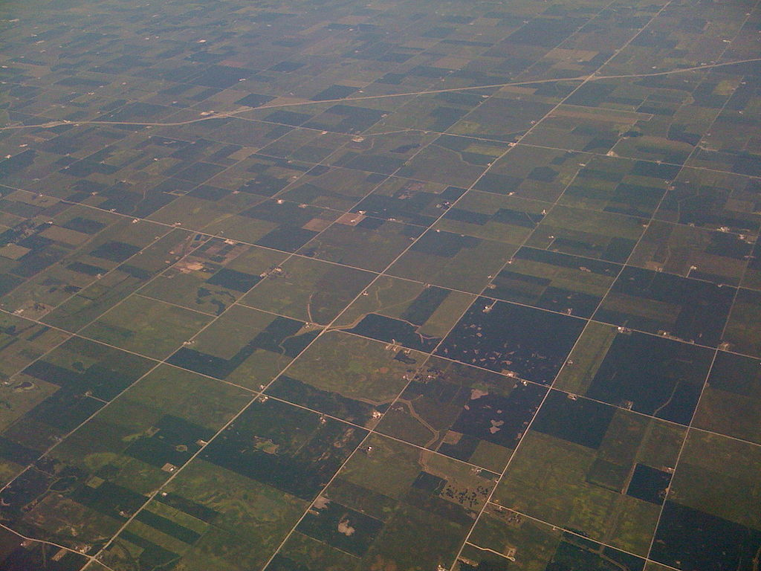

Envy-Free Cake-Cutting in Bounded Time
"וּנְחַלְתֶּם אוֹתָהּ אִישׁ כְּאָחִיו" (יחזקאל מז 14)
Erel Segal-Halevi
Advisors:
Yonatan Aumann
Avinatan Hassidim

Slide 2
n agents with different tastes
“I want lots of trees”
“I love the western areas”
“I want to be far from roads!”
Notes:
A metaphor for any divisible, heterogeneous good that people share
People may have different preferences regarding different parts of the cake

Slide 3
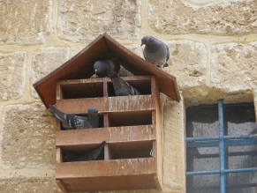
What is Fair?
Proportional Each agent gets a piece worth to it at least 1/n
Envy Free:
No agent prefers a piece allotted to someone else

Slide 4
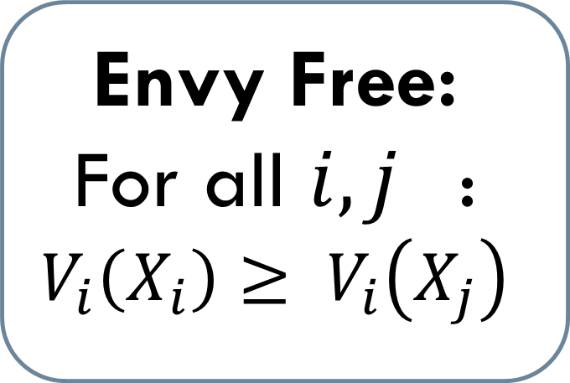
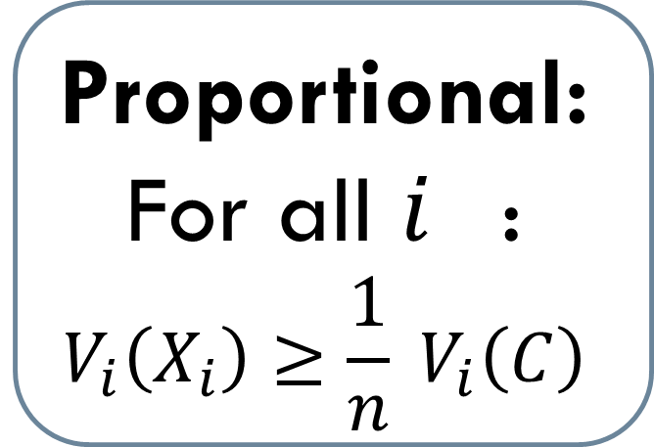
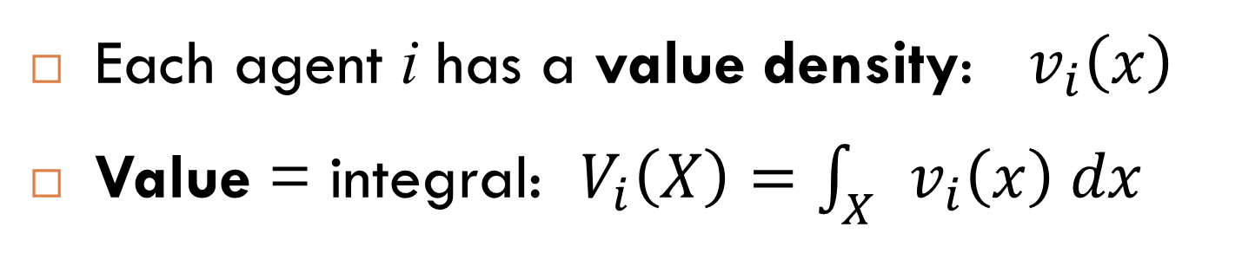
What is Fair?
Each agent i has a value density: $v_{i}\left(x\right)$
Value = integral: $V_{i}\left(X\right)=\int_{X}{v_{i}\left(x\right) dx}$
Proportional:
For all $i_{}$:
$$V_{i}\left(X_{i}\right)≥\frac{1}{n} V_{i}\left(C\right)$$
Envy Free:
For all ${i,j}_{}$:
$$V_{i}\left(X_{i}\right)≥ V_{i}\left(X_{j}\right)$$

Slide 5
2 agents: Blue, Green
Green: divide to two subjectively-equal parts.
Blue: pick more valuable part.
G
B
Proportional
Envy free

Slide 6
2 agents: Blue, Green
Each agent divides to 2 subjective halves.
Cut between two lines.
Each agent receives part with his line.
G
B
Proportional
Envy free

Slide 7



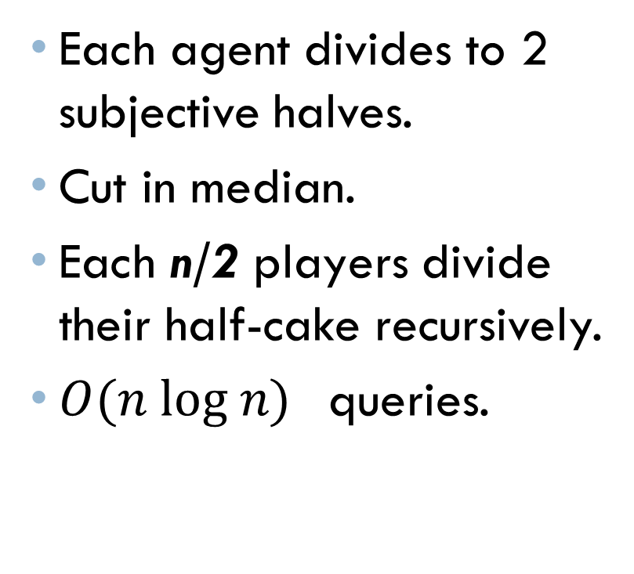
n agents
Shimon Even and Azaria Paz, 1984
Each agent divides to 2 subjective halves.
Cut in median.
Each n/2 players divide their half-cake recursively.
${O(n log n)}_{}$queries.
G
B
R
P
Proportional
Envy-free!

Slide 8

"קָשָׁה כִשְׁאוֹל קִנְאָה" (שיר השירים ח 6)
 | youtube.com/watch?v=WUquKkTmbww

Slide 9
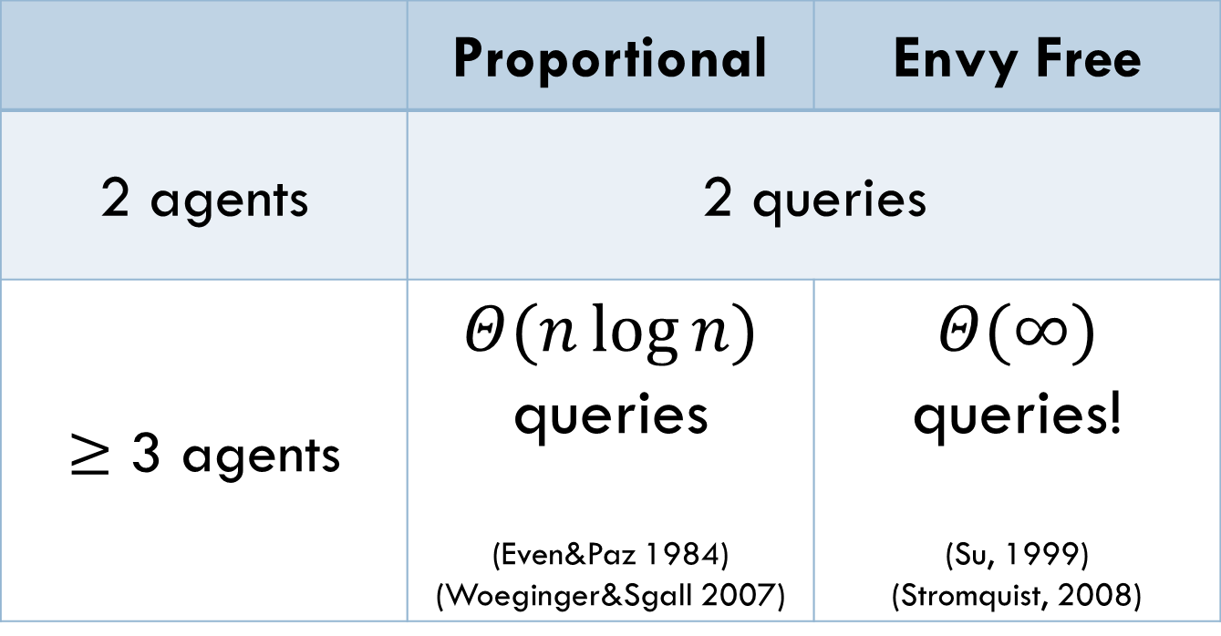
Fair Cake-Cutting: Connected pieces
 | Proportional | Envy Free
2 agents | 2 queries
$≥$ 3 agents | $$Θ(n\log{n)}$$ queries (Even&Paz 1984) (Woeginger&Sgall 2007) | $$Θ(∞)$$ queries! (Su, 1999) (Stromquist, 2008)

Slide 10
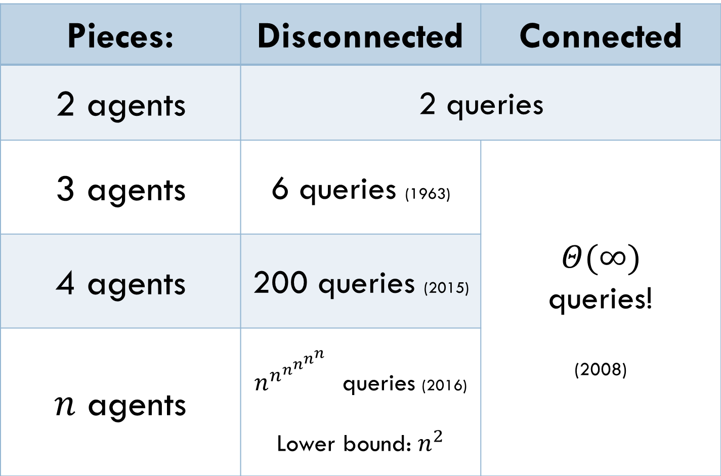
Envy-Free Cake-Cutting
Pieces: | Disconnected | Connected
2 agents | 2 queries
3 agents | 6 queries (1963) | $$Θ(∞)$$ queries! (2008)
4 agents | 200 queries (2015)
$n$ agents | $n^{n^{n^{n^{n^{n}}}}}$ queries (2016) Lower bound: $n^{2}$

Slide 11

This work: Waste Makes Haste (Segal-Halevi et al, AAMAS 2015)

Slide 12
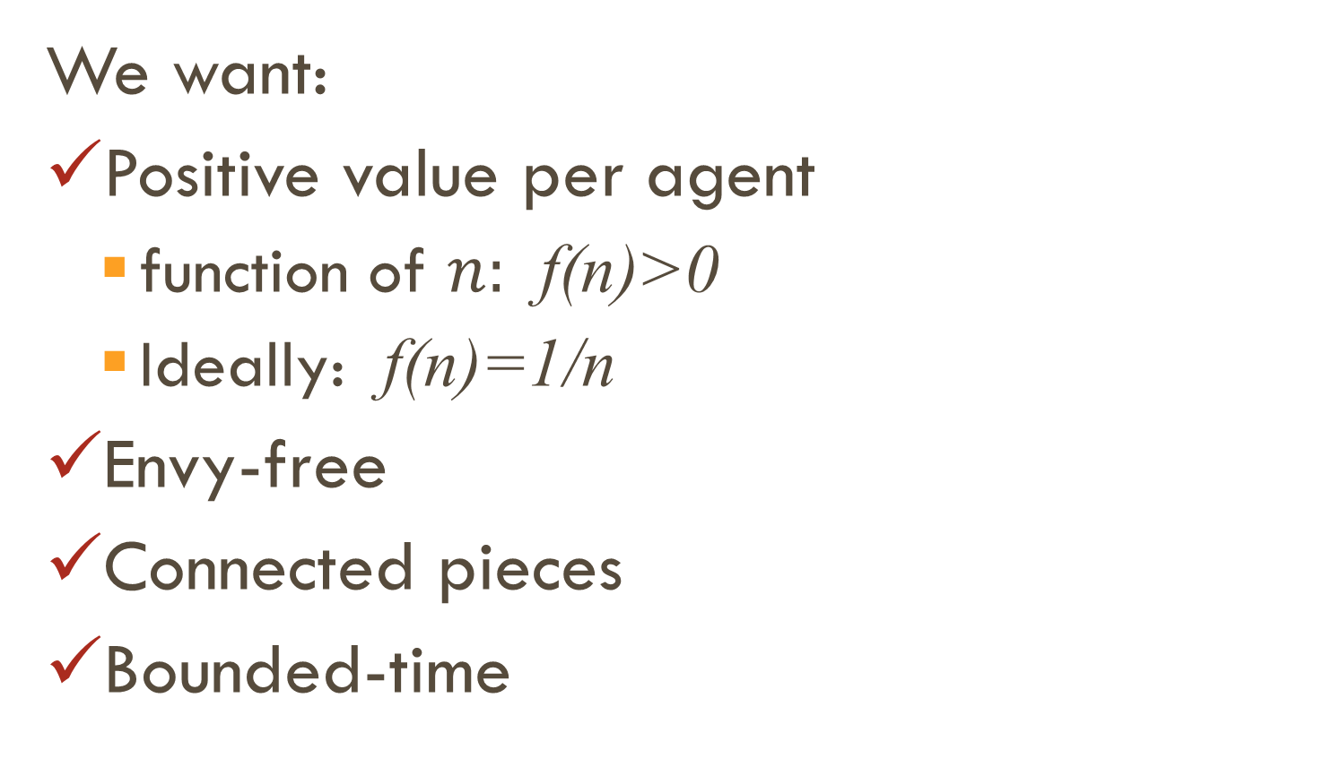
This work: Waste Makes Haste (Segal-Halevi et al, AAMAS 2015)
We want:
Positive value per agent
function of $n:$ f(n)>0
Ideally: f(n)=1/n
Envy-free
Connected pieces
Bounded-time

Slide 13
Envy-Free, Connected Pieces, 3 agents
Red: Equalize(3)
Blue: Equalize(2)
Green chooses, then Blue, then Red
Envy-free
Each gets at least ¼
Red
Blue
Green

Slide 14
Envy-Free Division and Matching
General scheme for envy-free division:
Create the agent-piece bipartite graph:
Each agent points to its best piece/s.
Find a perfect matching in that graph:
Each agent receives a best piece.
Perfect matching = Envy-free division!

Slide 15
Envy-Free Division and Matching
Red
Blue
Green
Red: Equalize(3) action creates bipartite graph: Each agent points to its best pieces.
Perfect matching = Envy-free division!

Slide 16
Envy-Free, Connected Pieces, 3 agents
Blue: Equalize(2) action transforms best-piece graph.
Perfect matching = Envy-free division!
Red
Blue
Green

Slide 17

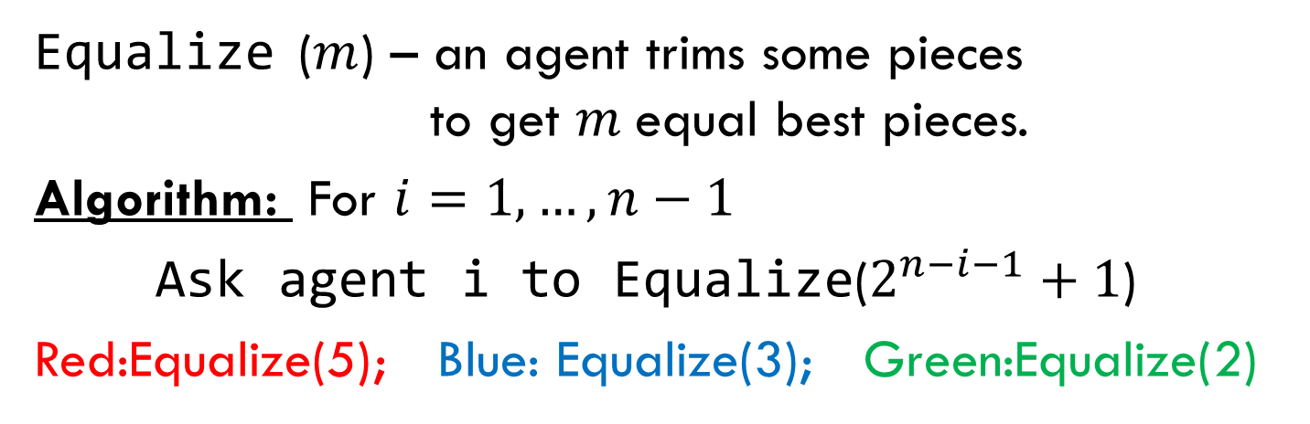
Envy-Free, Connected Pieces, $n$ agents
Red
Blue
Green
Brown
Equalize ($m$) – an agent trims some pieces to get $m$equal best pieces.
Algorithm: For $i=1,…,n−1$
Ask agent i to Equalize($2^{n−i−1}+1$)
Red:Equalize(5); Blue: Equalize(3); Green:Equalize(2)

Slide 18
Envy-Free, Connected Pieces, $n$ agents
Red
Blue
Green
Brown
Equalize ($m$) – an agent trims some pieces to get $m$equal best pieces.
Algorithm: For $i=1,…,n−1$
Ask agent i to Equalize($2^{n−i−1}+1$)
Red:Equalize(5); Blue: Equalize(3); Green:Equalize(2)

Slide 19
Envy-Free, Connected Pieces, $n$ agents
Red
Blue
Green
Brown
Equalize ($m$) – an agent trims some pieces to get $m$equal best pieces.
Algorithm: For $i=1,…,n−1$
Ask agent i to Equalize($2^{n−i−1}+1$)
Red:Equalize(5); Blue: Equalize(3); Green:Equalize(2)

Slide 20
Envy-Free, Connected Pieces, $n$ agents
Red
Blue
Green
Brown
Equalize ($m$) – an agent trims some pieces to get $m$equal best pieces.
Algorithm: For $i=1,…,n−1$
Ask agent i to Equalize($2^{n−i−1}+1$)
Red:Equalize(5); Blue: Equalize(3); Green:Equalize(2)

Slide 21
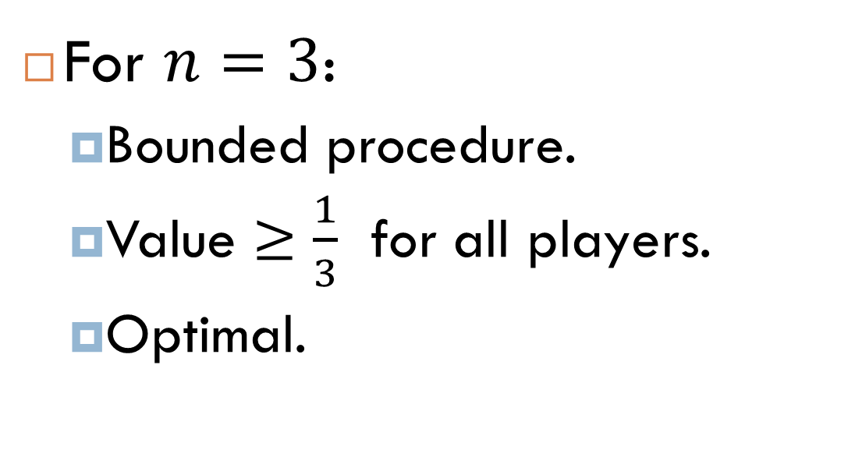
Can We Do Better?
For $n=3$:
Bounded procedure.
Value $≥\frac{1}{3}$ for all players.
Optimal.

Slide 22

Envy-Free and Proportional, $3$ agents
One of:
Red: Equalize(3).
Red: Equalize(3); Green:Equalize(2) .
Red: Equalize(3); Blue:Equalize(2) .
Green: Equalize(3) .
Green: Equalize(3); Red:Equalize(2) .
Green: Equalize(3); Blue:Equalize(2) .
Blue: Equalize(3) .
Blue: Equalize(3); Red:Equalize(2) .
Blue: Equalize(3); Green:Equalize(2) .

Slide 23
Envy-Free and Proportional, $3$ agents
R
B
G
G
R
B
G
B
R
R
B
G
B
R
G
R
G
B
B
G
R

Slide 24
Envy-Free and Proportional, $3$ agents
R
B
G
G
R
B
Green: Equalize(3); Red:Equalize(2) .

Slide 25
Envy-Free and Proportional, $3$ agents
R
B
G
G
R
B
✓

Slide 26
Envy-Free and Proportional, $3$ agents

Slide 27
Envy-Free and Proportional, $3$ agents
✓
✓

Slide 28
Envy-Free and Proportional, $3$ agents

Slide 29
Envy-Free and Proportional, $3$ agents

Slide 30
Envy-Free and Proportional, $3$ agents
Red
Blue
Green

Slide 31
Envy-Free and Proportional, $3$ agents
✓
✓
✓

Slide 32
Envy-Free and Proportional, $3$ agents

Slide 33
Envy-Free and Proportional, $3$ agents
Red
Blue
Green

Slide 34
Envy-Free and Proportional, $3$ agents
✓
✓
✓
✓
✓
✓

Slide 35
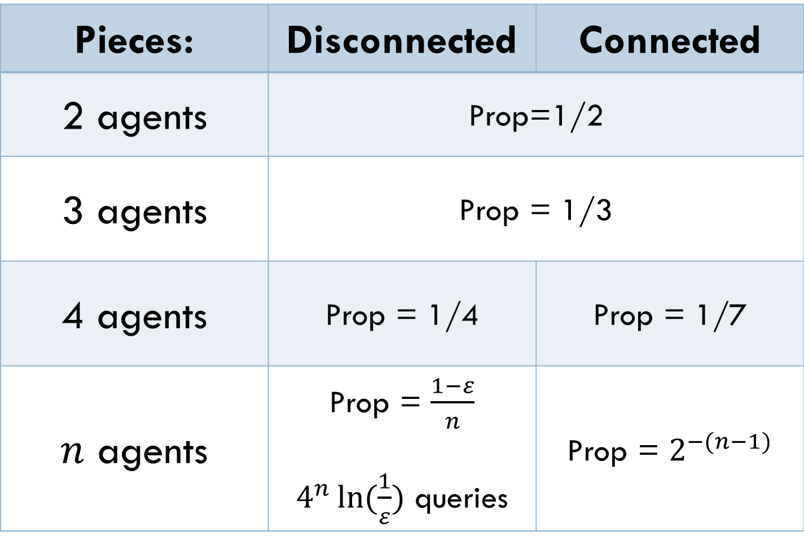
Envy-Free Cake-Cutting with Waste
Pieces: | Disconnected | Connected
2 agents | Prop=1/2
3 agents | Prop = 1/3
4 agents | Prop = 1/4 | Prop = 1/7
$n$ agents | Prop = $\frac{1−ε}{n}$ $4^{n}\ln{(\frac{1}{ε}})$ queries | Prop = $2^{−(n−1)}$

Slide 36
Envy-Free and Proportional?
With Waste: Envy-Free Proportional.
Can we find in bounded time a division:
Envy-Free
Proportional (Value ≥ 1/n):
Connected pieces?
For n=3: Yes!
For n ≥ 4: Open question.

Slide 37
Envy-Free Cake-Cutting in Bounded Time
"וּנְחַלְתֶּם אוֹתָהּ אִישׁ כְּאָחִיו" (יחזקאל מז 14)
Collaborations welcome!
erelsgl@gmail.com

