Slide 1

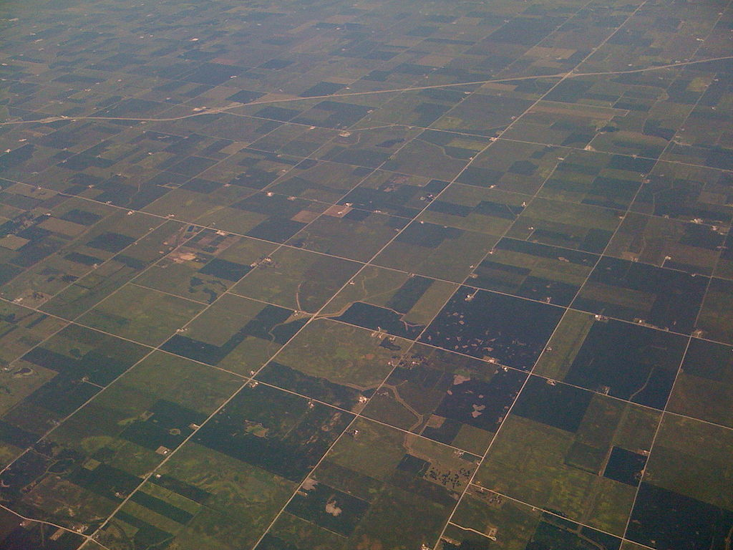

(Ezekiel 47:14)
Fair Division of Land
Erel Segal-haLevi
Advisors:
Yonatan Aumann Avinatan Hassidim
Notes:
1
1
1
1
1
1
1
1
1

Slide 2
Cake Cutting → Land Division
1. Geometry
2. Redivision: - More land
- More people
3. Family ownership
4. Land-value data

Slide 3
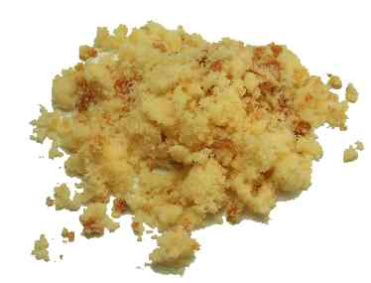
1. Geometry
“Wherever land is concerned, it is important that the parcels into which it is divided are nicely shaped”
(Dall’Aglio and Maccheroni, “Disputed Lands”, 2009)
→

Slide 4
1. Geometry
“Nice” shapes:
Rectangles – can be attained by reduction to 1-D.
Fat rectangles – cannot be attained by reduction to 1-D.

Slide 5
1. Geometry: example
Rectangle pieces:
- can give 1/2 to both agents.
Square pieces:
can give at most 1/4 to some agent.
Can we always give at least 1/4 to both?
What about n agents?
2 agents: blue and green

Slide 6
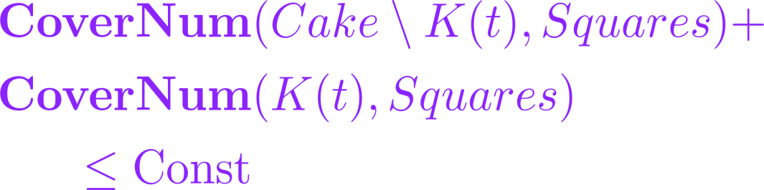
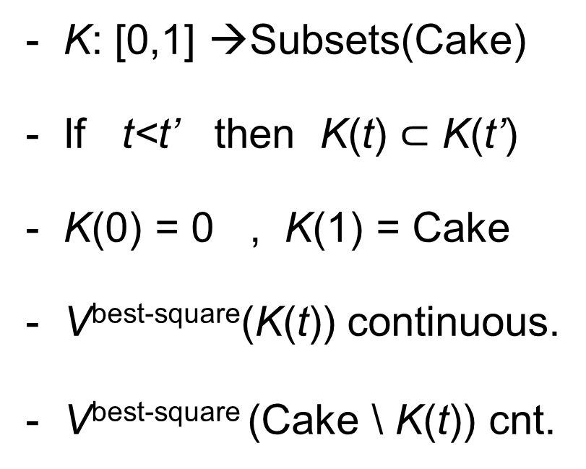
1. Geometry: example protocol
1. Geometry: the super-knife
- K: [0,1] →Subsets(Cake)
- If t<t’ then K(t) $⊂$ K(t’)
- K(0) = 0 , K(1) = Cake
- V^{best-square}(K(t)) continuous.
- V^{best-square} (Cake \ K(t)) cnt.
Stopper
Other
Division is envy-free;
Value-per-agent at least 1/4.

Slide 7
1. Geometry
For n agents:
we need a “kitchen” (set of knives)
Pieces: fat rectangles
Pieces: square-pairs
Pieces: fat convex polygons

Slide 8
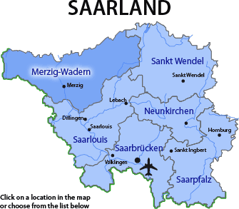
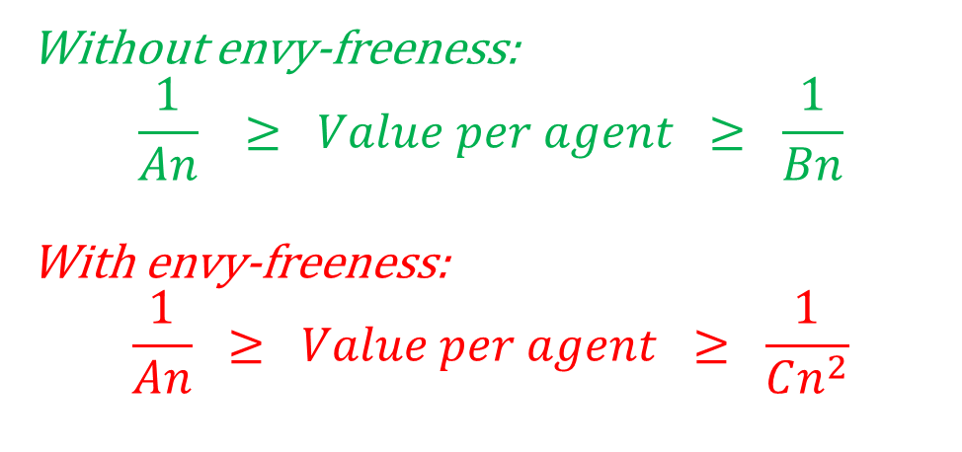
1. Geometry: non-square cakes
Cake: fat
Pieces: fat
Cake: infinite plane
Pieces: squares
Cake: rect. polygon
Pieces: rectangles
Without envy-freeness:
$$\frac{1}{An} ≥ Value per agent ≥ \frac{1}{Bn}$$
With envy-freeness:
$$\frac{1}{An} ≥ Value per agent ≥ \frac{1}{Cn^{2}}$$

Slide 9

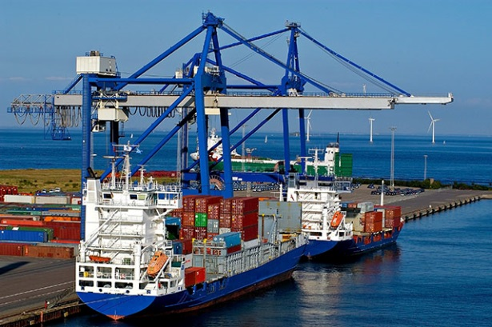
2. Redivision – more land
Joint work with Balázs Sziklai from the Hungarian Academy of Sciences
“Can anyone benefit from growth?”
(Moulin and Thomson, 1988)
Cake
Ext

Slide 10
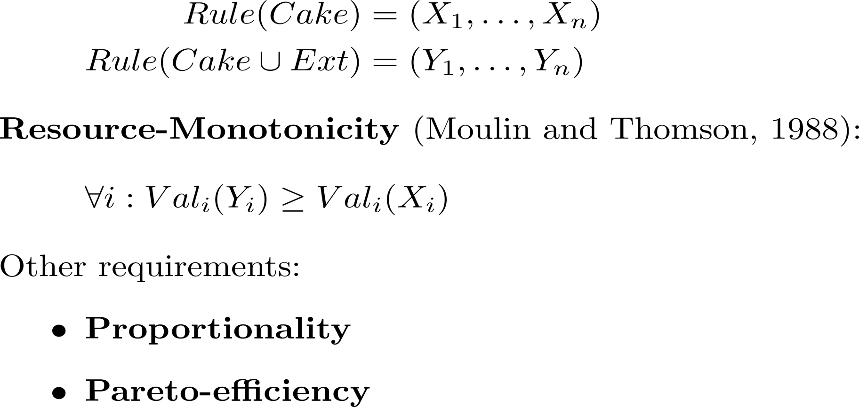
2. Redivision – more land
Cake
Ext

Slide 11
2. Redivision – more land
Cake
Ext
Cut-and-choose:
Blue cuts, Green chooses.
Value of Green in Cake: 2
Value of Green in Cake+Ext: 1
➔ not monotonic.

Slide 12
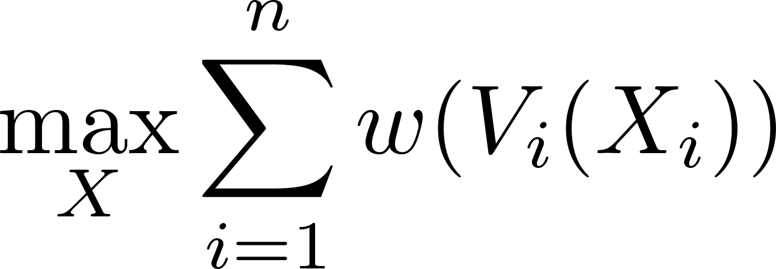
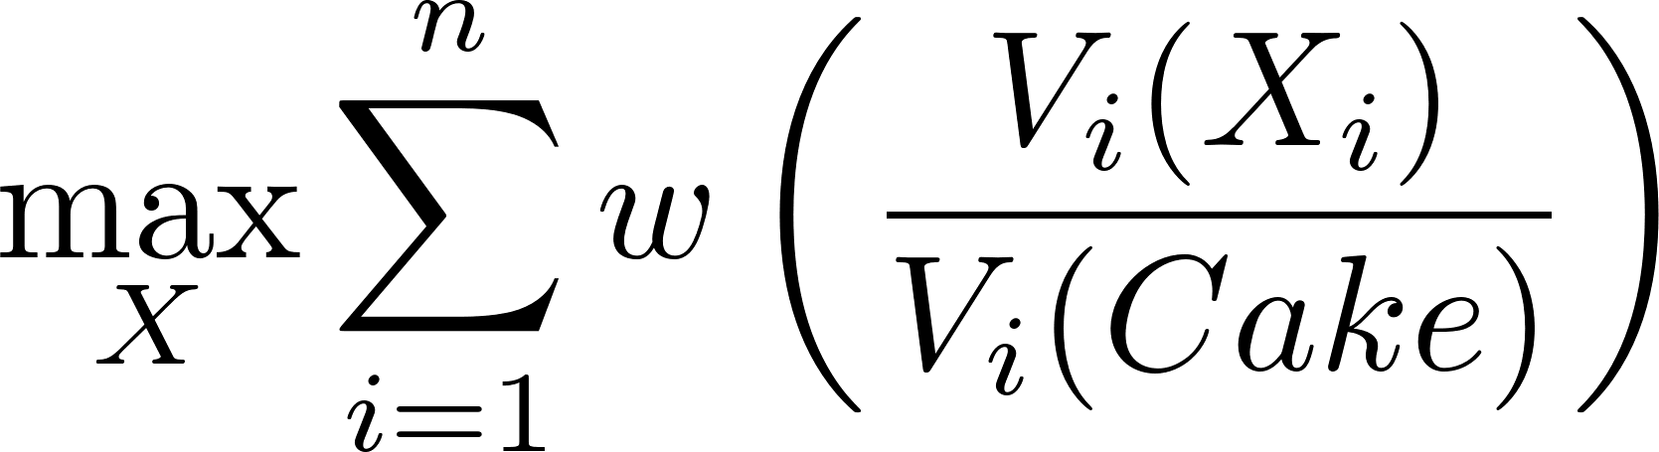
2. Redivision – more land
1. Exact division: Proportional, monotonic, but not Pareto.
2. Absolute-w-maximizer (w increasing and concave): Pareto, monotonic, but usually not proportional.
3. Relative-w-maximizer (w increasing and hyper-concave): Pareto, proportional, but usually not monotonic.

Slide 13
2. Redivision – more land
What rule is simultaneously absolute-w-maximizer and relative-w-maximizer, with same w?
--- The Nash-optimal rule! w = log.
Pareto, proportional, and monotonic.
Adds support to “The unreasonable fairness of maximum Nash welfare” (Caragiannis, Kurokawa, Moulin, Procaccia, Shah, Wang; ‘16)
- But, does not work with connected pieces.
- Impossible to get Pareto + prop. + monotonicity.

Slide 14
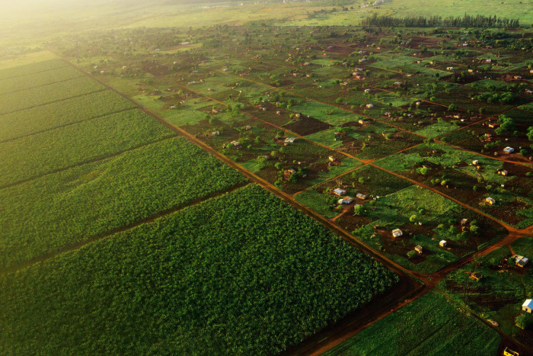
2. Redivision – more people
2. Redivision: More people
“Most previous studies assume that all agents are available at time of division. Here, agents arrive and depart as the cake is being divided”
(Walsh, “Online cake cutting”, 2011)

Slide 15
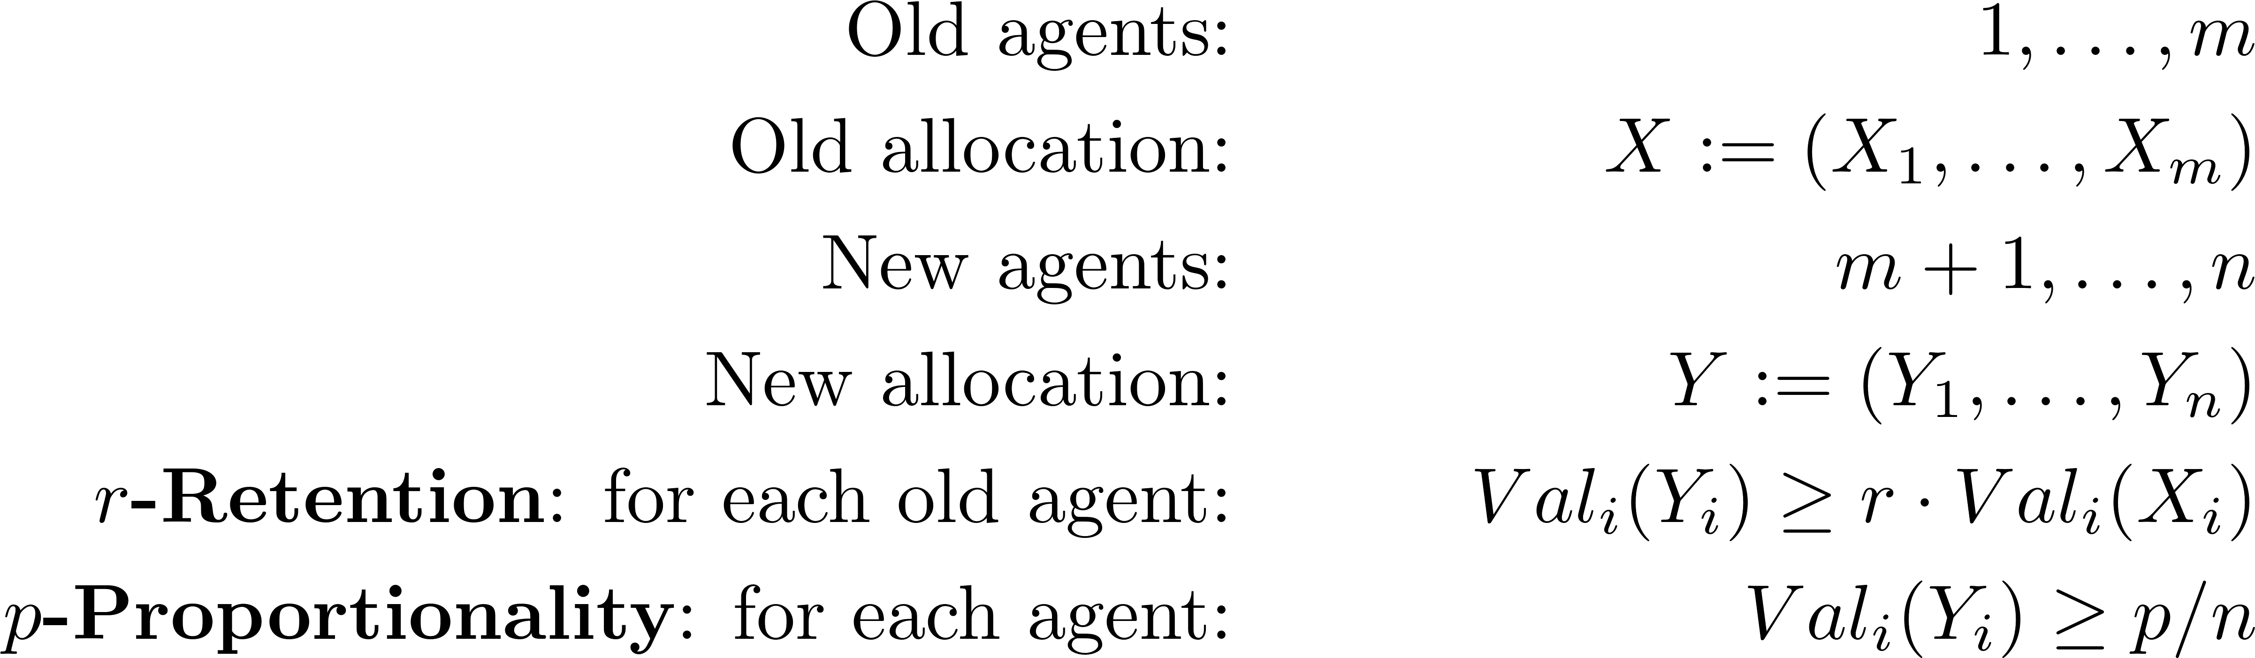
2. Redivision – more people
2. Redivision: More people
Without connectivity: possible (for r=1-p).
With connectivity: impossible.

Slide 16
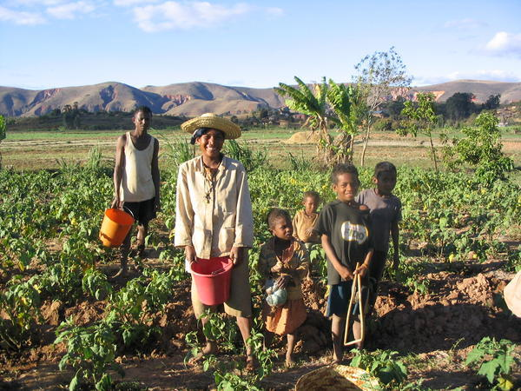
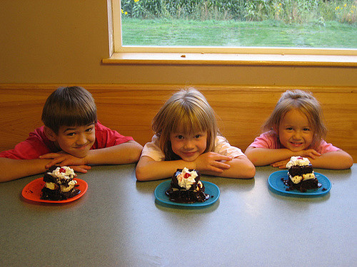
Cake Cutting → Land Division
1. Geometry 2. Redivision: - More land
- More people
3. Family ownership
4. Land-value data
→

Slide 17
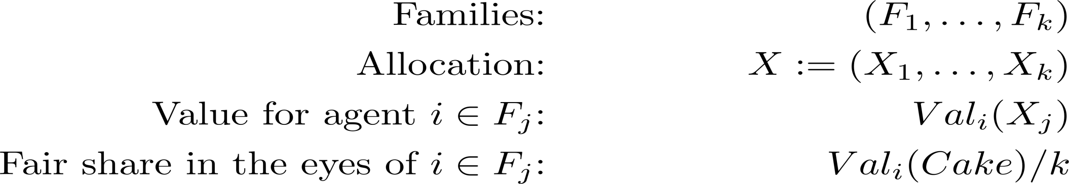
3. Family ownership

Slide 18
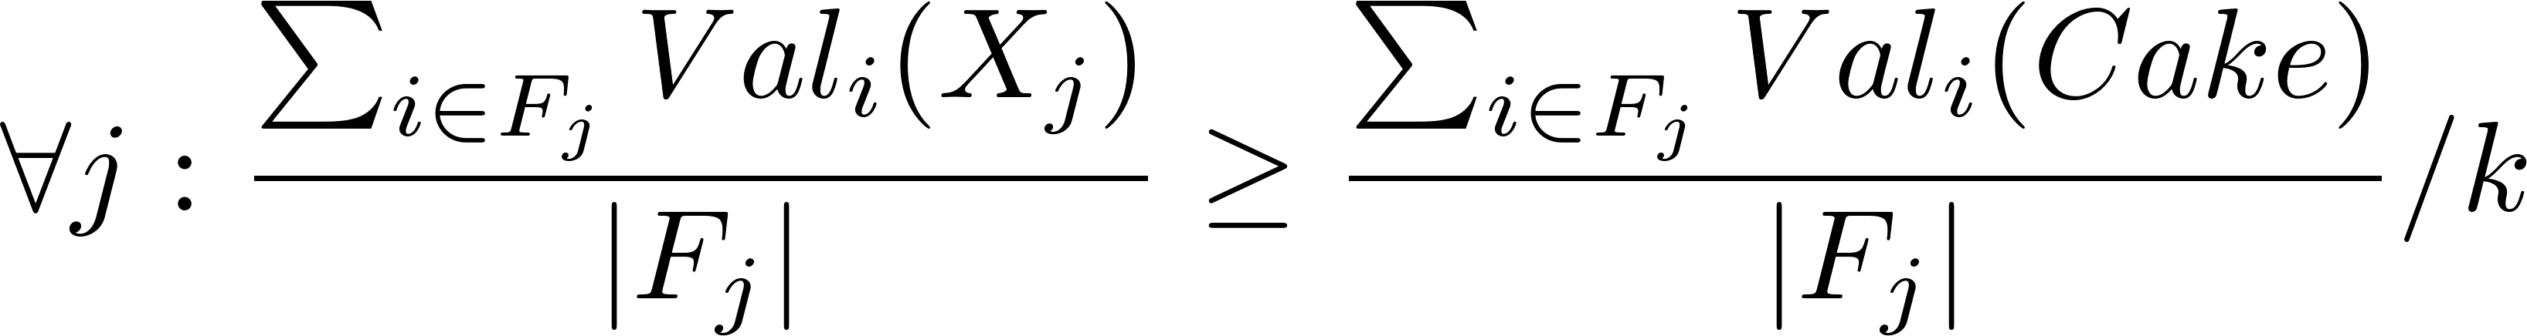
3. Family ownership
1. Average proportionality: Easy, but requires inter-personal summation.
2. Unanimous proportionality: No inter-personal sums, but disconnected. 3. Democratic proportionality: No inter-personal sums; connected for k=2.

Slide 19
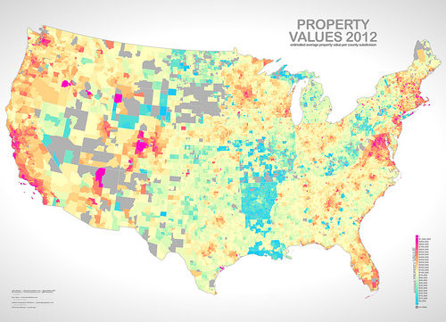
Cake Cutting → Land Division
1. Geometry 2. Redivision: - More land
- More people
3. Family ownership
4. Land-value data

Slide 20
4. Land-value data
Source: Map of economic (NPV) land-values.
Plus noise to simulate different valuations.
Experiment: compare “objective” division to classic (1-D) cake-cutting algorithms according to:
Envy,
Social welfare: egalitarian and utilitarian
Conclusion: Cake-cutting does much better.
Future work: make this experiment in 2-D.

Slide 21
(Ezekiel 47:14)
Lessons I learned so far:
1. Two-dimensional cake-cutting: Geometric concepts have economic implications.
2. Redivision and monotonicity: Nash-optimum is good.
3. Family ownership: Democracy is good.
4. Land-value data: Cake-cutting algorithms are great.
Thank you!

Slide 22
(Ezekiel 47:14)
Fair Division of Land
Erel Segal-haLevi
Advisors:
Yonatan Aumann Avinatan Hassidim
Notes:
22
22
22
22
22
22
22
22
22

Slide 23
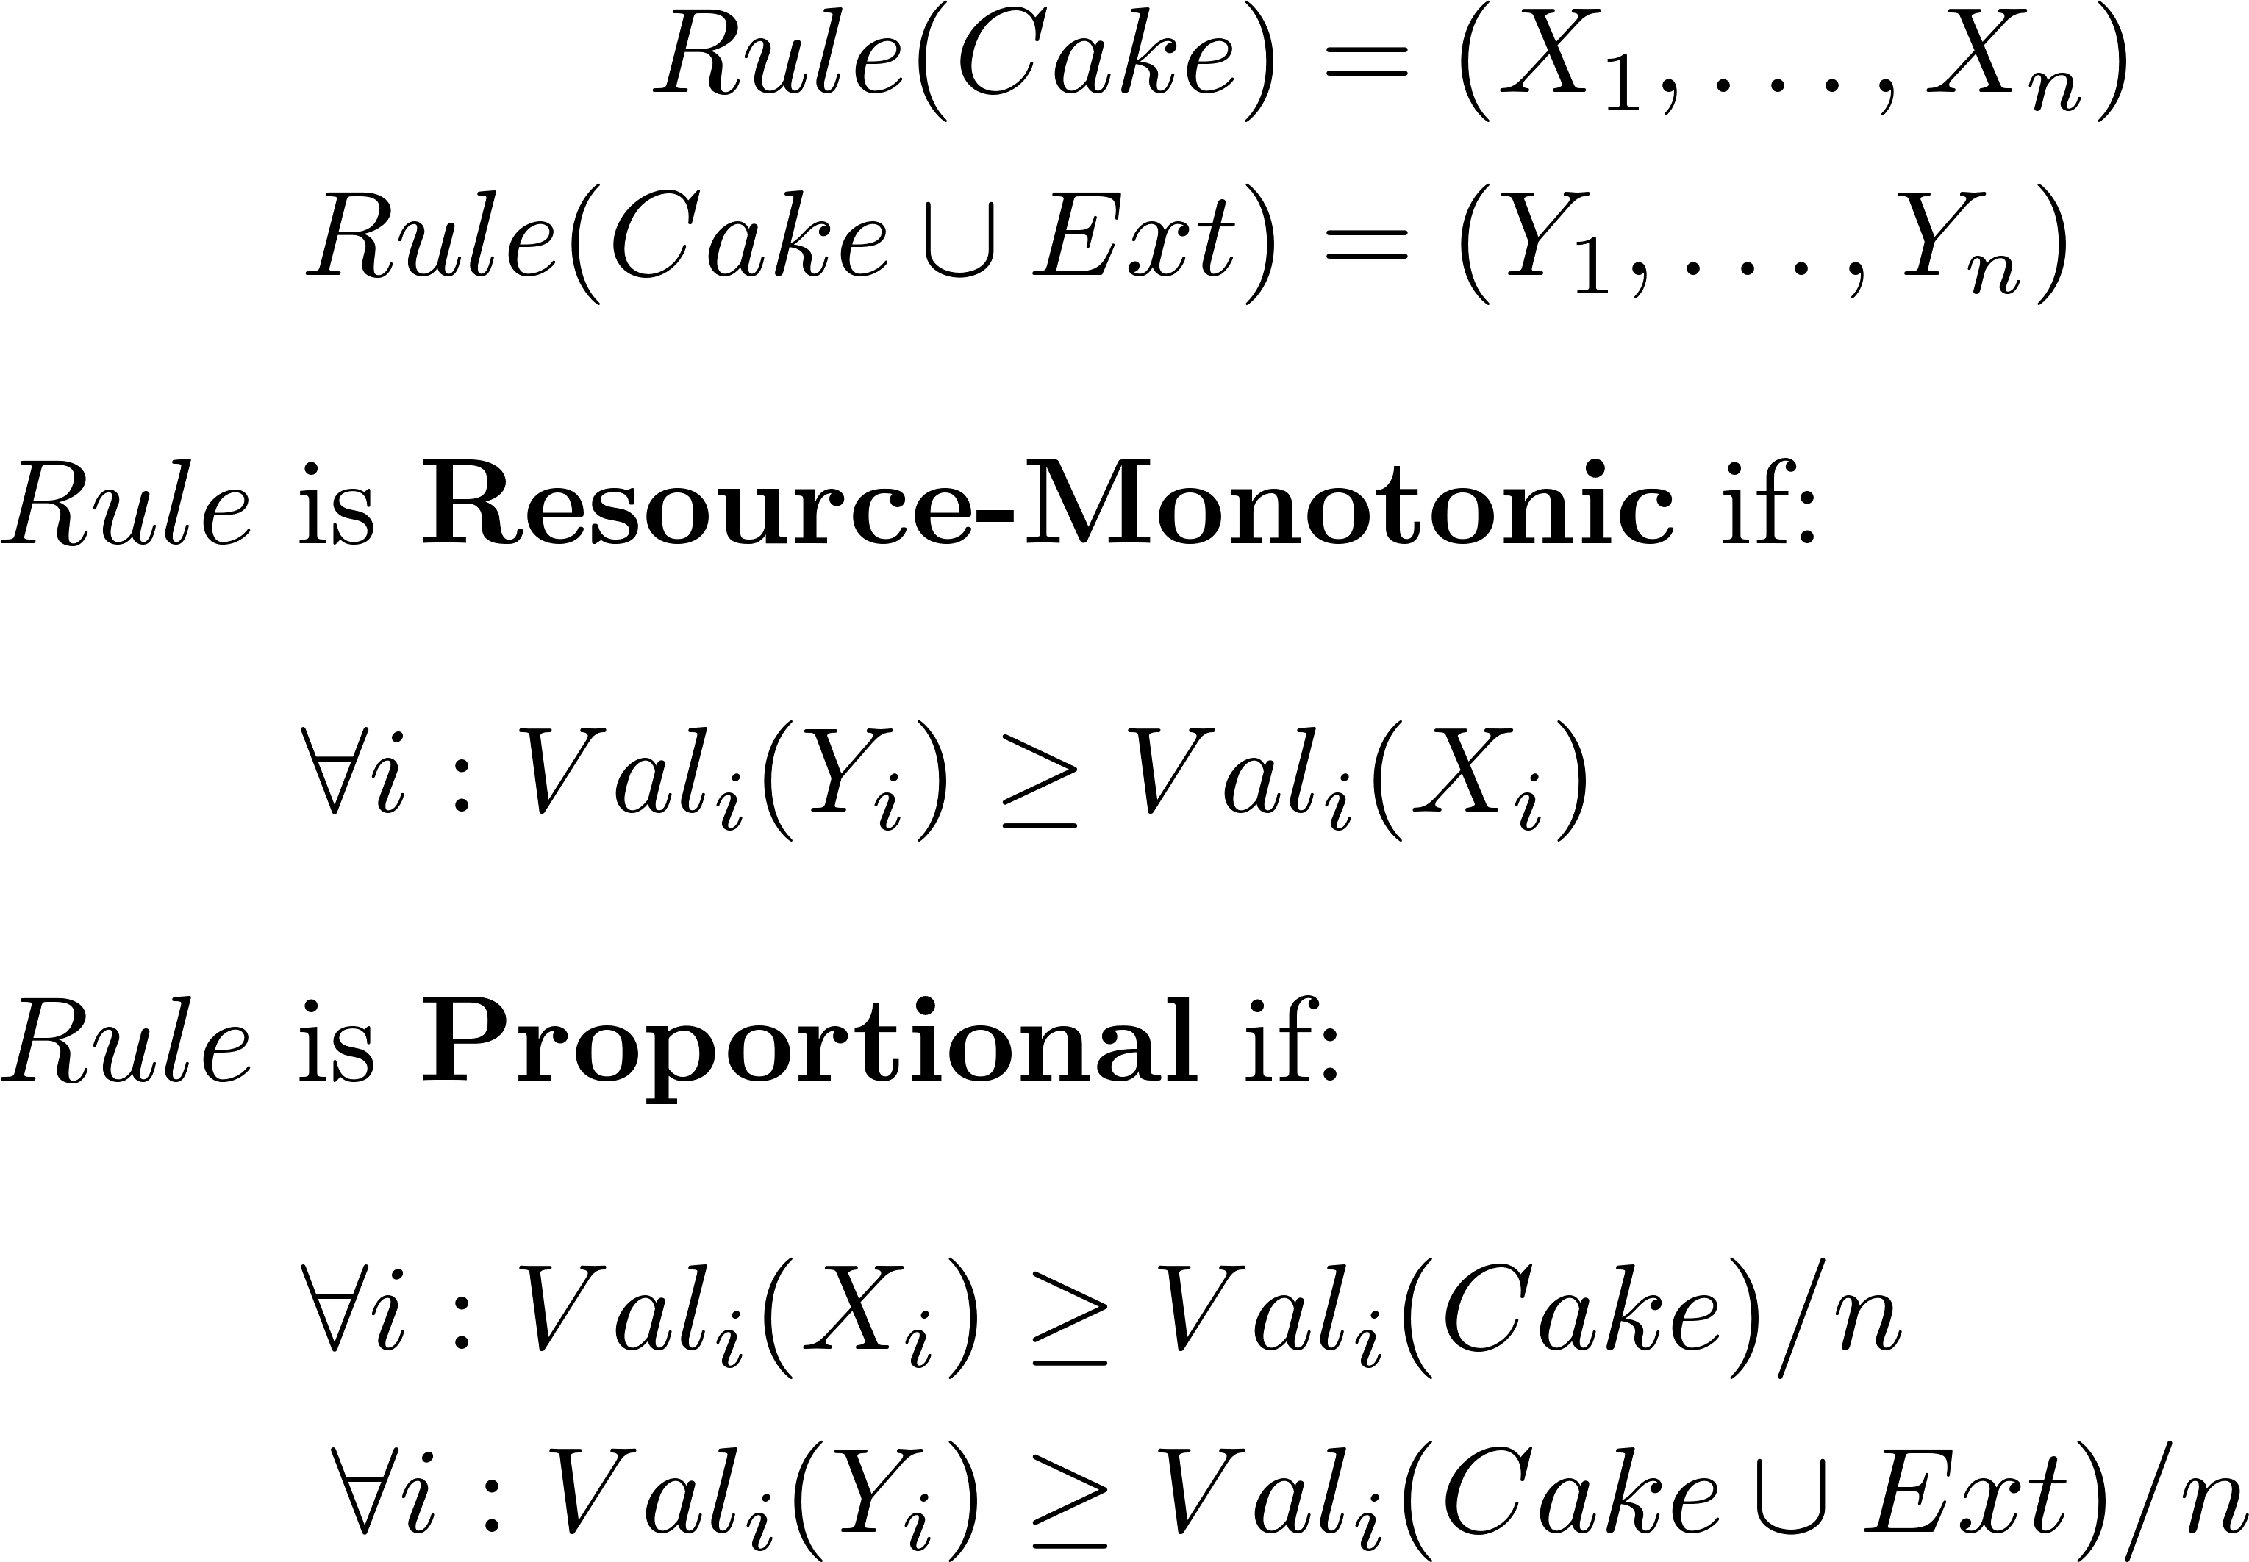
2. Resource-monotonicity
Notes:
Pieces do not have to be connected.
Value of Cake and of Ext can be different for different agents.

Slide 24
2. Resource-monotonicity
Cut-and-choose, and other classic cake-cutting algorithms, are:
Proportional,
Not resource-monotonic.

Slide 25
2. Resource-monotonicity
The Exact rule is:
Well-defined (convexity),
Proportional,
Resource-monotonic,
Not Pareto-efficient.

Slide 26
2. Resource-monotonicity
For every concave function w:
The Absolute-w-maximizer rule is:
Well-defined (compactness),
Pareto-efficient,
Resource-monotonic,
Usually not proportional,

Slide 27
2. Resource-monotonicity
For every mega-concave function w:
The Relative-w-maximizer rule is:
Well-defined (compactness),
Pareto-efficient,
Proportional,
Usually not monotonic.

Slide 28
2. Resource-monotonicity
What rule is simultaneously absolute-w-maximizer and relative-w-maximizer, with same w?
--- The Nash-optimal rule! w = log.
Well-defined (compactness),
Pareto-efficient,
Proportional,
Resource-monotonic.

Slide 29
1. Geometry: query model
General | One-dimensional
Eval(X): return value of piece X | Eval(a,b): return value of interval [a,b]
Mark(PieceSet, v): return X in PieceSet, s.t. Value(X)=v | Mark(a,v): return b in [0,1], s.t. Value([a,b])=v
→
→

Slide 30
1. Geometry: division protocol
Eval queries: each agent evals each quarter.
Choose favorite quarter of each agent.
Easy case: different choices.
Allocate choices and finish.
B
G

Slide 31
1. Geometry: division protocol
Eval queries: each agent evals each quarter.
Choose favorite quarter of each agent.
Hard case: same choice.
Mark queries: each agent marks corner-square inside choice, with value exactly 1/4.
G
B

Slide 32
1. Geometry: division protocol
Mark queries: each agent marks corner-square inside choice, with value exactly 1/4.
Cut between lines.

Slide 33
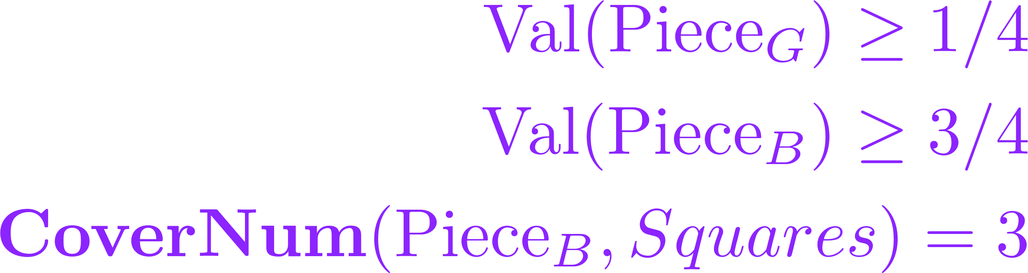
1. Geometry: division protocol
Mark queries: each agent marks corner-square inside choice, with value exactly 1/4.
Cut between lines.
Each person receives piece with his line.
B
Val ≥ 3/4
G
Val ≥ 1/4

Slide 34
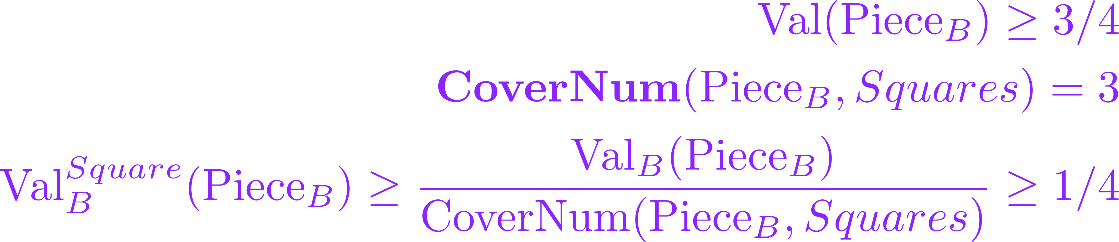
1. Geometry: division protocol
Mark queries: each agent marks corner-square inside choice, with value exactly 1/4.
Cut between lines.
Each person receives piece with his line.
B
Val ≥ 1/4
G
Val ≥ 1/4

Slide 35
1. Geometry
Cake: square
Pieces: squares
Value guarantee: 1/(4n-4)
Upper bound: 1/(2n)

Slide 36
1. Geometry
Cake: square
Pieces: rectangles with length/width at most R
Value guarantee: 1/(4n-5)
Upper bound: 1/(2n-1)

Slide 37
1. Geometry
Cake: square
Pieces: polygons with length/width at most 2
Value guarantee: 1/(2n-2)
Upper bound: 1/n

Slide 38
1. Geometry
Cake: square with 3 walls
Pieces: squares
Value guarantee: 1/(2n-1)
Upper bound: 1/(2n-1)

Slide 39
1. Geometry
Cake: square with 2 walls
Pieces: squares
Value guarantee: 1/(2n-1)
Upper bound: 1/(2n-1)

Slide 40
1. Geometry
Cake: square with 1 wall
Pieces: squares
Value guarantee: 1/(2n-2)
Upper bound: 1/(1.5n-1)

Slide 41
1. Geometry
Cake: square with no walls
Pieces: squares
Value guarantee: 1/(2n-4)
Upper bound: 1/n

Slide 42
1. Geometry
Cake: rectilinear, T outer corners
Pieces: rectangles
Value guarantee: 1/(n+T)
Upper bound: 1/(n+T)
1
5
6
2
4
3

Slide 43
1. Geometry
Cake: rectilinear, T outer corners
3 directions of walls
Pieces: squares
Value guarantee: 1/(2n-1+T)
Upper bound: 1/(2n-1+T)
1
5
6
2
4
3

Slide 44
1. Geometry
Cake: rectilinear, T outer corners
Pieces: squares
Value guarantee: ?
1
5
6
2
4
3

Slide 45
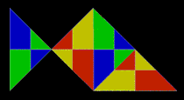
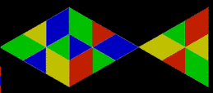
1. Geometry
Cake: fish
Pieces: fish
Value guarantee: 1/(16n-23)
Upper bound: 1/n

Slide 46
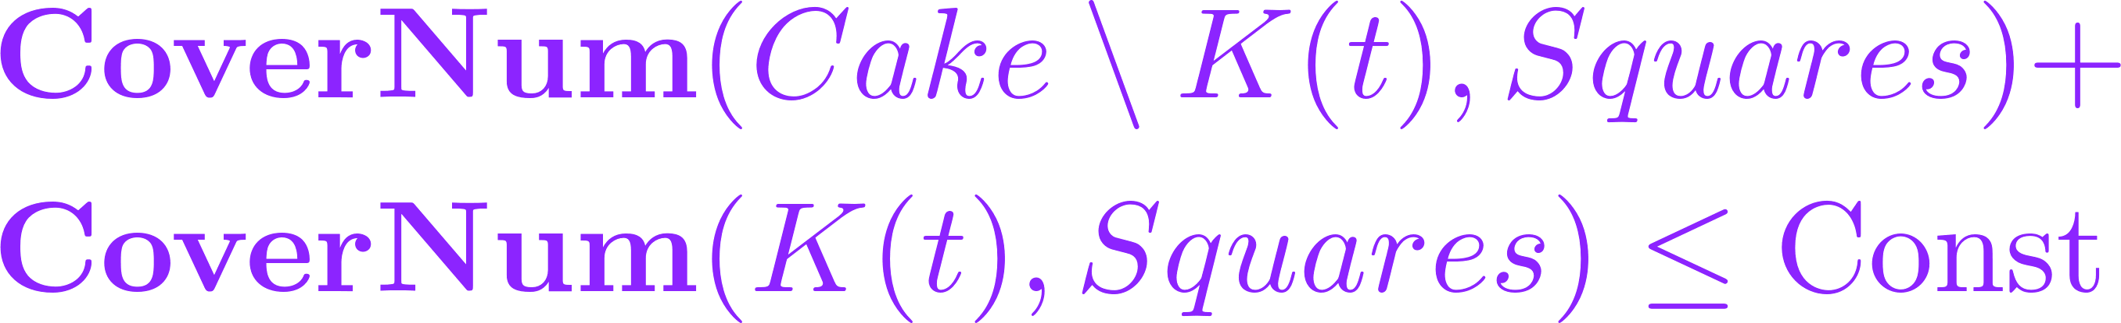
1. Geometry: envy-free
General | 1-D
Super knife - K: [0,1] → Borel(Cake) - K(0) = 0 , K(1) = Cake - If t’>t then K(t’) Ↄ K(t) - V^{squares}(K(t)) continuous - V^{squares}(Cake \ K(t)) cont. | Knife
→

Slide 47
1. Geometry: envy-free
Cake: square
Pieces: squares
Agents: 2
Value guarantee: 1/4 + envy-free
Upper bound: 1/4
Stopper
Other

Slide 48
1. Geometry: envy-free
Cake: square
Pieces: squares
Agents: n
Value guarantee: 1/(2n)² + envy-free
Upper bound: 1/(2n)

Slide 49
(Ezekiel 47:14)
Fair Division of Land
Erel Segal-haLevi
Advisors:
Yonatan Aumann Avinatan Hassidim
Notes:
49
49
49
49
49
49
49
49
49

