Slide 1


The AI Landscape
Session 1

Slide 2
Today: 90 minutes in four parts
15
30
30
15
min
min
min
min
Presentation
Guided lab
Capstone build
Recap & log
Families of AI, open and closed models, data tiers, capstone launch
Card sort: AI, traditional software, or Hybrid?
rotation using advanced prompting
Headline audit and
Every session follows the same 15-60-15 format.

Slide 3
Nine sessions, one capstone
The AI landscape and advanced prompting
Code generation and review
Presenting your work with AI
1
2
3
Custom assistants, guardrails, capstone lock-in
Retrieval-augmented generation (RAG)
Agents, human in the loop, bias
4
5
6
Vibe coding and rapid prototyping
Finalizing the capstone, governance audit
Capstone presentation and failure defense
7
8
9

Slide 4
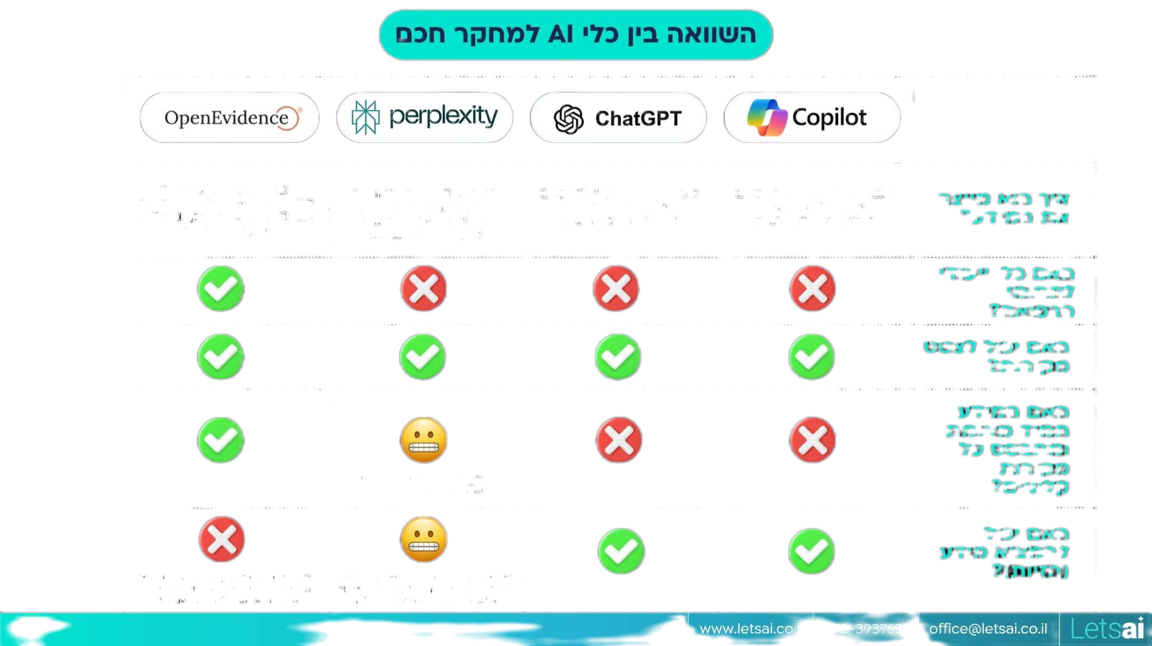
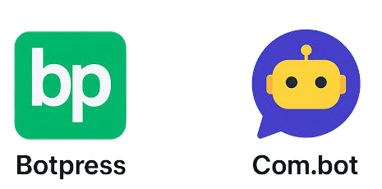
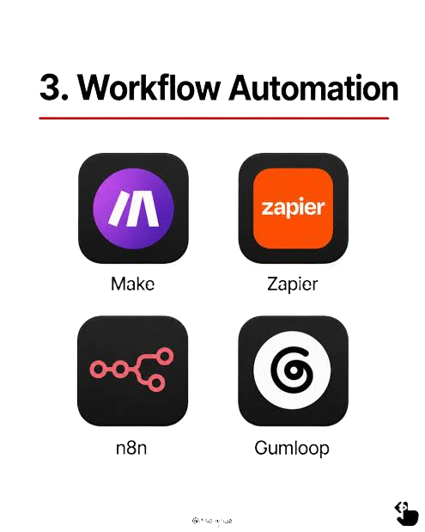


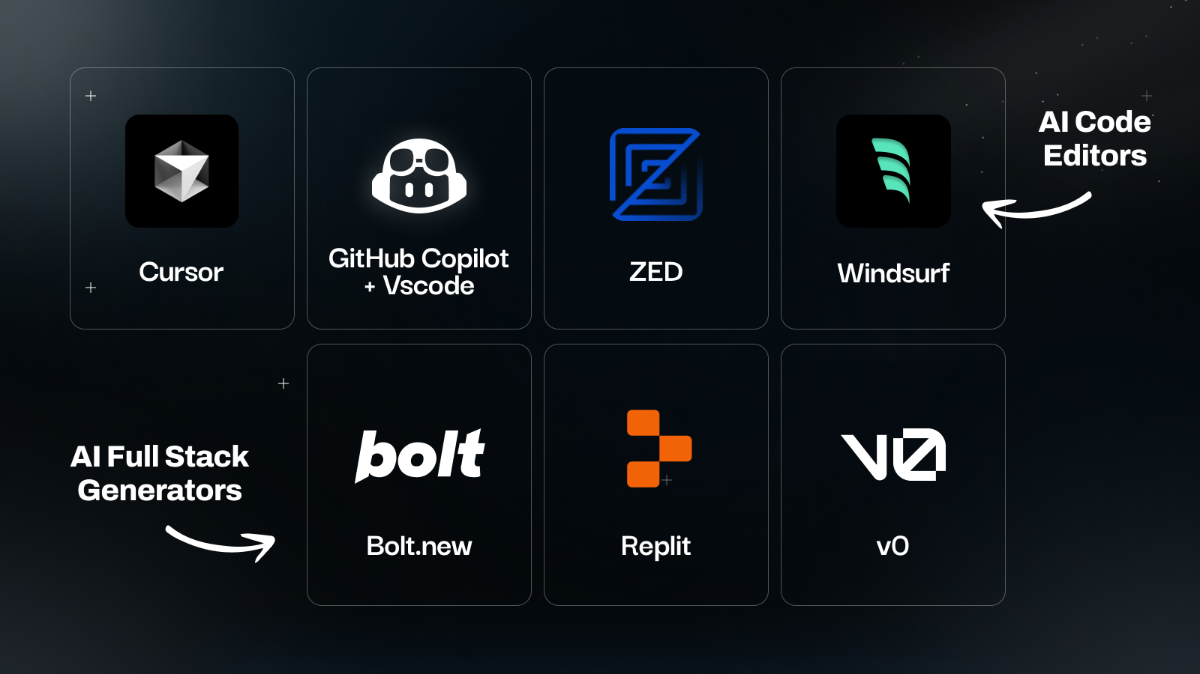

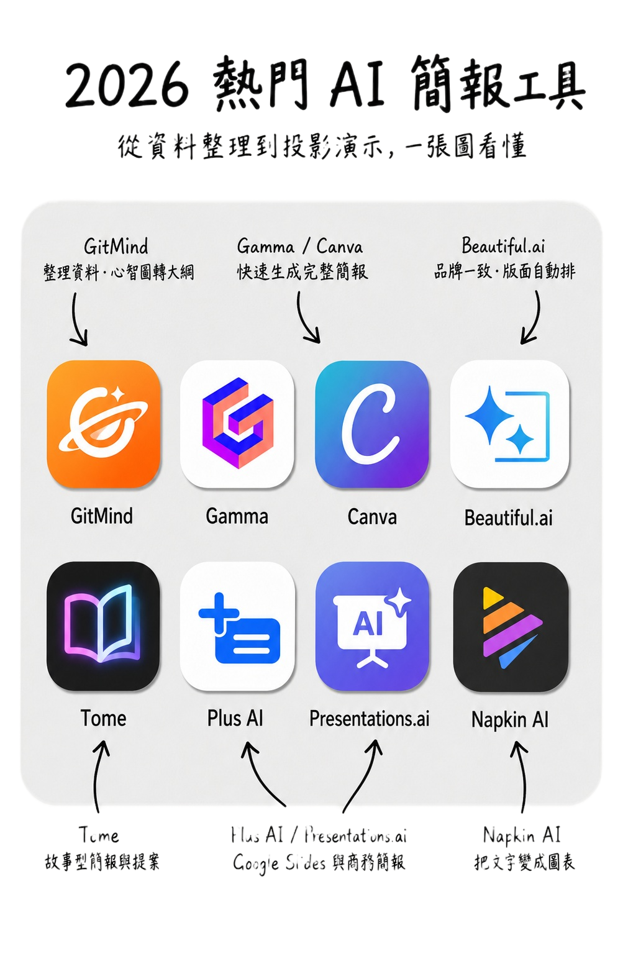

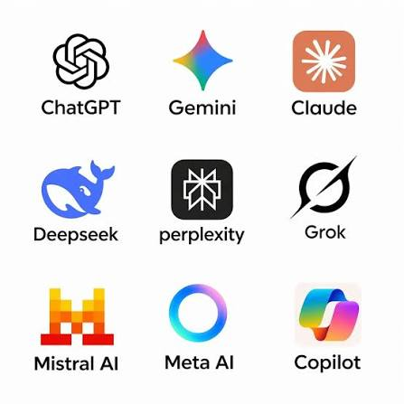

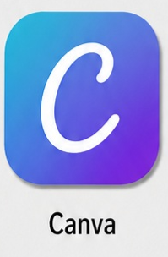









Literature
Assistance
Automation
Code
App builders
Scientific
Clinical
Visualization
Chat assistance

Slide 5









Nine families of AI in research and medicine
Chat assistants
Code and data
Visuals and decks
Explain, draft, brainstorm
Write, debug and review analysis code
Presentations, figures, schematics
Sessions 1, 4
Session 2
Session 3
Custom assistants
Evidence and literature
Agents
A chatbot with your rules and files
Answers grounded in papers you choose
Multi-step tasks with tools
Session 4
Session 5
Session 6
App builders
Scientific models
Clinical AI
Working tools from plain language
Protein structure, sequences, cell images
Imaging, scribes, decision support
Session 7
Today only
Session 6

Slide 6
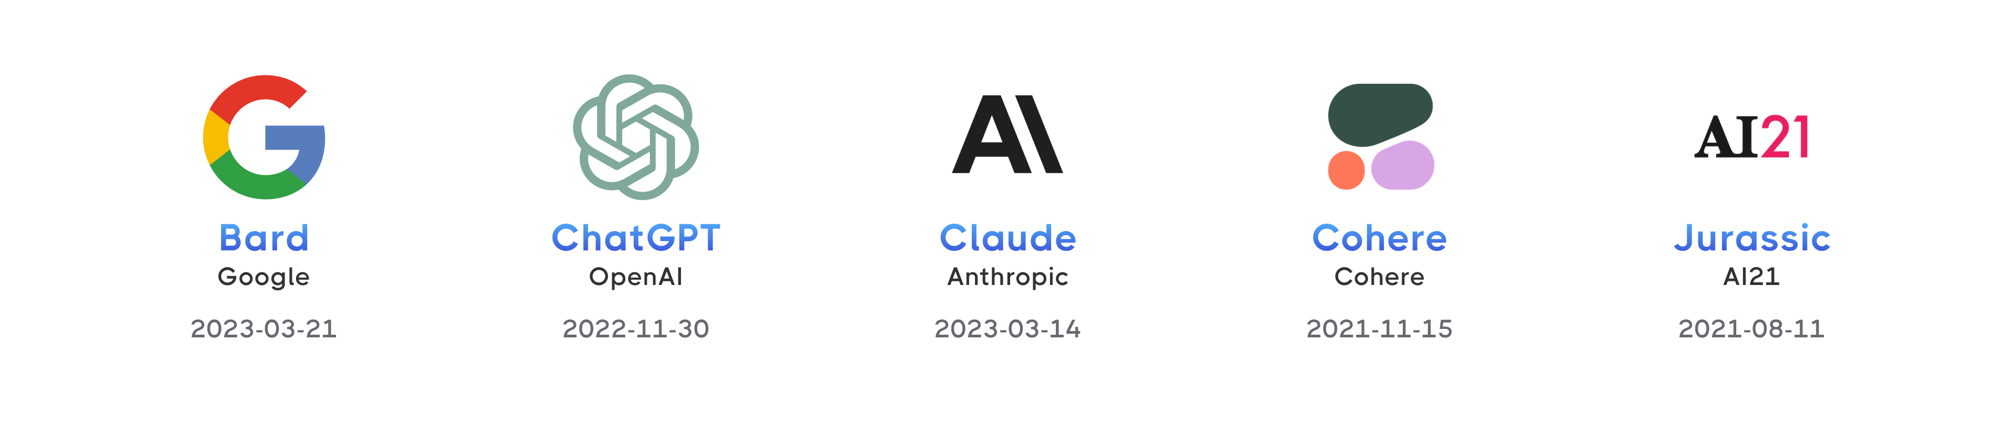
What links all of them together?

Slide 7
Open and closed models: where does the model run?
Closed models
Open-weight models
Examples: ChatGPT, Gemini, Claude
Examples: Llama, Mistral, Gemma, many on Hugging Face
You use them through a company's app or API
The model's weights are not public; you cannot run it yourself
Your input leaves the institution, unless a contract or an institutional account says how it is handled
The weights are published; you can download and run the model
It can run inside the institution, so the data never leaves
You maintain it, quality varies, and you must read its model card
Why it matters: where the model runs decides which data tier it may touch.

Slide 8
Thread 1: five questions for every AI output
1
Training data
What was the model trained on, or given to read?
2
Verification
How would I check, independently, whether this is wrong?
3
Representation
Who or what is missing from its data?
4
Costs
What did using it cost in privacy, time, or a skill I did not practise?
5
Baseline
Would a non-AI or traditional method do this better?

Slide 9
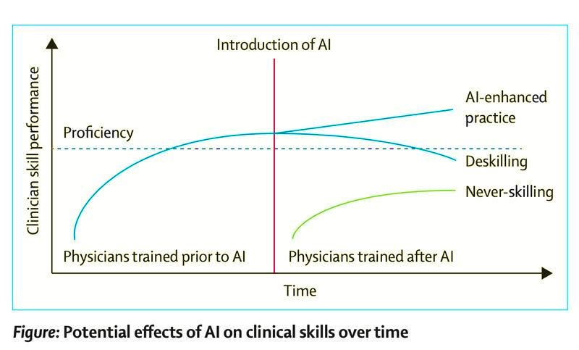
Deskilling
https://www.thelancet.com/journals/lancet/article/PIIS0140-6736(25)02075-6/fulltext

Slide 10
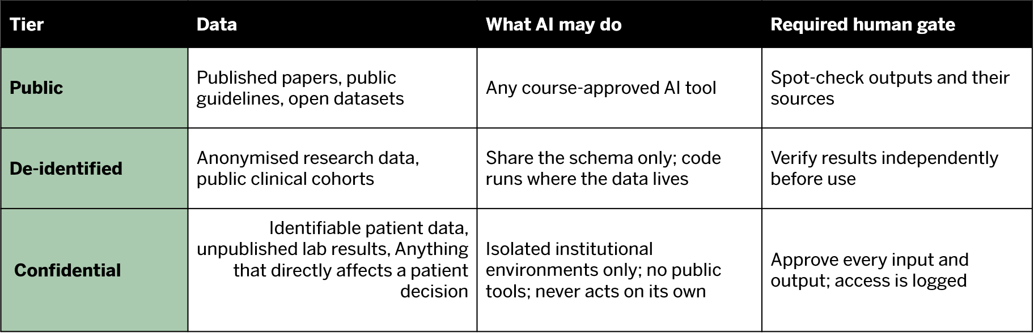
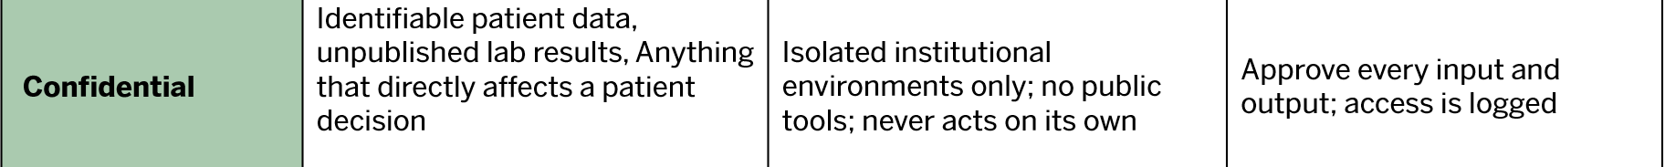
Thread 2: three data tiers decide what AI may see
Tier | Data | What AI may do | Required human gate
1
2
3
Rule for this course: no Tier 3 data in any public AI tool. Check whether you are signed in with a personal or an institutional account.

Slide 11
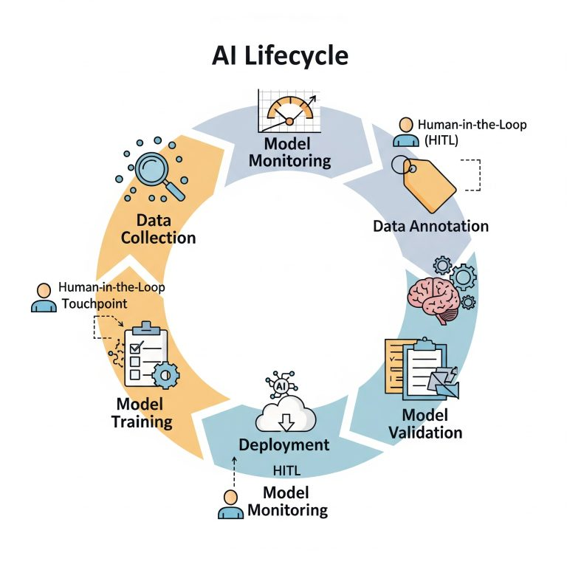
AI Lifecycle

Slide 12
AI Lifecycle
Review and correct
Annotate complex or subjective data
Validate model outputs
Catching nuance and bias
Providing continuous feedback for adaptive models
Human judgment for edge cases and subjective conten

Slide 13
Guided lab: AI, traditional, or hybrid?
Form groups of three, mixing biology and computer-science backgrounds where possible.

Slide 14
Four tests before you reach for AI
1
Is the task fixed or open-ended?
2
Can the answer be checked?
A fixed rule or formula favours traditional software. Open-ended language or pattern tasks favour AI.
If you cannot verify the output, AI is risky however good it sounds.
3
What does an error cost?
4
How sensitive is the data?
A wrong email is cheap. A wrong dose or a wrong statistic is not.
Tier 3 and Tier 4 data rule out public AI tools, whatever the task.
Three piles: AI · Traditional software · Hybrid, where AI drafts and a tool or a person checks

Slide 15
Card sort: 12 tasks, three piles
1
Calculate a drug dose from body weight
2
Find every trial on a clinical question
3
Summarise a paper you have already read
4
Run a t-test on your lab results
5
Draft an email to your PI
6
Brainstorm a differential diagnosis
7
Count cells in 200 microscopy images
8
Check a drug-drug interaction
9
Translate discharge instructions into Arabic
10
Predict a protein's 3D structure
11
Store and query patient records
12
Write a script to rename 500 data files
20 minutes: sort every card and write one sentence of justification. 10 minutes: compare with another group. Disagreements are the point.

Slide 16
Capstone build: build your prompt

Slide 17
Capstone: One Real Problem, Built and Defended
By Session 9 you will build and stress-test a working tool you can actually use in your lab.
FOUR TRACKS (Session 4 Lock-In)
THE 6-SLIDE DEFENSE (Session 9 · 6 Minutes)
Literature RAG
Synthesise evidence for a grant or paper
01. Workflow & Scope
Solves a real task; AI justified
02. Live Demo
Real/fabricated data; no Tier 3 exposed
Data Pipeline
Clean, analyse and plot your lab data
03. Output Verification
Independent check vs reference standard
04. Failure Analysis
One failure caught, documented & fixed
Custom Assistant
A guardrailed helper for lab protocols
05. Governance & Safety
Data tiers and human gates mapped
06. Disclosure & Q&A
2-sentence AI statement; peer critique
Rapid Prototype
A working tool for a clinical or lab task
MILESTONES: Session 1: Brainstorm Today ──▶ Session 4: Lock In Track ──▶ Session 9: Present & Defend

Slide 18
Advanced prompting for brainstorming
1
2
3
Give context
Fix the format
Give it a critical task
Your field, your methods, your constraints, and what you already tried
Ask for a table with exactly the columns you need
"Act as a skeptical PI reviewing these ideas"
4
5
6
Diverge, then converge
Ask it to interview you
Ask for the case against
"List 15 options, then rank them by impact and feasibility"
"Ask me five questions before you suggest anything"
"Which of these would a non-AI tool do better?"

Slide 19
A starter prompt to copy and adapt
I am a first-year MD-PhD student rotating in a [field] lab that studies [topic]. Our daily work includes [methods].
Before you suggest anything, ask me five questions about where time is lost or errors happen.
Then list 10 bottlenecks where AI could help, as a table: bottleneck | how it is done now | AI family | data tier | how I would check the output.
Finally, mark which of them a non-AI tool would solve better, and why.
Tier 1 only
Describe your work in general terms.
No patient details.
No unpublished results.
No lab-internal names or numbers.

Slide 20
Recap: audit the headlines
15 minutes · headline audit and Failure Log entry 1

Slide 21
Headline audit: what would you need to see?
A
B
Red flags
"Google AI system can surpass human experts in spotting breast cancer, study finds"
"ChatGPT can pass US medical licence exams, study claims"
Tested only on past data
Tested only where it was built
An exam or benchmark, not real practice
Accuracy, but no patient outcomes
No word on who was in the data
Tech Xplore, 3 January 2020
Times Higher Education, 9 February 2023
C
D
"Research suggests Epic Sepsis Model is lacking in predictive power"
"Widely used health care prediction algorithm biased against black people"
Healthcare IT News, 22 June 2021
Berkeley News, 24 October 2019
A and B: which red flags apply, and what would convince you? C and D: what kind of check exposed the problem?

Slide 22
See you in Session 2
Code generation and review
AI for MD-PhD · Weizmann Institute of Science · Session 1

