Slide 1


Build It by Describing It
Session 7
Notes:
Vibe coding: building an app by describing it in plain language. Four groups build a Methods Book app for the method cards students already write, two in Base44 and two in Google AI Studio, then audit another group's app built with the other tool. Icons: Font Awesome Free (CC BY 4.0).

Slide 2
Today
10 min
35 min
25 min
20 min
Vibe coding
Build
Swap & audit
Recap
What it is, two tools, and where your app and your data will live
Your group's Methods Book app, from one brief, with real method cards
Test another group's app, made with the other tool. Find what breaks.
What we found, which tool you would keep, and why
4 groups: Groups 1–2 build in Base44, Groups 3–4 in Google AI Studio. Each member brings one method from the course notebooks.
Notes:
Four groups: 1-2 Base44, 3-4 AI Studio. One account per group builds; every member adds a method card. Audit pairs: Group 1 tests Group 3's app and vice versa; Group 2 and Group 4 likewise. Assign groups and set up one account per group before class.

Slide 3





Vibe coding: describe it, run it, judge it by what it does
Describe
Generate
Run
Judge
Refine
in plain language
the AI writes all the code
a working app, in seconds
by what it does, not by the code
by asking again
Session 2: you read AI-written code line by line. Session 6: you wrote tools with AI and tested each one.
Today: you will never open the code. The only way to know the app is right is to use it like a sceptic: real content, odd inputs, and the question “where does my data go?”
Notes:
The term was coined in early 2025 for building software by describing it and accepting what the AI writes. It is excellent for prototypes and personal tools, and risky for anything that touches patients, because nobody has read the code.

Slide 4
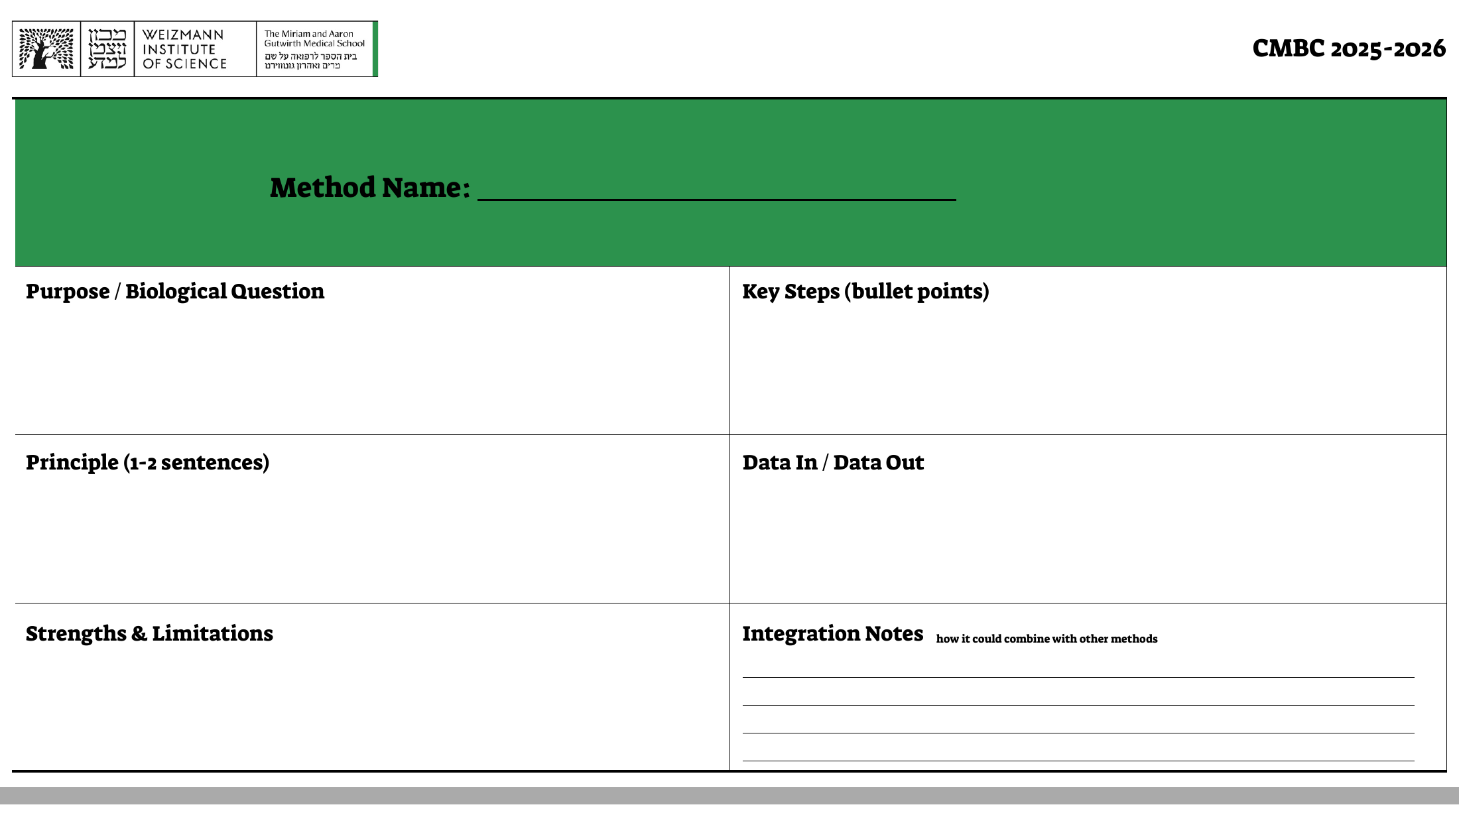





Today's app: your Methods Book
…as an app you keep all year
Every card, searchable by name and tag
Prints back as the same card
Exports to a file you own
Hebrew and English
Works on your phone
The method card you already fill in, one per method
Notes:
The card fields: method name; purpose / biological question; principle (1-2 sentences); key steps; data in / data out; strengths & limitations; integration notes. Each group member enters one method from course assignments 01-14 (e.g. proteomics imputation, GWAS, DESeq2), so the app holds real content from the first minute.

Slide 5


Two tools, one brief: two groups each
Base44
Google AI Studio
What you get
A hosted app with a database and log-in, at your own web address
What you get
A web app built and run inside AI Studio, code downloadable
Where entries live
Base44's servers: the same on every device
Where entries live
Your browser, on that device; keep exports
Who can open it
Public by default; your entries need log-in
Who can open it
Public link by default; visitors see the app, not your entries
Free plan
Limited messages: plan your requests
Free plan
Free with a Google account
Notes:
Codex (ChatGPT Edu) was the planned second tool, but its cloud mode needs the GitHub plugin, which is disabled in the Weizmann workspace; installing it locally is restricted. AI Studio runs in the browser and needs only a free Google account. Base44 free-plan credits were enough for a full build and several refinements in the instructor's test.

Slide 6

The brief: paste it as your first message
Build a personal "Methods Book" web app for an MD-PhD student (CMBC 2026-2027).
Each entry is one method card with these fields:
- Method name (required)
- Purpose / biological question
- Principle (1-2 sentences)
- Key steps (bullet points)
- Data in / data out
- Strengths & limitations
- Integration notes: how it could combine with other methods
Also: course session or assignment, date, tags, data tier (1 Public, 2 De-identified, 3 Confidential, 4 Clinical care), and "AI used?" (yes/no) with how.
Features:
- Add, edit and delete entries (ask for confirmation before deleting).
- A library list with search, and filtering by tag.
- An entry page laid out like a printed method card, with a "Print card" button.
- Export all entries to a JSON file, and import such a file back.
- Works in both Hebrew and English, and on a phone.
- Only the logged-in user can see their own entries.
Rules
Improve it only by asking. Never edit the code yourself.
Content: published or course methods only (Tier 1–2). Unpublished lab protocols are Tier 3: never in a hosted app.
Keep a JSON export of your entries.
Note each request you send: you will report how many it took.
Notes:
The brief is also in Session_7_App_Brief.txt for copy and paste. It deliberately does not say how to handle Hebrew direction, example entries or tier labels: those are things the audit should catch.

Slide 7


Build (35 min)
Paste the brief
~5 min
First message only. Wait for the app, then open it.
Add your method cards
~10 min
One per group member, from the course notebooks: at least one in Hebrew, one with symbols (µ, ±, ×, 10⁻⁸).
Use it like a sceptic
~10 min
Read every screen. What is wrong, missing or invented?
Fix by asking
~5 min
One request per problem. Count your requests.
Export a backup
2 min
Download the JSON. Open it: what is inside?
Get the link
3 min
Base44: Publish. AI Studio: Share. Note what the default visibility is.
Notes:
Walk around during 'use it like a sceptic'. Typical first-build problems in the instructor test: Hebrew shown left-to-right, invented example entries, an 'AI-assisted' badge on entries that say AI was not used, and invented meanings for the data tiers. Let students find them.

Slide 8





Swap & audit (25 min): Group 1 ↔ Group 3, Group 2 ↔ Group 4
Data survives
Real content
Odd inputs
Reload. Open on your phone. Export → delete one → import: is it back exactly?
Hebrew right-to-left, mixed with English terms. µ ± ×. A long protocol.
Empty method name. A duplicate name. A broken DOI.
Honest labels
Who can see it
Can you leave?
Is “AI used” right? What does it say Tier 1 means? Any entries nobody wrote?
Open the link in a private window and with another account. What is in the export file?
Import the other tool's export file. Does it work?
Notes:
Each Base44 group tests an AI Studio group's app and vice versa, with the sheet on the next slide; the builders stay silent while the other group tests. The private-window and second-account test is the most important one for Base44: entries must not be visible to anyone else.

Slide 9
Audit sheet
Test
Pass
Fail
Note
1. Entries survive a reload
2. Entries appear on your phone / another device
3. Export → delete one → import restores it exactly
4. Hebrew is right-to-left; English terms inside stay readable
5. µ ± × 10⁻⁸ display correctly
6. Empty method name is refused
7. Duplicate method name is flagged
8. DOI links work
9. “AI used” label matches the entry
10. Data tiers mean: 1 Public, 2 De-identified, 3 Confidential, 4 Clinical
11. No entries the group did not write
12. A stranger (private window / other account) sees no entries
13. Print card looks like the paper card
App of Group ___ (▢ Base44 ▢ AI Studio) Requests the builders needed: ____ Tested by Group ___
Notes:
Print one per group. Items 9-11 come from the instructor's own test build: both tools produced at least one of these problems on the first try.

Slide 10


What we found when we built it (before class)
Hebrew left-to-right
“AI-Assisted”, but it wasn't
Invented definitions
In both tools: punctuation on the wrong side, word order scrambled in the steps.
The entry said “AI not used” in Hebrew; the app read any text as “yes”.
“Tier 1: Primary Raw Assay / Sensor”. In this course Tier 1 means public data.
Invented content
Name in the backup
Two different formats
Six example methods with course codes and references that look real. Nobody wrote them.
One tool's export file carried the user's name and e-mail.
Same brief, different fields: one tool's export does not import into the other.
Notes:
From the instructor's test builds on 20 October 2026 (Base44 and Google AI Studio, same brief). The 'AI-assisted' badge, invented tier meaning, invented example entries and name-in-export came from the AI Studio build; Hebrew direction failed in both. Each was fixed with one request. Show this after the audit and compare with what the students found.

Slide 11
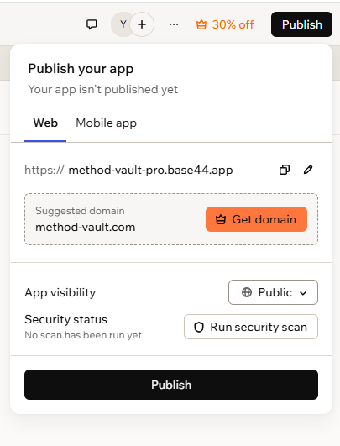
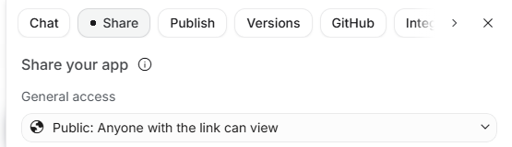
Public by default
AI Studio: General access → Public
Who can see your app right now? Anyone with the link, in both tools.
Who can see your entries? Base44: only if log-in is enforced; test it. AI Studio: they stay in your own browser.
What else is shared? AI Studio can also share your whole chat with the AI (off by default: keep it off).
Base44: App visibility → Public
Notes:
Screenshots from the instructor's test (20 October 2026); personal details cropped. Base44 also offers a built-in 'security scan' before publishing: worth asking whether a tool auditing its own app is enough.

Slide 12


Convenience or ownership: which would you keep?
Base44
AI Studio
Same entries on every device
Log-in and a web address in one click
Your data on their servers, under their plan and prices
Entries stay in your browser
Code you can download and host anywhere
One device, unless you export and import
Either way: export your entries regularly, keep the file, and remember that an export only protects you if something else can read it.
Notes:
Ask each group: would you keep your app after today, and would you rather have built it in the other tool? Why?

Slide 13



Discuss
Which problem would you never have found by reading the code, only by using the app?
What would have to change before an app built this way could touch patient data?
Your “AI used? how?” field: how would you turn it into a disclosure sentence for a paper?
When the other group opened your app, what could they see that you did not expect?
Notes:
Question 3 is the bridge to Session 8: formal AI-use disclosure for journals, funders and institutions.

Slide 14
See you in Session 8
Verification and AI disclosure
AI for MD-PhD · Weizmann Institute of Science · Session 7
Notes:
Next session: verification protocols for AI deliverables and formal AI disclosure statements.

