Slide 1

INTERNAL RULES AND REGULATIONS
INTRODUCTION
RULE 1 EXPLAINED
SELF-ASSESSMENT QUESTION

Slide 2
INTERNAL RULES AND REGULATIONS
INTRODUCTION
RULE 1 EXPLAINED
SELF-ASSESSMENT QUESTION

Slide 3
INTERNAL RULES AND REGULATIONS
INTRODUCTION
RULE 1 EXPLAINED
SELF-ASSESSMENT QUESTION

Slide 4
INTERNAL RULES AND REGULATIONS
INTRODUCTION
RULE 1 EXPLAINED
SELF-ASSESSMENT QUESTION

Slide 5
INTERNAL RULES AND REGULATIONS
INTRODUCTION
RULE 1 EXPLAINED
SELF-ASSESSMENT QUESTION

Slide 6

Internal Rules and Regulations are promulgated to guide the conduct and demeanor of the officers and employees during and after working hours within and outside the Bank Premises.

Slide 7


GENERAL PRINCIPLES
Applicable to all employees (officers and staff).
Must be read and understood by all.
Everybody’s responsibility to consistently and willingly follow.

Slide 8
RULE 1: HOURS OF WORK, BREAKS, & ATTENDANCE
Office Hours: 8:00 A.M.-12:00 Noon
1:00 P.M.-5:00 P.M.
Banking Hours: 8:00 A.M.-12:00 Noon
1:00 P.M.-4:00 P.M
*CAG/DUM: 8:30 A.M.-5:30 P.M.
8:30A.M.4:00P.M.

Slide 9

BREAKS
Coffee Breaks-15 minutes morning
-15 minutes afternoon
To be scheduled by Dep’t head or Branch Manager-not cumulative
Lunch break-12:00 Noon-1:00PM

Slide 10
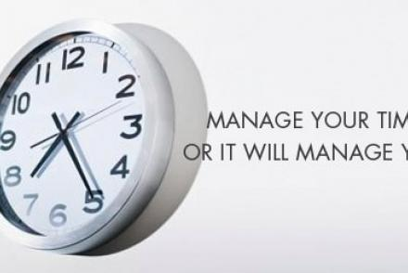
PUNCTUALITY/ATTENDANCE
All must be regular in attendance and punctual in reporting to work.
All employees record their attendance (ins and outs) in the DTR system

Slide 11
ATTENDANCE REGISTRY POLICY/PROCEDURE
Simultaneous Recording-Departure (Noon) and Arrival (PM) not allowed.
Not allowed to leave office, except: Coffee Breaks, Noon Breaks, Official Business (Travel/Trip Order)
Employee registers his time only (Ins and Outs using DTR System).

Slide 12

FIELDMEN
Personnel whose functions necessarily take them to the field
or outside the office during working hours.
May go directly to fieldwork without registering his time provided that he/she has a travel/office order.

Slide 13
Cont. ATTENDANCE REGISTRY POLICY/PROCEDURE
When leaving the work premises before 12:00 noon and 5:00 P.M.
  *Allowed only in case of emergency/ official business with prior permission
  Register his/her time in the DTR System:
  *Time of leaving from and
  *Returning to the office.

Slide 14
ABSENCE AND TARDINESS
Employee is absent if:
  He fails to record any one (1) of his time in/out
Employee is tardy if he reports for work:
  After 8:00 A.M.; after 1:00 P.M.
  Before 12:00 P.M.; before 5:00 P.M.

Slide 15

TARDINESS
Tardiness of more than one (1) hour shall be considered a half-day absence charged to earned leave credits.
Tardiness of 2 times or more per month, consecutive or not>>> Ground for disciplinary action including termination.

Slide 16

CONCLUDING NOTES:
Employees who are unable to meet their employment obligation of regular and reasonable attendance and punctuality are subject to disciplinary action, up to and including termination.

Slide 17

SELF-ASSESSMENT QUESTION:
Why does attendance matters?
CLICK HERE TO ANSWER

Slide 18
ANSWER:
SUBMIT

Slide 19
Reliable, consistent attendance is a requirement and essential function of all staff positions. When someone is tardy or is absent especially if without prior notice, work & services are interrupted and additional burden is placed on colleagues. Attendance and Punctuality is also an important factor in evaluating work performance.

Slide 20
THANK YOU!

