Slide 1

ICE2005_42 TermProject
ing

Slide 2
Pin 배치는 Double Checking하기~
LED 사용
7-Segment
d
Switch 사용
Reset은 만들기
Switch를 누르면 다음 Phase로 진행
Ex) Start → Layer1 → Layer2
VGA – Processing된 Image 띄우기

Slide 4
Memory Controller
data_i [7:0]
data_o [7:0]
Memory interface
cnt

Slide 5
Preprocessor
data_i [3x3x8:0]
row3_o [3x3x8:0]
State_i [2:0]
cnt_col_o [9:0]
cnt_row_o [9:0]
n_segment_up_o
(posedge clk), cnt_col +=1
if(cnt_col ==540) , cnt_row +=1

Slide 6
row1_i [7:0]
row2_i [7:0]
row3_i [7:0]

Slide 8
0
- BRAM + Memcontroller
- Preprocess
- CORE
- Controller(FSM)
- VGA_BUFFER
------------------------------
- VGA_PORT
- 7_Segment
- Buzzer
- LED

Slide 9
IDLE
1cycle
start
DONE
FETCH
CORE_done
&&
(cnt_row != 539
&& cnt_col == 539)
CORE_done
&&
(cnt_row == 539 && cnt_col == 539)
Fetch_done
core

Slide 10
Width : 8
BRAM
Preprocessor
BUFFER
8
CORE
CORE
Depth : 540 x 540
Mem Contoller
3
Gx
Gy
3x540x8
540
Accumulator
VGA_BUFFER
cnt_col
cnt_row
cnt_col
540
1
Buffer
VGA_PORT

Slide 11
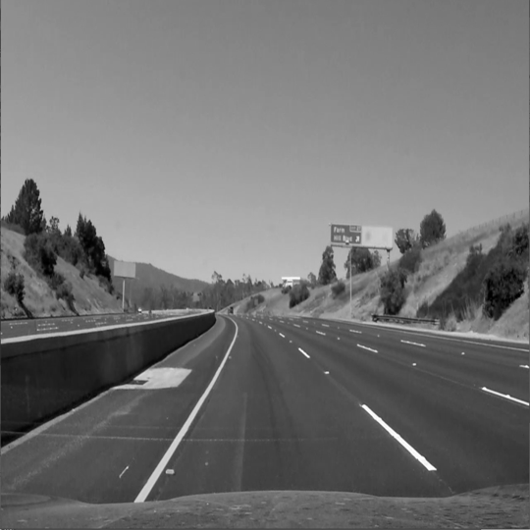
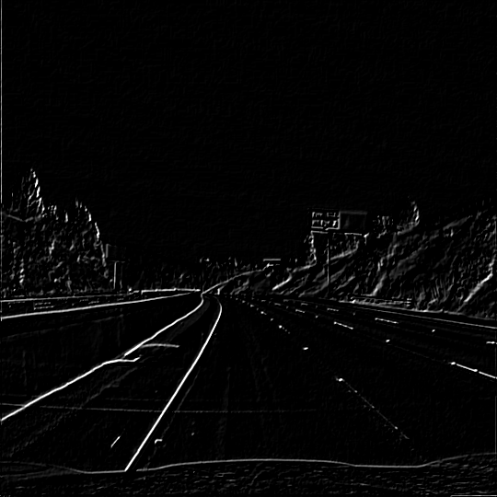
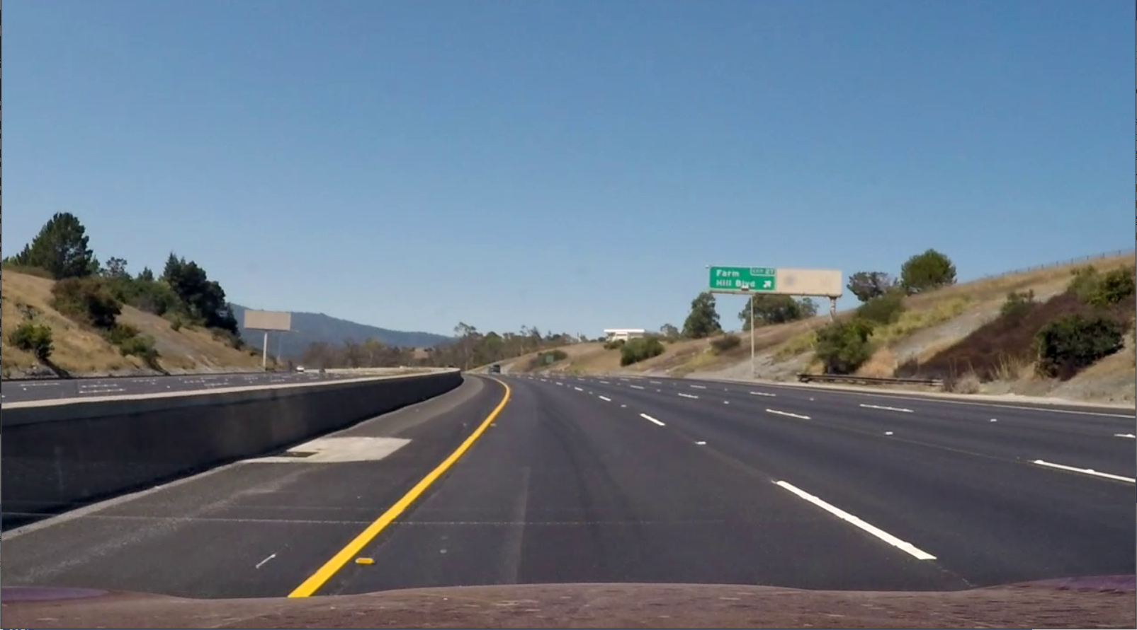
Img_Preprocess
Sobel_Operator
SW
HW

Slide 12
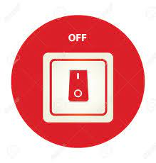


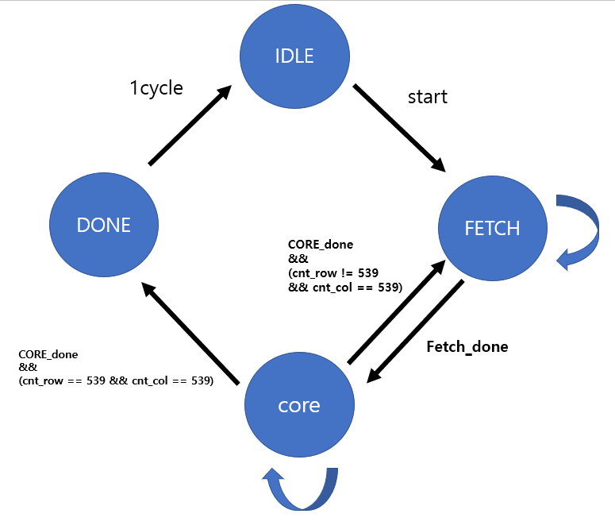
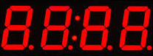


Switch
LED
BUZZER
1
When(RUN_MODE)
When(RUN_MODE)
When(1_line_done)
Controller
Start_i
seg_up_o
2
4
5
N_segment_port
7_segment
3
BRAM
fetch_run_i
fetch_done_o
Core_run_i
Core_done_o
data_o[7:0]
data_i[7:0]
data_o[0:9][7:0]
data_i[0:9][7:0]
Memory
interface
data_en_o
data_en_i
Core_en_o
Core_en_i
cnt_pos_row_o[9:0]
Pixel_o[7:0]
VGA
3x COL
BUFFER
cnt_ pos _col_o[9:0]
Pixel_en_o
Memory Controller
Preprocess
CORE
VGA_PORT
DATA FLOW
SOBEL_TOP
Control FLOW

Slide 13
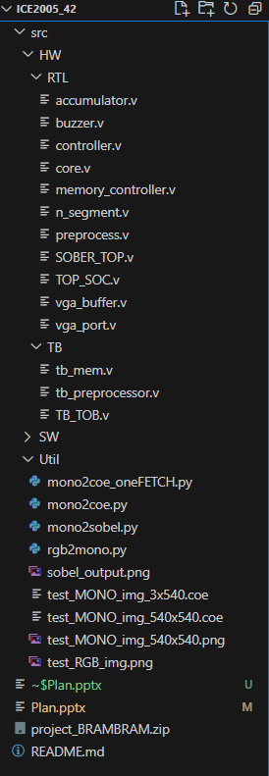
Switch
LED
BUZZER
1
When(RUN_MODE)
When(RUN_MODE)
Controller
Start_i
seg_up_o
When(1_line_done)
2
3
4
5
BRAM
fetch_run_i
fetch_done_o
Core_run_i
Core_done_o
N_segment_port
7_segment
data_o[7:0]
data_i[7:0]
data_o[0:9][7:0]
data_i[0:9][7:0]
Memory
interface
data_en_o
data_en_i
Core_en_o
Core_en_i
cnt_pos_row_o[9:0]
Pixel_o[7:0]
3x COL
BUFFER
cnt_ pos _col_o[9:0]
Pixel_en_o
Memory Controller
Preprocess
CORE
VGA
VGA_PORT

Slide 14
Switch
LED
BUZZER
1
When(RUN_MODE)
When(RUN_MODE)
When(1_line_done)
Controller
Start_i
cnt_IMG_row_o[9:0]
cnt_IMG_col_o[9:0]
seg_up_o
2
4
5
N_segment_port
7_segment
3
BRAM
fetch_run_i
fetch_done_o
Core_run_i
Core_done_o
data_o[7:0]
data_i[7:0]
data_o[0:9][7:0]
data_i[0:9][7:0]
Memory
interface
data_en_o
data_en_i
Core_en_o
Core_en_i
cnt_pos_row_o[9:0]
Pixel_o[7:0]
3x COL
BUFFER
Pixel_en_o
Preprocess
VGA
Memory Controller
CORE
SOBEL_TOP
DATA FLOW
Control FLOW
VGA_PORT

Slide 15
Switch2
LED
BUZZER
1
Switch1
When(RUN_MODE)
When(RUN_MODE)
When(1_line_done)
1
Controller
Is_mode2_i
cnt_IMG_row_o[9:0]
Is_mode1_i
cnt_IMG_col_o[9:0]
seg_up_o
2
4
5
N_segment_port
7_segment
3
BRAM
fetch_run_i
fetch_done_o
Core_run_i
Core_done_o
data_o[7:0]
data_i[7:0]
data_o[0:9][7:0]
data_i[0:9][7:0]
Memory
interface
data_en_o
data_en_i
Core_en_o
Core_en_i
cnt_pos_row_o[9:0]
Pixel_o[7:0]
3x COL
BUFFER
Pixel_en_o
Preprocess
VGA
Memory Controller
CORE
SOBEL_TOP
DATA FLOW
Control FLOW
VGA_PORT

Slide 16
VGA_RUN
Start && mode1
DONE
IDLE
Start && mode2
CORE_done
&&
(cnt_row == 539 && cnt_col == 539)
CORE_done
&&
(cnt_row != 539
&& cnt_col == 539)
core
FETCH
Fetch_done
Fetch_done

Slide 17
IDLE
DONE
mode1
mode2
MODE1 Ready
MODE2 Ready
Start
Start
VGA RUN
Mode1 Run
FETCH
Fetch_done
CORE_done
&&
(cnt_row != 539
&& cnt_col == 539)
(cnt_row == 539 && cnt_col == 539)
Start && mode2
core
CORE_done
&&
(cnt_row == 539 && cnt_col == 539)
VGA READY

Slide 18
VGA
Level Shift (FF)
7-Segment Controller
Buzzer Controller
VGA Controller
Controller
Mem Ctr B
Single Port
BRAM
Mem Ctr
PRE
CORE
Mem Ctr A
True Dual Port BRAM
Mode 2
Mode 1

Slide 19
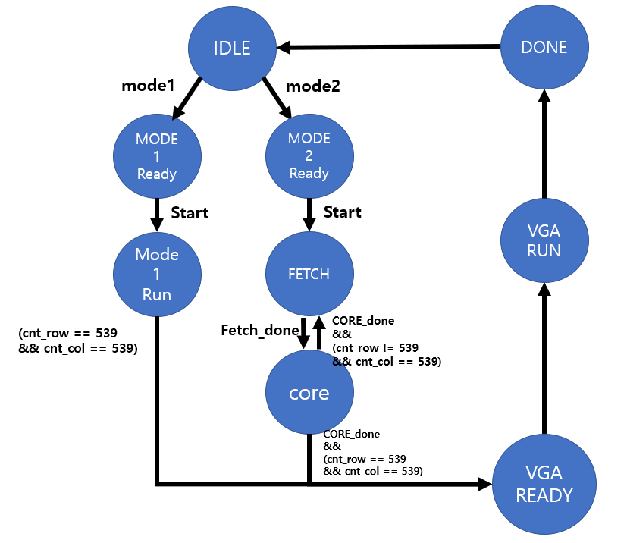
VGA
Switch
Level Shift (FF)
7-Segment Controller
Buzzer Controller
VGA Controller
Mem Ctr B
Controller
Single Port
BRAM
Mem Ctr
PRE
CORE
Mem Ctr A
True Dual Port BRAM
Mode 2
Mode 1

