Slide 1

Minimal Email Client
Yong Cho
Yoo Min Cha

Slide 2
Network Protocols
IMAP
“Internet Message Access Protocol”
Used for downloading emails
7-bit ascii
TCP port 993, 143
SMTP
“Simple Mail Transfer Protocol”
Sending email
7-bit ascii
TCP port 587, 465, 25

Slide 3



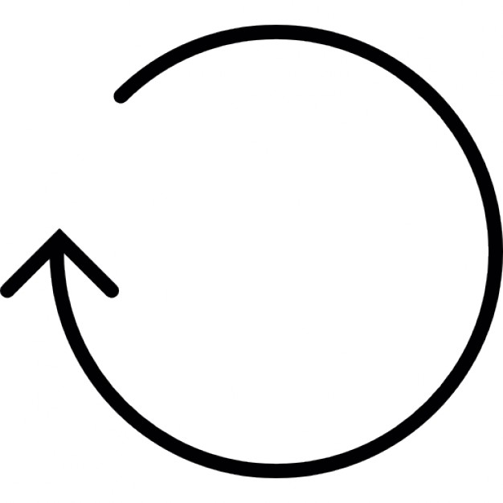
IMAP Flow
Main Thread (UI)
Thread 1
(Downloads Inbox)
Thread 2
(Other mailboxes)
Thread 3
(Polling)
- Initializes UI and other components
- Creates the other threads
SEARCH ALL
SELECT Inbox
SELECT Trash
1, 2, 3, 7, 10, …, 4020, 4023
3000 EXISTS
23 EXISTS
FETCH 2951:3000
FETCH 1:23
SEARCH ALL
Subject: ...
From: …
Subject: ...
From: …
1, 2, 3, 7, 10, …, 4020, 4023
FETCH 2901:2950
Subject: ...
From: …
SELECT Draft
SEARCH ALL
Event Loop
2 EXISTS
1, 2, 3, 7, 10,
…, 4020, 4023, 4024
FETCH 1:2
FETCH 1:50
Subject: ...
From: …
FETCH 4024
Subject: ...
From: …
Subject: ...
From: …

Slide 4
Program Structure - MVVM
Views
(Presentation)
Main Window
Popup Window 1
(Create Account)
Popup Window 2
(Compose Email)
Menu, Toolbar, Buttons, ...
Label, TextBox, Button ..
ViewModel
(Interaction)
Main Window ViewModel
Popup 1 ViewModel
Popup 2 ViewModel
ReadEmailCommand
WriteEmailCommand
ValidateAccount()
SubmitAccount()
SendEmail()
AttachFile()
Model
(System Logic
Data Access)
ImapClient
DatabaseManager
SmtpClient
FetchHeaders(uids)
FetchBody(uid)
LoadAccounts()
StoreAccount(account)
Connect()
SendMail(outMail)
TCP Socket
DBAdapter
TCP Socket

Slide 5
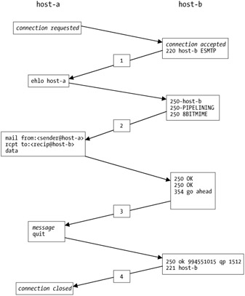
SMTP Client

