Slide 1
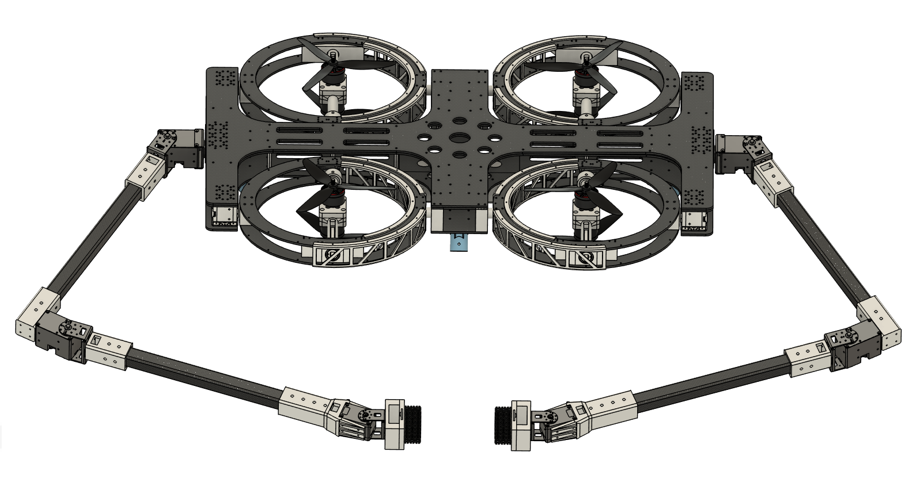
Keyframe-Guided Whole-Body Trajectory Optimization for
Dual-Arm Aerial Transport Through Narrow Gaps
Jaewoo Lee (2025-25829)
Yongjun You (2025-23893)
2026 Motion Planning and Decision Making for Autonomous Systems
Notes:
Hello. Our project is titled "Contact-Aware Whole-Body Trajectory Optimization for Dual-Arm Aerial Box Transport with Slip-Aware Force Regulation."

Slide 2
The Problem: Threading a Narrow Window
Why dual-arm aerial manipulation
Aerial manipulators extend the manipulation workspace into air
A single gripper only grasps small objects it can envelop
Dual-arm grasps large, flat objects by force closure
Task: box transport
Known-size box; two target poses at opposite face centers
Two end-effectors squeeze the faces; the box is held by friction
Cycle: approach, grasp, lift and transport, place
Deformable pads: virtual penetration sets the contact force
OAM-4D: omnidirectional tilt-rotor base with two 4-DoF arms
held by friction: |Fₜ| ≤ μFₙ
box
Fₙ
•mₒ
Fₙ
With a fixed squeeze force, the box can slip during fast transport.
gravity
Notes:
Aerial manipulation extends the manipulation workspace into the air. Most prior work uses a single gripper, which can only grasp small objects. With two arms, we can grasp large or flat objects through force closure.
Our task is to grasp and transport a box with a dual-arm manipulator. The box size is known, and the two target poses are at the centers of the opposite faces. The full cycle is approach, grasp, lift, transport, and place. The end-effectors are deformable pads, so the contact force is regulated through penetration.
However, since the box is held only by friction, the tangential force is bounded, and the box can slip during fast transport. To address this, we regulate the contact force according to the box acceleration.

Slide 3
Oour Idea: A Single Keyframe as the Seed
Single-arm / single End Effector
Coordinated · dual-arm / multi-contact
Lee '25 · Deng '25 · Peric '21 · Alharbat ‘25
Aerial physical interaction with one end-effector:
grasp-pull, push-slide, admittance / impedance.
Floating-base coupling solved, but no arm coordination.
Martijn '26 (Omni dual-arm platform)
Platform and roof-landing demonstrated; coordinated, force-aware planning still open.
Ours:
dual-arm whole-body contact-aware planning with slip-aware force regulation.
Floating (aerial)
Classical single-arm manipulation
Out of scope for this project.
Adorno '10 · Dehio '22 · Kurtz/IDTO '26 · Kim ‘25
Cooperative / dual-arm on a grounded base: squeezing, contact-implicit MPC, force-closure grasp.
Gravity is the main external load.
Fixed (grounded)
References
[1] Lee et al., IJRR 2025 [2] Deng et al., T-RO 2025 [3] Peric et al., ICRA 2021 [4] Alharbat et al., RA-L 2025 [5] Adorno et al., IROS 2010 [6] Dehio et al., RA-L 2022 [7] Kurtz et al. (IDTO), IJRR 2026 [8] Kim et al., 2025 [9] Martijn, 2026
Notes:
We organized the related work along two axes, single-arm versus dual-arm and grounded versus floating base. Due to time, I will skip the details. The key point is that an omnidirectional platform demonstrated control and roof-landing, but force-aware whole-body planning is still open.

Slide 4
The Result: A Better, Safer Passage
Whole-body model
Pinocchio + CasADi
Smooth contact
force from penetration
Box + friction
free body + cone
Plan only the base SE(3) trajectory and arm joint references; a robust controller handles thrust and tilt allocation
Smooth contact model: force is a differentiable function of virtual penetration
One OCP Planner covers all four phases (approach, grasp, transport, release). No complementarity, no active-set
The box is held only by friction, so the required squeeze grows with acceleration
Slip-aware
Normal Force rises with acc.
Multi-phase OCP Planner
CasADi NLP, IPOPT
Reference trajectory
Isaac Sim validation
Notes:
Now I will explain our proposed approach. The diagram on the left shows the pipeline, where each module feeds a single planner. The whole-body dynamics model is built with CasADi, together with a smooth contact model and a box module with friction. The planner output is then tracked by a controller and simulated in Isaac Sim.
There are four key features. First, we plan only the base SE(3) trajectory and the arm joint references, and a robust controller handles thrust and tilt allocation. Second, the smooth contact model makes the force a differentiable function of penetration. Third, a single planner covers all four phases through a simple state machine. Finally, since the box is held by friction, we regulate the contact force setpoint according to the acceleration.

Slide 5
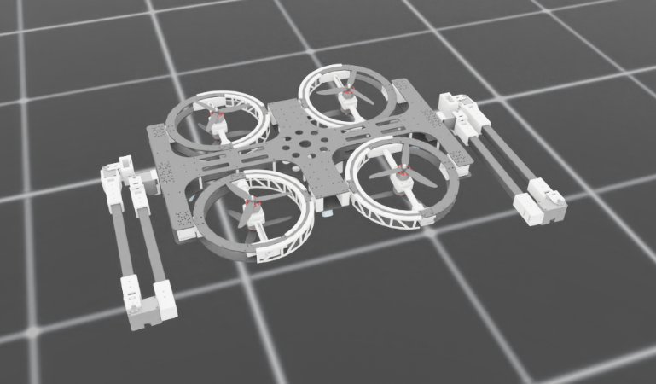
Experimental Plan and Timeline
Baselines and metrics
Baselines: fixed normal force; base and arm planned separately (not jointly)
Metrics: grasp success, force-tracking error, slip rate vs acceleration, placement accuracy, compute time …
Hypothesis
slip-aware sustains higher acceleration without slip than a fixed force
Isaac Sim environment (already built)
Setup Pinocchio + CasADi + IPOPT, Isaac Sim
Timeline
1
Whole-body multi-phase OCP; contact-model identification in sim
2
Slip-aware policy; transport experiments; baselines
3
Ablations and analysis; report and lightning talk
Notes:
For the experiments, the Isaac Sim environment is already set up, and we plan to use Pinocchio, CasADi, and IPOPT. The baselines we expect to compare against are a planner that applies a fixed normal force, and a planner that plans the base and the arms separately. For evaluation metrics, we can look at grasp success, slip rate versus acceleration, computation time, and so on. The timeline is shown below.

Slide 6
Plan and Timeline
Thank You
Notes:
Thank you, and we are happy to take questions.

Slide 7
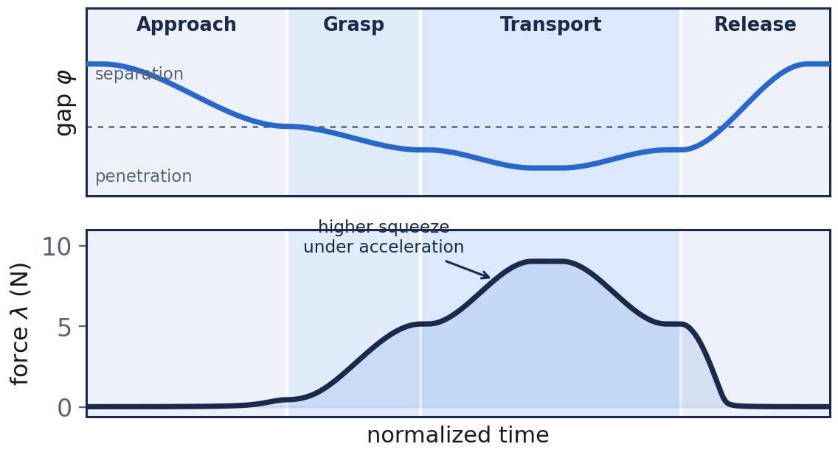
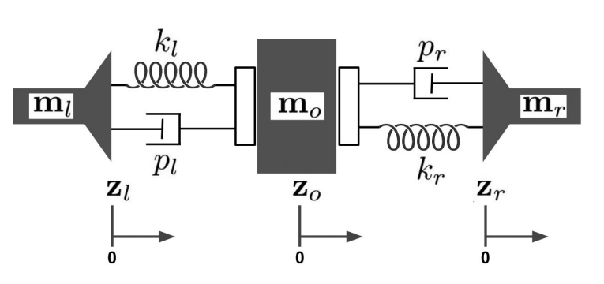

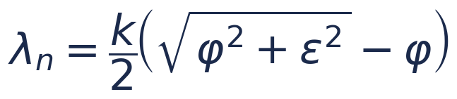
Approach: Whole-Body Contact-MPC
Plan only the base SE(3) trajectory and arm joint references; a robust controller handles thrust and tilt allocation
Smooth (soft) contact model: force is a smooth function of virtual penetration, set by the commanded end-effector pose (predictive admittance)
Prescribed mode schedule: approach, grasp, transport, release
Free-body object dynamics and the friction cone enter the MPC prediction; a light FSM switches phase objectives
smooth gap and contact force across the four phases
Key insight Smooth contact makes the non-contact to contact transition differentiable, so a single whole-body NMPC covers all phases. No complementarity, no active-set.
dynamics
smooth contact force
soft-contact pad model
Notes:
We plan only the base SE(3) trajectory and the arm joint references. A robust controller in the spirit of Lee 2025 handles thrust and tilt-rotor allocation, so contact force is never a direct decision variable. We use a smooth soft-contact model: the force is a smooth function of a virtual penetration, so we regulate it through the commanded end-effector pose. The mode schedule is prescribed. The key insight is that smoothing the contact makes the non-contact to contact transition differentiable, so a single whole-body NMPC handles all four phases without complementarity constraints or active-set switching.

Slide 8
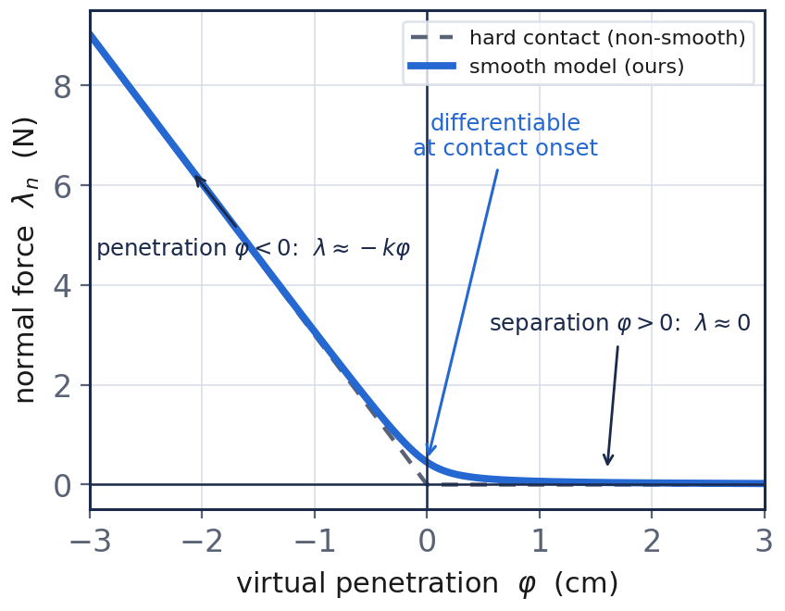
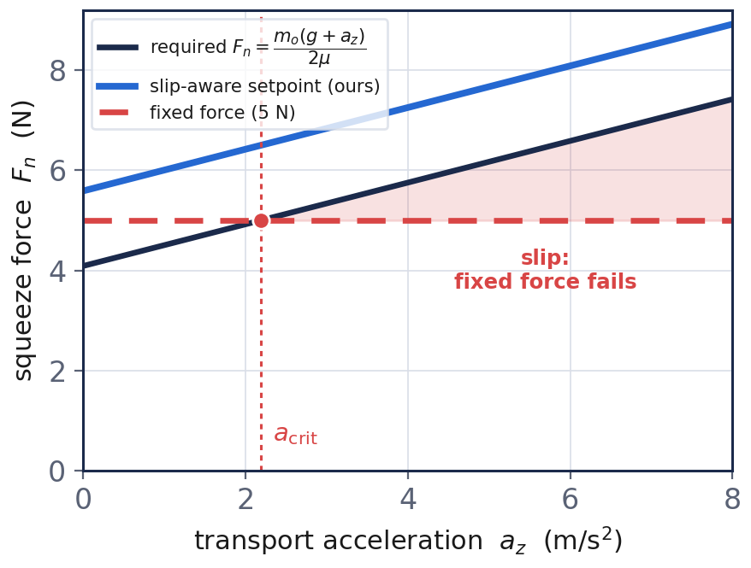

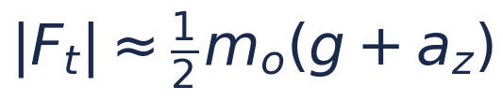
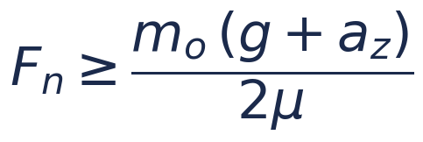
Key Idea: Slip-Aware Force Regulation
The box is held only by friction, with no form closure
Lifting and accelerating raises the required tangential force
So the required squeeze force grows with acceleration
Our policy raises the squeeze setpoint with the commanded acceleration, plus a safety margin; a fixed 5 N baseline slips past a critical acceleration
Mirrors human motor control: people raise grip force together with manipulation force (Zatsiorsky)
Key relations
Notes:
The box is held only by friction. During lift and acceleration the tangential force needed grows with the object mass times g plus a-z. So the squeeze force required to stay inside the friction cone scales with acceleration. Our policy raises the squeeze setpoint together with the commanded transport acceleration, with a safety margin. A fixed 5 N baseline is fine when slow, but past a critical acceleration the required force exceeds it and the box slips. This mirrors human motor control: people increase grip force together with manipulation force, while robots usually keep it constant.

