Slide 1



산업인공지능 개론
MINI PROJECT No. 2
학번 : 2021254001
이름 : 이용규

Slide 2
01. 개요
과제 개요
과제 목표
기계학습 - 분류,회귀를 이용하여 반드시 1개 이상의 예측 데이터를 생성할 것
과제 주제
분류, 회귀 관련 문제를 Data 구해서 진행 할 것
Data 취득 환경 : CPU : Intel(R) Core(TM) i7-10870H CPU @ 2.20GHz 2.21 GHz (8 Core)
주제 : CPU Core의 Load를 분석하여 CPU 온도 예측 하기
Data 취득 도구 : Core Temp

Slide 3
02. Data
Monitoring Tool로 부터 받은 Data
출력 항목
시간 | 각 Core의 온도 | 각 Core의 Load | 각 Core의 Speed | 각 Core의 Power
Data Sample (CPU Core 0의 온도,부하)
시간 | 온도(Core 0) | 부하(Core 0)
22:08:09 04/28/21 | 34 | 0
22:08:19 04/28/21 | 35 | 2
22:08:29 04/28/21 | 41 | 1
22:08:39 04/28/21 | 41 | 1
22:08:49 04/28/21 | 42 | 3
22:08:59 04/28/21 | 42 | 0
22:09:09 04/28/21 | 37 | 0
22:09:19 04/28/21 | 37 | 4
22:09:29 04/28/21 | 36 | 8
22:09:39 04/28/21 | 35 | 2
22:09:49 04/28/21 | 37 | 1
22:09:59 04/28/21 | 35 | 7

Slide 4
03. Sample Data Chart
Monitoring Tool로 부터 받은 Data
Data Chart

Slide 5
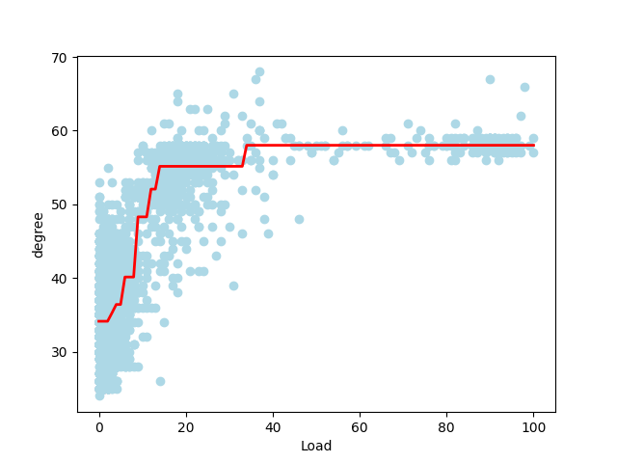
04. 결정 트리 회귀
Monitoring Tool로 부터 받은 Data
def DecisionTreeReg(): df = pd.read_csv('CT_log.csv',sep=',') X = df[['Core_load_0']].values y = df['Core 0 Temp'].values print(X.max()) tree = DecisionTreeRegressor(max_depth = 3) tree.fit(X,y) sort_idx = X.flatten().argsort() plt.scatter(X[sort_idx],y[sort_idx], c ='lightblue') plt.plot(X[sort_idx],tree.predict(X[sort_idx]), color = 'red',linewidth=2) plt.xlabel('Load') plt.ylabel('degree') plt.show()

Slide 6
05. 선형 회귀, 리지 회귀, 라소 회귀, 일래스틱 넷
Monitoring Tool로 부터 받은 Data
def RegTest():
df = pd.read_csv('CT_log.csv', sep=',') X = df[['Core_load_0']].values y = df['Core 0 Temp'].values sc_x = StandardScaler() sc_y = StandardScaler() X_std = sc_x.fit_transform(X) y_std = sc_y.fit_transform(y[:,np.newaxis]).flatten() X_train,X_test,y_train,y_test = train_test_split(X_std,y_std,test_size=0.5,random_state=123) linear = LinearRegression() ridge = Ridge(alpha=1.0,random_state=0) lasso = Lasso(alpha=1.0, random_state=0) enet = ElasticNet(alpha=1.0, l1_ratio=0.5) linear.fit(X_train,y_train) ridge.fit(X_train, y_train) lasso.fit(X_train, y_train) enet.fit(X_train, y_train)
linear_pred = linear.predict(X_train) ridge_pred = ridge.predict(X_train) lasso_pred = lasso.predict(X_train) enet_pred = enet.predict(X_train) print('Linear - RMSE for training data : ',np.sqrt(mean_squared_error(y_train, linear_pred))) print('Ridge - RMSE for training data : ', np.sqrt(mean_squared_error(y_train, ridge_pred))) print('Lasso - RMSE for training data : ', np.sqrt(mean_squared_error(y_train, lasso_pred))) print('Elastic Net - RMSE for training data : ', np.sqrt(mean_squared_error(y_train, enet_pred))) linear_pred = linear.predict(X_test) ridge_pred = ridge.predict(X_test) lasso_pred = lasso.predict(X_test) enet_pred = enet.predict(X_test) print('Linear - RMSE for test data : ', np.sqrt(mean_squared_error(y_test, linear_pred))) print('Ridge - RMSE for test data : ', np.sqrt(mean_squared_error(y_test, ridge_pred))) print('Lasso - RMSE for test data : ', np.sqrt(mean_squared_error(y_test, lasso_pred))) print('Elastic Net - RMSE for test data : ', np.sqrt(mean_squared_error(y_test, enet_pred))) print('Linear - score for training data : ', linear.score(X_train, y_train)) print('Ridge - score for training data : ', ridge.score(X_train, y_train)) print('Lasso - score for training data : ', lasso.score(X_train, y_train)) print('Elastic - score for training data : ', enet.score(X_train, y_train))

Slide 7
05. 선형 회귀, 리지 회귀, 라소 회귀, 일래스틱 넷
Monitoring Tool로 부터 받은 Data
Linear - RMSE for training data : 0.7284194811887688
Ridge - RMSE for training data : 0.7284195004806555
Lasso - RMSE for training data : 0.9947822234210796
Elastic Net - RMSE for training data : 0.9131989214670606
Linear - RMSE for test data : 0.7317756249810022
Ridge - RMSE for test data : 0.7317845284296439
Lasso - RMSE for test data : 1.0052066281195007
Elastic Net - RMSE for test data : 0.9259398209444635

Slide 8
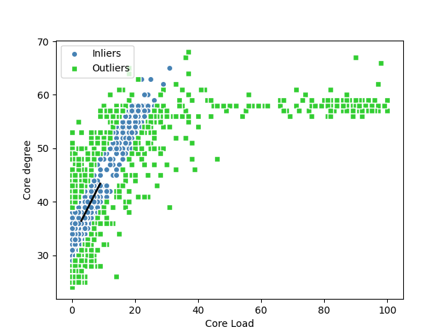
06. Ransac
Monitoring Tool로 부터 받은 Data
def Ransac(): df = pd.read_csv('CT_log.csv', sep=',') X = df[['Core_load_0']].values y = df['Core 0 Temp'].values ransac = RANSACRegressor(LinearRegression(), max_trials=100, min_samples=50, loss='absolute_loss',residual_threshold=5.0,random_state=0) ransac.fit(X,y) inlier_mssk = ransac.inlier_mask_ outlier_mask = np.logical_not(inlier_mssk) line_X = np.arange(3,10,1) line_y_ransac = ransac.predict(line_X[:, np.newaxis]) plt.scatter(X[inlier_mssk], y[inlier_mssk], c = 'steelblue', edgecolors='white', marker='o', label ='Inliers') plt.scatter(X[outlier_mask], y[outlier_mask], c = 'limegreen', edgecolors='white', marker='s', label ='Outliers') plt.plot(line_X, line_y_ransac,color='black',lw = 2) plt.xlabel('Core Load') plt.ylabel('Core degree') plt.legend(loc = 'upper left') plt.show()

Slide 9
07. SVR
Monitoring Tool로 부터 받은 Data
def SVR_Test(): df = pd.read_csv('CT_log.csv', sep=',') X = df[['Core_load_0']].values y = df['Core 0 Temp'].values svr_rbf = SVR(kernel='rbf', C = 100, gamma=0.1, epsilon=.1) svr_lin = SVR(kernel='linear', C = 100, gamma='auto') svr_poly = SVR(kernel='poly', C=100, gamma='auto', degree = 3, epsilon = .1, coef0 = 1) lw = 2 # svrs=[svr_rbf,svr_lin,svr_poly] # kernel_label = ['RBF','Linear', 'Polynomial'] # model_color = ['m','c','g'] svrs=[svr_rbf,svr_lin] kernel_label = ['RBF','Linear'] model_color = ['m','c','g'] fig, axes = plt.subplots(nrows =1 , ncols =2, figsize=(9,7),sharey= True)
for ix, svr in enumerate(svrs): axes[ix].plot(X, svr.fit(X,y).predict(X), color = model_color[ix], lw = lw, label = '{} model'.format(kernel_label[ix])) axes[ix].scatter(X[svr.support_], y[svr.support_], facecolor ="none", edgecolor=model_color[ix], s = 50, label = '{} support vectors'.format(kernel_label[ix])) axes[ix].scatter(X[np.setdiff1d(np.arange(len(X)),svr.support_)], y[np.setdiff1d(np.arange(len(X)), svr.support_)], facecolor = 'none', edgecolor='k',s= 50 , label = 'other training data') axes[ix].legend(loc = 'upper center', bbox_to_anchor=(0.5,1.1),ncol =1 ,fancybox = True, shadow = True) fig.text(0.5,0.04, 'data', ha = 'center', va = 'center') fig.text(0.06, 0.5, 'target', ha='center', va='center', rotation = 'vertical') #fig.suptitile("Support Vector Regression", fontsize = 14) plt.show()

Slide 10
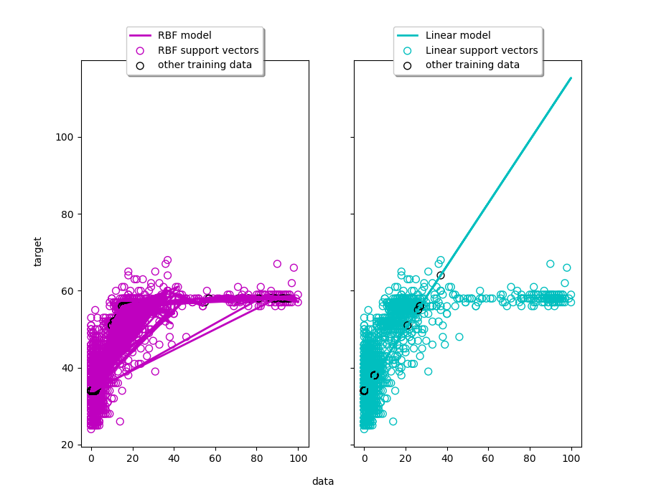
07. SVR
Monitoring Tool로 부터 받은 Data

Slide 11
감사합니다.

