Slide 1
The Influence of Media on
Tesla Inc.’s Stock Price
Official Answers
(Yiqing, Yong, Zack)

Slide 2

Introduction
Datasets:
-Daily Price: daily price of tesla stock since 2016
- Yahoo Finance
-Minutely Price: minutely price data since April
- Bloomberg Terminal
-CNBC_TSLA: all CNBC’s tweets about Tesla
- CNBC’s twitter Account
-Elon_Musk: all of Elon Musk’s past tweets
- Elon Musk’s twitter Account

Slide 3
Exploratory Data Analysis

Slide 4
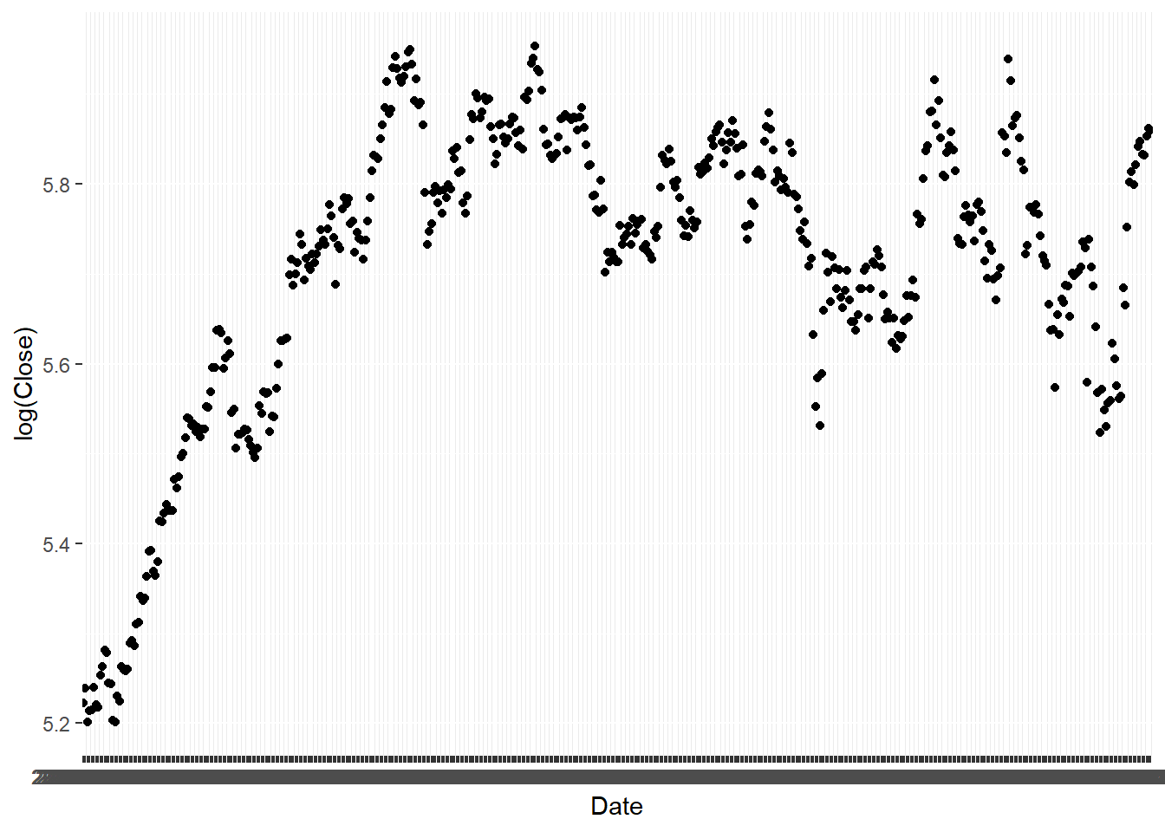
Stock Data
Tesla's stock price experienced a relatively steady growth at first but started to have more volatility during the past one year or so. This is the period in which we are mainly interested in.

Slide 5
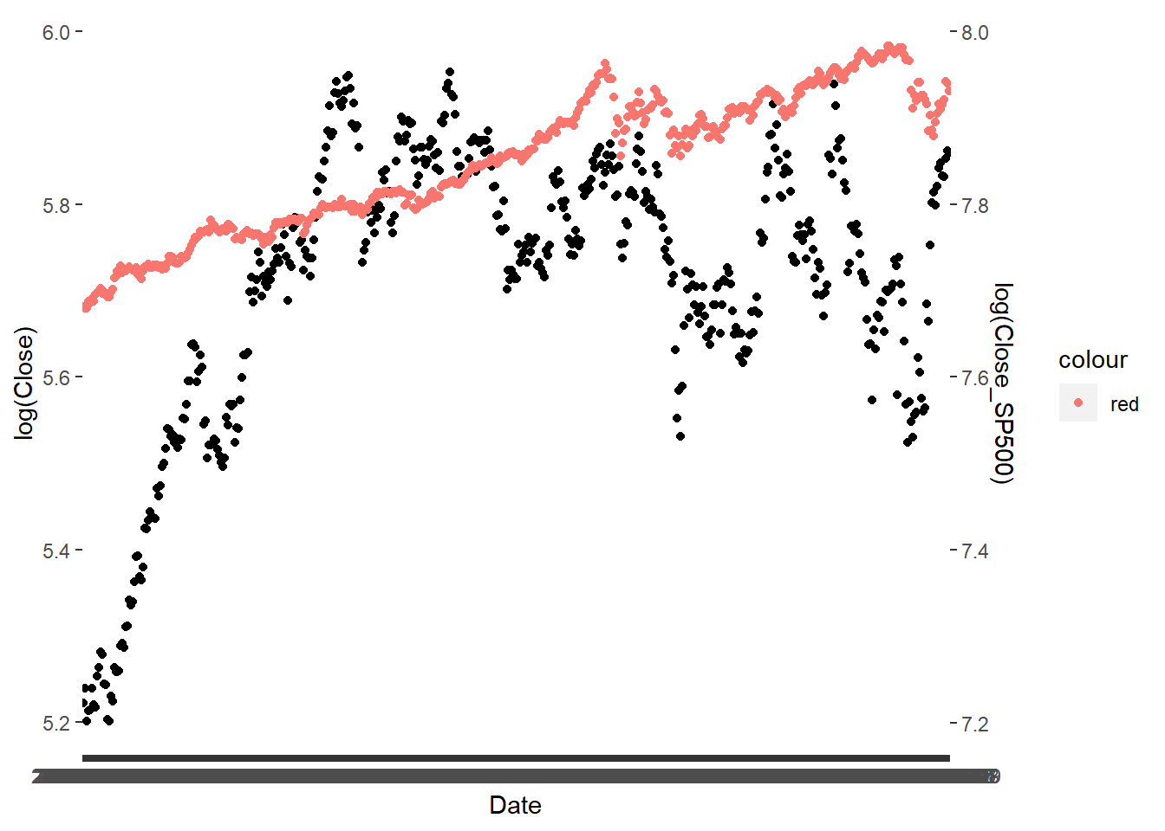
TSLA V.S. S&P 500

Slide 6
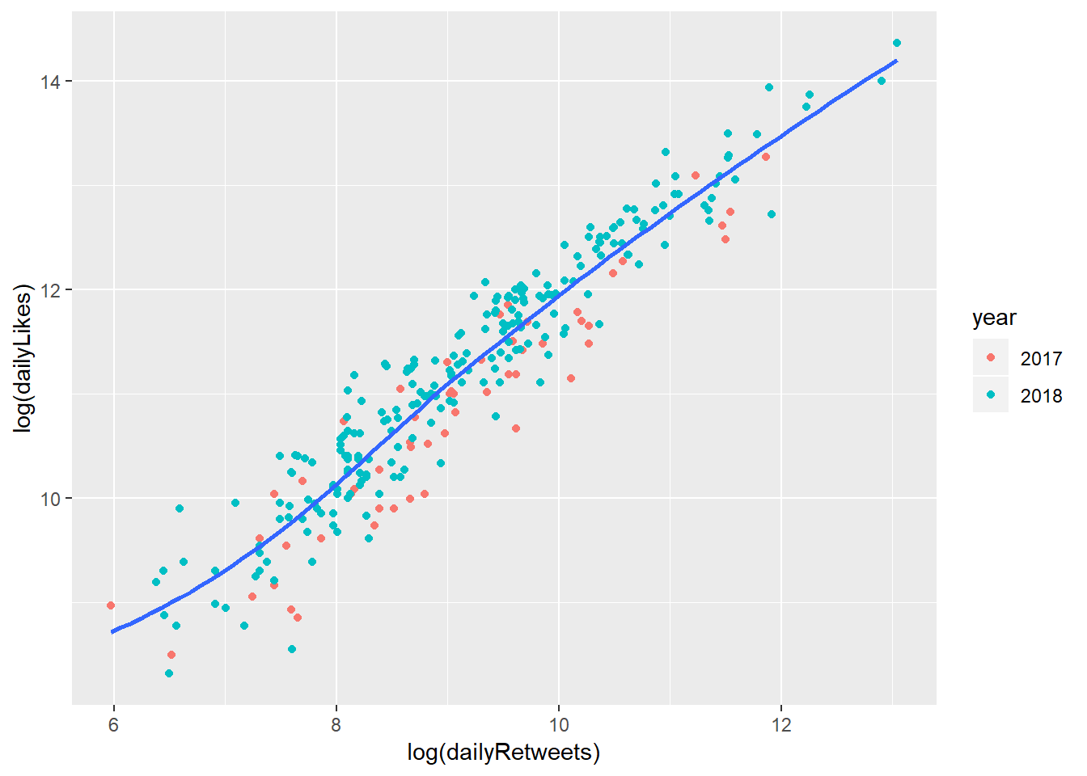
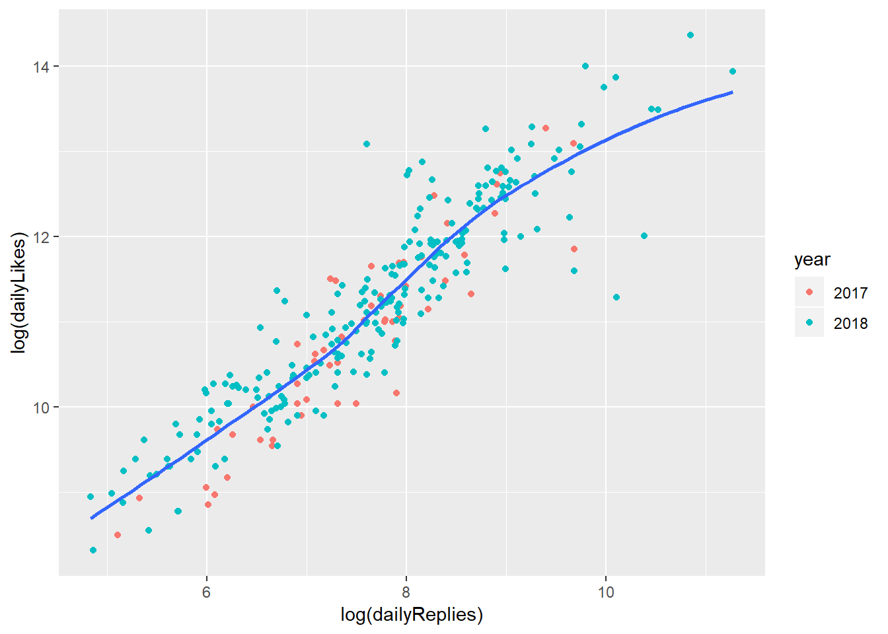
Twitter Data
* We performed the same analysis on both dataset we got but the results is very similar, so we only should the results for the CNBC dataset here.

Slide 7
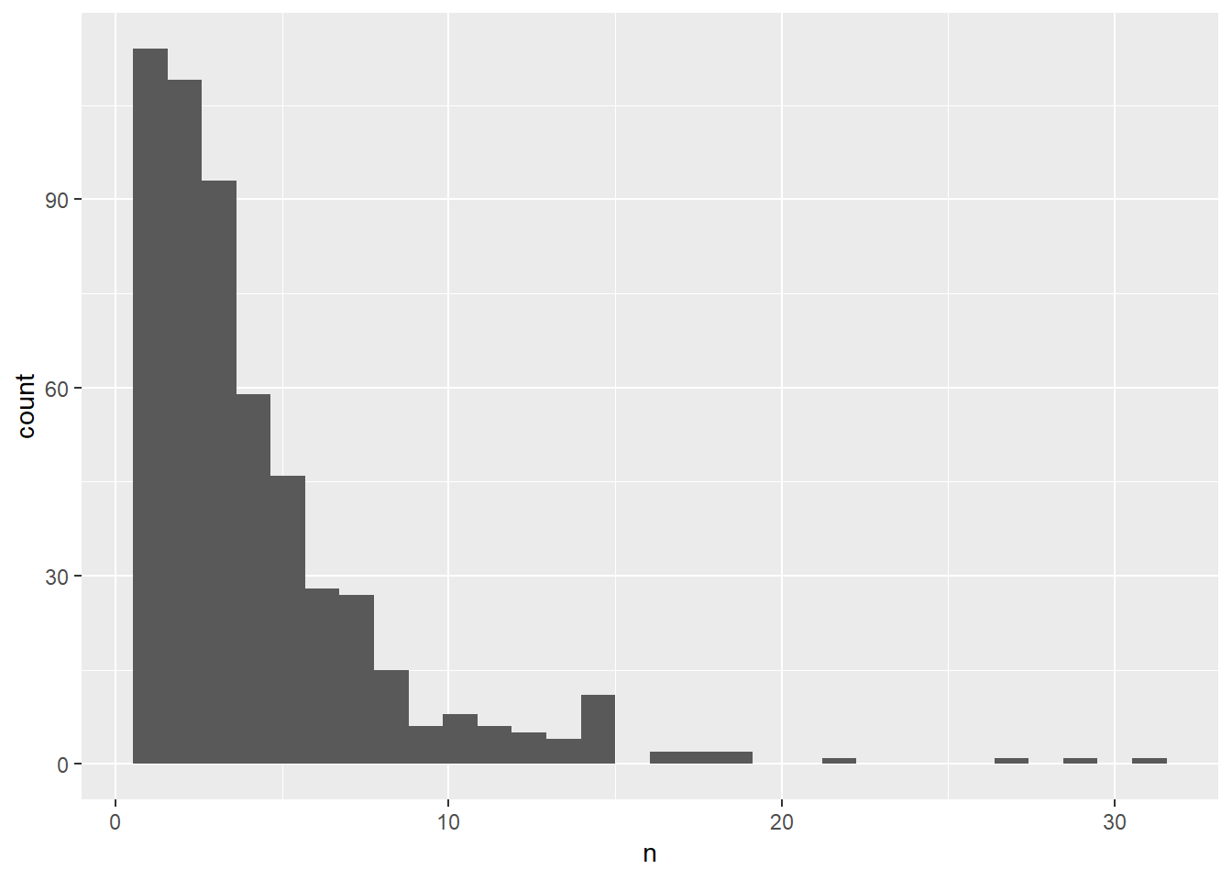
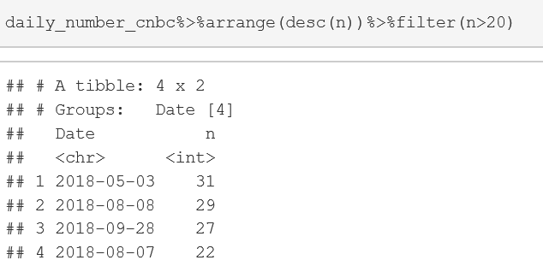

Twitter Data

Slide 8
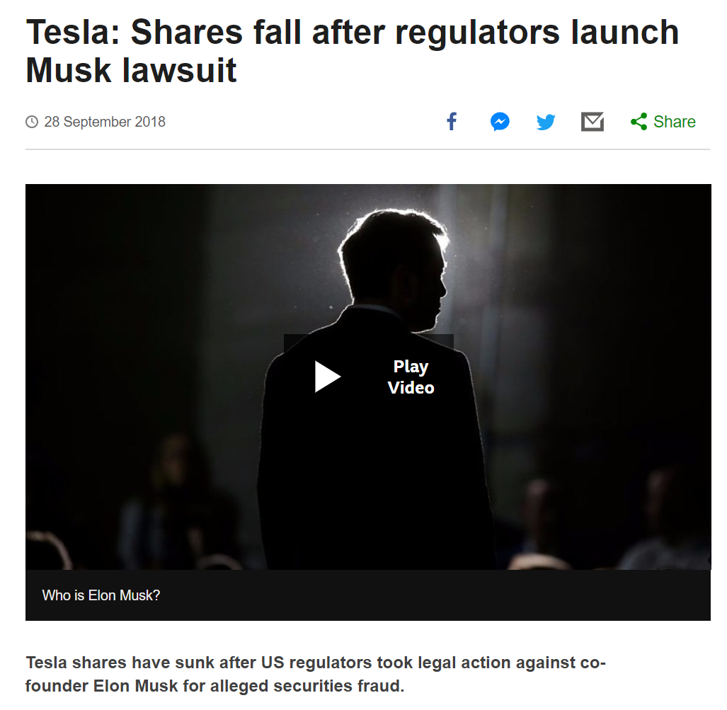
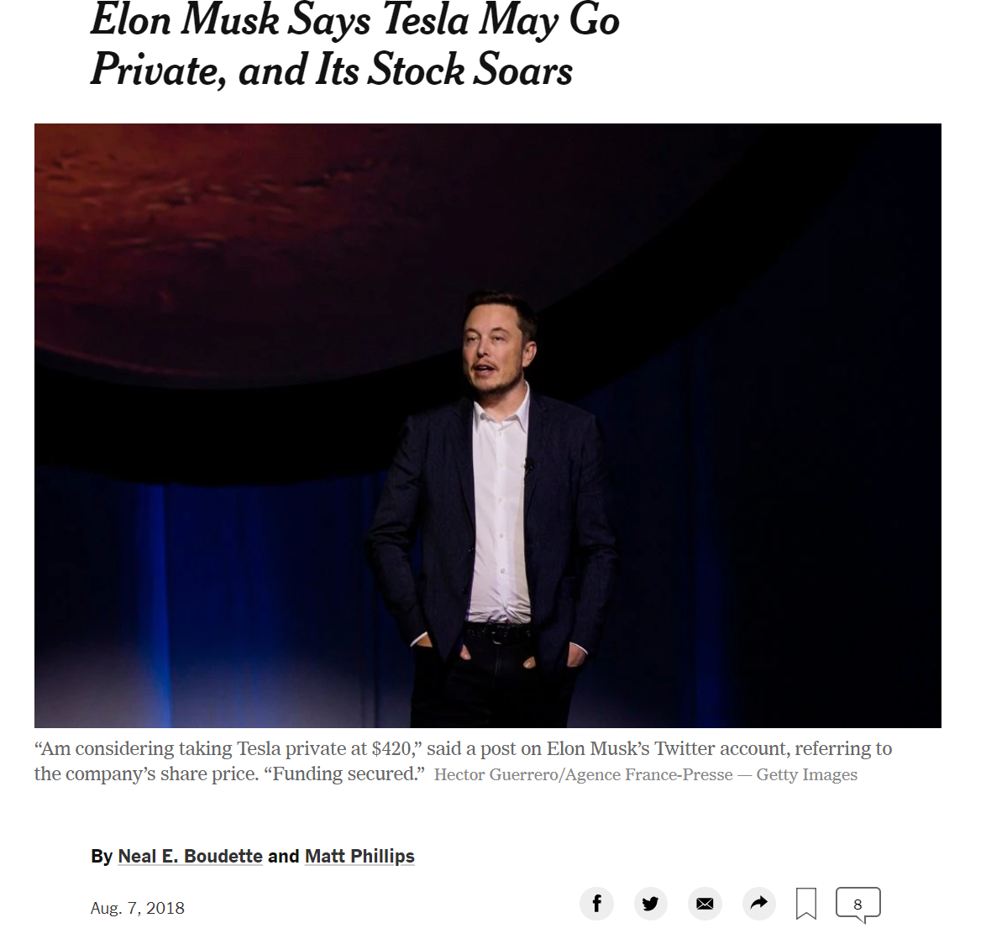
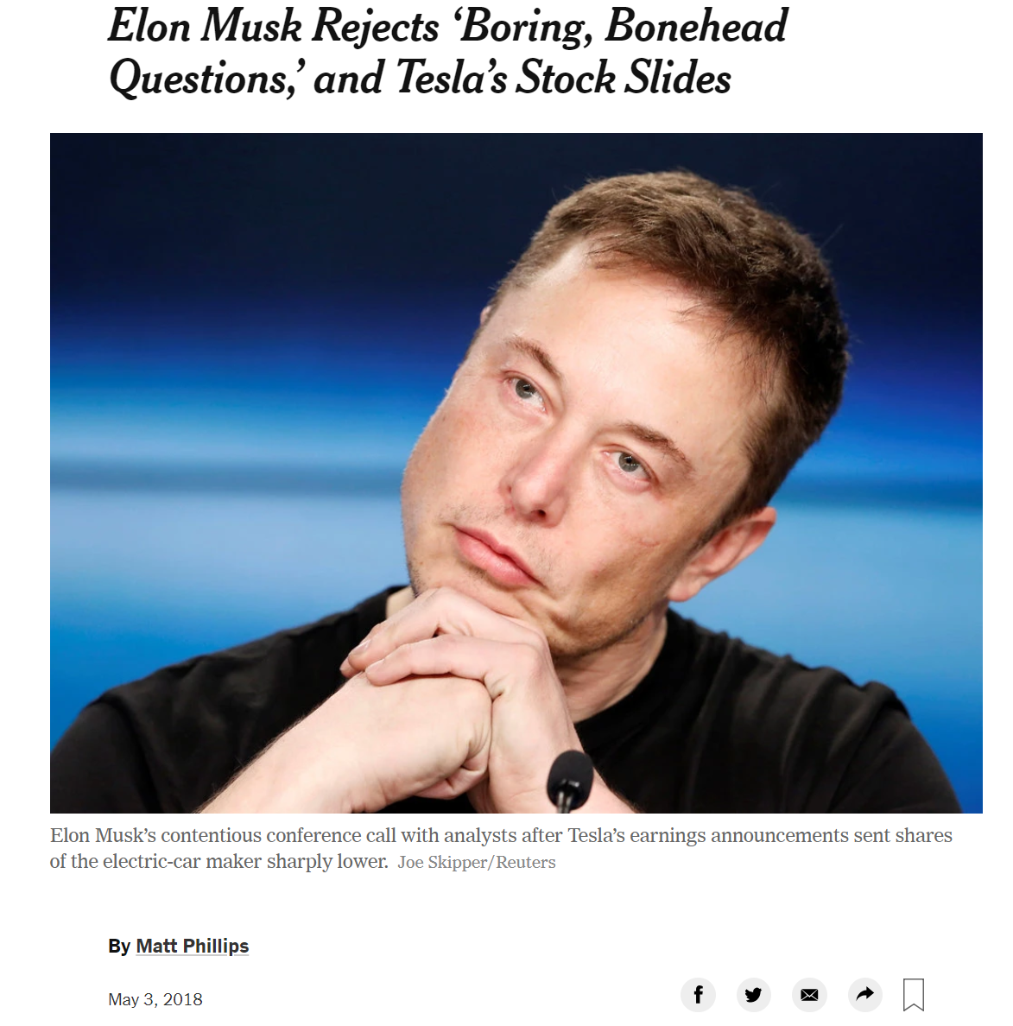
Twitter Data

Slide 9
Regression

Slide 10
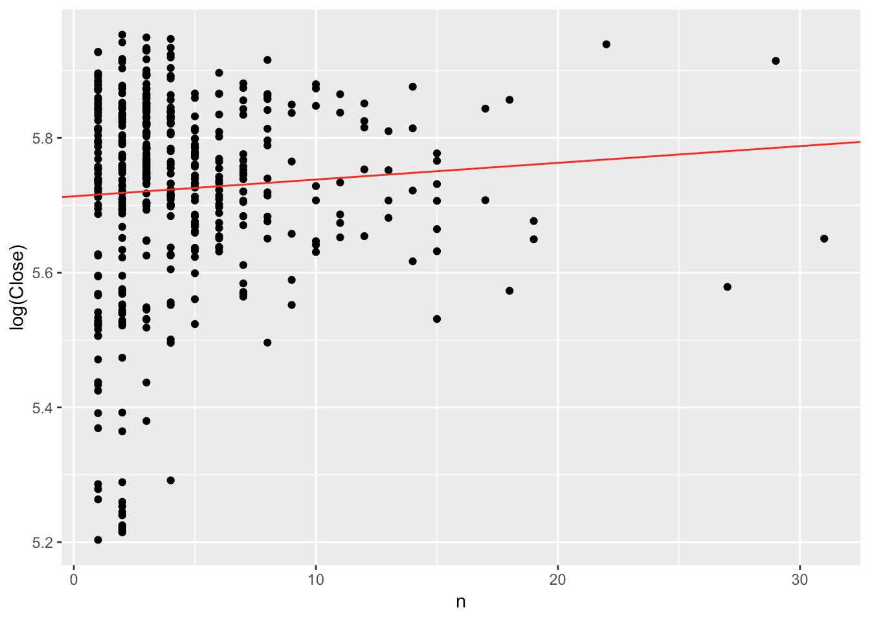
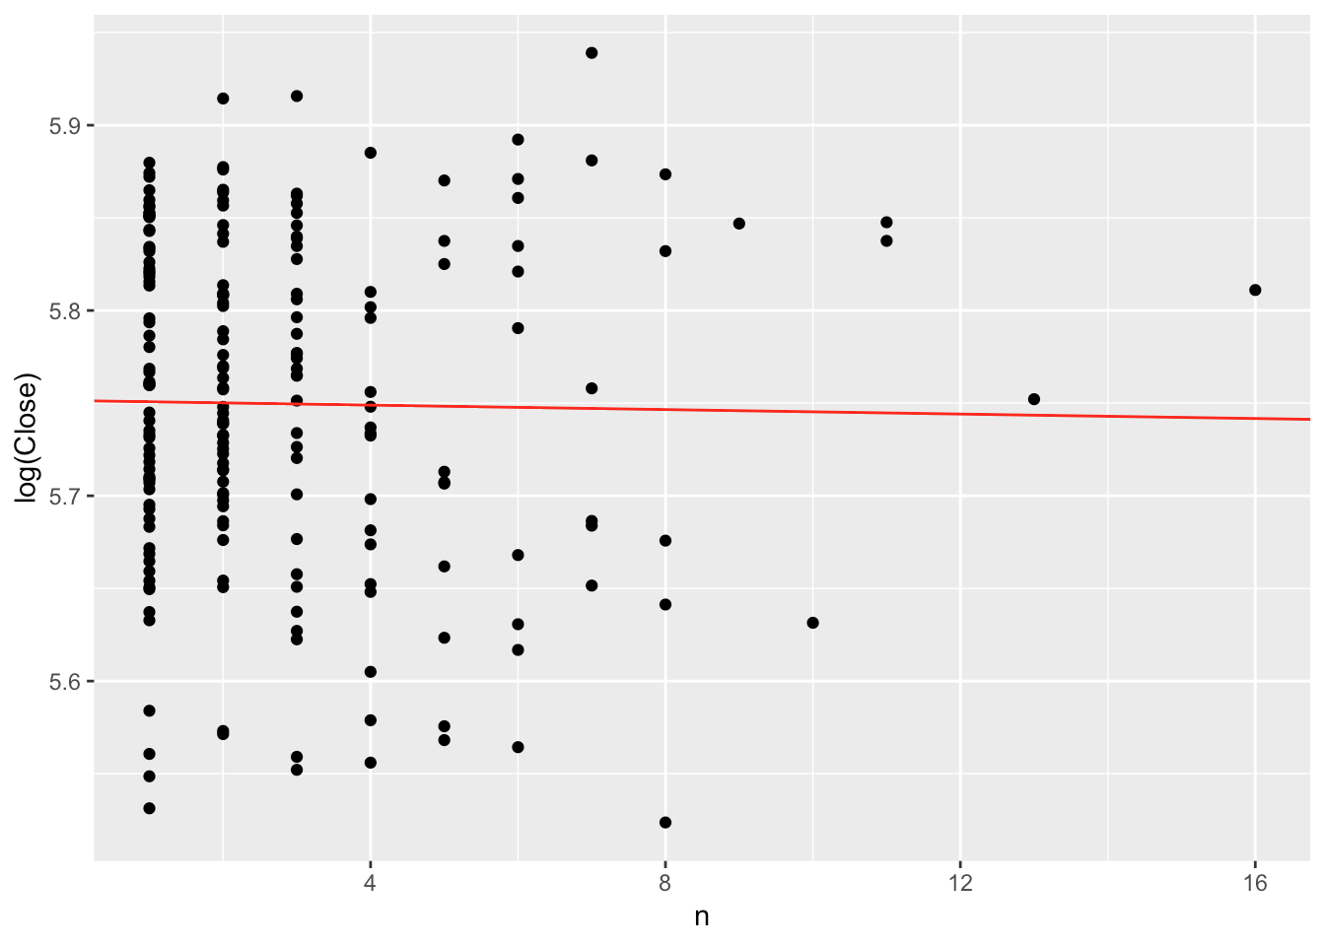
CNBC, number of news
Number of tweets on CNBC’S account
V.S.
log of the close price
The daily number of tweets that Musk wrote
V.S.
log of the close price
Notes:
CNBC and Elon musk with the Stock price

Slide 11
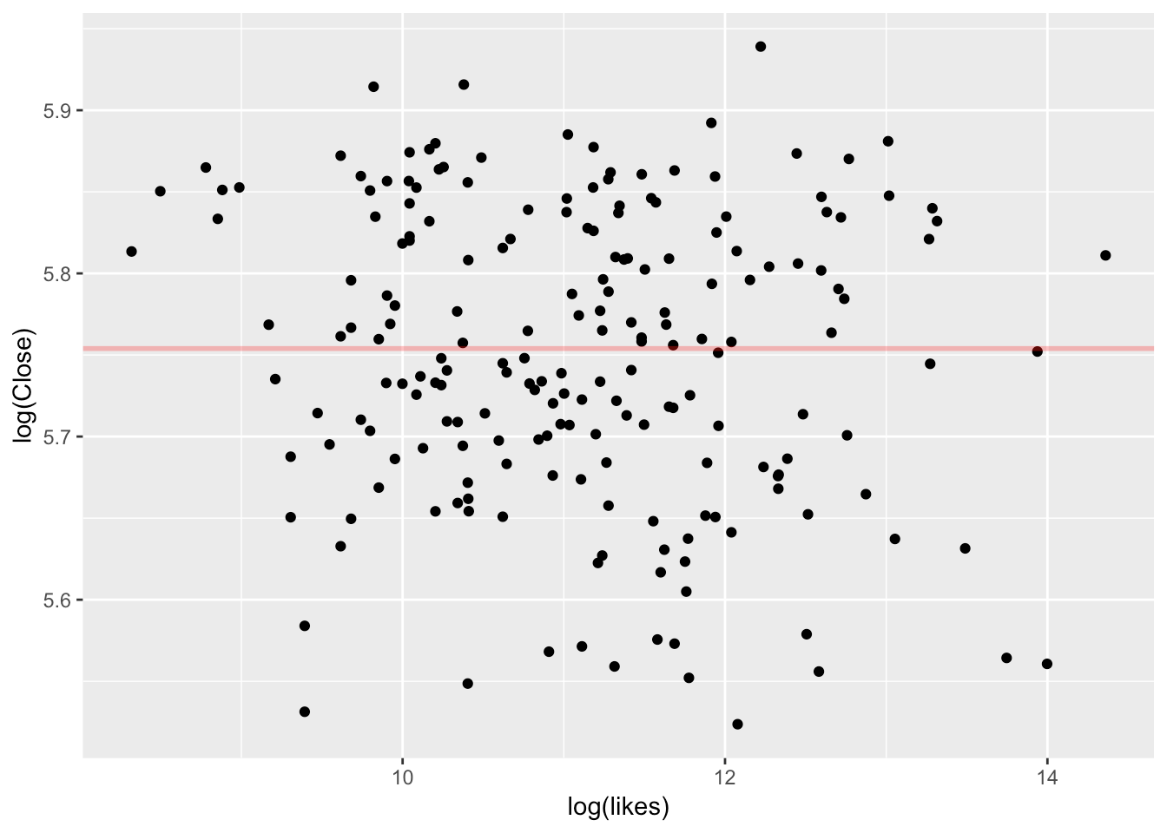
Linear Regression
Daily Likes
V.S.
Stock Price
Notes:
Twitter Daily likes and stock price

Slide 12
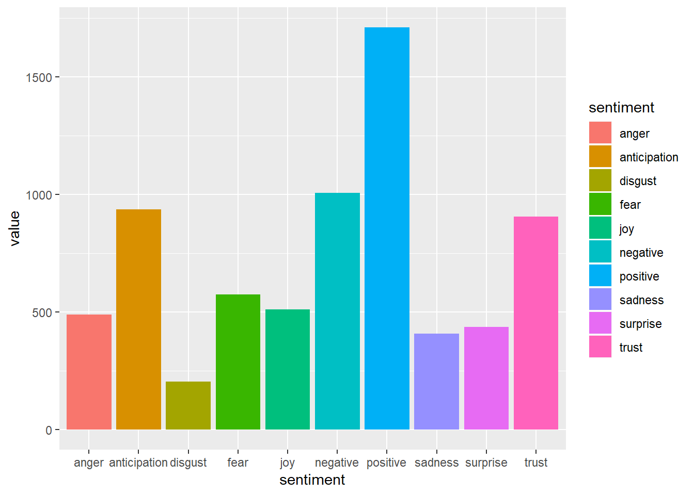
Content - Natural Language Processing
wash the tweet text off miscellaneous words
…
mutate(text = str_replace_all(text, "https?.*\\s?","")) %>% mutate(text = str_replace_all(text, "[#@].*\\s?","")) %>% mutate(text = str_replace_all(text, "pic.twitter.*\\s?","")) %>%
…
2) use the syuzhet library, we assign individual tweets with 10 categories of emotions.
Sentiment Levels of CNBC Tweets

Slide 13
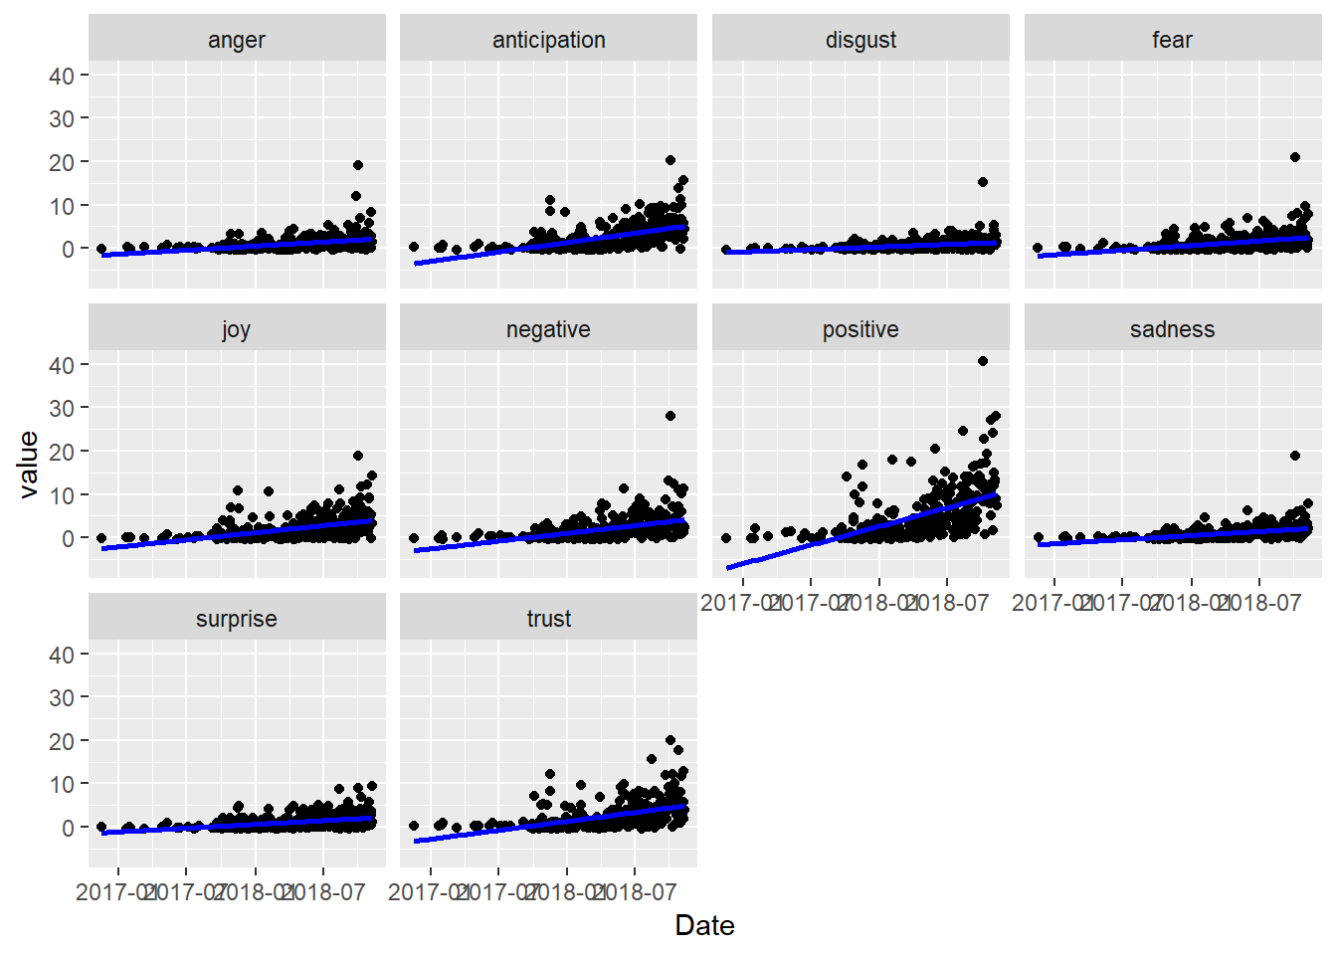
Plots - EDA
Group the tweets by day and sum the emotion scores
Analyze the trend of emotions
Different types of emotions are correlated with each other

Slide 14
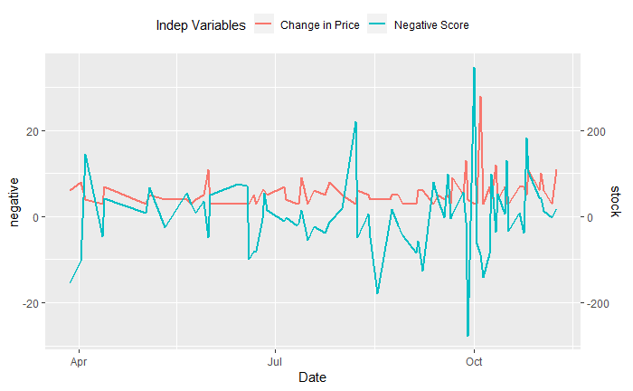
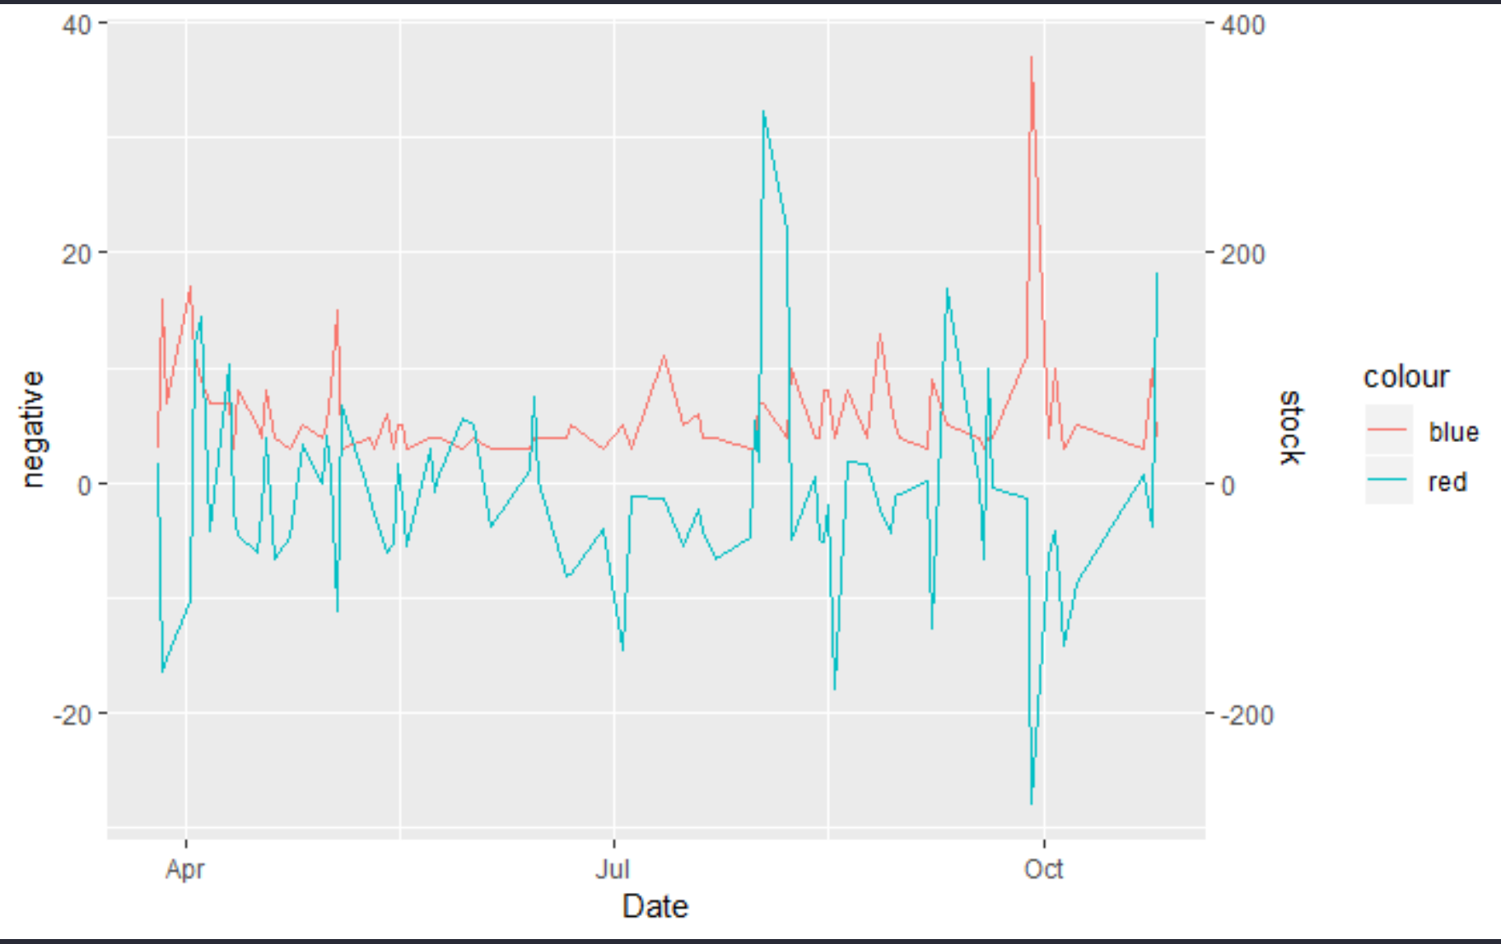
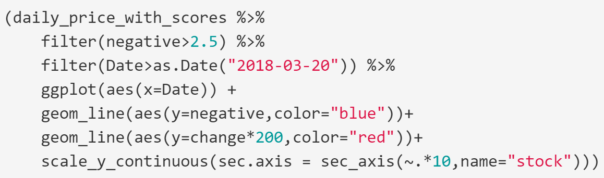
Plots - EDA (Negativity)
4) Filter out the low scores to reduce influence from noise
5) Plot the scores against the changes in TSLA price

Slide 15
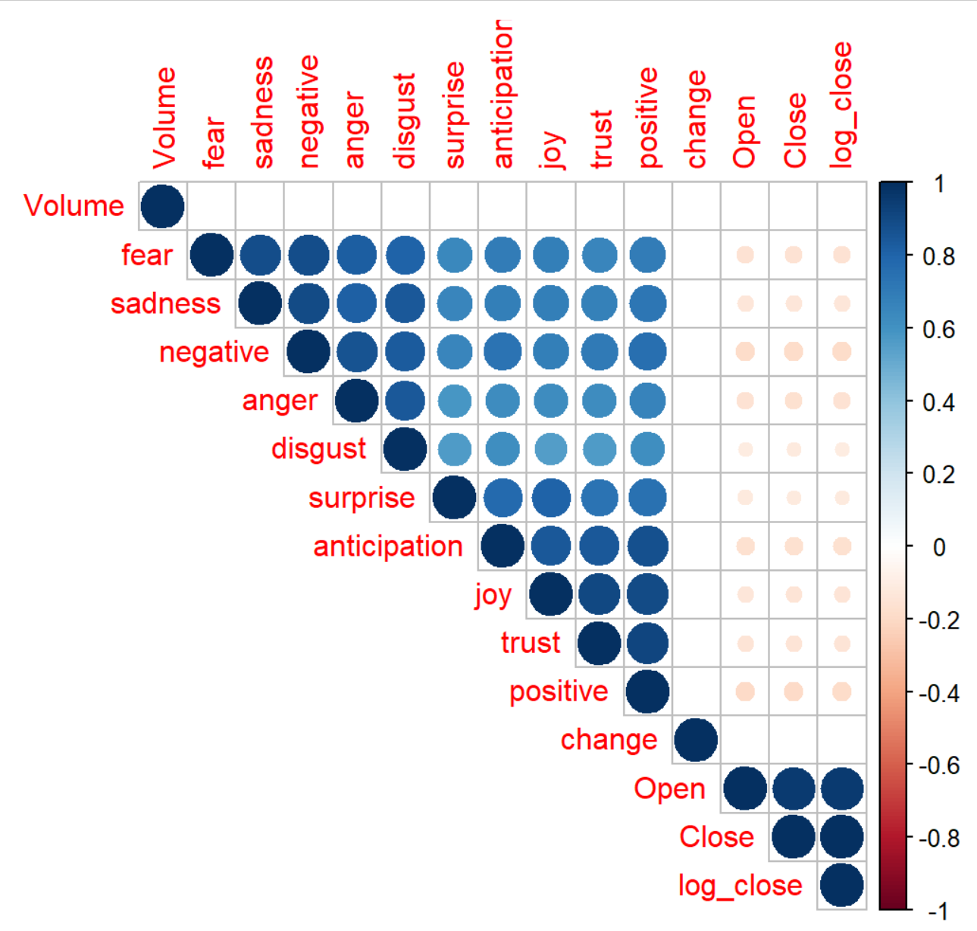
Modeling
Correlation Matrix by corrplot
* Blue: positive
* Red: negative
* Color intensity and size ~ proportional to the correlation coefficients.

Slide 16
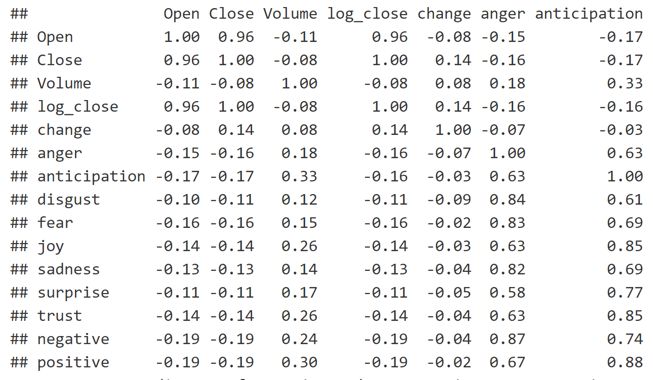
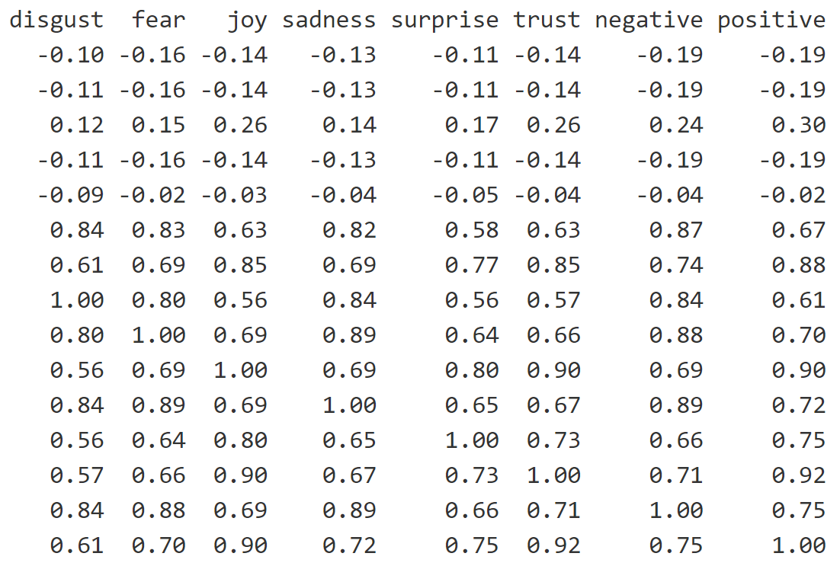
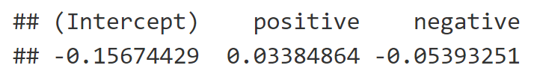
Modeling - Corr Matrix Table
Modeling - Logistic

Slide 17
Conclusion
The numbers of tweets is not a good predictor of the changes in Tesla’s stock price
The other variables are not significant predictors neither
Using minutely (instead of daily) stock prices do not have a significant influence
The numbers of optimistic and pessimistic tweets tend to experience similar changes, reflecting people’s splitted view on Tesla
All optimistic emotions such as anticipation and trust in tweets are weakly positively correlated with the trading volume of the Tesla stock, while all pessimistic emotions are less positively correlated
Shiny App: https://bit.ly/2Ldusnw

Slide 18
Future Analysis
Improve sentiment scoring analysis by exploring other models
Since TSLA stock surged in popularity both on Wall Street and on social media in recent years, our analysis window is likely limited and biased

Slide 19
