Slide 1

Giving a scientific talk
AKA how to get a good score in Honours Conference
Nichola Burton
Yong Zhi Foo

Slide 2
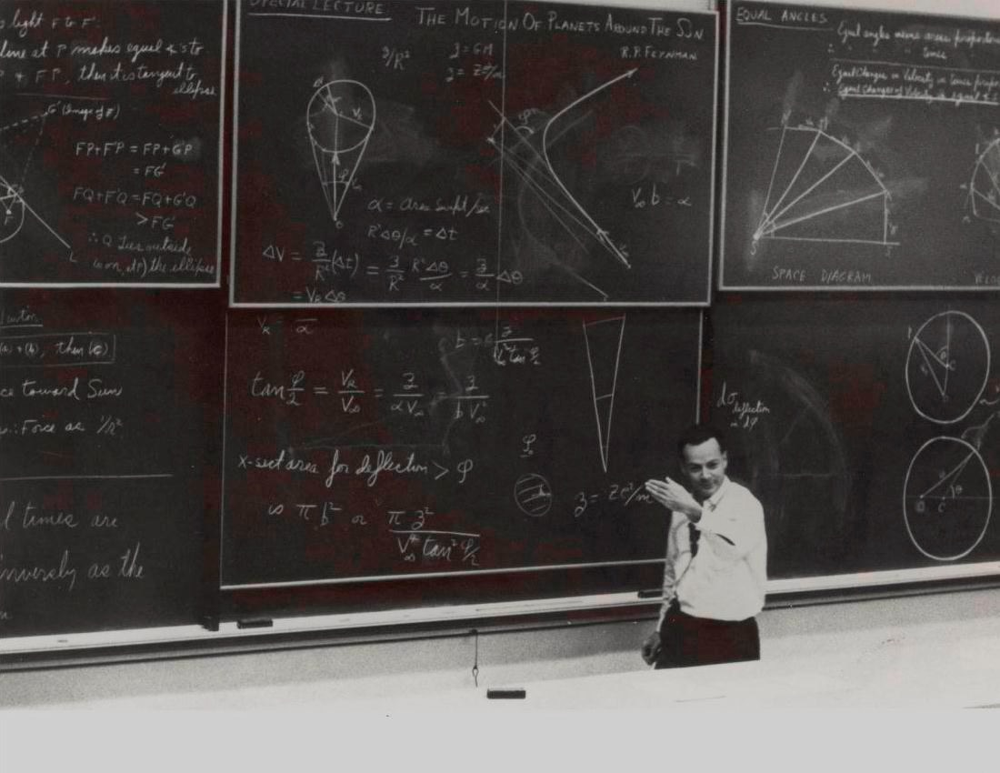
Designing your
slides

Slide 3
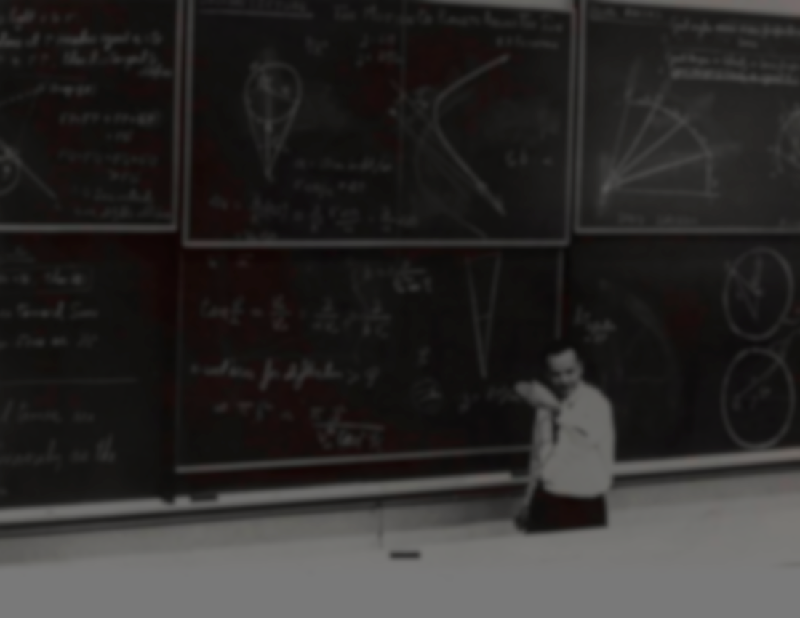
Slides are …...
Visual aids
Not text replacements

Slide 4
Dos & Don’ts

Slide 5
Keep it simple

Slide 6
Big legible fonts
Because there is no point having words that people can’t read
Don’t overcrowd your slides
“Breathing space” between elements
(citations can be smaller)

Slide 7
Big legible fonts
Because there is no point having words that people can’t read
Don’t overcrowd your slides
“Breathing space” between elements
(citations can be smaller)

Slide 8
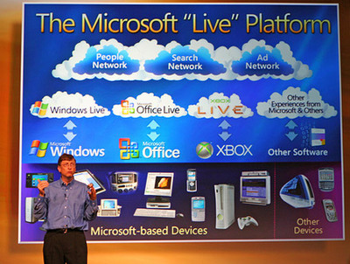

Slide 9
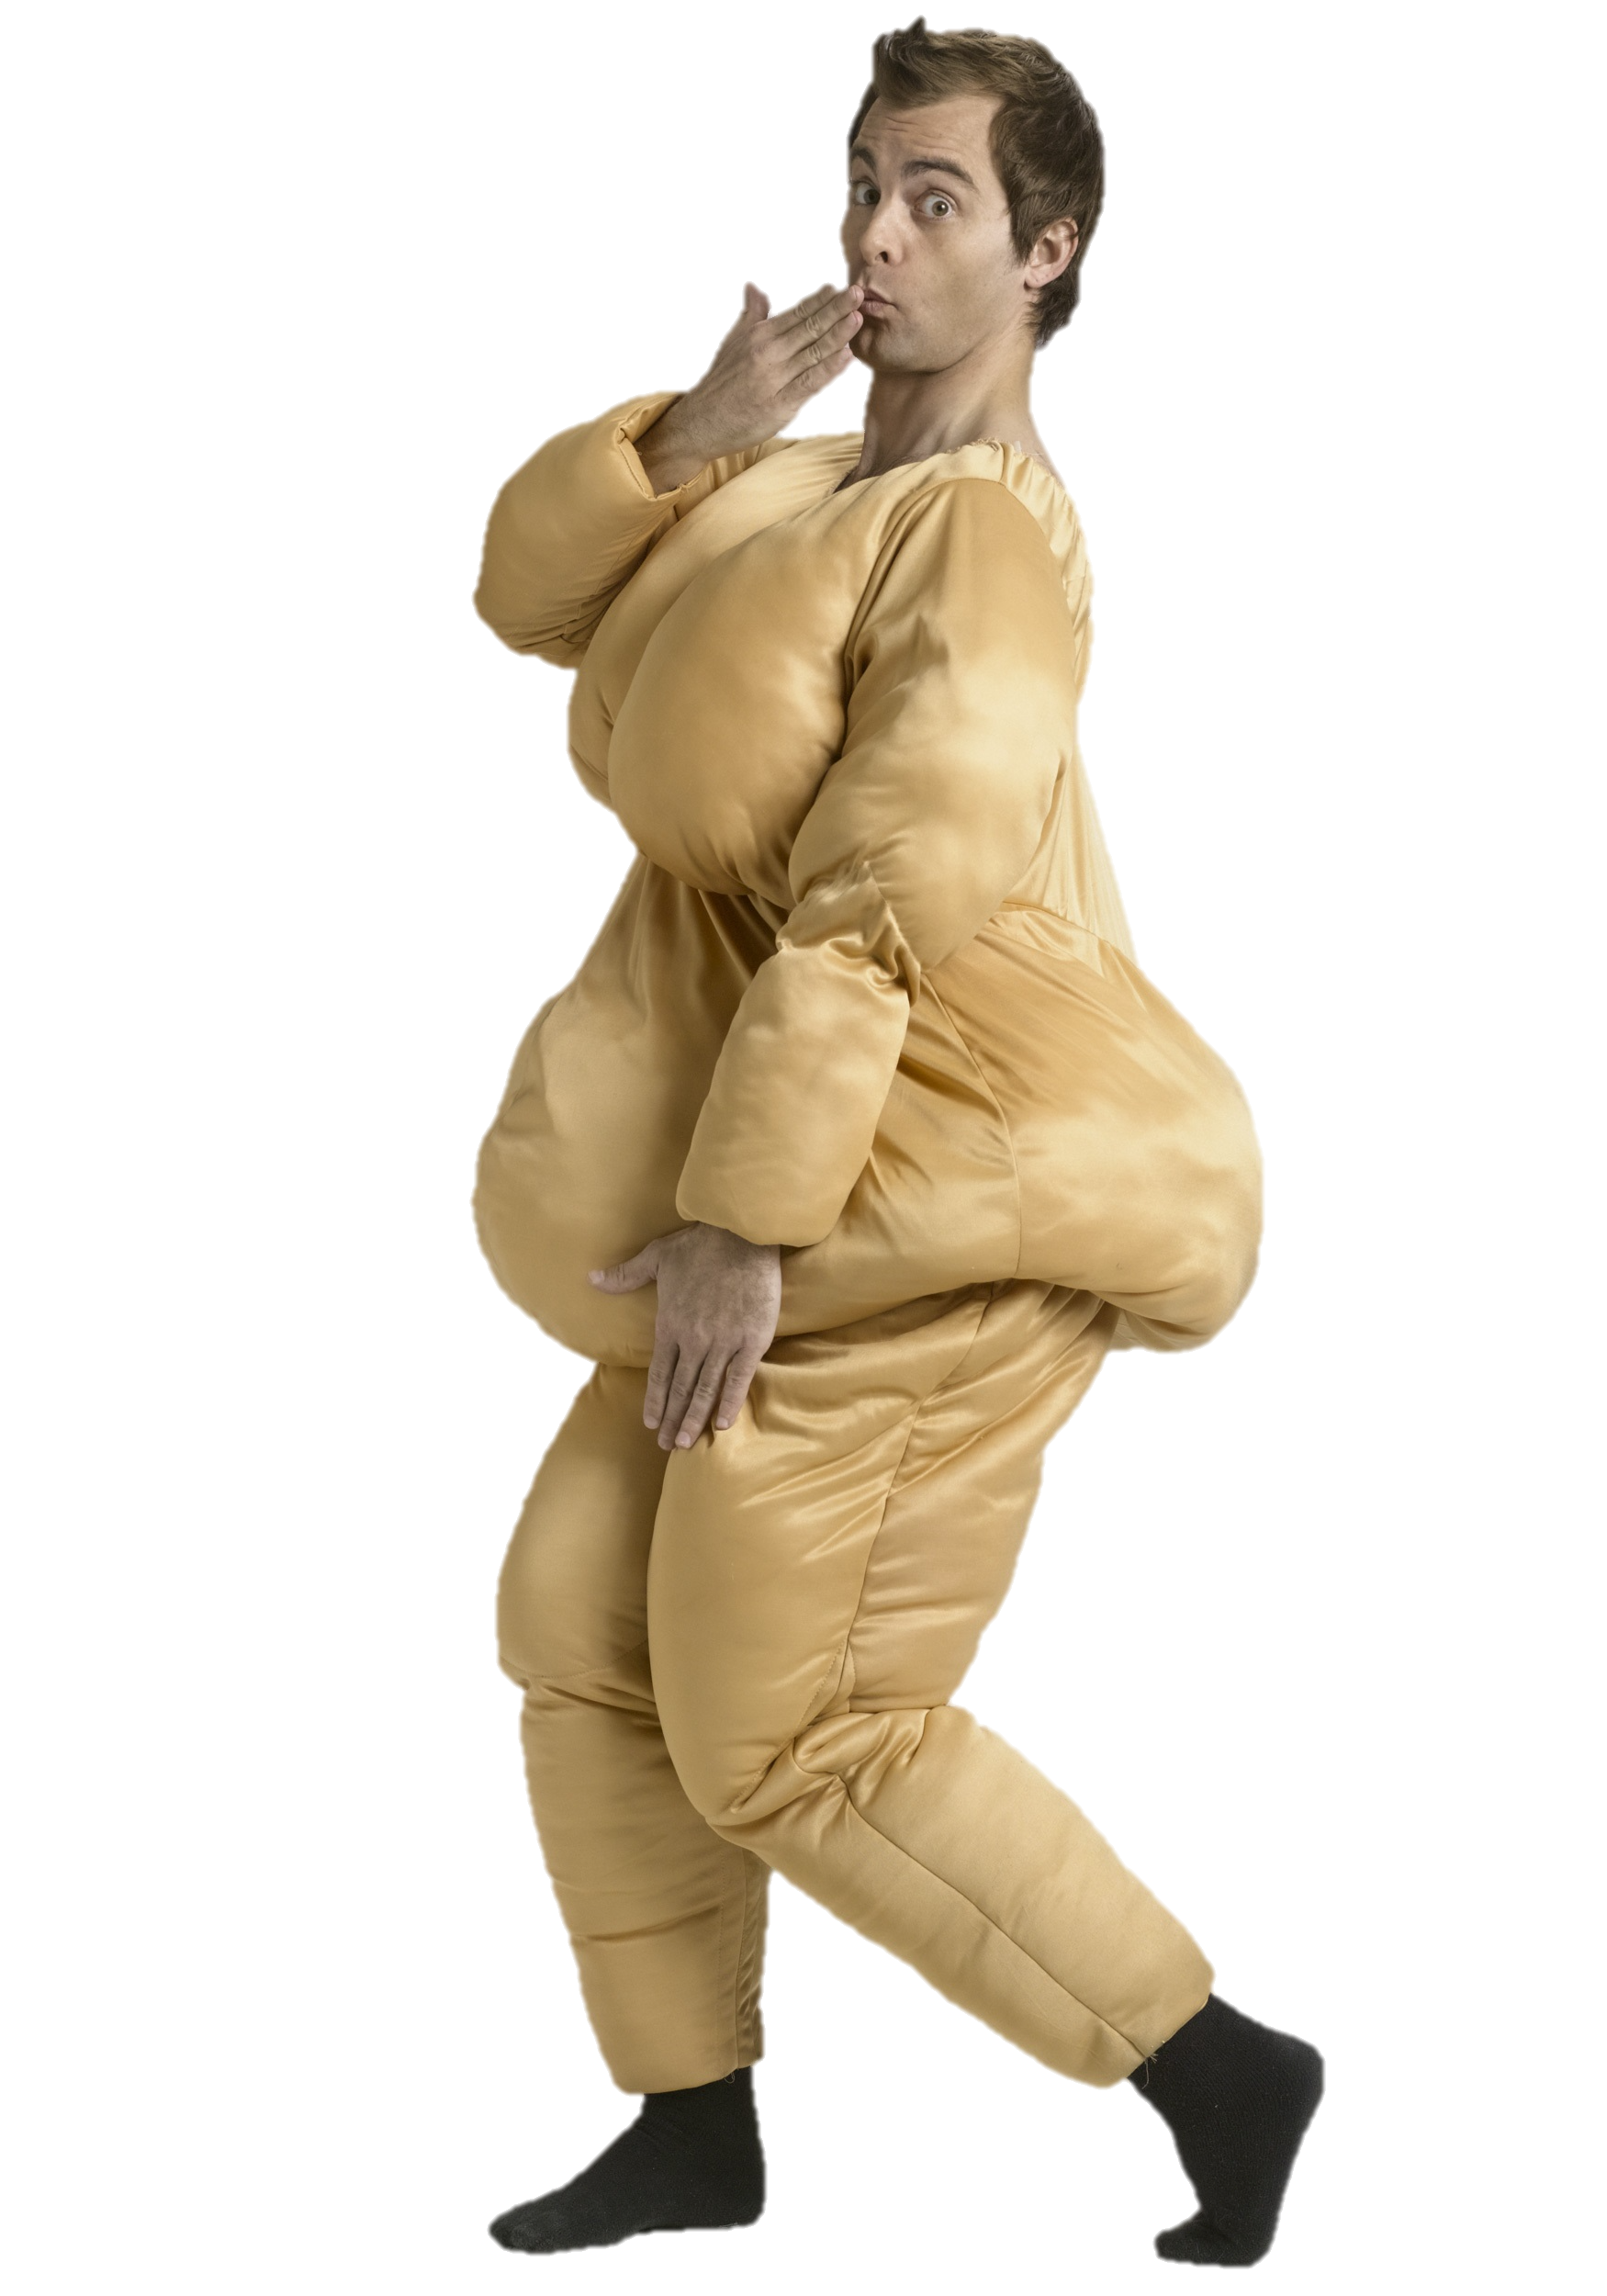
No visual
padding
which means...

Slide 10
No irrelevant pictures

Slide 11
No themes

Slide 12
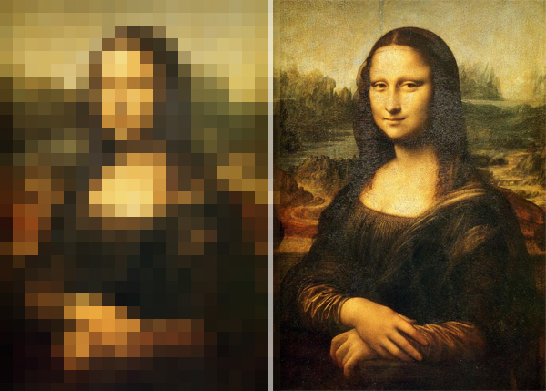
Use
high resolution images

Slide 13


Slide 14
Tip: You can ask Google image to search only for large images

Slide 15
Use animations
wisely
Motion captures attention
Animate points/images/figures
But avoid unnecessary animations/transitions

Slide 16
Use animations
wisely
Motion captures attention
Animate points/images/figures
But avoid unnecessary animations/transitions

Slide 17
Additional
Useful Tips

Slide 18
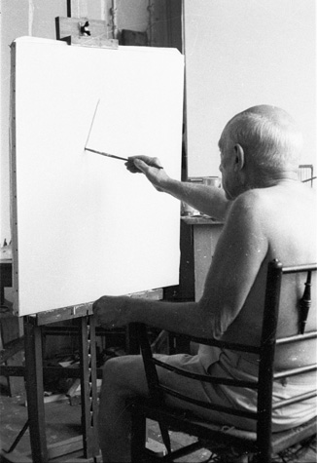
Start with a blank canvas

Slide 19
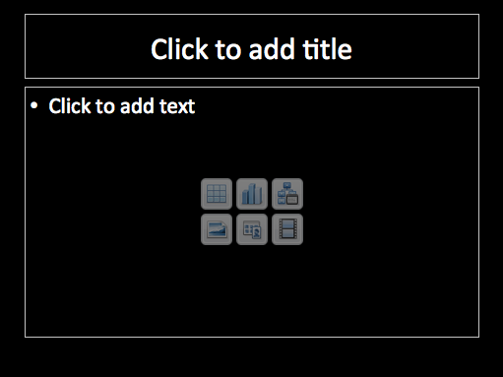

Slide 20
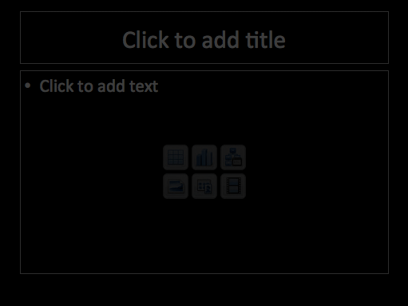
aka The PowerPoint Format of Death (Foo, 2018)

Slide 21



Maximise impact of images

Slide 22
Use pretty images

Slide 23
Let them occupy the whole slide…...

Slide 24
…...or half of it

Slide 25
Remove background

Slide 26



Remove background

Slide 27
Rule of thirds

Slide 28


Slide 29


Slide 30


Slide 31
Designing your
slides

Slide 32
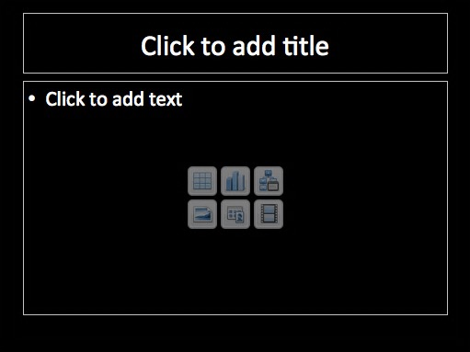

Slide 33
Sexual Selection for Male Physical Strength
Stronger men have more partners (Lassek & Gaulin, 2009; Gallup, White, and Gallup, 2007)
Sex differences in strength (Lassek & Gaulin, 2009)
  Men 60% more muscle mass, 90% stronger
UK Biobank Study (Sanjak et al., 2017)
  N > 500000
  Male strength under positive directional selection

Slide 34
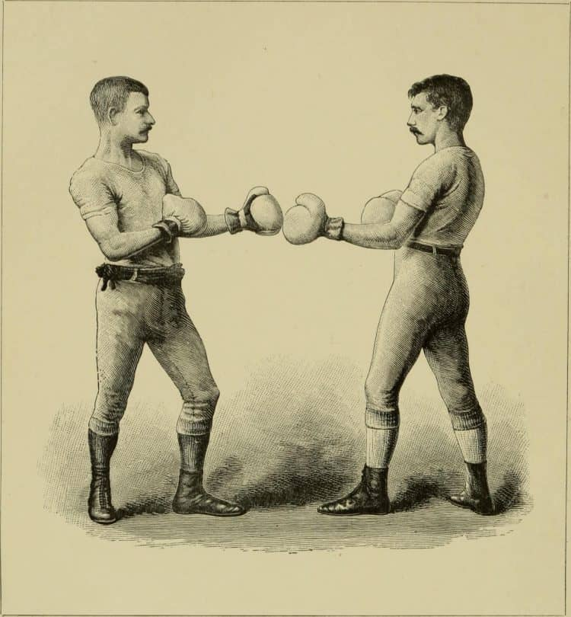
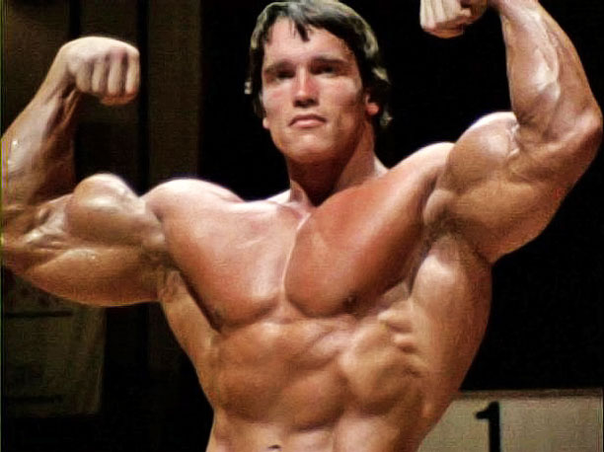
Sexual Selection for Male Physical Strength
Stronger men have more partners (Lassek & Gaulin, 2009; Gallup, White, and Gallup, 2007)
Sex differences in strength (Lassek & Gaulin, 2009)
  Men 60% more muscle mass, 90% stronger
UK Biobank Study (Sanjak et al., 2017)
  N > 500000
  Male strength under positive directional selection

Slide 35
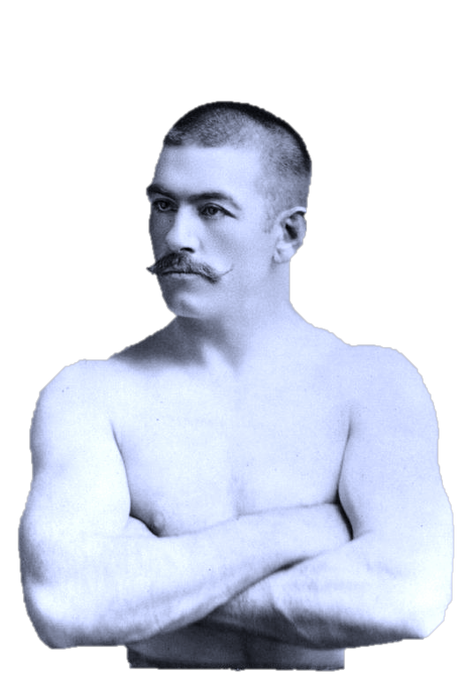
Sexual Selection
for Male Physical Strength
Stronger men ➔ More partners
Lassek & Gaulin, 2009; Gallup, White, and Gallup, 2007
Sex differences in strength
Lassek & Gaulin, 2009
  Men 60% more muscle mass, 90% stronger
UK Biobank Study
Sanjak et al., 2017, N > 500000
  Male strength under positive directional
  selection

Slide 36
Stay focused on the central question/take-home message

Slide 37
Aim of a scientific talk
  Communication with peers
  Not a lecture
  No need to impress – you are the expert!
Clarity and simplicity

Slide 38

DO NOT READ OUT YOUR TALK
Absolutely no notes!
No full sentences on slides (too tempting)

Slide 39

Presentation style
Conversational – explaining something you know well
Memorize first and last sentences and transitions, sticky spots
Don’t sound rigid/rehearsed *
Don’t panic if you get stuck!

Slide 40
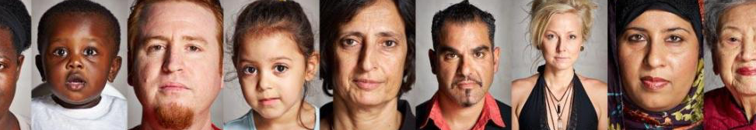
COVER SLIDE WITH YOUR TITLE
And Your Name
Supervised by:
Please Don’t Forget This!

Slide 41
Introduction
First impressions are important – start engagingly!
USE FACES!
Notes:
Jokes, anecdotes, something topical

Slide 42
Introduction: Autism
Autism is a developmental condition characterized by three clusters of features:
  Social Interaction
  Communication
  Restricted/repetitive behaviour and interests
  DSM-IV

Slide 43


Slide 44
Don’t need all the literature – enough to motivate study
Talk about findings, not papers or researchers
Author-date references
(Smaller but Legible, 2018)

Slide 45
Explicitly state aims and hypotheses

Slide 46
Method
Audience should always understand WHY – connect back to aims and hypotheses
If multiple tasks, start with list – which tasks are for what?

Slide 47
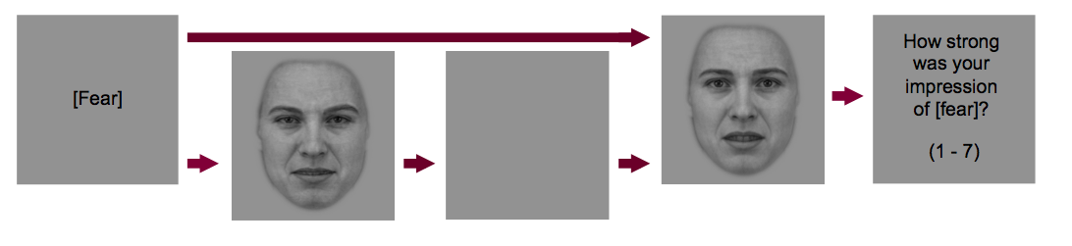

Slide 48
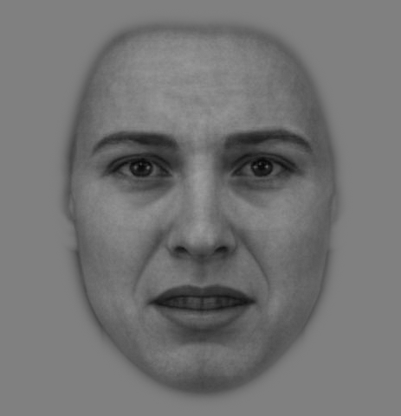
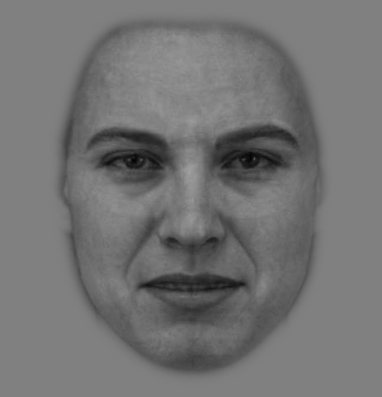

Slide 49
Results
In order of hypotheses
Remind the audience:
  What do we expect to see?
  Does this result support hypothesis?

Slide 50
*

Slide 51
Discussion
Main message
Supporting Results (and literature)
Limitations
Future Directions
Main Message Again!

Slide 52
References
Clark, A. P., Howard, K. L., Woods, A. T., Penton-Voak, I. S., & Neumann, C. (2018). Why rate when you could compare? Using the “EloChoice” package to assess pairwise comparisons of perceived physical strength. PLoS ONE, 13(1), e0190393.
Ewing, L., Caulfield, F., Read, A., & Rhodes, G. (2015). Perceived trustworthiness of faces drives trust behaviour in children. Developmental Science, 18(2), 327-334. doi:10.1111/desc.12218
Foo, Y. Z., Simmons, L. W., & Rhodes, G. (2017). Predictors of facial attractiveness and health in humans. Scientific Reports, 7, 39731.
Germine, L., Russell, R., Bronstad, P. M., Blokland, Gabriëlla A. M., Smoller, Jordan W., Kwok, H., . . . Wilmer, Jeremy B. (2015). Individual aesthetic preferences for faces are shaped mostly by environments, not genes. Current Biology, 25(20), 2684-2689. doi:10.1016/j.cub.2015.08.048
Germine, L. T., Duchaine, B., & Nakayama, K. (2011). Where cognitive development and aging meet: Face learning ability peaks after age 30. Cognition, 118(2), 201-210.
Hehman, E., Sutherland, C. A. M., Flake, J. K., & Slepian, M. L. (2017). The unique contributions of perceiver and target characteristics in person perception. Journal of personality and social psychology, 113(4), 513-529.
Hollis, G. (2018). Scoring best-worst data in unbalanced many-item designs, with applications to crowdsourcing semantic judgments. Behavior research methods, 50(2), 711-729.
Hollis, G., & Westbury, C. (2018). When is best-worst best? A comparison of best-worst scaling, numeric estimation, and rating scales for collection of semantic norms. Behavior research methods, 50(1), 115-133.
Hönekopp, J. (2006). Once more: is beauty in the eye of the beholder? Relative contributions of private and shared taste to judgments of facial attractiveness. Journal of Experimental Psychology: Human Perception and Performance, 32(2), 199.
Jenkins, R., White, D., Van Montfort, X., & Burton, A. M. (2011). Variability in photos of the same face. Cognition, 121(3), 313-323.
Lattery, K. (2011). Anchoring maximum difference scaling against a threshold–dual response and direct binary responses. Sawtooth Software Technical Paper Library.
Lee, J. A., Soutar, G., & Louviere, J. (2008). The best-worst scaling approach: An alternative to Schwartz's values survey. Journal of Personality Assessment, 90(4), 335-347. doi:10.1080/00223890802107925
Lee, J. A., Soutar, G. N., & Louviere, J. (2007). Measuring values using best-worst scaling: The LOV example. Psychology & Marketing, 24(12), 1043-1058. doi:10.1002/mar.20197
Louviere, J. J., Flynn, T. N., & Marley, A. A. J. (2015). Best-worst scaling: Theory, methods and applications: Cambridge University Press.
Ma, D. S., Correll, J., & Wittenbrink, B. (2015). The Chicago face database: A free stimulus set of faces and norming data. Behavior research methods, 47(4), 1122-1135.
Meissner, C. A., & Brigham, J. C. (2001). Thirty years of investigating the own-race bias in memory for faces: A meta-analytic review. Psychology, Public Policy, and Law, 7(1), 3.
Olivola, C. Y., Funk, F., & Todorov, A. (2014). Social attributions from faces bias human choices. Trends in Cognitive Sciences, 18(11), 566-570.
Orme, B. (2005). Accuracy of HB estimation in MaxDiff experiments. Sawtooth Software Research Paper,
Rule, N. O., Krendl, A. C., Ivcevic, Z., & Ambady, N. (2013). Accuracy and Consensus in Judgments of Trustworthiness From Faces: Behavioral and Neural Correlates. Journal of personality and social psychology, 104(3), 409-426. doi:10.1037/a0031050

Slide 53
Acknowledgements

Slide 55
Prepare for questions!
Don’t panic if you don’t know the answer
Plant a mole…

Slide 56
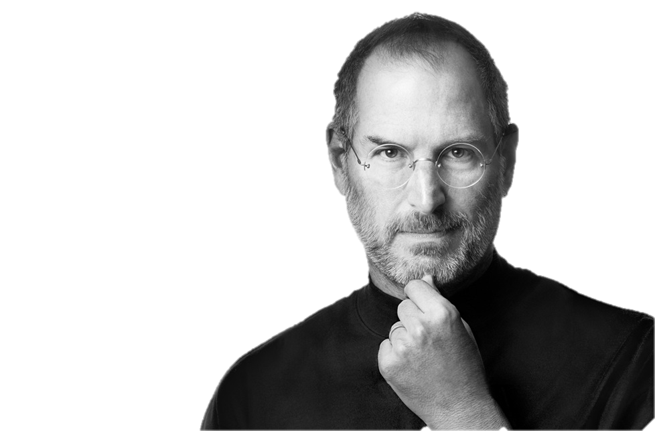
Let’s see an example from Steve Jobs
https://www.youtube.com/watch?v=9hUIxyE2Ns8

Slide 57
Quick discussion
What was good about his presentation?
Slide design?
Delivery?

