Slide 1
R – Data analysis and graphing
Clare Sutherland & Yong Zhi Foo
ARC Centre of Excellence in Cognition and its Disorders
School of Psychological Science, University of Western Australia

Slide 2
Download the materials here:
https://github.com/ClareSutherland/BasicR
Install psych and ggplot2 packages if you haven’t already:
> install.packages("psych")
> install.packages("ggplot2")
Check you can open R_workshop2.R script if you haven’t already

Slide 3

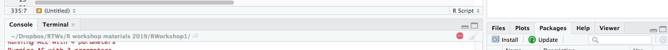


Reminder: common mistakes
Spelling mistakes – R is very picky!!!
Code is still running when you don’t want it to – press “esc” or the red button in the console (below) to stop
Plus sign appears and the code doesn’t run – there is a typo (e.g. you didn’t close brackets). Press “esc” to stop and start again.
Double check the script editor for errors:
Notes:
You can install a package in two ways; first by downloading using this code, or going into Tools> install.packages
Calling packages means that you only ever load code that you need to, so it’s faster
check data appears in the Environment tab of RStudio
View(data) will open it up so you can look at it

Slide 4

What will we cover today?
Descriptives
Analyses
Comparing means
Correlation
Data visualization
Boxplot
Scatterplot
Advanced script organization
RMarkdown

Slide 5
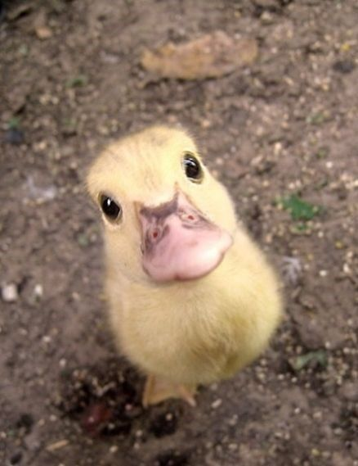
Duck categorisation continued…...
World-changing findings
Researchers discover how people categorise ducks!

Slide 6
Starting setup
> dir.name <- dirname(rstudioapi::getActiveDocumentContext()$path)
> setwd(dir.name)
> getwd()
Reminder from session 1: this piece of code will tell R to open files in the current folder
Reminder from session 1: library loads the script you need for your analysis (like opening a book)
> library(psych)
> library(ggplot2)
Notes:
list.files()
displays the files in your working directory. A good way to check whether you have entered the correct working directory

Slide 7
Load data
> DuckData <- read.csv("DuckGroups.csv", header = TRUE, na.strings = "")
> str(DuckData)
Reminder from session 1: arrow <- creates an object
na.strings identifies the missing/non-applicable values
str provides information about the variables (names/numbers and if they are factors)

Slide 8
Descriptive Stats
> describe(DuckData$DuckCategPerform)
> describeBy(DuckData$DuckCategPerform, group = DuckData$Group)
> describeBy(DuckData$DuckCategPerform, group = DuckData$Group, mat = TRUE)
describeBy allows you to compute the descriptives for individual groups in a between-subject variable
mat function set to TRUE lets you organize your descriptive statistics in a matrix format - easier if you want to export your results as a table.

Slide 9
Descriptive Stats
> describe(DuckData$DuckCategPerform)
> describeBy(DuckData$DuckCategPerform, group = DuckData$Group)
> describeBy(DuckData$DuckCategPerform, group = DuckData$Group, mat = TRUE)
Test yourself!!!
Write the code to generate the descriptive statistics for phobia scores, by Group
> describeBy(DuckData$Phobiascore, group = DuckData$Group, mat = TRUE)

Slide 10
T-test
Do our Groups differ in their categorisation performance?
> t.test(DuckCategPerform ~ Group, data = DuckData, var.equal = TRUE)
~ denotes the relationship between variables in the form of a formula (e.g. criterion ~ predictor)
var.equal refers to whether the variances for the groups are equal (you need to run Levene’s test separately)
If var.equal = FALSE, the function will correct for unequal variance (FALSE is also the default if you don’t specify anything)
Specify a paired t-test by including: paired = TRUE (default is between-subjects)
Notes:
Code to run a Levene’s test:

Slide 11
Correlation & regression
Remember how to subset dataset by rows?
> DuckPhobicPeople <- DuckData[DuckData$Group == ("DuckPhobic"),]
Is phobia score correlated with categorisation performance in duck phobic people?
> cor.test(DuckPhobicPeople$DuckCategPerform, DuckPhobicPeople$Phobiascore, method = "pearson")
Does phobia score predict categorisation performance in duck phobic people?
> regresults <- lm(DuckCategPerform ~ Phobiascore, data = DuckPhobicPeople)
> summary(regresults)
Notes:
We have to first select the duck phobic people only, because they have a phobic score (the non-phobic people don’t)
correlation is just one line of code, but regression has two, because you first run the model and THEN you ask for a summary of the model

Slide 12
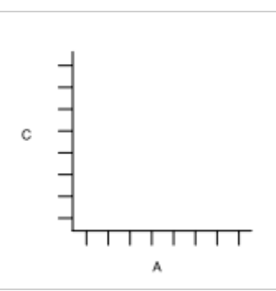
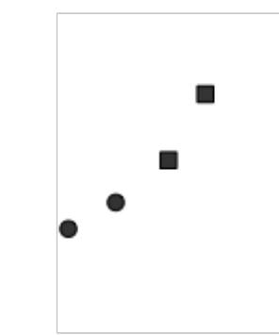
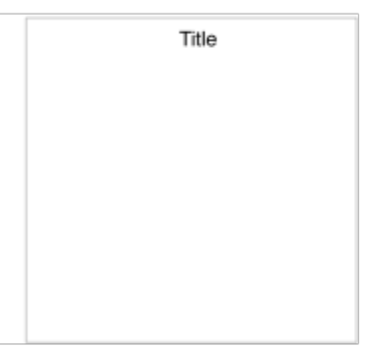
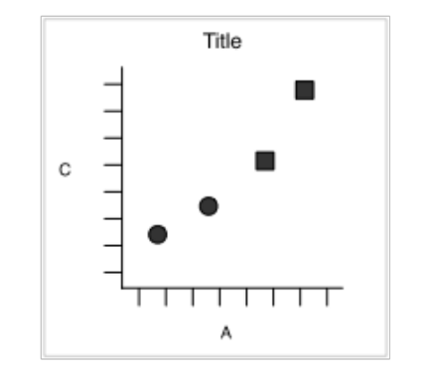
Graphing using ggplot2
ggplot2 – A graphing system based on describing the components of a graphic
+
+
=
Coordinate
System
Geometric
Objects
Title and labels
Voila!
Data source and which data in which axis
+
Objects in the graph e.g. scatterplot, boxplot, etc
+
Labels

Slide 13
Graphs
Boxplots for Group differences in categorisation performance:
> ggplot(DuckData, aes(Group,DuckCategPerform)) + geom_boxplot()
+ xlab("Duck Phobia Group") + ylab("Categorisation Performance")
Scatterplot for relationship between categorisation performance and phobia score in duck phobic people:
> ggplot(DuckPhobicPeople, aes(DuckCategPerform, Phobiascore)) + geom_point() + xlab("Categorisation score") + ylab("Phobia Score")

Slide 14
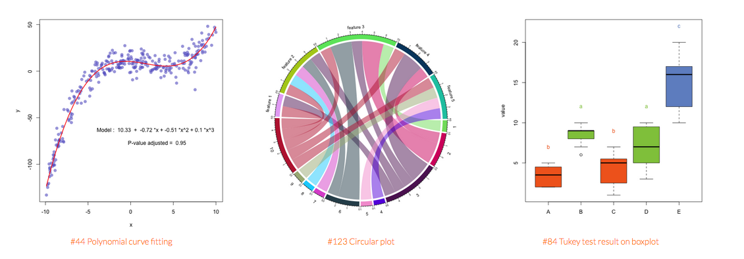
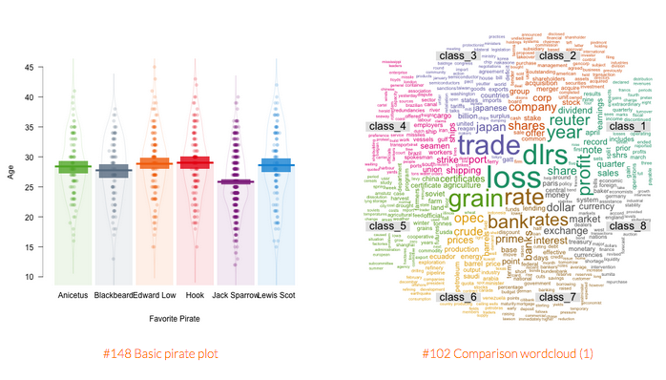
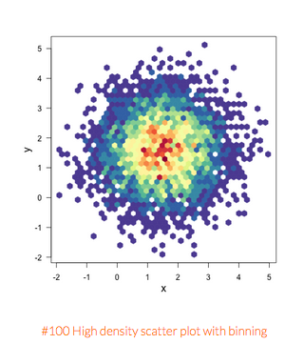
www.r-graph-gallery.com/

Slide 15
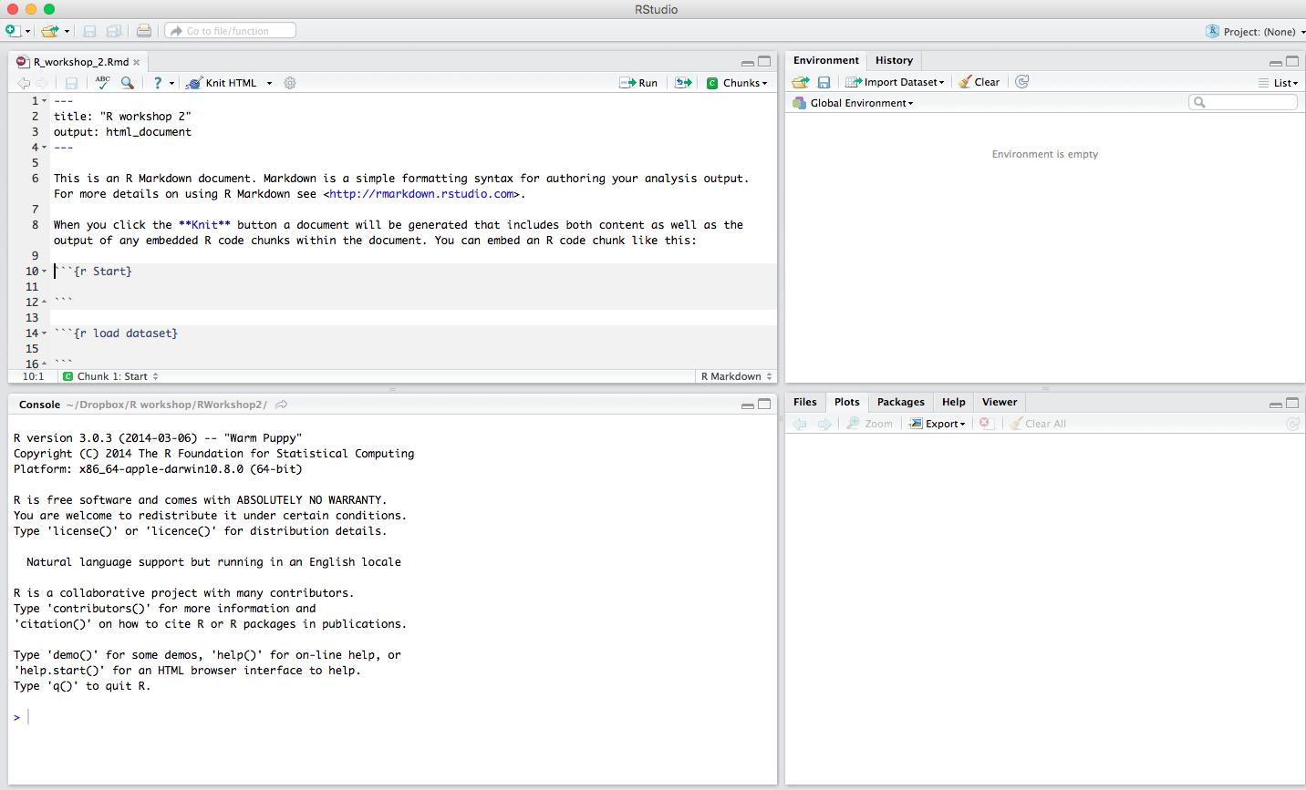
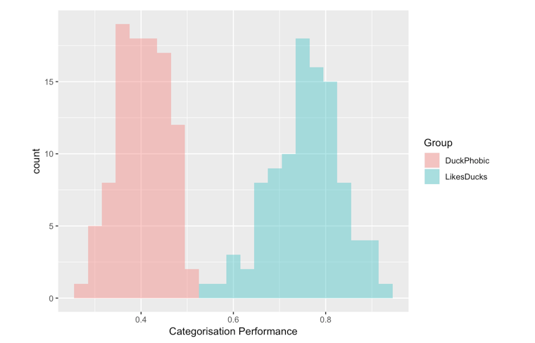
R Markdown
> install.packages("rmarkdown")
Notes:
Install/packages

Slide 16
Section begins
Section ends
Click here to jump to the section that you want

Slide 17
Rounding up
Descriptives
Analyses
Between subjects t-test
Correlation & regression
Data visualization
Boxplot
Scatterplot
Advanced script organization
RMarkdown

Slide 18

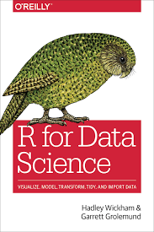

Useful resources
Packages used:
  pwr (Power analysis)
  psych (Statistical analyses)
  ggplot2 (Graphing)
Other useful packages/functions:
  dpylr & tidyr (data formatting)
  aov (Analysis of variance)
  nlme/lme4 (For advanced linear models)
Further help:
  Work through a textbook
  Rblogger
  Stackoverflow
  Google (our best friend!!)
  Ask a friend (buy them a coffee/beer!)

