Slide 1
legible-slides
Readable from the back row, and for every pair of eyes.
Yongbo Yu
KU Leuven · Research Centre for Information Systems Engineering

Slide 2
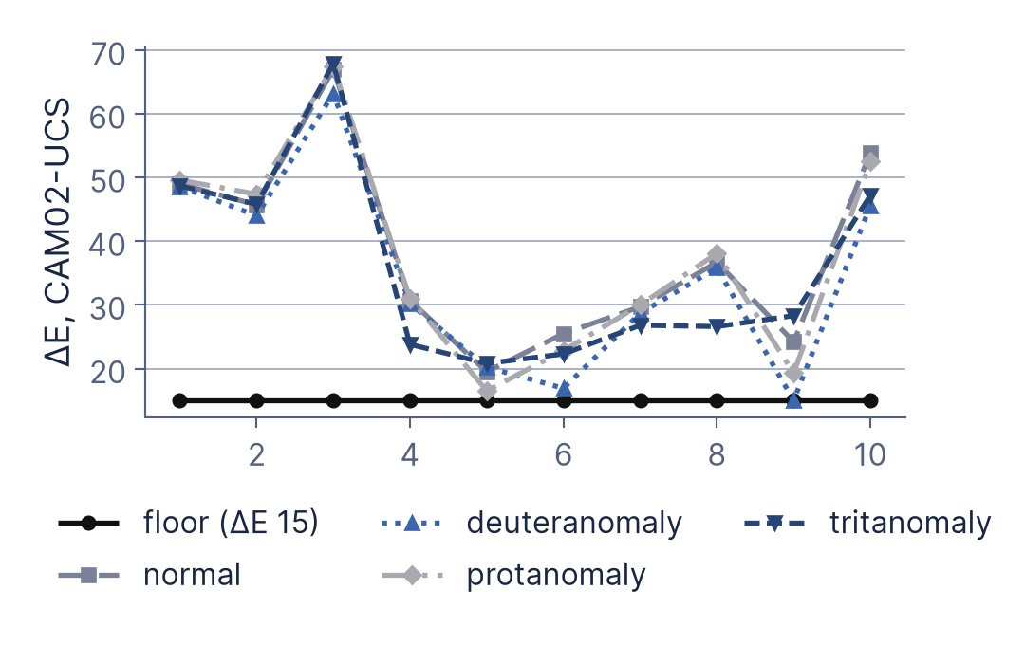
If a colour dies under colour-blindness or in grayscale, it is not in the palette.
The theme's ten pairs of data colours under deuteranomaly, the condition that binds this palette: the closest pair lands on 15.0, exactly the floor.¹

Slide 3
The headline is the claim, not a label.
A label
Results
A claim
Three series pass, and a fourth would fail without retuning.
Someone who reads only this knows the slide is about results, and knows nothing.
Someone who reads only this already has the finding, and the slide has only to prove it². Eight to fourteen words is the band, and two rendered lines is the ceiling this headline is sitting inside.

Slide 4
Every claim these slides make came from somewhere, and here is where.
Machado, Oliveira and Fernandes (2009) — Simulation of colour vision deficiency, IEEE TVCG
Alley, Schreiber, Ramsdell and Muffo (2006) — How headline design affects retention

