Slide 1
OOP_Project #1
Student Information Management System

Slide 2
Team Member
이승규 - develop & Presenter
김용덕 - develop
권용한 - develop
김찬경 - report & PPT
김효연 - report & PPT

Slide 3
INDEX
01
02
03
04
05
Project Description
SW System Design (UML Diagram)
Implement & Description
OOP Concept in our Program
Execution

Slide 4
Project Description
Simply

Slide 5
Project Description
Student Management System
Manage name, department, tel, student_id, birth_year, total_credit, total_avg information
Overview
Student.h + Student.cpp - student class definition + function implementation
Student_DB.h + Student_DB.cpp - DB class definition + function implementation
a.cpp - main
file1.txt – txt file for program maintain
Made by Visual Studio Compiler in Windows Environment

Slide 6
Main Function
Insert
Search
+ Display all
+ Modify
Sort
Exit

Slide 7
Additional Function & Variables
using operator
modify function
total_credit, total_avg variables
total_credit, total_avg search
total_credit, total_avg sort
ascending order, descending order

Slide 8
SW System Design
(UML Diagram)

Slide 9
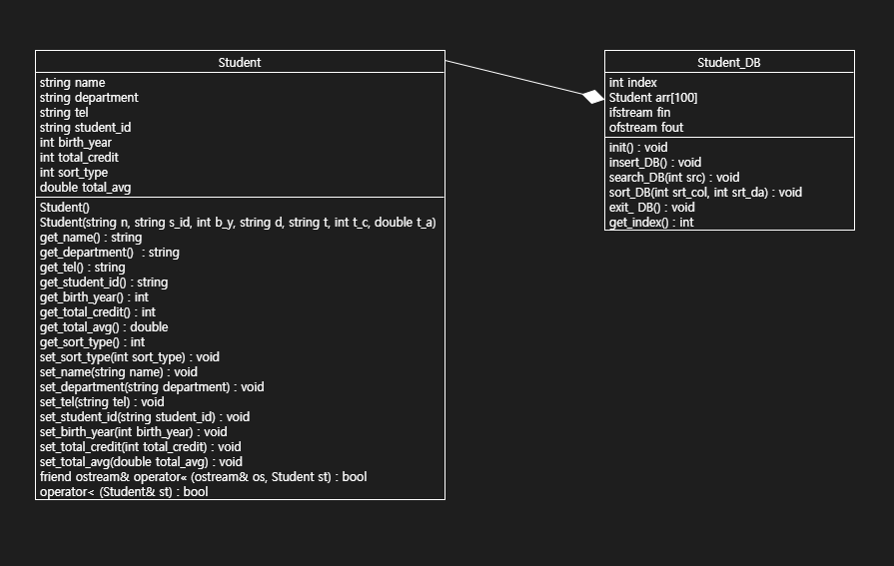
UML Diagram (class diagram)

Slide 10
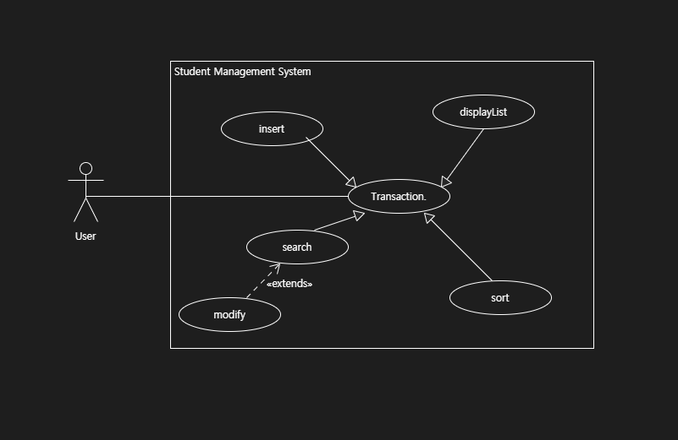
UML Diagram (use-case diagram)

Slide 11
Project Description
Implement & Description
Detail

Slide 12
Additional Function & Variables
using operator
modify function
total_credit, total_avg variables
total_credit, total_avg search
total_credit, total_avg sort
ascending order, descending order

Slide 13
Student.h Student class member variables :
String name, department, tel, student_id
int birth_year, total_credit, sort_type
double total_avg

Slide 14
Student.h constructor

Slide 15

Student.h getter
get_name
get_department
get_tel
get_student_id
get_birth_year
get_total_credit
get total_avg
get_sort_type

Slide 16

Student.h setter
set_sort_type
set_name
set_department
set_tel
set_student_id
set_birth_year
set_total_credit
set_total_avg

Slide 17
Student.cpp ostream& operator<< (ostream& os, Student st)
Define friend keyword to access private member variables
setw(n): Sets the field width to be used on output operations
ex) setw(3) << n // Output: 00n, 00 is blank
left : left side sort

Slide 18
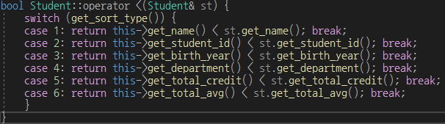
Student.cpp bool Student::operator <(Student& st)
Implement operation overload for convenient sorting
Ex) if sort_type==1, we can use sort() function as comparing name function

Slide 19
Student_DB.h Student_DB class member variables :
private :
int index
Student arr[100]
public :
ifstream fin
ofstream fout

Slide 20

Student_DB.h int get_index()

Slide 21
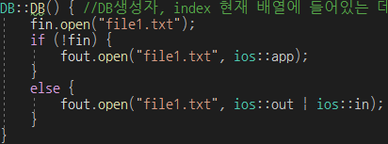
Student_DB.cpp constructor
if file1.txt exists then open, otherwise create the file1.txt

Slide 22
Student_DB.cpp void DB::init()
if, file1.txt exists, read every line in file1.txt
read line by line and then using substr() to divide information and store the divided information to each member variables
ex) KimHyoYeon 2018123456 Computer science
name = KimHyoYeon / stu_id = 2018123456 / department = Computer science
If there is blank(two times in a row) at the moment of storing, delete the blank
ex) name000 -> name, 000 is blank
At the moment of storing, convert to each data type, and store the data
Using stored information, store the student Object at arr[index]

Slide 23
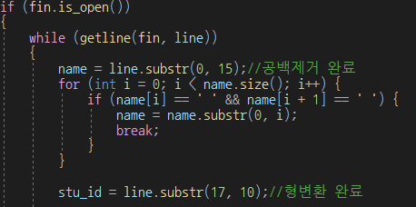
Student_DB.cpp void DB::init()

Slide 24
Student_DB.cpp void DB::insert_DB()
Insert each value and store the value at member variables
Insert in order of name, student_id, birth_year, department, tel, total_credit, total_avg
Check if there is same value stored when insert student_id, tel
Using checker variable to check repetition, if checker==1, there is same value
The length of student_id should be exactly 10 digits, if not insert until it becomes 10 digits
The length of tel should be exactly 12 digits, if not insert until it becomes 12 digits
cin.ignore() is used to delete getline’s linefeed
Insert total_credit range of 0 to 120, insert until it gets proper value
Insert total_avg range of 0.0 to 4.5, insert until it gets proper value
Using stored information, store the student Object at arr[index]
Store arr[index] at file1.txt

Slide 25
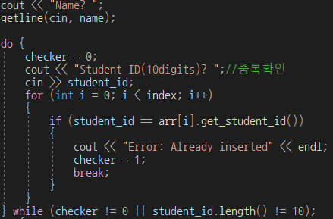
Student_DB.cpp void DB::insert_DB()

Slide 26
Student_DB.cpp void DB::search_DB(int src)
Get input src and the use switch function to move to proper menu
if src==1, using name to search, get name and compare the name with Student Object names stored at arr. If there is same name, print student information, otherwise print error message
if src==2, using Student ID to search, get ID and compare the ID with Student Object IDs stored at arr. If there is same ID, print student information, otherwise print error message
when using Student ID to search, you can modify student information. You could choose by Y or N. if Y is selected, you can modify data by selecting(using switch function) variable(ex. name)
if src==3, search using birth_year
if src==4, search using department
if src==5, search using total_credit, get range and print the student information at that range
if src==6, search using total_avg, get range and print the student information at thatrange
if src==7, print every student information
if src is inserted improperly, print error message

Slide 27
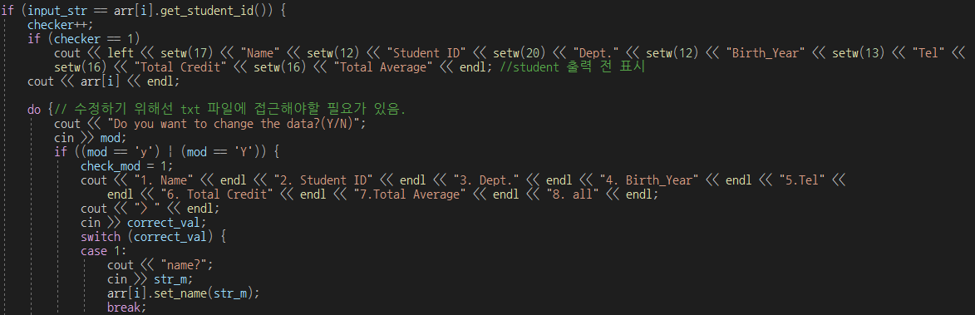
Student_DB.cpp void DB::search_DB(int src)

Slide 28
Student_DB.cpp void DB::sort_DB(int sort_type, int direction)
set all arr’s sort_type
if direction==1, ascending order, if direction==2, descending order
execute sort according to sort_type and direction
To prevent errors(if you do "sort" several times or if a file is newly created) that may occur, close the file and reopen it
Initialize the file pointer to the beginning.
Based on the newly arranged information, overwrite the file

Slide 29
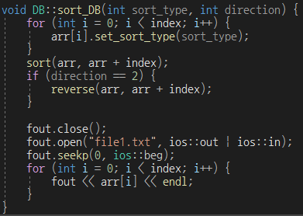
Student_DB.cpp void DB::sort_DB(int sort_type, int direction)

Slide 30

Student_DB.cpp void DB::exit_DB()
fin, fout close (close the file)

Slide 31
a.cpp(main) variables :
DB data_base
int menu, search, index, sort_type = 1, direction = 1

Slide 32
a.cpp(main) sequence :
data_base.init()
read information of file1.txt
while()
automatically execute sort_DB(int sort_type, int direction)
display menu and get input(menu)
>> if menu==1, execute insert_DB()
>> if menu==2, execute search_DB(search) + display + modify
>> if menu==3, change sort_type, direction
>> if menu==4, execute exit_DB(), End of the program

Slide 33
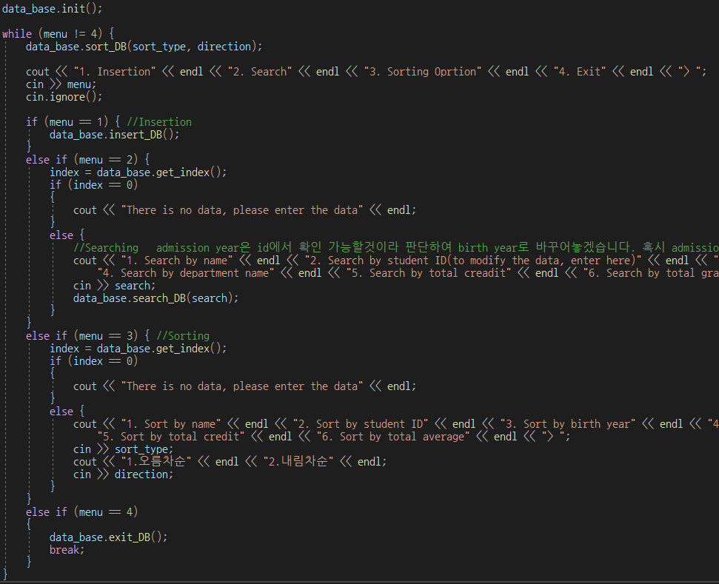

Slide 34
OOP concepts in our program
We create Student class, Student DB class and DB class use Student class for operation
By using setter, getter function, we can access to Student class private member variables
By using ‘friend’, we directly access to Student class member variables using operator(<<)
In position of users, they do not need to know how our program operate when they use our program. They can just input the menu and value to use our program
5. By using operator, we give polymorphism to our sorting operation

Slide 35
Execution

Slide 36
Thanks

