Slide 1
Special PU
Review

Slide 2
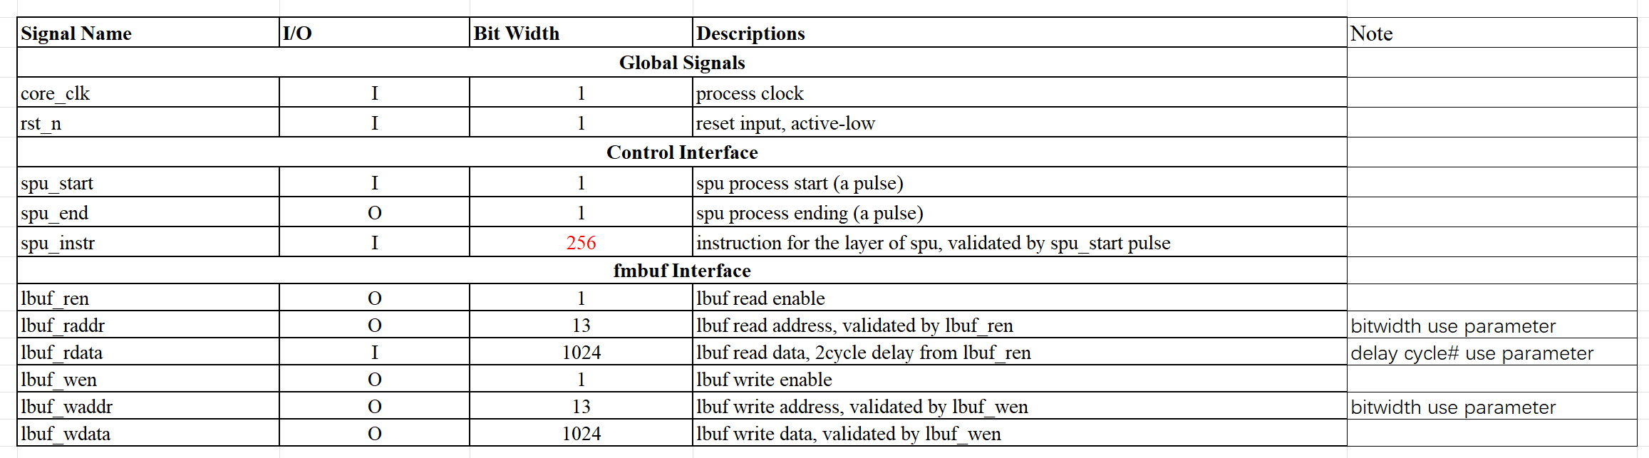

Slide 3
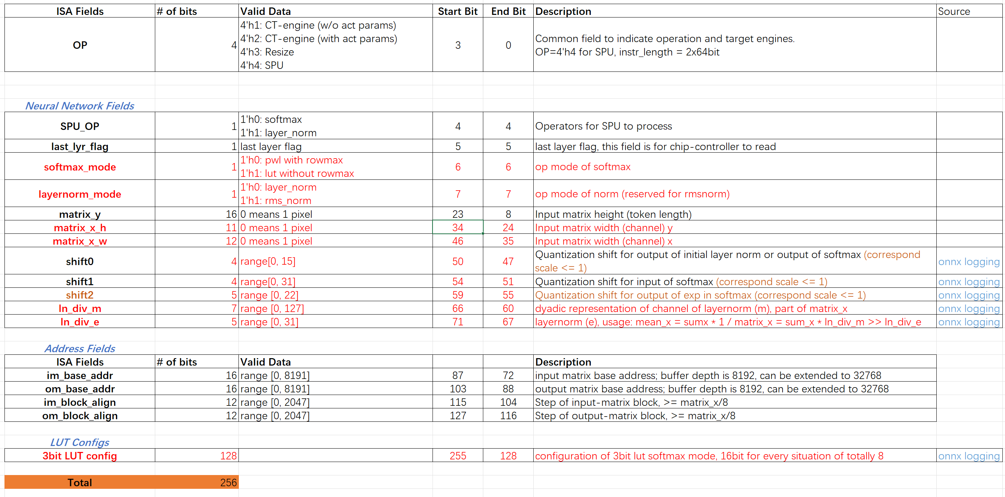

Slide 4
Process_time = f(SPU_OP, input_size, parallelism, rd_latency)
= f(op (SPU_OP), [y (matrix_y), x (matrix_x)] , [y_p (token parallelism), x_p (channel parallelism)], r (rd_latency))
SoftMax := 1 + 28×y/ y_p + (3×y/ y_p)×(x/ x_p -1) + (y_p /16)×(r-2) [pwl mode]
SoftMax := 1 + 25×y/ y_p + (2×y/ y_p)×(x/ x_p -1) + (y_p /16)×(r-2) [lut mode]
LayerNorm := 1 + 37×y/ y_p + (2×y/ y_p)×(x/ x_p -1) + (y_p /16)×(r-2)
SoftMax := 1 + 28×y/16 + (3×y/16)×(x/8 -1) + (y/16)×(r-2), [pwl mode] when [y_p, x_p] = [16, 8]
SoftMax := 1 + 25×y/16 + (2×y/16)×(x/8 -1) + (y/16)×(r-2), [lut mode] when [y_p, x_p] = [16, 8]
LayerNorm := 1 + 37×y/16 + (2×y/16)×(x/8 -1) + (y/16)×(r-2), when [y_p, x_p] = [16, 8]
Noted that the matrix_x should be the value after padding if needed. For example, matrix_x composes of matrix_x_h and matrix_x_w due to transpose. Then, they should be padded to a multiple of 4, so matrix_x should be change if needed.

