Slide 1
Docker Cluster
한국정보교육원
[클라우드 데브옵스(DevOps) 엔지니어 및 관리자 양성과정]
박용진

Slide 2
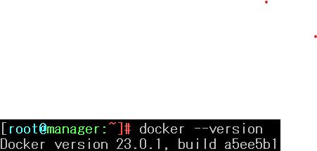


Docker Swarm Cluster
Manager, worker(1~2) – Version

Slide 3
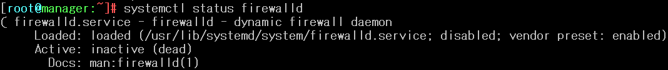
Docker Swarm Cluster
Linux Firewall ( disable , stop )

Slide 4
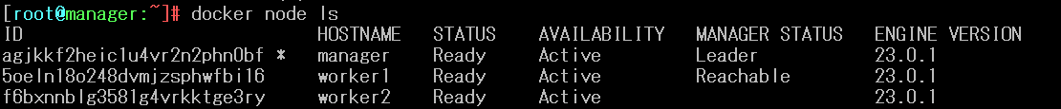
Docker Swarm Cluster
Clustering

Slide 5
Docker Service
Nginx Reserve Memory 100M, Limit Memory 120M, Apache volume mount, Replicas = 3
Apache Reserve Memory 100M, Limit Memory 200M, Nginx volume mount, Replicas = 3

Slide 6
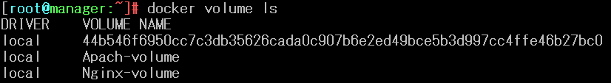
Docker Service
Apache Volume, Nginx Volume

Slide 7

Docker Service
Replica

Slide 8
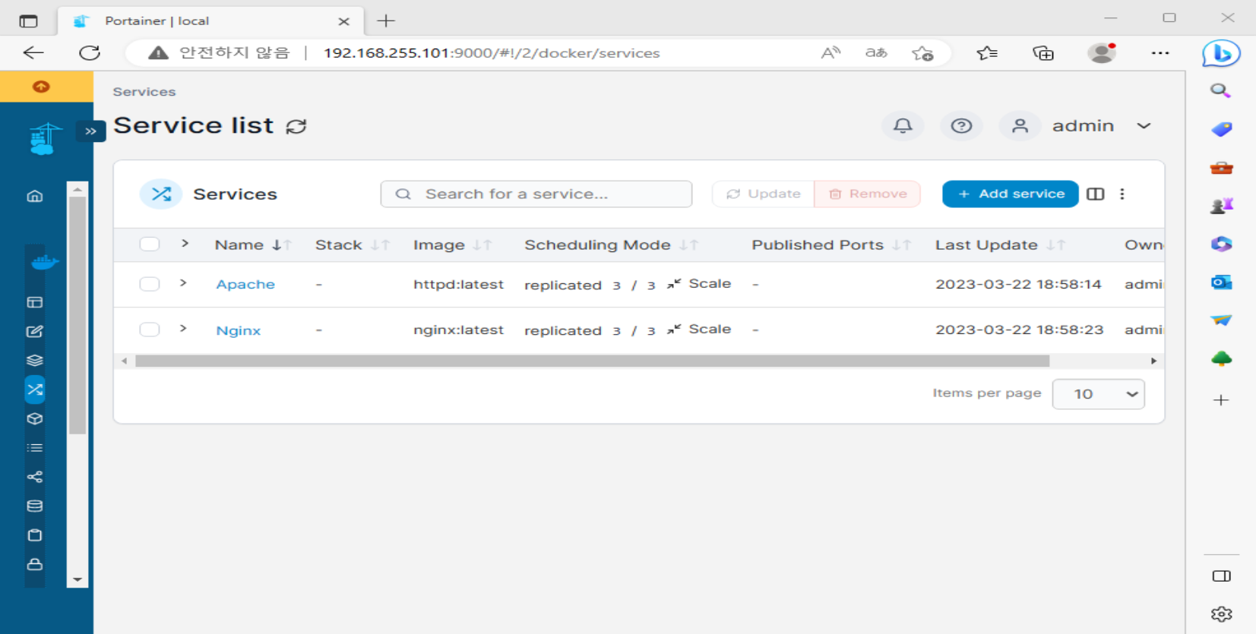
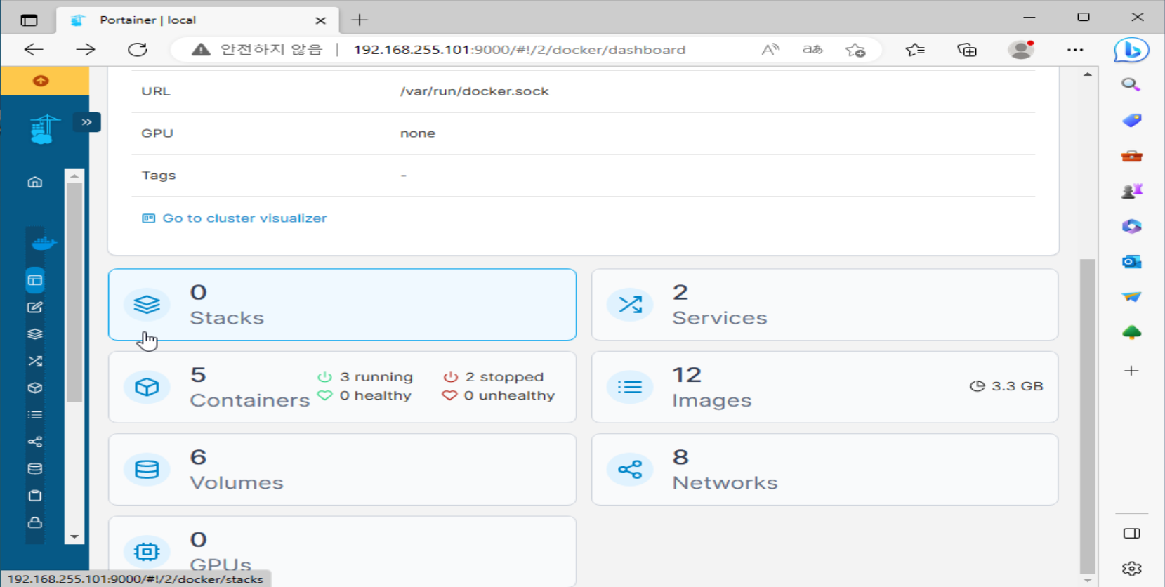
Portainer

