Slide 1
Stack1

Slide 2
Table of Contents
Stack
Stack
Stack Application 1: parentheses test
Stack Application 2 Function call
Recursive call
Memoization
DP
DFS
Practice 1,2,3

Slide 3

Stack
Characteristics of Stack
A stack is a data structure in the shape of stacked data like mounds of objects.
Data saved in a stack have linear structure.
Linear structure: the relations between data have 1:1 relations.
Nonlinear structure: the relations between data have 1:N. relations(ex. Tree)
Data can be inserted into or drawn out from a stack.
The last element added to the structure must be the first one to be removed, which is called LIFO ( Last-In-First-Out).
For example, if data are drawn out from a stack
after being inserted into a stack in the 1st, 2nd and 3rd order, the data can be drawn out in reverse order, namely
the 3rd, 2nd, and 1st order.

Slide 4
Implementation of Stacks
Data structure and operations required to implement stacks in a program
Data structure: a repository to store data linearly
Array can be used in the C language.
Sometimes the repository itself is called a stack.
The position of the lastly inserted element in a stack is called the ‘top’ of the stack
Operations
Insertion: save data in the storing place, which is normally called ‘push’.
Deletion: draw out data from the storing place. The data are drawn out in reverse order of the inserted data, which is called ‘pop’.
An operation to check whether the stack is empty or not. isEmpty
An operation to return the items (elements) on the top of the stack. peek

Slide 5
Insertion/Deletion process of stacks
An operation process to delete once after inserting elements A, B and C in an empty stack in order
A
B
C
C
push A
push B
push C
pop
A
B
A
C
B
A
B
A
top
top
top
top
top
Empty Stack

Slide 6
Push algorithm for Stack
The ‘top’ indicates the position of the last data in a stack.
push(s, x)
top ← top + 1;
if (top > stack_size) then
overflow;
else
s(top) ← x;
end push()

Slide 7
Pop algorithm for Stack
pop(s)
if (top = 0) then underflow;
else
{
return s(top);
top ← top – 1;
}
end pop()

Slide 8

Exercise 1
Let’s implement stacks
Using the implemented stacks, save three data in a stack, draw out three times and print out.
Notes:
int stack[100];
int top= -1; // Stack의 top의 초기값을-1로 설정
void push(int item)
{
if(top >= 99) return;
else stack[++top]=item;
}
int pop()
{
if(top==-1) { // 현재 Stack이 공백인 경우
printf("Stack is Empty!!\n");
return 0;
}
else return stack[top--];
}
void main(void)
{
int item;
push(1);
push(2);
push(3);
item = pop();
printf("pop item => %d\n", item);
item = pop();
printf("pop item => %d\n", item);
item = pop();
printf("pop item => %d\n", item);
}

Slide 9

Considerations for stack implementation
If a stack is implemented using 1D array, it has a strength that it is easy to implement but also has a weakness that it is hard to change the size of stacks.
To solve this problem, there is a method to implement stacks by dynamically allocating the storing place. This means the method to implement stacks using the dynamic connection list. Although this has a shortcoming that implementation is complicated, it also has a merit that the method uses memory efficiently. The dynamic implementation of stacks is omitted.

Slide 10
Stack Application 1 : Parentheses test
Types of parentheses: a bracket (‘[’, ‘]’), a brace (‘{’, ‘}’), and parentheses (‘(’, ‘)’)
Conditions
The number of parentheses on the left-hand side and the number of parentheses on the right-hand side must be the same.
In same parentheses, parenthesis on the left has to come out before parenthesis on the right.
Only the inclusion relation exists between parentheses.
Examples of wrongly used parentheses
(a(b)
a(b)c)
a{b(c[d]e}f)

Slide 11
Parentheses test using stacks
if( ( i==0 ) && ( j==0 )
(
(
(
(
(
(
Compare through pop
(
(
(
Compare through pop
(
Error!
Parenthesis still remains in the stack even though the parenthesis modification is finished.

Slide 12
Overview of algorithm that tests parentheses
While testing the parentheses in strings in order, insert into a stack if a left parenthesis is met and test whether it is matched with the right parenthesis after deleting the top parenthesis if a right parenthesis is met.
If the stack is empty, it is against the condition 1 or 2 and if the pair of parentheses are not matched, it violates the condition 3.
If parentheses still remain in the stacks even after the last parenthesis is tested, it violates the condition 1.

Slide 13
Exercise 2
Let’s prepare a program that tests pair of parentheses.
Let’s test use of the following parentheses with the prepared program.
( )( )((( )))
((( )((((( )( )((( )( ))((( ))))))
Notes:
char stack[100]={0};
int top = -1;
void push(int item)
{
if(top >= 99) return;
else stack[++top]=item;
}
int pop()
{
if(top==-1) { // 현재 Stack이 공백인 경우
printf("Stack is Empty!!\n");
return 0;
}
else return stack[top--];
}
int is_empty()
{
if (top == -1) return 1;
else return 0;
}
int check_matching(char *in)
{
int i, n = strlen(in);
for (i = 0; i < n; i++) {
switch(in[i]){
case '(':
push(in[i]);
break;
case ')':
if(is_empty()) return 0;
pop();
break;
}
}
if(!is_empty()) return 0;
return 1;
}
int main()
{
if( check_matching("((( )((((( )( )((( )( ))((( ))))))") == 1 )
printf("parenthesis검사성공\n");
else
printf("parenthesis검사실패\n");
}

Slide 14
Recursion

Slide 15
Stack Application 2 : function call
Function call
Manages the performance sequence according to the function call and return in the program
As this is a LIFO (Last-In, First-Out) structure where the lastly called function completes first and returns, manage the performance sequence using stacks of the LIFO structure.
If a function call occurs, insert into a system stack by storing information such as local variables necessary for execution of the called function, parameters, the address to return to after execution and others in a stack frame.
When implementing the function is finished, while deleting(pop) the top element (stack frame) of the system stack, return after checking the return address saved in the frame.
According to the function call and return, the system stack becomes an empty stack when the entire program performance is finished by repeating the process.

Slide 16

The performance sequence of the entire program according to function call and return
main( )
F_1( )
F_2( )
F_1( )
end main( )
F_2( )
end F_1( )
end F_2( )
1
3
2
Function call
4
Function call
5
8
return
6
return
9
7
stack_Frame(F_2) F_2( ) info related to function performance
stack_Frame(F_1) F_1( ) info related to function performance
stack_Frame(main) main( ) info related to function performance
Top (function currently being performed)

Slide 17
Recursive call
Being circularly performed by calling itself
If a function is created using the recursive call method rather than the general call method according to the characteristics of a work to be performed in the function, the size of program can be reduced and prepared simply.
Examples of recursion call) factorial
Factorial of n: an operation obtained by multiplying all natural numbers from 1 to n
n! = n x (n-1)!
(n-1)! = (n-1) x (n-2)!
(n-2)! = (n-2) x (n-3)!
…
2! = 2 x 1!
1! = 1
Repeat processes to find the high value by using the low value obtained last.

Slide 18
Execution when n=4 in factorial function
fact(4)
fact(3)
fact(2)
fact(1)
4 Ⅹ fact(3)
1
call
3 Ⅹ fact(2)
2
call
2 Ⅹ fact(1)
2
call
return 1;
6
return 6
5
return 2
4
return 1
7
return 24

Slide 19

M.C. Escher’s “Drawing Hands”

Slide 20
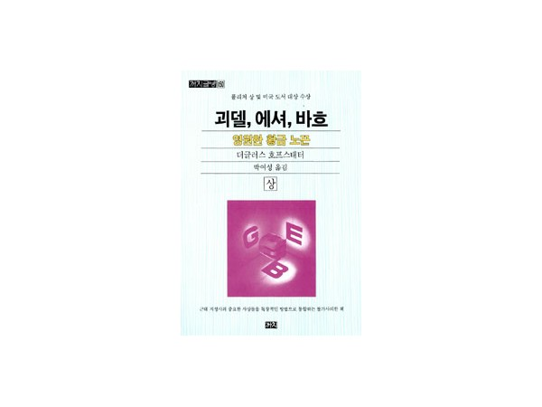



Gödel, Escher, Bach. Anniversary Edition:
Notes:
호프스태터는 <괴델, 에셔, 바흐>에 현대 수학자 괴델, 화가 에셔, 음악가 바흐라는 각 분야의 세계적인 거장들을 등장시키며 이들 사이의 공통점을 찾아 나섰다. 괴델의 정리, 에셔의 그림, 바흐의 음악은 다층 구조를 이루며 ‘이상한 고리’처럼 서로 엉켜 있다. 곧 가장 높은 층위는 가장 낮은 층위에 의해 규정되고, 다시금 가장 높은 층위가 가장 낮은 층위로 소급(지나간 일까지 거슬러 올라가서 미치게 함)되어 영향을 미치면서, 층위 사이에서 서로 상호 작용을 한다는 것이다. 이 엉킨 고리는 본래 그 자체에 역설적 측면을 내포하고 있다는 점에서 이상한 고리다. 결국 이 책의 요점은 ‘진리의 모순성’으로 모아진다

Slide 21
Recursion Example 1
Result
#include <stdio.h>
void recurse ( int count ) {
if(count==0) return;
printf(“Recursive Call %d\n", count );
recurse ( count - 1 );
}
int main() {
recurse ( 3 );
return 0;
}
Main()

Slide 22
Recursion Example 1
Result
#include <stdio.h>
void recurse ( int count ) {
if(count==0) return;
printf(" Recursive Call %d\n", count );
recurse ( count - 1 );
}
int main() {
recurse ( 3 );
return 0;
}
Recursive Call 3
Recursive Call 2
Recursive Call 1
Line 5
recurse(2)
Line 5
recurse(1)
Line 5
recurse(0)
Line 4
printf("", count );
Line 4
printf("", count );
Line 4
printf("", count );
Line 3
Line 3
Line 3
Line 3
Line 8
recurse(3)
Line 2
count
3
Line 2
count
2
Line 2
count
1
Line 2
count
0
R.A
OS
R.A
Line 9
R.A
Line 6
R.A
Line 6
R.A
Line 6
Main()
recurse(3)
recurse(2)
recurse(1)
recurse(0)

Slide 23
Recursion Example 2
#include <stdio.h>
void recurse ( int count )
{
if(count==0) return;
recurse ( count - 1 );
printf(" Recursive Call %d\n", count );
}
int main() {
recurse ( 3 );
return 0;
}
Result
Main()

Slide 24
Recursion Example 2
Result
#include <stdio.h>
void recurse ( int count ) {
if(count==0) return;
recurse ( count - 1 );
printf(" Recursive Call %d\n", count );
}
int main() {
recurse ( 3 );
return 0;
}
Recursive Call 1
Recursive Call 2
Recursive Call 3
Line 5
Printf(“’)
Line 5
Printf(“’)
Line 5
Printf(“’)
Line 4
recurse(2)
Line 4
recurse(1)
Line 4
recurse(0)
Line 3
Line 3
Line 3
Line 3
Line 8
recurse(3)
Line 2
count
3
Line 2
count
2
Line 2
count
1
Line 2
count
0
R.A
OS
R.A
Line 9
R.A
Line 5
R.A
Line 5
R.A
Line 5
Main()
recurse(3)
recurse(2)
recurse(1)
recurse(0)

Slide 25
Recursion Example 3
line | pins number | Total | formula
1 | 1 | 1 | 1
2 | 2
3 | 3
4 | 4
5 | 5
6 | 6
7 | 7
// BASE CASE
Triangle(n) = ;
Triangle(n) =

Slide 26
Recursion Example 3
line | pins number | Total | formula
1 | 1 | 1 | 1
2 | 2 | 3 | 2 + T(1)
3 | 3 | 6 | 3 + T(2)
4 | 4 | 10 | 4 + T(3)
5 | 5 | 15 | 5 + T(4)
6 | 6 | 21 | 6 + T(5)
7 | 7 | 28 | 7 + T(6)
1 If n = 1 // BASE CASE
Triangle(n) = n + Triangle(n -1); otherwise
Triangle(n) =

Slide 27
Recursion Example 4
rev_prt(“", 0, 2);
void rev_prt(char S[ ], int a, int b ) {
if (a > b) return;
else {
rev_prt (S, a+1, b);
printf("%c", S[a]);
}
}
Result
S[ ]
A | B | C | \n
b
a
S
R.A | Main
b
a
S
R.A
b
a
S
R.A
b
a
S
R.A
rev_prt(“ABC", 0, 2);
rev_prt(“ABC", __, __);
rev_prt(“ABC", __, __);
rev_prt(“ABC", __, __);

Slide 28
Recursion Example 4
void rev_prt(char S[ ], int a, int b ) {
if (a > b) return;
else {
rev_prt (S, a+1, b);
printf("%c", S[a]);
}
}
Result
C
B
A
S[ ]
A | B | C | \n
0 1 2
 | printf( S[0])
 | rev_prt (S, 1, 2)
b | 2
a | 0
S | 0x100
R.A | Main
 | printf( S[1])
 | rev_prt (S, 2, 2)
b | 2
a | 1
S | 0x100
R.A
 | printf( S[2])
 | rev_prt (S, 3, 2)
b | 2
a | 2
S | 0x100
R.A
b | 2
a | 3
S | 0x100
R.A
rev_prt(“ABC", 0, 2);
rev_prt(“ABC", __, __);
rev_prt(“ABC", __, __);
rev_prt(“ABC", __, __);

Slide 29
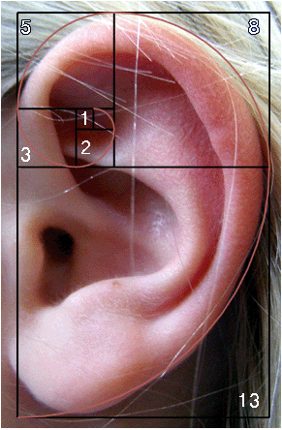
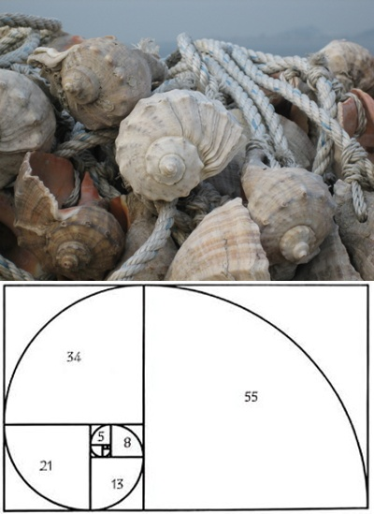

Fibonacci Number

Slide 30

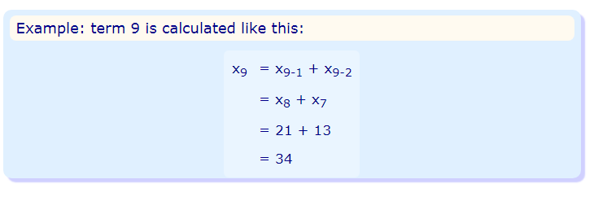
Fibonacci Number
The Rule is x_{n} = x_{n-1} + x_{n-2}
x_{n} is term number "n"
x_{n-1} is the previous term (n-1)
x_{n-2} is the term before that (n-2)

Slide 31
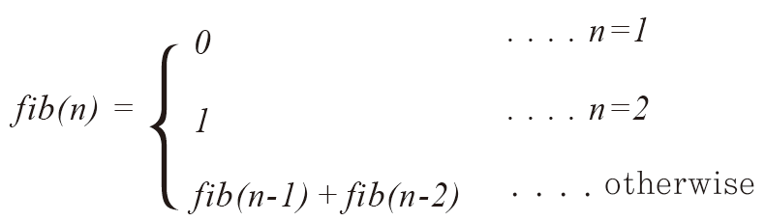
Fibonacci Number
The Rule is x_{n} = x_{n-1} + x_{n-2}

Slide 32
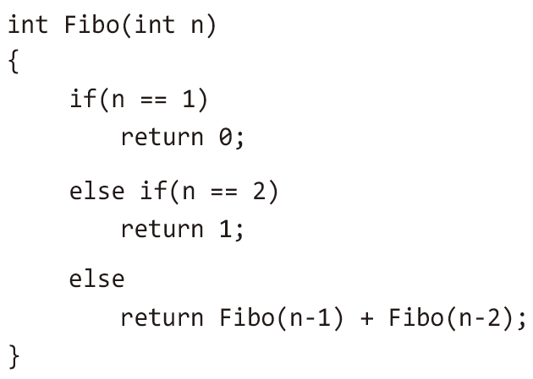
Fibonacci Number

Slide 33
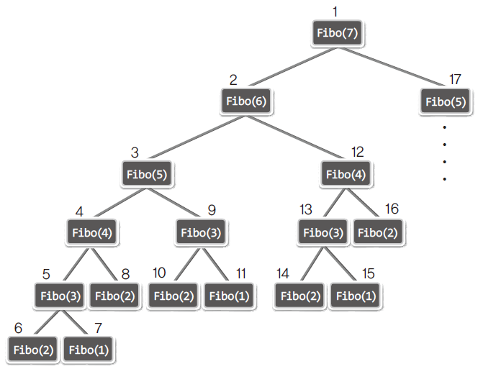
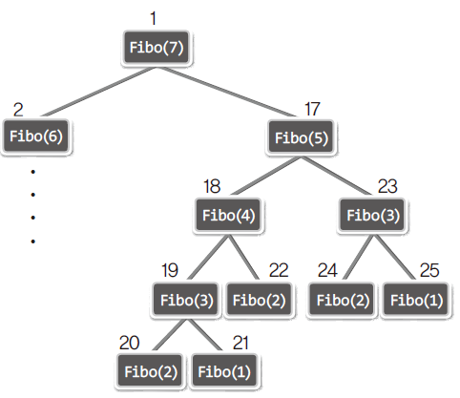
Fibonacci Number

Slide 34
Fibonacci Number : Iterative
int fib2 (int n)
{
index i;
int f[0..n];
f[0] = 0;
if (n > 0) {
f[1] = 1;
for (i = 2; i <= n; i++)
f[i] = f[i-1] + f[i-2];
}
return f[n];
}
T(n) = n + 1

Slide 35
Fibonacci Number : Recursive vs Iterative
n | n+1 | 2^{n/2} | Iterative | Recursive
40 | 41 | 1,048,576 | 41ns | 1048μs
60 | 61 | 1.1×10⁹ | 61ns | 1s
80 | 81 | 1.1×10¹² | 81ns | 18min
100 | 101 | 1.1×10¹⁵ | 101ns | 13days
120 | 121 | 1.2×10¹⁸ | 121ns | 36years
160 | 161 | 1.2×10²⁴ | 161ns | 3.8 ×10⁷years
200 | 201 | 1.3×10³⁰ | 201ns | 4 ×10¹³years

Slide 36
Hanoi Tower
Move n (3) disks from From to to
Move n-1 (2) disks from FROM to SPARE
Move 1 disk from FROM to TO
Move n-1 (2) disks from SPARE to TO
Alpha
Bravo
Charlie
From
Spare
TO

Slide 37
Hanoi Tower
Move n (3) disks from From to to
Move n-1 (2) disks from FROM to SPARE
Move 1 disk from FROM to TO
Move n-1 (2) disks from SPARE to TO
Charlie
Bravo
Alpha
From
Spare
TO

Slide 38
Hanoi Tower
Move n (3) disks from From to to
Move n-1 (2) disks from FROM to SPARE
Move 1 disk from FROM to TO
Move n-1 (2) disks from SPARE to TO
Alpha
Charlie
Bravo
From
Spare
TO

Slide 39
Hanoi towers
Move n (3) disks from From to to
Move n-1 (2) disks from FROM to SPARE
Move 1 disk from FROM to TO
Move n-1 (2) disks from SPARE to TO
Alpha
Bravo
Charlie
From
Spare
TO

Slide 40
Hanoi towers
Move n (3) disks from From to to
Move n-1 (2) disks from FROM to SPARE
Move 1 disk from FROM to TO
Move n-1 (2) disks from SPARE to TO
Bravo
Alpha
Charlie
From
Spare
TO

Slide 41
Hanoi towers
Move n (4) disks from FROM to TO
Move n-1 (3) disks from FROM to SPARE
Move 1 disk from FROM to TO
Move n-1 (3) disks from SPARE to TO
From
Spare
TO

Slide 42
Hanoi towers
def hanoi(n, ffrom, to, spare):
if n > 0:
hanoi(n-1, ffrom, spare, to)
print("%d번 원반을 %s에서 %s로 옮김" %(n, ffrom, to))
hanoi(n-1, spare, to, ffrom)
print("원반의 갯수 : ")
n = int(input())
hanoi(n, 'from', 'to' , 'spare' )
A
from
B
to
C
spare

Slide 43
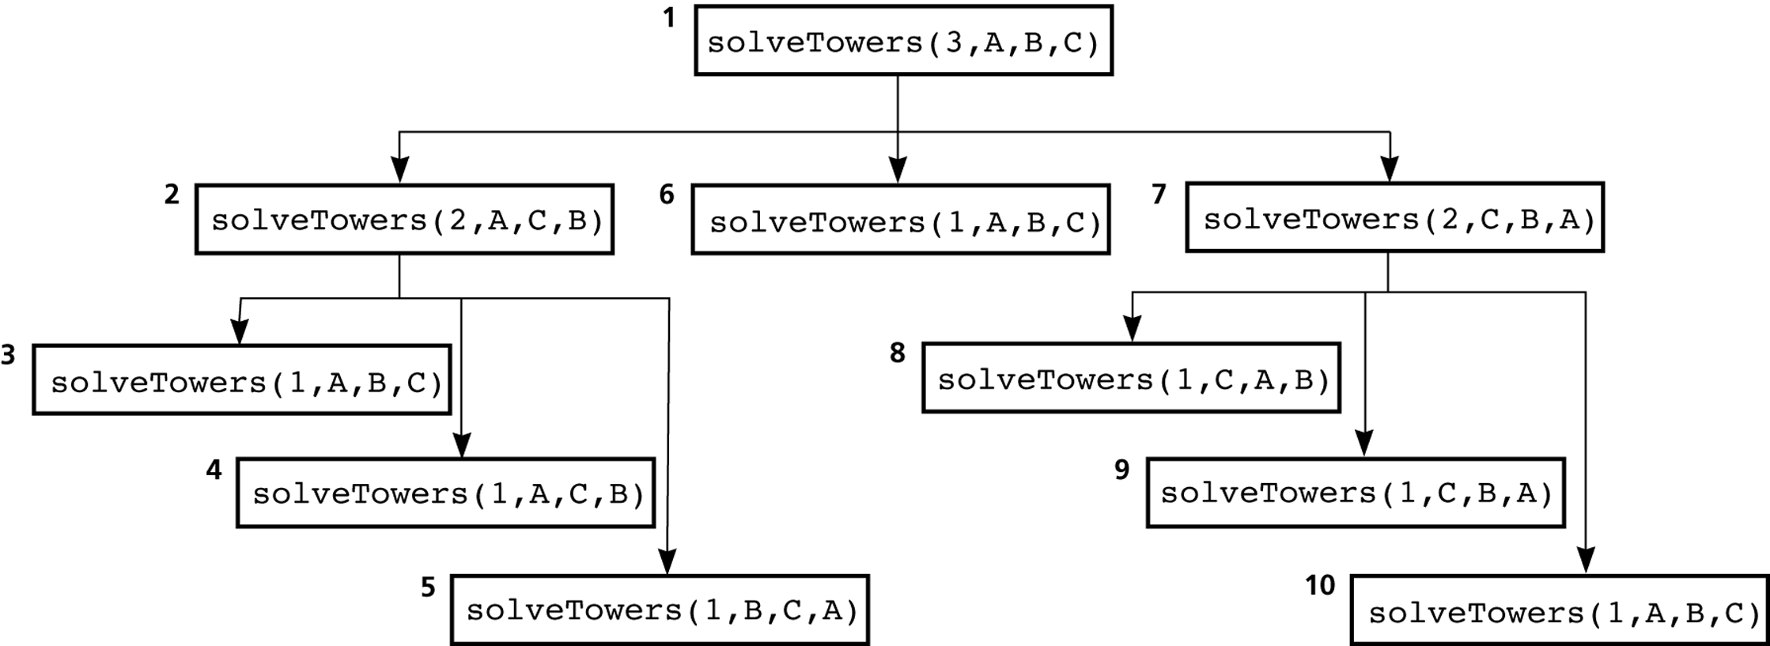
Hanoi towers
Recursion tree:
The order of recursive calls that results from solveTowers(3,A,B,C)
A
B
C

Slide 44

Exercise1 Going up the Stairs
Gildong tries to climb n steps.
Gildong can climb first or second steps at a time, depending on the mood as he goes up the stairs.
When the height n of the stairs is given, write a program to find the number of cases in which Gildong can climb this step.
If there are three stairs, Gildong will go up 1, 1, 1, or 1,2 or 2, 1.
There are three different ways to get up to.
Input
Number of stairs n is entered (only n is a natural number less than 20).
Output
Gil-Dong prints out all the ways to climb the stairs.
Input Output
3 3

Slide 45
계단오르기
Here = 0
1
2
2
3
3
4
Here== n
Ans++
Here== n
Ans++
Here > n
3
4
Here== n
Ans++
Here > n

Slide 46
연습문제 3
다음은 연결되어 있는 두 개의 정점 사이의 간선을 순서대로 나열 해 놓은 것이다. 모든 정점을 깊이 우선 탐색하여 화면에 깊이 우선 탐색 경로를 출력하시오. 시작 정점을 1로 하시오
Input : 1 2 1 3 2 4 2 5 4 6 5 6 6 7 3 7
Output : 1 2 4 6 5 7 3
1
2
3
4
5
6
7

Slide 47
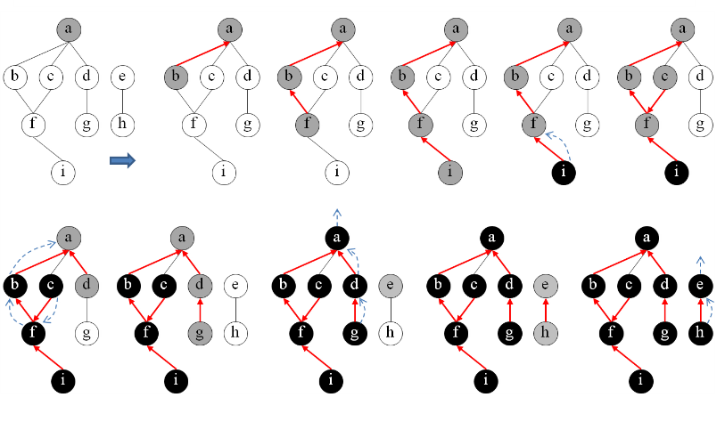
DFS - 예

Slide 48
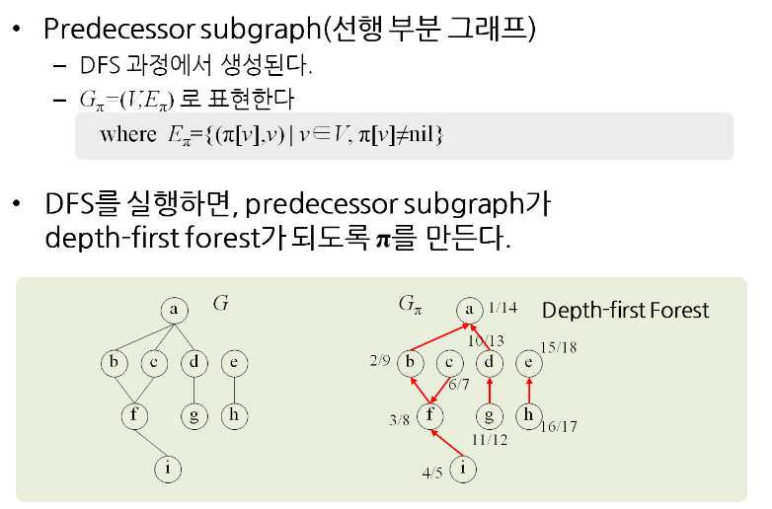
Depth First Forest

Slide 49
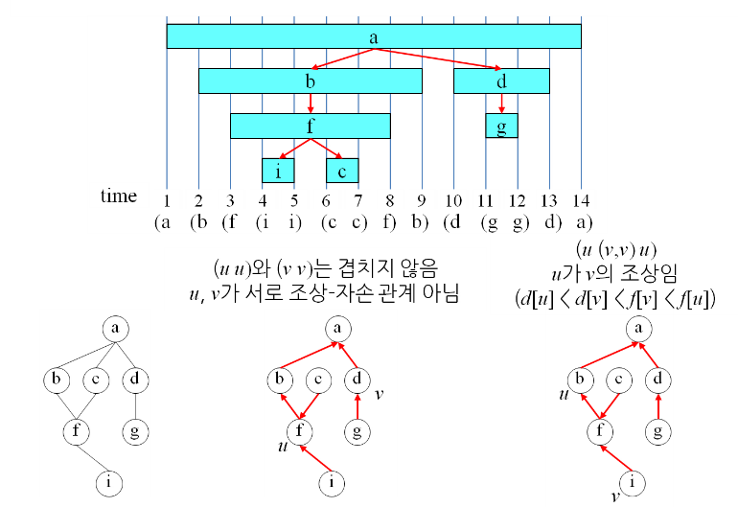
Parenthesis Theorem - 그림

Slide 50
Preprocessing 1
1 2 1 3 2 4 2 5 4 6 5 6 6 7 3 7
 | 0 | 1 | 2 | 3 | 4 | 5 | 6 | 7
0
1 |  |  | 1 | 1
2 |  | 1 |  |  | 1 | 1
3 |  | 1 |  |  |  |  |  | 1
4 |  |  | 1 |  |  | 1 | 1
5 |  |  | 1 |  | 1 |  | 1
6 |  |  |  |  |  | 1 |  | 1
7 |  |  |  | 1 |  |  | 1
Data = list(map(int,input().split()))
for i in range(howmany):
Start= Data[i*2]
Stop = Data[i*2+1]
MyMap[Start][Stop] = 1
MyMap[Stop][Start] = 1

Slide 51
Preprocessing 2
1 2 1 3 2 4 2 5 4 6 5 6 6 7 3 7
MyMap
 | 0 | 1 | 2 | 3 | 4 | 5 | 6 | 7
0
1 |  |  | 1 | 1
2 |  | 1 |  |  | 1 | 1
3 |  | 1 |  |  |  |  |  | 1
4 |  |  | 1 |  |  |  | 1
5 |  |  | 1 |  |  |  | 1
6 |  |  |  |  | 1 | 1 |  | 1
7 |  |  |  | 1 |  |  | 1
1
2
3
4
5
6
7
visited
0 | 1 | 2 | 3 | 4 | 5 | 6 | 7

Slide 52
Simulation here = 1
MyMap
 | 0 | 1 | 2 | 3 | 4 | 5 | 6 | 7
0
1 |  |  | 1 | 1
2 |  | 1 |  |  | 1 | 1
3 |  | 1 |  |  |  |  |  | 1
4 |  |  | 1 |  |  |  | 1
5 |  |  | 1 |  |  |  | 1
6 |  |  |  |  | 1 | 1 |  | 1
7 |  |  |  | 1 |  |  | 1
1
2
3
4
5
visited
6
7
0 | 1 | 2 | 3 | 4 | 5 | 6 | 7
T
1

Slide 53
Simulation here = 2
MyMap
 | 0 | 1 | 2 | 3 | 4 | 5 | 6 | 7
0
1 |  |  | 1 | 1
2 |  | 1 |  |  | 1 | 1
3 |  | 1 |  |  |  |  |  | 1
4 |  |  | 1 |  |  |  | 1
5 |  |  | 1 |  |  |  | 1
6 |  |  |  |  | 1 | 1 |  | 1
7 |  |  |  | 1 |  |  | 1
1
2
3
4
5
visited
6
7
0 | 1 | 2 | 3 | 4 | 5 | 6 | 7
 | T
T
1
2

Slide 54
Simulation here = 4
MyMap
 | 0 | 1 | 2 | 3 | 4 | 5 | 6 | 7
0
1 |  |  | 1 | 1
2 |  | 1 |  |  | 1 | 1
3 |  | 1 |  |  |  |  |  | 1
4 |  |  | 1 |  |  |  | 1
5 |  |  | 1 |  |  |  | 1
6 |  |  |  |  | 1 | 1 |  | 1
7 |  |  |  | 1 |  |  | 1
1
2
3
4
5
visited
6
7
0 | 1 | 2 | 3 | 4 | 5 | 6 | 7
 | T | T
T
1 2
4

Slide 55
DFS(1)
def DFS(here):
print(here)
Visited[here] = True
for next in range(8):
if MyMap[here][next] and not visited[next]:
DFS(next)

