Slide 1
Determining Key Factors Contributing to Employee Attrition and Job Salary by Machine Learning
Yongjun Chu
April 17, 2019

Slide 2
Agenda
Dataset description and exploratory analysis
Select a model that best describe the probabilities of employee departures
Build a model that explain the discrepancy in salary
Conclusion

Slide 3
We have a relatively small data set
Dataset 870 obs. and 37 variables
## $ Age : int 32 40 35 32 24 27 41 37 34 34 ...
## $ Attrition : Factor w/ 2 levels "No","Yes": 1 1 1 1 1 1 1 1 1 1 ...
## $ BusinessTravel : Factor w/ 3 levels "Non-Travel","Travel_Frequently",..: 3 3 2 3 2 2 ...
## $ DailyRate : int 117 1308 200 801 567 294 1283 309 1333 653 ...
## $ Department : Factor w/ 3 levels "Human Resources",..: 3 2 2 3 2 2 2 3 3 2 ...
Dataset is imbalanced in terms of employee stays vs. departures :
## 0 1
## 0.8390805 0.1609195
Break into a train dataset (80%) and a test dataset (20%)

Slide 4
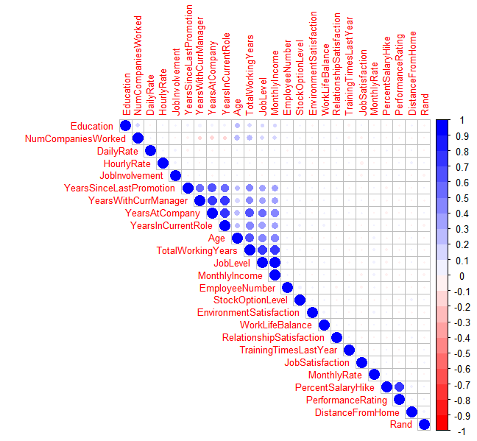
A few variables are strongly correlated
YearsAtCompany, YearsInCurrentRole
and YearsWithCurrManager
MonthlyIncome, JobLevel and TotalWorkingYears
PercentSalaryHike and PerformanceRating

Slide 5
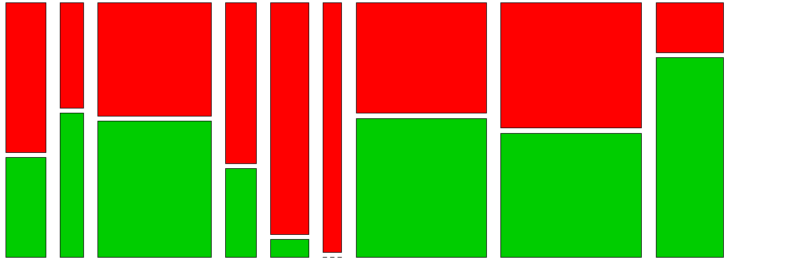
Sale representatives are more likely to leave
Human Resources
Manager
Research Director
Healthcare rep.
Laboratory Technician
Manuf. Director
Research Scientist
Sales Executive
Sales Rep.
Stay
Leave
Job Role

Slide 6
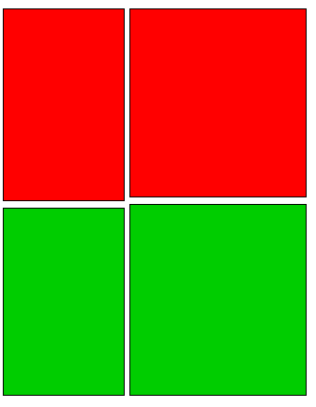
Gender is not significantly related to attrition
Female
Male
Stay
Leave
Gender

Slide 7
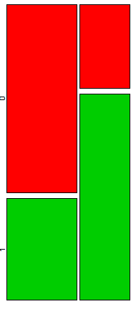
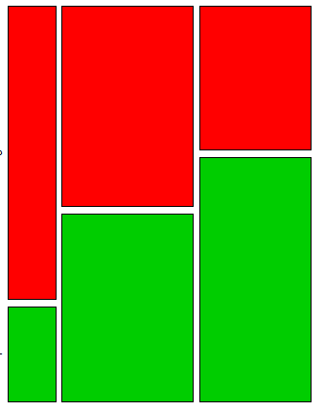
Employees who often work over time and being single are strong candidates for attrition
No
Yes
Divorced
Married
Single
Stay
Stay
Leave
Leave
OverTime
MaritalStatus

Slide 8
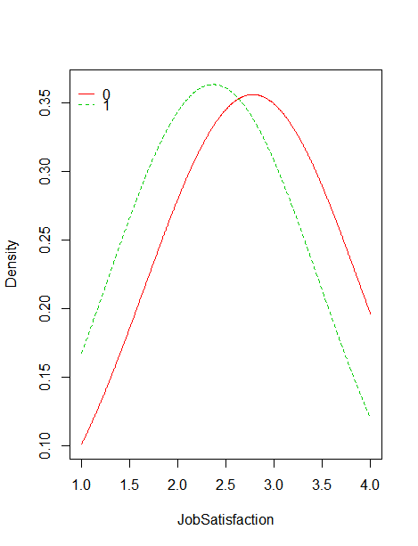
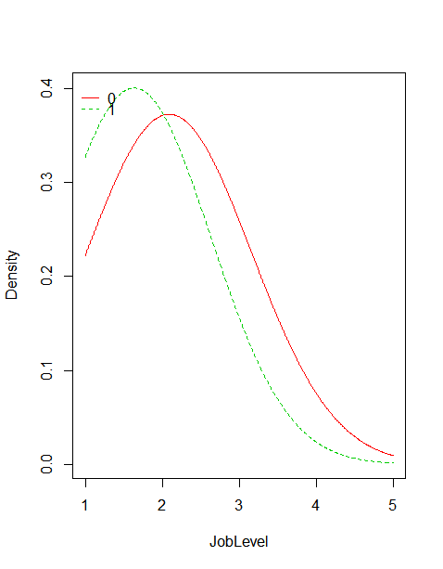
Job Satisfaction and Job Level are negatively correlated with attrition

Slide 9
Three different types of classification models were trained and tested
Three different types of classification models were fitted to the data for training and testing
Naïve Bayes: convert continuous variables to categorical by PDF
Logistic Regression: convert categorical variables to numeric
XGBoost: convert categorical variable to numeric

Slide 10
Things to consider when dealing with imbalanced dataset
ROC curve (receiver operating characteristic curve), not accuracy, is a better metric to evaluate model performance
The cutoff rate to assign a person to attrition has to be determined for each model. The default value of 0.5 is not ideal in this situation.
## 0 1
## 0.8390805 0.1609195

Slide 11
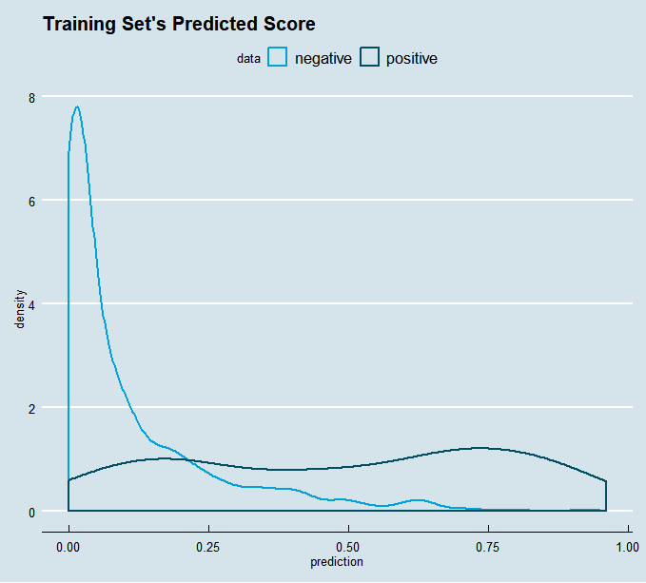
All models have trouble to accurately predict the positive outcomes
From logistic regression analysis; the pseudo R2 is only 0.371

Slide 12
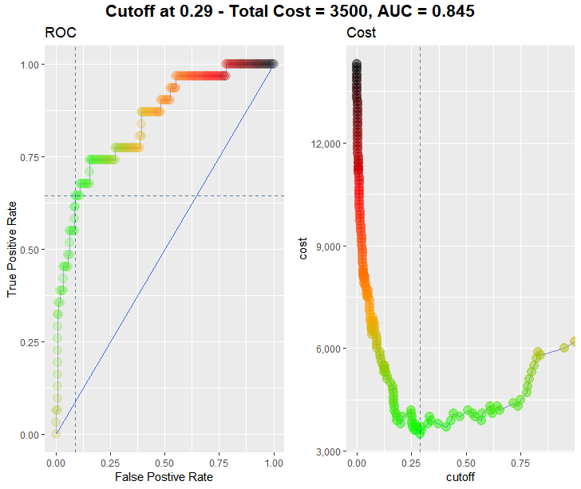
The cutoff rate of 0.29 was found for logistic regression model

Slide 13
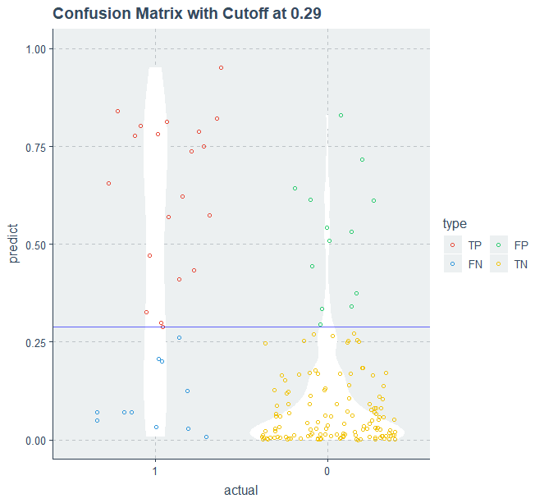
The cutoff rate of 0.29 strikes a good balance of sensitivity and specificity
logistic regression analysis

Slide 14
The logistic regression model outperformed the other two models
 | Logistic/Train | Logistic/test | XGBoost/Train | XGBoost/Test | NB/Train | NB/Test
Accuracy | 0.87 | 0.82 | 0.9 | 0.87 | 0.85 | 0.83
Sensivity | 0.68 | 0.68 | 0.54 | 0.45 | 0.59 | 0.64
Specificty | 0.91 | 0.85 | 0.97 | 0.96 | 0.9 | 0.87

Slide 15
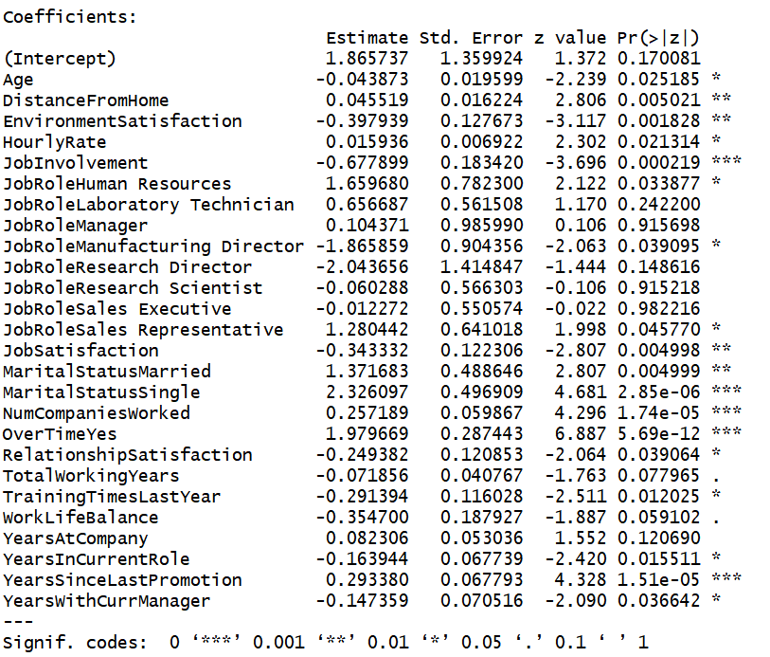
OverTime, MaritalStatus and YearsSinceLastPromotion being the top three factors contributing to attrition
Final Model (from logistic regression):
Attrition ~ Age + DistanceFromHome + EnvironmentSatisfaction +
HourlyRate + JobInvolvement + JobRole + JobSatisfaction +
MaritalStatus + NumCompaniesWorked + OverTime + RelationshipSatisfaction +
TotalWorkingYears + TrainingTimesLastYear + WorkLifeBalance +
YearsAtCompany + YearsInCurrentRole + YearsSinceLastPromotion +
YearsWithCurrManager

Slide 16
Finding factors contributing to employee monthly income discrepancy
Two different types of regression models were chosen:
Multiple linear regression
LASSO

Slide 17
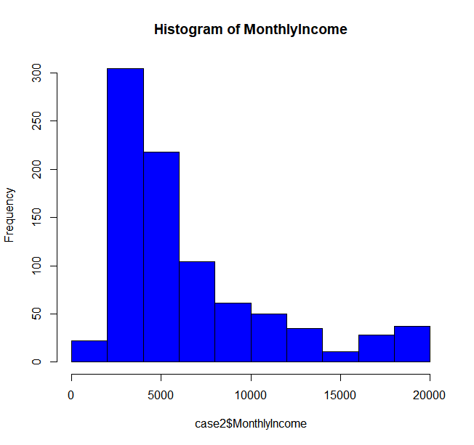
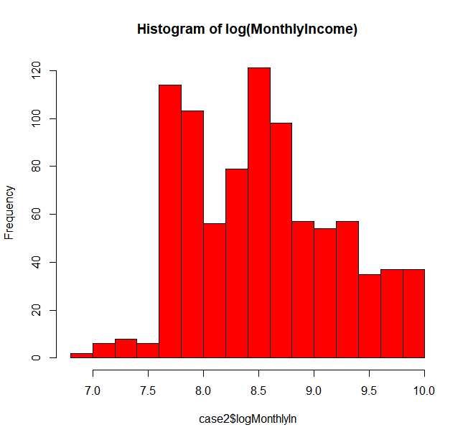
Preliminary analysis suggested a log-transformation of dependent variable MonthlyIncome being preferred

Slide 18
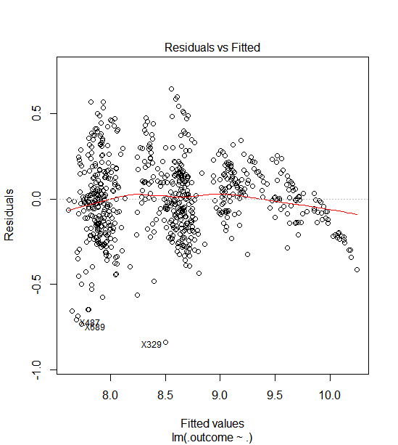
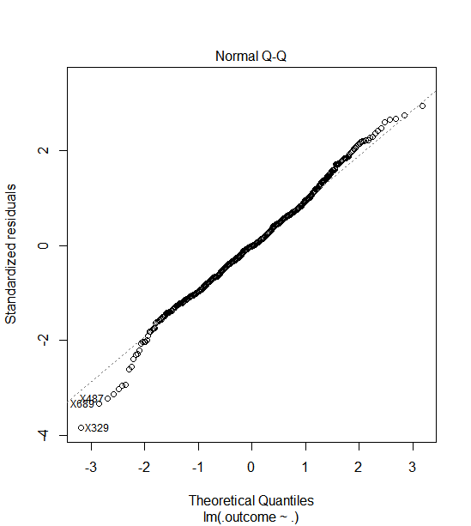
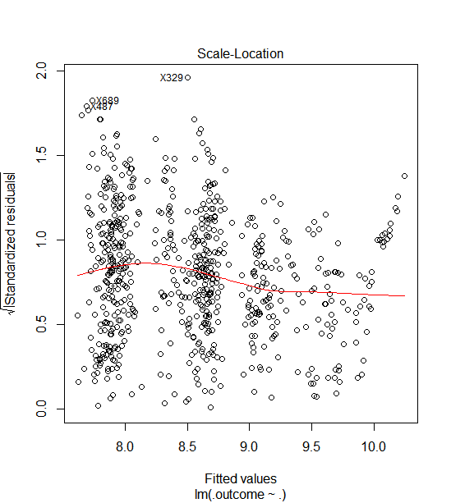
Assumptions for multiple linear regression are mostly satisfied

Slide 19
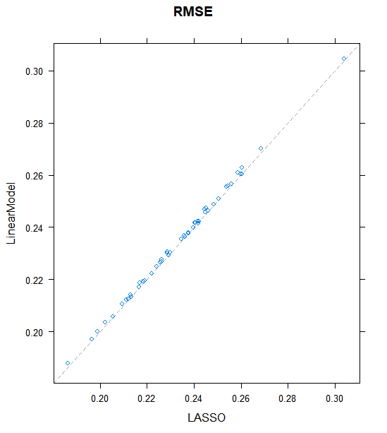
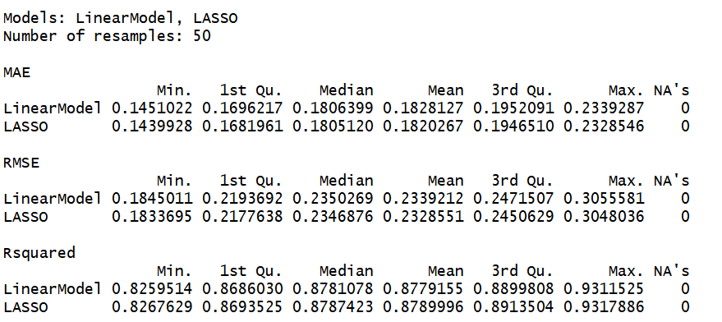
MLR and LASSO performed equally well

Slide 20
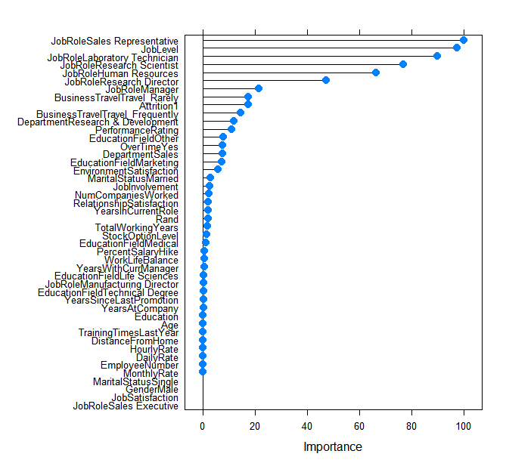
LASSO identified JobRole and JobLevel being important variables

Slide 21
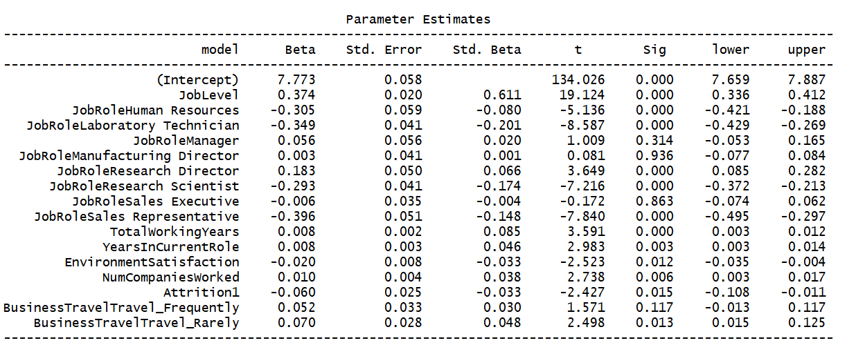
MLR stepwise selection identified JobRole, JobLevel and TotalWorkingYears being top 3 significant variables
logMonthlyIn ~ JobLevel + JobRole + TotalWorkingYears + YearsInCurrentRole + EnvironmentSatisfaction + NumCompaniesWorked +Attrition + BusinessTravel

Slide 22
Conclusions
The top three factors that play significant roles in employee attrition in our company are OverTime, MaritalStatus and YearsSinceLastPromotion
We may use obtained model to predict our current employees. Appropriate actions may then be taken to prevent talent loss
The top three factors that contributed to the discrepancy of employee monthly income are: JobRole and JobLevel and TotalWorkingYears.

