Slide 1
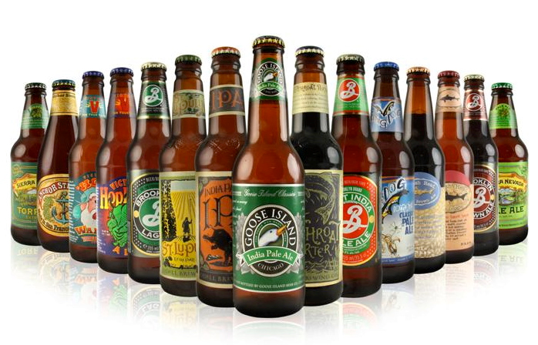
Some Interesting Discoveries about Craft Beer Brewery Industry in US
Yongjun Chu

Slide 2
Who are the craft brewers?
American craft brewers are “small, independent and traditional”:
“small” is defined as an “annual production of 6 million barrels of beer or less”;
“independent” is defined as at least 75% owned or controlled by a craft brewer;
“traditional” is defined as brewing in which at least 50% of the beer’s volume consists of “traditional or innovative” ingredients.
----From The US Brewer’s Association

Slide 3
We obtained two datasets about craft beer and brewers
Craft beer data (2410 entries):
ABV: Alcohol By Volume; IBU: International Bitterness Units of the beer
Craft beer brewer data (558 entries):

Slide 4
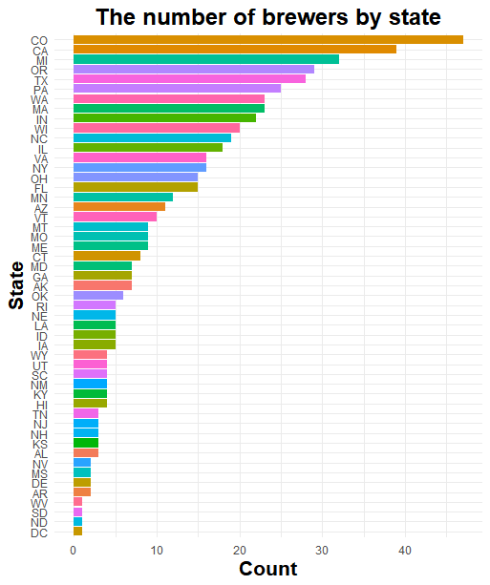
Which states have the most craft beer brewers?
Top Five:
Colorado (47)
California
Michigan
Oregon
Texas
Bottom Four:
DC(1)
North Dakota(1)
South Dakota(1)
West Virginia(1)

Slide 5
How are the beer ABV and IBU values distributed in each state?

Slide 6
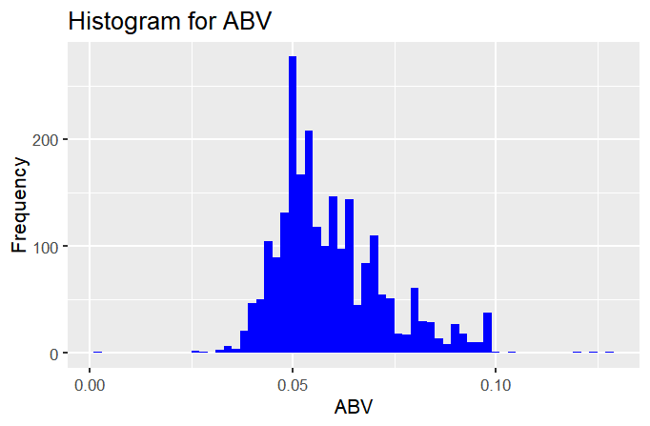
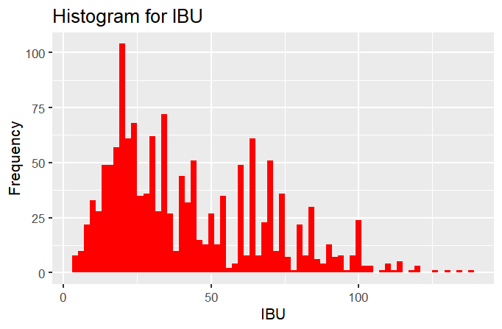
The distributions of ABV and IBU values are both right skewed

Slide 7
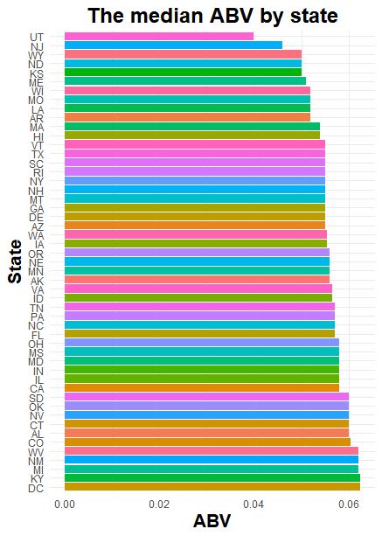
The median ABV values are not so different among states
DC: 0.0625 or 6.25 %

Slide 8
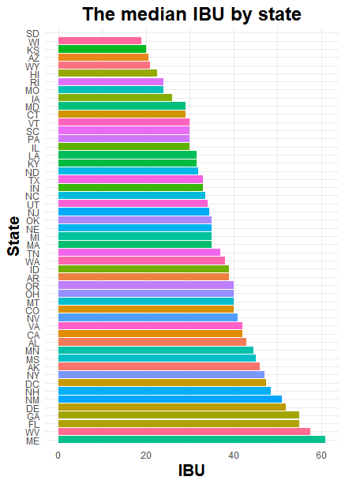
The median IBU values vary considerably among states
Potential bias: over 1,000 IBU values were missing in the datasets.
ME: 61

Slide 9
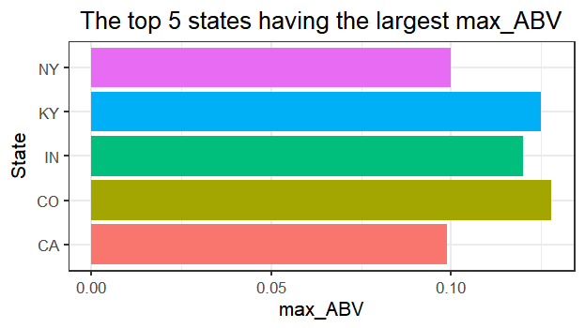
Which state’s beer has the most alcohol content by volume (ABV)?
Colorado (0.128)
Lee Hill Series Vol. 5

Slide 10
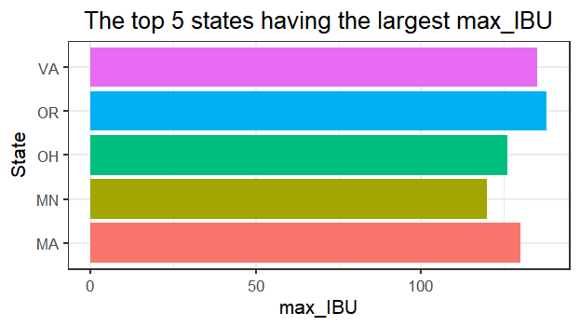
Which state has the most bitter (IBU) beer?
Oregon (138)
Bitter Bitch Imperial IPA

Slide 11
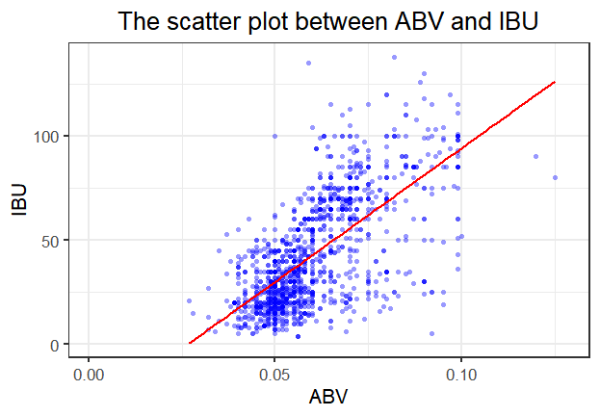

The bitterness of the beer and its alcoholic content appears to be positively correlated
r$=0.67$
$$p<2.2e−16$$

Slide 12
Thank You!
Questions / Comments?
Presentation video link: https://www.screencast.com/t/uKGLXQkN

