Slide 1
The time point of disappearing referenced threads
Search
Delete
Search
Thread 1
Remove from data structure
Access
Access
Node A
Grace period
Cannot access to Node A
r
Access
Delete Node A
P
P
r
Access
Thread 2
Insert
Search
Search
1.
2.
F
x
A (41, 67)
P
P
B (0, 69)
C (78, 58)
r
B
A
y
r
C
x
E (64, 5)
D (27, 36)
F (91, 95)
D
y
3.
4.
G
H
G (4, 2)
H (81, 27)
E

Slide 2
Insert
Remove
A
A
A
50
A
50
A
50
Remove 32
A
50
Insert 30
Ancestor
N
40
B
B
B
20
N
30
Successor
C
C
B
20
C
30
B
32
D
H
D
H
Initial state
I
E
I
E
Ancestor
C
B
X, 62
RT
∞1
Y=65
Y=63
X, 37
Y, 63
Parent
Successor
D
B
(92, 70)
J
F
J
F
Parent
F
Y=54
A
(36, 23)
Y, 65
Y, 54
L
∞2
R
∞3
G
G
G
X, 42
C
(55, 67)
X, 77
D
(76, 56)
(a)
(b)
∞3 > ∞1 > ∞2
A
E
Current
Current
H
E
(38, 23)
F
(56, 61)
G
(68, 52)
H
(86, 29)
X=37
X=42
X=62
X=77
Subtree
Internal node
Leaf node
Mark
Search path nodes
Tag

Slide 3
Remove()
Search path
E
E
Internal node
Parent
Parent
Leaf node
GP(a)
GP(a)
J
F
Marking
J
F
Subtree
Call Cleanup() and retry
Call Cleanup() and retry
Mark
P(a)
P(a)
G
S(a)
G
S(a)
Tag
Leaf
Leaf
a
S(a)
a
(a)
(b)
(c)
Cleanup()
GP(a)
GP(a)
A
A
Ancestor
Ancestor
P(a)
B
B
P(a)
Successor
Insert new node n
C
adjust nodes
S(a)
new
S(a)
Tagging
a
S(a)
(a)
D
H
(b)
a
n
I
E
Parent
Mark
J
F
Tag
Subtree
Internal node
Leaf node
G
S(a)
Leaf

Slide 4
NNS()
Thread A
Prepare NNC node
Collect()
Deactivate node A
Initial state
RT
∞1
Search active NNC node or allocate new NNC node to A
Call NearestSearch() to update CN
IL
∞2
R
∞3
NNC array
…
A
B
C
…
Active NNC node A
LL
∞4
LR
∞5
The number of threads
target
CN
RN
NNC active period
Returns CN or RN closest to the target
∞3 > ∞1 > ∞2 > ∞5 > ∞4
Call sync() to update RN
Thread B
Contains()
Contains()
Thread C
Insert()
Contains()

Slide 5
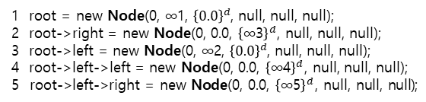
1 root = new Node(0, ∞1, ${\left\{0.0\right\}}^{d}$, null, null, null);
2 root->right = new Node(0, 0.0, ${\left\{\text{∞}\text{3}\right\}}^{d}$, null, null, null);
3 root->left = new Node(0, ∞2, ${\left\{0.0\right\}}^{d}$, null, null, null);
4 root->left->left = new Node(0, 0.0, ${\left\{\text{∞}\text{4}\right\}}^{d}$, null, null, null);
5 root->left->right = new Node(0, 0.0, ${\left\{\text{∞}\text{5}\right\}}^{d}$, null, null, null);
ParticleCollisionPass
1 2 3 4 5 6 7 8 9 10 11 12 13 14 15 16 17 18 19 20 21 22 23 24 25 26 27 28 29 30 | loop particle in scene.particle vec4 gl_Position = u_ProjView * vec4(a_Position,1) vec2 TexCoord = (gl_Position.xy + vec2(1)) * 0.5 ivec2 texel_base = ivec2(TexCoord.x * u_ClientWidth, TexCoord.y * u_ClientHeight) vec4 curr_pos = texelFectch(u_CDTxture, texel_base, 0) float particle_min_length = 100000 float g_collision_range = 0.01 if a_CollideTime < 0 loop ty in -texel_collide_range <= ty <= texel_collide_range loop tx in -texel_collide_range <= tx <= texel_collide_range ivec2 texel = texel_base + ivec2(tx, ty) if tx == 0 && ty == 00 continue vec4 particle_pos = texelFetch(u_CDTexture, texel, 0) float len = length(curr_pos.xyz – particle_pos.xyz) if g_collision_range > len && len < particle_min_length particle_min_length = len particle_collide_pos = particle_pos particle_collision = true if particle_collision == true f_Speed = a_Speed * 0.2 v_Dir = normalize(curr_pos.xyz – particle_collide_pos.xyz) f_CollideTime = g_collision_time v_Position = a_Position + (v_Dir * f_Speed) else vec3 temp = (a_Dir * a_Speed) + (g_gravity * g_tick) v_Dir = normalize(temp) f_Speed = length(temp) f_CollideTime = a_CollideTime – g_tick v_Position = a_Position + (v_Dir * f_Speed) * g_tick
Insert(double k[DIMENSION])
28 start_op();
29 search_field f;
30 while (true) {
31 Search(f, k);
32 if not (isEqual(k, f.cr->k)) {
33 Node* new_internal = new_node();
34 Node* new_leaf = new_node();
35 new_leaf->SetKey(k);
36 new_leaf->pr = new_internal;
37 int dim = GetMinDiffDimension(new_leaf->k, f.cr->k);
38 new_internal->d = dim;
39 new_internal->c = (new_leaf->k[dim] + f.cr->k[dim]) / 2;
40 new_internal->pr = f.pr;
41 bool new_leaf_dir = new_leaf->k [dim] < f.cr->k[dim];
42 if (new_leaf_dir) {
43 new_internal->lt = new_leaf;
44 new_internal->rt = f.cr;
45 else
46 new_internal->lt = f.cr;
47 new_internal->rt = new_leaf;
48 if (f.pr->CAS_Child(f.cr, null, new_internal, null, f.cr_dir))
49 CAS(&f.cr->pr, f.pr, new_internal);
50 f.pr = new_internal;
51 f.cr = new_leaf;
52 f.cr_dir = new_leaf_dir;
53 Sync(f.pr, f.cr);
54 end_op(); return true;
55 else {
56 del_node(new_leaf);
57 del_node(new_internal);
58 Node* child = f.pr->GetChild(f.cr_dir);
59 if ((child==f.cr) && (IsMark(child) || IsTag(child)) )
60 Cleanup(f);
61 else end_op(); return false;
class Node { int d; double c; double k[]; Node* lt, rt, pr; }
class Neighbor { Node* p; double d; }
class NNCollector { double tgt[]; Neighbor* cn, rn; }
struct search_field { Node* ac; sc; pr; cr; bool sc_dir; cr_dir; }
struct seek_field { Node* pr; cr; bool cr_dir; double hi[]; double lo[]; }
class HD-Tree {
bool Contains(double k[DIMENSION]);
bool Insert(double k[DIMENSION]);
bool Remove(double k[DIMENSION]);
double[] NNS(double k[]);
}
Member:
Node* root;
NNCollector* nncs[MAX_THREAD];
Search(search_field& f, double k[DIMENSION])
6 f.ac = root;
7 f.sc = root->lt;
8 f.sc_dir = true;
9 f.pr = f.sc;
10 f.cr = f.pr->lt
11 f.cr_dir = true;
12 while not (f.cr->isLeaf())
13 if not (IsTag(f.pr)) {
14 f.ac = f.pr;
15 f.sc = f.cr;
16 f.sc_dir = f.cr_dir;
17 f.pr = f.cr;
18 f.cr_dir = k[f.pr->d] < f.pr->c;
19 f.cr = f.pr->GetChild(f.cr_dir);
Contains(double k[DIMENSION])
20 start_op();
21 search_field f;
22 Search(f, k);
23 if not (IsMark(f.cr))
24 if (isEqual(k, f.cr->k))
25 Sync(f.pr, f.cr);
26 end_op(); return true;
27 end_op(); return false;
sturct Node {
vec4 aabb;
ivec4 info;
ivec4 vertexRef[2048];
}
CAS_Child(Node* old, ptrdiff_t old_lsb, Node* new, ptrdiff_t
new_lsb, bool ch_dir)
ptrdiff_t old_ptr = old | old_lsb;
ptrdiff_t new_ptr = new | new_lsb;
return (ch_dir) ? CAS(&lt, old_ptr, new_ptr) : CAS(&rt, old_ptr, new_ptr);

Slide 6
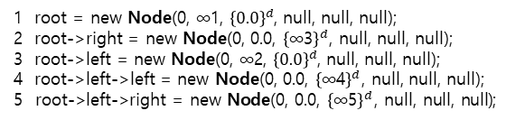
class Node { int d; double c; double k[]; Node* lt, rt, pr; }
1 root = new Node(0, ∞1, ${\left\{0.0\right\}}^{d}$, null, null, null);
2 root->right = new Node(0, 0.0, ${\left\{\text{∞}\text{3}\right\}}^{d}$, null, null, null);
3 root->left = new Node(0, ∞2, ${\left\{0.0\right\}}^{d}$, null, null, null);
4 root->left->left = new Node(0, 0.0, ${\left\{\text{∞}\text{4}\right\}}^{d}$, null, null, null);
5 root->left->right = new Node(0, 0.0, ${\left\{\text{∞}\text{5}\right\}}^{d}$, null, null, null);
enum RemoveMode { INJECTION, CLEANUP };
Remove(double k[DIMENSION])
62 start_op();
63 search_field f;
64 RemoveMode mode = INJECTION;
65 Node* del = null;
66 while (true) {
67 Search(f, k);
68 if (INJECTION == mode)
69 if not (isEqual(k, f.cr->k))
70 end_op(); return false;
71 del = f.cr;
72 if (f.pr->CAS_Child(f.cr, null, f.cr, MARK, f.cr_dir))
73 mode = CLEANUP;
74 if (Cleanup(f)) end_op(); return true;
75 else
76 Node* child = f.pr->GetChild(f.cr_dir);
77 if ((child==f.cr) && (IsMark(child) || IsTag(child)) )
78 Cleanup(f);
79 else
80 if (del != f.cr)
81 end_op(); return true;
82 else if (Cleanup(f))
83 end_op(); return true;
class Neighbor { Node* p; double d; }
class NNCollector { double tgt[]; Neighbor* cn, rn; }
struct search_field { Node* ac; sc; pr; cr; bool sc_dir; cr_dir; }
struct seek_field { Node* pr; cr; bool cr_dir; double hi[]; double lo[]; }
class HD-Tree {
bool Contains(double k[DIMENSION]);
bool Insert(double k[DIMENSION]);
bool Remove(double k[DIMENSION]);
double[] NNS(double k[]);
}
Member:
Node* root;
NNCollector* nncs[MAX_THREAD];
Insert(double k[DIMENSION])
28 start_op();
29 search_field f;
30 while (true) {
31 Search(f, k);
32 if not (isEqual(k, f.cr->k)) {
33 Node* new_internal = new_node();
34 Node* new_leaf = new_node();
35 new_leaf->SetKey(k);
36 new_leaf->pr = new_internal;
37 int dim = GetMinDiffDimension(new_leaf->k, f.cr->k);
38 new_internal->d = dim;
39 new_internal->c = (new_leaf->k[dim] + f.cr->k[dim]) / 2;
40 new_internal->pr = f.pr;
41 bool new_leaf_dir = new_leaf->k [dim] < f.cr->k[dim];
42 if (new_leaf_dir) {
43 new_internal->lt = new_leaf;
44 new_internal->rt = f.cr;
45 else
46 new_internal->lt = f.cr;
47 new_internal->rt = new_leaf;
48 if (f.pr->CAS_Child(f.cr, null, new_internal, null, f.cr_dir))
49 CAS(&f.cr->pr, f.pr, new_internal);
50 f.pr = new_internal;
51 f.cr = new_leaf;
52 f.cr_dir = new_leaf_dir;
53 Sync(f.pr, f.cr);
54 end_op(); return true;
55 else {
56 del_node(new_leaf);
57 del_node(new_internal);
58 Node* child = f.pr->GetChild(f.cr_dir);
59 if ((child==f.cr) && (IsMark(child) || IsTag(child)) )
60 Cleanup(f);
61 else end_op(); return false;
Search(search_field& f, double k[DIMENSION])
6 f.ac = root;
7 f.sc = root->lt;
8 f.sc_dir = true;
9 f.pr = f.sc;
10 f.cr = f.pr->lt
11 f.cr_dir = true;
12 while not (f.cr->isLeaf())
13 if not (IsTag(f.pr)) {
14 f.ac = f.pr;
15 f.sc = f.cr;
16 f.sc_dir = f.cr_dir;
17 f.pr = f.cr;
18 f.cr_dir = k[f.pr->d] < f.pr->c;
19 f.cr = f.pr->GetChild(f.cr_dir);
Cleanup(search_field& f)
84 Node* child = f.pr->GetChild(f.cr_dir);
85 Node* sibling = f.pr->GetChild(!f.cr_dir);
86 if not (IsMark(child))
87 sibling = child;
88 f.cr_dir = !f.cr_dir;
89 if not (IsTag(sibling))
f.pr->CAS_Child(sibling, LSB(sibling), sibling,
LSB(sibling)|TAG, !f.cr_dir);
91 sibling = f.pr->GetChild(!f.cr_dir);
92 if not (IsTag(sibling)) return false;
93 if (f.ac->CAS_Child(f.sc, null, LSB(sibling),
LSB(sibling)&MARK, f.sc_dir))
94 CAS(&sibling->pr, f.pr, f.ac);
95 retire_subtree(f.sc, sibling);
96 return true;
97 return false;
Contains(double k[DIMENSION])
20 start_op();
21 search_field f;
22 Search(f, k);
23 if not (IsMark(f.cr))
24 if (isEqual(k, f.cr->k))
25 Sync(f.pr, f.cr);
26 end_op(); return true;
27 end_op(); return false;
CAS_Child(Node* old, ptrdiff_t old_lsb, Node* new, ptrdiff_t
new_lsb, bool ch_dir)
ptrdiff_t old_ptr = old | old_lsb;
ptrdiff_t new_ptr = new | new_lsb;
return (ch_dir) ? CAS(&lt, old_ptr, new_ptr) : CAS(&rt, old_ptr, new_ptr);

Slide 7
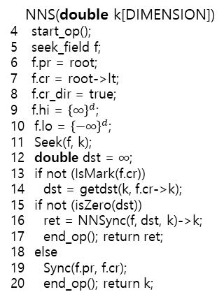
enum NeighborType { COLLECTED, REPORTED };
enum NNSyncMode { INIT, COLLECT };
NNSync(seek_field& f, double dst, double k[DIMENSION])
35 NNCollector* nnc = null;
36 NNSyncMode mode = INIT;
37 while (true) {
38 for (int i = 0; i < MAX_THREAD; ++i)
39 if (IsActive(nncs[i]))
40 if (isEqual(k, nncs[i]->tgt))
41 nnc = nncs[i];
42 mode = COLLECT;
43 break;
44 if (INIT == mode)
45 nnc = new_nnc(k, new_nbr(f.cr, dst), new_nbr(f.cr, dst));
46 NNCollector* old_nnc = nncs[tid];
47 while (false == CAS(&nncs[tid], old_nnc|DEACTIVATION, nnc))
48 old_nnc = nncs[tid];
49 retire(old_nnc->cn);
50 retire(old_nnc->rn);
51 retire(old_nnc);
52 mode = COLLECT;
53 if (COLLECT == mode) {
54 nnc = Collect(f, dst, k, nnc);
55 Deactivate(nnc);
56 return Process(nnc);
NeighborSearch(seek_field& f, double dst, double
k[DIMENSION])
62 double leaf_key[] = f.cr->k;
63 while (root != f.pr) {
64 bool bVisited = false;
65 if (f.cr_dir) {
66 bVisited = f.pr->c >= f.hi[f.pr->d];
67 else
68 bVisited = f.pr->c <= f.lo[f.pr->d];
69 if (bVisited && (abs(f.pr->c - k[f.pr->d]) < dst))
70 f.cr_dir = !f.cr_dir;
71 f.cr = f.pr->GetChild(f.cr_dir);
72 Seek(f, k);
73 leaf_key = f.cr->k;
74 double leaf_dst = getdst(k, leaf_key);
75 if (leaf_dst < dst)
76 if not (IsMark(f.cr))
77 dst = leaf_dst;
78 break;
79 else
80 f.cr = f.pr;
81 f.pr = f.pr->pr;
82 f.cr_dir = f.pr->GetChildDir(leaf_key);
83 if (f.cr_dir)
84 if (f.pr->c > f.hi[f.pr->d]) f.hi[f.pr->d] = f.pr->c;
85 else
86 if (f.pr->c < f.lo[f.pr->d]) f.lo[f.pr->d] = f.pr->c;
1 for (int i = 0; i < MAX_THREAD; ++i)
2 nncs[i] = new NNCollector();
3 Deactivate(nncs[i]);
NNS(double k[DIMENSION])
4 start_op();
5 seek_field f;
6 f.pr = root;
7 f.cr = root->lt;
8 f.cr_dir = true;
9 f.hi = ${\left\{\text{∞}\right\}}^{d}$;
10 f.lo = ${\left\{−\text{∞}\right\}}^{d}$;
11 Seek(f, k);
12 double dst = $\text{∞}$;
13 if not (IsMark(f.cr))
14 dst = getdst(k, f.cr->k);
15 if not (isZero(dst))
16 ret = NNSync(f, dst, k)->k;
17 end_op(); return ret;
18 else
19 Sync(f.pr, f.cr);
20 end_op(); return k;
Seek(seek_field& f, double k[DIMENSION])
21 while not (f.cr->isLeaf())
22 f.pr = f.cr;
23 f.cr_dir = k[f.pr->d] < f.pr->c;
24 f.cr = f.pr->GetChild(f.cr_dir);
25 if (f.cr_dir)
26 f.hi[f.pr->d] = f.pr->c;
27 else
28 f.lo[f.pr->d] = f.pr->c;
Collect(seek_field& f, double dst, double k[DIMENSION],
NNCollector* nnc)
57 while ((root != f.pr) && (false == isZero(dst)))
58 NeighborSearch(f, dst, k);
59 if (CheckValid(f.pr, f.cr))
60 dst = UpdateNbr(nnc, f.cr, COLLECTED);
61 return nnc;
UpdateNbr(NNCollector* nnc, Node* cr,
NeighborType nt)
87 double dst = getdst(cr->k, nnc->tgt);
88 while (true)
89 if (IsActive(nnc))
90 if (true == IsNearNbr(nnc, dst))
91 Neighbor* nbr = new_nbr(cr, dst);
92 Neighbor* old_nbr = null;
93 bool result = false;
94 if (COLLECTED == nt)
95 old_nbr = nnc->cn;
96 result = CAS(&nnc->cn, old_nbr, nbr);
97 else
98 old_nbr = nnc->rn;
99 result = CAS(&nnc->rn, old_nbr, nbr);
100 if (result)
101 retire(old_nbr);
102 return dst;
103 else del_nbr(nbr);
104 else return dst;
Sync(Node* pr, Node* cr)
29 for (int i = 0; i < MAX_THREAD; ++i)
30 if (IsActive(nncs[i])) {
31 if (IsNearNbr(nncs[i], getdst(cr->k, nncs[i]->tgt)))
32 if (CheckValid(pr, cr))
33 UpdateNbr(nncs[i], cr, REPORTED);
34 else break;
IsNearNbr(NNCollector* nnc, double target_dst)
return (target_dst < nnc->cn->d
&& target_dst < nnc->rn->d);
Process(NNCollector* nnc)
return (nnc->rn->d < nnc->cn->d)
? nnc->rn->p : nnc->cn->p;
CheckValid(Node* pr, Node* cr)
bool cr_dir = cr->k[pr->d] < pr->c;
Node* child = pr->GetChild(cr_dir);
while not (child->isLeaf())
cr_dir = cr->k[child->d] < child->c;
child = child->GetChild(cr_dir);
if (IsMark(child)) return false;
return child == cr;
Deactivate(NNCollector* nnc)
NNCollector* old_nnc = nnc;
while not (CAS(&nnc, old_nnc, old_nnc|DEACTIVATION))
old_nnc = nnc;

Slide 8

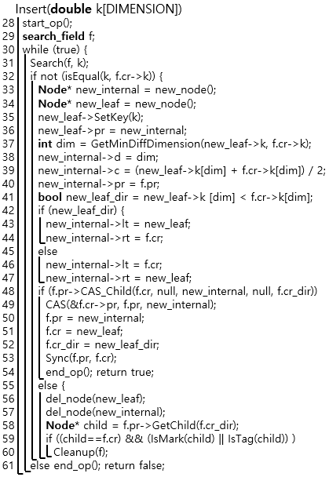
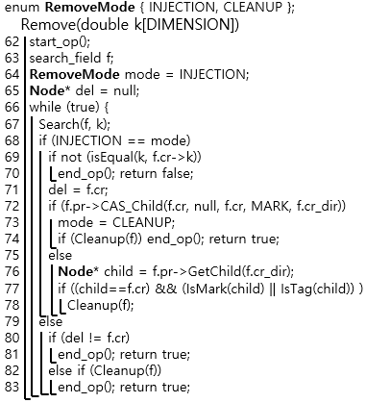
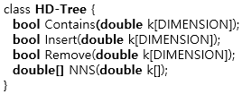


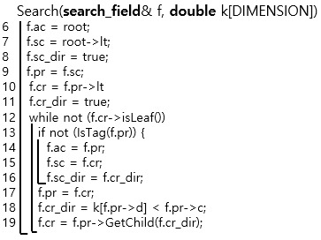
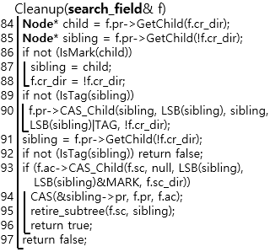
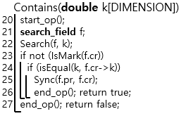


Slide 9
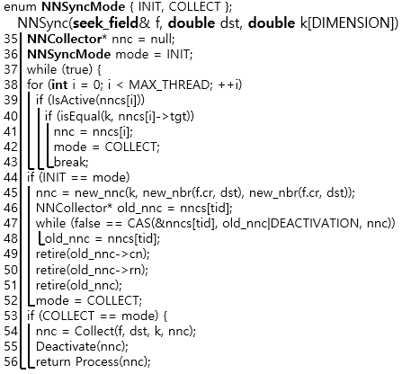
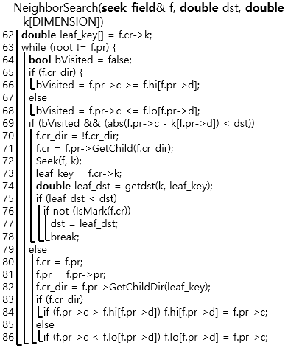

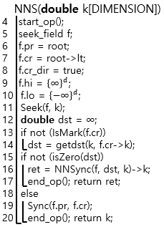
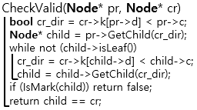
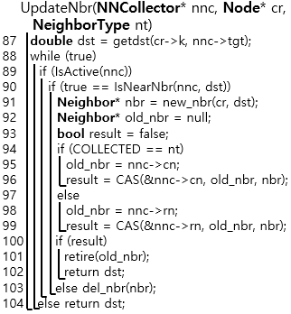
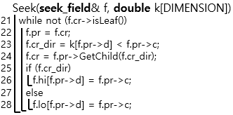
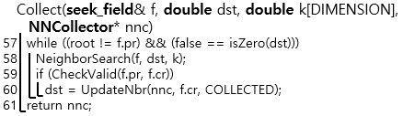
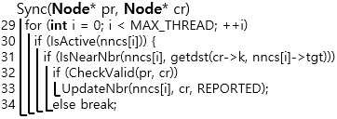




Slide 10
